Slide 1
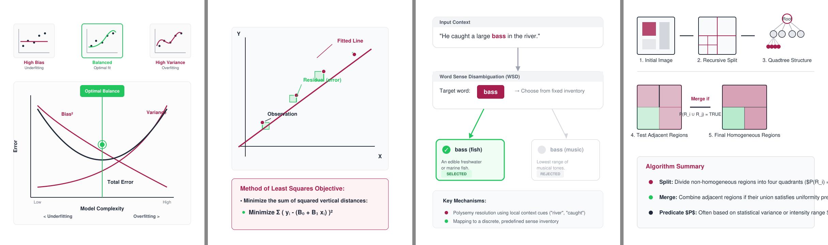

IPD PROJECT REVIEW 2026
TITLE PAGE
Project – Learnova
Theme – EdTech · Generative AI
Category – Software
Group No. – 1 (AI & DS, DJSCE)
Team – Swayam · Kawaljeet · Jeevesh · Rishit
HoD – Dr. Pratik Kanani
Notes:
Title (Swayam, 20 s)
Good morning. We are Group 1 from the Department of AI and Data Science, and our project is Learnova. I am Swayam, and with me
are Kawaljeet, Jeevesh and Rishit. We worked under the guidance of our Head of Department, Dr. Pratik Kanani. In the next twelve
minutes we will show you the problem we saw, how we solved it, and what we measured.

Slide 2
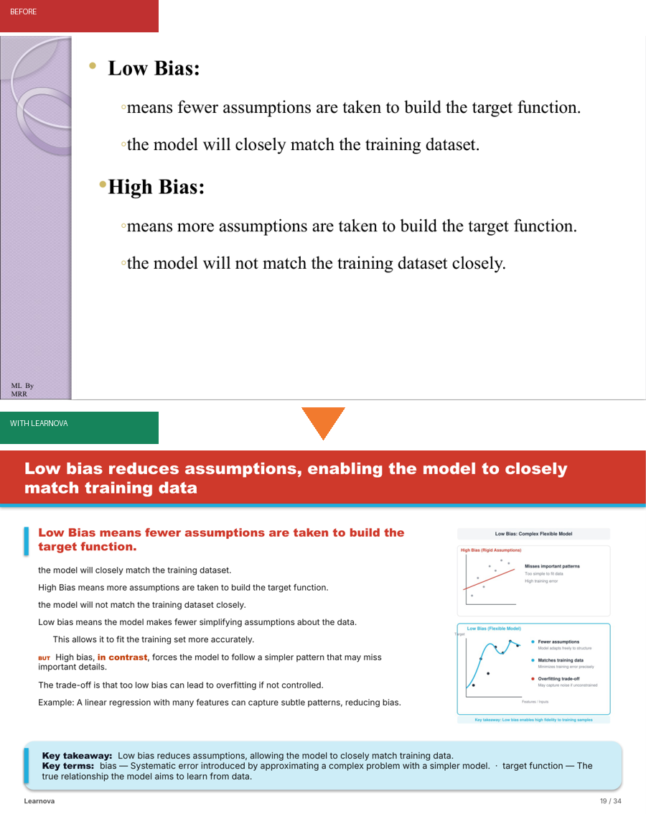

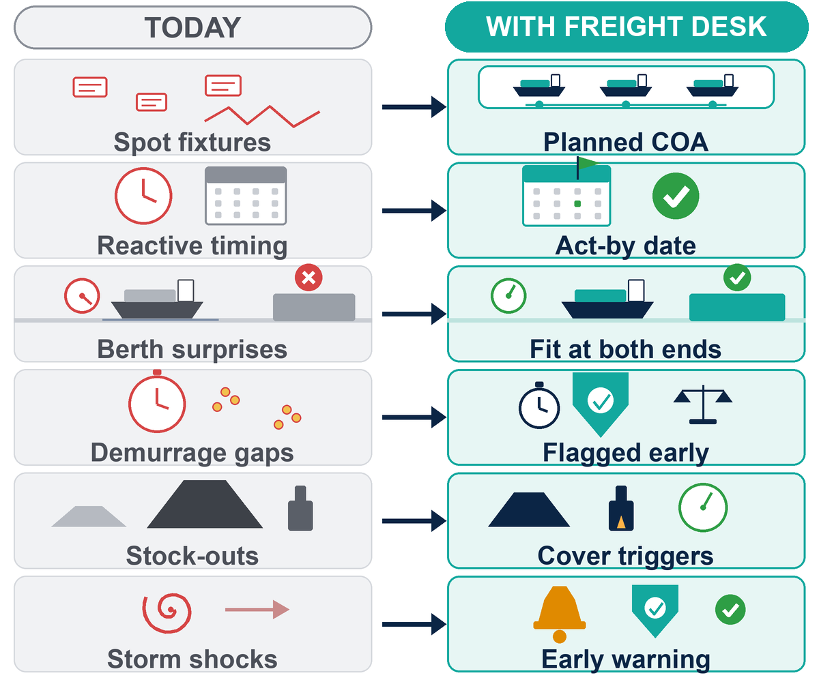

LEARNOVA — IDEA
Learnova
5 real lecture decks: 83 untitled slides · 0 diagrams · 0 quizzes
Proposed Solution: Teachers reuse old decks for years and students revise from them before every exam, yet most are walls of bullets with pictures of equations. Learnova takes the deck a teacher already has (PPTX, PDF, Word notes or a topic) and rebuilds it as an editable PowerPoint, an interactive web deck and a study pack — every point kept, plus a visual, an illustration, quizzes, solved steps and labs.
Detailed explanation of the proposed solution
How it addresses the problem
Innovation and uniqueness of the solution
Slide Reader: every page read with titles, bullet levels, tables, figures; OCR only for picture slides.
Decision Engine: 27 detectors pick process, timeline, comparison, definition, chart or cards — with a reason.
Assertion Titles: each title states the point of its slide; split parts are named, never “(2/5)”.
Illustrations: AI-drawn diagram, teacher's figure or offline scene on every slide, linked as an HTML page.
Explainers & Labs: beginner step-by-step solutions and hands-on labs for hard topics.
Outputs: editable PPTX, web deck, study pack, share link, tutor.
Redesign, not generate: starts from the teacher's own deck; other tools start from a prompt.
Faithful by design: source text kept verbatim; 98–100% of facts retained on real decks.
Explainable choices: every visual decision shows its rule and confidence.
PSF metric + CLASS: our own slide-fitness score and load-optimal slide splitting.
Two safety nets: 5 Gemini keys rotate; if all fail, offline rules finish the deck.
Verified AI output: diagrams sanitised, labs code-checked, titles grounded in the slide.
Works offline: no paid licence, runs on a college laptop.
PHASE 1 · Sep–Dec 2025
PHASE 2 · Jan–Jul 2026
PHASE 3 · Aug–Oct 2026
LIVE CODE
Research and design
Build the platform
Real decks, AI, research
github.com/SDP42/LearnovaV2
Open source · 774 tests · demo decks
Literature + competitor study
Problem, architecture, UI plan
Prototype V1 → Learnova V2
Engine, builders, accounts
Reader + OCR, illustrations, labs
AI key pool, papers, review
Notes:
Idea and the problem (Swayam, 1 min 30 s)
Every one of us has studied from lecture slides the night before an exam. Teachers reuse the same decks for years, and most of
them are walls of bullet points, pictures of equations and slides with no title at all. *(point at the red number at the top)*
In five real decks from our own courses we counted 83 slides without a title, no diagrams and no quizzes.
Tools like Gamma or Copilot make a new deck from a prompt. But a teacher does not want a new deck; they want their own deck, with
their own content, made better. And those tools rewrite the text, so facts can change.
So our idea is simple: redesign, do not regenerate. Learnova takes the deck the teacher already has, as PowerPoint, PDF or
Word notes, and rebuilds it. Every point is kept. Each slide gets a title that states its point, a suitable visual, an
illustration, and where it helps, a step-by-step solution, a lab or a quiz. *(point at the before-and-after picture)* This is
the same slide before and after.
What makes it different is on the right: it is faithful by design, every choice shows its reason, it has our own scoring metric,
and it works even without internet or any paid AI.

Slide 3































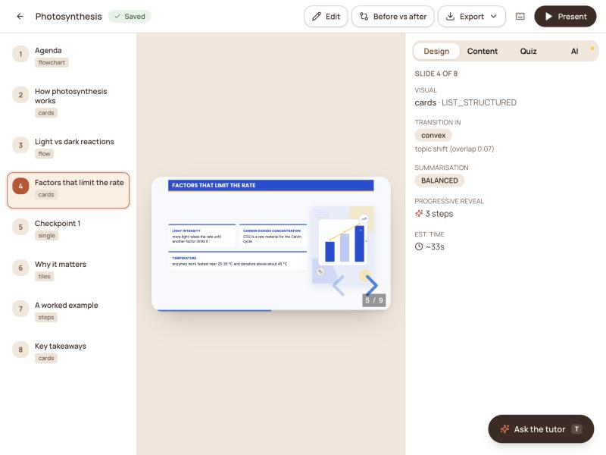
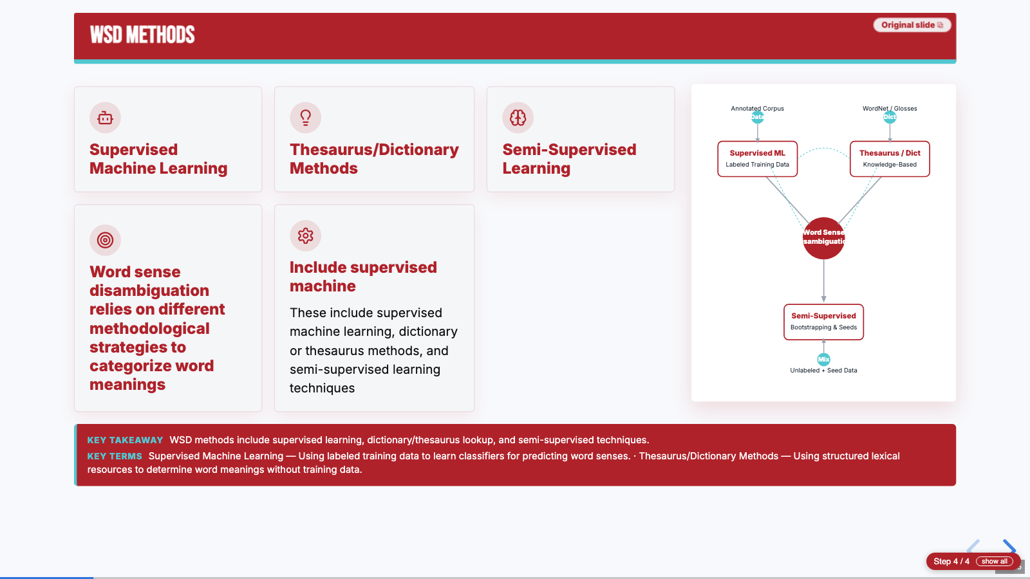
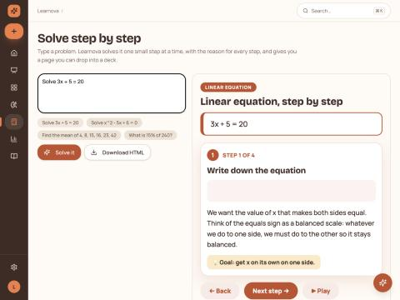
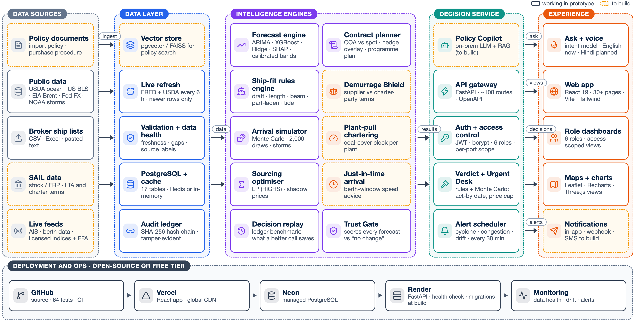

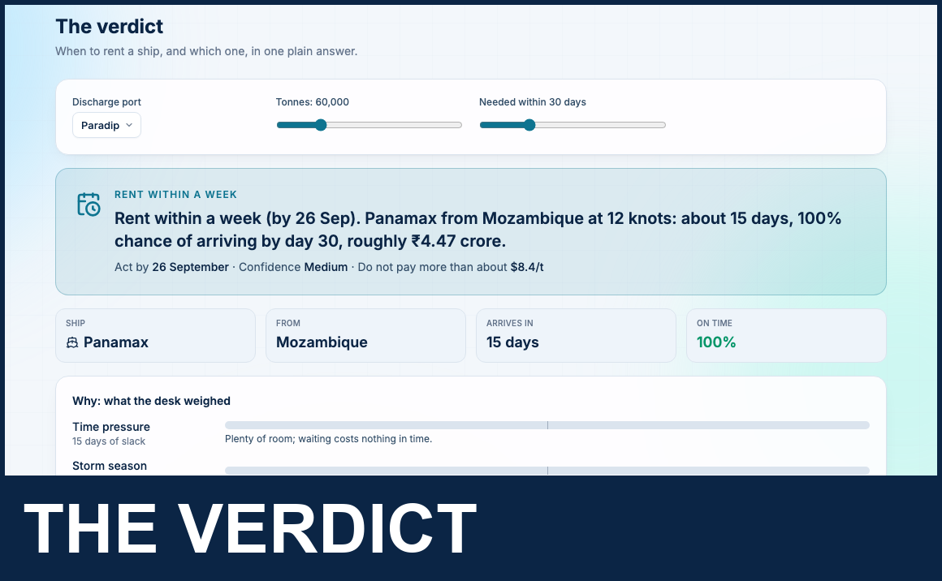
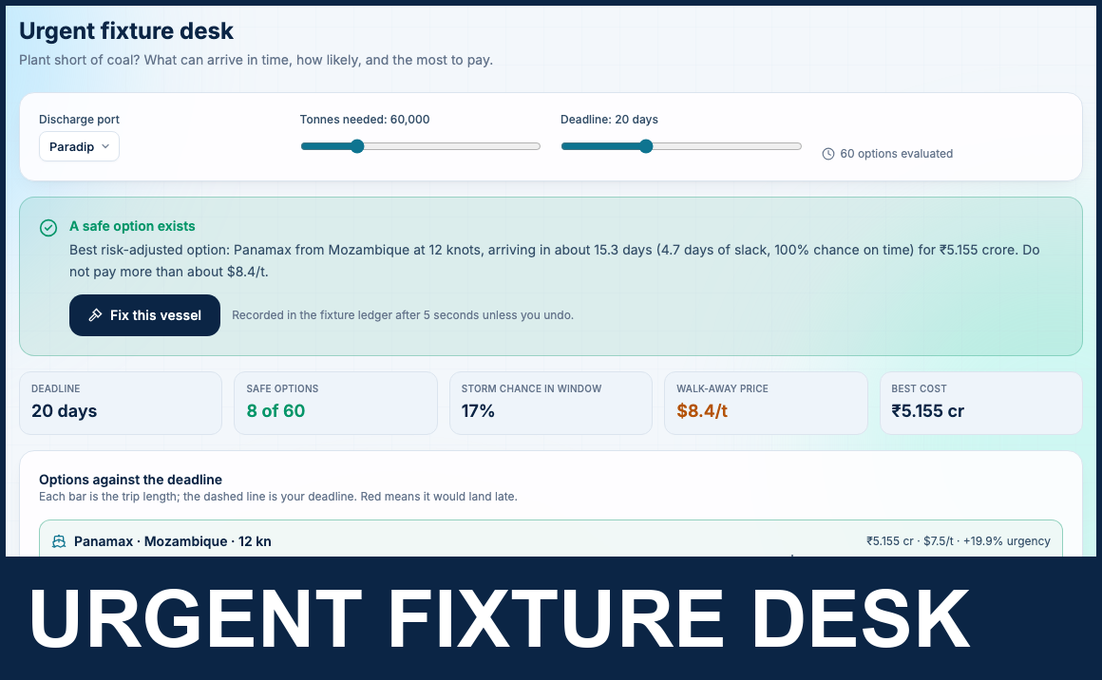
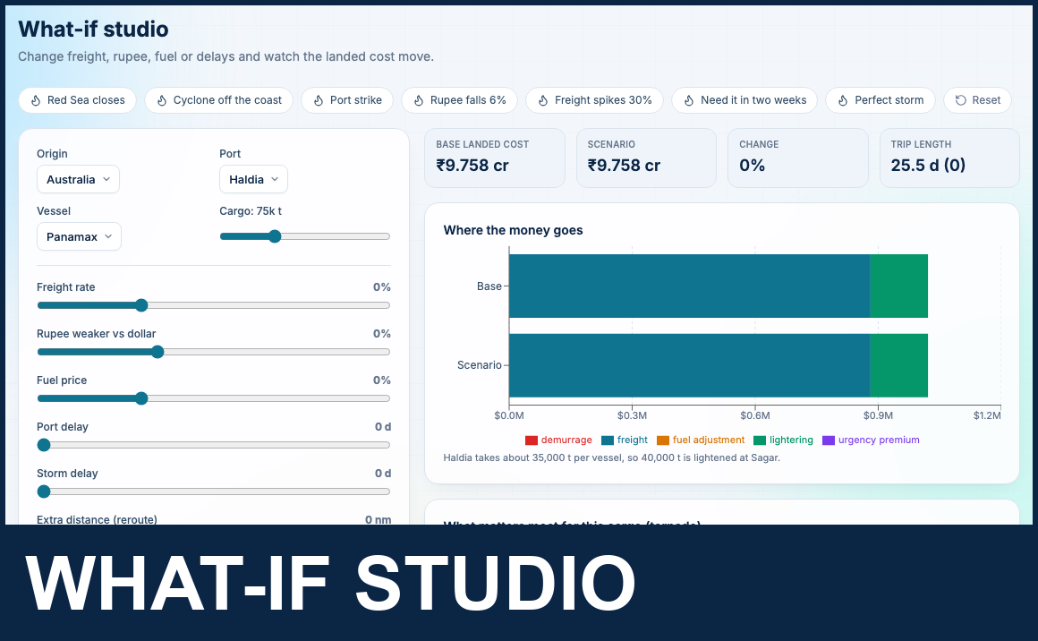
TECHNICAL APPROACH
Learnova
System architecture and technology stack
INPUTS
INGEST
ENGINES
AI SERVICE
OUTPUTS
Technologies to be used
PowerPoint .pptx
Convert
Planner + CLASS
LLM router
Editable PPTX
python-pptx · LibreOffice
teacher's old deck, any template
LibreOffice headless
PPTX → PDF, cached by hash
Python dynamic programming
load-optimal split, agenda
Gemini ×5 · Groq · NVIDIA
failover, per-key pacing
python-pptx native shapes
linked pictures, notes
React
Vite
Tailwind
Reveal.js
Python
FastAPI
SQLite
PyMuPDF
Slide PDF
Slide reader
Decision engine
AI polish
Web deck
PyMuPDF
exported or scanned slides
PyMuPDF geometry rules
titles, levels, tables, figures
27 rule detectors
visual family + reason
Gemini 3.5 Flash-Lite
assertion titles, explanations
Reveal.js · HTML5
reveals, labs, flip cards
LibreOffice
Tesseract
Gemini
Groq
SymPy
pytest
GitHub
Docker
Frontend: React 18 · Vite · Tailwind CSS · Reveal.js web deck · PWA
Backend: Python 3.12 · FastAPI · Pydantic · job queue · SQLite · OTP auth
Documents: python-pptx · PyMuPDF · LibreOffice · python-docx · Tesseract OCR
AI / NLP: Gemini (5-key pool) · Groq · NVIDIA NIM via failover router
Maths & labs: SymPy exact solvers · JavaScript lab engine · SVG
Quality & DevOps: pytest (774 tests) · layout audit · GitHub · Docker
Word / notes
OCR decision
Layout engine
Topic diagrams
Study pack
python-docx · Markdown
.docx, markdown, plain text
Tesseract OCR
only when γ ≤ 0.42, conf ≥ 62
glyph metrics · python-pptx
11 pt floor, no broken words
SVG → CairoSVG → PNG
sanitised, linked HTML page
HTML · CSV (Anki)
flashcards, quiz bank
Typed topic
Repair rules
Explainer solvers
AI labs
Share + present
React form → REST
a syllabus line or prompt
Python · regex · DP
logos, page numbers, glued titles
SymPy · exact fractions
steps with reasons
JavaScript · Node check
no network, no storage
React 18 · FastAPI
view-only link, presenter
Teacher labs
Colour DNA
PSF scorer + audit
Offline fallback
Deck tutor
HTML · JavaScript
own labs added via the API
Pillow colour clustering
source palette → deck theme
NumPy · pytest
fitness, overflow, facts kept
rules · scenes · labs
works with no key at all
router + deck context
answers only from the deck
Data and storage
API and jobs
Security
Deploy and test
WORKING PROTOTYPE · real screens from Learnova
SQLite for users, decks and jobs; content-hash caches for PDFs, diagrams and labs
FastAPI with about 70 REST routes, background job queue, live progress, OpenAPI docs
OTP e-mail sign-in, hashed codes, rate limits, SVG sanitiser, lab-code gate
One laptop or server; Vercel-ready front end; 774 pytest tests on GitHub
Notes:
Technical approach and tech stack (Swayam, 1 min 40 s)
This is the architecture, left to right. Inputs: PowerPoint, PDF, Word notes or a typed topic. Ingest: LibreOffice
converts PowerPoint to PDF, and our slide reader, built on PyMuPDF, recovers titles, bullet levels, tables and figures. OCR with
Tesseract runs only when a page is mostly a picture.
The engines are our own work: the planner splits long sections, the decision engine picks one of 27 visual forms with a reason,
the layout engine measures text so nothing overflows, and the solvers compute every number exactly with SymPy.
The AI service uses five Gemini keys with Groq and NVIDIA as backups, and everything it writes is checked before use. If no
key works, offline rules still finish the deck. Outputs are an editable PowerPoint, an interactive web deck, a study pack and
a share link.
On the right is the stack: React and Vite for the front end, FastAPI and Python for the back end, SQLite for data, and pytest with
755 tests. The bottom row shows storage, the API, security and deployment.
*Handover:* Kawaljeet will now explain the method step by step and why it is feasible.

Slide 4
METHODOLOGY
Learnova
Six stages from the teacher's old deck to a checked, interactive one
Methodology and process for implementation
1 · READ
2 · CLEAN
3 · PLAN
4 · DECIDE
5 · ENRICH
6 · BUILD + AUDIT
▸ PPTX → PDF with LibreOffice, cached by file hash
▸ Words read with position, size, weight (PyMuPDF)
▸ Title rule: size ≥ 1.18 × body size
▸ OCR only if γ ≤ 0.42, confidence ≥ 62
▸ Tables and figures kept in place
▸ Text on ≥ max(3, 0.3n) pages removed: logos, footers
▸ Glued titles split by dynamic programming
▸ Split words and wrapped lines joined
▸ Chart debris and page counters dropped
▸ Repeated pictures marked as decoration
▸ Pages grouped into topics and sections
▸ CLASS splits long sections at least load cost
▸ Agenda, glossary and summary slides added
▸ Parts get names, never “(2/5)”
▸ Each part stays under the load limit
▸ 27 detectors score every slide
▸ Visual family d* = highest confidence
▸ Exclusion rules stop clashing choices
▸ Reason and confidence stored per slide
▸ Flowchart, algorithm, code, equations, charts…
▸ AI titles kept only if grounded in the slide
▸ Topic diagrams from the 5-key Gemini pool
▸ Exact step-by-step explainers (SymPy)
▸ Labs: built-in, AI-written + checked, or offline
▸ Quizzes and flashcards from slide facts
▸ Glyph-measured fitting, 11 pt floor
▸ Editable PPTX, web deck and study pack
▸ PSF score, overflow and fact audit
▸ Caches make every re-run instant
▸ Notes and alt text on every slide
Our own formulas behind each decision
How we built it
OCR decision
γ = |I ∖ M| / |I| use OCR only if γ ≤ 0.42
share of the page that is picture, not text
Slide fitness (PSF)
PSF = E^0.40 · (1 − L)^0.42 · C^0.18
efficiency, cognitive load L, coherence
Research + design
Sep–Dec 2025
Build platform
Jan–Jul 2026
Test + publish
Aug–Oct 2026
✓ Agile: weekly sprints, reviewed with our guide every week
✓ Test-first: 774 automated tests, gold sets of 101 slides
✓ Measured: every claim on these slides comes from a script
✓ Documented: IPD diary, report and two research papers
CLASS splitting
F(i) = min_p [ F(p) + cost(p, i) ]
cost = L + 0.9(1 − E) + 0.25·overflow² + 0.35
Word-safe layout
σ = max(0.62, min(1, W / w)), s* ≥ 11 pt
largest font on a 0.5 pt grid that fits
Notes:
Methodology (Kawaljeet, 1 min 30 s)
Thank you, Swayam. Our method has six stages. Read: every word is read with its position, size and weight, so we know what is
a title and what is a bullet. Clean: anything repeated on many pages, like a college logo or a footer, is removed, and titles
that lost their spaces are split back into words using dynamic programming.
A procedure with decisions becomes a real flowchart with Yes and No branches, and program code appears like an editor, with a note for each line and its output. Algorithms and equations are kept whole: pseudocode goes into one numbered panel with its indentation, and equations are written as real PowerPoint equations, the way Word shows them, not as plain text. Plan: long sections are split with our algorithm CLASS, which picks the split points with the lowest cognitive load.
Decide: 27 detectors score each slide, and the best one decides whether it becomes a process, a timeline, a comparison, and
so on. Enrich: AI adds titles, diagrams and labs, but only after a check, and solved problems get exact steps. **Build and
audit**: we produce the files and then score every slide.
*(point at the formulas)* These four formulas are ours: when to use OCR, the Pedagogical Slide Fitness score, the CLASS cost, and
the rule that keeps words from breaking. On the right is how we worked: research from September to December, building until
July, and testing and writing since August.

Slide 5
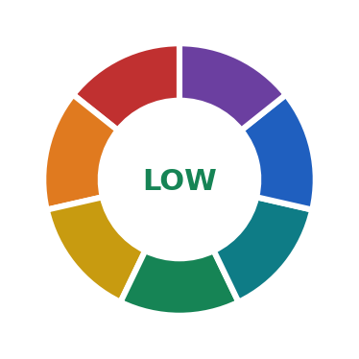













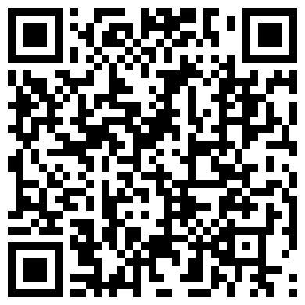


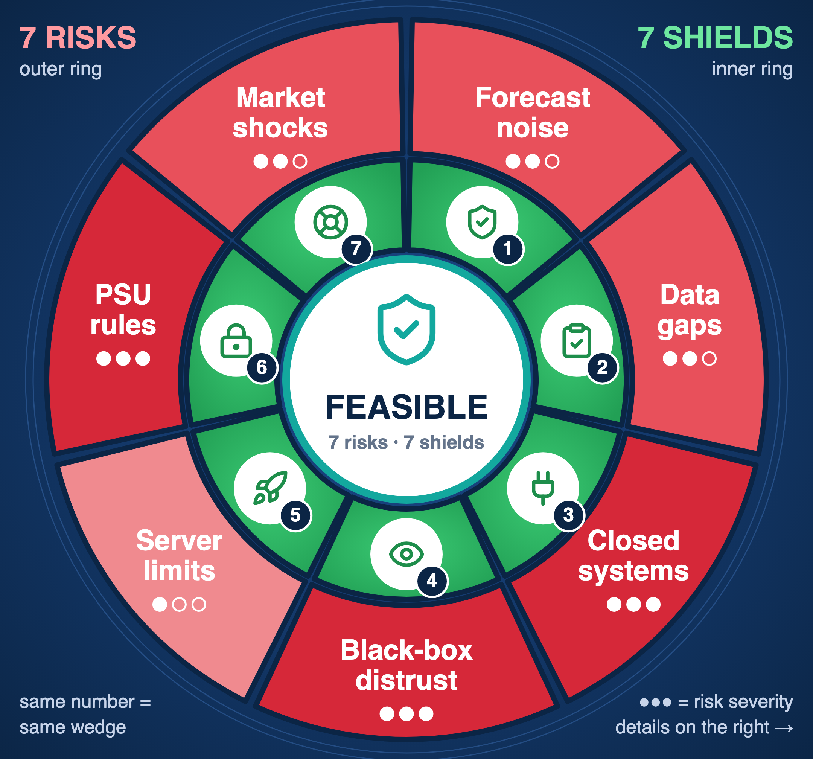



FEASIBILITY AND VIABILITY
Learnova
Running today · pilot-ready · every risk has a safeguard
Analysis of the feasibility of the idea
Potential challenges and risks
Strategies for overcoming these challenges
7 risks found · 7 safeguards built
We listed what could stop Learnova in a real classroom and built one safeguard for each. Each risk is rated by how likely it is and how much harm it would do if it happened; the right-hand column shows the safeguard already in the code. Residual risk after safeguards: LOW.
Faithful Reader
TECHNICAL
Built and running end to end: FastAPI back end, React front end, 16 pipeline stages as separate modules, 774 automated tests and a layout audit.
1
vs Messy PDFs
774 tests
Geometry rules, a DP title splitter and the γ ≤ 0.42 OCR test keep messy PDFs, logos and picture slides correct; 98–100% of facts kept.
DATA
No dataset to collect: input is the college's own PPTX, PDF and DOCX material. Verified on 7 real decks (15–216 pages) and 101 gold-labelled slides.
Grounded AI
7 real decks
2
vs Hallucination
An AI title or explanation is used only if it reuses the slide's own words and fits length rules; every number in a solution comes from SymPy.
ECONOMIC
₹0 to run offline; free-tier Gemini keys (pool of 5) are optional. One department PC replaces paid AI-slide plans ($10–20 per teacher per month).
₹0 offline
Key Pool + Offline
Risk
Likely
Impact
Safeguard in code
3
vs Quota / cost
Offline first: free Gemini and Groq key pools are used only when the rule result is weak; spent keys are skipped; offline rules always finish.
Messy or scanned PDFs
High
High
Geometry rules + OCR test
OPERATIONAL
No retraining for staff: upload, review, download. Every slide stays editable, every choice shows its reason; students need only a browser or phone.
editable
AI makes up facts
Grounding check, SymPy maths
Glass-box Decisions
Med
High
4
vs Black-box
Keys or quota run out
High
Med
5-key pool + offline rules
Each visual records the detector that fired, its confidence and the runner-up; the teacher can switch it in the editor in one click.
SECURITY
OTP sign-in with hashed codes and rate limits; AI diagrams sanitised, AI lab code checked before use; share links view-only; data stays on campus.
sanitised
Teachers distrust AI
Med
High
Reason + confidence shown
Measured Layout
Text overflows slides
Glyph fit, CLASS split
5
vs Broken layout
Med
Med
Text is measured glyph by glyph with an 11 pt floor; long sections split by CLASS. Result on 7 decks: 0 overflow, 0 broken words.
SCALE
Time grows linearly: a 216-page PDF becomes a full deck in ~35 s offline. Parallel workers, job queue and content-hash caches make re-runs instant.
Slow on long decks
Parallel + caches
~35 s / 216 pp
Low
Med
Fast by Design
Unsafe generated code
Low
High
Sanitiser + node --check
6
vs Slow decks
Diagrams and labs run in parallel (2 requests per key) before the build; with 5 keys 40 diagrams take ≈ 42 s instead of 3 min.
VERIFY IT
YOURSELF
scan / click
ADOPTION PATH · low-risk, one step at a time
1 · PILOT
2 · DEPT
3 · COLLEGE
Safe Generated Code
7
vs Unsafe code
Our AI & DS courses; 3–4 faculty
Shared server, deck + lab library
LMS export, regional languages
SVG whitelist removes scripts and links; lab JavaScript must pass node --check and may not use network, eval, cookies or storage.
Code
Tests
Gold sets
Papers
Notes:
Feasibility and viability (Kawaljeet, 1 min 30 s)
Is it feasible? It already runs. Technically, it works end to end with 755 automated tests. Data: we need no dataset; the
input is the college's own material, and we tested on seven real decks. Economically, it costs nothing offline, and one
department computer replaces paid AI-slide plans. Operationally, teachers only upload and download, and everything stays
editable.
In the middle are the seven risks we found, each rated by likelihood and impact, and the safeguard already in the code. For
example, the risk that AI invents facts is high impact, so AI text is accepted only if it uses the slide's own words, and numbers
always come from SymPy. On the right are our seven strategies, and at the bottom the adoption path: our own courses first, then
the department, then the college. You can scan these codes to check the code, tests and papers yourself.
*Handover:* Jeevesh will show what this changes for students and teachers.

Slide 6
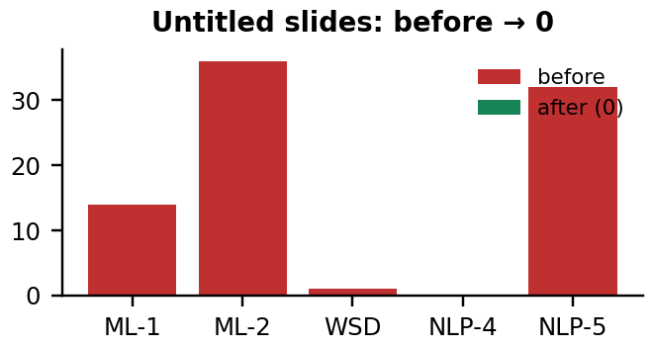
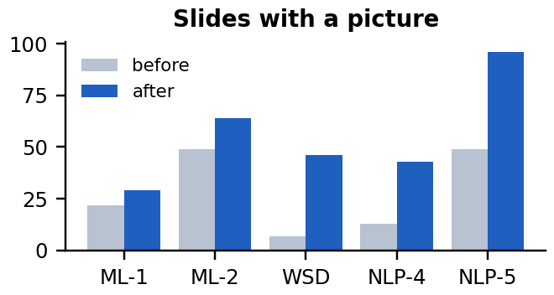
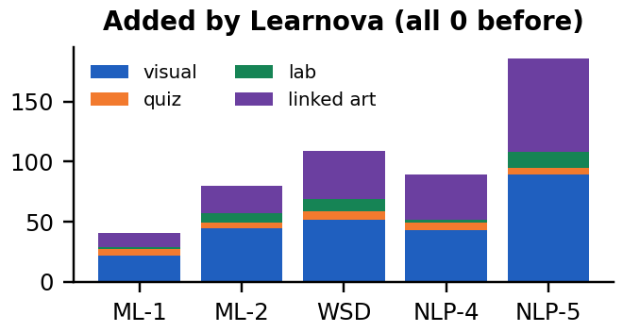
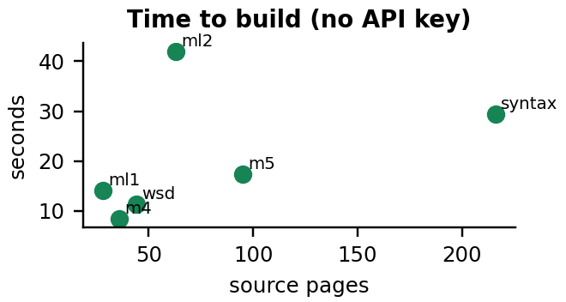









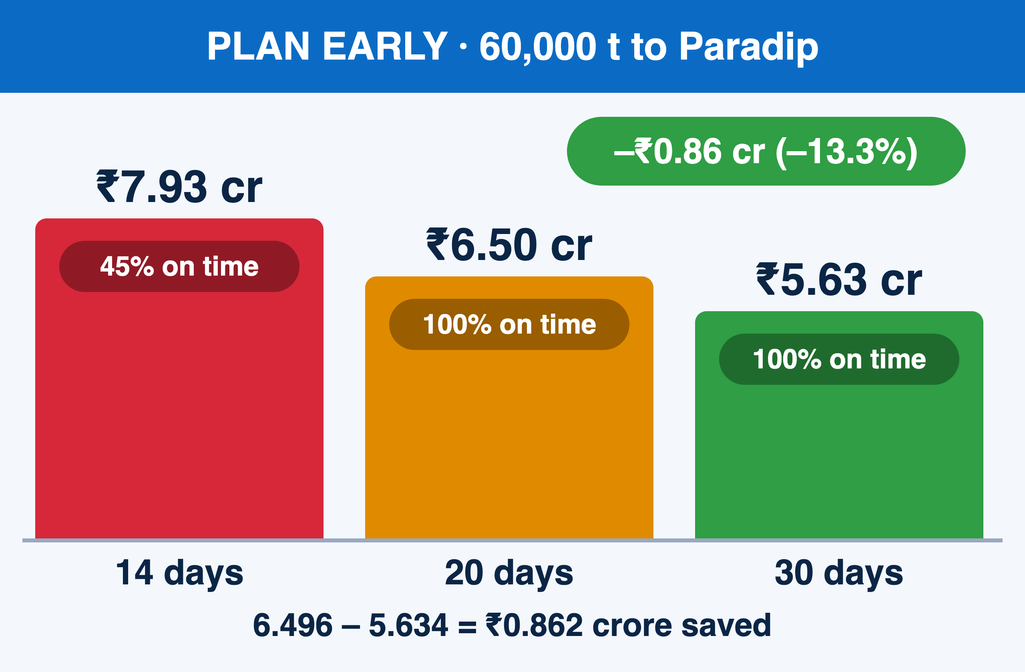
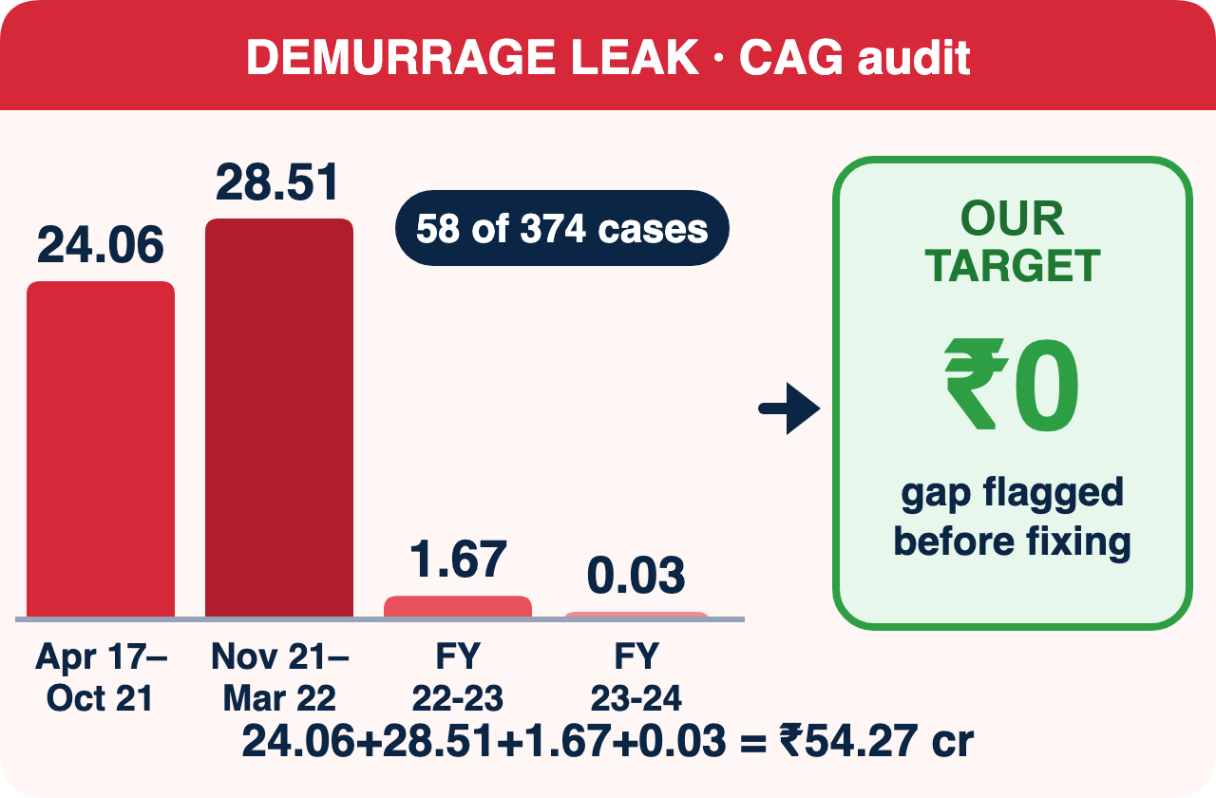
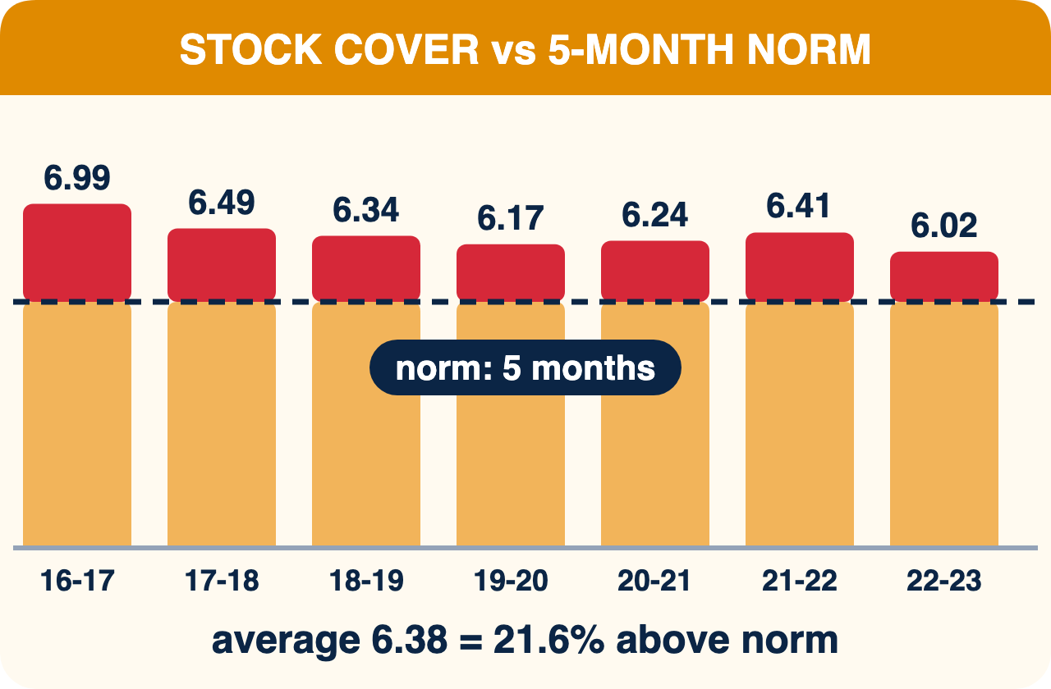
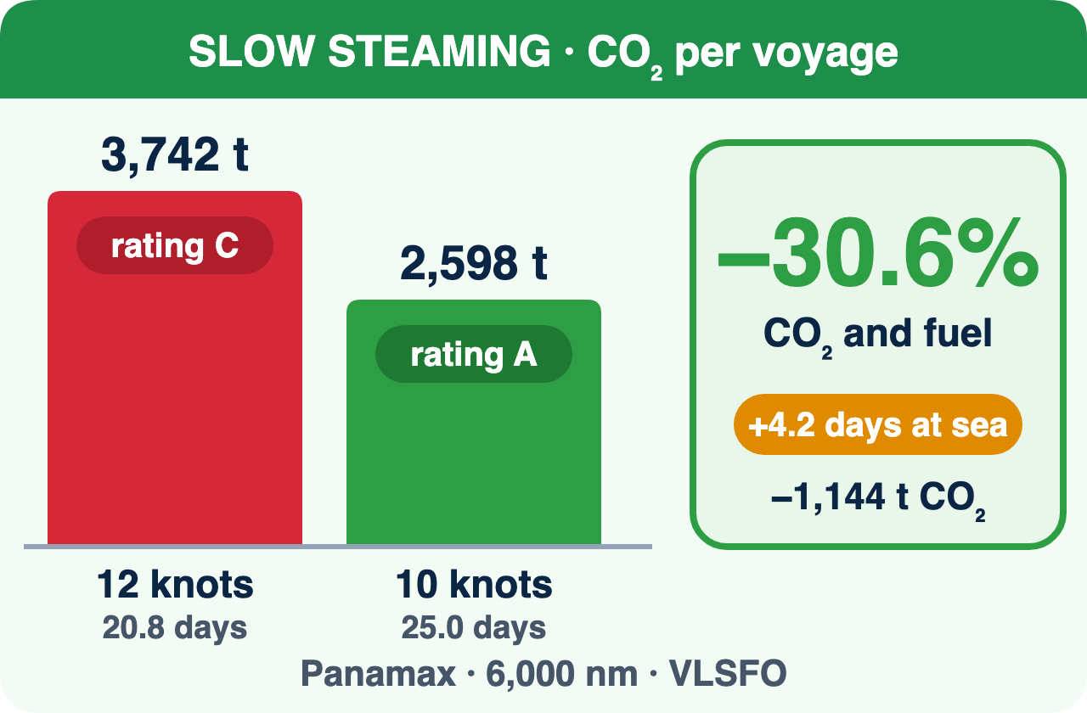
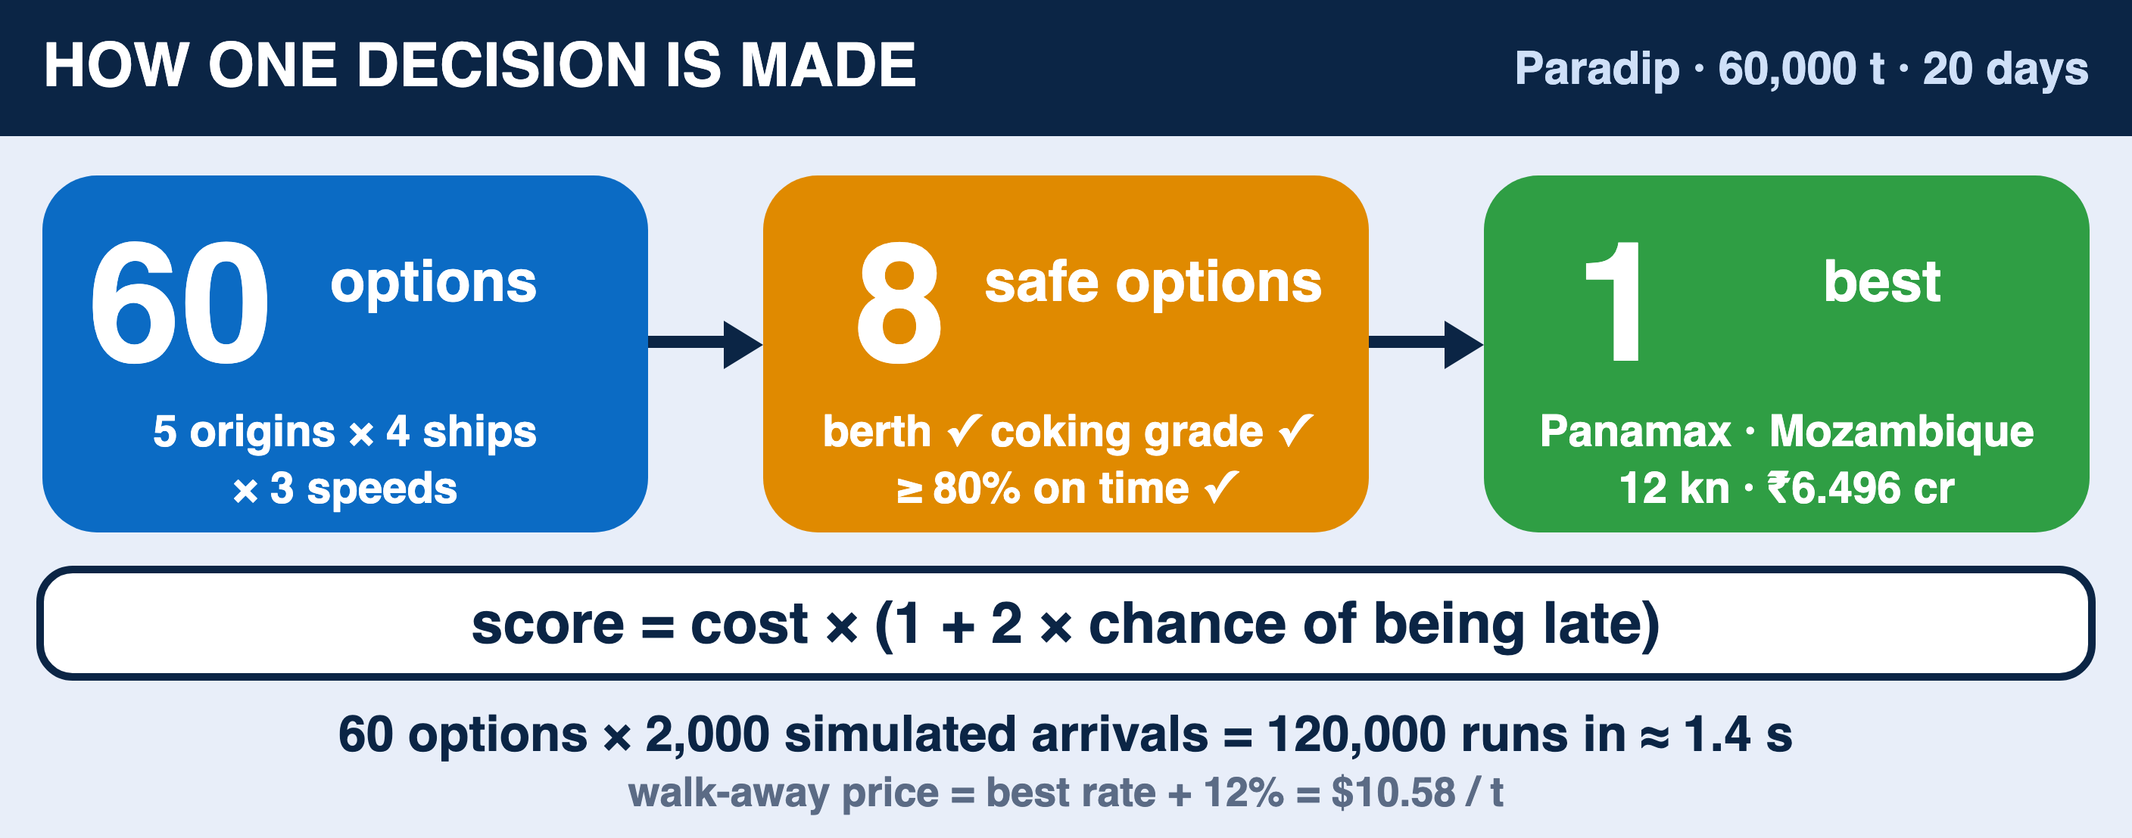
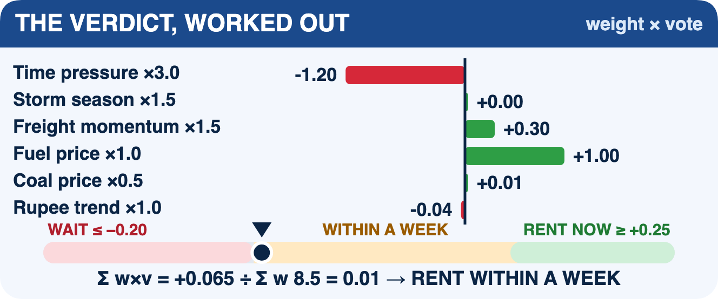
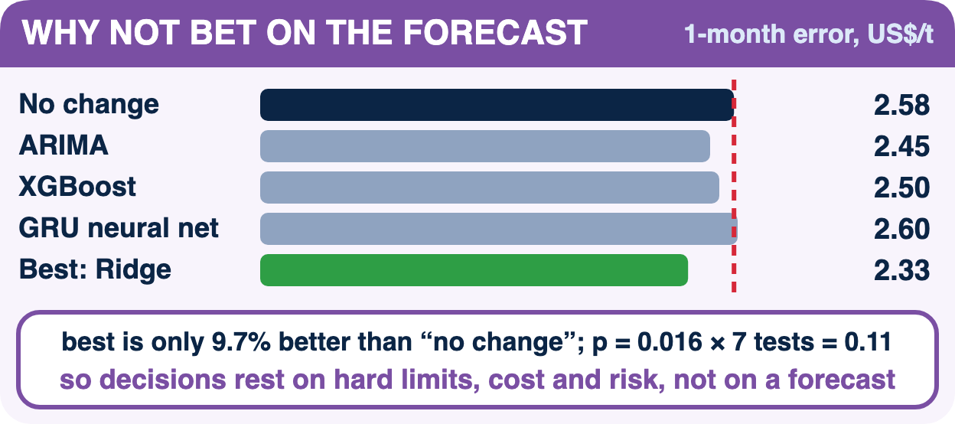
IMPACT AND BENEFITS
Measured on our own test decks — not on promises
Learnova
Untitled slides across 5 real decks fell from 83 to 0. Every slide now states its point in a full-sentence title.
Slides with a picture rose on every deck: the teacher's own figures are kept and AI diagrams are added on topic slides.
Visual slides, quizzes, labs and linked illustrations went from zero to hundreds, all built from the deck's own content.
Build time grows in a straight line with length: a 216-page PDF becomes a full deck in about 35 s with no API key.
EDUCATIONAL
SOCIAL
INSTITUTIONAL
TECHNOLOGICAL
One idea per slide with a picture, so the eye has one thing to read. Solved problems become step-by-step explainers with a reason for each step, and hard topics get labs and quizzes to practise on.
Runs offline and free on a college laptop, so students without paid tools, fast internet or a laptop of their own get the same material through a share link on any phone. Plain words and alt text help first-generation learners.
Course decks become consistent and accessible across the department. A shared library of decks and labs builds up every semester and supports flipped, remote and revision classes.
Explainable rules instead of a black box, our own PSF score and CLASS splitting, and AI used only where its output can be checked: sanitised diagrams, checked code, grounded titles.
Students
revise with visuals, quizzes and labs
Faculty
old deck redesigned in about a minute
HoD / Department
consistent, reusable course material
Exam preparation
flashcards, quiz bank, cheat sheet
Remote learners
share link on any phone, works offline
Accessibility
readable text, alt text, plain words
83 → 0
untitled slides
251
visual slides added
190
linked illustrations
98–100%
facts kept
0
overflow or broken words
26 / 26
explainers correct
Notes:
Impact and benefits (Jeevesh, 1 min 20 s)
Thank you. Everything on this slide is measured, not promised. *(left to right)* Untitled slides went from 83 to zero. Slides
with a picture went up on every deck. Visual slides, quizzes, labs and illustrations went from zero to hundreds. And the time
grows in a straight line: a 216-page PDF becomes a full deck in about 35 seconds without any API key.
The impact is educational, because each slide has one idea and a picture, and hard topics have labs, with a short quiz every four slides so students stay active; social, because it is
free and works on a phone; institutional, because the department builds a shared library of decks and labs; and
technological, because AI is used only where its output can be checked. The bottom row sums it up: 98 to 100 percent of
facts kept, zero broken words, and all 26 test problems solved correctly.

Slide 7
LITERATURE REVIEW
Learnova
What earlier work found, what it left open, and how Learnova closes the gap
Paper
Method
Finding
Gap left open
How Learnova addresses it
Fu et al., 2022
DOC2PPT — AAAI
Neural model turns a research paper into new slides section by section
Readable slides from long documents
Writes new text; drops points; needs training data; not for existing decks
Starts from the teacher's own deck and keeps every point verbatim
Sun et al., 2021
D2S — NAACL
Query-based summarisation: a slide title is used to retrieve and write its bullets
Titles can steer content selection
Abstractive text can drift from the source; no visual or layout choice
Titles are grounded in the slide's words; 27 detectors choose a visual
Hu & Wan, 2015
PPSGen — IEEE TKDE
Learns sentence importance and fills slides by integer programming
Extractive selection keeps facts
Bullet text only: no diagrams, no layout fitting, no interactivity
Adds diagrams, labs and quizzes; fits every slide by glyph measurement
Maynez et al., 2020
Faithfulness — ACL
Human study of hallucination in neural abstractive summaries
Many model summaries contain unsupported content
Generation without checks is unsafe for study material
AI output is accepted only after grounding, sanitising or code checks
Garner & Alley, 2013
Assertion–evidence — IJEE
Classroom study comparing sentence-headline slides with topic-bullet slides
Assertion titles + visual evidence improve understanding
Redesigning decks by hand takes teachers many hours
Writes assertion titles and visuals automatically, in about a minute
Mackinlay, 1986
APT — ACM TOG
Rules of expressiveness and effectiveness choose a chart for data
Visual choice can be automated with explicit rules
Covers data charts only, not lecture text
Extends rule-based choice to 27 slide families with confidence and reason
Research gap
Earlier systems either generate new slides from a document, which changes the teacher's wording and can invent content, or select sentences without any visual design. Design research tells us what a good slide looks like but leaves the redesign to the teacher. No published system takes an existing lecture deck, keeps every point, explains each design decision and checks the AI output it adds. Learnova is built for exactly this gap.
Also reviewed
Tufte 2003 · Sweller 1988 · Cowan 2001 · Mayer 2009 · Knuth & Plass 1981 · Moritz 2019 · Ji 2023 · Kasneci 2023 · Renkl 2014 · Hundhausen 2002 · Wieman 2008 · Chi & Wylie 2014; tools: Gamma, Copilot, Gemini Slides, Canva. Full list with links on the next slide.
Notes:
Literature review (Jeevesh, 1 min 10 s)
We studied earlier work before building. DOC2PPT and D2S generate new slides from documents, but they rewrite the text and can
drop points. PPSGen keeps sentences but gives only bullets, with no visuals. Maynez and colleagues showed that model summaries
often contain content that is not in the source, which is why we keep the teacher's text and check every AI output. Garner and
Alley showed that sentence titles with visual evidence help students understand, and Mackinlay showed that visual choices can be
made by rules.
*(point at the research gap box)* The gap: no system takes an existing lecture deck, keeps every point, explains its design
choices and checks what AI adds. That is the gap Learnova fills.
*Handover:* Rishit will cover our research output and conclusions.

Slide 8














































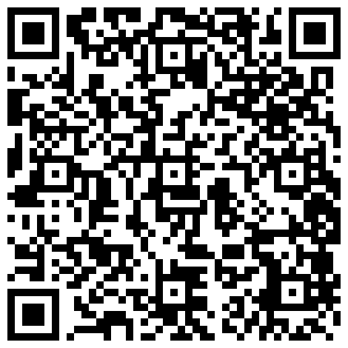











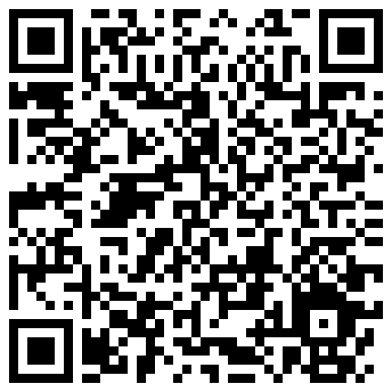





RESEARCH AND REFERENCES
12 road signs · 36 sources · scan any code to check
Learnova
THE PROBLEM
why old decks fail learners
SLIDE DESIGN
what a good slide looks like
SLIDE GENERATION
prior systems we improve on
FAITHFULNESS
why we keep text verbatim
Tufte 2003: Cognitive Style of PowerPoint
bullets fragment the argument
edwardtufte.com
Garner & Alley 2013, IJEE
assertion-evidence beats bullets
ijee.ie
Fu et al. 2022: DOC2PPT
paper → slides, neural
doi.org/10.1609/aaai.v36i1.19943
Maynez et al. 2020, ACL
summaries hallucinate and omit
aclanthology.org/2020.acl-main.173
Sweller 1988: Cognitive load
working memory limits learning
doi.org/10.1207/s15516709cog1202_4
Alley et al. 2006
sentence headlines aid retention
Technical Communication 53(2)
Sun et al. 2021: D2S
query-based summarisation
aclanthology.org/2021.naacl-main.111
Ji et al. 2023, ACM CSUR
survey of hallucination
doi.org/10.1145/3571730
Cowan 2001: the magical number 4
about four chunks at a time
doi.org/10.1017/S0140525X01003922
Mayer 2009: Multimedia Learning
coherence, signalling, contiguity
cambridge.org
Hu & Wan 2015: PPSGen
learned sentence selection
doi.org/10.1109/TKDE.2014.2359652
Kasneci et al. 2023
LLMs in education: risks
doi.org/10.1016/j.lindif.2023.102274
WORKED EXAMPLES
steps with reasons
INTERACTIVE LABS
learning by doing
LAYOUT & DESIGN RULES
algorithms we adapted
DOCUMENTS & OCR
reading real decks
Sweller & Cooper 1985
worked examples teach novices
doi.org/10.1207/s1532690xci0201_3
Hundhausen et al. 2002
engagement drives visualisation gains
doi.org/10.1006/jvlc.2002.0237
Knuth & Plass 1981
optimal line breaking → CLASS
doi.org/10.1002/spe.4380111102
Smith 2007: Tesseract OCR
open-source OCR engine
github.com/tesseract-ocr
Atkinson et al. 2000
principles of example study
doi.org/10.3102/00346543070002181
Wieman et al. 2008: PhET
simulations that teach
doi.org/10.1126/science.1161948
Mackinlay 1986: APT
automatic visual design rules
doi.org/10.1145/22949.22950
PyMuPDF + LibreOffice
PDF geometry, PPTX → PDF
pymupdf.readthedocs.io
Renkl 2014, Cognitive Science
example-based learning theory
doi.org/10.1111/cogs.12086
Chi & Wylie 2014: ICAP
interactive > active > passive
doi.org/10.1080/00461520.2014.965823
Moritz et al. 2019: Draco
design knowledge as constraints
doi.org/10.1109/TVCG.2018.2865240
python-pptx
native, editable PowerPoint
python-pptx.readthedocs.io
CODE AND TESTS
open, testable, honest
TRY IT
run it today
TOOLS COMPARED
what exists today
AI MODELS
what powers the AI layer
Source code
774 tests, all modules
github.com/SDP42/LearnovaV2
Run locally
uvicorn API + Vite web app
README on GitHub
Gamma
prompt → new deck
gamma.app
Gold sets
101 labelled slides
tests/fixtures on GitHub
Demo decks
7 real decks rebuilt
docs/review on GitHub
Microsoft Copilot / Gemini Slides
AI inside office suites
microsoft.com · workspace.google.com
Google Gemini API
5-key pool, diagrams, titles
ai.google.dev
Measurement scripts
every number on these slides
scripts/research on GitHub
API docs
every endpoint, try it live
localhost:8000/docs
Canva Magic Design
template-first AI slides
canva.com
Notes:
Research and references (Rishit, 40 s)
Thank you. These are the sources behind each part of the project, grouped by topic: why old decks fail learners, what a good
slide looks like, earlier slide generators, faithfulness, worked examples, labs, and layout rules. Every card has a QR code, so
you can open the source directly. From this work we wrote two research papers, one in IEEE format and one in Springer LNCS format,
on our own algorithms.

Slide 9

CONCLUSIONS OBTAINED
Learnova
What the project set out to do, what we achieved, and what comes next
Objectives versus outcomes
Key conclusions
Keep every point of the teacher's deck
98–100% of facts kept on 7 real decks
● Redesign beats regeneration: starting from the teacher's deck keeps it trusted and correct.
● Rules + checked AI work together: rules give speed and reasons; AI adds titles, diagrams and labs only after a check.
● Exact maths matters: SymPy solvers were right even where our own hand answers were wrong.
● Measure honestly: PSF showed where rebuilt slides were longer, and we report it.
● Built for real classrooms: free, offline, editable, and fast enough to use before a lecture.
● Checks catch real bugs: our own tests found and fixed a lab-gate and a key-pool fault.
● Explainability builds trust: teachers accept a visual faster when they can see why it was chosen.
Give every slide a clear title
untitled slides 83 → 0 on 5 decks
Pick the right visual, with a reason
97% correct on 101 gold slides, < 1 ms each
Illustrate every topic slide
251 visual slides, 190 linked illustrations
Explain solved problems step by step
26 / 26 correct, 0 false alarms on 52 sentences
No overflow, no broken words
0 on every rebuilt deck
Work on any uploaded file
9 / 9 unseen files built; 2.3% slides flagged
Future scope
• Classroom study with our own students next semester
• Hindi and Marathi decks; voice narration
• LMS export (Moodle, Google Classroom)
• Calibrate PSF weights with student ratings
• Department server and shared lab library
• Handwritten-slide OCR and more solver types
Outputs: 2 research papers · IPD report · open-source code
Lower cognitive load on every deck
better on long PDFs, mixed on short decks
In one line
Learnova turns the decks teachers already have into faithful, visual and interactive lessons in about a minute, explains every design choice it makes, and uses AI only where its output can be checked.
Status: working prototype, tested on 7 real decks, ready for a department pilot.
Notes:
Conclusions obtained (Rishit, 1 min 20 s)
On the left are our objectives and what we achieved. We kept every point, removed every untitled slide, chose the right visual on
97 percent of 101 labelled slides, illustrated every topic slide, solved all test problems correctly, and had no overflow at all.
We are honest about one thing *(point at the orange row)*: our load score improved on long PDFs but is mixed on short decks,
because adding explanations makes slides longer.
Our key conclusions: redesigning beats regenerating; rules and checked AI work best together; exact maths matters, because our
solvers were right even where our own hand answers were wrong; and measuring honestly helped us find and fix real bugs. Next, we
plan a classroom study, Hindi and Marathi support, and export to Moodle and Google Classroom.

Slide 10
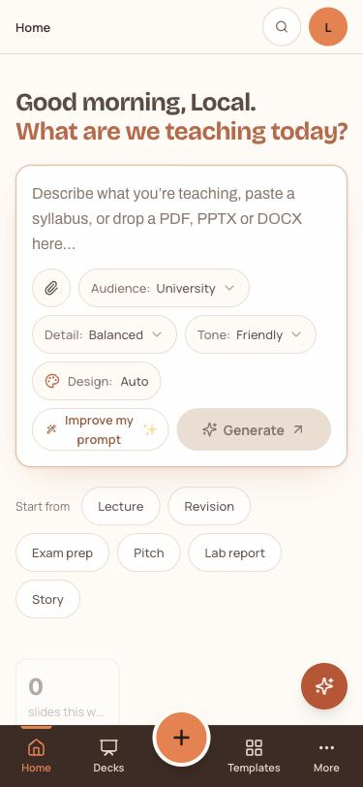
THANK YOU
Learnova
LEARNOVA
Old decks. New learning.
A faithful, explainable and interactive redesign of the lecture decks teachers already have — every point kept, every slide illustrated, every AI output checked.
Team
Swayam Devendra Panchal · Kawaljeet Singh Bharaj
Jeevesh Bharat Bodhani · Rishit Pankajkumar Lahoti
Guided by
Dr. Pratik Kanani, Head of Department
Artificial Intelligence and Data Science, DJSCE, Mumbai
What it gives back
Editable PowerPoint · interactive web deck · study pack · labs · quizzes · step-by-step explainers · deck tutor
Questions and live demo welcome
83→0
untitled slides
98–100%
facts kept
774
automated tests
~35 s
216-page deck
Try it yourself
Scan for the source code, demo decks, test suite and both research papers.
github.com/SDP42/LearnovaV2
Upload any lecture deck: PPTX, PDF or Word. Get back an editable PowerPoint, an interactive web deck and a study pack.
Runs on one laptop: FastAPI + React, works offline, free.
Notes:
Thank you and live demo (Rishit, 40 s, then demo)
To sum up: Learnova turns old decks into new learning. Every point is kept, every slide is illustrated and every AI output is
checked. Thank you. We would be happy to show a live demo: we can upload any deck you give us right now. *(open
http://localhost:5190, upload a small PPT, show the progress, then open the web deck and the PowerPoint)* We welcome your
questions.

