Slide 1

Module No. 1 Introduction to Machine Learning
Dr. Mrunal Rane • 34 slides

Slide 2

Agenda
Syllabus
Supervised Learning
1
2
Feature space
Hypothesis
3
4
Inductive bias
Variance
5
6
Learnova
1 / 34
Notes:
Reveal, one click at a time:
1. Syllabus
2. Supervised Learning
3. Feature space
4. Hypothesis
5. Inductive bias
6. Bias and variance
7. Low Bias
8. Variance
Pause: ask the class what they already know about “Agenda” before revealing the slide.
~68s

Slide 3






Syllabus
Introduction to Machine Learning
Types of Machine Learning, Issues in Machine
Steps involved in developing a Machine Learning
Hypothesis and Inductive Bias
Slide outlines
This slide outlines the course content, covering different machine learning categories, common challenges, real-world uses, the stages of building an ML system, and key concepts like hypothesis and inductive bias
ALSO ON THIS SLIDE
Understanding these foundations helps students grasp how ML models are designed and evaluated. Example: Think of the syllabus as a roadmap for a journey into machine learning.
Key takeaway: The syllabus maps ML types, challenges, applications, development steps, and core concepts.
Key terms: Inductive bias — Assumptions a learning algorithm uses to predict unseen outputs.
Learnova
▶ Open the interactive lab: Syllabus — step-through
2 / 34
Notes:
Reveal, one click at a time:
1. Introduction to Machine Learning:
2. Types of Machine Learning, Issues in Machine
3. Learning,
4. Application of Machine Learning,
5. Steps involved in developing a Machine Learning
6. Application.
7. Hypothesis and Inductive Bias
Say what these mean, in your own words:
- Inductive bias: Assumptions a learning algorithm uses to predict unseen outputs.
Pause: ask the class what they already know about “Syllabus” before revealing the slide.
~61s
Ask the class: Explain this slide in your own words, in one sentence.

Slide 4
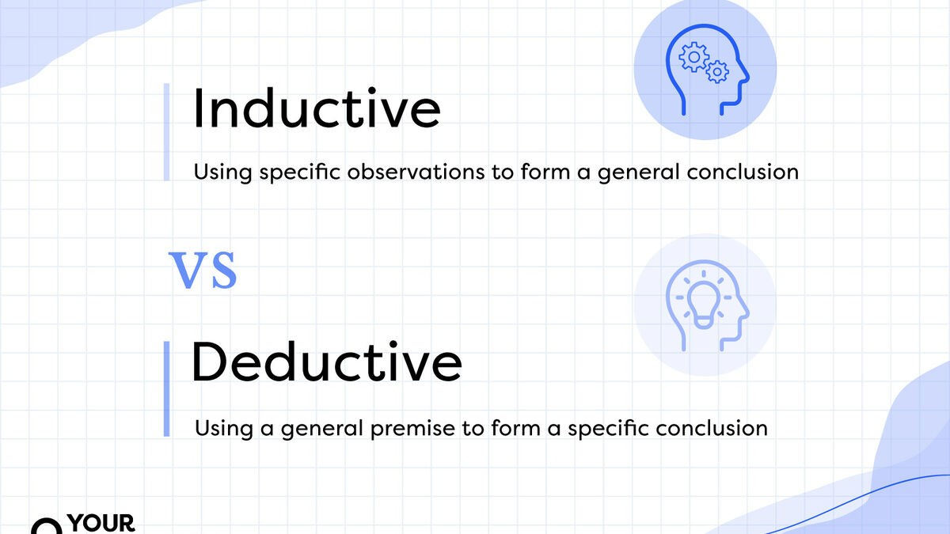
Syllabus (continued)
Learnova
3 / 34
Notes:
Read these exactly (do not paraphrase):
- Syllabus (continued)
Pause: ask the class what they already know about “Syllabus (continued)” before revealing the slide.
Wording matters here — slow down, keep it precise.
~19s
Text in the figure: Inductive Using specific observations to form a general conclusion VS _Deductive I Using a general premise to form a specific conclusion =
Ask the class: What might explain these numbers?

Slide 5
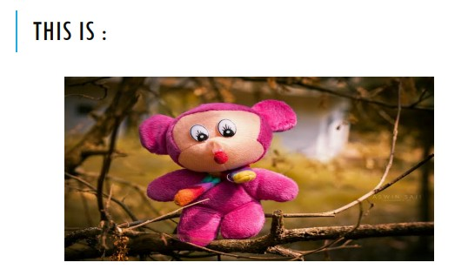
Training data shapes the model by providing incomplete information and influencing predictions
Training data.
Incomplete information.
Model makes assumptions.
Training data supplies the examples the model learns from.
BECAUSE Because data is often incomplete, the model must make assumptions to generalize.
These assumptions guide how the model predicts new instances.
E.G. Example: Like learning to recognize cats from a few pictures, the model infers unseen features.
Key takeaway: Training data gives incomplete clues, forcing the model to assume patterns for new cases.
Key terms: Model — A mathematical representation that maps inputs to outputs.
Learnova
4 / 34
Notes:
Reveal, one click at a time:
1. Training data
2. Incomplete information
3. Model makes assumptions
4. Prediction
5. Training data supplies the examples the model learns from.
6. Because data is often incomplete, the model must make assumptions to generalize.
7. These assumptions guide how the model predicts new instances.
Say what these mean, in your own words:
- Model: A mathematical representation that maps inputs to outputs.
Pause: ask the class what they already know about “Training data shapes the model by providing incomplete information and influencing predictions” before revealing the slide.
~61s
Ask the class: Explain this slide in your own words, in one sentence.

Slide 6
Checkpoint 1
QUESTION · UNDERSTAND
Which term matches this description: “A mathematical representation that maps inputs to outputs.”?
Bias
overfitting
A
B
variance
Model
C
D
Answer: D
Model: A mathematical representation that maps inputs to outputs.
Learnova
5 / 34
Notes:
KEY POINT TO LAND: Answer, then check your reasoning.
Pause: ask the class what they already know about “Checkpoint 1” before revealing the slide.
~44s

Slide 7


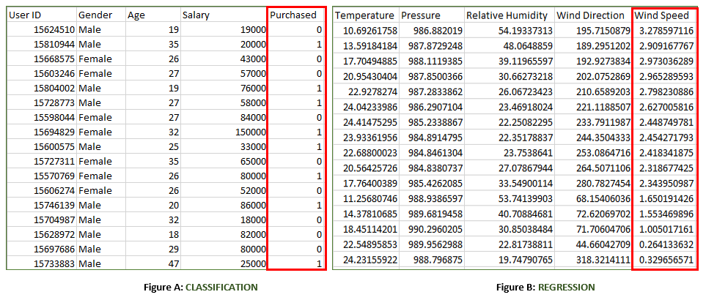


Supervised learning uses features and outputs to learn continuous or discrete patterns
Features (X)
Output (Y)
Supervised learning, each
In supervised learning, each instance has input features (X) and an output label (Y)
Algorithm learns
The algorithm learns a mapping that can predict continuous values or discrete categories
Example: Predicting house prices (continuous) or spam emails (discrete)
ALSO ON THIS SLIDE
Instances
Key terms: Features — Input variables that describe each instance.
Learnova
6 / 34
Notes:
Reveal, one click at a time:
1. Features (X)
2. Output (Y)
3. Instances
4. Continuous
5. Discrete
6. In supervised learning, each instance has input features (X) and an output label (Y).
7. The algorithm learns a mapping that can predict continuous values or discrete categories.
Read these exactly (do not paraphrase):
- Supervised learning uses features and outputs to learn continuous or discrete patterns Features (X) Output (Y) Instances Continuous Discrete In supervised learning, each instance has input features (X) and an output label (Y).
- Example: Predicting house prices (continuous) or spam emails (discrete).
Say what these mean, in your own words:
- Features: Input variables that describe each instance.
Pause: ask the class what they already know about “Supervised learning uses features and outputs to learn continuous or discrete patterns” before revealing the slide.
Wording matters here — slow down, keep it precise.
~61s
Ask the class: Explain this slide in your own words, in one sentence.

Slide 8
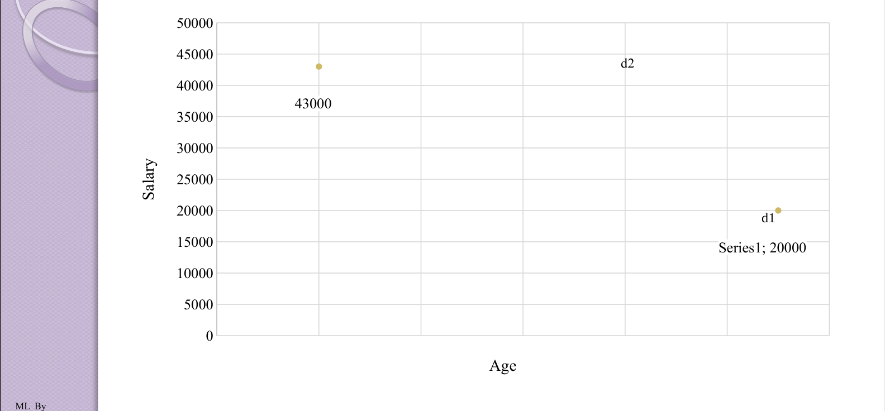
Feature space
Learnova
7 / 34
Notes:
Pause: ask the class what they already know about “Feature space” before revealing the slide.
~19s
Ask the class: Explain this slide in your own words, in one sentence.

Slide 9
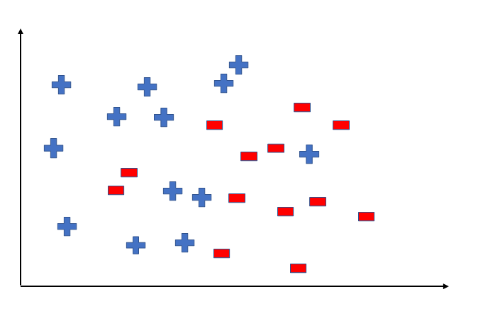
Hypothesis
Hypothesis (h) A hypothesis is a function that best describes the target in supervised machine learning. The hypothesis that an algorithm would come up depends upon the data and also depends upon the restrictions and bias that we have imposed on the data.
The hypothesis represents the model’s guess of the underlying relationship.
Its form depends on the training data and any constraints or biases we set.
The algorithm selects the hypothesis that best fits the data.
Example: Choosing a straight line when data points lie roughly along a line.
Key takeaway: A hypothesis is the algorithm’s chosen function that best fits the data under imposed biases.
Key terms: Hypothesis — A candidate function mapping inputs to predicted outputs.
Learnova
8 / 34
Notes:
Reveal, one click at a time:
1. Hypothesis (h) A hypothesis is a function that best describes the target in supervised machine learning. The hypothesis
2. The hypothesis represents the model’s guess of the underlying relationship.
3. Its form depends on the training data and any constraints or biases we set.
4. The algorithm selects the hypothesis that best fits the data.
5. Example: Choosing a straight line when data points lie roughly along a line.
Read these exactly (do not paraphrase):
- Hypothesis Hypothesis (h) A hypothesis is a function that best describes the target in supervised machine learning.
Say what these mean, in your own words:
- Hypothesis: A candidate function mapping inputs to predicted outputs.
Pause: ask the class what they already know about “Hypothesis” before revealing the slide.
~47s
Ask the class: Explain this slide in your own words, in one sentence.

Slide 10
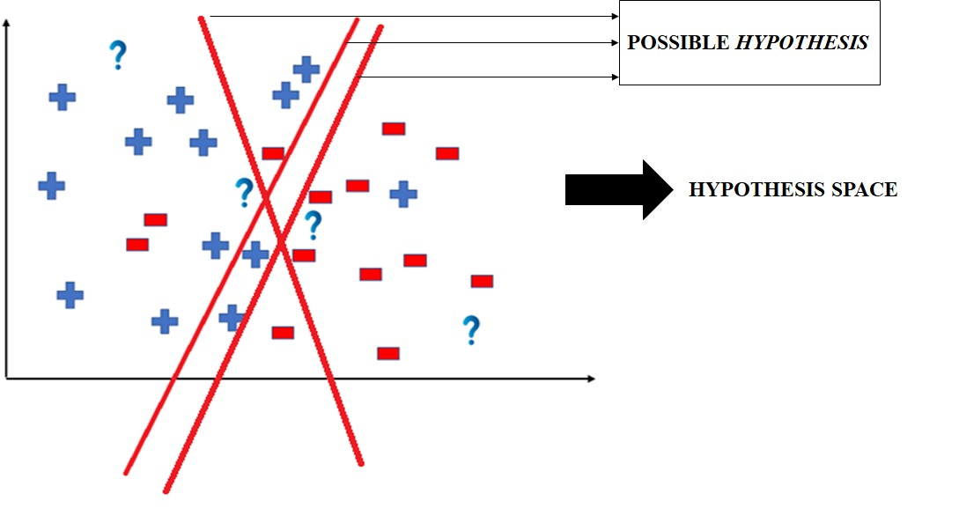
Hypothesis (continued)
Learnova
9 / 34
Notes:
Read these exactly (do not paraphrase):
- Hypothesis (continued)
Pause: ask the class what they already know about “Hypothesis (continued)” before revealing the slide.
Wording matters here — slow down, keep it precise.
~19s
Text in the figure: >| >| POSSIBLE HYPOTHESIS >| —- HYPOTHESIS SPACE
Ask the class: What might explain these numbers?

Slide 11
Checkpoint 2
QUESTION · UNDERSTAND
Which term matches this description: “A candidate function mapping inputs to predicted outputs.”?
Bias
Hypothesis
A
B
High bias
underfitting
C
D
Answer: B
Hypothesis: A candidate function mapping inputs to predicted outputs.
Learnova
10 / 34
Notes:
KEY POINT TO LAND: Answer, then check your reasoning.
Pause: ask the class what they already know about “Checkpoint 2” before revealing the slide.
~44s

Slide 12
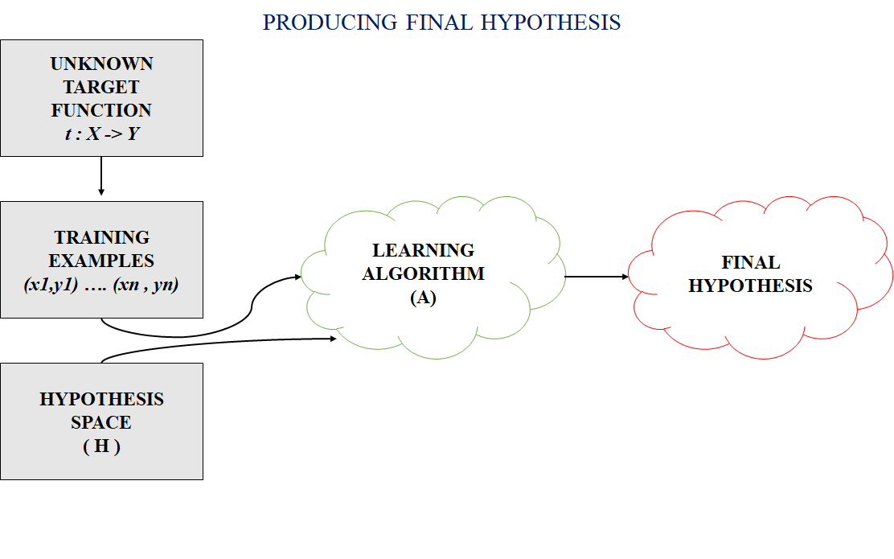
The hypothesis space contains all legal hypotheses from which the algorithm selects the best one
Hypothesis Space (H) Hypothesis space is the set of all the possible legal hypothesis. This is the set from which the machine learning algorithm would determine the best possible (only one) which would best describe the target function or the outputs.
The hypothesis space is the set of all possible models the algorithm can consider.
The learning process searches this space to find the single hypothesis that best explains the target function.
Example: All possible decision trees of a given depth form the hypothesis space.
Key takeaway: The hypothesis space contains every legal model the algorithm can evaluate to find the best fit.
Key terms: Hypothesis space — The set of all permissible hypotheses the algorithm can choose.
Learnova
11 / 34
Notes:
Reveal, one click at a time:
1. Hypothesis Space (H) Hypothesis space is the set of all the possible legal hypothesis. This is the set from which the ma
2. The hypothesis space is the set of all possible models the algorithm can consider.
3. The learning process searches this space to find the single hypothesis that best explains the target function.
4. Example: All possible decision trees of a given depth form the hypothesis space.
Read these exactly (do not paraphrase):
- The hypothesis space contains all legal hypotheses from which the algorithm selects the best one Hypothesis Space (H) Hypothesis space is the set of all the possible legal hypothesis.
- This is the set from which the machine learning algorithm would determine the best possible (only one) which would best describe the target function or the outputs.
Say what these mean, in your own words:
- Hypothesis space: The set of all permissible hypotheses the algorithm can choose.
Pause: ask the class what they already know about “The hypothesis space contains all legal hypotheses from which the algorithm selects the best one” before revealing the slide.
Wording matters here — slow down, keep it precise.
~40s
Ask the class: Explain this slide in your own words, in one sentence.

Slide 13
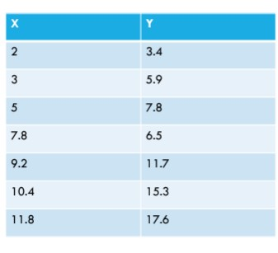
Hypothesis: Data
Learnova
12 / 34
Notes:
Reveal, one click at a time:
1. Data:
2. Model?
3. Hypothesis?
Pause: ask the class what they already know about “Hypothesis: Data” before revealing the slide.
~33s
Ask the class: Explain this slide in your own words, in one sentence.

Slide 14
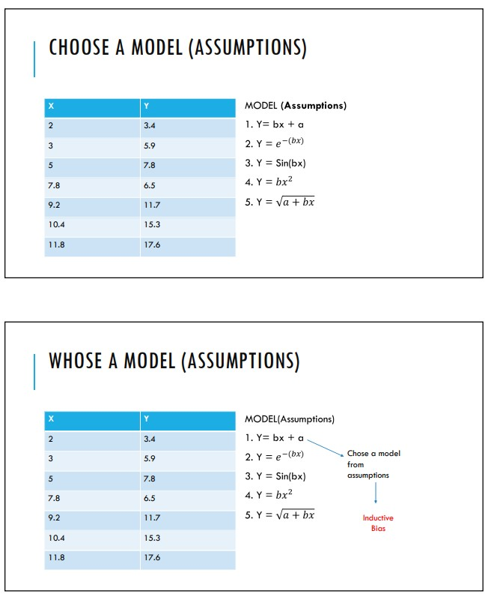

Hypothesis, data, and inductive bias are interrelated in learning
Inductive bias
Hypothesis is derived
The hypothesis is derived from data, but its selection is guided by inductive bias
Bias determines which hypotheses the algorithm considers plausible given the data
Example: Assuming linearity biases the algorithm toward linear models
Key terms: Inductive bias — Assumptions that influence hypothesis selection.
Learnova
13 / 34
Notes:
Reveal, one click at a time:
1. Hypothesis?
2. Data
3. Inductive bias
4. The hypothesis is derived from data, but its selection is guided by inductive bias.
5. Bias determines which hypotheses the algorithm considers plausible given the data.
6. Example: Assuming linearity biases the algorithm toward linear models.
Say what these mean, in your own words:
- Inductive bias: Assumptions that influence hypothesis selection.
Pause: ask the class what they already know about “Hypothesis, data, and inductive bias are interrelated in learning” before revealing the slide.
~54s
Ask the class: Explain this slide in your own words, in one sentence.

Slide 15

Inductive bias consists of assumptions a learning algorithm uses to predict outputs
1
The inductive bias (also known as learning bias) of a learning algorithm is the set of assumptions that the learner uses to predict outputs.
2
Y = a + b*X
3
The inductive bias (also known as learning bias) of a learning algorithm is the set of assumptions that the learner uses to predict outputs.
4
Y = a + b*X
5
This bias shapes how the algorithm generalizes from training data to unseen data.
6
For example, a linear bias assumes a relationship like Y = a + b*X, guiding the model toward linear solutions.
7
Example: Choosing a straight line when data roughly follows a linear trend.
Key terms: Learning bias — Another name for inductive bias.
Learnova
14 / 34
Notes:
Reveal, one click at a time:
1. The inductive bias (also known as learning bias) of a learning algorithm is the set of assumptions that the learner uses
2. Y = a + b*X
3. This bias shapes how the algorithm generalizes from training data to unseen data.
4. For example, a linear bias assumes a relationship like Y = a + b*X, guiding the model toward linear solutions.
5. Example: Choosing a straight line when data roughly follows a linear trend.
Read these exactly (do not paraphrase):
- Inductive bias consists of assumptions a learning algorithm uses to predict outputs The inductive bias (also known as learning bias) of a learning algorithm is the set of assumptions that the learner uses to predict outputs.
- Y = a + b*X This bias shapes how the algorithm generalizes from training data to unseen data.
- For example, a linear bias assumes a relationship like Y = a + b*X, guiding the model toward linear solutions.
Say what these mean, in your own words:
- Learning bias: Another name for inductive bias.
Pause: ask the class what they already know about “Inductive bias consists of assumptions a learning algorithm uses to predict outputs” before revealing the slide.
Wording matters here — slow down, keep it precise.
~47s
Ask the class: What happens to the result if one of the inputs doubles?

Slide 16
Checkpoint 3
QUESTION · UNDERSTAND
Which term matches this description: “Another name for inductive bias.”?
Learning bias
underfitting
A
B
Model
target function
C
D
Answer: A
Learning bias: Another name for inductive bias.
Learnova
15 / 34
Notes:
KEY POINT TO LAND: Answer, then check your reasoning.
Pause: ask the class what they already know about “Checkpoint 3” before revealing the slide.
~44s

Slide 17

Inductive bias: Rule for Labelling
1
Rule for Labelling
2
Class 1 0 h ′: IF x ≥ 20 THEN “1” ELSE “0”.
3
h ′ is consistent with the training examples in the table. For example, h ′ (27) = 1, c(27) = 1, h′ (27) = c(27) h ′ (15) = 0, c(15) = 0, h′ (15) = c(15) for x = 5 and x = 28 (not in training data),
4
h ′ (5) = 0, h′ (28) = 1.
5
The following proposition also explains the data: h ′′: IF x ≥ 19 THEN “0” ELSE “1”.
Key takeaway: Inductive bias is a labeling rule that must be consistent with all training examples.
Learnova
▶ Open the interactive lab: Inductive bias: Rule for Labelling — step-through
16 / 34
Notes:
Reveal, one click at a time:
1. Rule for Labelling
2. Class 1 0 h ′: IF x ≥ 20 THEN “1” ELSE “0”.
3. h ′ is consistent with the training examples in the table. For example, h ′ (27) = 1, c(27) = 1, h′ (27) = c(27) h ′ (15
4. h ′ (5) = 0, h′ (28) = 1.
5. The following proposition also explains the data: h ′′: IF x ≥ 19 THEN “0” ELSE “1”.
Read these exactly (do not paraphrase):
- Inductive bias: Rule for Labelling Rule for Labelling Class 1 0 h ′: IF x ≥ 20 THEN “1” ELSE “0”.
- For example, h ′ (27) = 1, c(27) = 1, h′ (27) = c(27) h ′ (15) = 0, c(15) = 0, h′ (15) = c(15) for x = 5 and x = 28 (not in training data), h ′ (5) = 0, h′ (28) = 1.
- The following proposition also explains the data: h ′′: IF x ≥ 19 THEN “0” ELSE “1”.
Pause: ask the class what they already know about “Inductive bias: Rule for Labelling” before revealing the slide.
Wording matters here — slow down, keep it precise.
~47s
Ask the class: Where could you break this chain of events?

Slide 18
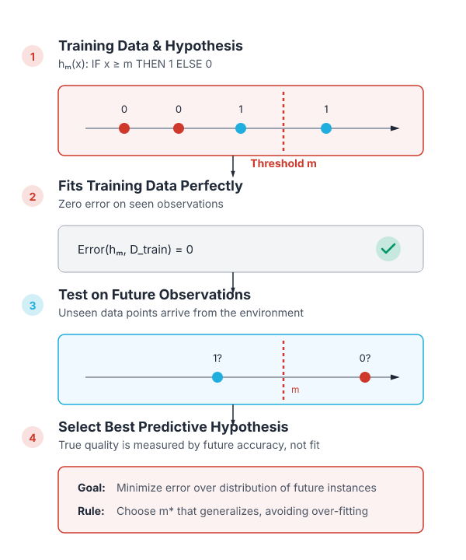
A hypothesis must predict future observations, not just fit training data
It is not enough that the hypothesis explains the given data; it must also predict correctly the class label of future observations.
So, consider a set of such hypotheses and choose the “best” one.
The set of hypotheses can be defined using a parameter, say m, as given below: hm: IF x ≥ m THEN “1” ELSE ”0”.
IN PLAIN WORDS
The model should generalize beyond the training set. By considering a family of hypotheses parameterized by m, we choose the one that best balances fit and future prediction accuracy. For example, choosing the threshold that correctly classifies new numbers.
Key terms: Hypothesis — A rule that predicts class labels.
Learnova
17 / 34
Notes:
Reveal, one click at a time:
1. It is not enough that the hypothesis explains the given data; it must also predict correctly the class label of future o
2. So, consider a set of such hypotheses and choose the “best” one.
3. The set of hypotheses can be defined using a parameter, say m, as given below: hm: IF x ≥ m THEN “1” ELSE ”0”.
Read these exactly (do not paraphrase):
- A hypothesis must predict future observations, not just fit training data It is not enough that the hypothesis explains the given data; it must also predict correctly the class label of future observations.
- The set of hypotheses can be defined using a parameter, say m, as given below: hm: IF x ≥ m THEN “1” ELSE ”0”.
Say what these mean, in your own words:
- Hypothesis: A rule that predicts class labels.
Pause: ask the class what they already know about “A hypothesis must predict future observations, not just fit training data” before revealing the slide.
Wording matters here — slow down, keep it precise.
~33s
Ask the class: Explain this slide in your own words, in one sentence.

Slide 19

Bias and variance trade-off balances underfitting and overfitting in supervised learning
Bias | Variance
The correct balance of bias | Vital
High bias = underfitting | Causes overfitting
High bias leads to underfitting, while high
Key takeaway: 3 bias compared on variance.
Key terms: High bias — more assumptions are taken to build the target function · Bias — Error from erroneous assumptions in the learning algorithm.
Learnova
18 / 34
Notes:
Reveal, one click at a time:
1. used in supervised machine learning
2. The correct balance of bias and variance is vital
3. bias-variance trade-off
4. Bias
5. High bias = underfitting
6. High bias leads to underfitting, while high variance causes overfitting.
7. The goal is to find the sweet spot where the model captures underlying patterns without memorizing noise.
Read these exactly (do not paraphrase):
- Bias and variance trade-off balances underfitting and overfitting in supervised learning used in supervised machine learning The correct balance of bias and variance is vital bias-variance trade-off Bias High bias = underfitting High bias leads to underfitting, while high variance causes overfitting.
Say what these mean, in your own words:
- High bias: more assumptions are taken to build the target function
- Bias: Error from erroneous assumptions in the learning algorithm.
Pause: ask the class what they already know about “Bias and variance trade-off balances underfitting and overfitting in supervised learning” before revealing the slide.
~61s
Ask the class: Explain this slide in your own words, in one sentence.

Slide 20
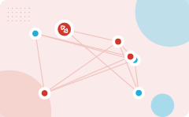
Low bias reduces assumptions, enabling the model to closely match training data
Low Bias means fewer assumptions
are taken to build the target function
The model will closely match
the training dataset
Low bias means the model
makes fewer simplifying assumptions about the data
1
2
3
This allows it to fit
the training set more accurately
High bias
in contrast, forces the model to follow a simpler pattern that may miss important details
The trade-off is that too
low bias can lead to overfitting if not controlled
4
5
6
ALSO ON THIS SLIDE
Example: A linear regression with many features can capture subtle patterns, reducing bias.
Key takeaway: One trigger sets off a chain of 6 effects.
Key terms: bias — Systematic error introduced by approximating a complex problem with a simpler model. · target function — The true relationship the model aims to learn from data.
Learnova
19 / 34
Notes:
Reveal, one click at a time:
1. Low Bias means fewer assumptions are taken to build the target function.
2. the model will closely match the training dataset.
3. High Bias means more assumptions are taken to build the target function.
4. the model will not match the training dataset closely.
5. Low bias means the model makes fewer simplifying assumptions about the data.
6. This allows it to fit the training set more accurately.
7. High bias, in contrast, forces the model to follow a simpler pattern that may miss important details.
Say what these mean, in your own words:
- bias: Systematic error introduced by approximating a complex problem with a simpler model.
- target function: The true relationship the model aims to learn from data.
Pause: ask the class what they already know about “Low bias reduces assumptions, enabling the model to closely match training data” before revealing the slide.
~61s
Ask the class: Give one real-life example of this idea.

Slide 21
Checkpoint 4
QUESTION · UNDERSTAND
Which term matches this description: “Systematic error introduced by approximating a complex problem with a simpler model.”?
bias
underfitting
A
B
target function
Hypothesis
C
D
Answer: A
bias: Systematic error introduced by approximating a complex problem with a simpler model.
Learnova
20 / 34
Notes:
KEY POINT TO LAND: Answer, then check your reasoning.
Pause: ask the class what they already know about “Checkpoint 4” before revealing the slide.
~44s

Slide 22

High variance measures how much a model’s predictions change across training subsets
1
2
3
4
High variance = overfitting
Measure of spread in data
from its mean position
Is the amount
by which the performance of a predictive model changes when it is trained on different subsets of the training data
Is the variability
of the model that how much it is sensitive to another subset of the training dataset. i.e. how much it can adjust on the new subset of the training dataset
Key takeaway: 4 steps — from “High variance = overfitting” to “Is the variability”.
Key terms: variance — Sensitivity of a model’s predictions to variations in the training data.
Learnova
21 / 34
Notes:
Reveal, one click at a time:
1. High variance = overfitting
2. the measure of spread in data from its mean position.
3. is the amount by which the performance of a predictive model changes when it is trained on different subsets of the trai
4. is the variability of the model that how much it is sensitive to another subset of the training dataset. i.e. how much i
Read these exactly (do not paraphrase):
- High variance measures how much a model’s predictions change across training subsets High variance = overfitting the measure of spread in data from its mean position.
Say what these mean, in your own words:
- variance: Sensitivity of a model’s predictions to variations in the training data.
Pause: ask the class what they already know about “High variance measures how much a model’s predictions change across training subsets” before revealing the slide.
~40s
Ask the class: Explain this slide in your own words, in one sentence.

Slide 23
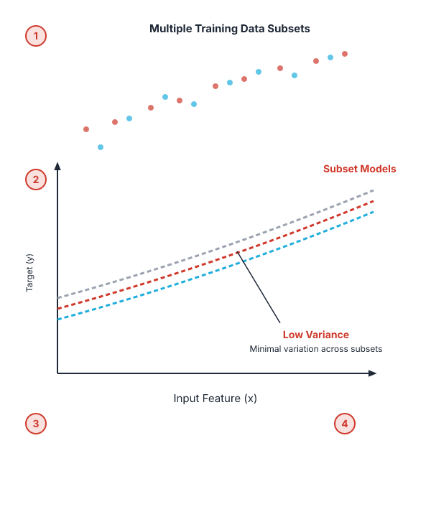
Low variance ensures consistent predictions across different training data subsets
Low variance
That the model is less sensitive to changes in the training data and can produce consistent estimates of the target function with different subsets of data from the same distribution
This is the case of underfitting when the model fails to generalize on both training and test data
IN PLAIN WORDS
A model with low variance reacts little to changes in the training set. It produces stable estimates of the target function. This stability indicates that the model generalizes well to unseen data. However, if the model also has high bias, it may still underfit the underlying pattern. For example, a simple decision stump that always splits on the same feature shows low variance.
Key takeaway: Low variance models give stable predictions across different training subsets.
Key terms: underfitting — When a model is too simple to capture the underlying data pattern.
Learnova
22 / 34
Notes:
Read these exactly (do not paraphrase):
- Low variance ensures consistent predictions across different training data subsets Low variance means that the model is less sensitive to changes in the training data and can produce consistent estimates of the target function with different subsets of data from the same distribution.
Say what these mean, in your own words:
- underfitting: When a model is too simple to capture the underlying data pattern.
Pause: ask the class what they already know about “Low variance ensures consistent predictions across different training data subsets” before revealing the slide.
Wording matters here — slow down, keep it precise.
~19s
Ask the class: Give one real-life example of this idea.

Slide 24
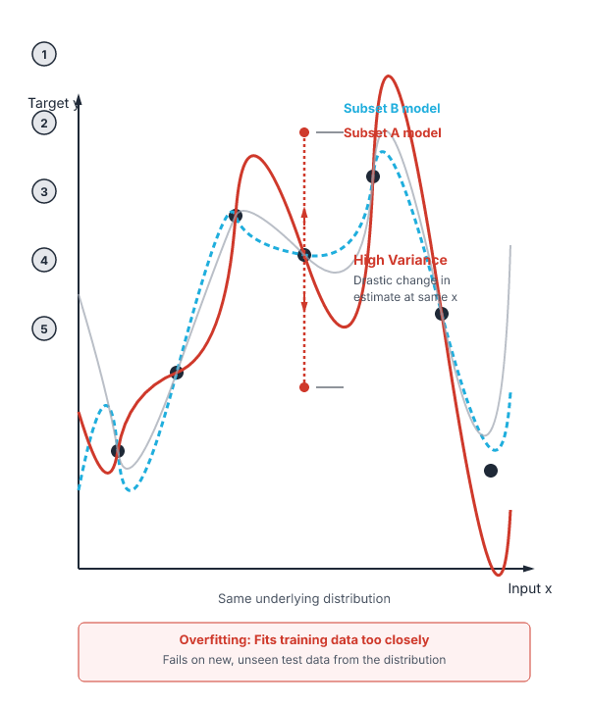
High variance causes a model to change its predictions drastically with different training subsets
High variance
That the model is very sensitive to changes in the training data and can result in significant changes in the estimate of the target function when trained on different subsets of data from the same distribution
This is the case of overfitting when the model performs well on the training data but poorly on new, unseen test data
It fits the training data too closely that it fails on the new training dataset
Key takeaway: That the model is very sensitive to changes in the training data and can result in significant changes in the estimate of the target function when trained on different subsets of data from the same distribution.
Key terms: overfitting — When a model learns noise in the training data, performing poorly on new data.
Learnova
23 / 34
Notes:
Read these exactly (do not paraphrase):
- High variance causes a model to change its predictions drastically with different training subsets High variance means that the model is very sensitive to changes in the training data and can result in significant changes in the estimate of the target function when trained on different subsets of data from the same distribution.
Say what these mean, in your own words:
- overfitting: When a model learns noise in the training data, performing poorly on new data.
Pause: ask the class what they already know about “High variance causes a model to change its predictions drastically with different training subsets” before revealing the slide.
~19s
Ask the class: Give one real-life example of this idea.

Slide 25
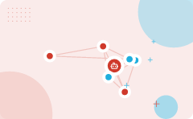
Combining bias and variance determines whether a model is accurate, consistent, or both
High-Bias, Low-Variance: With High bias and low variance, predictions are consistent but inaccurate on average. This case occurs when a model does not learn well with the training dataset or uses few numbers of the parameter. It leads to underfitting problems in the model.
High-Bias, High-Variance: With high bias and high variance, predictions are inconsistent and also inaccurate on average.
Low-Bias, Low-Variance: The combination of low bias and low variance shows an ideal machine learning model.
However, it is not possible practically.
Low-Bias, High-Variance: With low bias and high variance, model predictions are inconsistent and accurate on average.
This case occurs when the model learns with a large number of parameters and hence leads to an overfitting
Key terms: Low bias — fewer assumptions are taken to build the target function · bias-variance trade-off — The balance between a model’s simplicity (bias) and its sensitivity to data (variance).
Learnova
24 / 34
Notes:
Reveal, one click at a time:
1. Low-Bias, Low-Variance: The combination of low bias and low variance shows an ideal machine learning model.
2. However, it is not possible practically.
3. Low-Bias, High-Variance: With low bias and high variance, model predictions are inconsistent and accurate on average.
4. This case occurs when the model learns with a large number of parameters and hence leads to an overfitting
5. High-Bias, Low-Variance: With High bias and low variance, predictions are consistent but inaccurate on average. This cas
6. High-Bias, High-Variance: With high bias and high variance, predictions are inconsistent and also inaccurate on average.
Say what these mean, in your own words:
- Low bias: fewer assumptions are taken to build the target function
- bias-variance trade-off: The balance between a model’s simplicity (bias) and its sensitivity to data (variance).
Pause: ask the class what they already know about “Combining bias and variance determines whether a model is accurate, consistent, or both” before revealing the slide.
~54s
Ask the class: Where could you break this chain of events?

Slide 26
Checkpoint 5
QUESTION · UNDERSTAND
Which term matches this description: “fewer assumptions are taken to build the target function”?
Model
Low bias
A
B
overfitting
variance
C
D
Answer: B
Low bias: fewer assumptions are taken to build the target function
Learnova
25 / 34
Notes:
KEY POINT TO LAND: Answer, then check your reasoning.
Pause: ask the class what they already know about “Checkpoint 5” before revealing the slide.
~44s

Slide 27
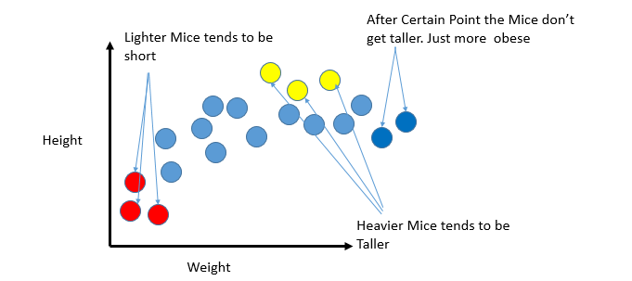
Combinations of Bias-Variance (continued)
Learnova
26 / 34
Notes:
Read these exactly (do not paraphrase):
- Combinations of Bias-Variance (continued)
Pause: ask the class what they already know about “Combinations of Bias-Variance (continued)” before revealing the slide.
Wording matters here — slow down, keep it precise.
~19s
Ask the class: What might explain these numbers?

Slide 28
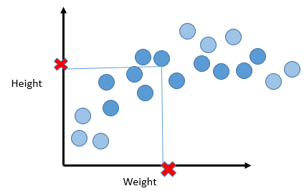
Combinations of Bias-Variance (continued)
Learnova
27 / 34
Notes:
Read these exactly (do not paraphrase):
- Combinations of Bias-Variance (continued)
Pause: ask the class what they already know about “Combinations of Bias-Variance (continued)” before revealing the slide.
Wording matters here — slow down, keep it precise.
~19s
Text in the figure: Height Weight
Ask the class: What might explain these numbers?

Slide 29
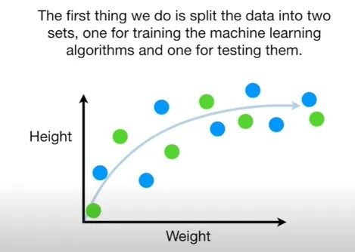
Combinations of Bias-Variance (continued)
Learnova
28 / 34
Notes:
Read these exactly (do not paraphrase):
- Combinations of Bias-Variance (continued)
Pause: ask the class what they already know about “Combinations of Bias-Variance (continued)” before revealing the slide.
Wording matters here — slow down, keep it precise.
~19s
Text in the figure: The first thing we do is split the data into two
sets, one for training the machine learning
algorithms and one for testing them.
e@
e@
Height ) e e
e
Ve
LJ
Weight
Ask the class: What might explain these numbers?

Slide 30
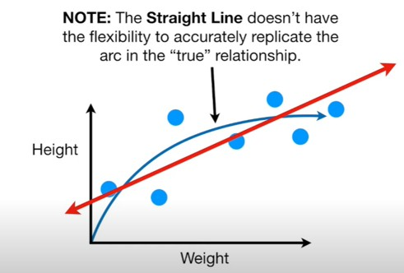
Combinations of Bias-Variance (continued)
Learnova
29 / 34
Notes:
Read these exactly (do not paraphrase):
- Combinations of Bias-Variance (continued)
Pause: ask the class what they already know about “Combinations of Bias-Variance (continued)” before revealing the slide.
Wording matters here — slow down, keep it precise.
~19s
Text in the figure: NOTE: The Straight Line doesn’t have the flexibility to accurately replicate the arc in the “true” relationship. Weight
Ask the class: What might explain these numbers?

Slide 31
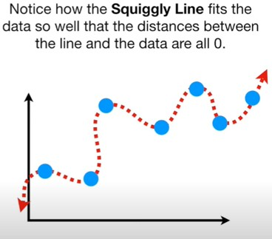
Combinations of Bias-Variance (continued)
Learnova
30 / 34
Notes:
Read these exactly (do not paraphrase):
- Combinations of Bias-Variance (continued)
Pause: ask the class what they already know about “Combinations of Bias-Variance (continued)” before revealing the slide.
Wording matters here — slow down, keep it precise.
~19s
Text in the figure: Notice how the Squiggly Line fits the data so well that the distances between the line and the data are all 0.
Ask the class: What might explain these numbers?

Slide 32
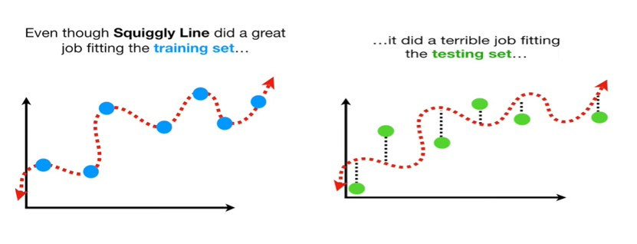
Combinations of Bias-Variance (continued)
Learnova
31 / 34
Notes:
Read these exactly (do not paraphrase):
- Combinations of Bias-Variance (continued)
Pause: ask the class what they already know about “Combinations of Bias-Variance (continued)” before revealing the slide.
Wording matters here — slow down, keep it precise.
~19s
Text in the figure: Even though Squiggly Line did a great did a terrible job fitting job fitting the training set... the testing set...
Ask the class: What might explain these numbers?

Slide 33
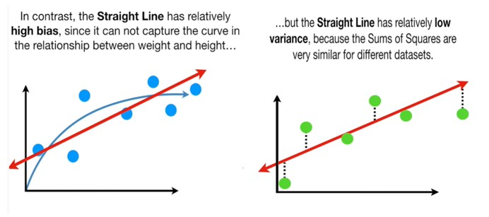
Combinations of Bias-Variance (continued)
Learnova
32 / 34
Notes:
Read these exactly (do not paraphrase):
- Combinations of Bias-Variance (continued)
Pause: ask the class what they already know about “Combinations of Bias-Variance (continued)” before revealing the slide.
Wording matters here — slow down, keep it precise.
~19s
Text in the figure: In contrast, the Straight Line has relatively ...but the Straight Line has relatively low high bias, since it can not capture the curve in variance, because the Sums of Squares are the relationship between weight and height... very similar for different datasets.
Ask the class: What might explain these numbers?

Slide 34
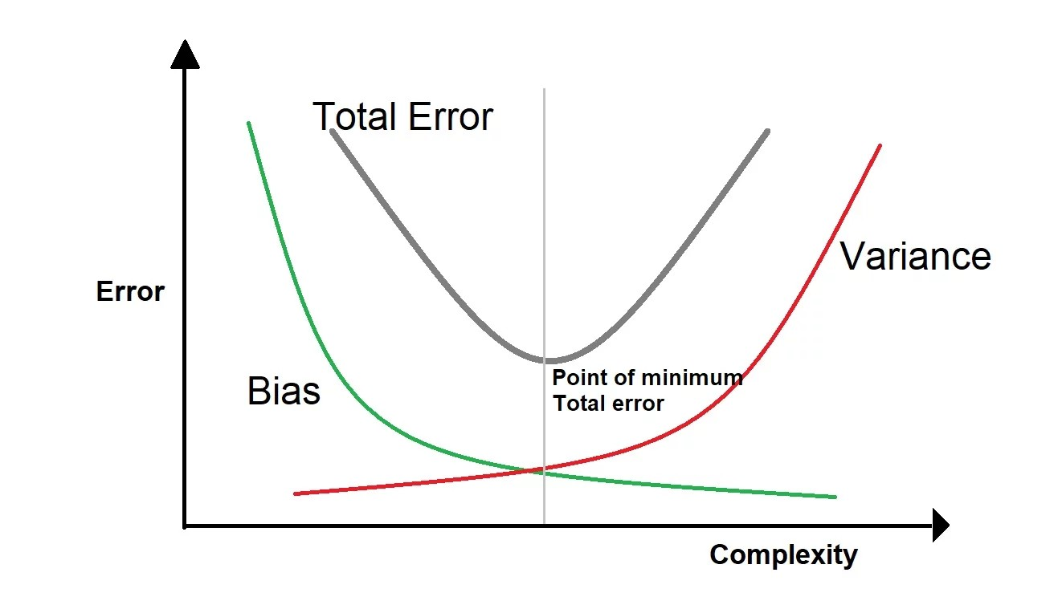
Trade-off
Total Error Variance Error — > Complexity
Learnova
33 / 34
Notes:
Pause: ask the class what they already know about “Trade-off” before revealing the slide.
~19s
Text in the figure: Total Error Variance Error Point of minimu Bias Total error Complexity
Ask the class: Explain this slide in your own words, in one sentence.

Slide 35
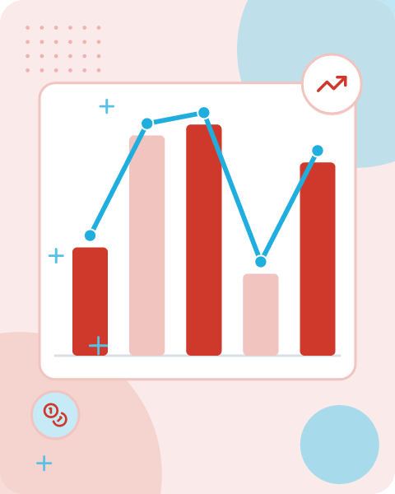

Key takeaways
Syllabus
Introduction to Machine Learning
Supervised Learning
Features (X)
Hypothesis Space (H) Hypothesis space is the set of all the possible legal hypothesis
Inductive bias
It is not enough that the hypothesis explains the given data
Low Bias
means fewer assumptions are taken to build the target function
ALSO ON THIS SLIDE
Low variance: Low variance means that the model is less sensitive to changes in the training data and can produce consistent estimates…
Key takeaway: Key takeaways: focus on hypothesis space, inductive bias, and managing bias‑variance.
Learnova
34 / 34
Notes:
Reveal, one click at a time:
1. Syllabus: Introduction to Machine Learning:
2. Supervised Learning: Features (X)
3. Hypothesis: Hypothesis Space (H) Hypothesis space is the set of all the possible legal hypothesis.
4. Hypothesis: Hypothesis?
5. Inductive bias: It is not enough that the hypothesis explains the given data;
6. Low Bias: Low Bias means fewer assumptions are taken to build the target function.
7. Low variance: Low variance means that the model is less sensitive to changes in the training data and can produce consis
Read these exactly (do not paraphrase):
- Key takeaways Syllabus: Introduction to Machine Learning: Supervised Learning: Features (X) Hypothesis: Hypothesis Space (H) Hypothesis space is the set of all the possible legal hypothesis.
- Inductive bias: It is not enough that the hypothesis explains the given data; Low Bias: Low Bias means fewer assumptions are taken to build the target function.
- Low variance: Low variance means that the model is less sensitive to changes in the training data and can produce consistent estimates…
Pause: ask the class what they already know about “Key takeaways” before revealing the slide.
Wording matters here — slow down, keep it precise.
~61s

Slide 36
Thank you
Questions?

