Slide 1
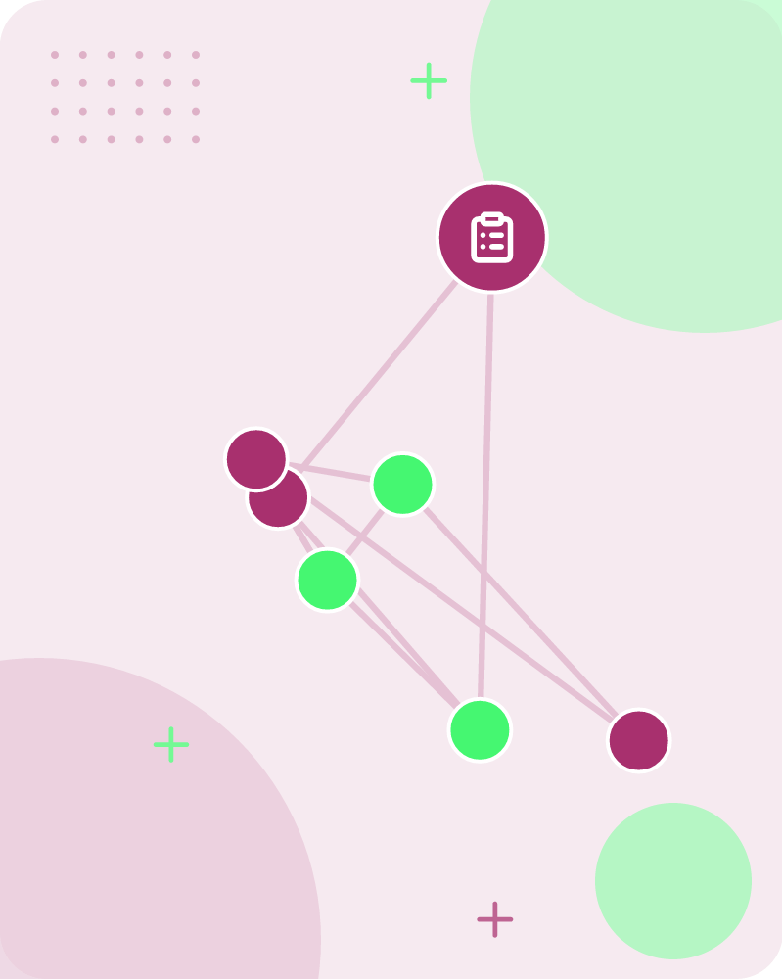
Regression
Dr. Mrunal Rane · Andrew Ng • 69 slides

Slide 2
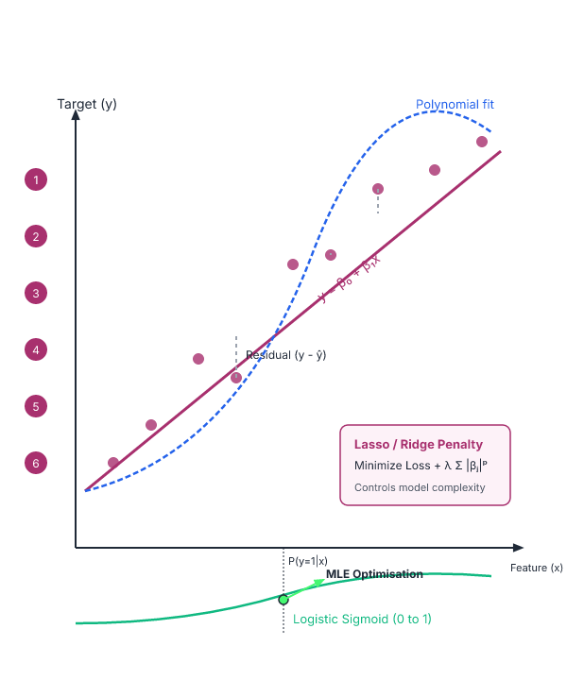
The syllabus outlines key supervised learning techniques and their mathematical foundations
Linear Regression
Gradient Descent
1
2
Lasso and Ridge Regression
Polynomial Regression
3
4
Logistic Regression
Maximum Likelihood Function
5
6
Key takeaway: The syllabus covers supervised learning techniques like linear regression, gradient descent, and logistic regression.
Key terms: Regression — supervised machine learning technique which is used to predict continuous values
Learnova
1 / 69
Notes:
Reveal, one click at a time:
1. Linear Regression
2. Gradient Descent
3. Lasso and Ridge Regression
4. Polynomial Regression
5. Logistic Regression
6. Maximum Likelihood Function
Say what these mean, in your own words:
- Regression: supervised machine learning technique which is used to predict continuous values
Pause: ask the class what they already know about “The syllabus outlines key supervised learning techniques and their mathematical foundations” before revealing the slide.
~54s
Ask the class: Which step would break the whole process if it failed — and why?

Slide 3
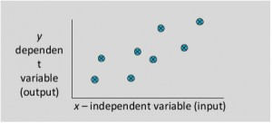
Regression
Regression
Regression is a supervised machine learning technique which is used to predict continuous values.
Regression analysis is a set of statistical methods used for the estimation of relationships between a dependent variable and one or more independent variables.
It can be utilized to assess the strength of the relationship between variables and for modeling the future relationship between them.
IN PLAIN WORDS
Regression learns from labeled data to estimate how a dependent variable changes with one or more independent variables. It measures the strength of these relationships and can forecast future values. The technique is essential for tasks where outcomes are numeric, such as predicting house prices or stock returns. For example, estimating a student's final grade from hours studied and attendance.
Is Supervised or Unsupervised? What is the basic requirement of Supervised learning?
Key takeaway: Regression is a supervised machine learning technique used to predict continuous values and estimate variable relationships.
Key terms: dependent variable — the outcome we aim to predict in regression analysis · independent variable — the predictor or feature used to estimate the dependent variable
Learnova
▶ Open the interactive lab: Regression — step-through
2 / 69
Notes:
Say what these mean, in your own words:
- dependent variable: the outcome we aim to predict in regression analysis
- independent variable: the predictor or feature used to estimate the dependent variable
Pause: ask the class what they already know about “Regression” before revealing the slide.
~19s
Ask the class: Explain this slide in your own words, in one sentence.

Slide 4

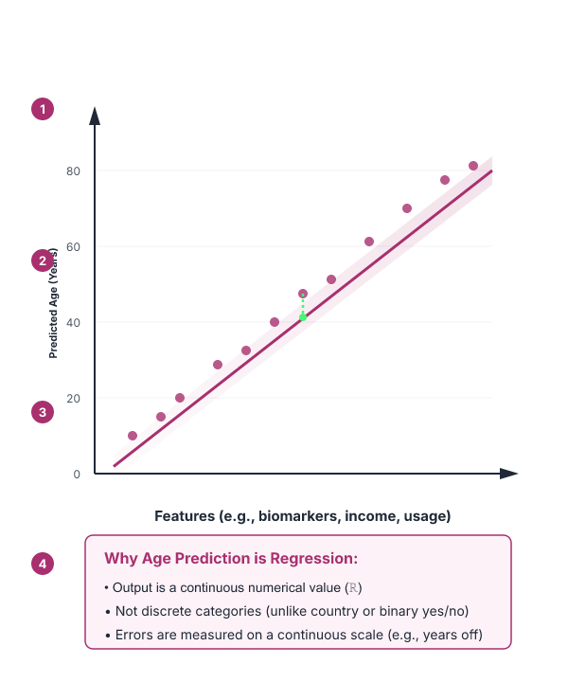


Predicting a person's age from features is a regression task, not a classification task
Predict age of a person
A regression task to predict a continuous value (age) for a person from features.
Predict the country
A classification task to determine the origin country of a person.
Stock price prediction
Predicting whether the stock price of a company will increase tomorrow (binary classification).
ALSO ON THIS SLIDE
Which of the following is a regression task?ch of the following is a regression task? from where the
Learnova
3 / 69
Notes:
Reveal, one click at a time:
1. Which of the following is a regression task?ch of the following is a regression task?
2. Predict age of a
3. Predict the country
4. Predicting whether
5. person
6. from where the
7. stock price of a
Pause: ask the class what they already know about “Predicting a person's age from features is a regression task, not a classification task” before revealing the slide.
~61s
Ask the class: Explain this slide in your own words, in one sentence.

Slide 5
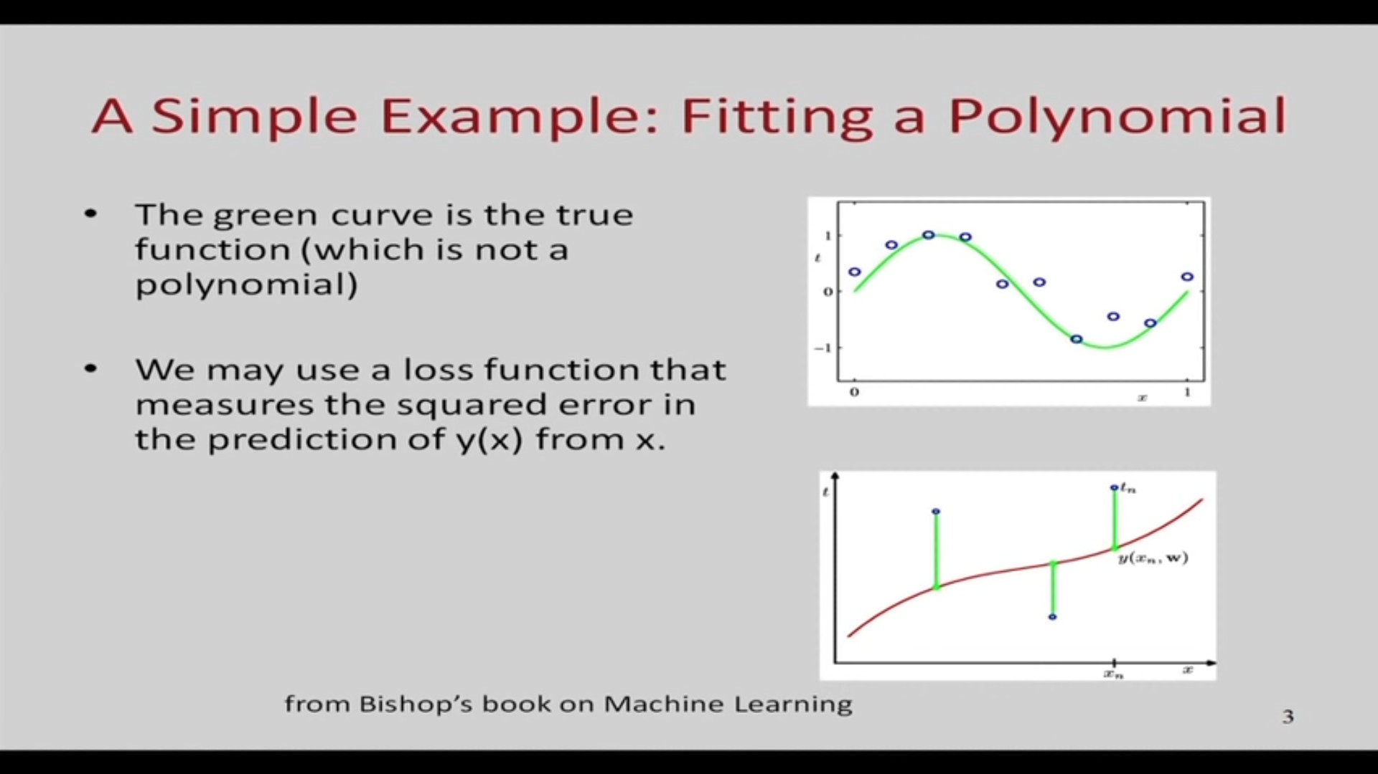
Regression (continued)
Learnova
4 / 69
Notes:
Read these exactly (do not paraphrase):
- Regression (continued)
Pause: ask the class what they already know about “Regression (continued)” before revealing the slide.
Wording matters here — slow down, keep it precise.
~19s
Text in the figure: A Simple Example: Fitting a Polynomial The green curve is the true function (which is nota | polynomial) yj We may use a loss function that measures the squared error in the prediction of y(x) from x. from Bishop’s book on Machine Learning
Ask the class: What might explain these numbers?

Slide 6
Checkpoint 1
QUESTION · UNDERSTAND
Which term matches this description: “the outcome we aim to predict in regression analysis”?
independent variable
Fixed learning rate
A
B
Diverge
dependent variable
C
D
Answer: D
dependent variable: the outcome we aim to predict in regression analysis
Learnova
5 / 69
Notes:
KEY POINT TO LAND: Answer, then check your reasoning.
Pause: ask the class what they already know about “Checkpoint 1” before revealing the slide.
~44s

Slide 7
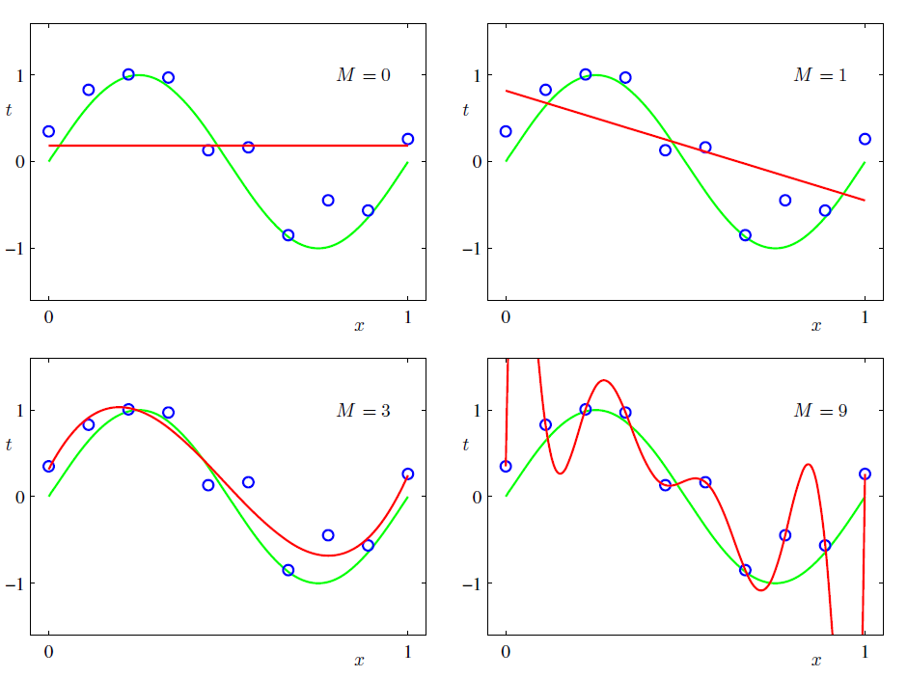
Some fits to the data : which is the best?
Learnova
6 / 69
Notes:
Pause: ask the class what they already know about “Some fits to the data : which is the best?” before revealing the slide.
~19s
Ask the class: Explain this slide in your own words, in one sentence.

Slide 8
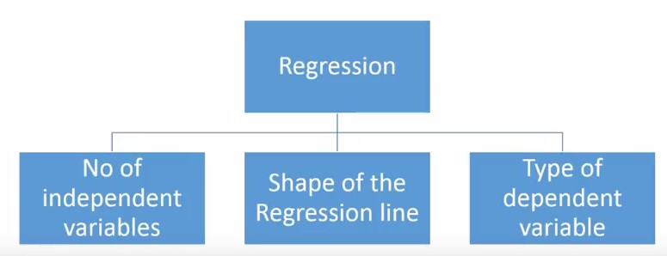
Types of regression models
No of Type of independent pees ai wie dependent ‘ Regression line : variables variable
Learnova
7 / 69
Notes:
Pause: ask the class what they already know about “Types of regression models” before revealing the slide.
~19s
Text in the figure: Regression No of Type of Shape of the independent dependent Regression line variables variable
Ask the class: What might explain these numbers?

Slide 9
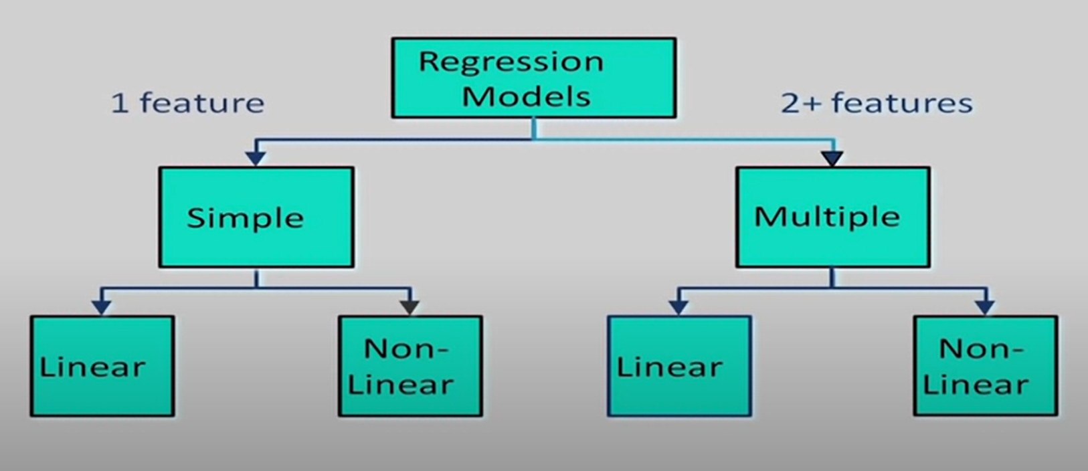
Types of regression models (continued)
Regression 1 feature Models 2+ features = Non- F Non- Linear Linear c Linear Linear
Learnova
8 / 69
Notes:
Read these exactly (do not paraphrase):
- Types of regression models (continued)
Pause: ask the class what they already know about “Types of regression models (continued)” before revealing the slide.
Wording matters here — slow down, keep it precise.
~19s
Text in the figure: Regression 1 feature Models 2+ features Non- Non- Linear 5 Linear Linear
Ask the class: What might explain these numbers?

Slide 10
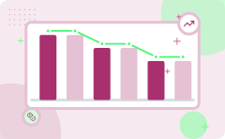
Housing price prediction is a supervised regression problem using size as the input feature
Identify the target values
We first list all the given housing prices from the dataset.
1
Count the number of houses — N = 10
There are 10 price values in total in this dataset.
2
Calculate the average price — Average = (3000000)/(10) = 300000
Divide the total sum by the number of houses to get the mean price, which is a baseline regression prediction.
3
Answer: 300000
Learnova
9 / 69
Notes:
Reveal, one click at a time:
1. 500000
2. 500000
3. 400000
4. 400000
5. 300000
6. 300000
7. Price
Read these exactly (do not paraphrase):
- Housing price prediction is a supervised regression problem using size as the input feature 500000 500000 400000 400000 300000 300000 Price 200000 200000 100000 100000 1000 1000 1500 1500 2000 2000 2500 2500 3000 3000 Size (feet2) Supervised Learning Regression Problem Given the “right answer” for Predict real-valued output each example in the data.
Pause: ask the class what they already know about “Housing price prediction is a supervised regression problem using size as the input feature” before revealing the slide.
Wording matters here — slow down, keep it precise.
~61s
Ask the class: Explain this slide in your own words, in one sentence.

Slide 11
Checkpoint 2
QUESTION · APPLY
Which statement describes Advantages?
Lasso and Ridge Regression
It is often quite prone to noise and overfitting
A
B
What is the basic requirement of Supervised learning?
Linear regression performs exceptionally well for linearly separable data
C
D
Answer: D
Advantages: Linear regression performs exceptionally well for linearly separable data. Disadvantages: The assumption of linearity between dependent and independent variables.
Learnova
10 / 69
Notes:
KEY POINT TO LAND: Answer, then check your reasoning.
Pause: ask the class what they already know about “Checkpoint 2” before revealing the slide.
~44s

Slide 12

How do we represent h ?
1
2
3
Training Set
Input data (Size of house)
Learning Algorithm
Univariate linear regression
Estimated Price
Output prediction
ALSO ON THIS SLIDE
Linear regression with one variable.
Learnova
▶ Open the interactive lab: How do we represent h ? — step-through
11 / 69
Notes:
Reveal, one click at a time:
1. Training Set
2. Learning Algorithm
3. Size of
4. Estimated
5. house
6. price
7. Linear regression with one variable. Univariate linear regression.
Pause: ask the class what they already know about “How do we represent h ?” before revealing the slide.
~61s
Ask the class: Explain this slide in your own words, in one sentence.

Slide 13
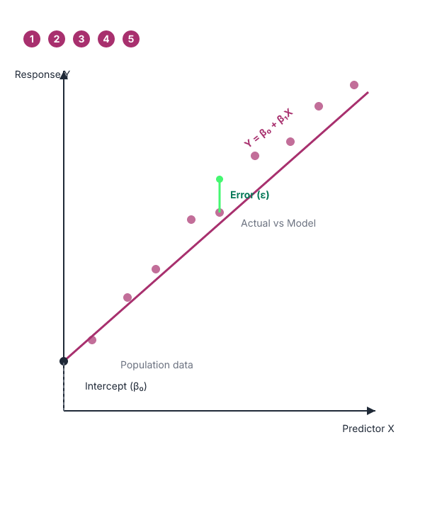


Linear Regression Model
Linear Function
Relationship between variables is a linear function.
Parameters
Population, random Y-intercept, slope, and error.
Key takeaway: Linear regression models assume a linear function relationship containing a population, slope, y-intercept, and error.
Learnova
▶ Open the interactive lab: Simple Linear Regression Lab
12 / 69
Notes:
Reveal, one click at a time:
1. Relationship Between Variables Is a Linear Function
2. Population Population Random Y-Intercept Slope Error
Pause: ask the class what they already know about “Linear Regression Model” before revealing the slide.
~26s
Ask the class: Explain this slide in your own words, in one sentence.

Slide 14
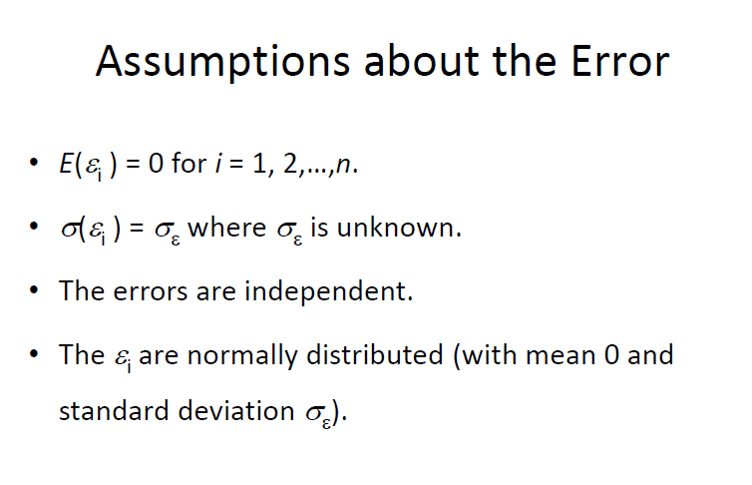
Assumptions about the error
Learnova
13 / 69
Notes:
Pause: ask the class what they already know about “Assumptions about the error” before revealing the slide.
~19s
Text in the figure: Assumptions about the Error E(é)=0 2,...,n. ) = o where o, is unknown. The errors are independent. The & are normally distributed (with mean 0 and e standard deviation o,).
Ask the class: Explain this slide in your own words, in one sentence.

Slide 15
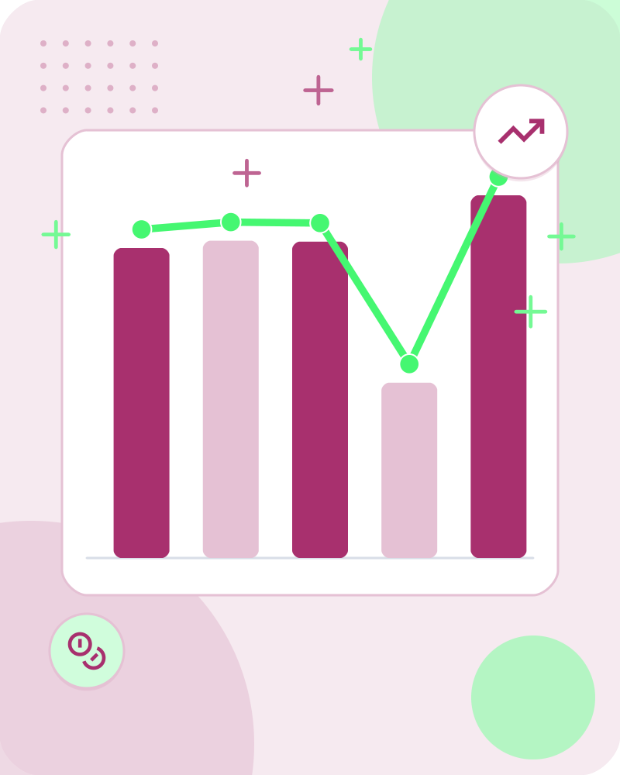



Training Set
Data Representation
Hypothesis Function
Parameters
Key takeaway: Training sets use features like house size in square feet to predict prices using parameters b and w.
Also in this lecture: Batch Gradient Descent Batch: Each step of gradient descent uses all the training examples.
Learnova
▶ Open the interactive lab: Training Set — step-through
14 / 69
Notes:
Reveal, one click at a time:
1. Size in feet2 (x)
2. Price ($) in 1000's (y)
3. Hypothesis:
4. hb,w(x)= b+wx
5. ‘s: Parameters
6. b,w How to choose ‘s?
7. b,w
Read these exactly (do not paraphrase):
- Training Set Size in feet2 (x) Price ($) in 1000's (y) Hypothesis: hb,w(x)= b+wx ‘s: Parameters b,w How to choose ‘s?
Pause: ask the class what they already know about “Training Set” before revealing the slide.
Wording matters here — slow down, keep it precise.
~61s
Ask the class: Explain this slide in your own words, in one sentence.

Slide 16
Checkpoint 3
QUESTION · RECALL
Fill in the blank: “Actual line from which the _____ are drawn.”
improving
cause
A
B
house
examples
C
D
Answer: D
“Actual line from which the examples are drawn.”
Learnova
15 / 69
Notes:
KEY POINT TO LAND: Answer, then check your reasoning.
Pause: ask the class what they already know about “Checkpoint 3” before revealing the slide.
~44s

Slide 17

Training Set: Hb,w(x)= b+wx
EQUATIONS
$$hb,w\left(x\right)=b+wx$$
$$b=0$$
$$b=1$$
$$w=0$$
Key takeaway: Hypothesis functions compute predicted values using varying parameters for slope and intercept.
Learnova
16 / 69
Notes:
Reveal, one click at a time:
1. hb,w(x)= b+wx
2. b = 1.5
3. b = 0
4. b = 1
5. w = 0
6. w = 0.5
Read these exactly (do not paraphrase):
- Training Set: Hb,w(x)= b+wx hb,w(x)= b+wx b = 1.5 b = 0 b = 1 w = 0 w = 0.5
Pause: ask the class what they already know about “Training Set: Hb,w(x)= b+wx” before revealing the slide.
Wording matters here — slow down, keep it precise.
~54s
Ask the class: Explain this slide in your own words, in one sentence.

Slide 18
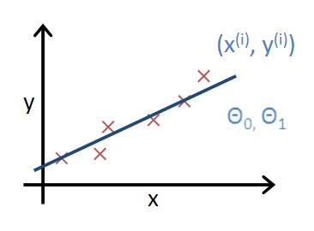
We select b and w so that the hypothesis hb,w(x) closely matches the training data
Hypothesis Optimization
Choose b and w so that hb,w(x) is close to y for training examples (x,y)
Ensures close match to training data
Key takeaway: Parameters b and w are selected so the hypothesis closely matches the training data.
Learnova
17 / 69
Notes:
Read these exactly (do not paraphrase):
- We select b and w so that the hypothesis hb,w(x) closely matches the training data Choose b, w so that hb,w(x) is close to y for training examples (x,y)
Pause: ask the class what they already know about “We select b and w so that the hypothesis hb,w(x) closely matches the training data” before revealing the slide.
Wording matters here — slow down, keep it precise.
~19s
Ask the class: Explain this slide in your own words, in one sentence.

Slide 19
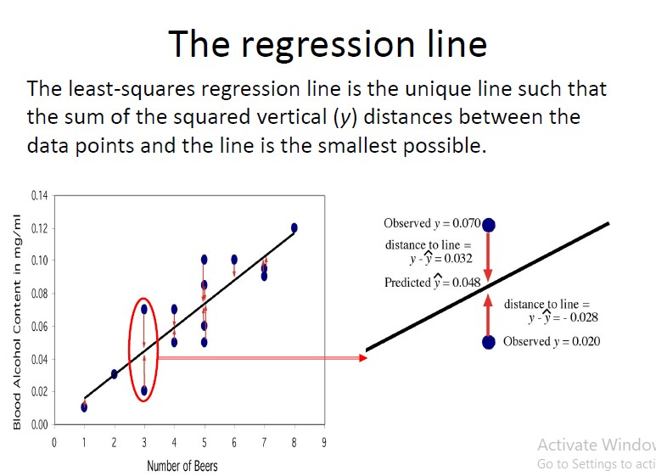
Training Set (continued)
Learnova
18 / 69
Notes:
Read these exactly (do not paraphrase):
- Training Set (continued)
Pause: ask the class what they already know about “Training Set (continued)” before revealing the slide.
Wording matters here — slow down, keep it precise.
~19s
Text in the figure: The regression line The least-squares regression line is the unique line such that the sum of the squared vertical (y) distances between the data points and the line is the smallest possible. 12 Observed y = 0.070, distance to line = 10 “za Predicted y = 0.048 distance,to line = y-y=- 0.028 Observed y = 0.020 0 1 2 3 4 5 6 7 8 9 Number of Beers
Ask the class: What might explain these numbers?

Slide 20
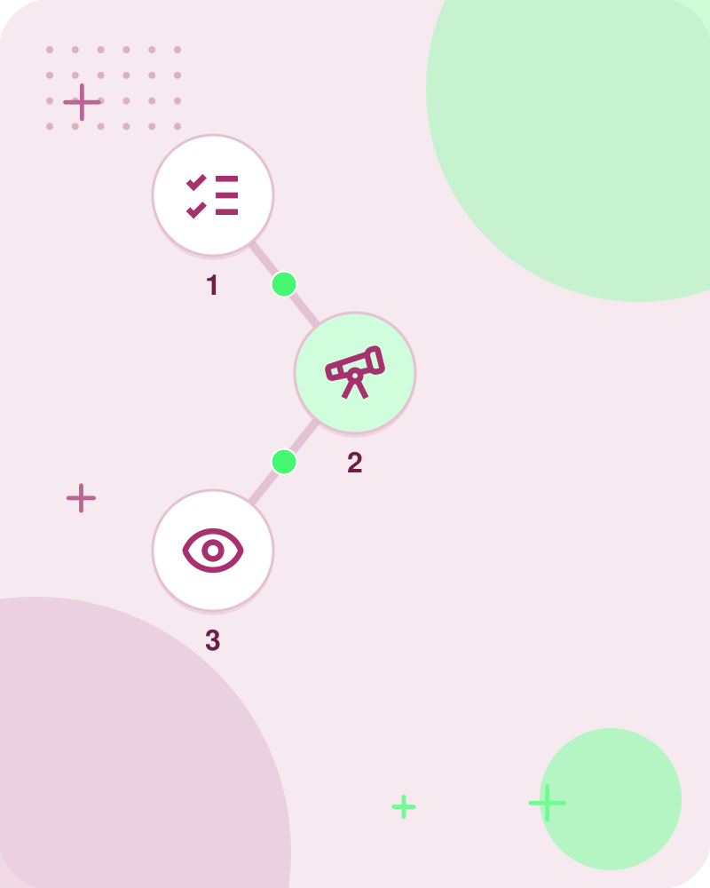
Criterion for choosing what line to draw
Method of Least Squares
The method of least squares chooses the line that makes the sum of squares of the residuals as small as possible.
Minimizes errors for the given observations (x, y)
Key takeaway: The method of least squares minimizes the sum of squared residuals to draw the best line.
Learnova
▶ Open the interactive lab: Least‑Squares Line‑Drawing Lab
19 / 69
Notes:
Read these exactly (do not paraphrase):
- Criterion for choosing what line to draw method of least squares The method of least squares chooses the line ( Bo and By) that makes the sum of squares of the residuals €;2 as small Minimizes for the given observations (x,, y,)
Pause: ask the class what they already know about “Criterion for choosing what line to draw” before revealing the slide.
Wording matters here — slow down, keep it precise.
~19s
Ask the class: Explain this slide in your own words, in one sentence.

Slide 21
Checkpoint 4
QUESTION · APPLY
Which expression gives Setting w to zero yields a hypothesis function hw(x) = 0?
Key takeaways
Setting w to zero
A
B
Regression
w = 0
C
D
Answer: D
w = 0
Learnova
20 / 69
Notes:
KEY POINT TO LAND: Answer, then check your reasoning.
Pause: ask the class what they already know about “Checkpoint 4” before revealing the slide.
~44s

Slide 22
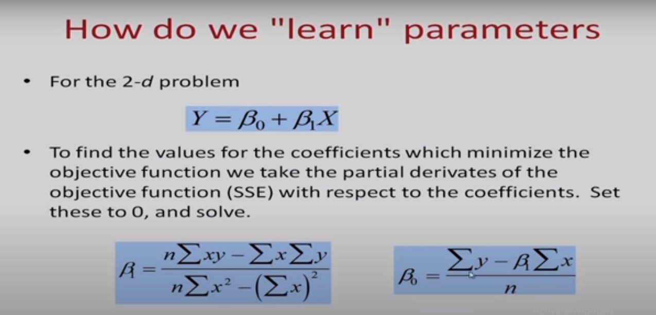
Criterion for choosing what line to draw (continued)
Learnova
21 / 69
Notes:
Read these exactly (do not paraphrase):
- Criterion for choosing what line to draw (continued)
Pause: ask the class what they already know about “Criterion for choosing what line to draw (continued)” before revealing the slide.
Wording matters here — slow down, keep it precise.
~19s
Text in the figure: How do we "learn" parameters Forthe 2-d problem To find the values for the coefficients which minimize the objective function we take the partial derivates of the objective function (SSE) with respect to the coefficients. Set these to O, and solve.
Ask the class: What might explain these numbers?

Slide 23
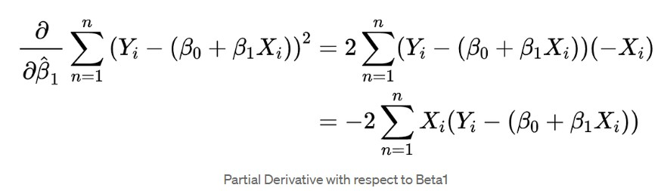
Criterion for choosing what line to draw (continued)
Learnova
22 / 69
Notes:
Read these exactly (do not paraphrase):
- Criterion for choosing what line to draw (continued)
Pause: ask the class what they already know about “Criterion for choosing what line to draw (continued)” before revealing the slide.
Wording matters here — slow down, keep it precise.
~19s
Ask the class: What might explain these numbers?

Slide 24
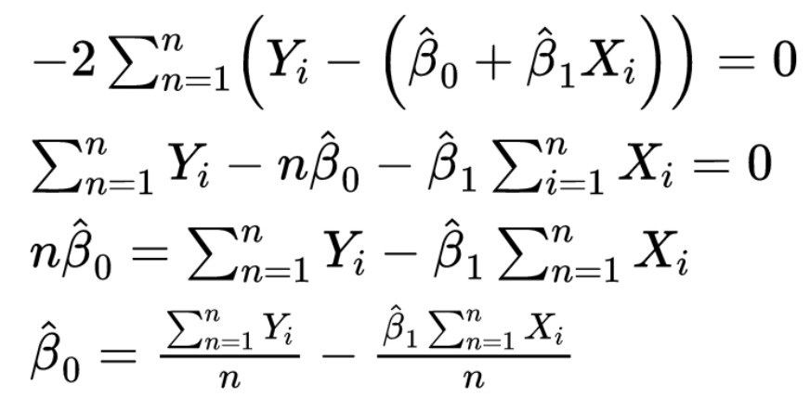
Criterion for choosing what line to draw (continued)
Learnova
23 / 69
Notes:
Read these exactly (do not paraphrase):
- Criterion for choosing what line to draw (continued)
Pause: ask the class what they already know about “Criterion for choosing what line to draw (continued)” before revealing the slide.
Wording matters here — slow down, keep it precise.
~19s
Ask the class: What might explain these numbers?

Slide 25
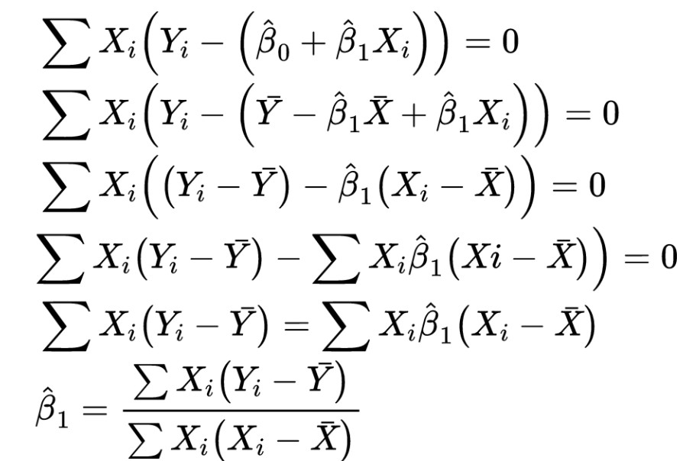
Criterion for choosing what line to draw (continued)
Learnova
24 / 69
Notes:
Read these exactly (do not paraphrase):
- Criterion for choosing what line to draw (continued)
Pause: ask the class what they already know about “Criterion for choosing what line to draw (continued)” before revealing the slide.
Wording matters here — slow down, keep it precise.
~19s
Text in the figure: = (4) + =0 =0 Xi ((¥i - ¥) - — X)) =0 Xi(¥i ¥) — Xi, X)) =0 —¥) = (% — X) X;(¥; — Y) — X)
Ask the class: What might explain these numbers?

Slide 26
Checkpoint 5
QUESTION · RECALL
Fill in the blank: “Batch: Each step of gradient descent uses all the training _____.”
optima
examples
A
B
satisfied
mathematical
C
D
Answer: B
“Batch: Each step of gradient descent uses all the training examples.”
Learnova
25 / 69
Notes:
KEY POINT TO LAND: Answer, then check your reasoning.
Pause: ask the class what they already know about “Checkpoint 5” before revealing the slide.
~44s

Slide 27
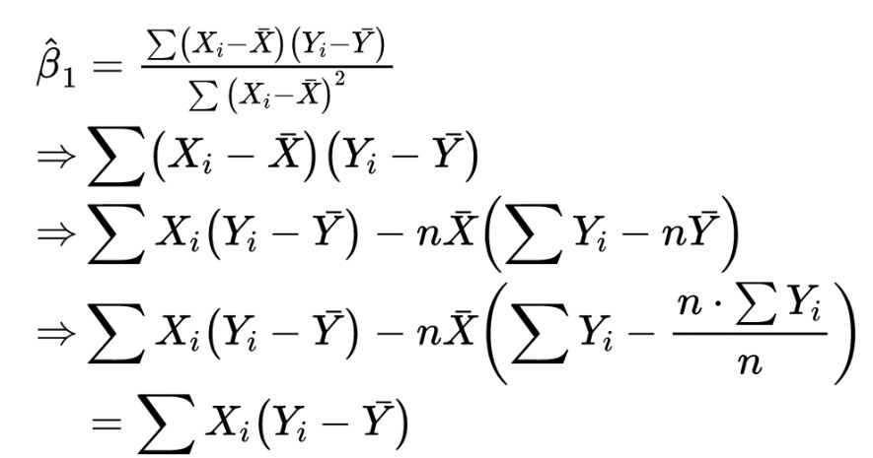
Criterion for choosing what line to draw (continued)
Learnova
26 / 69
Notes:
Read these exactly (do not paraphrase):
- Criterion for choosing what line to draw (continued)
Pause: ask the class what they already know about “Criterion for choosing what line to draw (continued)” before revealing the slide.
Wording matters here — slow down, keep it precise.
~19s
Text in the figure: Ht | g, = i(¥; —-Y) —nX i(¥; —Y n
Ask the class: What might explain these numbers?

Slide 28
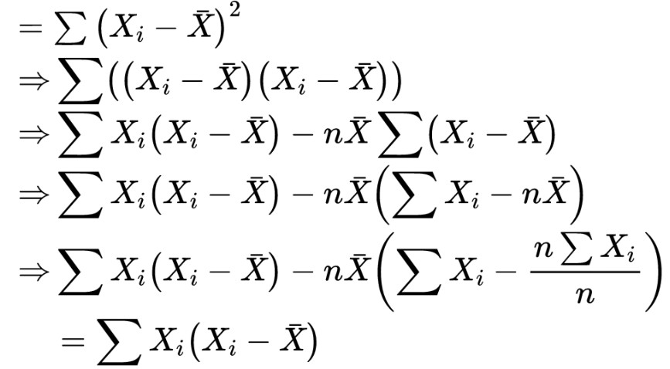
Criterion for choosing what line to draw (continued)
Learnova
27 / 69
Notes:
Read these exactly (do not paraphrase):
- Criterion for choosing what line to draw (continued)
Pause: ask the class what they already know about “Criterion for choosing what line to draw (continued)” before revealing the slide.
Wording matters here — slow down, keep it precise.
~19s
Text in the figure: XY X) => — X) - X) = Xi(Xi - X) — nk) = — X) ) X)
Ask the class: What might explain these numbers?

Slide 29
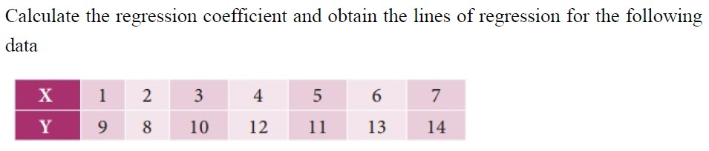
Example
Learnova
28 / 69
Notes:
Pause: ask the class what they already know about “Example” before revealing the slide.
~19s
Text in the figure: Calculate the regression coefficient and obtain the lines of regression for the following
data
mM: Ee: Ba:
Mao s ob 2p on BB hw“
Ask the class: What might explain these numbers?

Slide 30
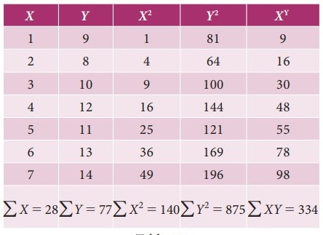
Example (continued)
Learnova
29 / 69
Notes:
Read these exactly (do not paraphrase):
- Example (continued) XY
Pause: ask the class what they already know about “Example (continued)” before revealing the slide.
Wording matters here — slow down, keep it precise.
~19s
Text in the figure: 1 9 1 81 9 2 8 64 16 3 10 9 100 30 4 12 16 144 48 5 11 25 121 55 6 13 36 169 78 7 14 49 196 98 X=28 k= 140 > XY = 334
Ask the class: Explain this slide in your own words, in one sentence.

Slide 31
Checkpoint 6
QUESTION · UNDERSTAND
Which term matches this description: “A tuning parameter that determines the step size at each iteration.”?
Local minimum
Causation
A
B
Diverge
Learning rate
C
D
Answer: D
Learning rate: A tuning parameter that determines the step size at each iteration.
Learnova
30 / 69
Notes:
KEY POINT TO LAND: Answer, then check your reasoning.
Pause: ask the class what they already know about “Checkpoint 6” before revealing the slide.
~44s

Slide 32
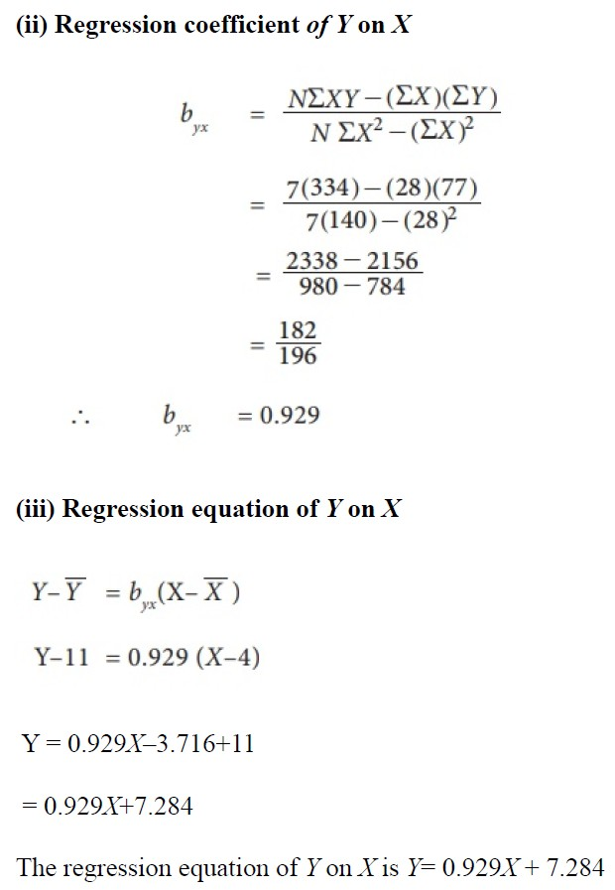
Example (continued)
Learnova
31 / 69
Notes:
Read these exactly (do not paraphrase):
- Example (continued)
Pause: ask the class what they already know about “Example (continued)” before revealing the slide.
Wording matters here — slow down, keep it precise.
~19s
Text in the figure: (ii) Regression coefficient of Y on X —(2X)(ZY) mx NN _ 7(334)—(28)(77) 7(140) _ 2156 980 — 784 _ 182 ~ 196 b = 0.929 (iii) Regression equation of Y on X Y-Y =b (X-X) Y-11 =0.929 (X-4) 3 = 0.929.X4+7.284 The regression equation of Yon Y1s Y= 0.929X + 7.284
Ask the class: What might explain these numbers?

Slide 33
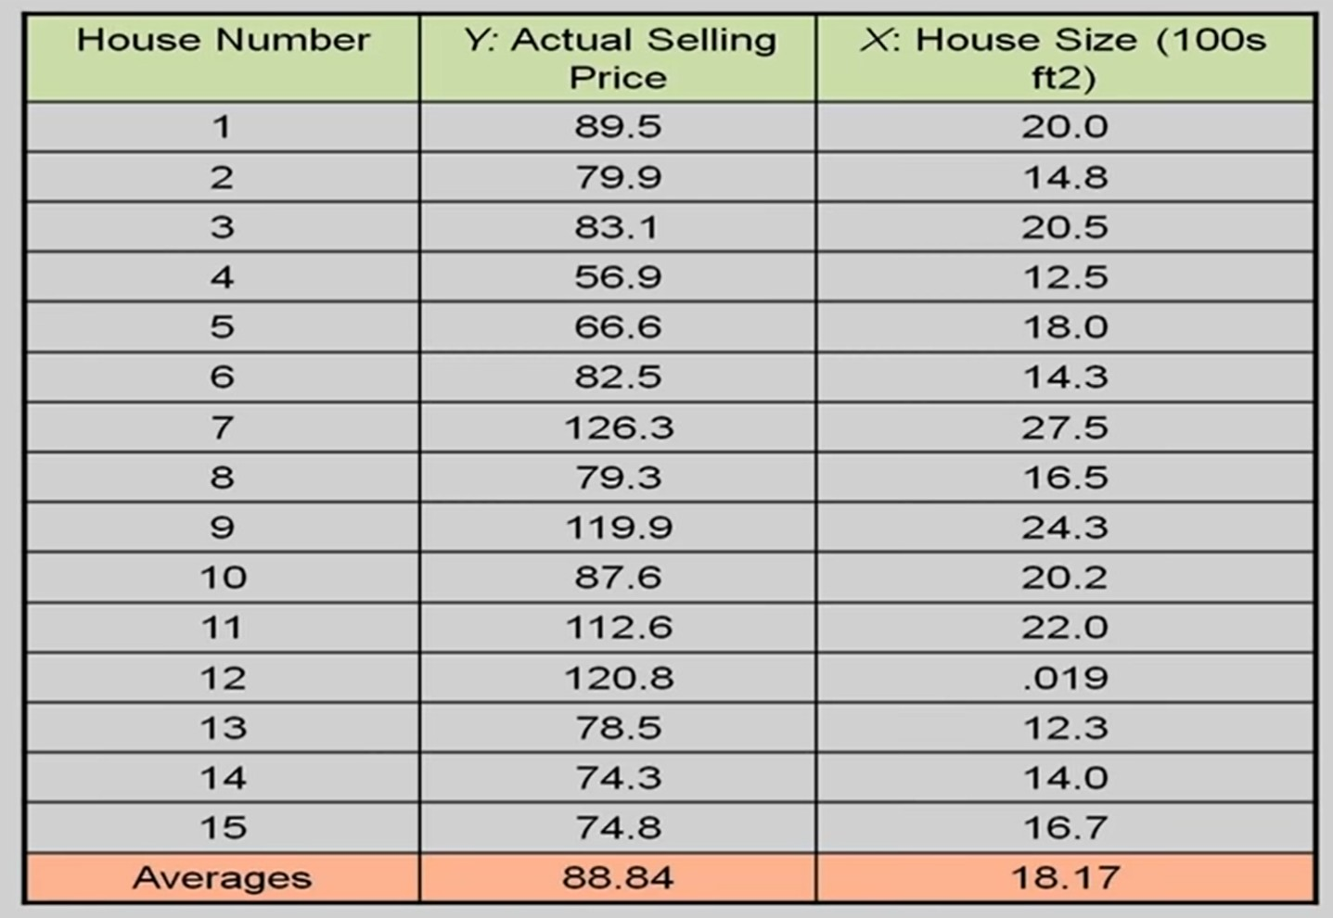
Example (continued)
Learnova
32 / 69
Notes:
Read these exactly (do not paraphrase):
- Example (continued)
Pause: ask the class what they already know about “Example (continued)” before revealing the slide.
Wording matters here — slow down, keep it precise.
~19s
Text in the figure: House Number Y: Actual Selling xX: House Size (100s Price ft2)
Ask the class: What might explain these numbers?

Slide 34
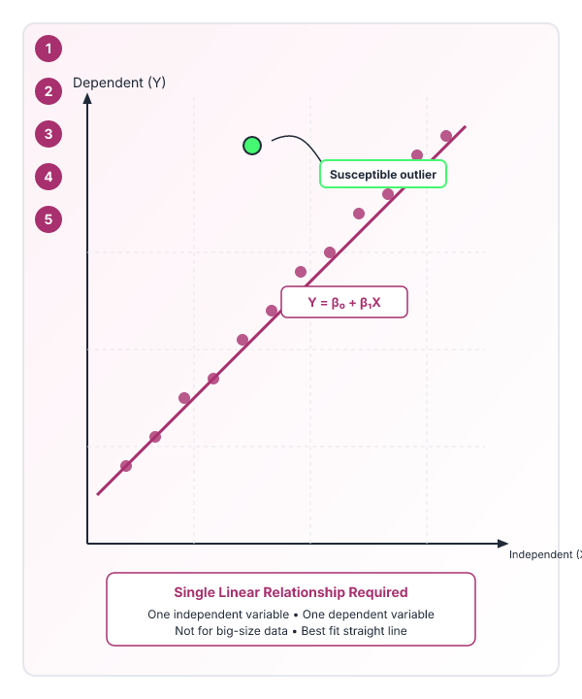
Linear regression requires a single linear relationship between variables
1
There is only one independent and dependent variable.
2
There should be a linear relationship between independent and dependent variables.
3
The type of regression line is a best fit straight line.
4
More susceptible to outliers; should not be used for big-size data.
IN PLAIN WORDS
Linear regression models a straight-line relationship between one independent variable and one dependent variable. It is sensitive to outliers, so it is not ideal for large datasets with extreme values. The model assumes a linear trend and uses a best-fit line to describe the data. For example, predicting a person’s weight from their height using a straight line.
Key terms: Regression — supervised machine learning technique which is used to predict continuous values · outliers — Data points that differ markedly from other observations. · best-fit line — The straight line that minimizes the sum of squared errors.
Learnova
33 / 69
Notes:
Reveal, one click at a time:
1. more susceptible to outliers hence;
2. it should not be used in the case of big-size data.
3. There should be a linear relationship between independent and dependent variables.
4. There is only one independent and dependent variable.
5. The type of regression line: a best fit straight line.
Read these exactly (do not paraphrase):
- Linear regression requires a single linear relationship between variables more susceptible to outliers hence; it should not be used in the case of big-size data.
Say what these mean, in your own words:
- Regression: supervised machine learning technique which is used to predict continuous values
- outliers: Data points that differ markedly from other observations.
- best-fit line: The straight line that minimizes the sum of squared errors.
Pause: ask the class what they already know about “Linear regression requires a single linear relationship between variables” before revealing the slide.
~47s
Ask the class: Explain this slide in your own words, in one sentence.

Slide 35

Advantages and Disadvantages of LR
Advantages | Disadvantages
Linear regression performs exceptionally well for linearly separable data | The assumption of linearity between dependent and independent variables
Easier to implement, interpret and efficient to train | It is often quite prone to noise and overfitting
It handles overfitting pretty well using dimensionally reduction techniques, regularization, and cross-validation | Linear regression is quite sensitive to outliers Hence, it should not be used in the case of big-size data.
Key takeaway: Linear regression is efficient and handles linearly separable data, but is sensitive to outliers and noise.
Learnova
▶ Open the interactive lab: Advantages and Disadvantages of LR — step-through
34 / 69
Notes:
Full detail (from the source):
[TABLE DATA] | Advantages | Disadvantages | | --- | --- | | Linear regression performs exceptionally well for linearly separable data | The assumption of linearity between dependent and independent variables | | Easier to implement, interpret and efficient to train | It is often quite prone to noise and overfitting | | It handles overfitting pretty well using dimensionally reduction techniques, regularization, and cross-validation | Linear regression is quite sensitive to outliers Hence, it should not be used in the case of big-size data.
|
~19s

Slide 36
Checkpoint 7
QUESTION · UNDERSTAND
Which term matches this description: “supervised machine learning technique which is used to predict continuous values”?
dependent variable
independent variables
A
B
Local optima
Regression
C
D
Answer: D
Regression: supervised machine learning technique which is used to predict continuous values
Learnova
35 / 69
Notes:
KEY POINT TO LAND: Answer, then check your reasoning.
Pause: ask the class what they already know about “Checkpoint 7” before revealing the slide.
~44s

Slide 37
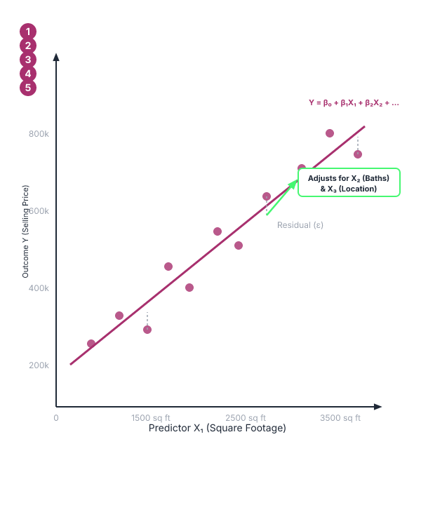


Multiple linear regression estimates one outcome from several predictors
Definition
Multiple linear regression is used to estimate the relationship between two or more independent variables and one dependent variable.
House Price Example
Depends on location, bedrooms, bathrooms, year built, and square footage.
Child Height Example
Depends on mother's height, father's height, nutrition, and environmental factors.
IN PLAIN WORDS
Multiple linear regression extends simple regression by using two or more independent variables to predict a single dependent variable. It captures how each predictor contributes to the outcome while controlling for the others. This method is common in real-world problems like house pricing or child growth studies. For example, estimating house price from location, size, and age of the property.
Key terms: independent variables — Predictor variables that influence the outcome. · dependent variable — Outcome variable that the model aims to predict.
Learnova
36 / 69
Notes:
Reveal, one click at a time:
1. Multiple linear regression is used to estimate the relationship between two or more independent variables and one depend
2. Example:
3. The selling price of a house can depend on the desirability of the location, the number of bedrooms, the number of bathr
4. The height of a child can depend on the height of the mother, the height of the father, nutrition, and environmental fac
Say what these mean, in your own words:
- independent variables: Predictor variables that influence the outcome.
- dependent variable: Outcome variable that the model aims to predict.
Pause: ask the class what they already know about “Multiple linear regression estimates one outcome from several predictors” before revealing the slide.
~40s
Ask the class: Explain this slide in your own words, in one sentence.

Slide 38
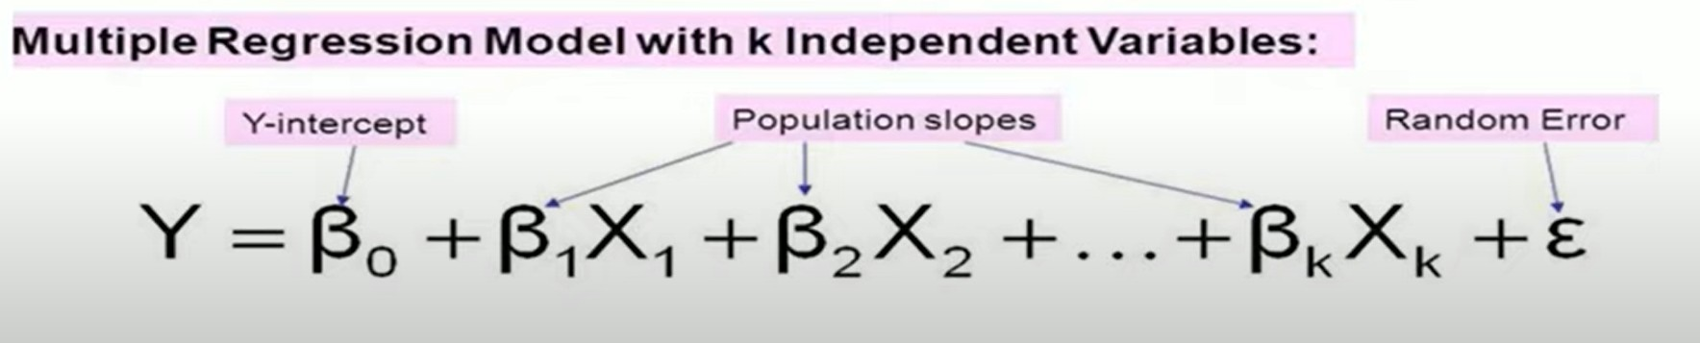
Multiple linear regression model
Learnova
37 / 69
Notes:
Pause: ask the class what they already know about “Multiple linear regression model” before revealing the slide.
~19s
Ask the class: Explain this slide in your own words, in one sentence.

Slide 39
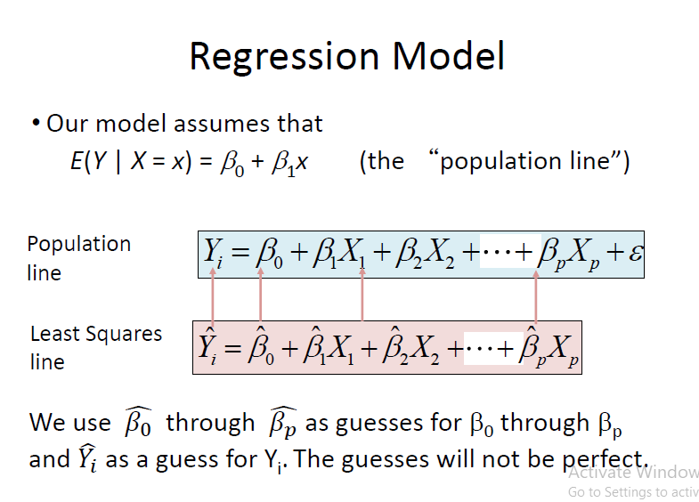
The regression model is the equation we aim to estimate
“Actual line from which the examples are drawn”
— The regression model is the equation we aim to estimate
Learnova
38 / 69
Notes:
Pause: ask the class what they already know about “The regression model is the equation we aim to estimate” before revealing the slide.
~19s
Ask the class: Explain this slide in your own words, in one sentence.

Slide 40
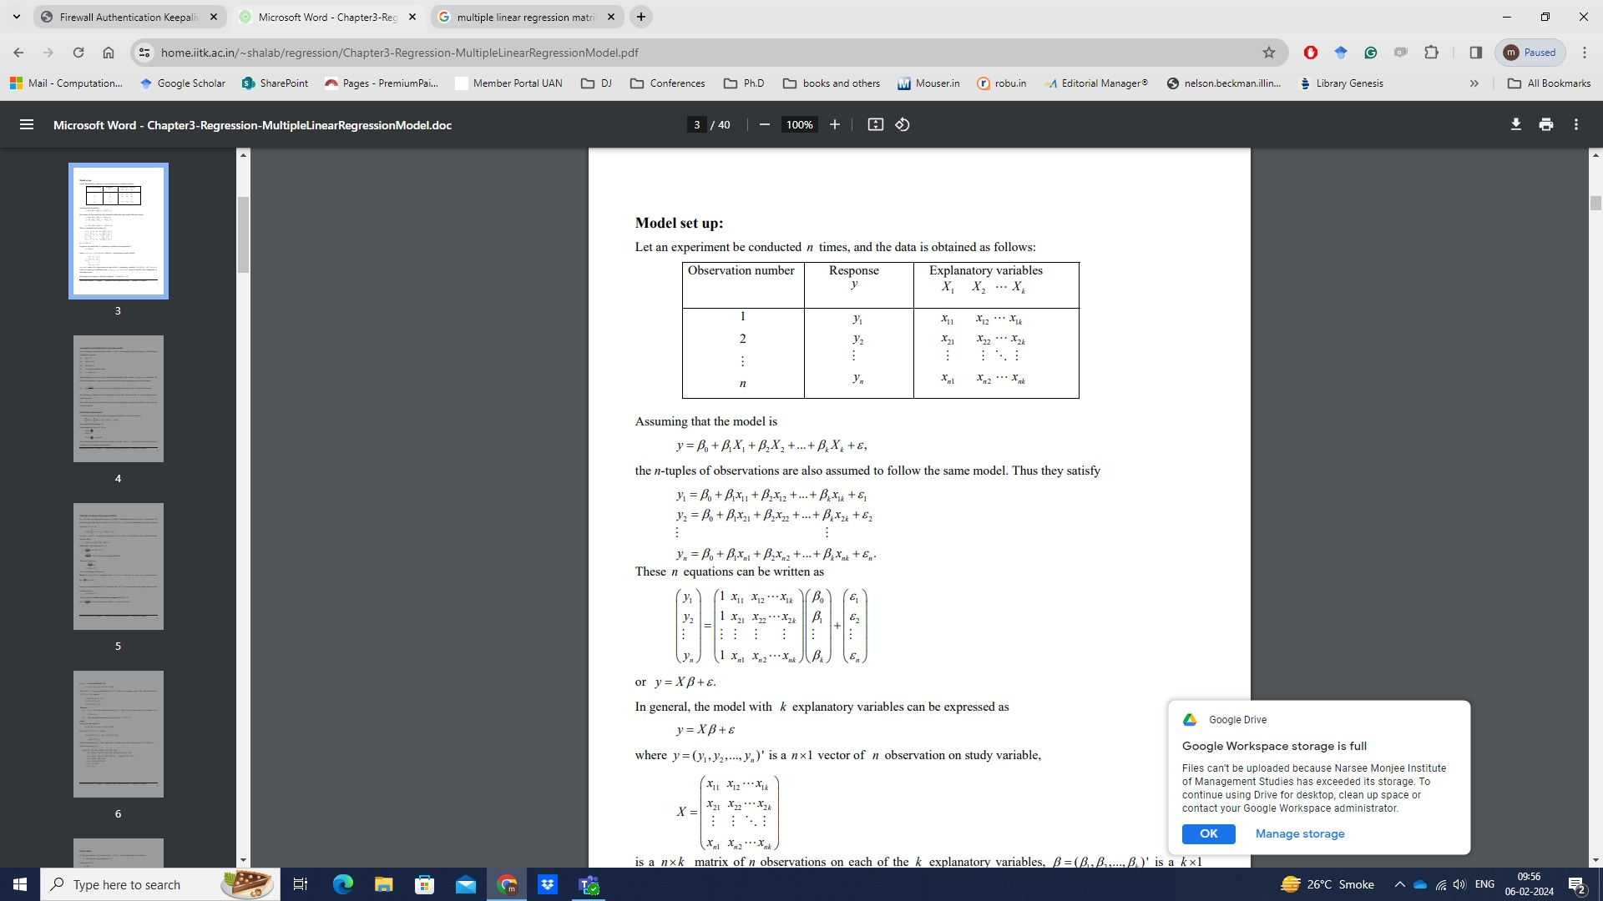
Multiple linear regression model (2)
Learnova
39 / 69
Notes:
Read these exactly (do not paraphrase):
- Multiple linear regression model (2)
Pause: ask the class what they already know about “Multiple linear regression model (2)” before revealing the slide.
Wording matters here — slow down, keep it precise.
~19s
Text in the figure: Firewall Authentication multiple regression ca ion/Chapter3-Regression-MultipleLinearRegressionModel.pdf tr I= Mail - Computation 9 Pages - PremiumPai Member Portal [9 DJ (4 Conferen i robu.in Manager® & nesis Let an experiment be conducted n times, and the data is obtained as follows: Observation number | Response Explanatory variables Assuming that the model is Bot BX, the n-tuples of observations are also assumed to follow the same model. Thus they satis Be Bo + Bx Bia * These n equations can be written as In general, the model with & explanatory variables can be ex is a vector of 1 observa
Ask the class: Explain this slide in your own words, in one sentence.

Slide 41
Cost function seeks parameters that minimize prediction error
Find b and w to minimize J ().
Key takeaway: The cost function searches for parameters b and w that minimize overall prediction error.
Learnova
40 / 69
Notes:
Read these exactly (do not paraphrase):
- Cost function seeks parameters that minimize prediction error Find b and w to minimize J ()
Pause: ask the class what they already know about “Cost function seeks parameters that minimize prediction error” before revealing the slide.
Wording matters here — slow down, keep it precise.
~19s
Ask the class: Explain this slide in your own words, in one sentence.

Slide 42

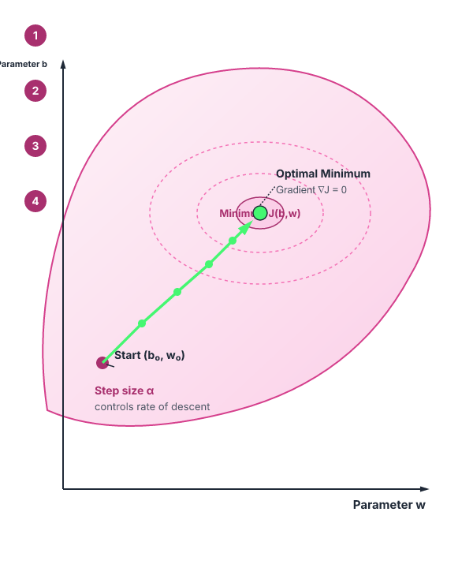

Gradient descent iteratively adjusts parameters to reduce the cost function
Start with some
Keep changing to reduce
until we hopefully end up at a minimum
ALSO ON THIS SLIDE
Outline:
Learnova
41 / 69
Notes:
Reveal, one click at a time:
1. J(b,w)
2. Outline:
3. b,w
4. Start with some
5. Keep changing to reduce
6. until we hopefully end up at a minimum
Read these exactly (do not paraphrase):
- Gradient descent iteratively adjusts parameters to reduce the cost function J(b,w) Outline: b,w Start with some Keep changing to reduce until we hopefully end up at a minimum
Pause: ask the class what they already know about “Gradient descent iteratively adjusts parameters to reduce the cost function” before revealing the slide.
Wording matters here — slow down, keep it precise.
~54s
Ask the class: Explain this slide in your own words, in one sentence.

Slide 43
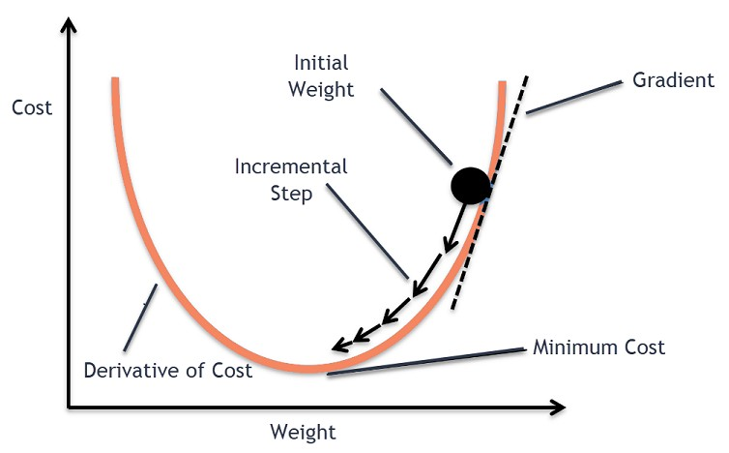
Gradient descent/delta rule/LMS method
Learnova
42 / 69
Notes:
Pause: ask the class what they already know about “Gradient descent/delta rule/LMS method” before revealing the slide.
~19s
Text in the figure: Initial Gradient Weight \ 1 Cost / U Incremental Step Minimum Cost Derivative of Cost
Ask the class: Explain this slide in your own words, in one sentence.

Slide 44

Simplified hypothesis uses a linear model with zero bias and slope w
1
Simplified
2
Hypothesis: hb,w(x)= b+wx
3
hw(x)= wx b=0
4
Parameters:
5
b, w Cost Function:
6
Goal:
Learnova
43 / 69
Notes:
Reveal, one click at a time:
1. Simplified
2. Hypothesis: hb,w(x)= b+wx
3. hw(x)= wx b=0
4. Parameters:
5. b, w Cost Function:
6. Goal:
Read these exactly (do not paraphrase):
- Simplified hypothesis uses a linear model with zero bias and slope w Simplified Hypothesis: hb,w(x)= b+wx hw(x)= wx b=0 Parameters: b, w Cost Function: Goal:
Pause: ask the class what they already know about “Simplified hypothesis uses a linear model with zero bias and slope w” before revealing the slide.
Wording matters here — slow down, keep it precise.
~54s
Ask the class: Explain this slide in your own words, in one sentence.

Slide 45
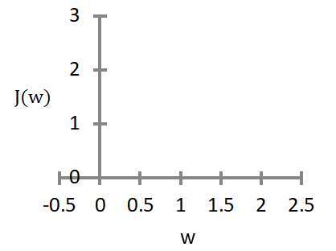
Setting w to one yields a hypothesis function hw(x) = x
SETTING W TO ONE YIELDS A HYPOTHESIS FUNCTION HW(X) = X
Hw(x)
$$w=1$$
J(w)
(for fixed, this is a function of x)
(function of the parameter)
hw(x) w = 1
Key takeaway: Setting slope w to 1 defines a hypothesis function where prediction equals the input feature.
Learnova
44 / 69
Notes:
Reveal, one click at a time:
1. hw(x)
2. J(w)
3. (for fixed, this is a function of x)
4. (function of the parameter)
5. hw(x) w = 1
Read these exactly (do not paraphrase):
- Setting w to one yields a hypothesis function hw(x) = x hw(x) J(w) (for fixed, this is a function of x) (function of the parameter) hw(x) w = 1
Pause: ask the class what they already know about “Setting w to one yields a hypothesis function hw(x) = x” before revealing the slide.
Wording matters here — slow down, keep it precise.
~47s
Ask the class: What happens to the result if one of the inputs doubles?

Slide 46
Setting w to 0.5 yields a hypothesis function hw(x) = 0.5x
SETTING W TO 0.5 YIELDS A HYPOTHESIS FUNCTION HW(X) = 0.5X
Hw(x)
$$w=0$$
J(w)
(function of the parameter)
(for fixed, this is a function of x)
w = 0.5
Key takeaway: Setting slope w to 0.5 yields a hypothesis function scaling the input feature by half.
Learnova
45 / 69
Notes:
Reveal, one click at a time:
1. hw(x)
2. J(w)
3. (function of the parameter)
4. (for fixed, this is a function of x)
5. w = 0.5
Read these exactly (do not paraphrase):
- Setting w to 0.5 yields a hypothesis function hw(x) = 0.5x hw(x) J(w) (function of the parameter) (for fixed, this is a function of x) w = 0.5
Pause: ask the class what they already know about “Setting w to 0.5 yields a hypothesis function hw(x) = 0.5x” before revealing the slide.
Wording matters here — slow down, keep it precise.
~47s
Ask the class: What happens to the result if one of the inputs doubles?

Slide 47
Setting w to zero yields a hypothesis function hw(x) = 0
SETTING W TO ZERO YIELDS A HYPOTHESIS FUNCTION HW(X) = 0
Hw(x)
$$w=0$$
J(w)
(function of the parameter)
(for fixed, this is a function of x)
hw(x) w = 0
Key takeaway: Setting slope w to zero produces a flat hypothesis function outputting zero for inputs.
Learnova
46 / 69
Notes:
Reveal, one click at a time:
1. hw(x)
2. J(w)
3. (function of the parameter)
4. (for fixed, this is a function of x)
5. hw(x) w = 0
Read these exactly (do not paraphrase):
- Setting w to zero yields a hypothesis function hw(x) = 0 hw(x) J(w) (function of the parameter) (for fixed, this is a function of x) hw(x) w = 0
Pause: ask the class what they already know about “Setting w to zero yields a hypothesis function hw(x) = 0” before revealing the slide.
Wording matters here — slow down, keep it precise.
~47s
Ask the class: What happens to the result if one of the inputs doubles?

Slide 48
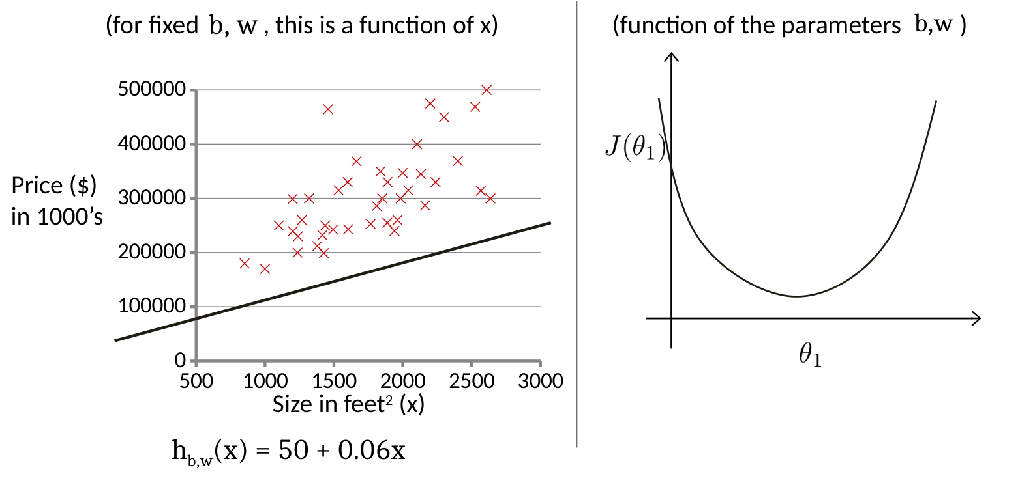

The hypothesis hb,w(x) predicts price from size using a linear equation
b, w
(for fixed , this is a function of x)
Price ()
1000’s
in 1000’s
1000 1500 2000 2500 3000
ALSO ON THIS SLIDE
Size in feet2 (x)
Learnova
47 / 69
Notes:
Reveal, one click at a time:
1. hb,w(x)
2. J(b,w)
3. b,w
4. b, w
5. (for fixed , this is a function of x)
6. (function of the parameters )
7. 500000
Read these exactly (do not paraphrase):
- The hypothesis hb,w(x) predicts price from size using a linear equation hb,w(x) J(b,w) b,w b, w (for fixed , this is a function of x) (function of the parameters ) 500000 400000 Price ($) 300000 in 1000’s 200000 100000 1000 1500 2000 2500 3000 Size in feet2 (x) hb,w(x) = 50 + 0.06x
Pause: ask the class what they already know about “The hypothesis hb,w(x) predicts price from size using a linear equation” before revealing the slide.
Wording matters here — slow down, keep it precise.
~61s
Ask the class: Which step would break the whole process if it failed — and why?

Slide 49
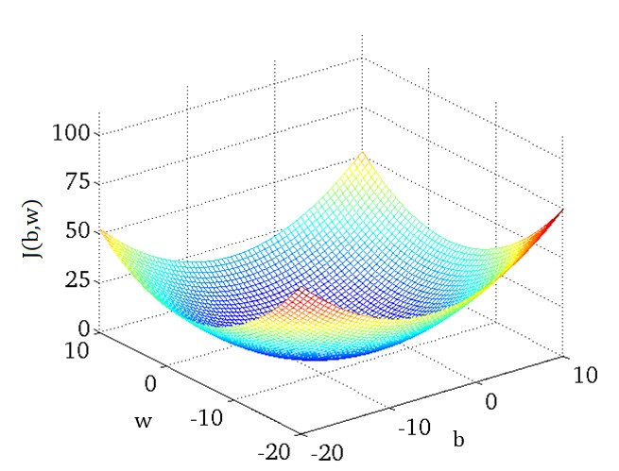
Gradient descent/delta rule/LMS method (continued)
Learnova
48 / 69
Notes:
Read these exactly (do not paraphrase):
- Gradient descent/delta rule/LMS method (continued)
Pause: ask the class what they already know about “Gradient descent/delta rule/LMS method (continued)” before revealing the slide.
Wording matters here — slow down, keep it precise.
~19s
Text in the figure: ae EN SOO KLE <>
Ask the class: Explain this slide in your own words, in one sentence.

Slide 50
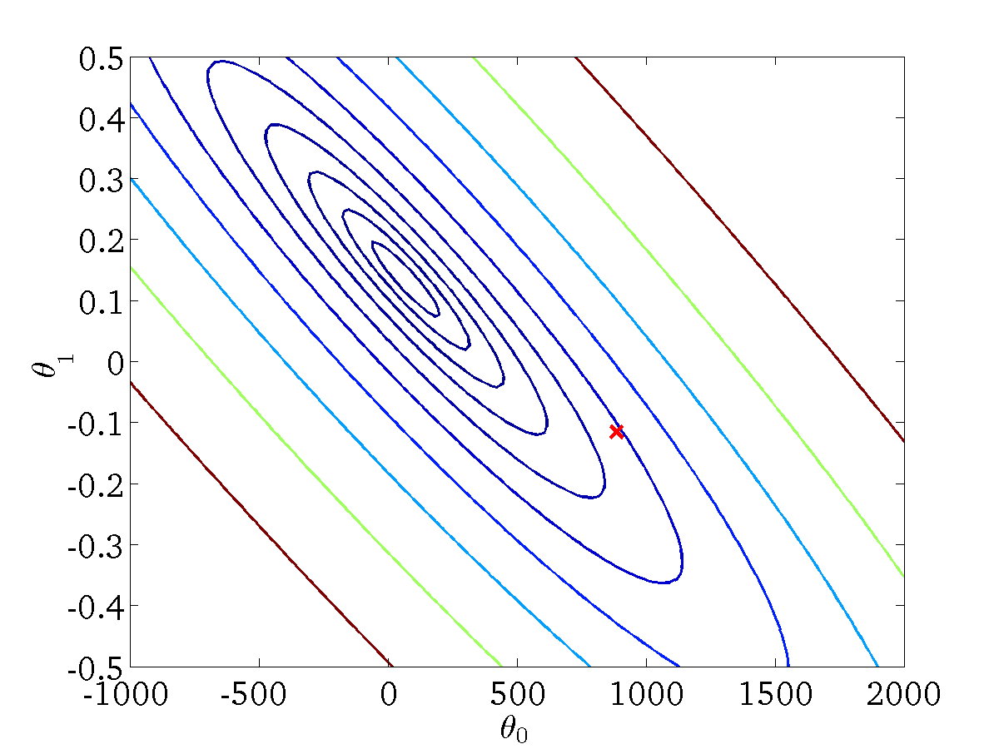
Gradient descent/delta rule/LMS method: Fixed
“(for fixed, this is a function of x)”
— Gradient descent/delta rule/LMS method: Fixed
Key takeaway: With parameters fixed, cost functions evaluate prediction error exclusively as a function of data.
Learnova
49 / 69
Notes:
Read these exactly (do not paraphrase):
- Gradient descent/delta rule/LMS method: Fixed (for fixed, this is a function of x)
Pause: ask the class what they already know about “Gradient descent/delta rule/LMS method: Fixed” before revealing the slide.
Wording matters here — slow down, keep it precise.
~19s
Ask the class: Explain this slide in your own words, in one sentence.

Slide 51

Gradient descent/delta rule/LMS method: Fixed
“(for fixed, this is a function of x)”
— Gradient descent/delta rule/LMS method: Fixed
Key takeaway: Fixed parameter evaluations plot how cost varies with respect to hypothesis inputs.
Learnova
50 / 69
Notes:
Read these exactly (do not paraphrase):
- Gradient descent/delta rule/LMS method: Fixed (for fixed, this is a function of x)
Pause: ask the class what they already know about “Gradient descent/delta rule/LMS method: Fixed” before revealing the slide.
Wording matters here — slow down, keep it precise.
~19s
Ask the class: Explain this slide in your own words, in one sentence.

Slide 52
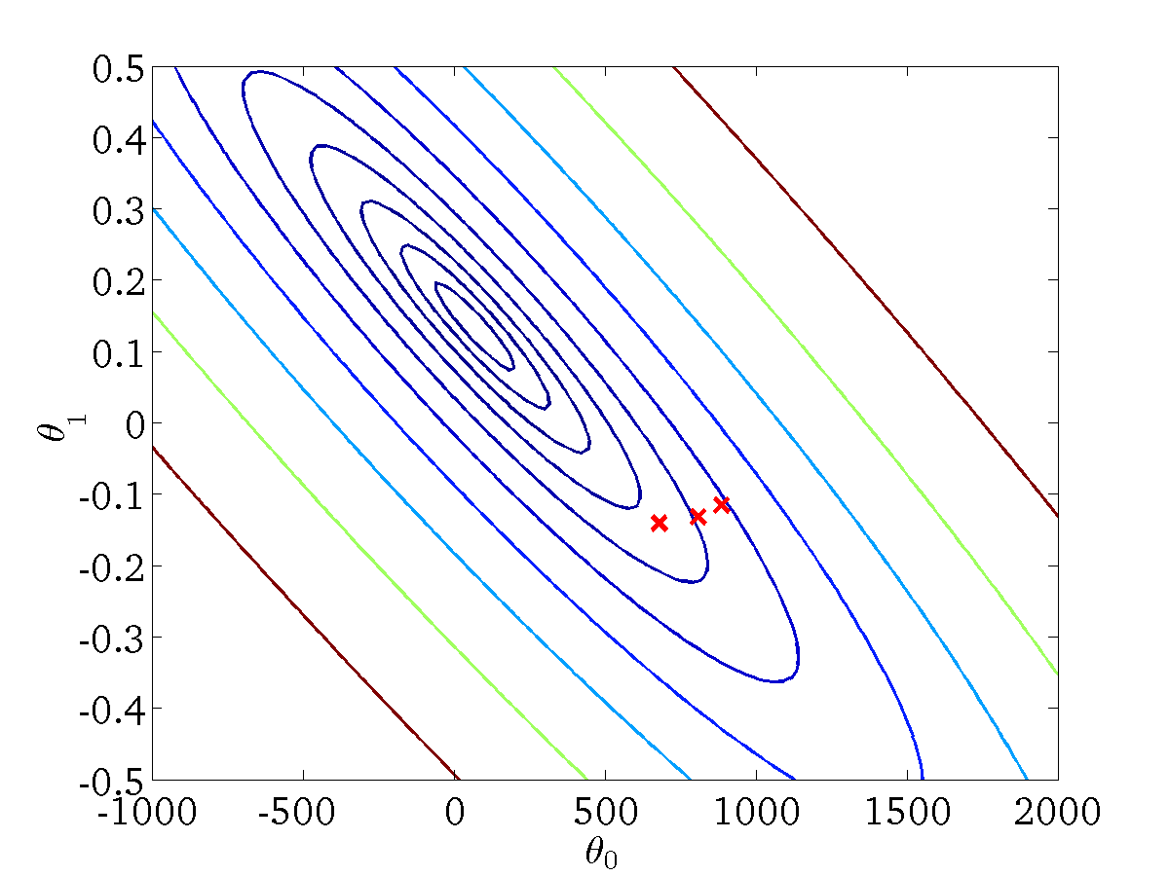
Gradient descent/delta rule/LMS method: Fixed
“(for fixed, this is a function of x)”
— Gradient descent/delta rule/LMS method: Fixed
Key takeaway: Cost function curves illustrate error values corresponding to fixed model parameters.
Learnova
51 / 69
Notes:
Read these exactly (do not paraphrase):
- Gradient descent/delta rule/LMS method: Fixed (for fixed, this is a function of x)
Pause: ask the class what they already know about “Gradient descent/delta rule/LMS method: Fixed” before revealing the slide.
Wording matters here — slow down, keep it precise.
~19s
Ask the class: Explain this slide in your own words, in one sentence.

Slide 53

Gradient descent/delta rule/LMS method: Fixed
“(for fixed, this is a function of x)”
— Gradient descent/delta rule/LMS method: Fixed
Key takeaway: Analyzing fixed parameters helps visualize the error landscape during gradient descent optimization.
Learnova
52 / 69
Notes:
Read these exactly (do not paraphrase):
- Gradient descent/delta rule/LMS method: Fixed (for fixed, this is a function of x)
Pause: ask the class what they already know about “Gradient descent/delta rule/LMS method: Fixed” before revealing the slide.
Wording matters here — slow down, keep it precise.
~19s
Ask the class: Explain this slide in your own words, in one sentence.

Slide 54
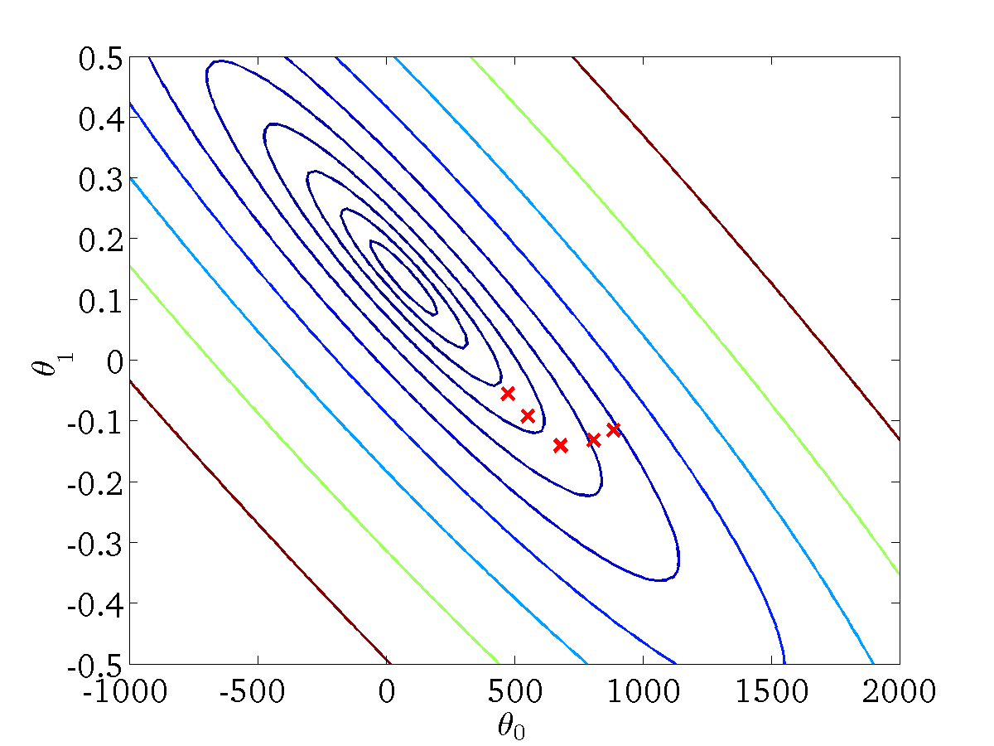
Gradient descent/delta rule/LMS method: Fixed
“(for fixed, this is a function of x)”
— Gradient descent/delta rule/LMS method: Fixed
Key takeaway: Fixed parameter states map the relationship between input features and resulting hypothesis costs.
Learnova
53 / 69
Notes:
Read these exactly (do not paraphrase):
- Gradient descent/delta rule/LMS method: Fixed (for fixed, this is a function of x)
Pause: ask the class what they already know about “Gradient descent/delta rule/LMS method: Fixed” before revealing the slide.
Wording matters here — slow down, keep it precise.
~19s
Ask the class: Explain this slide in your own words, in one sentence.

Slide 55

Gradient descent/delta rule/LMS method: Fixed
“(for fixed, this is a function of x)”
— Gradient descent/delta rule/LMS method: Fixed
Key takeaway: Error surfaces demonstrate how specific parameter choices impact overall hypothesis performance.
Learnova
54 / 69
Notes:
Read these exactly (do not paraphrase):
- Gradient descent/delta rule/LMS method: Fixed (for fixed, this is a function of x)
Pause: ask the class what they already know about “Gradient descent/delta rule/LMS method: Fixed” before revealing the slide.
Wording matters here — slow down, keep it precise.
~19s
Ask the class: Explain this slide in your own words, in one sentence.

Slide 56

Gradient descent/delta rule/LMS method: Fixed
“(for fixed, this is a function of x)”
— Gradient descent/delta rule/LMS method: Fixed
Key takeaway: Holding parameters constant isolates the mathematical behavior of the hypothesis function.
Learnova
55 / 69
Notes:
Read these exactly (do not paraphrase):
- Gradient descent/delta rule/LMS method: Fixed (for fixed, this is a function of x)
Pause: ask the class what they already know about “Gradient descent/delta rule/LMS method: Fixed” before revealing the slide.
Wording matters here — slow down, keep it precise.
~19s
Ask the class: Explain this slide in your own words, in one sentence.

Slide 57
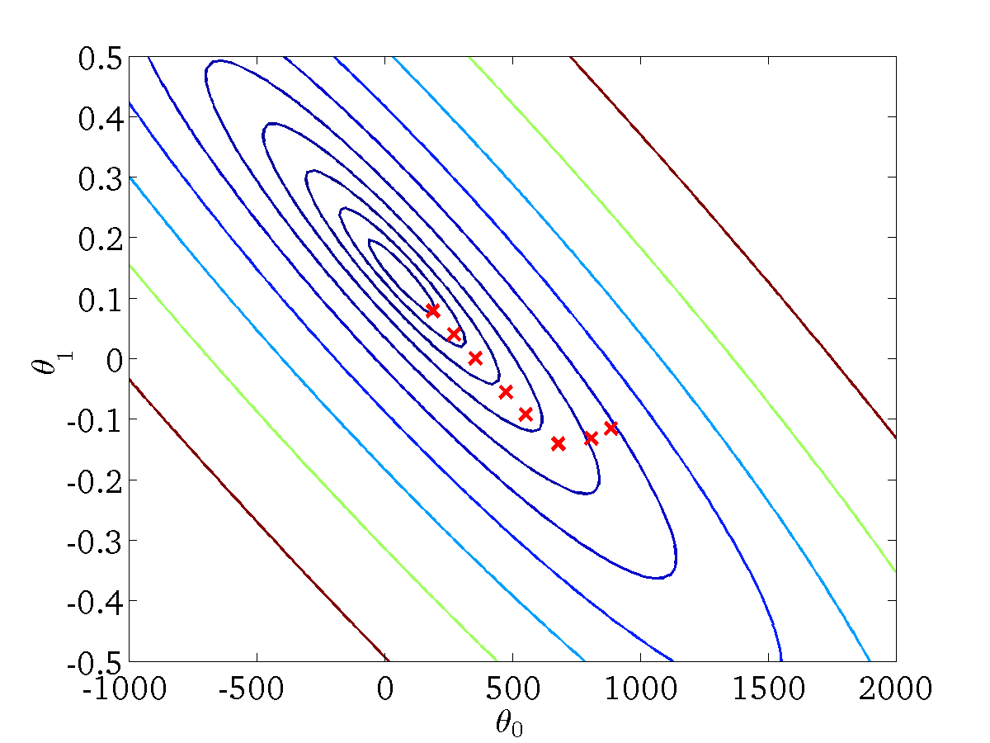
Gradient descent/delta rule/LMS method: Fixed
“(for fixed, this is a function of x)”
— Gradient descent/delta rule/LMS method: Fixed
Key takeaway: Fixed-parameter analyses assist in understanding gradient descent convergence mechanics.
Learnova
56 / 69
Notes:
Read these exactly (do not paraphrase):
- Gradient descent/delta rule/LMS method: Fixed (for fixed, this is a function of x)
Pause: ask the class what they already know about “Gradient descent/delta rule/LMS method: Fixed” before revealing the slide.
Wording matters here — slow down, keep it precise.
~19s
Ask the class: Explain this slide in your own words, in one sentence.

Slide 58

Gradient descent/delta rule/LMS method: Fixed
“(for fixed, this is a function of x)”
— Gradient descent/delta rule/LMS method: Fixed
Key takeaway: Cost functions plotted against fixed parameters reveal the optimal direction for gradient updates.
Learnova
57 / 69
Notes:
Read these exactly (do not paraphrase):
- Gradient descent/delta rule/LMS method: Fixed (for fixed, this is a function of x)
Pause: ask the class what they already know about “Gradient descent/delta rule/LMS method: Fixed” before revealing the slide.
Wording matters here — slow down, keep it precise.
~19s
Ask the class: Explain this slide in your own words, in one sentence.

Slide 59
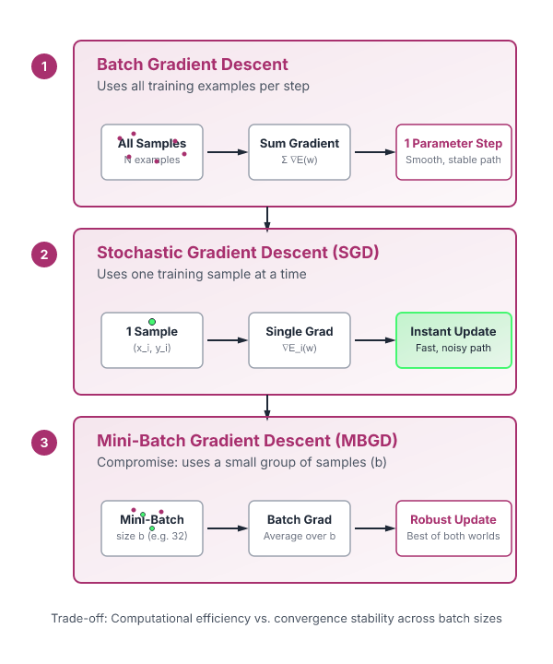
Gradient descent/delta rule/LMS method: 1. Batch Gradient
1. Batch Gradient Descent.
Batch: Each step of gradient descent uses all the training examples.
2. Stochastic Gradient Descent (SGD).
Uses one training sample at a time.
Parameters are updated after every sample.
3. Mini-Batch Gradient Descent (MBGD) This is a compromise between Batch GD and SGD.
BUT Instead of using: all samples (Batch).
or one sample (SGD).
it uses a small group (mini-batch).
Learnova
58 / 69
Notes:
Reveal, one click at a time:
1. 1. Batch Gradient Descent
2. Batch: Each step of gradient descent uses all the training examples.
3. 2. Stochastic Gradient Descent (SGD)
4. Uses one training sample at a time.
5. Parameters are updated after every sample.
6. 3. Mini-Batch Gradient Descent (MBGD) This is a compromise between Batch GD and SGD.
7. Instead of using: all samples (Batch),
Read these exactly (do not paraphrase):
- Stochastic Gradient Descent (SGD) Uses one training sample at a time.
- Mini-Batch Gradient Descent (MBGD) This is a compromise between Batch GD and SGD.
- Instead of using: all samples (Batch), or one sample (SGD), it uses a small group (mini-batch).
Pause: ask the class what they already know about “Gradient descent/delta rule/LMS method: 1. Batch Gradient” before revealing the slide.
~61s
Ask the class: Explain this slide in your own words, in one sentence.

Slide 60
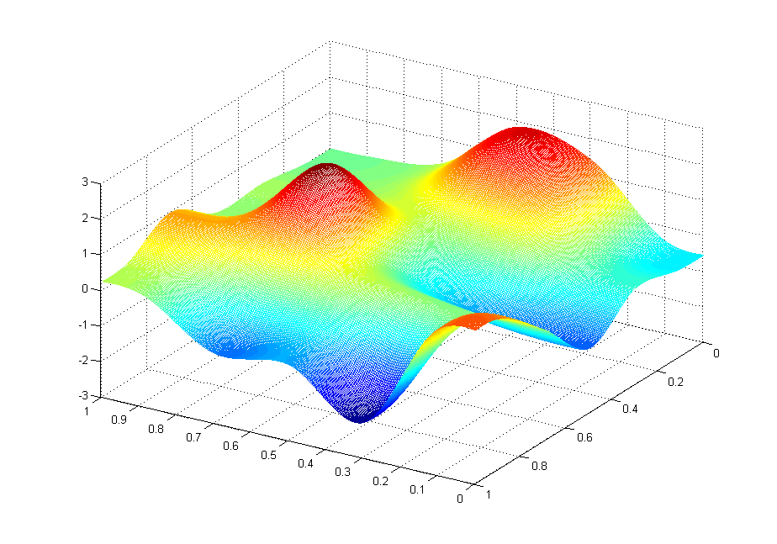
Gradient descent/delta rule/LMS method (continued)
Learnova
59 / 69
Notes:
Read these exactly (do not paraphrase):
- Gradient descent/delta rule/LMS method (continued)
Pause: ask the class what they already know about “Gradient descent/delta rule/LMS method (continued)” before revealing the slide.
Wording matters here — slow down, keep it precise.
~19s
Ask the class: Explain this slide in your own words, in one sentence.

Slide 61
Property of gradient descent
Learnova
60 / 69
Notes:
Pause: ask the class what they already know about “Property of gradient descent” before revealing the slide.
~19s
Ask the class: Explain this slide in your own words, in one sentence.

Slide 62
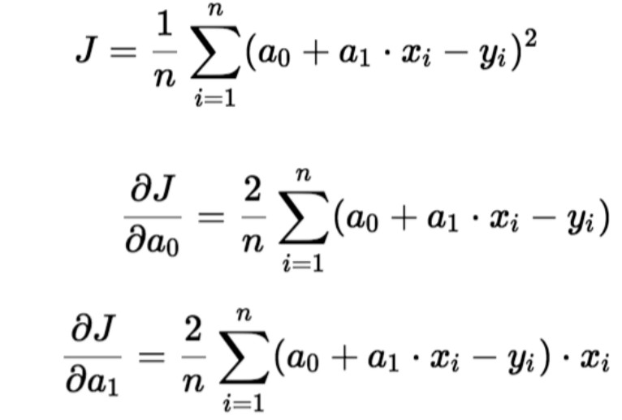
Gradient descent algorithm
Learnova
61 / 69
Notes:
Pause: ask the class what they already know about “Gradient descent algorithm” before revealing the slide.
~19s
Ask the class: What might explain these numbers?

Slide 63






Gradient descent requires simultaneous updates for correct weight adjustments
Simultaneous update
Gradient descent depends on updating weights simultaneously rather than sequentially
Ensures that all
This ensures that all parameters are adjusted based on the same gradient calculations at the current step
Using correct simultaneous updates prevents calculation errors during optimization
Example: Adjusting multiple steering angles at once instead of one wheel at a time
ALSO ON THIS SLIDE
Incorrect:
Key terms: Simultaneous update — Updating all model parameters together at the end of a single iteration.
Learnova
62 / 69
Notes:
Reveal, one click at a time:
1. Simultaneous update
2. Correct: Simultaneous update
3. Incorrect:
4. Gradient descent depends on updating weights simultaneously rather than sequentially.
5. This ensures that all parameters are adjusted based on the same gradient calculations at the current step.
6. Using correct simultaneous updates prevents calculation errors during optimization.
7. Example: Adjusting multiple steering angles at once instead of one wheel at a time.
Say what these mean, in your own words:
- Simultaneous update: Updating all model parameters together at the end of a single iteration.
Pause: ask the class what they already know about “Gradient descent requires simultaneous updates for correct weight adjustments” before revealing the slide.
~61s
Ask the class: Explain this slide in your own words, in one sentence.

Slide 64

Learning rate size determines whether gradient descent converges or diverges
ALGORITHM
1
If α is too small, gradient descent can be slow.
2
If α is too large, gradient descent can overshoot the minimum. It may fail to converge, or even diverge.
3
The learning rate alpha controls the step size taken during gradient descent.
4
If alpha is too small, the algorithm becomes very slow.
5
If alpha is too large, it can overshoot the minimum and fail to converge or even diverge.
6
Example: Taking tiny steps down a mountain takes forever, while giant leaps cause you to jump right past the bottom.
Key terms: Learning rate — A tuning parameter that determines the step size at each iteration. · Diverge — Moving further away from the optimal minimum instead of getting closer.
Learnova
63 / 69
Notes:
Reveal, one click at a time:
1. If α is too small, gradient descent can be slow.
2. If α is too large, gradient descent can overshoot the minimum. It may fail to converge, or even diverge.
3. The learning rate alpha controls the step size taken during gradient descent.
4. If alpha is too small, the algorithm becomes very slow.
5. If alpha is too large, it can overshoot the minimum and fail to converge or even diverge.
6. Example: Taking tiny steps down a mountain takes forever, while giant leaps cause you to jump right past the bottom.
Say what these mean, in your own words:
- Learning rate: A tuning parameter that determines the step size at each iteration.
- Diverge: Moving further away from the optimal minimum instead of getting closer.
Pause: ask the class what they already know about “Learning rate size determines whether gradient descent converges or diverges” before revealing the slide.
~54s
Ask the class: Explain this slide in your own words, in one sentence.

Slide 65
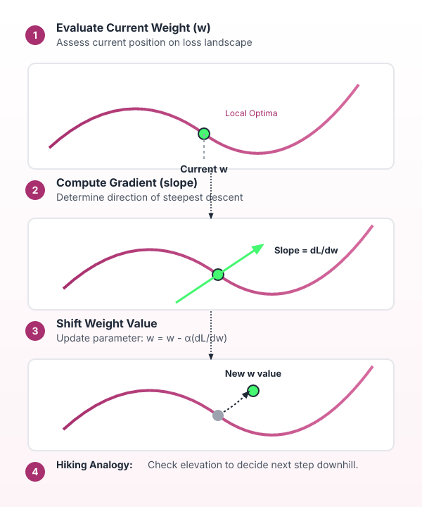



Gradient descent updates the current value of weight at local optima
w at local optima
Current value of w
Algorithm evaluates
The algorithm evaluates the current value of the weight at local optima
Helps determine
This helps determine the ongoing optimization path of the model parameters
Weight value
The weight value continuously shifts according to the gradient
Example: Checking your current elevation on a hiking trail to decide the next step
Key terms: Local optima — A point where the function value is smaller than surrounding points. · Current value of w — The active parameter weight being evaluated in the optimization step.
Also in this lecture: If α is too small, gradient descent can be slow.
Learnova
64 / 69
Notes:
Reveal, one click at a time:
1. w at local optima
2. Current value of w
3. The algorithm evaluates the current value of the weight at local optima.
4. This helps determine the ongoing optimization path of the model parameters.
5. The weight value continuously shifts according to the gradient.
6. Example: Checking your current elevation on a hiking trail to decide the next step.
Say what these mean, in your own words:
- Local optima: A point where the function value is smaller than surrounding points.
- Current value of w: The active parameter weight being evaluated in the optimization step.
Pause: ask the class what they already know about “Gradient descent updates the current value of weight at local optima” before revealing the slide.
~54s
Ask the class: Explain this slide in your own words, in one sentence.

Slide 66

Gradient descent automatically takes smaller steps as it approaches a local minimum
Gradient descent can converge
to a local minimum, even with the learning rate α fixed
As we approach a local
minimum, gradient descent will automatically take smaller steps
So
So, no need to decrease α over time
1
2
3
As the algorithm approaches
the minimum, the gradient naturally shrinks
This causes gradient descent
to automatically take smaller steps without needing to decrease alpha over time
Example
Example: Rolling a ball into a bowl slows down automatically as it nears the bottom
4
5
6
Key takeaway: One trigger sets off a chain of 6 effects.
Key terms: Local minimum — The lowest point in a local neighborhood of the cost function. · Fixed learning rate — A constant step-size multiplier that does not change manually over time.
Learnova
65 / 69
Notes:
Reveal, one click at a time:
1. Gradient descent can converge to a local minimum, even with the learning rate α fixed.
2. As we approach a local minimum, gradient descent will automatically take smaller steps. So, no need to decrease α over t
3. Gradient descent can converge to a local minimum even with a fixed learning rate.
4. As the algorithm approaches the minimum, the gradient naturally shrinks.
5. This causes gradient descent to automatically take smaller steps without needing to decrease alpha over time.
6. Example: Rolling a ball into a bowl slows down automatically as it nears the bottom.
Say what these mean, in your own words:
- Local minimum: The lowest point in a local neighborhood of the cost function.
- Fixed learning rate: A constant step-size multiplier that does not change manually over time.
Pause: ask the class what they already know about “Gradient descent automatically takes smaller steps as it approaches a local minimum” before revealing the slide.
~54s
Ask the class: Explain this slide in your own words, in one sentence.

Slide 67

Regression analysis establishes functional relationships and supports data-driven decisions
Predicts and forecasts future values based on historical data.
Measures the strength and direction of relationships between variables.
Establishes a functional relationship between one dependent variable
and one or more independent variables.
Identifies the effect of independent variables on the dependent variable
Identifies significant factors influencing the target variable.
Supports data-driven decision making in business, healthcare, finance,
and engineering.
Improves planning and resource allocation by identifying trends and
patterns.
Helps evaluate model performance by analysing prediction errors (e.g.,
MSE, RMSE, MAE) and improving the model.
Discovers trends and opportunities for business growth and
optimisation.
Key terms: Dependent variable — The target outcome variable predicted or explained by the model. · Independent variables — The predictor factors used to analyze effects on the dependent variable.
Learnova
66 / 69
Notes:
Reveal, one click at a time:
1. Establishes a functional relationship between one dependent variable
2. and one or more independent variables.
3. Predicts and forecasts future values based on historical data.
4. Identifies the effect of independent variables on the dependent variable:
5. Identifies significant factors influencing the target variable.
6. Supports data-driven decision making in business, healthcare, finance,
7. and engineering.
Read these exactly (do not paraphrase):
- Helps evaluate model performance by analysing prediction errors (e.g., MSE, RMSE, MAE) and improving the model.
Say what these mean, in your own words:
- Dependent variable: The target outcome variable predicted or explained by the model.
- Independent variables: The predictor factors used to analyze effects on the dependent variable.
Pause: ask the class what they already know about “Regression analysis establishes functional relationships and supports data-driven decisions” before revealing the slide.
~61s
Ask the class: Explain this slide in your own words, in one sentence.

Slide 68
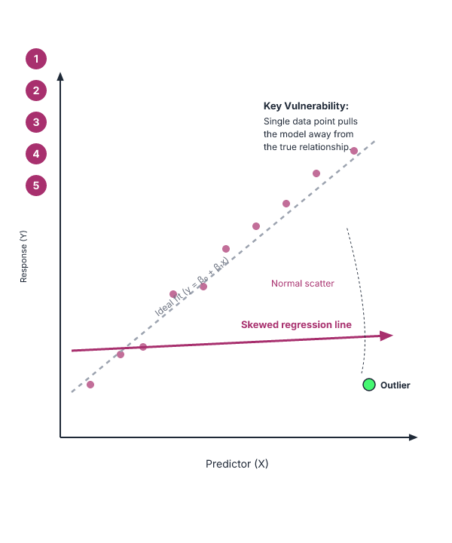



Regression analysis assumes linear relationships and remains sensitive to outliers
Assumes a linear and stable relationship between variables
Sensitive to outliers and noisy data
Requires statistical assumptions to be satisfied
Does not imply causation
Standard linear regression cannot predict categorical outcomes
Prediction accuracy depends on data quality and feature selection
ALSO ON THIS SLIDE
Example: A single extreme data point drastically skews the fitted regression line.
Key terms: Regression — supervised machine learning technique which is used to predict continuous values · Outliers — Extreme data points that significantly differ from other observations. · Causation — Indication that one event is the direct result of the occurrence of another.
Learnova
67 / 69
Notes:
Reveal, one click at a time:
1. Assumes a linear and stable relationship between variables.
2. Sensitive to outliers and noisy data.
3. Requires statistical assumptions to be satisfied.
4. Does not imply causation.
5. Standard linear regression cannot predict categorical outcomes.
6. Prediction accuracy depends on data quality and feature selection.
7. Regression models assume a linear and stable relationship between variables.
Say what these mean, in your own words:
- Regression: supervised machine learning technique which is used to predict continuous values
- Outliers: Extreme data points that significantly differ from other observations.
- Causation: Indication that one event is the direct result of the occurrence of another.
Pause: ask the class what they already know about “Regression analysis assumes linear relationships and remains sensitive to outliers” before revealing the slide.
~61s
Ask the class: Explain this slide in your own words, in one sentence.

Slide 69

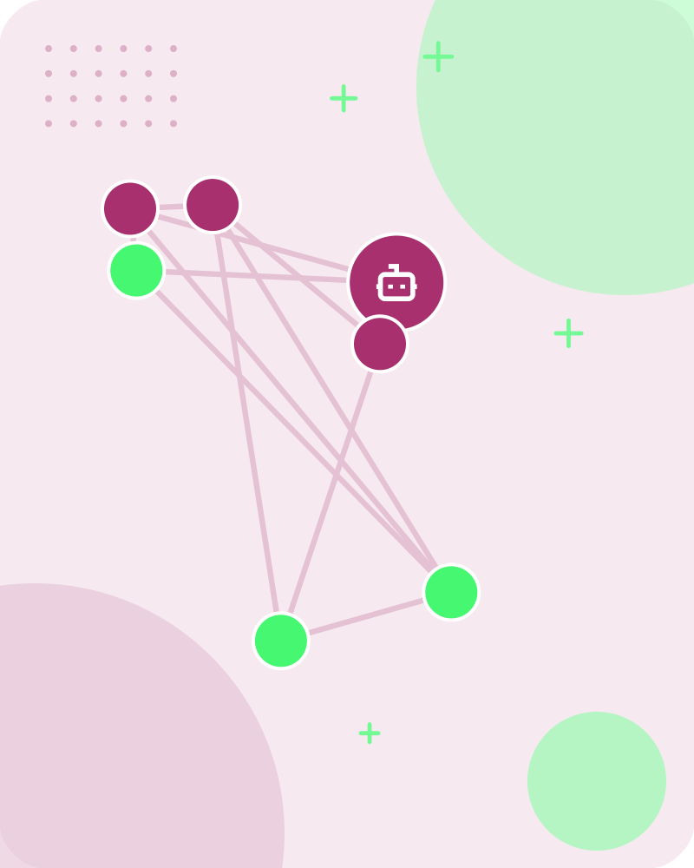

Glossary
Regression
supervised machine learning technique which is used to predict continuous values
Sgd
Stochastic Gradient Descent
Regression analysis
set of statistical methods used for the estimation of relationships between a dependent variable and one or more independent variables
Mbgd
Mini-Batch Gradient Descent
Learnova
68 / 69
Notes:
Reveal, one click at a time:
1. Regression: supervised machine learning technique which is used to predict continuous values
2. Sgd: Stochastic Gradient Descent
3. Regression analysis: set of statistical methods used for the estimation of relationships between a dependent variable an
4. Mbgd: Mini-Batch Gradient Descent
Pause: ask the class what they already know about “Glossary” before revealing the slide.
~40s

Slide 70


Key takeaways
Syllabus
Linear Regression
Linear Regression Model
Relationship Between Variables Is a Linear Function
Gradient descent algorithm
Simultaneous update
ALSO ON THIS SLIDE
Example: XY Have some function Want: J(b,w) Gradient descent/delta rule/LMS method: (for fixed, this is a function of x)
Learnova
69 / 69
Notes:
Reveal, one click at a time:
1. Syllabus: Linear Regression
2. Linear Regression Model: Relationship Between Variables Is a Linear Function
3. Example: XY
4. Have some function Want: J(b,w)
5. Gradient descent/delta rule/LMS method: (for fixed, this is a function of x)
6. Gradient descent/delta rule/LMS method: (for fixed, this is a function of x)
7. Gradient descent algorithm: Simultaneous update
Read these exactly (do not paraphrase):
- Key takeaways Syllabus: Linear Regression Linear Regression Model: Relationship Between Variables Is a Linear Function Example: XY Have some function Want: J(b,w) Gradient descent/delta rule/LMS method: (for fixed, this is a function of x) Gradient descent/delta rule/LMS method: (for fixed, this is a function of x) Gradient descent algorithm: Simultaneous update
Pause: ask the class what they already know about “Key takeaways” before revealing the slide.
Wording matters here — slow down, keep it precise.
~61s

Slide 71
Thank you
Questions?

