Slide 1
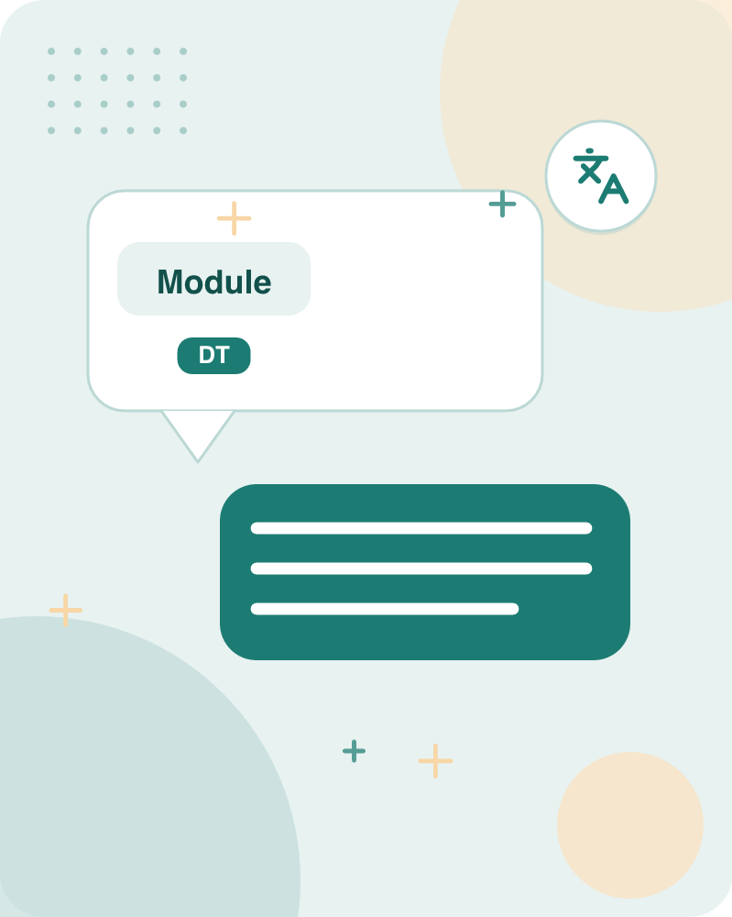
Module 3: Syntax Analysis
By Tina D’abreo • 52 slides

Slide 2
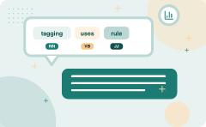
POS tagging uses rule-based, stochastic, and transformation-based methods
POS | Transformation-based
Part-Of-Speech tagging (POS) | Rule-based, Stochastic and Transformation-based tagging
Difficulties /Challenges in POS tagging | Refine initial guesses with learned corrections
(HMM Viterbi) for POS tagging
Tagging assigns grammatical categories to words
Key takeaway: 4 pos compared on transformation-based.
Key terms: Hidden Markov Model — A statistical model that predicts hidden states, like POS tags, from observed data. · Conditional Random Field — A discriminative model that estimates the probability of a sequence of tags given the input.
Learnova
▶ Open the interactive lab: POS Tagging (HMM) Lab
1 / 52
Notes:
Reveal, one click at a time:
1. Part-Of-Speech tagging (POS)
2. Tag set for English (Upenn Treebank)
3. Difficulties /Challenges in POS tagging
4. Rule-based, Stochastic and Transformation-based tagging
5. Generative Model: Hidden Markov Model
6. (HMM Viterbi) for POS tagging
7. Issues in HMM POS tagging
Read these exactly (do not paraphrase):
- POS tagging uses rule-based, stochastic, and transformation-based methods Part-Of-Speech tagging (POS) Tag set for English (Upenn Treebank) Difficulties /Challenges in POS tagging Rule-based, Stochastic and Transformation-based tagging Generative Model: Hidden Markov Model (HMM Viterbi) for POS tagging Issues in HMM POS tagging Discriminative Model: Maximum Entropy model Conditional random Field (CRF), CYK.
Say what these mean, in your own words:
- Hidden Markov Model: A statistical model that predicts hidden states, like POS tags, from observed data.
- Conditional Random Field: A discriminative model that estimates the probability of a sequence of tags given the input.
Pause: ask the class what they already know about “POS tagging uses rule-based, stochastic, and transformation-based methods” before revealing the slide.
~61s
Ask the class: Which step would break the whole process if it failed — and why?

Slide 3

English parts-of-speech include nouns, verbs, adjectives, adverbs, and functional words
Part of Speech | Examples
Nouns | Proper: Ravi, IBM, India; Common: Child, Dog, House
Pronoun
Verbs
Adverbs
Prepositions | in, out, besides, in front of, below, opposite
Adjectives
Conjunctions | and, or, for, yet, although, because, not only
Interjections | oh, wow, alas, yippee (followed by !)
Key takeaway: English parts of speech include nouns, verbs, adjectives, adverbs, pronouns, prepositions, conjunctions, interjections, particles, and determiners.
Key terms: Interjection — A word expressing emotion, often followed by an exclamation mark.
Learnova
2 / 52
Notes:
Reveal, one click at a time:
1. Following are the Parts-of-Speech:
2. Nouns:
3. Proper Nouns – Ravi, IBM, India
4. Common Nouns – Child, Dog, House
5. Pronoun:
6. Verbs
7. Adverbs
Say what these mean, in your own words:
- Interjection: A word expressing emotion, often followed by an exclamation mark.
Pause: ask the class what they already know about “English parts-of-speech include nouns, verbs, adjectives, adverbs, and functional words” before revealing the slide.
~61s
Ask the class: Explain this slide in your own words, in one sentence.

Slide 4
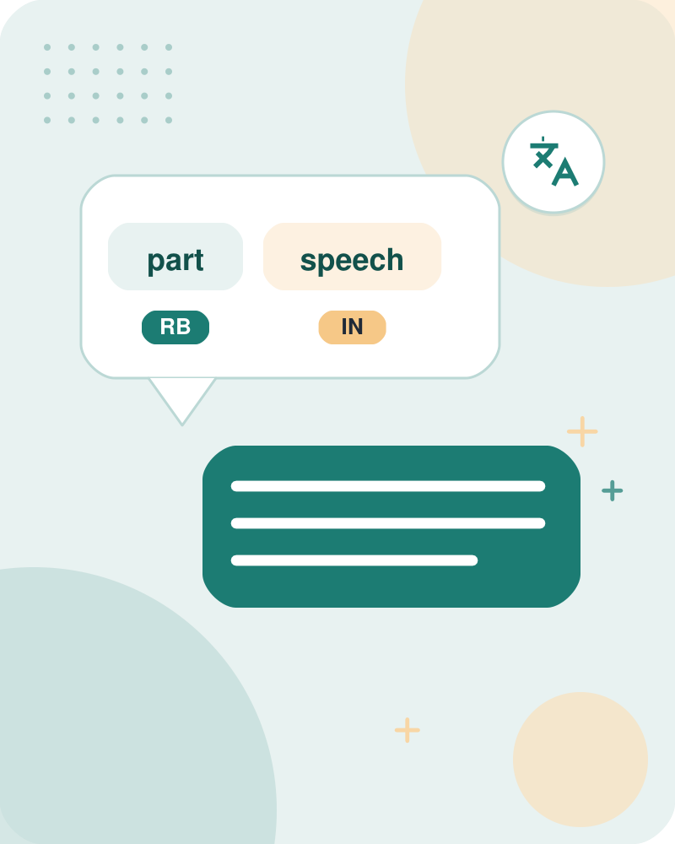



A part-of-speech is a grammatical category grouping words with similar properties
Part‑of‑Speech Definition
A grammatical category grouping words with similar properties.
Four Major Word Classes
Nouns, Verbs, Adjectives, Adverbs.
Example
Both "run" and "jump" belong to the verb class because they describe actions.
ALSO ON THIS SLIDE
In grammar, a part-of-speech (POS) is also called a word class. It groups words that behave similarly in sentences.
Key terms: pos — Part-Of-Speech tagging · Word class — A category of words sharing grammatical functions, such as nouns or verbs.
Learnova
3 / 52
Notes:
Reveal, one click at a time:
1. In grammar, a part-of-speech (POS) is known as word class or grammatical category, which is a category of words that hav
2. The English language has four major word classes:
3. Nouns, Verbs, Adjectives, and Adverbs.
4. In grammar, a part-of-speech (POS) is also called a word class.
5. It groups words that behave similarly in sentences.
6. English has four major classes: nouns, verbs, adjectives, and adverbs.
7. Example: Both "run" and "jump" belong to the verb class because they describe actions.
Read these exactly (do not paraphrase):
- A part-of-speech is a grammatical category grouping words with similar properties In grammar, a part-of-speech (POS) is known as word class or grammatical category, which is a category of words that have similar grammatical properties.
- In grammar, a part-of-speech (POS) is also called a word class.
Say what these mean, in your own words:
- pos: Part-Of-Speech tagging
- Word class: A category of words sharing grammatical functions, such as nouns or verbs.
Pause: ask the class what they already know about “A part-of-speech is a grammatical category grouping words with similar properties” before revealing the slide.
~61s
Ask the class: Give one real-life example of this idea.

Slide 5
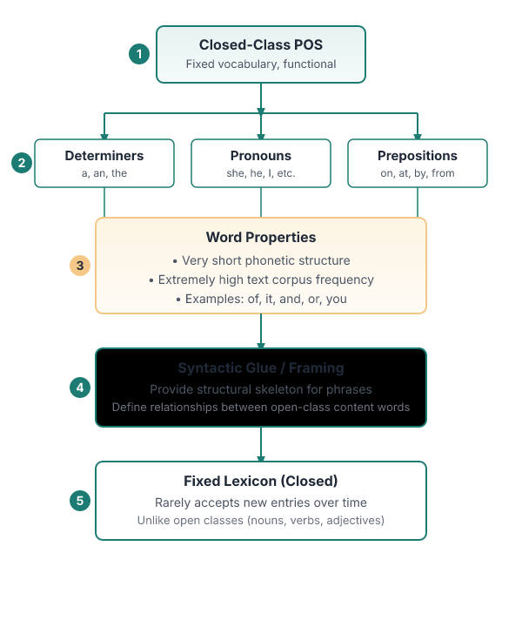



Closed-class parts-of-speech are functional words with a fixed vocabulary
Determiners
a, an, the
Pronouns
she, he, I, others
Prepositions
on, under, over, near, by, at, from, to, with
ALSO ON THIS SLIDE
Parts-of-speech can be divided into two broad supercategories: Closed class types Closed classes are those with a relatively fixed/number of words, and we rarely add new words to these POS, such as prepositions. Closed class words are generally functional words like of, it, and, or you, which tend to be very short, occur frequently, and often have structuring uses in grammar.
Key terms: Closed class — A POS group with a limited, stable set of words, like prepositions.
Learnova
4 / 52
Notes:
Reveal, one click at a time:
1. Parts-of-speech can be divided into two broad supercategories:
2. Closed class types
3. Closed classes are those with a relatively fixed/number of words, and we rarely add new words to these POS, such as prep
4. Closed class words are generally functional words like of, it, and, or you, which tend to be very short, occur frequentl
5. Example of closed class-
6. Determiners: a, an, the
7. Pronouns: she, he, I, others
Say what these mean, in your own words:
- Closed class: A POS group with a limited, stable set of words, like prepositions.
Pause: ask the class what they already know about “Closed-class parts-of-speech are functional words with a fixed vocabulary” before revealing the slide.
~61s
Ask the class: Explain this slide in your own words, in one sentence.

Slide 6
Checkpoint 1
QUESTION · UNDERSTAND
Which term matches this description: “A POS group with a limited, stable set of words, like prepositions.”?
Tag
Taggit
A
B
JIS
Closed class
C
D
Answer: D
Closed class: A POS group with a limited, stable set of words, like prepositions.
Learnova
5 / 52
Notes:
KEY POINT TO LAND: Answer, then check your reasoning.
Pause: ask the class what they already know about “Checkpoint 1” before revealing the slide.
~44s

Slide 7
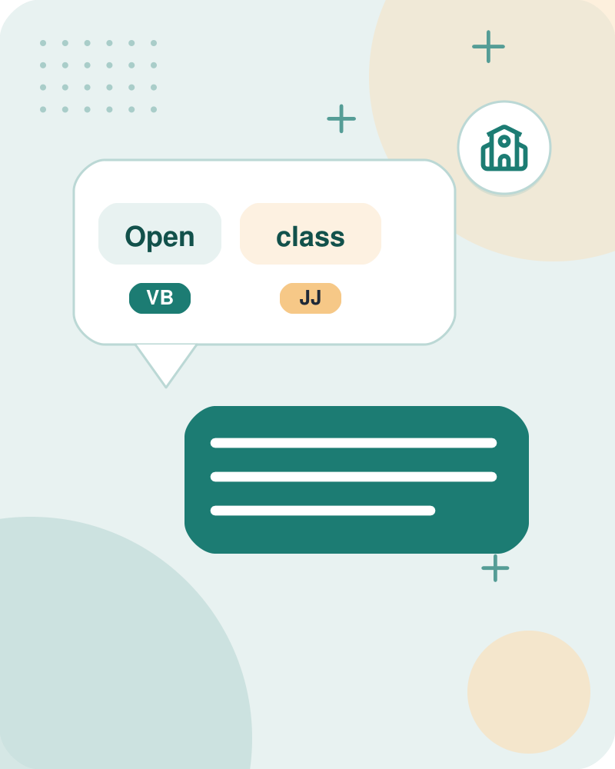



Open-class parts-of-speech are content words that expand over time
Nouns
computer, board, peace, school
Verbs
say, walk, run, belong
Adjectives
clean, quick, rapid, enormous
Adverbs
quickly, softly, enormously, cheerfully
ALSO ON THIS SLIDE
Parts-of-speech can be divided into two broad supercategories: Open class types Open Classes are mostly content-bearing, i.e., they refer to objects, actions, and features; it's called open classes since new words are added all the time. By contrast, nouns and verbs, adjectives, and adverbs belong to open classes; new nouns and verbs like iPhone or to fax are continually being created or borrowed.
Key terms: Open class — A POS group that regularly gains new words, such as nouns and verbs.
Learnova
6 / 52
Notes:
Reveal, one click at a time:
1. Parts-of-speech can be divided into two broad supercategories:
2. Open class types
3. Open Classes are mostly content-bearing, i.e., they refer to objects, actions, and features; it's called open classes si
4. By contrast, nouns and verbs, adjectives, and adverbs belong to open classes; new nouns and verbs like iPhone or to fax
5. Example of open class-
6. Nouns: computer, board, peace, school
7. Verbs: say, walk, run, belong
Read these exactly (do not paraphrase):
- Open-class parts-of-speech are content words that expand over time Parts-of-speech can be divided into two broad supercategories: Open class types Open Classes are mostly content-bearing, i.e., they refer to objects, actions, and features; it's called open classes since new words are added all the time.
- By contrast, nouns and verbs, adjectives, and adverbs belong to open classes; new nouns and verbs like iPhone or to fax are continually being created or borrowed.
Say what these mean, in your own words:
- Open class: A POS group that regularly gains new words, such as nouns and verbs.
Pause: ask the class what they already know about “Open-class parts-of-speech are content words that expand over time” before revealing the slide.
Wording matters here — slow down, keep it precise.
~61s
Ask the class: Explain this slide in your own words, in one sentence.

Slide 8
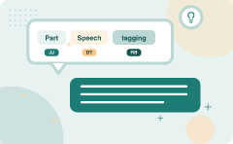
Part-Of-Speech tagging (POS) (5/8)
Word | POS Category
Our | Pronoun
Dog, cat, home | Noun
A, the | Determiners
Brown | Adjective
Away | Adverb
From | Preposition
Key takeaway: POS tagging assigns specific grammatical categories to individual words within a sentence based on their context.
Learnova
▶ Open the interactive lab: POS Tagging (HMM) Lab
7 / 52
Notes:
Read these exactly (do not paraphrase):
- Part-Of-Speech tagging (POS) (5/8)
Full detail (from the source):
- Part-of-Speech (POS) tagging is a natural language processing technique that involves assigning specific grammatical categories or labels (such as nouns, verbs, adjectives, adverbs, pronouns, etc.) to individual words within a sentence.
- Example: “Our dog chased a brown cat away from the home” [TABLE DATA] | Word | POS Category | | --- | --- | | Our | Pronoun | | Dog, cat, home | Noun | | A, the | Determiners | | Brown | Adjective | | Away | Adverb | | From | Preposition |
Wording matters here — slow down, keep it precise.
~19s

Slide 9

Part-Of-Speech tagging (POS) (6/8)
POS Category | Word
Noun (N) | Boy, toys, bag
Determiners (Det) | the
Verb (V) | put
Preposition (P) | in
Key takeaway: The POS tagging problem requires identifying the actual grammatical category for each word in an English text.
Learnova
8 / 52
Notes:
Read these exactly (do not paraphrase):
- Part-Of-Speech tagging (POS) (6/8)
Full detail (from the source):
- Part-of-Speech (POS) tagging problem is defined as a problem to identify the actual category for each of the word.
- Given a text in english, identify the parts of speech of each word in the sentence - “The boy put the toys in the bag” [TABLE DATA] | POS Category | Word | | --- | --- | | Noun (N) | Boy, toys, bag | | Determiners (Det) | the | | Verb (V) | put | | Preposition (P) | in |
Wording matters here — slow down, keep it precise.
~19s

Slide 10

POS tagging requires tokenization to separate punctuation from words
Part-of-speech tagging
The process of assigning a part-of-speech or other syntactic class marker to each word in a corpus
Because tags are generally also applied to punctuation, tagging requires that the punctuation marks (period, comma, etc) be separated off of the words
Thus tokenization o is usually performed before, or as part of, the tagging process, separating commas, quotation marks, etc., from words, and disambiguating end-of-sentence punctuation
Key takeaway: The process of assigning a part-of-speech or other syntactic class marker to each word in a corpus.
Key terms: Tokenization — The process of splitting text into words and punctuation marks.
Learnova
9 / 52
Notes:
Read these exactly (do not paraphrase):
- POS tagging requires tokenization to separate punctuation from words Part-of-speech tagging (or just tagging for short) is the process of assigning a part-of-speech or other syntactic class marker to each word in a corpus.
- Because tags are generally also applied to punctuation, tagging requires that the punctuation marks (period, comma, etc) be separated off of the words.
Say what these mean, in your own words:
- Tokenization: The process of splitting text into words and punctuation marks.
Pause: ask the class what they already know about “POS tagging requires tokenization to separate punctuation from words” before revealing the slide.
Wording matters here — slow down, keep it precise.
~19s
Ask the class: Give one real-life example of this idea.

Slide 11
Checkpoint 2
QUESTION · UNDERSTAND
Which term matches this description: “The process of splitting text into words and punctuation marks.”?
Tokenization
cc
A
B
Rule-based tagger
Hidden Markov Model
C
D
Answer: A
Tokenization: The process of splitting text into words and punctuation marks.
Learnova
10 / 52
Notes:
KEY POINT TO LAND: Answer, then check your reasoning.
Pause: ask the class what they already know about “Checkpoint 2” before revealing the slide.
~44s

Slide 12
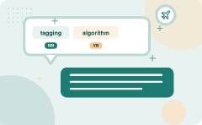
A tagging algorithm outputs the best tag for each word in a string
ALSO ON THIS SLIDE
The input to tagging algorithm is a string of words and a specific tagset. The output is a single best tag for each word. Example: The input is a sequence of words and a predefined tagset.
Key takeaway: A tagging algorithm takes a string of words and a predefined tagset to output the single best tag per word.
Key terms: Tagset — A predefined list of possible part-of-speech tags.
Learnova
11 / 52
Notes:
Reveal, one click at a time:
1. The input to tagging algorithm is a string of words and a specific tagset. The output is a single best tag for each word
2. Example:
3. Book/VB that/DT flight/NN
4. Does/VBZ that/DT flight/NN serve/VB dinner/NN?/.
5. The input is a sequence of words and a predefined tagset.
6. The algorithm assigns one tag per word, producing a labeled sentence such as Book/VB that/DT flight/NN.
7. Example: Input: "Book that flight" → Output: Book/VB that/DT flight/NN.
Read these exactly (do not paraphrase):
- Example: Input: "Book that flight" → Output: Book/VB that/DT flight/NN.
Say what these mean, in your own words:
- Tagset: A predefined list of possible part-of-speech tags.
Pause: ask the class what they already know about “A tagging algorithm outputs the best tag for each word in a string” before revealing the slide.
~61s
Ask the class: Explain this slide in your own words, in one sentence.

Slide 13
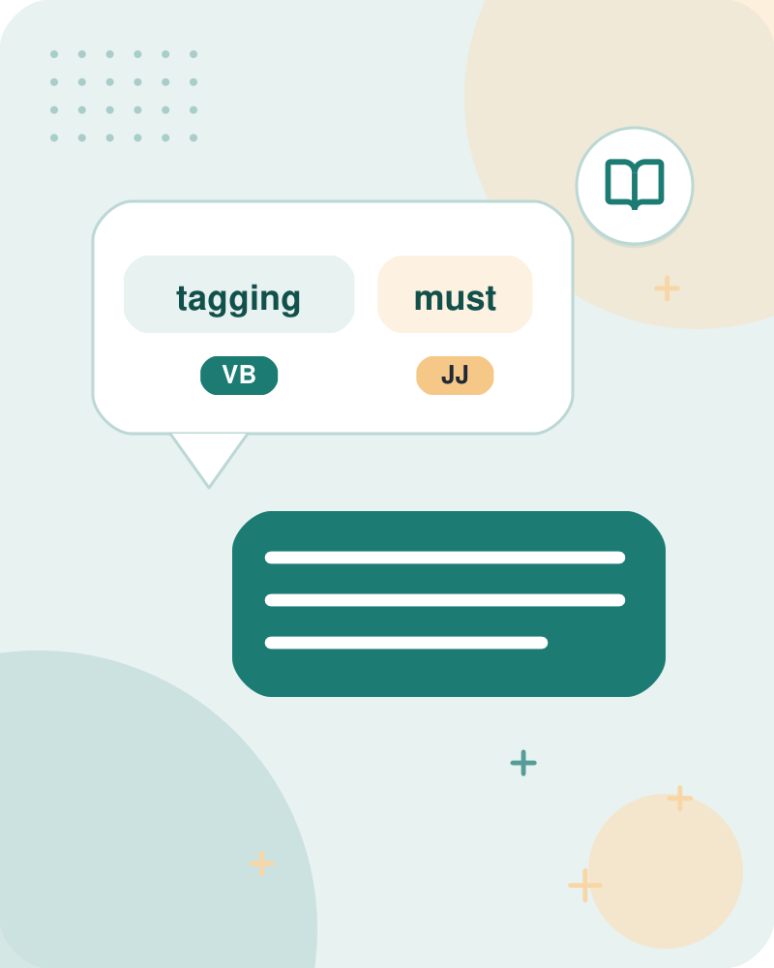
POS tagging must resolve word ambiguities using context
Tagging decisions are difficult to make.
Automatically assigning tags to the words is not trivial.
E.G. For example, book is ambiguous.
That is, it has more than one possible usage and part-of-speech.
It can be a verb (as in book that flight or to book the suspect) or a noun (as in hand me that book, or a book of matches).
ALSO Similarly that can be a determiner (as in Does that flight serve dinner), or a complementizer (as in I thought that your flight was earlier).
The problem of POS-tagging is to resolve these ambiguities, choosing the proper tag for the context.
Key takeaway: POS tagging must resolve word ambiguities by choosing the proper part-of-speech tag for the specific context.
Key terms: Ambiguity — A word having multiple possible part-of-speech tags.
Learnova
12 / 52
Notes:
Reveal, one click at a time:
1. Tagging decisions are difficult to make.
2. Automatically assigning tags to the words is not trivial
3. For example, book is ambiguous
4. That is, it has more than one possible usage and part-of-speech.
5. It can be a verb (as in book that flight or to book the suspect) or a noun (as in hand me that book, or a book of matche
6. Similarly that can be a determiner (as in Does that flight serve dinner), or a complementizer (as in I thought that your
7. The problem of POS-tagging is to resolve these ambiguities, choosing the proper tag for the context.
Read these exactly (do not paraphrase):
- It can be a verb (as in book that flight or to book the suspect) or a noun (as in hand me that book, or a book of matches).
- Similarly that can be a determiner (as in Does that flight serve dinner), or a complementizer (as in I thought that your flight was earlier).
Say what these mean, in your own words:
- Ambiguity: A word having multiple possible part-of-speech tags.
Pause: ask the class what they already know about “POS tagging must resolve word ambiguities using context” before revealing the slide.
Wording matters here — slow down, keep it precise.
~61s
Ask the class: Explain this slide in your own words, in one sentence.

Slide 14
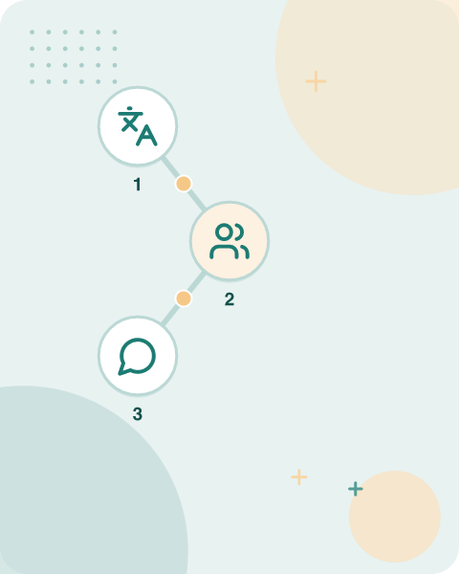
Many common English words are ambiguous and need contextual disambiguation
Most
UNAMBIGUOUS WORDS
Only a single tag.
Many
AMBIGUOUS WORDS
e.g., can: auxiliary, noun, verb.
IN PLAIN WORDS
Although most words have a single tag, frequent words like "can" can be a noun, verb, or auxiliary. Taggers must choose the correct tag based on surrounding words. For example, "Can" in "I can swim" is a verb, while in "a can of soda" it is a noun.
For example ‘can’ can be an auxiliary (‘to be able’), A noun (‘a metal container’), or A verb (‘to put something in such a metal container’)).
Key terms: Auxiliary — A helping verb that modifies the main verb, such as "can" in "can swim".
Learnova
13 / 52
Notes:
Reveal, one click at a time:
1. Most words in English are unambiguous; i.e., they have only a single tag.
2. But many of the most common words of English are ambiguous
3. For example ‘can’ can be an auxiliary (‘to be able’),
4. A noun (‘a metal container’), or
5. A verb (‘to put something in such a metal container’)).
Read these exactly (do not paraphrase):
- Many common English words are ambiguous and need contextual disambiguation Most words in English are unambiguous; i.e., they have only a single tag.
- But many of the most common words of English are ambiguous For example ‘can’ can be an auxiliary (‘to be able’), A noun (‘a metal container’), or A verb (‘to put something in such a metal container’)).
Say what these mean, in your own words:
- Auxiliary: A helping verb that modifies the main verb, such as "can" in "can swim".
Pause: ask the class what they already know about “Many common English words are ambiguous and need contextual disambiguation” before revealing the slide.
Wording matters here — slow down, keep it precise.
~47s
Ask the class: Explain this slide in your own words, in one sentence.

Slide 15
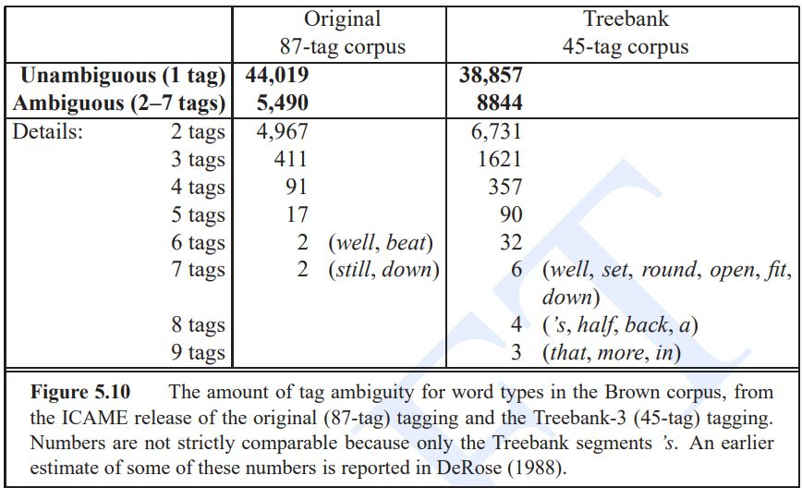
Difficulties /Challenges in POS tagging (continued)
Learnova
14 / 52
Notes:
Read these exactly (do not paraphrase):
- Difficulties /Challenges in POS tagging (continued)
Pause: ask the class what they already know about “Difficulties /Challenges in POS tagging (continued)” before revealing the slide.
Wording matters here — slow down, keep it precise.
~19s
Text in the figure: ee Original Treebank Unambiguous (1 tag)} 44,019 38,857 4,967 6,731 411 1621 91 357 17 90 2 (well, beat) 32 2 (still, down) 6 (well, set, round, open, fit, down) 4 (’s, half, back, a) 3 (that, more, in) Figure 5.10 The amount of tag ambiguity for word types in the Brown corpus, from the ICAME release of the original (87-tag) tagging and the Treebank-3 (45-tag) tagging. Numbers are not strictly comparable because only the Treebank segments An earlier estimate of some of these numbers is reported in DeRose (1988).
Ask the class: What might explain these numbers?

Slide 16
Checkpoint 3
QUESTION · UNDERSTAND
Which term matches this description: “A helping verb that modifies the main verb, such as "can" in "can swim".”?
Auxiliary
JIS
A
B
n-gram
VB
C
D
Answer: A
Auxiliary: A helping verb that modifies the main verb, such as "can" in "can swim".
Learnova
15 / 52
Notes:
KEY POINT TO LAND: Answer, then check your reasoning.
Pause: ask the class what they already know about “Checkpoint 3” before revealing the slide.
~44s

Slide 17
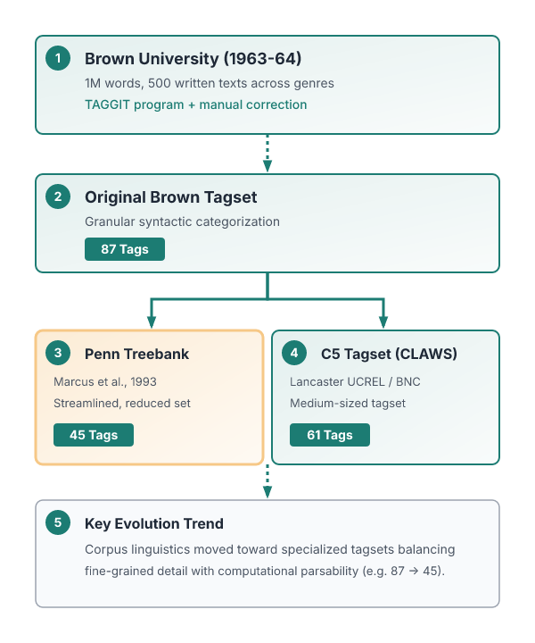




English tagsets evolved from the 87-tag Brown corpus to the 45-tag Penn Treebank
87
THERE ARE SMALL NUMBER OF POPULAR
There are small number of popular tagsets for English, many of which evolved from the 87-tag tagset used for the Brown corpus
1 million
WORD COLLECTION
Brown Corpus is a 1 million word collection of samples from 500 written texts from different genres which was assembled at Brown University in 1963-64
500
WRITTEN TEXTS
64
WRITTEN TEXTS
ALSO ON THIS SLIDE
Besides this original Brown tagset, two of the most commonly used tagsets are: The small 45-tag Penn Treebank tagset (Marcus et al., 1993), The medium-sized 61 tag C5 tagset used by the Lancaster UCREL project’s CLAWS (the Constituent Likelihood Automatic Word-tagging System) tagger to tag the British National Corpus
Key takeaway: English tagsets evolved from the 87-tag Brown corpus to the 45-tag Penn Treebank and 61-tag C5 tagsets.
Key terms: Taggit — first large rule-based tagger that used context-pattern rules · Brown Corpus — A 1-million-word collection of diverse texts used for early POS tagging.
Learnova
16 / 52
Notes:
Reveal, one click at a time:
1. There are small number of popular tagsets for English, many of which evolved from the 87-tag tagset used for the Brown c
2. Brown Corpus is a 1 million word collection of samples from 500 written texts from different genres which was assembled
3. This corpus was tagged with parts-of-speech by first applying the TAGGIT program and then hand-correcting the tags. → Br
4. Besides this original Brown tagset, two of the most commonly used tagsets are:
5. The small 45-tag Penn Treebank tagset (Marcus et al., 1993),
6. The medium-sized 61 tag C5 tagset used by the Lancaster UCREL project’s CLAWS (the Constituent Likelihood Automatic Word
Read these exactly (do not paraphrase):
- English tagsets evolved from the 87-tag Brown corpus to the 45-tag Penn Treebank There are small number of popular tagsets for English, many of which evolved from the 87-tag tagset used for the Brown corpus Brown Corpus is a 1 million word collection of samples from 500 written texts from different genres which was assembled at Brown University in 1963-64.
- → Brown Corpus Tagset Besides this original Brown tagset, two of the most commonly used tagsets are: The small 45-tag Penn Treebank tagset (Marcus et al., 1993), The medium-sized 61 tag C5 tagset used by the Lancaster UCREL project’s CLAWS (the Constituent Likelihood Automatic Word-tagging System) tagger to tag the British National Corpus
Say what these mean, in your own words:
- Taggit: first large rule-based tagger that used context-pattern rules
- Brown Corpus: A 1-million-word collection of diverse texts used for early POS tagging.
Pause: ask the class what they already know about “English tagsets evolved from the 87-tag Brown corpus to the 45-tag Penn Treebank” before revealing the slide.
Wording matters here — slow down, keep it precise.
~54s
Ask the class: What might explain these numbers?

Slide 18


Tag Description Example lists part-of-speech tags with sample words
Clear tag mapping
Large tag set
ALSO ON THIS SLIDE
Tag Description Example | Tag Description Example CE Coordin. Conjunction and, but, or Symbol +,%, & CD Cardinal number one, two, three “to” to DT Determiner a, the Interjection ah, oops EX Existential ‘there’ there Verb, base form eat FW Foreign word mea culpa Verb, past tense ate IN Preposition/sub-conj in, by Verb, gerund eating JJ Adjective yellow Verb, past participle eaten
Key takeaway: Standard tag sets list specific descriptions and sample words for categories like conjunctions, determiners, and verbs.
Key terms: Tag — A label indicating a word's grammatical category · POS — Part-of-speech, the grammatical function of a word
Learnova
17 / 52
Notes:
Say what these mean, in your own words:
- Tag: A label indicating a word's grammatical category
- POS: Part-of-speech, the grammatical function of a word
Pause: ask the class what they already know about “Tag Description Example lists part-of-speech tags with sample words” before revealing the slide.
~19s
Ask the class: Explain this slide in your own words, in one sentence.

Slide 19
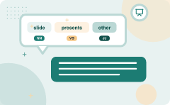
Adj slide presents comparative, superlative, and other adjective forms
RP Particle up, off Figure 5.6 Penn Treebank part-of-speech tags (including punctuation).
JIS Adj., superlative wildest Verb, 3sg pres eats LS List item marker 1, 2, One Wh-determiner which, that MD Modal can, should Wh-pronoun what, who NN Noun, sing. or mass llama Possessive wh- whose
Noun, plural llamas Wh-adverb how, where
NNP Proper noun, singular Dollar sign NNPS Proper noun, plural Carolinas Pound sign # PDT all, both Left quote * or “ POS Possessive ending Right quote or” PRP Personal pronoun I, you, he Left parenthesis PRP _ Possessive pronoun your, one’s Right parenthesis RB Adverb quickly, never Comma 5
Adverb, comparative _faster; Sentence-final punc.!?
  superlative —_fastest Mid-sentence —-
Key terms: Adj. — Abbreviation for adjective, a word describing a noun · JIS — Abbreviation for superlative adjective, the highest degree
Learnova
18 / 52
Notes:
Reveal, one click at a time:
1. Adj., comparative bigger Verb, non-3sg pres
2. JIS Adj., superlative wildest Verb, 3sg pres eats LS List item marker 1, 2, One Wh-determiner which, that MD Modal can,
3. Noun, plural llamas Wh-adverb how, where
4. NNP Proper noun, singular Dollar sign $ NNPS Proper noun, plural Carolinas Pound sign # PDT all, both Left quote * or “
5. Adverb, comparative _faster; Sentence-final punc.!?
6. superlative —_fastest Mid-sentence —-
7. RP Particle up, off Figure 5.6 Penn Treebank part-of-speech tags (including punctuation).
Read these exactly (do not paraphrase):
- or mass llama Possessive wh- whose Noun, plural llamas Wh-adverb how, where NNP Proper noun, singular Dollar sign $ NNPS Proper noun, plural Carolinas Pound sign # PDT all, both Left quote * or “ POS Possessive ending Right quote or” PRP Personal pronoun I, you, he Left parenthesis PRP$ _ Possessive pronoun your, one’s Right parenthesis RB Adverb quickly, never Comma 5 Adverb, comparative _faster; Sentence-final punc.!?
- superlative —_fastest Mid-sentence —- RP Particle up, off Figure 5.6 Penn Treebank part-of-speech tags (including punctuation).
Say what these mean, in your own words:
- Adj.: Abbreviation for adjective, a word describing a noun
- JIS: Abbreviation for superlative adjective, the highest degree
Pause: ask the class what they already know about “Adj slide presents comparative, superlative, and other adjective forms” before revealing the slide.
Wording matters here — slow down, keep it precise.
~61s
Ask the class: Explain this slide in your own words, in one sentence.

Slide 20
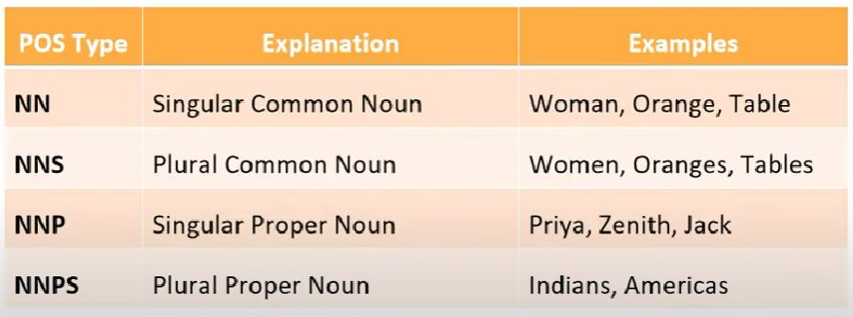
Tag set for English: Noun Types
Learnova
19 / 52
Notes:
Pause: ask the class what they already know about “Tag set for English: Noun Types” before revealing the slide.
~19s
Text in the figure: NN Singular Common Noun Woman, Orange, Table
NNS Plural Common Noun Women, Oranges, Tables
NNP Singular Proper Noun Priya, Zenith, Jack
NNPS Plural Proper Noun Indians, Americas
Ask the class: Explain this slide in your own words, in one sentence.

Slide 21
Checkpoint 4
QUESTION · UNDERSTAND
Which term matches this description: “Abbreviation for adjective, a word describing a noun”?
Tokenization
RB
A
B
Adj.
cc
C
D
Answer: C
Adj.: Abbreviation for adjective, a word describing a noun
Learnova
20 / 52
Notes:
KEY POINT TO LAND: Answer, then check your reasoning.
Pause: ask the class what they already know about “Checkpoint 4” before revealing the slide.
~44s

Slide 22
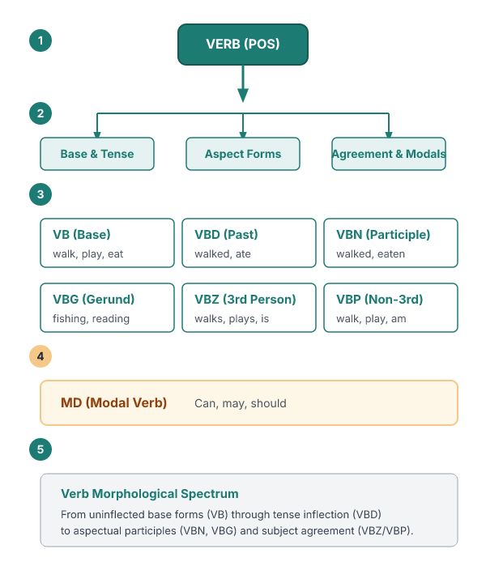



POS Type slide explains verb forms and their tense or aspect
VB Base form of a Verb walk, play, eat, read
VBD Past Tense of a Verb Walked, played, ate, read
VBG Gerund form of a Verb fishing, walking, reading
VBZ 3'4 person verb on present tense Walks, plays, eats, read, is
VBP Non 34 person verb on present tense Walk, play, eat, read, am, are
ALSO ON THIS SLIDE
MD Modal Verb Can, may, should
Key terms: VB — Base form of a verb, used in infinitives · VBD — Past tense form of a verb, indicating completed action
Learnova
21 / 52
Notes:
Reveal, one click at a time:
1. VB Base form of a Verb walk, play, eat, read
2. VBD Past Tense of a Verb Walked, played, ate, read
3. VBN Past Participle of a Verb Walked, played, eaten, read
4. VBG Gerund form of a Verb fishing, walking, reading
5. VBZ 3'4 person verb on present tense Walks, plays, eats, read, is
6. VBP Non 34 person verb on present tense Walk, play, eat, read, am, are
7. MD Modal Verb Can, may, should
Say what these mean, in your own words:
- VB: Base form of a verb, used in infinitives
- VBD: Past tense form of a verb, indicating completed action
Pause: ask the class what they already know about “POS Type slide explains verb forms and their tense or aspect” before revealing the slide.
~61s
Ask the class: Explain this slide in your own words, in one sentence.

Slide 23

POS Type slide details adjective and adverb comparative and superlative forms
POS Type | Explanation | Examples
JIS Superlative Adjective Best, smallest, fastest
RB Adverb Back, behind, fast, slow
JJ Adjective Intelligent, small, fast
Comparative Adjective Better, smaller, faster
RBR Comparative Adverb Slower, faster
RBS Superlative Adverb Slowest, fastest
Key terms: JJ — Adjective, a word that modifies a noun · RB — Adverb, a word that modifies a verb, adjective, or other adverb
Learnova
22 / 52
Notes:
Reveal, one click at a time:
1. POS Type | Explanation | Examples
2. JJ Adjective Intelligent, small, fast
3. Comparative Adjective Better, smaller, faster
4. JIS Superlative Adjective Best, smallest, fastest
5. RB Adverb Back, behind, fast, slow
6. RBR Comparative Adverb Slower, faster
7. RBS Superlative Adverb Slowest, fastest
Say what these mean, in your own words:
- JJ: Adjective, a word that modifies a noun
- RB: Adverb, a word that modifies a verb, adjective, or other adverb
Pause: ask the class what they already know about “POS Type slide details adjective and adverb comparative and superlative forms” before revealing the slide.
~61s
Ask the class: Explain this slide in your own words, in one sentence.

Slide 24
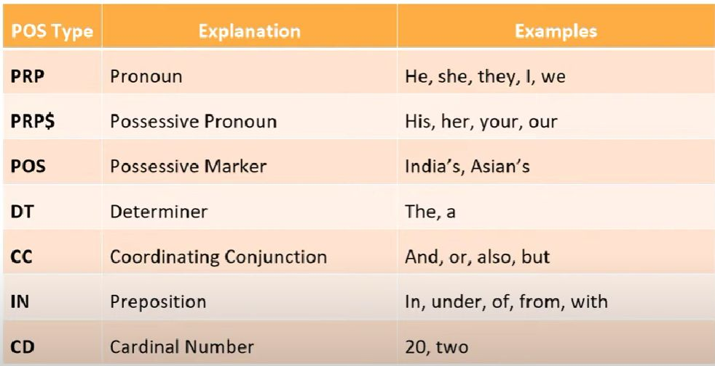
Pronoun, Determiner, Preposition slide lists these three word classes
Learnova
23 / 52
Notes:
Say what these mean, in your own words:
- Pronoun: A word that replaces a noun or noun phrase
- Preposition: A word that shows relationship between nouns or pronouns
Pause: ask the class what they already know about “Pronoun, Determiner, Preposition slide lists these three word classes” before revealing the slide.
~19s
Text in the figure: POS Type Explanation Examples PRP Pronoun He, she, they, |, we PRPS Possessive Pronoun His, her, your, our POS Possessive Marker India’s, Asian’s DT Determiner The, a cc Coordinating Conjunction And, or, also, but IN Preposition In, under, of, from, with cD Cardinal Number 20, two
Ask the class: Explain this slide in your own words, in one sentence.

Slide 25
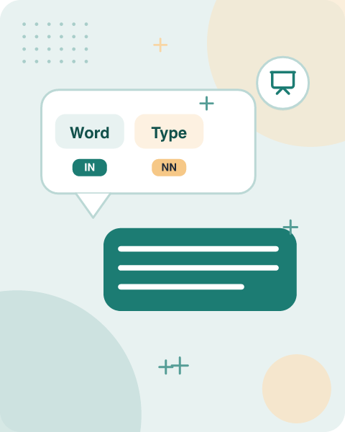


Word POS Type slide shows a sentence with each word’s grammatical tag
Word POS Type Explanation
I PRP Pronoun
al VBP Non 3 person verb on present tense a DT Determiner girl NN Singular Common Noun
Statement: Kavya is a intelligent girl
NNP Singular Proper Noun
Key terms: PRP — Personal pronoun, referring to a person or thing · DT — Determiner, a word that introduces a noun
Learnova
24 / 52
Notes:
Reveal, one click at a time:
1. Word POS Type Explanation
2. I PRP Pronoun
3. al VBP Non 3 person verb on present tense a DT Determiner girl NN Singular Common Noun
4. Statement: Kavya is a intelligent girl.
5. NNP Singular Proper Noun
6. ea VBZ (Aux. verb) person verb on present tense a DT Determiner
Read these exactly (do not paraphrase):
- NNP Singular Proper Noun ea VBZ (Aux.
- verb) person verb on present tense a DT Determiner
Say what these mean, in your own words:
- PRP: Personal pronoun, referring to a person or thing
- DT: Determiner, a word that introduces a noun
Pause: ask the class what they already know about “Word POS Type slide shows a sentence with each word’s grammatical tag” before revealing the slide.
Wording matters here — slow down, keep it precise.
~54s
Ask the class: Explain this slide in your own words, in one sentence.

Slide 26
Checkpoint 5
QUESTION · UNDERSTAND
Which term matches this description: “Personal pronoun, referring to a person or thing”?
cc
PRP
A
B
Tag
Hidden Markov Model
C
D
Answer: B
PRP: Personal pronoun, referring to a person or thing
Learnova
25 / 52
Notes:
KEY POINT TO LAND: Answer, then check your reasoning.
Pause: ask the class what they already know about “Checkpoint 5” before revealing the slide.
~44s

Slide 27

Word POS Type slide demonstrates verb tense tagging in simple sentences
Statement: She plays tennis.
She PRP Pronoun
Play VBP Non 34 person verb on present tense
Statement: They play football.
Word POS Type Explanation
They PRP Pronoun
Football NN Singular Common Noun
Key takeaway: Simple sentence analysis demonstrates tagging pronoun, verb tense, and singular common noun categories.
Key terms: VBZ — Verb, third person singular present tense · VBP — Verb, non-third person singular present tense
Learnova
26 / 52
Notes:
Reveal, one click at a time:
1. Statement: She plays tennis.
2. She PRP Pronoun
3. plays VBZ person verb on present tense
4. tennis NN Singular Common Noun
5. Statement: They play football.
6. Word POS Type Explanation
7. They PRP Pronoun
Say what these mean, in your own words:
- VBZ: Verb, third person singular present tense
- VBP: Verb, non-third person singular present tense
Pause: ask the class what they already know about “Word POS Type slide demonstrates verb tense tagging in simple sentences” before revealing the slide.
~61s
Ask the class: Explain this slide in your own words, in one sentence.

Slide 28
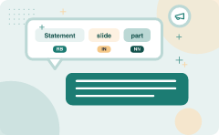
Statement slide illustrates part-of-speech tags for a complex sentence
For IN Preposition Something NN Singular Common Noun completely RB Adverb different JJ Adjective
Statement: And now for something completely different
POS Type Explanation
And cc Coordinating Conjunction
Now RB Adverb
Key takeaway: Complex sentences contain diverse POS tags including coordinating conjunctions, adverbs, prepositions, and adjectives.
Key terms: cc — Coordinating conjunction, linking clauses or phrases · RB — Adverb, modifying verbs, adjectives, or other adverbs
Learnova
27 / 52
Notes:
Reveal, one click at a time:
1. Statement: And now for something completely different
2. POS Type Explanation
3. And cc Coordinating Conjunction
4. now RB Adverb
5. for IN Preposition Something NN Singular Common Noun completely RB Adverb different JJ Adjective
Say what these mean, in your own words:
- cc: Coordinating conjunction, linking clauses or phrases
- RB: Adverb, modifying verbs, adjectives, or other adverbs
Pause: ask the class what they already know about “Statement slide illustrates part-of-speech tags for a complex sentence” before revealing the slide.
~47s
Ask the class: Explain this slide in your own words, in one sentence.

Slide 29
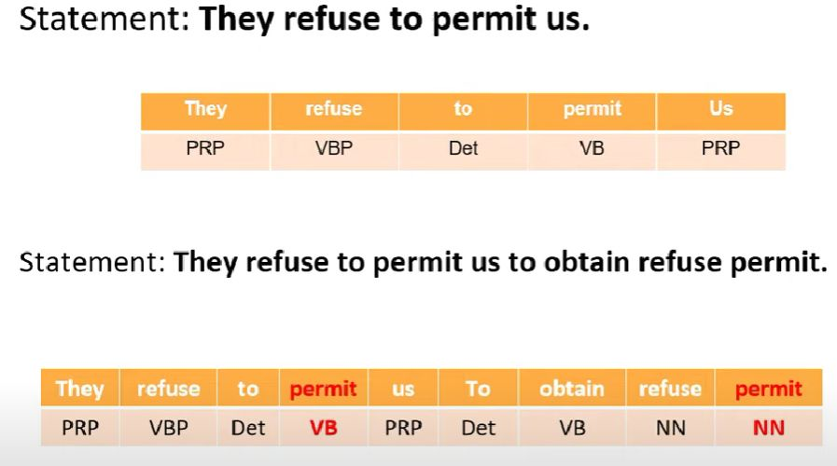
Tag set for English
Learnova
28 / 52
Notes:
Pause: ask the class what they already know about “Tag set for English” before revealing the slide.
~19s
Text in the figure: Statement: They refuse to permit us. They | refuse to permit Us PRP VBP Det VB PRP Statement: They refuse to permit us to obtain refuse permit. They | refuse | to us To obtain | refuse PRP VBP Det VB PRP Det VB NN NN
Ask the class: Explain this slide in your own words, in one sentence.

Slide 30
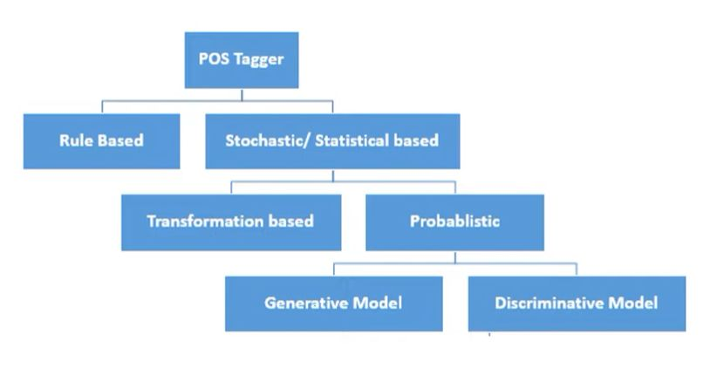
POS Taggers
[ a ; 1 Rule Based Stochastic/ Statistical based i L 7 Transformation based Probablistic i L 7
Learnova
29 / 52
Notes:
Pause: ask the class what they already know about “POS Taggers” before revealing the slide.
~19s
Text in the figure: POS Tagger 1 Rule Based Stochastic/ Statistical based
Ask the class: Explain this slide in your own words, in one sentence.

Slide 31
Checkpoint 6
QUESTION · UNDERSTAND
Which term matches this description: “Coordinating conjunction, linking clauses or phrases”?
cc
Hidden Markov Model
A
B
VBD
Tag
C
D
Answer: A
cc: Coordinating conjunction, linking clauses or phrases
Learnova
30 / 52
Notes:
KEY POINT TO LAND: Answer, then check your reasoning.
Pause: ask the class what they already know about “Checkpoint 6” before revealing the slide.
~44s

Slide 32
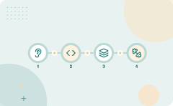
Rule-based tagger slide explains a two-stage tagging algorithm using dictionaries and rules
Rule-based | Rules
Part-of-speech tagging is the oldest approach that uses hand written | For tagging
Taggers depends on dictionary or lexicon to get possible tags for each word to be tagged | The second stage used large lists of hand-written disambiguation rules to winnow down this list to a single part-of-speech for each word
Key takeaway: Rule-based taggers use a two-stage architecture with dictionaries and hand-written disambiguation rules to tag words.
Key terms: Rule-based tagger — A POS tagger that uses hand-written rules for disambiguation · Lexicon — A dictionary of words with possible part-of-speech tags
Learnova
31 / 52
Notes:
Reveal, one click at a time:
1. Rule-based part-of-speech tagging is the oldest approach that uses hand written rules for tagging
2. Rule-based taggers depends on dictionary or lexicon to get possible tags for each word to be tagged.
3. This algorithm automatically assigns part-of-speech that were based on a two stage architecture (Harris, 1962; Klein and
4. The first stage used a dictionary to assign each word a list of potential parts-of-speech.
5. The second stage used large lists of hand-written disambiguation rules to winnow down this list to a single part-of-spee
6. Example:
7. I want to play/VB a sport on weekend
Read these exactly (do not paraphrase):
- This algorithm automatically assigns part-of-speech that were based on a two stage architecture (Harris, 1962; Klein and Simmons, 1963; Greene and Rubin, 1971).
Say what these mean, in your own words:
- Rule-based tagger: A POS tagger that uses hand-written rules for disambiguation
- Lexicon: A dictionary of words with possible part-of-speech tags
Pause: ask the class what they already know about “Rule-based tagger slide explains a two-stage tagging algorithm using dictionaries and rules” before revealing the slide.
~61s
Ask the class: Explain this slide in your own words, in one sentence.

Slide 33
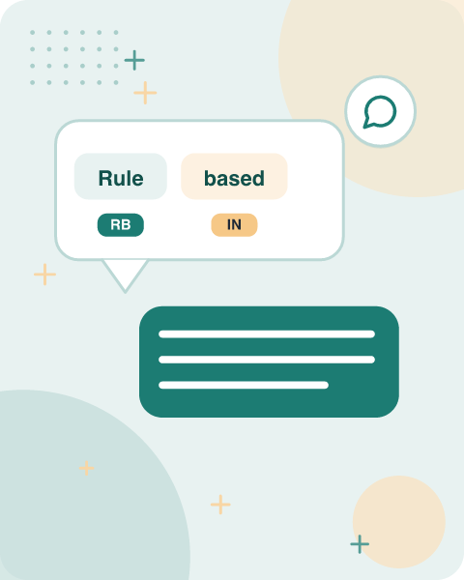




Rule-based tagger rules slide discusses context-pattern rules and their limitations
Rules
The rules may be context-pattern rules or as regular expressions compiled into finite-automata that are intersected with lexically ambiguous sentence representation
TAGGIT is the first large rule-based tagger that used context-pattern rules
Hard coded rules are required
Rules has to be updated on language change
Lexicon needs to be checked every time which is not efficient approach
Strong language expert team is required
ALSO ON THIS SLIDE
Limitations:
Key takeaway: TAGGIT was the first large rule-based tagger, but such systems require hard-coded rules and frequent lexicon updates.
Key terms: context-pattern rules — Rules that use surrounding words to decide a tag · finite-automata — Computational models that recognize patterns in text
Learnova
32 / 52
Notes:
Reveal, one click at a time:
1. The rules may be context-pattern rules or as regular expressions compiled into finite-automata that are intersected with
2. TAGGIT is the first large rule-based tagger that used context-pattern rules
3. Limitations:
4. Hard coded rules are required
5. Rules has to be updated on language change
6. Lexicon needs to be checked every time which is not efficient approach
7. Strong language expert team is required
Say what these mean, in your own words:
- context-pattern rules: Rules that use surrounding words to decide a tag
- finite-automata: Computational models that recognize patterns in text
Pause: ask the class what they already know about “Rule-based tagger rules slide discusses context-pattern rules and their limitations” before revealing the slide.
~61s
Ask the class: Explain this slide in your own words, in one sentence.

Slide 34

Rule based taggers use additional POS features to refine lexical entries
“Additional POS features”
— Rule based taggers use additional POS features to refine lexical entries
Key terms: POS features — Attributes that help distinguish part-of-speech tags in lexical entries · lexical entry — A dictionary-like record that associates a word form with its possible tags
Learnova
33 / 52
Notes:
Read these exactly (do not paraphrase):
- Rule based taggers use additional POS features to refine lexical entries Additional POS features smaller COMPARATIVE entire ABSOLUTE ATTRIBUTIVE fast SUPERLATIVE that CENTRAL DEMONSTRATIVE SG all PREDETERMINER SG/PL QUANTIFIER dog’s GENITIVE SG furniture NOMINATIVE SG NOINDEFDETERMINER one-third SG she PERSONAL FEMININE NOMINATIVE SG3 show PRESENT -SG3 VFIN show NOMINATIVE SG shown SVOO SVO SV occurred occurred Figure 5.11 Sample lexical entries from the ENGTWOL lexicon described in Vouti- lainen (1995) and Heikkila (1995).
Say what these mean, in your own words:
- POS features: Attributes that help distinguish part-of-speech tags in lexical entries
- lexical entry: A dictionary-like record that associates a word form with its possible tags
Pause: ask the class what they already know about “Rule based taggers use additional POS features to refine lexical entries” before revealing the slide.
Wording matters here — slow down, keep it precise.
~19s
Ask the class: Explain this slide in your own words, in one sentence.

Slide 35

Stochastic taggers disambiguate words by using probability models
Another technique of tagging is Stochastic POS Tagging.
Here the question that arises here is which model can be stochastic.
Two Approaches
Word Frequency Approach
  In this approach, the stochastic taggers disambiguate the words based on the probability that a word occurs with a particular tag.
  We can also say that the tag encountered most frequently with the word in the training set is the one assigned to an ambiguous instance of that word.
  The main issue with this approach is that it may yield an inadmissible sequence of tags.
ALSO ON THIS SLIDE
Any number of different approaches to the problem of part-of-speech tagging can be referred to as stochastic taggers.
Key takeaway: Stochastic POS taggers use probability models and word frequencies to disambiguate and assign tags to words.
Key terms: stochastic tagger — A tagger that assigns tags based on statistical likelihoods · frequency approach — Assigns the most frequent tag seen in training data to ambiguous words
Learnova
34 / 52
Notes:
Reveal, one click at a time:
1. Another technique of tagging is Stochastic POS Tagging.
2. Here the question that arises here is which model can be stochastic.
3. The model that includes frequency or probability (statistics) can be called stochastic.
4. Any number of different approaches to the problem of part-of-speech tagging can be referred to as stochastic taggers.
5. Two Approaches:
6. Word Frequency Approach
7. In this approach, the stochastic taggers disambiguate the words based on the probability that a word occurs with a parti
Read these exactly (do not paraphrase):
- The model that includes frequency or probability (statistics) can be called stochastic.
Say what these mean, in your own words:
- stochastic tagger: A tagger that assigns tags based on statistical likelihoods
- frequency approach: Assigns the most frequent tag seen in training data to ambiguous words
Pause: ask the class what they already know about “Stochastic taggers disambiguate words by using probability models” before revealing the slide.
~61s
Ask the class: Explain this slide in your own words, in one sentence.

Slide 36
Checkpoint 7
QUESTION · UNDERSTAND
Which term matches this description: “A tagger that assigns tags based on statistical likelihoods”?
n-gram
Open class
A
B
stochastic tagger
Brown Corpus
C
D
Answer: C
stochastic tagger: A tagger that assigns tags based on statistical likelihoods
Learnova
35 / 52
Notes:
KEY POINT TO LAND: Answer, then check your reasoning.
Pause: ask the class what they already know about “Checkpoint 7” before revealing the slide.
~44s

Slide 37
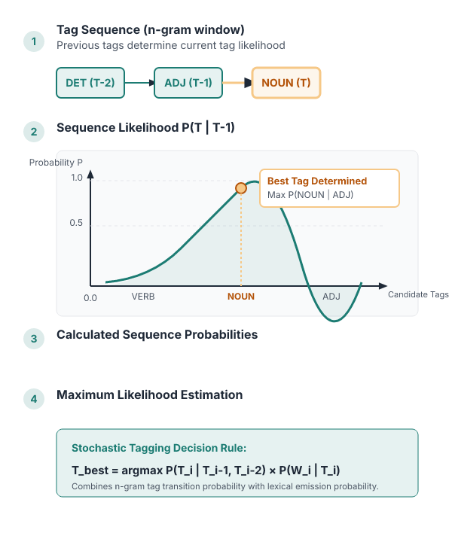
Tag sequence probabilities compute the likelihood of tag sequences in stochastic tagging
Two Approaches.
Tag Sequence Probabilities.
It is another approach of stochastic tagging, where the tagger calculates the probability of a given sequence of tags occurring.
ALSO It is also called the n-gram approach.
It is called so because the best tag for a given word is determined by the probability at which it occurs with the n previous tags.
IN PLAIN WORDS
Stochastic taggers can use tag sequence probabilities to choose the best tag for a word. This method, known as the n-gram approach, looks at the probability of a tag occurring with the previous n tags. It helps capture contextual patterns that single-word frequencies miss. For example, choosing the tag for "bank" after "river" versus after "money"
Key takeaway: Tag sequence probabilities use n-gram approaches to determine a word's best tag based on previous tags.
Key terms: n-gram — A sequence of n tags used to estimate probability in a tagger
Learnova
36 / 52
Notes:
Reveal, one click at a time:
1. Two Approaches:
2. Tag Sequence Probabilities
3. It is another approach of stochastic tagging, where the tagger calculates the probability of a given sequence of tags oc
4. It is also called the n-gram approach.
5. It is called so because the best tag for a given word is determined by the probability at which it occurs with the n pre
Say what these mean, in your own words:
- n-gram: A sequence of n tags used to estimate probability in a tagger
Pause: ask the class what they already know about “Tag sequence probabilities compute the likelihood of tag sequences in stochastic tagging” before revealing the slide.
~47s
Ask the class: Explain this slide in your own words, in one sentence.

Slide 38
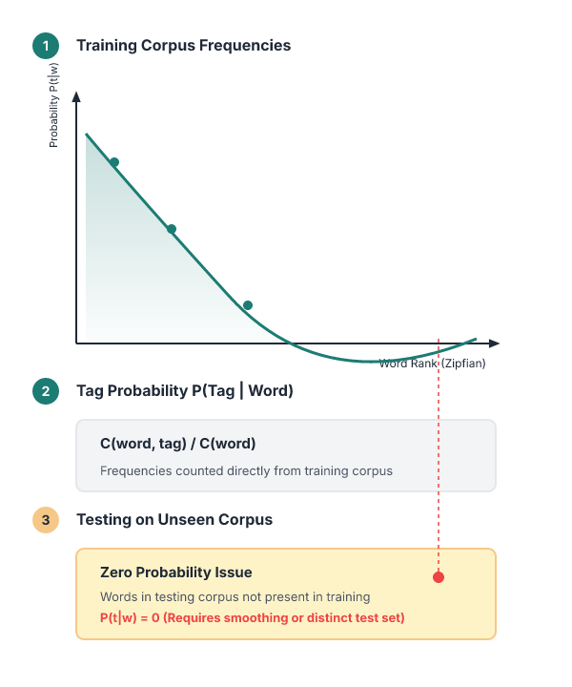
Stochastic POS taggers rely on training corpora to estimate tag probabilities
Two Approaches.
Properties of Stochastic POST Tagging.
Stochastic POS taggers possess the following properties −.
This POS tagging is based on the probability of the tag occurring.
It requires training corpus.
There would be no probability for the words that do not exist in the corpus.
It uses different testing corpus (other than training corpus).
IN PLAIN WORDS
These taggers need a labeled training corpus to learn how often tags occur. They cannot assign probabilities to words absent from the corpus. Testing on a separate corpus evaluates how well the learned probabilities generalize to new data.
Key terms: Following — Parts-of-Speech · training corpus — A set of sentences with correct tags used to learn probabilities
Learnova
37 / 52
Notes:
Reveal, one click at a time:
1. Two Approaches:
2. Properties of Stochastic POST Tagging
3. Stochastic POS taggers possess the following properties −
4. This POS tagging is based on the probability of the tag occurring.
5. It requires training corpus
6. There would be no probability for the words that do not exist in the corpus.
7. It uses different testing corpus (other than training corpus).
Read these exactly (do not paraphrase):
- It uses different testing corpus (other than training corpus).
Say what these mean, in your own words:
- Following: Parts-of-Speech
- training corpus: A set of sentences with correct tags used to learn probabilities
Pause: ask the class what they already know about “Stochastic POS taggers rely on training corpora to estimate tag probabilities” before revealing the slide.
~61s
Ask the class: Explain this slide in your own words, in one sentence.

Slide 39
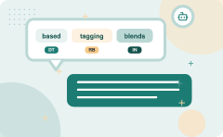
Transformation-based tagging blends rule-based and stochastic methods through machine learning
Transformation Based Tagging is also called as Brill Tagging
This tagger is based on the concept of Transformation-Based Learning (TBL) approach
It draws inspiration from both rule-based and stochastic taggers
Like rule-based taggers, TBL is based on rules that specify what tags should be assigned to what word
And like stochastic taggers, TBL is a machine learning technique, in which rules are automatically induced from data
ALSO ON THIS SLIDE
TBL uses Supervised Learning There is assumption of pre-tagged training corpus
Key takeaway: Transformation-based tagging, or Brill tagging, uses supervised learning to automatically induce rules from data.
Key terms: Transformation-Based Learning — A supervised learning method that induces rules from data · Brill Tagger — A popular implementation of transformation-based tagging
Learnova
38 / 52
Notes:
Reveal, one click at a time:
1. Transformation Based Tagging is also called as Brill Tagging
2. This tagger is based on the concept of Transformation-Based Learning (TBL) approach
3. TBL uses Supervised Learning
4. There is assumption of pre-tagged training corpus
5. It draws inspiration from both rule-based and stochastic taggers
6. Like rule-based taggers, TBL is based on rules that specify what tags should be assigned to what word
7. And like stochastic taggers, TBL is a machine learning technique, in which rules are automatically induced from data
Read these exactly (do not paraphrase):
- Transformation-based tagging blends rule-based and stochastic methods through machine learning Transformation Based Tagging is also called as Brill Tagging This tagger is based on the concept of Transformation-Based Learning (TBL) approach TBL uses Supervised Learning There is assumption of pre-tagged training corpus It draws inspiration from both rule-based and stochastic taggers Like rule-based taggers, TBL is based on rules that specify what tags should be assigned to what word And like stochastic taggers, TBL is a machine learning technique, in which rules are automatically induced from data
Say what these mean, in your own words:
- Transformation-Based Learning: A supervised learning method that induces rules from data
- Brill Tagger: A popular implementation of transformation-based tagging
Pause: ask the class what they already know about “Transformation-based tagging blends rule-based and stochastic methods through machine learning” before revealing the slide.
Wording matters here — slow down, keep it precise.
~61s
Ask the class: Explain this slide in your own words, in one sentence.

Slide 40


The TBL algorithm applies increasingly specific rules to refine initial tags
1
2
3
Corpus is first tagged using
the broadest rule, that is, the one that applies to the most cases
Slightly more specific rule
is chosen, which changes some of the original tags
Even narrower rule
which changes a smaller number of tags (some of which might be previously
ALSO ON THIS SLIDE
The TBL algorithm has a set of tagging rules. changed tags)
Key takeaway: The TBL algorithm applies progressively narrower rules to refine and change previously assigned tags.
Key terms: tbl — Transformation-Based Learning · tagging rule — A condition that changes a tag based on context
Learnova
39 / 52
Notes:
Reveal, one click at a time:
1. The TBL algorithm has a set of tagging rules.
2. A corpus is first tagged using the broadest rule, that is, the one that applies to the most cases. Then a slightly more
3. Next an even narrower rule, which changes a smaller number of tags (some of which might be previously
4. changed tags)
Read these exactly (do not paraphrase):
- Next an even narrower rule, which changes a smaller number of tags (some of which might be previously changed tags)
Say what these mean, in your own words:
- tbl: Transformation-Based Learning
- tagging rule: A condition that changes a tag based on context
Pause: ask the class what they already know about “The TBL algorithm applies increasingly specific rules to refine initial tags” before revealing the slide.
~40s
Ask the class: Which step would break the whole process if it failed — and why?

Slide 41
Checkpoint 8
QUESTION · UNDERSTAND
Which term matches this description: “A condition that changes a tag based on context”?
most likely tag
PRP
A
B
n-gram
tagging rule
C
D
Answer: D
tagging rule: A condition that changes a tag based on context
Learnova
40 / 52
Notes:
KEY POINT TO LAND: Answer, then check your reasoning.
Pause: ask the class what they already know about “Checkpoint 8” before revealing the slide.
~44s

Slide 42
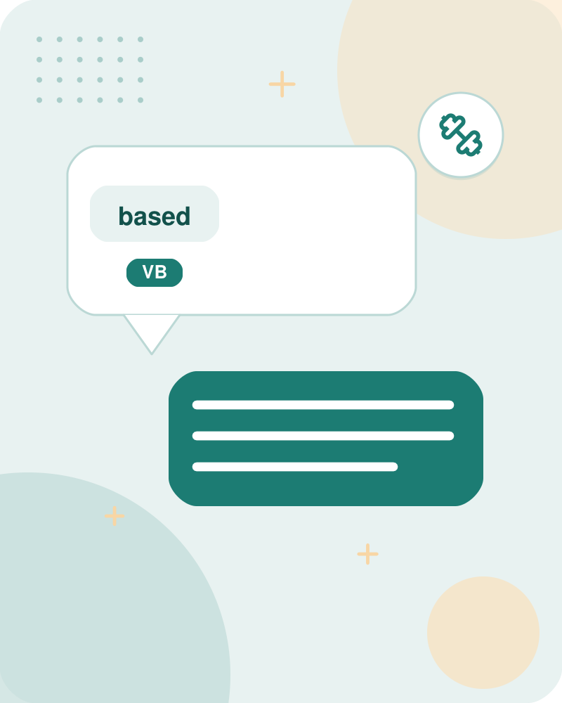
Transformation-based taggers label training data with most frequent tags before rule induction
Label the training set with most frequent tags.
‘Can’ can be Noun as well.
The can was rusted.
as Modal verb.
ALSO TBL uses ML as well as grammar rules.
Modal verb is never preceded by the determiner.
Initially each word receives its most common tag from the training set.
THEN The algorithm then learns rules that correct mislabelled words, such as distinguishing the modal verb "can" from the noun "can".
This hybrid approach uses both data and grammar.
Key takeaway: TBL initializes training data with most frequent tags before learning grammar rules to correct mislabeled words.
Key terms: most frequent tag — The tag that appears most often for a word in training data
Learnova
41 / 52
Notes:
Reveal, one click at a time:
1. Label the training set with most frequent tags.
2. ‘Can’ can be Noun as well
3. The can was rusted
4. as Modal verb
5. TBL uses ML as well as grammar rules
6. Modal verb is never preceded by the determiner
7. Initially each word receives its most common tag from the training set.
Read these exactly (do not paraphrase):
- The algorithm then learns rules that correct mislabelled words, such as distinguishing the modal verb "can" from the noun "can".
Say what these mean, in your own words:
- most frequent tag: The tag that appears most often for a word in training data
Pause: ask the class what they already know about “Transformation-based taggers label training data with most frequent tags before rule induction” before revealing the slide.
~61s
Ask the class: Explain this slide in your own words, in one sentence.

Slide 43
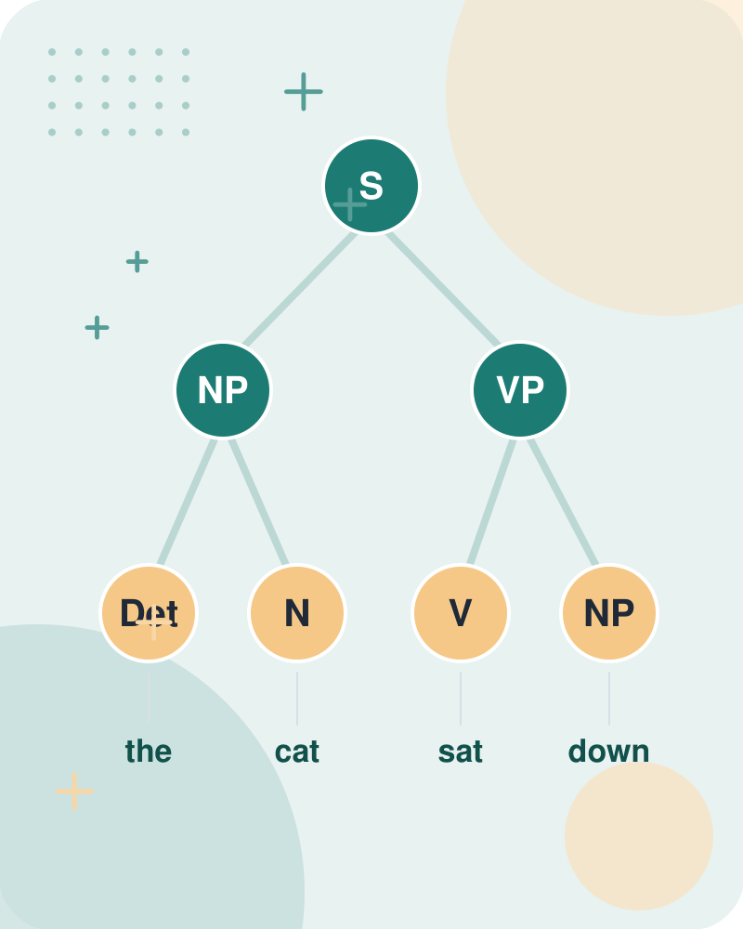
Adding transformation rules reduces training mistakes by correcting unlikely tag pairs
Add transformation rules to reduce training mistakes.
ALSO Also in corpus, possibility of ‘determiner modal verb’ pair is zero.
SO Hence ‘can’ is replaced by Noun Tag.
ALSO Similarly, rusted can be VBD and VBN.
In grammar, VBN is preceded by VBD.
And in corpus VBD-VBD pair is negligible.
IN PLAIN WORDS
Rules are added to fix errors like "determiner modal verb" pairs, which rarely occur. For example, the word "can" is replaced with a noun tag when the preceding word is a determiner. Such targeted corrections improve overall tagging accuracy.
Key terms: transformation rule — A rule that changes a tag based on surrounding context
Learnova
42 / 52
Notes:
Reveal, one click at a time:
1. Add transformation rules to reduce training mistakes
2. Also in corpus, possibility of ‘determiner modal verb’ pair is zero
3. Hence ‘can’ is replaced by Noun Tag
4. Similarly, rusted can be VBD and VBN
5. In grammar, VBN is preceded by VBD
6. And in corpus VBD-VBD pair is negligible
Say what these mean, in your own words:
- transformation rule: A rule that changes a tag based on surrounding context
Pause: ask the class what they already know about “Adding transformation rules reduces training mistakes by correcting unlikely tag pairs” before revealing the slide.
~54s
Ask the class: Explain this slide in your own words, in one sentence.

Slide 44
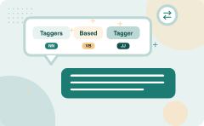
POS Taggers - Transformation Based Tagger (3/6)
The | Can | Was | rusted
DET | MD | VBD | VBD
Key takeaway: Initial tagging of words like 'can' can mistakenly assign modal verb tags instead of nouns.
Learnova
▶ Open the interactive lab: Transformation‑Based POS Tagging Lab
43 / 52
Notes:
Read these exactly (do not paraphrase):
- POS Taggers - Transformation Based Tagger (3/6)
Pause: ask the class what they already know about “POS Taggers - Transformation Based Tagger” before revealing the slide.
Wording matters here — slow down, keep it precise.
~19s

Slide 45

POS Taggers - Transformation Based Tagger (3/6)
The | Can | Was | rusted
DET | NN | VBD | VBN
Key takeaway: Taggers initially assign specific base tags like nouns and verbs before applying transformation correction rules.
Learnova
44 / 52
Notes:
Read these exactly (do not paraphrase):
- POS Taggers - Transformation Based Tagger (3/6)
Pause: ask the class what they already know about “POS Taggers - Transformation Based Tagger” before revealing the slide.
Wording matters here — slow down, keep it precise.
~19s

Slide 46
Checkpoint 9
QUESTION · UNDERSTAND
Which term matches this description: “A rule that changes a tag based on surrounding context”?
lexical entry
finite-automata
A
B
most frequent tag
transformation rule
C
D
Answer: D
transformation rule: A rule that changes a tag based on surrounding context
Learnova
45 / 52
Notes:
KEY POINT TO LAND: Answer, then check your reasoning.
Pause: ask the class what they already know about “Checkpoint 9” before revealing the slide.
~44s

Slide 47
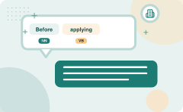
Before applying rules, the tagger assigns each word its most likely tag from a corpus
Before the rules
Before the rules apply, the tagger labels every word with its most-likely tag
We
We get these most-likely tags from a tagged corpus
For example
For example, in the Brown corpus, race is most likely to be a noun race/NN is incorrect in above sentence race/NN is correctly tagged in above sentence
IN PLAIN WORDS
The tagger first labels every word with the tag that appears most often in a labeled corpus, such as the Brown corpus. For instance, "race" is usually tagged as a noun, but in the sentence "race/NN is incorrect" it should be a verb. This initial labeling sets the stage for rule corrections.
Key takeaway: Taggers rely on a tagged corpus to assign every word its most likely tag before applying correction rules.
Key terms: Brown corpus — 1 million word collection of samples from 500 written texts from different genres which was assembled at Brown University in… · most likely tag — The tag with the highest frequency for a word in training data
Learnova
46 / 52
Notes:
Reveal, one click at a time:
1. Before the rules apply, the tagger labels every word with its most-likely tag.
2. We get these most-likely tags from a tagged corpus.
3. For example, in the Brown corpus, race is most likely to be a noun
4. race/NN is incorrect in above sentence
5. race/NN is correctly tagged in above sentence
Say what these mean, in your own words:
- Brown corpus: 1 million word collection of samples from 500 written texts from different genres which was assembled at Brown University in…
- most likely tag: The tag with the highest frequency for a word in training data
Pause: ask the class what they already know about “Before applying rules, the tagger assigns each word its most likely tag from a corpus” before revealing the slide.
~47s
Ask the class: How does each level depend on the one beneath it?

Slide 48

POS Taggers - Transformation Based Tagger (4/6)
Is | expected | to | race | tomorrow
VBZ | VBN | TO | NN | NN
Key takeaway: Words like 'race' may be incorrectly tagged as nouns by initial frequency-based methods in a sentence.
Learnova
47 / 52
Notes:
Read these exactly (do not paraphrase):
- POS Taggers - Transformation Based Tagger (4/6)
Pause: ask the class what they already know about “POS Taggers - Transformation Based Tagger” before revealing the slide.
Wording matters here — slow down, keep it precise.
~19s

Slide 49

POS Taggers - Transformation Based Tagger (4/6)
The | Race | for | outer | space
DET | NN | IN | JJ | NN
Key takeaway: Sentences contain multiple POS tags such as determiners, nouns, prepositions, and adjectives.
Learnova
48 / 52
Notes:
Read these exactly (do not paraphrase):
- POS Taggers - Transformation Based Tagger (4/6)
Pause: ask the class what they already know about “POS Taggers - Transformation Based Tagger” before revealing the slide.
Wording matters here — slow down, keep it precise.
~19s

Slide 50

POS Taggers - Transformation Based Tagger (5/6)
Is | expected | to | race | tomorrow
VBZ | VBN | TO | VB | NN
Key takeaway: Brill's tagger applies transformation rules, such as changing NN to VB when preceded by TO.
Learnova
49 / 52
Notes:
Read these exactly (do not paraphrase):
- POS Taggers - Transformation Based Tagger (5/6)
Full detail (from the source):
- After selecting most likely tag.
Brill’s tagger, applies transformation rules - Change NN to VB when previous tag is TO - Hence the correction would be [TABLE DATA] | Is | expected | to | race | tomorrow | | --- | --- | --- | --- | --- | | VBZ | VBN | TO | VB | NN |
Wording matters here — slow down, keep it precise.
~19s

Slide 51
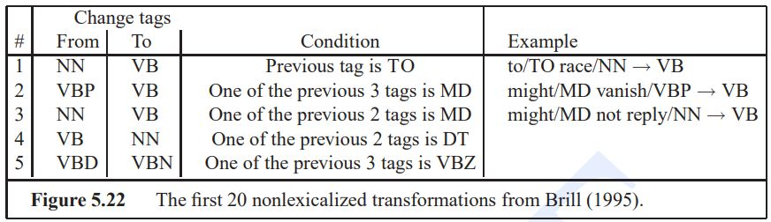
POS Taggers - Transformation Based Tagger (continued)
Learnova
50 / 52
Notes:
Read these exactly (do not paraphrase):
- POS Taggers - Transformation Based Tagger (continued)
Pause: ask the class what they already know about “POS Taggers - Transformation Based Tagger (continued)” before revealing the slide.
Wording matters here — slow down, keep it precise.
~19s
Ask the class: What might explain these numbers?

Slide 52
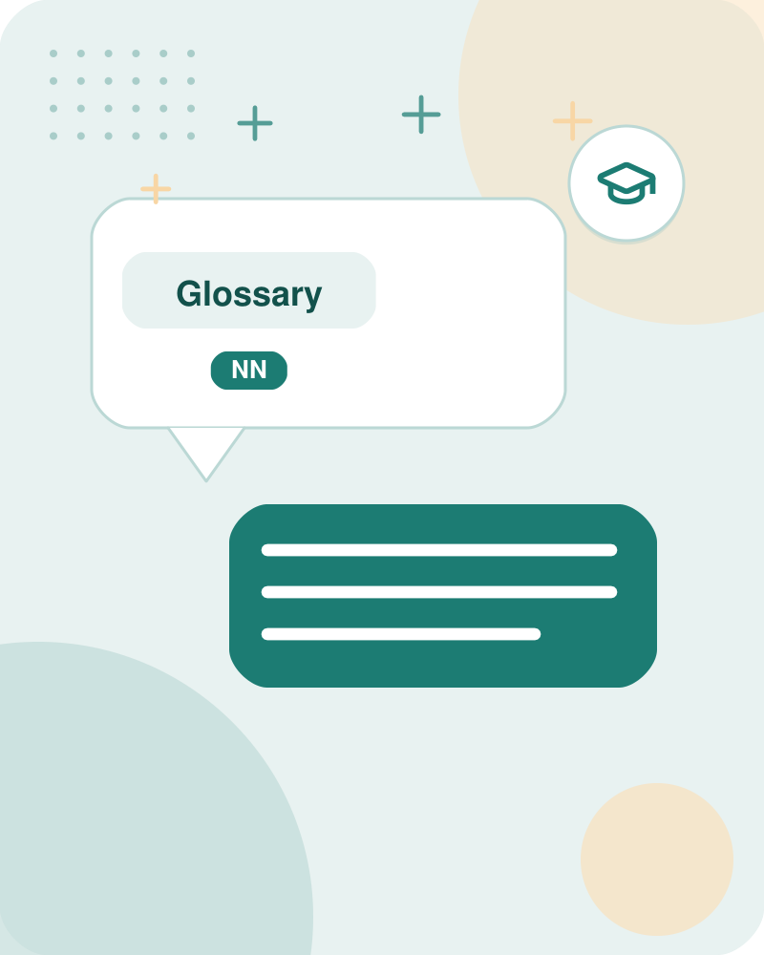


Glossary
Brown corpus
1 million word collection of samples from 500 written texts from different genres which was assembled at Brown University in…
Taggit
first large rule-based tagger that used context-pattern rules
The output
single best tag for each word
ALSO ON THIS SLIDE
rule-based part-of-speech tagg: oldest approach that uses hand written rules for tagging
Key takeaway: The Brown corpus contains one million words from 500 written texts assembled at Brown University.
Learnova
51 / 52
Notes:
Reveal, one click at a time:
1. Brown corpus: 1 million word collection of samples from 500 written texts from different genres which was assembled at B
2. Taggit: first large rule-based tagger that used context-pattern rules
3. The output: single best tag for each word
4. rule-based part-of-speech tagg: oldest approach that uses hand written rules for tagging
Pause: ask the class what they already know about “Glossary” before revealing the slide.
~40s

Slide 53
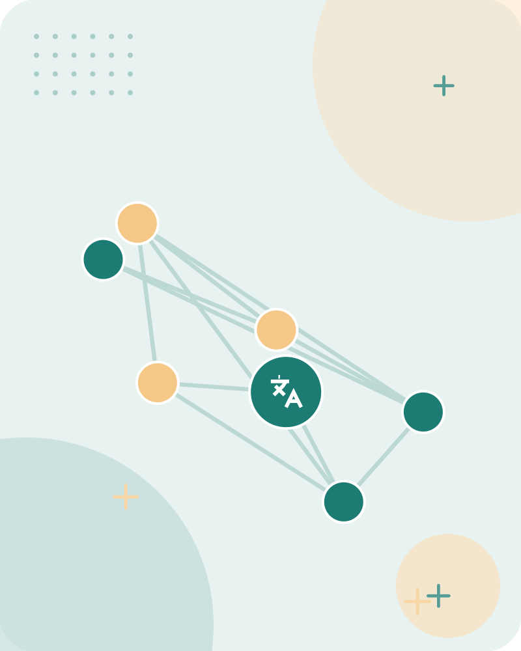


Key takeaways
Content
Part-Of-Speech tagging (POS)
Tag set for English
Noun Types
Word POS Type Explanation
Statement: She plays tennis
POS Taggers - Rule based Tagger
Additional POS features
ALSO ON THIS SLIDE
Part-Of-Speech tagging (POS): Parts-of-speech can be divided into two broad supercategories: Difficulties /Challenges in POS taggin: Most words in English are unambiguous; i.e., they have only a single tag. POS Taggers - Transformation Based Tag: Transformation Based Tagging is also called as Brill Tagging
Key takeaway: POS tagging encompasses multiple tagger types, distinct tag sets, and specific linguistic challenge resolutions.
Learnova
52 / 52
Notes:
Reveal, one click at a time:
1. Content: Part-Of-Speech tagging (POS)
2. Part-Of-Speech tagging (POS): Parts-of-speech can be divided into two broad supercategories:
3. Difficulties /Challenges in POS taggin: Most words in English are unambiguous; i.e., they have only a single tag.
4. Tag set for English: Noun Types
5. Word POS Type Explanation: Statement: She plays tennis.
6. POS Taggers - Rule based Tagger: Additional POS features
7. POS Taggers - Transformation Based Tag: Transformation Based Tagging is also called as Brill Tagging
Read these exactly (do not paraphrase):
- Key takeaways Content: Part-Of-Speech tagging (POS) Part-Of-Speech tagging (POS): Parts-of-speech can be divided into two broad supercategories: Difficulties /Challenges in POS taggin: Most words in English are unambiguous; i.e., they have only a single tag.
Pause: ask the class what they already know about “Key takeaways” before revealing the slide.
~61s

Slide 54
Thank you
Questions?

