Slide 1

MODULE 4
SUBTITLE COMES HERE • 114 slides

Slide 2
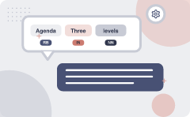
Agenda
MODULE 4
SEMANTIC ANALYSIS
1
2
LEXICAL SEMANTICS
Three levels of meaning
3
4
Terminology
Polysemy
5
6
Metonymy or Systematic Polysemy: A systemati
Multiple related meanings
7
8
Learnova
1 / 114
Notes:
Pause: ask the class what they already know about “Agenda” before revealing the slide.
~19s

Slide 3







Lexical semantics studies meaning through dictionaries and disambiguation algorithms
Introduction, Meaning Representation
Lexical Semantics
Corpus Study, Study of Various language dictionaries like wordnet, Babelnet
Relations among lexemes & their senses –Homonymy, Polysemy, Synonymy, Hyponymy
Semantic Ambiguity
Word Sense Disambiguation (WSD)
IN PLAIN WORDS
Lexical semantics examines how words convey meaning by exploring dictionaries like WordNet and BabelNet. It identifies relationships such as homonymy, polysemy, synonymy, and hyponymy. Word sense disambiguation resolves ambiguous senses using knowledge-based methods like Lesk, supervised classifiers, semi-supervised learning, and unsupervised techniques. For example, using WordNet, the word "bank" is linked to senses of a financial institution and a riverbank.
Key terms: Word sense disambiguation — important method of NLP by which the meaning of a word is determined, which is used in a particular context · Word Sense Disambiguation — Process of determining which meaning of a word is used in context. · Lesk’s Algorithm — Knowledge-based WSD method that matches dictionary definitions with context.
Learnova
2 / 114
Notes:
Reveal, one click at a time:
1. Introduction, Meaning Representation
2. Lexical Semantics
3. Corpus Study, Study of Various language dictionaries like wordnet, Babelnet
4. Relations among lexemes & their senses –Homonymy, Polysemy, Synonymy, Hyponymy
5. Semantic Ambiguity
6. Word Sense Disambiguation (WSD)
7. Knowledge based approach (Lesk’s Algorithm)
Read these exactly (do not paraphrase):
- Lexical semantics studies meaning through dictionaries and disambiguation algorithms Introduction, Meaning Representation Lexical Semantics Corpus Study, Study of Various language dictionaries like wordnet, Babelnet Relations among lexemes & their senses –Homonymy, Polysemy, Synonymy, Hyponymy Semantic Ambiguity Word Sense Disambiguation (WSD) Knowledge based approach (Lesk’s Algorithm) Supervised (Naïve Bayes, Decision List) Introduction to Semi-supervised method (Yarowsky) Unsupervised (Hyperlex)
Say what these mean, in your own words:
- Word sense disambiguation: important method of NLP by which the meaning of a word is determined, which is used in a particular context
- Word Sense Disambiguation: Process of determining which meaning of a word is used in context.
- Lesk’s Algorithm: Knowledge-based WSD method that matches dictionary definitions with context.
Pause: ask the class what they already know about “Lexical semantics studies meaning through dictionaries and disambiguation algorithms” before revealing the slide.
Wording matters here — slow down, keep it precise.
~61s
Ask the class: Explain this slide in your own words, in one sentence.

Slide 4

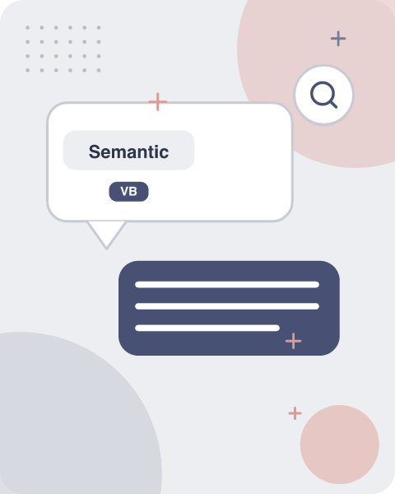




Semantic analysis extracts meaning from text by parsing grammatical structure
Semantic analysis is the process of finding the meaning from text
Analysis
This analysis gives the power to computers
Understand and interpret
to understand and interpret sentences, paragraphs, or whole documents
Analyzing their grammatical
by analyzing their grammatical structure
identifying the relationships between individual words of the sentence in a particular context
IN PLAIN WORDS
Semantic analysis identifies the meaning of sentences, paragraphs, or documents. It parses grammatical structure and discovers relationships between words. This enables computers to understand and interpret natural language, moving beyond syntactic parsing to grasp contextual meaning. For example, recognizing that "bank" in "deposit money" refers to a financial institution.
Key terms: Semantic analysis — Computational process of extracting meaning from text.
Learnova
3 / 114
Notes:
Reveal, one click at a time:
1. Semantic analysis is the process of finding the meaning from text.
2. This analysis gives the power to computers
3. to understand and interpret sentences, paragraphs, or whole documents,
4. by analyzing their grammatical structure
5. identifying the relationships between individual words of the sentence in a particular context.
Read these exactly (do not paraphrase):
- Semantic analysis extracts meaning from text by parsing grammatical structure Semantic analysis is the process of finding the meaning from text.
Say what these mean, in your own words:
- Semantic analysis: Computational process of extracting meaning from text.
Pause: ask the class what they already know about “Semantic analysis extracts meaning from text by parsing grammatical structure” before revealing the slide.
Wording matters here — slow down, keep it precise.
~47s
Ask the class: Explain this slide in your own words, in one sentence.

Slide 5
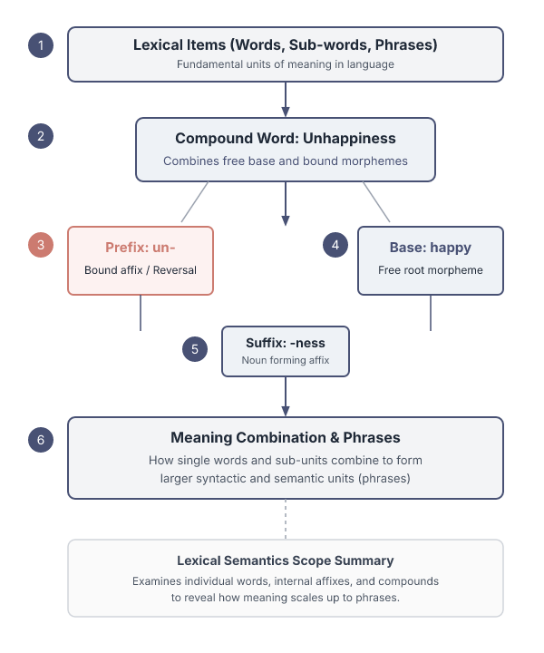
Lexical semantics studies the meaning of individual words and their parts
It is the study of the meaning of individual words.
It involves words, sub-words, affixes (sub-units), compound words, and phrases also.
All the words, sub-words, etc. are collectively known as lexical items.
Lexical semantics focuses on how single words convey meaning.
It includes analysis of sub-words, affixes, compounds, and phrases.
All these elements are called lexical items, and their study reveals how words combine to form larger units.
Example: The word "unhappiness" is a compound of "un-" and "happiness".
Key terms: Lexical items — Words, sub-words, affixes, compounds, and phrases studied in lexical semantics.
Learnova
4 / 114
Notes:
Reveal, one click at a time:
1. It is the study of the meaning of individual words.
2. It involves words, sub-words, affixes (sub-units), compound words, and phrases also.
3. All the words, sub-words, etc. are collectively known as lexical items.
4. Lexical semantics focuses on how single words convey meaning.
5. It includes analysis of sub-words, affixes, compounds, and phrases.
6. All these elements are called lexical items, and their study reveals how words combine to form larger units.
7. Example: The word "unhappiness" is a compound of "un-" and "happiness".
Read these exactly (do not paraphrase):
- Lexical semantics studies the meaning of individual words and their parts It is the study of the meaning of individual words.
- It involves words, sub-words, affixes (sub-units), compound words, and phrases also.
- Example: The word "unhappiness" is a compound of "un-" and "happiness".
Say what these mean, in your own words:
- Lexical items: Words, sub-words, affixes, compounds, and phrases studied in lexical semantics.
Pause: ask the class what they already know about “Lexical semantics studies the meaning of individual words and their parts” before revealing the slide.
~61s
Ask the class: Give one real-life example of this idea.

Slide 6
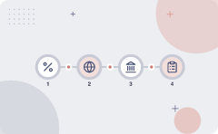
Meaning is structured across lexical, sentential, and discourse levels
Meaning | Discourse
+ context + world knowledge | Or Pragmatics
Sentential or compositional semantics interprets how words combine to form sentence meaning | Or pragmatic semantics adds context and world knowledge to interpret larger texts
Key takeaway: Key difference — Meaning: + context + world knowledge | Discourse: Or Pragmatics
Key terms: Pragmatics — Study of how context influences interpretation of language.
Learnova
5 / 114
Notes:
Reveal, one click at a time:
1. 1. Lexical Semantics (words) Co
2. 2. Sentential / Compositional / Formal Semantics
3. 3. Discourse or Pragmatics
4. meaning + context + world knowledge
5. Lexical semantics deals with word meanings.
6. Sentential or compositional semantics interprets how words combine to form sentence meaning.
7. Discourse or pragmatic semantics adds context and world knowledge to interpret larger texts.
Read these exactly (do not paraphrase):
- Lexical Semantics (words) Co 2.
- Example: The sentence "She saw the bank" requires context to determine which bank.
Say what these mean, in your own words:
- Pragmatics: Study of how context influences interpretation of language.
Pause: ask the class what they already know about “Meaning is structured across lexical, sentential, and discourse levels” before revealing the slide.
~61s
Ask the class: What might explain these numbers?

Slide 7
Checkpoint 1
QUESTION · UNDERSTAND
Which term matches this description: “Study of how context influences interpretation of language.”?
Lexeme
Direct hypernym
A
B
Pragmatics
Ambiguity
C
D
Answer: C
Pragmatics: Study of how context influences interpretation of language.
Learnova
6 / 114
Notes:
KEY POINT TO LAND: Answer, then check your reasoning.
Pause: ask the class what they already know about “Checkpoint 1” before revealing the slide.
~44s

Slide 8

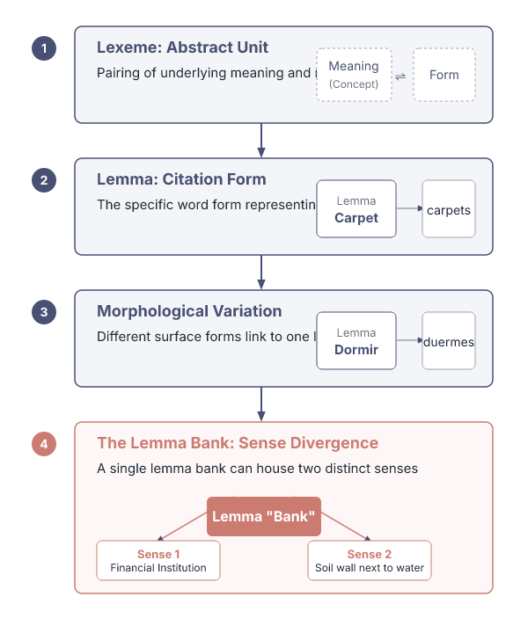




Lexeme and lemma distinguish meaning and word form in lexical studies
Lexeme: a pairing of meaning and form
Lemma: the word form that represents a lexeme
Carpet is the lemma for carpets Dormir is the lemma for duermes
Lemma bank
The lemma bank has two senses
Financial insitution
Soil wall next to water
IN PLAIN WORDS
A lexeme pairs a meaning with its form, while a lemma is the canonical word form representing that lexeme. For example, "carpet" is the lemma for the plural "carpets". Lemmas help organize dictionaries and computational models. For example, the lemma "dormir" represents the Spanish verb for "to sleep".
Asense is a discrete representation of one aspect of the meaning of a word
Key terms: Lexeme — Unit combining a specific meaning with its form. · Lemma — Canonical word form representing a lexeme.
Learnova
7 / 114
Notes:
Reveal, one click at a time:
1. Lexeme: a pairing of meaning and form
2. Lemma: the word form that represents a lexeme
3. Carpet is the lemma for carpets Dormir is the lemma for duermes
4. The lemma bank has two senses:
5. Financial insitution
6. Soil wall next to water
7. Asense is a discrete representation of one aspect of the meaning of a word
Say what these mean, in your own words:
- Lexeme: Unit combining a specific meaning with its form.
- Lemma: Canonical word form representing a lexeme.
Pause: ask the class what they already know about “Lexeme and lemma distinguish meaning and word form in lexical studies” before revealing the slide.
~61s
Ask the class: Explain this slide in your own words, in one sentence.

Slide 9
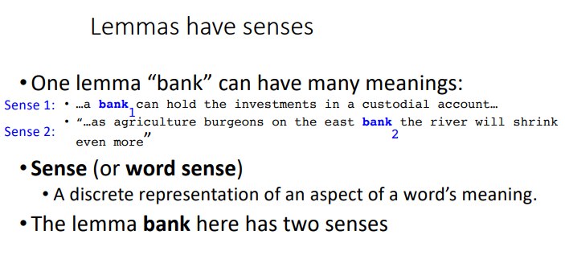
Terminology (continued)
Learnova
8 / 114
Notes:
Read these exactly (do not paraphrase):
- Terminology (continued)
Pause: ask the class what they already know about “Terminology (continued)” before revealing the slide.
Wording matters here — slow down, keep it precise.
~19s
Text in the figure: Lemmas have senses *One lemma “bank” can have many meanings: ..a hold the investments in a custodial account... agriculture burgeons on the east bank the river will shrink Sense 2: ” 2 even more Sense (or word sense) A discrete representation of an aspect of a word’s meaning. lemma bank here has two senses
Ask the class: What might explain these numbers?

Slide 10
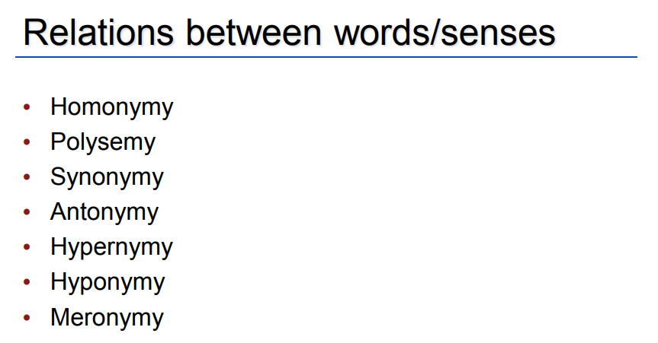
Terminology (continued)
Relations between words/senses * Homonymy * Polysemy « Synonymy « Antonymy * Hypernymy * Hyponymy « Meronymy
Learnova
9 / 114
Notes:
Read these exactly (do not paraphrase):
- Terminology (continued)
Pause: ask the class what they already know about “Terminology (continued)” before revealing the slide.
Wording matters here — slow down, keep it precise.
~19s
Text in the figure: Relations between words/senses Homonymy Polysemy Synonymy Antonymy Hypernymy Hyponymy Meronymy
Ask the class: What might explain these numbers?

Slide 11
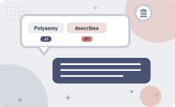
Polysemy describes related multiple meanings of a single word
1. The bank was constructed in 1875 out of local red brick.
2.1 withdrew the money from the bank
Are those the same sense?
Sense 2: “A financial institution”
Sense 1: “The building belonging to a financial institution”
A polysemous word has related meanings
Most non-rare words have multiple meanings
IN PLAIN WORDS
Polysemy occurs when a word has several related senses, such as "bank" meaning a building or a financial institution. The senses are connected, unlike homonyms which share form but not meaning. Most common words are polysemous. For example, "Bank" can mean a financial institution or the side of a river.
Key terms: Polysemy — A single word having multiple related meanings.
Learnova
10 / 114
Notes:
Reveal, one click at a time:
1. 1. The bank was constructed in 1875 out of local red brick.
2. 2.1 withdrew the money from the bank
3. Are those the same sense?
4. Sense 2: “A financial institution”
5. Sense 1: “The building belonging to a financial institution”
6. A polysemous word has related meanings
7. Most non-rare words have multiple meanings
Read these exactly (do not paraphrase):
- Sense 2: “A financial institution” Sense 1: “The building belonging to a financial institution” A polysemous word has related meanings Most non-rare words have multiple meanings
Say what these mean, in your own words:
- Polysemy: A single word having multiple related meanings.
Pause: ask the class what they already know about “Polysemy describes related multiple meanings of a single word” before revealing the slide.
~61s
Ask the class: Explain this slide in your own words, in one sentence.

Slide 12
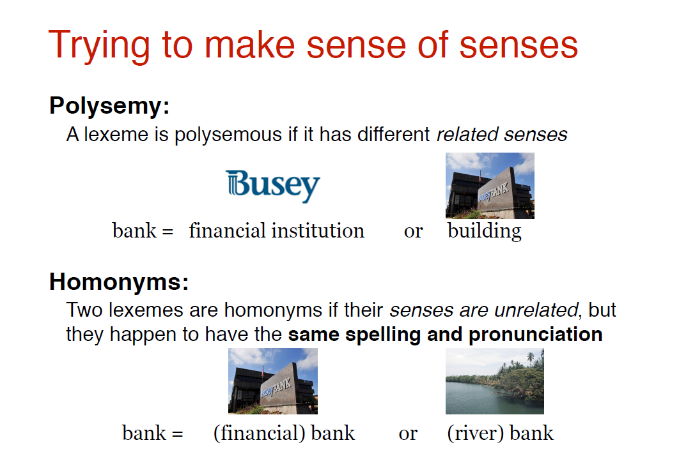
Polysemy (continued)
Learnova
11 / 114
Notes:
Read these exactly (do not paraphrase):
- Polysemy (continued)
Pause: ask the class what they already know about “Polysemy (continued)” before revealing the slide.
Wording matters here — slow down, keep it precise.
~19s
Text in the figure: Trying to make sense of senses Polysemy: A lexeme is polysemous if it has different related senses Busey — bank = financialinstitution or building Homonyms: Two lexemes are homonyms if their senses are unrelated, but they happen to have the same spelling and pronunciation bank or (river) bank
Ask the class: What might explain these numbers?

Slide 13
Checkpoint 2
QUESTION · UNDERSTAND
Which term matches this description: “A single word having multiple related meanings.”?
Thesaurus/Dictionary Methods
score vector
A
B
high-density component
Polysemy
C
D
Answer: D
Polysemy: A single word having multiple related meanings.
Learnova
12 / 114
Notes:
KEY POINT TO LAND: Answer, then check your reasoning.
Pause: ask the class what they already know about “Checkpoint 2” before revealing the slide.
~44s

Slide 14

Systematic polysemy links senses through institutional or object relationships
Lots of types of polysemy are systematic
  School, university, hospital
  Allcan mean the institution or the building.
Asystematic relationship:
  Building <> Organization
Other such kinds of systematic polysemy
Author (Jane Austen wrote Emma)
  Works of Author (I love Jane Austen)
Tree (Plums have beautiful blossoms)
  Fruit (I ate a preserved plum)
IN PLAIN WORDS
Systematic polysemy connects senses that share a conceptual relationship, such as "school" meaning an institution or its building. Non-systematic polysemy lacks such a clear link, like "author" versus "works of author". These patterns help disambiguate meaning. For example, "Hospital" can refer to the building or the medical organization.
Key terms: Systematic polysemy — Polysemy where senses share a conceptual relationship.
Learnova
13 / 114
Notes:
Reveal, one click at a time:
1. Lots of types of polysemy are systematic
2. School, university, hospital
3. Allcan mean the institution or the building.
4. Asystematic relationship:
5. Building <> Organization
6. Other such kinds of systematic polysemy:
7. Author (Jane Austen wrote Emma)
Read these exactly (do not paraphrase):
- Asystematic relationship: Building <> Organization Other such kinds of systematic polysemy: Author (Jane Austen wrote Emma) Works of Author (I love Jane Austen) Tree (Plums have beautiful blossoms) Fruit (I ate a preserved plum)
Say what these mean, in your own words:
- Systematic polysemy: Polysemy where senses share a conceptual relationship.
Pause: ask the class what they already know about “Systematic polysemy links senses through institutional or object relationships” before revealing the slide.
Wording matters here — slow down, keep it precise.
~61s
Ask the class: Explain this slide in your own words, in one sentence.

Slide 15
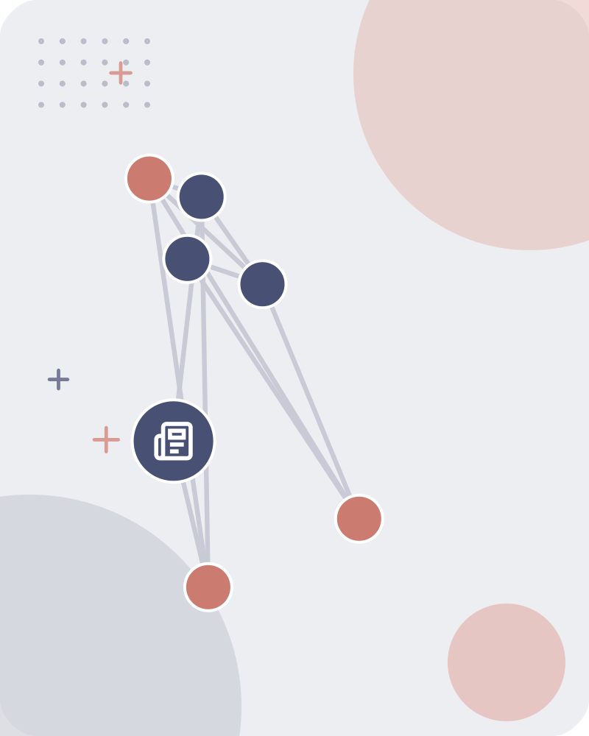
Multiple related meanings
S: (n) newspaper, paper (a daily or weekly publication on folded sheets; contains news and articles and advertisements) "he read his newspaper at breakfast" S: (n) newspaper, paper, newspaper publisher (a business firm that publishes newspapers) "Murdoch owns many newspapers" S: (n) newspaper, paper (the physical object that is the product of a newspaper publisher) "when it began to rain he covered his head with a newspaper" S: (n) newspaper, newsprint (cheap paper made from wood pulp and used for printing newspapers) "they used bales of newspaper every day”.
Learnova
14 / 114
Notes:
Read these exactly (do not paraphrase):
- Multiple related meanings S: (n) newspaper, paper (a daily or weekly publication on folded sheets; contains news and articles and advertisements) "he read his newspaper at breakfast" S: (n) newspaper, paper, newspaper publisher (a business firm that publishes newspapers) "Murdoch owns many newspapers" S: (n) newspaper, paper (the physical object that is the product of a newspaper publisher) "when it began to rain he covered his head with a newspaper" S: (n) newspaper, newsprint (cheap paper made from wood pulp and used for printing newspapers) "they used bales of newspaper every day”
Pause: ask the class what they already know about “Multiple related meanings” before revealing the slide.
Wording matters here — slow down, keep it precise.
~19s
Ask the class: Explain this slide in your own words, in one sentence.

Slide 16
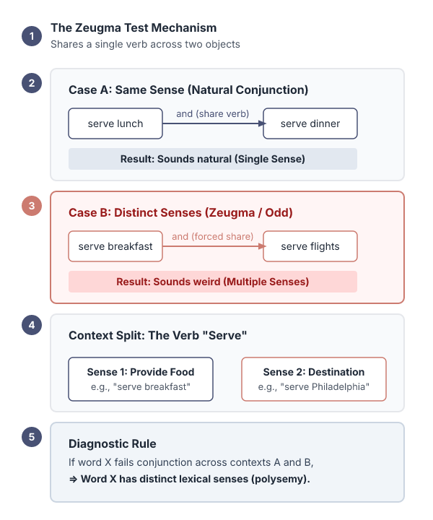
The zeugma test distinguishes multiple senses of a word
The “zeugma” test: Two senses of serve?
flights serve breakfast?
Does Lufthansa serve Philadelphia?
Does Lufthansa serve breakfast and San Jose?
BECAUSE Since this conjunction sounds weird.
we say that these are two different senses of “serve”.
The zeugma test checks whether a word can logically share a sense across different contexts.
If a conjunction sounds odd, the word likely has separate senses.
E.G. For example, "serve" in "serve breakfast" versus "serve flights" indicates distinct meanings.
Example: "Serve" in "serve lunch" vs. "serve a flight".
Key terms: Zeugma — Test to determine if a word shares a sense across contexts.
Learnova
15 / 114
Notes:
Reveal, one click at a time:
1. The “zeugma” test: Two senses of serve?
2. flights serve breakfast?
3. Does Lufthansa serve Philadelphia?
4. Does Lufthansa serve breakfast and San Jose?
5. Since this conjunction sounds weird,
6. we say that these are two different senses of “serve”
7. The zeugma test checks whether a word can logically share a sense across different contexts.
Read these exactly (do not paraphrase):
- For example, "serve" in "serve breakfast" versus "serve flights" indicates distinct meanings.
- "serve a flight".
Say what these mean, in your own words:
- Zeugma: Test to determine if a word shares a sense across contexts.
Pause: ask the class what they already know about “The zeugma test distinguishes multiple senses of a word” before revealing the slide.
~61s
Ask the class: Which step would break the whole process if it failed — and why?

Slide 17
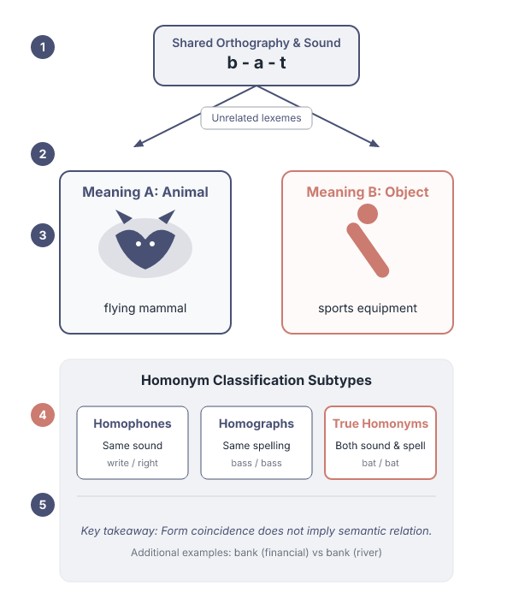

Homonyms share form but have unrelated meanings across categories
Homonyms
lexemes that share a form, but unrelated meanings
Homophones
write and right, piece and peace
Homographs
bass and bass
Example
"Bat" can mean a flying mammal or a baseball club
ALSO ON THIS SLIDE
bat (wooden stick thing) vs bat (flying scary mammal) bank (financial institution) vs bank (riverside) Homonyms are lexemes that look or sound the same yet have unrelated meanings, such as "bat" the animal versus "bat" the sports equipment. They can be homophones (same sound), homographs (same spelling), or both.
Key terms: Homonym — Word that shares form but not meaning with another.
Learnova
16 / 114
Notes:
Reveal, one click at a time:
1. Homonyms: lexemes that share a form, but unrelated meanings
2. bat (wooden stick thing) vs bat (flying scary mammal) bank (financial institution) vs bank (riverside)
3. Can be homophones, homographs, or both:
4. Homophones: write and right, piece and peace
5. Homographs: bass and bass
6. Homonyms are lexemes that look or sound the same yet have unrelated meanings, such as "bat" the animal versus "bat" the
7. They can be homophones (same sound), homographs (same spelling), or both.
Read these exactly (do not paraphrase):
- Homonyms share form but have unrelated meanings across categories Homonyms: lexemes that share a form, but unrelated meanings bat (wooden stick thing) vs bat (flying scary mammal) bank (financial institution) vs bank (riverside) Can be homophones, homographs, or both: Homophones: write and right, piece and peace Homographs: bass and bass Homonyms are lexemes that look or sound the same yet have unrelated meanings, such as "bat" the animal versus "bat" the sports equipment.
- They can be homophones (same sound), homographs (same spelling), or both.
Say what these mean, in your own words:
- Homonym: Word that shares form but not meaning with another.
Pause: ask the class what they already know about “Homonyms share form but have unrelated meanings across categories” before revealing the slide.
Wording matters here — slow down, keep it precise.
~61s
Ask the class: Explain this slide in your own words, in one sentence.

Slide 18
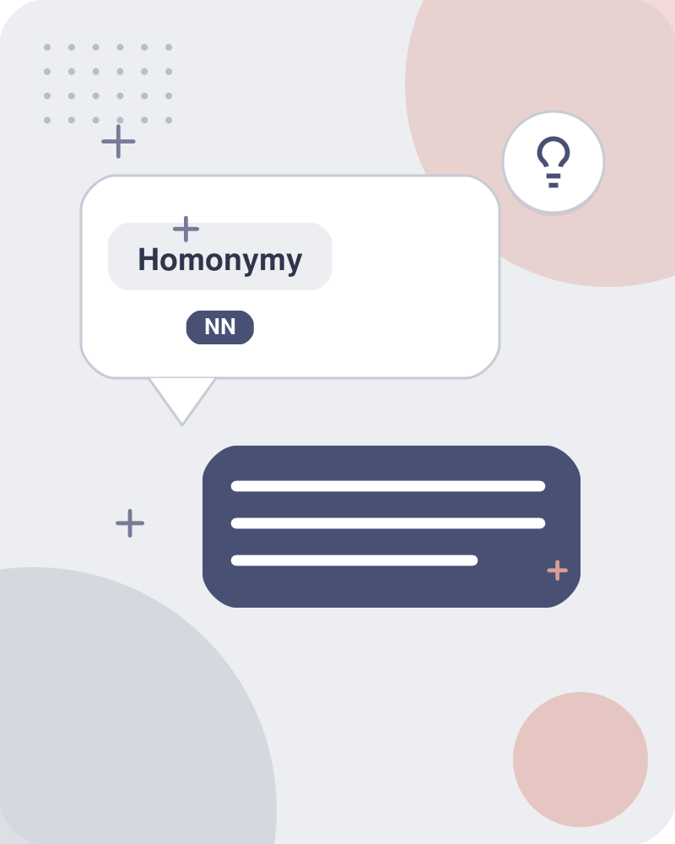
Homonymy describes unrelated meanings while polysemy describes related meanings
Homonymy: unrelated Polysemy: related meaning.
Learnova
17 / 114
Notes:
Pause: ask the class what they already know about “Homonymy describes unrelated meanings while polysemy describes related meanings” before revealing the slide.
~19s
Ask the class: Explain this slide in your own words, in one sentence.

Slide 19
Checkpoint 3
QUESTION · UNDERSTAND
Which term matches this description: “Word that shares form but not meaning with another.”?
Vector
wsd
A
B
Polysemy
Homonym
C
D
Answer: D
Homonym: Word that shares form but not meaning with another.
Learnova
18 / 114
Notes:
KEY POINT TO LAND: Answer, then check your reasoning.
Pause: ask the class what they already know about “Checkpoint 3” before revealing the slide.
~44s

Slide 20
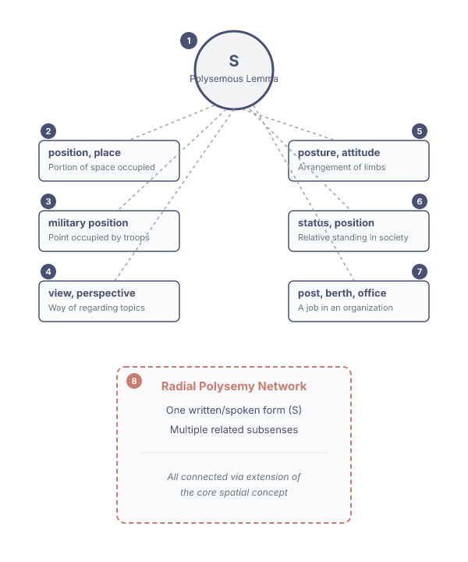
Homonymy (2/2): S
S: (n) position, place (the particular portion of space occupied by something) "he put the lamp back in its place" S: (n) military position, position (a point occupied by troops for tactical reasons) S: (n) position, view, perspective (a way of regarding situations or topics what follows from the positivist view" S: (n) position, posture, attitude (the arrangement of the body and its limbs) "he assumed an attitude of surrender" S: (n) status, position (the relative position or standing of things or especially persons in a society) "he had the status of a minor"; "the novel attained the status of a classic"; "atheists do not enjoy a favorable position in American life" S: (n) position, post, berth, office, spot, billet, place, situation (a job in an organization) "he occupied a post in the treasury".
IN PLAIN WORDS
The same spelling "S" is used for many different concepts. In everyday life it can refer to a place or a job. In the military it marks a tactical spot. In philosophy it can mean a viewpoint. In social terms it can denote status. Context tells which meaning applies. For example, "S" as a job: he occupied a post in the treasury.
Key terms: hyponym — a more specific word within a broader category · hypernym — a more general word that includes other terms
Learnova
19 / 114
Notes:
Read these exactly (do not paraphrase):
- Homonymy (2/2): S S: (n) position, place (the particular portion of space occupied by something) "he put the lamp back in its place" S: (n) military position, position (a point occupied by troops for tactical reasons) S: (n) position, view, perspective (a way of regarding situations or topics what follows from the positivist view" S: (n) position, posture, attitude (the arrangement of the body and its limbs) "he assumed an attitude of surrender" S: (n) status, position (the relative position or standing of things or especially persons in a society) "he had the status of a minor"; "the novel attained the status of a classic"; "atheists do not enjoy a favorable position in American life" S: (n) position, post, berth, office, spot, billet, place, situation (a job in an organization) "he occupied a post in the treasury"
Say what these mean, in your own words:
- hyponym: a more specific word within a broader category
- hypernym: a more general word that includes other terms
Pause: ask the class what they already know about “Homonymy (2/2): S” before revealing the slide.
Wording matters here — slow down, keep it precise.
~19s
Ask the class: Explain this slide in your own words, in one sentence.

Slide 21

Homonymy creates challenges for NLP, information retrieval, and machine translation
Homonymy causes problems for NLP
Information retrieval
Machine Translation
1
2
3
Bat
bat: murciélago (animal) or bate (for baseball)
Bass (stringed instrument) vs. bass (fish)
4
5
Key takeaway: One trigger sets off a chain of 5 effects.
Learnova
20 / 114
Notes:
Reveal, one click at a time:
1. Homonymy causes problems for NLP
2. Information retrieval
3. Machine Translation
4. bat: murciélago (animal) or bate (for baseball)
5. bass (stringed instrument) vs. bass (fish)
Read these exactly (do not paraphrase):
- Homonymy creates challenges for NLP, information retrieval, and machine translation Homonymy causes problems for NLP Information retrieval Machine Translation bat: murciélago (animal) or bate (for baseball) bass (stringed instrument) vs.
- bass (fish)
Pause: ask the class what they already know about “Homonymy creates challenges for NLP, information retrieval, and machine translation” before revealing the slide.
Wording matters here — slow down, keep it precise.
~47s
Ask the class: Where could you break this chain of events?

Slide 22
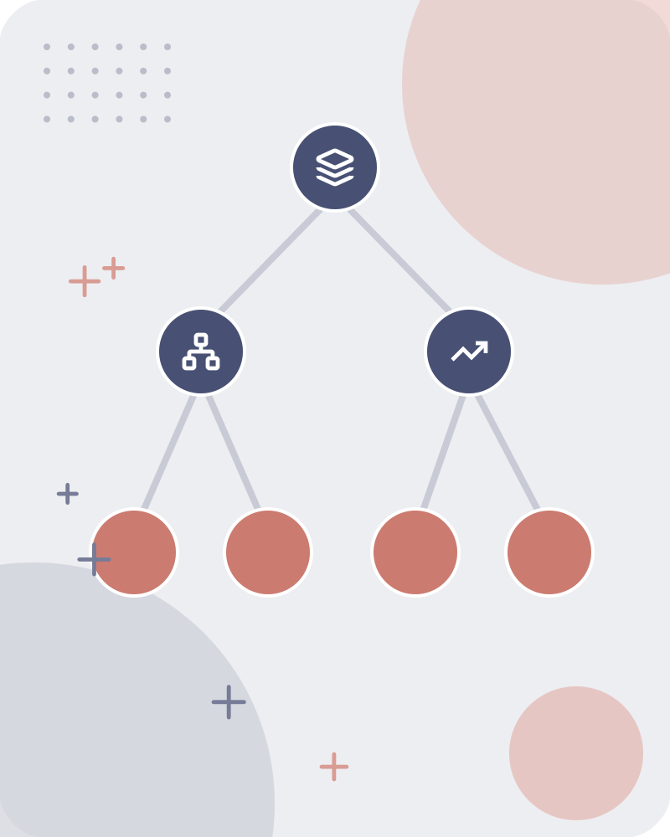


Senses relate through symmetry, hierarchy, or part-whole connections
Synonyms
couch/sofa Two lemmas with the same sense
Antonyms
cold/hot, rise/fall, in/out Two lemmas with the opposite sense
Hypernyms and hyponyms
pet/dog The hyponym (dog) is more specific than the hypernym (pet)
Holonyms and meronyms
car/wheel The meronym (wheel) is a part of the holonym (car)
IN PLAIN WORDS
Senses can be symmetrical, like synonyms or antonyms, where two words share or oppose meaning. They can be hierarchical, where one sense is a specific instance of another, such as dog under pet. They can also be part-whole, where a wheel is part of a car. For example, "Dog" is a hyponym of "pet".
Symmetric relations: Hierarchical relations:
Key terms: hypernym — a general category that includes more specific terms · holonym — a whole that contains other parts, like a car containing wheels
Learnova
▶ Open the interactive lab: Senses relate through symmetry, hierarchy, or part-whole connections — step-through
21 / 114
Notes:
Reveal, one click at a time:
1. Symmetric relations:
2. Synonyms: couch/sofa Two lemmas with the same sense
3. Antonyms: cold/hot, rise/fall, in/out Two lemmas with the opposite sense
4. Hierarchical relations:
5. Hypernyms and hyponyms: pet/dog The hyponym (dog) is more specific than the hypernym (pet)
6. Holonyms and meronyms: car/wheel The meronym (wheel) is a part of the holonym (car)
Read these exactly (do not paraphrase):
- Senses relate through symmetry, hierarchy, or part-whole connections Symmetric relations: Synonyms: couch/sofa Two lemmas with the same sense Antonyms: cold/hot, rise/fall, in/out Two lemmas with the opposite sense Hierarchical relations: Hypernyms and hyponyms: pet/dog The hyponym (dog) is more specific than the hypernym (pet) Holonyms and meronyms: car/wheel The meronym (wheel) is a part of the holonym (car)
Say what these mean, in your own words:
- hypernym: a general category that includes more specific terms
- holonym: a whole that contains other parts, like a car containing wheels
Pause: ask the class what they already know about “Senses relate through symmetry, hierarchy, or part-whole connections” before revealing the slide.
Wording matters here — slow down, keep it precise.
~54s
Ask the class: Explain this slide in your own words, in one sentence.

Slide 23

Synonyms are words that can replace each other in many contexts
Words that have the same meaning in some or all contexts
filbert / hazelnut
couch / sofa
big / large
automobile / car
vomit / throw up
ALSO ON THIS SLIDE
Water / H20 Two words are synonyms if they can be substituted for each other in all situations (strict/perfect definition).
Learnova
22 / 114
Notes:
Reveal, one click at a time:
1. Words that have the same meaning in some or all contexts.
2. filbert / hazelnut
3. couch / sofa
4. big / large
5. automobile / car
6. vomit / throw up
7. Water / H20
Read these exactly (do not paraphrase):
- filbert / hazelnut couch / sofa big / large automobile / car vomit / throw up Water / H20 Two words are synonyms if they can be substituted for each other in all situations (strict/perfect definition).
Pause: ask the class what they already know about “Synonyms are words that can replace each other in many contexts” before revealing the slide.
Wording matters here — slow down, keep it precise.
~61s
Ask the class: Explain this slide in your own words, in one sentence.

Slide 24




Perfect synonymy is rare because social factors affect word acceptability
But there are few (or no) examples of perfect synonymy
Even if many aspects of meaning are identical
Still may not preserve the acceptability based on notions of politeness, slang, register, genre, etc
Learnova
23 / 114
Notes:
Reveal, one click at a time:
1. But there are few (or no) examples of perfect synonymy.
2. Even if many aspects of meaning are identical
3. Still may not preserve the acceptability based on notions of politeness, slang, register, genre, etc.
Read these exactly (do not paraphrase):
- Perfect synonymy is rare because social factors affect word acceptability But there are few (or no) examples of perfect synonymy.
Pause: ask the class what they already know about “Perfect synonymy is rare because social factors affect word acceptability” before revealing the slide.
Wording matters here — slow down, keep it precise.
~33s
Ask the class: Explain this slide in your own words, in one sentence.

Slide 25
Checkpoint 4
QUESTION · RECALL
Fill in the blank: “But there are few (or no) _____ of perfect synonymy.”
examples
again
A
B
billet
content
C
D
Answer: A
“But there are few (or no) examples of perfect synonymy.”
Learnova
24 / 114
Notes:
KEY POINT TO LAND: Answer, then check your reasoning.
Pause: ask the class what they already know about “Checkpoint 4” before revealing the slide.
~44s

Slide 26
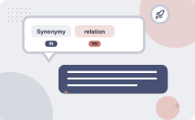
Synonymy is a relation between senses, not whole words
Consider the words big and large Are they synonyms?
How big is that plane?
Would | be flying on a large or small plane?
How about here
Miss Nelson became a kind of big sister to Benjamin.
Miss Nelson became a kind of large sister to Benjamin.
big has a sense that means being older, or grown up
large lacks this sense
ALSO ON THIS SLIDE
between senses rather than words
Learnova
25 / 114
Notes:
Reveal, one click at a time:
1. between senses rather than words
2. Consider the words big and large Are they synonyms?
3. How big is that plane?
4. Would | be flying on a large or small plane?
5. How about here:
6. Miss Nelson became a kind of big sister to Benjamin.
7. Miss Nelson became a kind of large sister to Benjamin.
Pause: ask the class what they already know about “Synonymy is a relation between senses, not whole words” before revealing the slide.
~61s
Ask the class: Explain this slide in your own words, in one sentence.

Slide 27
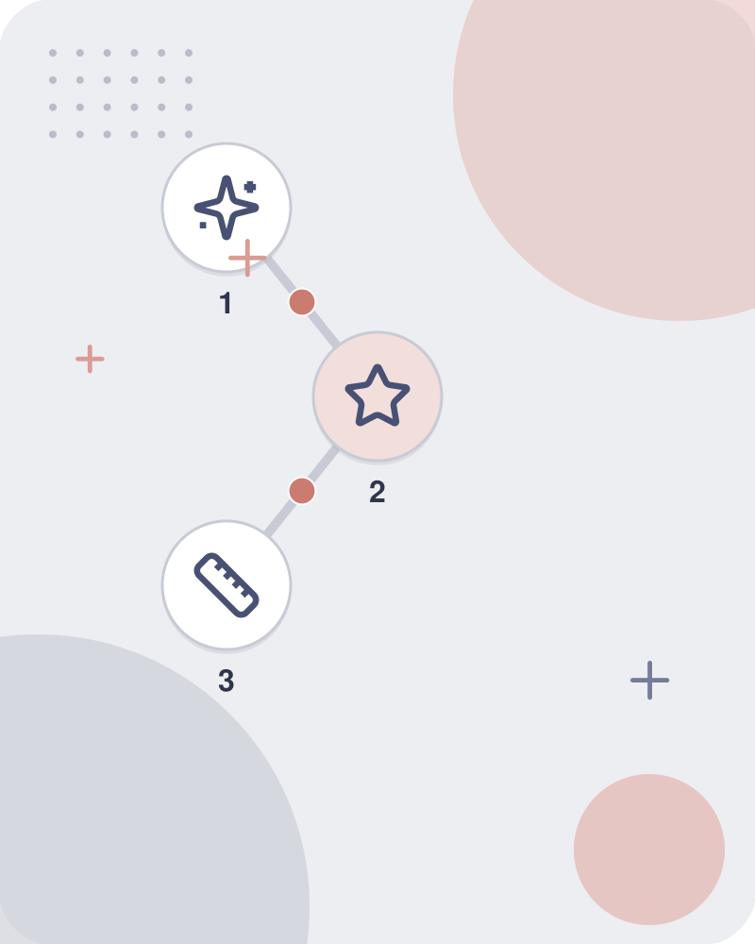

Antonyms are senses that oppose each other on a specific feature
Senses that are opposites with respect to one feature of meaning
Otherwise, they are very similar!
More formally: antonyms can
define a binary opposition or be at opposite ends of a scale
Learnova
26 / 114
Notes:
Reveal, one click at a time:
1. Senses that are opposites with respect to one feature of meaning
2. Otherwise, they are very similar!
3. More formally: antonyms can
4. define a binary opposition or be at opposite ends of a scale
Pause: ask the class what they already know about “Antonyms are senses that oppose each other on a specific feature” before revealing the slide.
~40s
Ask the class: Explain this slide in your own words, in one sentence.

Slide 28
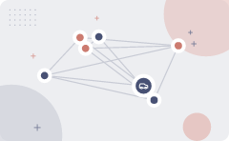
Hyponyms are specific instances of a hypernym, forming a subclass relationship
Hyponym: the sense is a subclass of another sense
caris ahyponym of vehicle
dog is a hyponym of animal
mango is a hyponym of fruit
Hypernym: the sense is a superclass vehicle is a hypernym of car
animal is a hypernym of dog fruitis ahypernym of mango
Hypernym hyponym
Learnova
27 / 114
Notes:
Reveal, one click at a time:
1. Hyponym: the sense is a subclass of another sense
2. caris ahyponym of vehicle
3. dog is a hyponym of animal
4. mango is a hyponym of fruit
5. Hypernym: the sense is a superclass vehicle is a hypernym of car
6. animal is a hypernym of dog fruitis ahypernym of mango
7. hypernym hyponym
Pause: ask the class what they already know about “Hyponyms are specific instances of a hypernym, forming a subclass relationship” before revealing the slide.
~61s
Ask the class: Explain this slide in your own words, in one sentence.

Slide 29
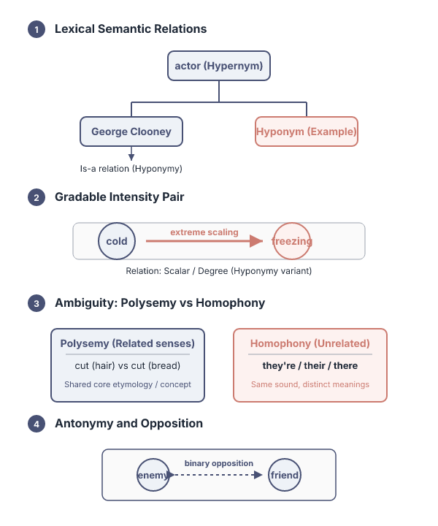
Classifying words reveals whether they are hyponyms, hypernyms, or other relations
Classify the following examples in terms of what lexical semantic relation they exhibit cold freezing they’re their hair head enemy friend cut (hair) cut (bread).
George Clooney actor.
Learnova
28 / 114
Notes:
Reveal, one click at a time:
1. Classify the following examples in terms of what lexical semantic relation they exhibit cold freezing they’re their hair
2. George Clooney actor
Read these exactly (do not paraphrase):
- Classifying words reveals whether they are hyponyms, hypernyms, or other relations Classify the following examples in terms of what lexical semantic relation they exhibit cold freezing they’re their hair head enemy friend cut (hair) cut (bread) George Clooney actor
Pause: ask the class what they already know about “Classifying words reveals whether they are hyponyms, hypernyms, or other relations” before revealing the slide.
Wording matters here — slow down, keep it precise.
~26s
Ask the class: Explain this slide in your own words, in one sentence.

Slide 30
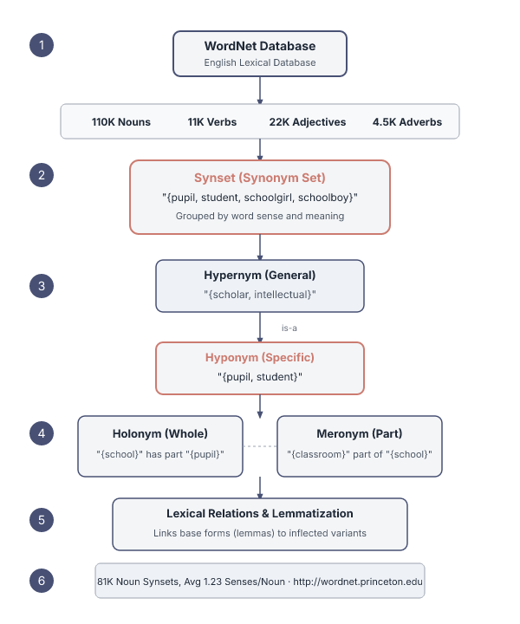
WordNet organizes English word senses into synonym sets linked by semantic relations
Very large lexical database of English: 110K nouns, 11K verbs, 22K adjectives, 4.5K adverbs (WordNets for many other languages exist or are under construction).
Word senses grouped into synonym sets (“synsets”) linked into a conceptual-semantic hierarchy 81K noun synsets, 13K verb synsets, 19K adj. synsets, 3.5K adv synsets Avg. # of senses: 1.23 nouns, 2.16 verbs, 1.41 adj, 1.24 adverbs.
Conceptual-semantic relations: hypernym/hyponym also holonym/meronym Also lexical relations, in particular lemmatization.
Available at http://wordnet.princeton.edu.
Key terms: Synset — A synonym set grouping words with identical meanings into a conceptual-semantic hierarchy. · Hypernym — A word with a broad meaning that subsumes more specific concepts.
Learnova
29 / 114
Notes:
Reveal, one click at a time:
1. Very large lexical database of English: 110K nouns, 11K verbs, 22K adjectives, 4.5K adverbs (WordNets for many other lan
2. Word senses grouped into synonym sets (“synsets”) linked into a conceptual-semantic hierarchy 81K noun synsets, 13K verb
3. Conceptual-semantic relations: hypernym/hyponym also holonym/meronym Also lexical relations, in particular lemmatization
4. Available at http://wordnet.princeton.edu
Read these exactly (do not paraphrase):
- WordNet organizes English word senses into synonym sets linked by semantic relations Very large lexical database of English: 110K nouns, 11K verbs, 22K adjectives, 4.5K adverbs (WordNets for many other languages exist or are under construction) Word senses grouped into synonym sets (“synsets”) linked into a conceptual-semantic hierarchy 81K noun synsets, 13K verb synsets, 19K adj.
Say what these mean, in your own words:
- Synset: A synonym set grouping words with identical meanings into a conceptual-semantic hierarchy.
- Hypernym: A word with a broad meaning that subsumes more specific concepts.
Pause: ask the class what they already know about “WordNet organizes English word senses into synonym sets linked by semantic relations” before revealing the slide.
~40s
Ask the class: Explain this slide in your own words, in one sentence.

Slide 31
Checkpoint 5
QUESTION · UNDERSTAND
Which term matches this description: “A synonym set grouping words with identical meanings into a conceptual-semantic hierarchy.”?
Vocabulary
mst
A
B
holonym
Synset
C
D
Answer: D
Synset: A synonym set grouping words with identical meanings into a conceptual-semantic hierarchy.
Learnova
30 / 114
Notes:
KEY POINT TO LAND: Answer, then check your reasoning.
Pause: ask the class what they already know about “Checkpoint 5” before revealing the slide.
~44s

Slide 32
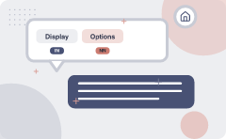
Display Options: | (Select option to change) 8 (Change )
WordNet Search - 3.0 - WordNet home page - Glossary - Help Word to search for: bass (Search WordNet)
Key: "S:" = Show Synset (semantic) relations, "W:" = Show Word (lexical) relations
Noun
  (n) bass (the lowest part of the musical range)
  S: (n) bass, bass part (the lowest part in polyphonic music)
S: (n) bass, basso (an adult male singer with the lowest voice)
S: (n) sea bass, bass (the lean flesh of a saltwater fish of the family Serranidae)
+4 more
Adjective
S: (adj) bass, deep (having or denoting a low vocal or instrumental range) "a deep voice"; "a bass voice is lower than a baritone voice"; "a bass clarinet"
WordNet home page
Learnova
31 / 114
Notes:
Reveal, one click at a time:
1. WordNet Search - 3.0 - WordNet home page - Glossary - Help Word to search for: bass (Search WordNet)
2. Key: "S:" = Show Synset (semantic) relations, "W:" = Show Word (lexical) relations
3. Noun
4. (n) bass (the lowest part of the musical range)
5. S: (n) bass, bass part (the lowest part in polyphonic music)
6. S: (n) bass, basso (an adult male singer with the lowest voice)
7. S: (n) sea bass, bass (the lean flesh of a saltwater fish of the family Serranidae)
Read these exactly (do not paraphrase):
- Display Options: | (Select option to change) 8 (Change ) WordNet Search - 3.0 - WordNet home page - Glossary - Help Word to search for: bass (Search WordNet) Key: "S:" = Show Synset (semantic) relations, "W:" = Show Word (lexical) relations Noun (n) bass (the lowest part of the musical range) S: (n) bass, bass part (the lowest part in polyphonic music) S: (n) bass, basso (an adult male singer with the lowest voice) S: (n) sea bass, bass (the lean flesh of a saltwater fish of the family Serranidae) S: (n) freshwater bass, bass (any of various North American freshwater fish with lean flesh (especially of the genus Micropterus)) S: (n) bass, bass voice, basso (the lowest adult male singing voice) (n) bass (the member with the lowest range of a family of musical instruments) S: (n) bass (nontechnical name for any of numerous edible marine and freshwater spiny-finned fishes) Adjective S: (adj) bass, deep (having or denoting a low vocal or instrumental range) "a deep voice"; "a bass voice is lower than a baritone voice"; "a bass clarinet" WordNet home page
Pause: ask the class what they already know about “Display Options: | (Select option to change) 8 (Change )” before revealing the slide.
Wording matters here — slow down, keep it precise.
~61s
Ask the class: Explain this slide in your own words, in one sentence.

Slide 33
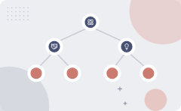
Noun synsets connect through hierarchical relations like hypernyms meronyms and holonyms
Instance hypernym/hyponym (between concepts and instances) Austen is an instance hyponym of author
Member holonym/meronym (groups and members) professor is a member meronym of (a university’s) faculty
Hypernym/hyponym (between concepts) The more general ‘meal’ is a hypernym of
the more specific ‘breakfast’
ALSO ON THIS SLIDE
Part holonym/meronym (wholes and parts) wheel is a part meronym of (is a part of) car. Substance meronym/holonym (substances and components) flour is a substance meronym of (is made of) bread
Key terms: Meronym — A term denoting a part of a larger whole, such as wheel for a car. · Holonym — A term denoting a whole whose parts are represented by other words.
Learnova
32 / 114
Notes:
Reveal, one click at a time:
1. Hypernym/hyponym (between concepts) The more general ‘meal’ is a hypernym of
2. the more specific ‘breakfast’
3. Instance hypernym/hyponym (between concepts and instances) Austen is an instance hyponym of author
4. Member holonym/meronym (groups and members) professor is a member meronym of (a university’s) faculty
5. Part holonym/meronym (wholes and parts) wheel is a part meronym of (is a part of) car.
6. Substance meronym/holonym (substances and components) flour is a substance meronym of (is made of) bread
Read these exactly (do not paraphrase):
- Noun synsets connect through hierarchical relations like hypernyms meronyms and holonyms Hypernym/hyponym (between concepts) The more general ‘meal’ is a hypernym of the more specific ‘breakfast’ Instance hypernym/hyponym (between concepts and instances) Austen is an instance hyponym of author Member holonym/meronym (groups and members) professor is a member meronym of (a university’s) faculty Part holonym/meronym (wholes and parts) wheel is a part meronym of (is a part of) car.
- Substance meronym/holonym (substances and components) flour is a substance meronym of (is made of) bread
Say what these mean, in your own words:
- Meronym: A term denoting a part of a larger whole, such as wheel for a car.
- Holonym: A term denoting a whole whose parts are represented by other words.
Pause: ask the class what they already know about “Noun synsets connect through hierarchical relations like hypernyms meronyms and holonyms” before revealing the slide.
Wording matters here — slow down, keep it precise.
~54s
Ask the class: Explain this slide in your own words, in one sentence.

Slide 34
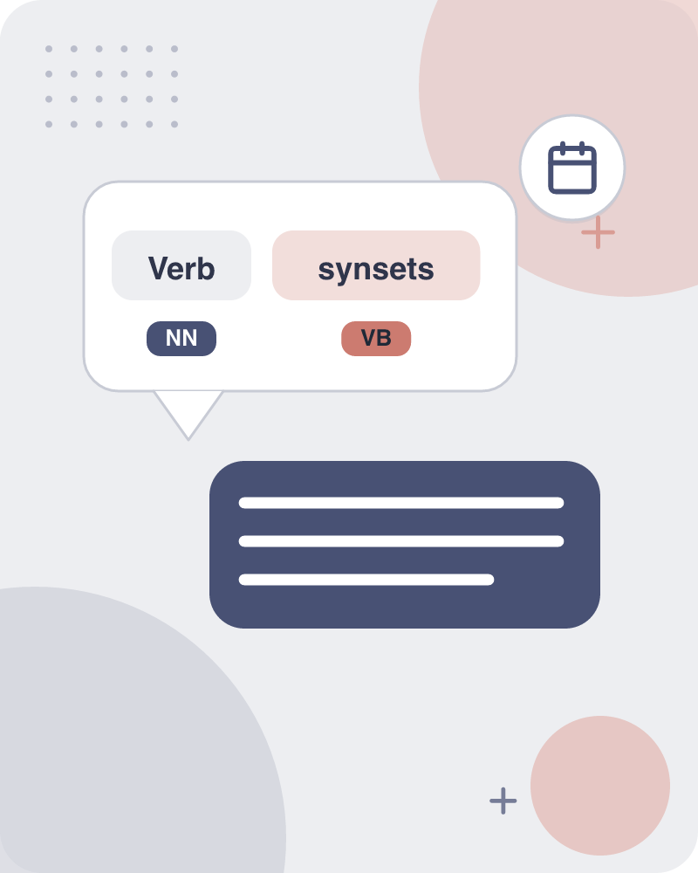
Verb synsets utilize hypernym troponym and entailment relations to connect events
Hypernym/troponym (between events): travel/fly, walk/stroll Flying is a troponym of traveling: it denotes a specific manner of traveling.
Entailment (between events): snore/sleep Snoring entails (presupposes) sleeping.
Verbs connect through specific hierarchical relations that describe events.
BUT A troponym specifies the manner of an action, while entailment shows that one event presupposes another.
BECAUSE Example: Flying is a troponym of traveling because it describes a specific manner of travel.
Key terms: Troponym — A verb describing a specific manner of doing a more general action. · Entailment — A relation where one event logically presupposes the occurrence of another.
Learnova
33 / 114
Notes:
Reveal, one click at a time:
1. Hypernym/troponym (between events): travel/fly, walk/stroll Flying is a troponym of traveling: it denotes a specific man
2. Entailment (between events): snore/sleep Snoring entails (presupposes) sleeping
3. Verbs connect through specific hierarchical relations that describe events.
4. A troponym specifies the manner of an action, while entailment shows that one event presupposes another.
5. Example: Flying is a troponym of traveling because it describes a specific manner of travel.
Read these exactly (do not paraphrase):
- Verb synsets utilize hypernym troponym and entailment relations to connect events Hypernym/troponym (between events): travel/fly, walk/stroll Flying is a troponym of traveling: it denotes a specific manner of traveling Entailment (between events): snore/sleep Snoring entails (presupposes) sleeping Verbs connect through specific hierarchical relations that describe events.
Say what these mean, in your own words:
- Troponym: A verb describing a specific manner of doing a more general action.
- Entailment: A relation where one event logically presupposes the occurrence of another.
Pause: ask the class what they already know about “Verb synsets utilize hypernym troponym and entailment relations to connect events” before revealing the slide.
~47s
Ask the class: Give one real-life example of this idea.

Slide 35
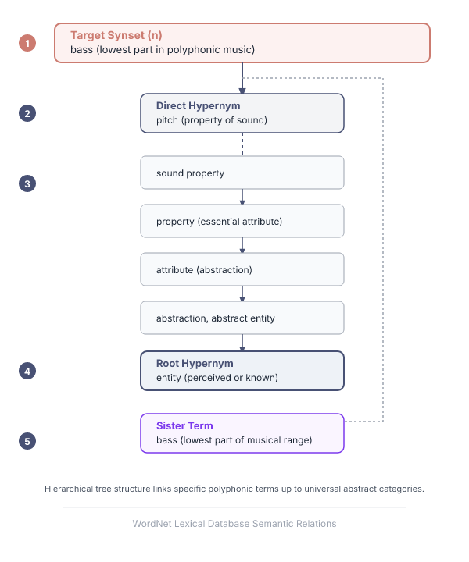



Direct and inherited hypernyms link verb synsets to broader abstract concepts
5S: (n) bass (the lowest part of the musical range)
direct hypernym | inherited hypernym / sister term
S: (n) pitch (the property of sound that varies with variation in the frequency of vibration)
S: (n) property (a basic or essential attribute shared by all members of a class) "a stuc
S: attribute (an abstraction belonging to or characteristic of an entity)
IN PLAIN WORDS
This slide illustrates how specific terms connect upward to general categories through direct and inherited hypernyms. It traces a specific musical term through broader semantic properties up to abstract entities. For example, bass connects upward through pitch and sound property to abstract entity.
Key terms: Direct hypernym — The immediate broader category or parent concept of a given term. · Inherited hypernym — A higher-level category passed down through multiple hierarchical levels.
Learnova
34 / 114
Notes:
Reveal, one click at a time:
1. 5S: (n) bass (the lowest part of the musical range)
2. direct hypernym | inherited hypernym / sister term
3. S: (n) pitch (the property of sound that varies with variation in the frequency of vibration)
4. S: (n) sound property (an attribute of sound)
5. S: (n) property (a basic or essential attribute shared by all members of a class) "a stuc
6. S: attribute (an abstraction belonging to or characteristic of an entity)
7. S: (n) abstraction, abstract entity (a general concept formed by extractins
Read these exactly (do not paraphrase):
- Direct and inherited hypernyms link verb synsets to broader abstract concepts 5S: (n) bass (the lowest part of the musical range) direct hypernym | inherited hypernym / sister term S: (n) pitch (the property of sound that varies with variation in the frequency of vibration) S: (n) sound property (an attribute of sound) S: (n) property (a basic or essential attribute shared by all members of a class) "a stuc S: attribute (an abstraction belonging to or characteristic of an entity) S: (n) abstraction, abstract entity (a general concept formed by extractins S: (a) entity (that which is perceived or known or inferred to have S: (n) bass, bass part (the lowest part in polyphonic music)
Say what these mean, in your own words:
- Direct hypernym: The immediate broader category or parent concept of a given term.
- Inherited hypernym: A higher-level category passed down through multiple hierarchical levels.
Pause: ask the class what they already know about “Direct and inherited hypernyms link verb synsets to broader abstract concepts” before revealing the slide.
Wording matters here — slow down, keep it precise.
~61s
Ask the class: Explain this slide in your own words, in one sentence.

Slide 36
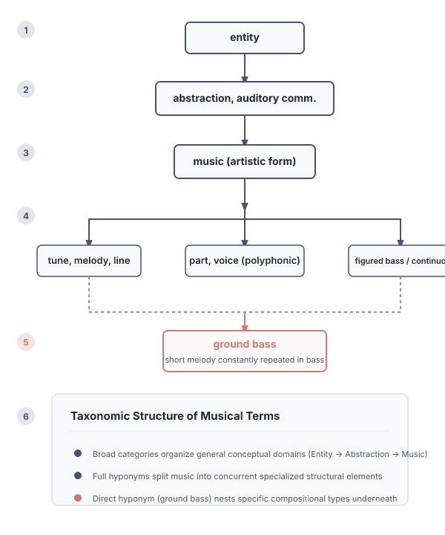
Direct and full hyponyms organize specific terms under broader conceptual categories
direct hyponym / full hyponym.
S: (a) ground bass (a short melody in the bass that is constantly repeated) S: (n) figured bass, basso continuo, continuo, thorough bass (a bass part written out in full and acc.
S: (n) part, voice (the melody carried by a particular voice or instrument in polyphonic music) "he.
S:(n) tune, melody, air, strain, melodic line, line, melodic phrase (a succession of notes for.
S: (n) music (an artistic form of auditory communication incorporating instrumental «.
S: (n) auditory communication (communication that relies on hearing).
S: (n) communication (something that is communicated by or to or betw.
S: (n) abstraction, abstract entity (a general concept formed by ext.
IN PLAIN WORDS
This slide demonstrates how general concepts branch downward into specialized hyponyms. It maps out detailed variations that belong to a broader upper-level abstraction or entity category. For example, ground bass and melodic line act as specific hyponyms under broader musical categories.
S: (n) entity (that which is perceived or known or inferred tc.
Key terms: Direct hyponym — An immediately more specific sub-concept belonging to a broader category. · Full hyponym — A specific sub-concept positioned lower in the hierarchical taxonomy.
Learnova
35 / 114
Notes:
Reveal, one click at a time:
1. direct hyponym / full hyponym
2. S: (a) ground bass (a short melody in the bass that is constantly repeated) S: (n) figured bass, basso continuo, continu
3. S: (n) part, voice (the melody carried by a particular voice or instrument in polyphonic music) "he
4. S:(n) tune, melody, air, strain, melodic line, line, melodic phrase (a succession of notes for
5. S: (n) music (an artistic form of auditory communication incorporating instrumental «
6. S: (n) auditory communication (communication that relies on hearing)
7. S: (n) communication (something that is communicated by or to or betw
Read these exactly (do not paraphrase):
- Direct and full hyponyms organize specific terms under broader conceptual categories direct hyponym / full hyponym S: (a) ground bass (a short melody in the bass that is constantly repeated) S: (n) figured bass, basso continuo, continuo, thorough bass (a bass part written out in full and acc S: (n) part, voice (the melody carried by a particular voice or instrument in polyphonic music) "he S:(n) tune, melody, air, strain, melodic line, line, melodic phrase (a succession of notes for S: (n) music (an artistic form of auditory communication incorporating instrumental « S: (n) auditory communication (communication that relies on hearing) S: (n) communication (something that is communicated by or to or betw S: (n) abstraction, abstract entity (a general concept formed by ext S: (n) entity (that which is perceived or known or inferred tc
Say what these mean, in your own words:
- Direct hyponym: An immediately more specific sub-concept belonging to a broader category.
- Full hyponym: A specific sub-concept positioned lower in the hierarchical taxonomy.
Pause: ask the class what they already know about “Direct and full hyponyms organize specific terms under broader conceptual categories” before revealing the slide.
Wording matters here — slow down, keep it precise.
~61s
Ask the class: Explain this slide in your own words, in one sentence.

Slide 37
Checkpoint 6
QUESTION · UNDERSTAND
Which term matches this description: “An immediately more specific sub-concept belonging to a broader category.”?
wsd
Direct hyponym
A
B
Collocational features
SemCor corpus
C
D
Answer: B
Direct hyponym: An immediately more specific sub-concept belonging to a broader category.
Learnova
36 / 114
Notes:
KEY POINT TO LAND: Answer, then check your reasoning.
Pause: ask the class what they already know about “Checkpoint 6” before revealing the slide.
~44s

Slide 38
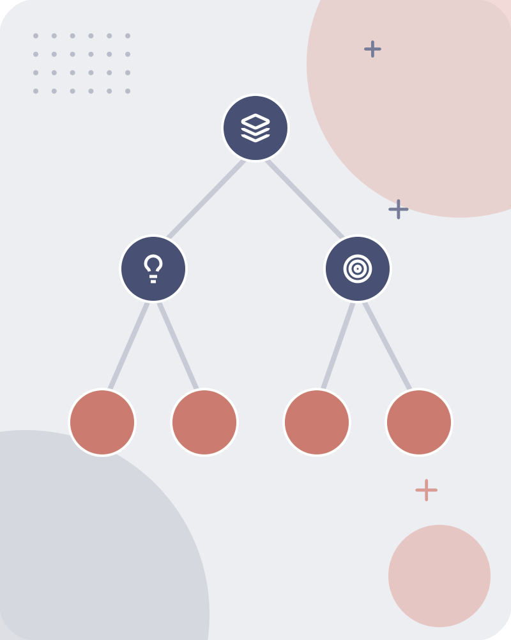
Hierarchical synset RELATIONS:VERBS: WORD SENSE DISAMBIGUATION
WORD SENSE DISAMBIGUATION.
Key terms: Word sense disambiguation — important method of NLP by which the meaning of a word is determined, which is used in a particular context
Learnova
▶ Open the interactive lab: Naive Bayes WSD Lab
37 / 114
Notes:
Say what these mean, in your own words:
- Word sense disambiguation: important method of NLP by which the meaning of a word is determined, which is used in a particular context
Pause: ask the class what they already know about “Hierarchical synset RELATIONS:VERBS: WORD SENSE DISAMBIGUATION” before revealing the slide.
~19s
Ask the class: Explain this slide in your own words, in one sentence.

Slide 39
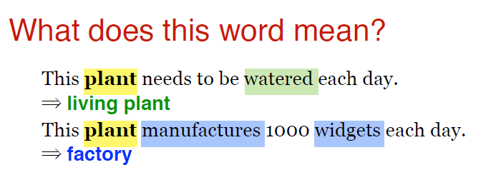
Word sense disambiguation
Learnova
▶ Open the interactive lab: Naive Bayes WSD Lab
38 / 114
Notes:
Pause: ask the class what they already know about “Word sense disambiguation” before revealing the slide.
~19s
Text in the figure: What does this word mean? This needs to be watered each day. = living plant This manufactures 1000 widgets each day. = factory
Ask the class: What might explain these numbers?

Slide 40
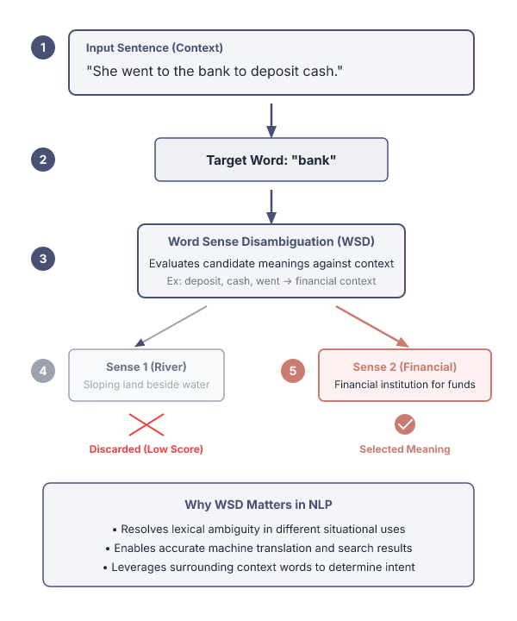
Word sense disambiguation selects the correct word meaning based on context
The task of selecting the correct sense for a word is called word sense disambiguation, or WSD. word sense.
Word Sense Disambiguation is an important method of NLP by which the meaning of a word is determined, which is used in a particular context.
NLP systems often face the challenge of properly identifying words, and determining the specific usage of a word in a particular sentence.
Word Sense Disambiguation basically solves the ambiguity that arises in determining the meaning of the same word used in different situations.
Key terms: wsd — Word Sense Disambiguation · Word Sense Disambiguation — The computational task of identifying which meaning of a polysemous word is used in context. · Ambiguity — The presence of multiple possible interpretations for the same word.
Learnova
39 / 114
Notes:
Reveal, one click at a time:
1. The task of selecting the correct sense for a word is called word sense disambiguation, or WSD. word sense.
2. Word Sense Disambiguation is an important method of NLP by which the meaning of a word is determined, which is used in a
3. NLP systems often face the challenge of properly identifying words, and determining the specific usage of a word in a pa
4. Word Sense Disambiguation basically solves the ambiguity that arises in determining the meaning of the same word used in
Say what these mean, in your own words:
- wsd: Word Sense Disambiguation
- Word Sense Disambiguation: The computational task of identifying which meaning of a polysemous word is used in context.
- Ambiguity: The presence of multiple possible interpretations for the same word.
Pause: ask the class what they already know about “Word sense disambiguation selects the correct word meaning based on context” before revealing the slide.
~40s
Ask the class: Explain this slide in your own words, in one sentence.

Slide 41
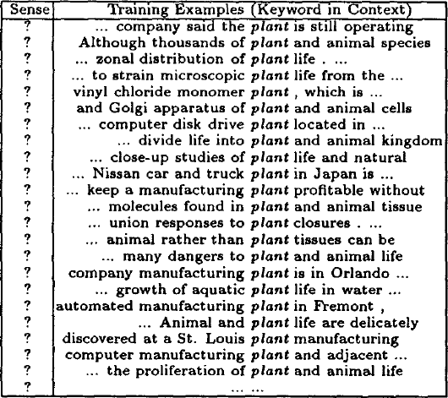
The data
Learnova
40 / 114
Notes:
Pause: ask the class what they already know about “The data” before revealing the slide.
~19s
Text in the figure: ? ~, company said the plant is still operating
? Although thousands of plant and animal species
7 +. zonal distribution of plant life . ...
? ... to strain microscopic plant life from the ...
2 vinyl chloride monomer plant , which is ...
? and Golgi apparatus of plant and animal cells
? .. computer disk drive plant located in ...
? ... divide life into plant and animal kingdom
? ... close-up studies of plant life and natural
2 ... Nissan car and truck plant in Japan is ...
? ... keep a manufacturing plant profitable without
? .. molecules found in plant and animal tissue
? .. union respo
Ask the class: What might explain these numbers?

Slide 42
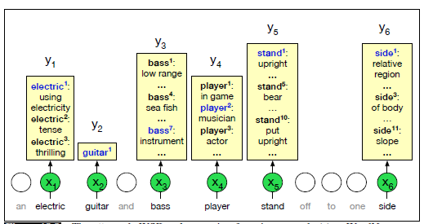
The data (continued)
Learnova
41 / 114
Notes:
Read these exactly (do not paraphrase):
- The data (continued)
Pause: ask the class what they already know about “The data (continued)” before revealing the slide.
Wording matters here — slow down, keep it precise.
~19s
Text in the figure: electric’: using lectricit electric? tense electric*®: 000 an electric off to one side
Ask the class: What might explain these numbers?

Slide 43
Checkpoint 7
QUESTION · UNDERSTAND
Which term matches this description: “The computational task of identifying which meaning of a polysemous word is used in context.”?
Inverse document frequency
Word Sense Disambiguation
A
B
A decision list
Classes
C
D
Answer: B
Word Sense Disambiguation: The computational task of identifying which meaning of a polysemous word is used in context.
Learnova
42 / 114
Notes:
KEY POINT TO LAND: Answer, then check your reasoning.
Pause: ask the class what they already know about “Checkpoint 7” before revealing the slide.
~44s

Slide 44
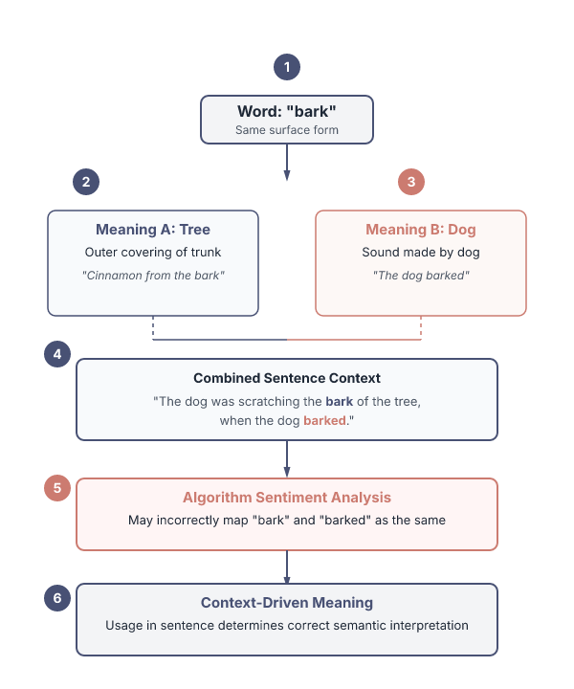
Context determines the correct meaning of ambiguous words like bark
One meaning of the word refers to the outer covering of the tree.
The other meaning refers to the sound made by a dog. here the same word has different meanings.
Let us take a piece of text.
“Cinnamon comes from the bark of the Cinnamon tree.”.
“The dog barked at the stranger.”.
Let us now try a sentence with both words.
“The dog was scratching the bark of the tree, when the man approached the dog to make it stop, the dog barked.”.
if this sentence is passed to an algorithm for sentiment analysis, “bark” and “barked” might mean the same meaning.
IN PLAIN WORDS
Words can have multiple distinct meanings depending on how they appear in a sentence. Automated systems must analyze context to prevent semantic errors during text processing tasks. For example, the word bark can refer to tree covering or a dog sound depending on context.
SO Hence, same words can mean differently based on the usage of the word in a particular sentence.
Key terms: Sentiment analysis — An automated process used to determine the emotional tone or meaning behind text. · Context — The surrounding text that clarifies the intended meaning of a specific word.
Learnova
43 / 114
Notes:
Reveal, one click at a time:
1. One meaning of the word refers to the outer covering of the tree.
2. The other meaning refers to the sound made by a dog. here the same word has different meanings.
3. Let us take a piece of text:
4. “Cinnamon comes from the bark of the Cinnamon tree.”
5. “The dog barked at the stranger.”
6. Let us now try a sentence with both words:
7. “The dog was scratching the bark of the tree, when the man approached the dog to make it stop, the dog barked.”
Read these exactly (do not paraphrase):
- Context determines the correct meaning of ambiguous words like bark One meaning of the word refers to the outer covering of the tree.
- The other meaning refers to the sound made by a dog.
- Let us take a piece of text: “Cinnamon comes from the bark of the Cinnamon tree.”
- “The dog barked at the stranger.”
Say what these mean, in your own words:
- Sentiment analysis: An automated process used to determine the emotional tone or meaning behind text.
- Context: The surrounding text that clarifies the intended meaning of a specific word.
Pause: ask the class what they already know about “Context determines the correct meaning of ambiguous words like bark” before revealing the slide.
Wording matters here — slow down, keep it precise.
~61s
Ask the class: Explain this slide in your own words, in one sentence.

Slide 45
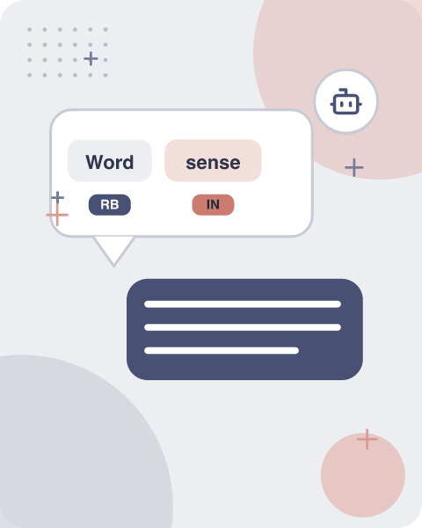




Word sense disambiguation relies on supervised thesaurus and semi-supervised methods
Supervised Machine Learning
Thesaurus/Dictionary Methods
Researchers use multiple computational approaches to solve the disambiguation challenge
Methods range
These methods range from dictionary-based resources to machine learning models trained on annotated corpora
Example: Training an algorithm using a dictionary of pre-labeled word senses
Key terms: Supervised Machine Learning — Training an algorithm using labeled examples to classify new data. · Thesaurus/Dictionary Methods — Approaches using lexical resources and semantic definitions to determine word meanings.
Learnova
44 / 114
Notes:
Reveal, one click at a time:
1. Supervised Machine Learning
2. Thesaurus/Dictionary Methods
3. Semi-Supervised Learning
4. Researchers use multiple computational approaches to solve the disambiguation challenge.
5. These methods range from dictionary-based resources to machine learning models trained on annotated corpora.
6. Example: Training an algorithm using a dictionary of pre-labeled word senses.
Say what these mean, in your own words:
- Supervised Machine Learning: Training an algorithm using labeled examples to classify new data.
- Thesaurus/Dictionary Methods: Approaches using lexical resources and semantic definitions to determine word meanings.
Pause: ask the class what they already know about “Word sense disambiguation relies on supervised thesaurus and semi-supervised methods” before revealing the slide.
~54s
Ask the class: Explain this slide in your own words, in one sentence.

Slide 46

Supervised machine learning approaches train classifiers using tagged word corpora
Supervised machine learning approach
a training corpus of words tagged in context with their sense
used to train a classifier that can tag words in new text
Summary of what we need
the tag set (“sense inventory”)
the training corpus
A set of features extracted from the training corpus
A classifier
IN PLAIN WORDS
Supervised WSD requires a defined tag set, a training corpus with sense-tagged words, extracted features, and a trained classifier. This setup allows systems to predict the correct sense for new text. For example, training a text classifier using a dataset where every noun is manually labeled with its dictionary sense.
Key terms: Training corpus — A collection of annotated text used to teach a machine learning model. · Classifier — An algorithm that assigns a categorical label to input data based on features.
Learnova
45 / 114
Notes:
Reveal, one click at a time:
1. Supervised machine learning approach:
2. a training corpus of words tagged in context with their sense
3. used to train a classifier that can tag words in new text
4. Summary of what we need:
5. the tag set (“sense inventory”)
6. the training corpus
7. A set of features extracted from the training corpus
Read these exactly (do not paraphrase):
- Supervised machine learning approaches train classifiers using tagged word corpora Supervised machine learning approach: a training corpus of words tagged in context with their sense used to train a classifier that can tag words in new text Summary of what we need: the tag set (“sense inventory”) the training corpus A set of features extracted from the training corpus A classifier
Say what these mean, in your own words:
- Training corpus: A collection of annotated text used to teach a machine learning model.
- Classifier: An algorithm that assigns a categorical label to input data based on features.
Pause: ask the class what they already know about “Supervised machine learning approaches train classifiers using tagged word corpora” before revealing the slide.
Wording matters here — slow down, keep it precise.
~61s
Ask the class: Explain this slide in your own words, in one sentence.

Slide 47
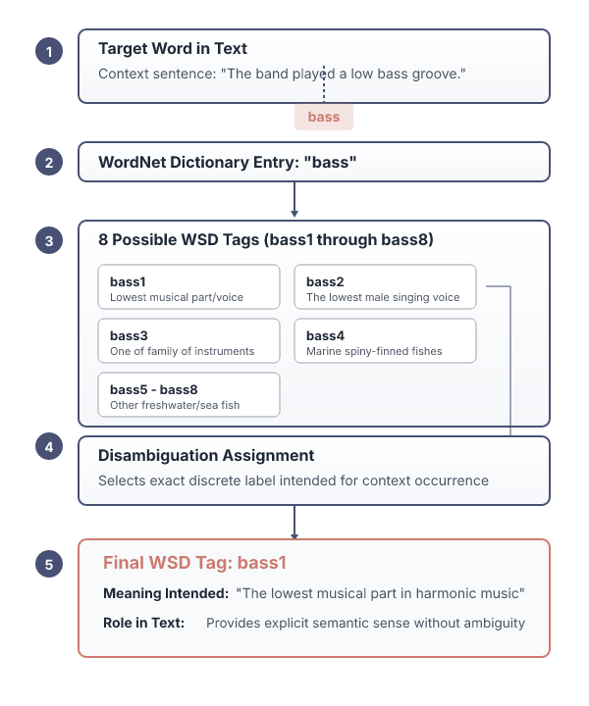
WSD tags represent specific dictionary senses assigned to words in text
What’s a tag? A dictionary sense?
E.G. For example, for WordNet an instance of “bass” in a text has 8 possible tags or labels (bass1 through bass8).
Tags serve as discrete labels that indicate the exact dictionary definition intended for a word occurrence.
E.G. For example, a word with multiple entries will have distinct tags for each possible meaning.
Example: Labeling an instance of bass with 'bass1' to indicate the lowest musical part.
Key terms: Tag — A label assigned to a word in text to denote its specific sense. · Sense inventory — The complete set of possible meaning definitions available for words in a lexicon.
Learnova
46 / 114
Notes:
Reveal, one click at a time:
1. What’s a tag? A dictionary sense?
2. For example, for WordNet an instance of “bass” in a text has 8 possible tags or labels (bass1 through bass8).
3. Tags serve as discrete labels that indicate the exact dictionary definition intended for a word occurrence.
4. For example, a word with multiple entries will have distinct tags for each possible meaning.
5. Example: Labeling an instance of bass with 'bass1' to indicate the lowest musical part.
Read these exactly (do not paraphrase):
- For example, for WordNet an instance of “bass” in a text has 8 possible tags or labels (bass1 through bass8).
Say what these mean, in your own words:
- Tag: A label assigned to a word in text to denote its specific sense.
- Sense inventory: The complete set of possible meaning definitions available for words in a lexicon.
Pause: ask the class what they already know about “WSD tags represent specific dictionary senses assigned to words in text” before revealing the slide.
~47s
Ask the class: What might explain these numbers?

Slide 48
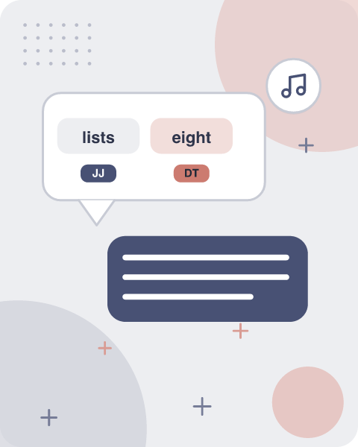




WordNet lists eight distinct semantic senses for the single word bass
1
1. BASS --(THE LOWEST PART
1. bass --(the lowest part of the musical range) 2. bass, bass part --(the lowest part in polyphonic music) 3. bass, basso --(an adult male singer with the lowest voice) 4. sea bass, bass --(flesh of lean-fleshed saltwater fish of the family
2
1. BASS --(THE LOWEST PART
3
1. BASS --(THE LOWEST PART
4
1. BASS --(THE LOWEST PART
Key takeaway: Headline: 1 — 1. bass --(the lowest part.
Learnova
47 / 114
Notes:
Reveal, one click at a time:
1. 1. bass --(the lowest part of the musical range) 2. bass, bass part --(the lowest part in polyphonic music) 3. bass, bas
2. Serranidae)
3. 5. freshwater bass, bass --(any of various North American lean-fleshed freshwater fishes especially of the genus Micropt
Read these exactly (do not paraphrase):
- bass --(the lowest part of the musical range) 2.
- bass, bass part --(the lowest part in polyphonic music) 3.
- bass, basso --(an adult male singer with the lowest voice) 4.
- sea bass, bass --(flesh of lean-fleshed saltwater fish of the family Serranidae) 5.
Pause: ask the class what they already know about “WordNet lists eight distinct semantic senses for the single word bass” before revealing the slide.
Wording matters here — slow down, keep it precise.
~33s
Ask the class: What might explain these numbers?

Slide 49
Checkpoint 8
QUESTION · RECALL
What was the figure for “1. bass --(the lowest part”?
0
2
A
B
1
3
C
D
Answer: C
1. bass --(the lowest part of the musical range) 2. bass, bass part --(the lowest part in polyphonic music) 3. bass, basso --(an adult male singer with the lowest voice) 4. sea bass, bass --(flesh of lean-fleshed saltwater fish of the family
Learnova
48 / 114
Notes:
KEY POINT TO LAND: Answer, then check your reasoning.
Pause: ask the class what they already know about “Checkpoint 8” before revealing the slide.
~44s

Slide 50

INVENTORY OF SENSETAGS FOR BASS
WordNet Sense | Spanish Translation | Roget Category | Target Word in Context
4 bass | lubina | / FISH INSECT | . . . fish as Pacific salmon and striped bass and. . .
4 bass | lubina | / FISH INSECT | . . . produce filets of smoked bass or sturgeon. . .
7 bass | bajo | MUSIC | . . . exciting jazz bass player since Ray Brown. . .
7 bass | bajo | MUSIC | . . . play bass because he doesn’t have to solo. . .
Key takeaway: 4 rows · WordNet Sense, Spanish Translation, Roget Category, Target Word in Context
Learnova
▶ Open the interactive lab: INVENTORY OF SENSETAGS FOR BASS — step-through
49 / 114
Notes:
Full detail (from the source):
[TABLE DATA] | WordNet Sense | Spanish Translation | Roget Category | Target Word in Context | | --- | --- | --- | --- | | 4 bass | lubina | / FISH INSECT | .
.
.
fish as Pacific salmon and striped bass and.
.
.
| | 4 bass | lubina | / FISH INSECT | .
.
~19s

Slide 51
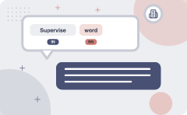
Supervised word sense disambiguation utilizes specific corpora with manually tagged examples
IN PLAIN WORDS
Supervised word sense disambiguation uses pre-tagged text datasets to train systems. This matters because it provides the labeled examples required for accurate machine learning models. It works by collecting corpora where words are explicitly linked to dictionary senses. For example, semCor provides 234,000 words from the Brown Corpus manually tagged with WordNet senses.
Lexical sample task: Line-hard-serve corpus --4000 examples of each Interest corpus --2369 sense-tagged examples All words:
Key takeaway: Highest: SemCor: (234000).
Key terms: Semantic concordance — A corpus where each open-class word is labeled with a sense from a dictionary. · SemCor — A subset of the Brown Corpus manually tagged with WordNet senses.
Learnova
50 / 114
Notes:
Reveal, one click at a time:
1. Lexical sample task:
2. Line-hard-serve corpus --4000 examples of each
3. Interest corpus --2369 sense-tagged examples
4. All words:
5. Semantic concordance: a corpus in which each open-class word is labeled with a sense from a specific dictionary/thesauru
6. SemCor: 234,000 words from Brown Corpus, manually tagged with WordNet senses
7. SENSEVAL-3competition corpora --2081 tagged word tokens
Say what these mean, in your own words:
- Semantic concordance: A corpus where each open-class word is labeled with a sense from a dictionary.
- SemCor: A subset of the Brown Corpus manually tagged with WordNet senses.
Pause: ask the class what they already know about “Supervised word sense disambiguation utilizes specific corpora with manually tagged examples” before revealing the slide.
~61s
Ask the class: Explain this slide in your own words, in one sentence.

Slide 52

SemCor corpus entries annotate words with parts of speech and lemmas
MARKUP EXAMPLE
1
wf pos=PRP>He</wf>
2
wf pos=VB lemma=recognize wnsn=4 lexsn=2:31:00::>recognized</wf>
3
wf pos=DT>the</wf>
4
wf pos=NN lemma=gesture wnsn=1 lexsn=1:04:00::>gesture</wf>
5
punc>.</punc>
6
SemCor data explicitly marks the grammatical structure and dictionary meanings of text.
7
This matters because it gives computational tools precise linguistic annotations to learn from.
8
It works by wrapping words in XML-like tags detailing part of speech, lemma, and WordNet sense number.
9
Example: The word recognized is tagged with its part of speech, lemma, and WordNet sense number.
Key terms: Lemma — The base dictionary form of a word. · Part of speech — A category assigned to a word based on its syntactic roles.
Learnova
51 / 114
Notes:
Reveal, one click at a time:
1. wf pos=PRP>He</wf>
2. wf pos=VB lemma=recognize wnsn=4 lexsn=2:31:00::>recognized</wf>
3. wf pos=DT>the</wf>
4. wf pos=NN lemma=gesture wnsn=1 lexsn=1:04:00::>gesture</wf>
5. punc>.</punc>
6. SemCor data explicitly marks the grammatical structure and dictionary meanings of text.
7. This matters because it gives computational tools precise linguistic annotations to learn from.
Read these exactly (do not paraphrase):
- SemCor corpus entries annotate words with parts of speech and lemmas wf pos=PRP>He</wf> wf pos=VB lemma=recognize wnsn=4 lexsn=2:31:00::>recognized</wf> wf pos=DT>the</wf> wf pos=NN lemma=gesture wnsn=1 lexsn=1:04:00::>gesture</wf> punc>.</punc> SemCor data explicitly marks the grammatical structure and dictionary meanings of text.
Say what these mean, in your own words:
- Lemma: The base dictionary form of a word.
- Part of speech: A category assigned to a word based on its syntactic roles.
Pause: ask the class what they already know about “SemCor corpus entries annotate words with parts of speech and lemmas” before revealing the slide.
~61s
Ask the class: Explain this slide in your own words, in one sentence.

Slide 53
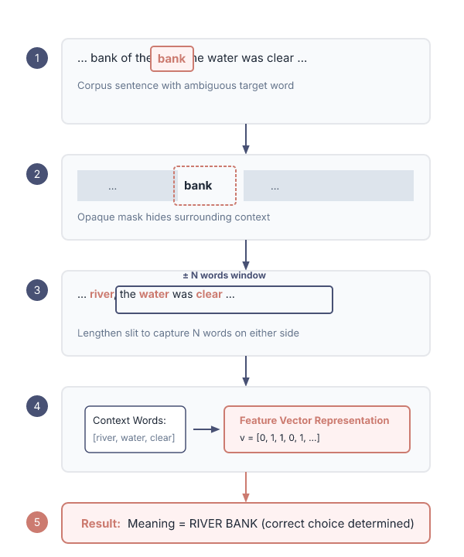
Surrounding context words determine the meaning of a target word
SUPERVISED WSD 3: EXTRACT FEATURE VECTORS.
“If one examines the words in a book, one at a time as through an opaque mask with a hole in it one word wide, then it is obviously impossible to determine, one at a time, the meaning of the words… But if one lengthens the slit in the opaque mask, until one can see not only the central word in question but also say N words on either side, then if N is large enough one can unambiguously decide the meaning of the central word… The practical question is: ``What minimum value of N will, at least in a tolerable fraction of cases, lead to the correct choice of meaning for the central word?”.
Learnova
52 / 114
Notes:
Reveal, one click at a time:
1. SUPERVISED WSD 3: EXTRACT FEATURE VECTORS
2. “If one examines the words in a book, one at a time as through an opaque mask with a hole in it one word wide, then it i
Read these exactly (do not paraphrase):
- Surrounding context words determine the meaning of a target word SUPERVISED WSD 3: EXTRACT FEATURE VECTORS “If one examines the words in a book, one at a time as through an opaque mask with a hole in it one word wide, then it is obviously impossible to determine, one at a time, the meaning of the words… But if one lengthens the slit in the opaque mask, until one can see not only the central word in question but also say N words on either side, then if N is large enough one can unambiguously decide the meaning of the central word… The practical question is: ``What minimum value of N will, at least in a tolerable fraction of cases, lead to the correct choice of meaning for the central word?”
Pause: ask the class what they already know about “Surrounding context words determine the meaning of a target word” before revealing the slide.
Wording matters here — slow down, keep it precise.
~26s
Ask the class: Explain this slide in your own words, in one sentence.

Slide 54

Feature vectors represent target word observations using ordered lists of values
A simple representation for each observation (each instance of a target word).
Vectors of sets of feature/value pairs.
Represented as a ordered list of values.
These vectors represent, e.g., the window of words around the target.
Feature vectors organize text observations into structured numerical formats.
BECAUSE This matters because algorithms require mathematical representations instead of raw text to process data.
It works by mapping context words and features into an ordered list of values representing a window around a target.
Example: A vector records the specific words appearing within a two-word radius of a target.
Key terms: Feature vector — A simple representation of an observation using an ordered list of feature-value pairs.
Learnova
53 / 114
Notes:
Reveal, one click at a time:
1. FEATUREVECTORS
2. A simple representation for each observation (each instance of a target word)
3. Vectors of sets of feature/value pairs
4. Represented as a ordered list of values
5. These vectors represent, e.g., the window of words around the target
6. Feature vectors organize text observations into structured numerical formats.
7. This matters because algorithms require mathematical representations instead of raw text to process data.
Read these exactly (do not paraphrase):
- Feature vectors represent target word observations using ordered lists of values FEATUREVECTORS A simple representation for each observation (each instance of a target word) Vectors of sets of feature/value pairs Represented as a ordered list of values These vectors represent, e.g., the window of words around the target Feature vectors organize text observations into structured numerical formats.
Say what these mean, in your own words:
- Feature vector: A simple representation of an observation using an ordered list of feature-value pairs.
Pause: ask the class what they already know about “Feature vectors represent target word observations using ordered lists of values” before revealing the slide.
~61s
Ask the class: Explain this slide in your own words, in one sentence.

Slide 55
Checkpoint 9
QUESTION · UNDERSTAND
Which term matches this description: “A simple representation of an observation using an ordered list of feature-value pairs.”?
Document frequency
Systematic polysemy
A
B
ConditionalProbabilities
Feature vector
C
D
Answer: D
Feature vector: A simple representation of an observation using an ordered list of feature-value pairs.
Learnova
54 / 114
Notes:
KEY POINT TO LAND: Answer, then check your reasoning.
Pause: ask the class what they already know about “Checkpoint 9” before revealing the slide.
~44s

Slide 56
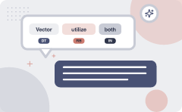
Vector representations utilize both collocational and bag-of-words features
Collocational features and bag-of-words features
Collocational
Features about words at specific positions near target word
  Often limited to just word identity and POS
Bag-of-words
Features about words that occur anywhere in the window (regardless of position)
  Typically limited to frequency counts
ALSO ON THIS SLIDE
Feature vectors divide context information into position-dependent and position-independent metrics. This matters because different features capture distinct types of linguistic clues. Collocational features track exact positions, while bag-of-words features count total occurrences within a window regardless of location. Example: Tracking the exact word immediately to the left is collocational, while counting total nearby words is bag-of-words.
Key terms: Collocational features — Information about words and parts of speech at specific positions near a target. · Bag-of-words features — Frequency counts of words occurring anywhere within a surrounding window.
Learnova
▶ Open the interactive lab: Vector Representations: Collocational vs Bag‑of‑Words Features
55 / 114
Notes:
Reveal, one click at a time:
1. Collocational features and bag-of-words features
2. Collocational
3. Features about words at specific positions near target word
4. Often limited to just word identity and POS
5. Bag-of-words
6. Features about words that occur anywhere in the window (regardless of position)
7. Typically limited to frequency counts
Read these exactly (do not paraphrase):
- Vector representations utilize both collocational and bag-of-words features Collocational features and bag-of-words features Collocational Features about words at specific positions near target word Often limited to just word identity and POS Bag-of-words Features about words that occur anywhere in the window (regardless of position) Typically limited to frequency counts Feature vectors divide context information into position-dependent and position-independent metrics.
Say what these mean, in your own words:
- Collocational features: Information about words and parts of speech at specific positions near a target.
- Bag-of-words features: Frequency counts of words occurring anywhere within a surrounding window.
Pause: ask the class what they already know about “Vector representations utilize both collocational and bag-of-words features” before revealing the slide.
~61s
Ask the class: Explain this slide in your own words, in one sentence.

Slide 57

Example text demonstrates establishing a specific context window around a target word
Example text (WSJ): An electric guitar and bass player stand off to one side not really part of the scene.
Assume a window of +/--2 from the target.
Example sentences illustrate how to isolate text segments for analysis.
BECAUSE This matters because it establishes a concrete boundary for what context an algorithm examines.
It works by centering on a target word and selecting a fixed number of surrounding words on each side.
Example: Looking two words left and two words right of the target word bass in a sentence.
Learnova
56 / 114
Notes:
Reveal, one click at a time:
1. EXAMPLES
2. Example text (WSJ): An electric guitar and bass player stand off to one side not really part of the scene
3. Assume a window of +/--2 from the target
4. Example sentences illustrate how to isolate text segments for analysis.
5. This matters because it establishes a concrete boundary for what context an algorithm examines.
6. It works by centering on a target word and selecting a fixed number of surrounding words on each side.
7. Example: Looking two words left and two words right of the target word bass in a sentence.
Read these exactly (do not paraphrase):
- Example text demonstrates establishing a specific context window around a target word EXAMPLES Example text (WSJ): An electric guitar and bass player stand off to one side not really part of the scene Assume a window of +/--2 from the target Example sentences illustrate how to isolate text segments for analysis.
Pause: ask the class what they already know about “Example text demonstrates establishing a specific context window around a target word” before revealing the slide.
~61s
Ask the class: What might explain these numbers?

Slide 58
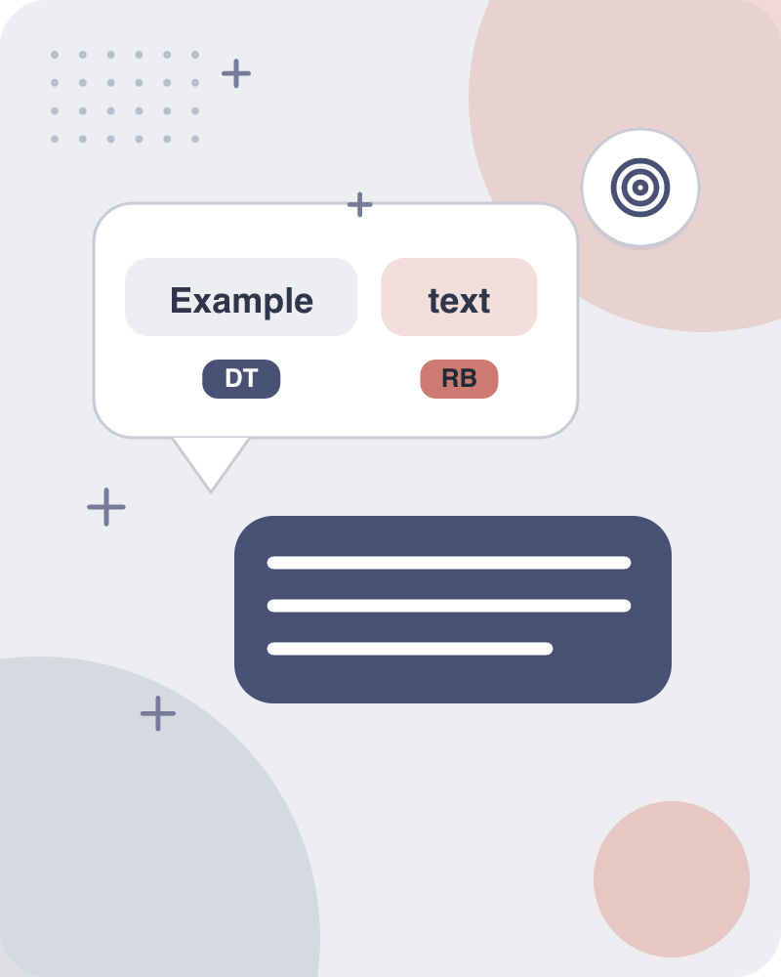
Example text demonstrates establishing a specific context window around a target word
Example text (WSJ) An electric guitar and bass player stand off to one side not really part of the scene.
Assume a window of +/--2 from the target.
Example sentences illustrate how to isolate text segments for analysis.
BECAUSE This matters because it establishes a concrete boundary for what context an algorithm examines.
It works by centering on a target word and selecting a fixed number of surrounding words on each side.
Example: Examining words within a plus-or-minus two word window around bass in a Wall Street Journal excerpt.
Key terms: wsj — Example text
Learnova
57 / 114
Notes:
Reveal, one click at a time:
1. EXAMPLES
2. Example text (WSJ) An electric guitar and bass player stand off to one side not really part of the scene,
3. Assume a window of +/--2 from the target
4. Example sentences illustrate how to isolate text segments for analysis.
5. This matters because it establishes a concrete boundary for what context an algorithm examines.
6. It works by centering on a target word and selecting a fixed number of surrounding words on each side.
7. Example: Examining words within a plus-or-minus two word window around bass in a Wall Street Journal excerpt.
Read these exactly (do not paraphrase):
- Example text demonstrates establishing a specific context window around a target word EXAMPLES Example text (WSJ) An electric guitar and bass player stand off to one side not really part of the scene, Assume a window of +/--2 from the target Example sentences illustrate how to isolate text segments for analysis.
Say what these mean, in your own words:
- wsj: Example text
Pause: ask the class what they already know about “Example text demonstrates establishing a specific context window around a target word” before revealing the slide.
~61s
Ask the class: What might explain these numbers?

Slide 59



Collocational features capture position-specific information for words in a window
1
I+
i+1
2
[WI—
[wi—2
1,
WI— W
wi—1,w
1,2,3
GRAMS
word 1,2,3 grams in window of ±3 is common
ALSO ON THIS SLIDE
POSi—2,wi—1,POSi—1,wi+1,POSi+1,wi+2,POS
Key takeaway: Headline: 1 — i+.
Learnova
58 / 114
Notes:
Reveal, one click at a time:
1. COLLOCATIONAL FEATURES
2. Position-specific information about the words and collocations in window
3. guitar and bass player stand
4. i+1
5. [wi—2
6. wi—1,w
7. POSi—2,wi—1,POSi—1,wi+1,POSi+1,wi+2,POS
Read these exactly (do not paraphrase):
- Collocational features capture position-specific information for words in a window COLLOCATIONAL FEATURES Position-specific information about the words and collocations in window guitar and bass player stand i+1 [wi—2 wi—1,w POSi—2,wi—1,POSi—1,wi+1,POSi+1,wi+2,POS i+2 [ g u i t a r, NN, and, CC, player, NN, stand, VB, and g u i t a r, player stand] word 1,2,3 grams in window of ±3 is common
Pause: ask the class what they already know about “Collocational features capture position-specific information for words in a window” before revealing the slide.
Wording matters here — slow down, keep it precise.
~61s
Ask the class: What might explain these numbers?

Slide 60
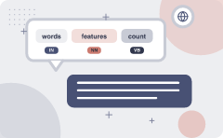
Bag-of-words features count term frequencies while ignoring word positions
“an unordered set of words” – position ignored
Counts of words occur within the window.
Then count how often each of those terms occurs in a given window
sometimes just a binary “indicator” 1 or 0
ALSO ON THIS SLIDE
BAG-OF-WORDS FEATURES First choose a vocabulary
Learnova
59 / 114
Notes:
Reveal, one click at a time:
1. BAG-OF-WORDS FEATURES
2. “an unordered set of words” – position ignored
3. Counts of words occur within the window.
4. First choose a vocabulary
5. Then count how often each of those terms occurs in a given window
6. sometimes just a binary “indicator” 1 or 0
Read these exactly (do not paraphrase):
- Bag-of-words features count term frequencies while ignoring word positions BAG-OF-WORDS FEATURES “an unordered set of words” – position ignored Counts of words occur within the window.
Pause: ask the class what they already know about “Bag-of-words features count term frequencies while ignoring word positions” before revealing the slide.
Wording matters here — slow down, keep it precise.
~54s
Ask the class: Explain this slide in your own words, in one sentence.

Slide 61
Checkpoint 10
QUESTION · RECALL
What was the figure for “Assume a window of +/--”?
3
1
A
B
2
4
C
D
Answer: C
Assume a window of +/--2 from the target
Learnova
60 / 114
Notes:
KEY POINT TO LAND: Answer, then check your reasoning.
Pause: ask the class what they already know about “Checkpoint 10” before revealing the slide.
~44s

Slide 62
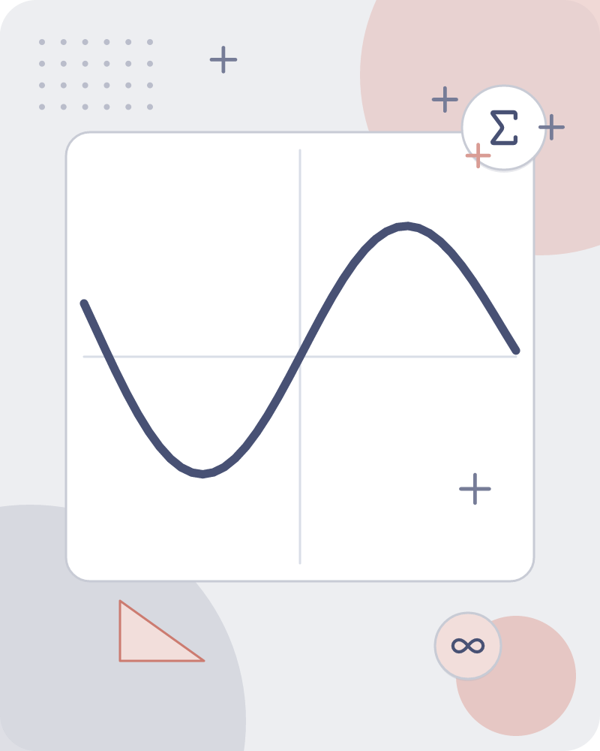
Co-occurrence vectors represent words as frequency arrays based on a fixed vocabulary
Assume we’ve settled on a possible vocabulary of 12 words in “bass” sentences
[fishing, big, sound, player, fly, rod, pound, double, runs, playing, guitar, band]
Vector
The vector for
guitar and bass player stand [0,0,0,1,0,0,0,0,0,0,1,0]
IN PLAIN WORDS
For example, a 12-word vocabulary maps the sentence 'guitar and bass player stand' to [0,0,0,1,0,0,0,0,0,0,1,0].
Key terms: Vocabulary — A fixed set of selected words used to build feature vectors. · Vector — An array of numbers representing word occurrences within a given context.
Learnova
61 / 114
Notes:
Reveal, one click at a time:
1. Assume we’ve settled on a possible vocabulary of 12 words in “bass” sentences:
2. [fishing, big, sound, player, fly, rod, pound, double, runs, playing, guitar, band]
3. The vector for:
4. guitar and bass player stand [0,0,0,1,0,0,0,0,0,0,1,0]
Say what these mean, in your own words:
- Vocabulary: A fixed set of selected words used to build feature vectors.
- Vector: An array of numbers representing word occurrences within a given context.
Pause: ask the class what they already know about “Co-occurrence vectors represent words as frequency arrays based on a fixed vocabulary” before revealing the slide.
~40s
Ask the class: Explain this slide in your own words, in one sentence.

Slide 63

Classification maps an input word and features to a predicted class from a fixed set
Classification | Features
: DEFINITION | A word w and some features f
Takes an input word with its | And assigns it to a predefined class
Key takeaway: Key difference — Classification: : DEFINITION | Features: A word w and some features f
Key terms: Classification — The process of predicting a class for an input word and features. · Classes — A fixed set of categories like C = {c1, c2,…, cJ}.
Learnova
62 / 114
Notes:
Reveal, one click at a time:
1. CLASSIFICATION: DEFINITION
2. a word w and some features f
3. a fixed set of classes C = {c1, c2,…, cJ}
4. Output: a predicted class c∈C
5. Classification takes an input word with its features and assigns it to a predefined class.
6. This process helps categorize ambiguous terms into specific meanings using a fixed set of options.
7. Example: Mapping the word 'bass' to either the fish class or the music class.
Read these exactly (do not paraphrase):
- Classification maps an input word and features to a predicted class from a fixed set CLASSIFICATION: DEFINITION a word w and some features f a fixed set of classes C = {c1, c2,…, cJ} Output: a predicted class c∈C Classification takes an input word with its features and assigns it to a predefined class.
Say what these mean, in your own words:
- Classification: The process of predicting a class for an input word and features.
- Classes: A fixed set of categories like C = {c1, c2,…, cJ}.
Pause: ask the class what they already know about “Classification maps an input word and features to a predicted class from a fixed set” before revealing the slide.
~61s
Ask the class: What happens to the result if one of the inputs doubles?

Slide 64
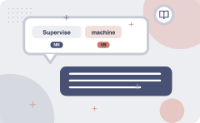
Supervised machine learning uses hand-labeled text windows to learn a classifier
Input
a word w in a text window d (which we’ll call a “document”)
a fixed set of classes C = {c1, c2,…, cJ}
A training set of m hand-labeledtext windows again called
  “documents” (d1,c1),....,(dm,cm)
Output
a learned classifier γ:d →c
ALSO ON THIS SLIDE
“documents” (d1,c1),....,(dm,cm) Supervised machine learning trains a system using hand-labeled text windows and documents. It takes inputs like a word in a text window and learns a function that outputs a predicted class. Example: Using labeled documents (d1, c1) to learn a classifier mapping documents to classes.
Key terms: Supervised machine learning — An approach using a training set of hand-labeled documents to learn a classifier. · Classifier — A learned function that maps an input text window to an output class.
Learnova
63 / 114
Notes:
Reveal, one click at a time:
1. Input:
2. a word w in a text window d (which we’ll call a “document”)
3. a fixed set of classes C = {c1, c2,…, cJ}
4. A training set of m hand-labeledtext windows again called
5. “documents” (d1,c1),....,(dm,cm)
6. Output:
7. a learned classifier γ:d →c
Read these exactly (do not paraphrase):
- Supervised machine learning uses hand-labeled text windows to learn a classifier Input: a word w in a text window d (which we’ll call a “document”) a fixed set of classes C = {c1, c2,…, cJ} A training set of m hand-labeledtext windows again called “documents” (d1,c1),....,(dm,cm) Output: a learned classifier γ:d →c Supervised machine learning trains a system using hand-labeled text windows and documents.
- Example: Using labeled documents (d1, c1) to learn a classifier mapping documents to classes.
Say what these mean, in your own words:
- Supervised machine learning: An approach using a training set of hand-labeled documents to learn a classifier.
- Classifier: A learned function that maps an input text window to an output class.
Pause: ask the class what they already know about “Supervised machine learning uses hand-labeled text windows to learn a classifier” before revealing the slide.
Wording matters here — slow down, keep it precise.
~61s
Ask the class: Explain this slide in your own words, in one sentence.

Slide 65
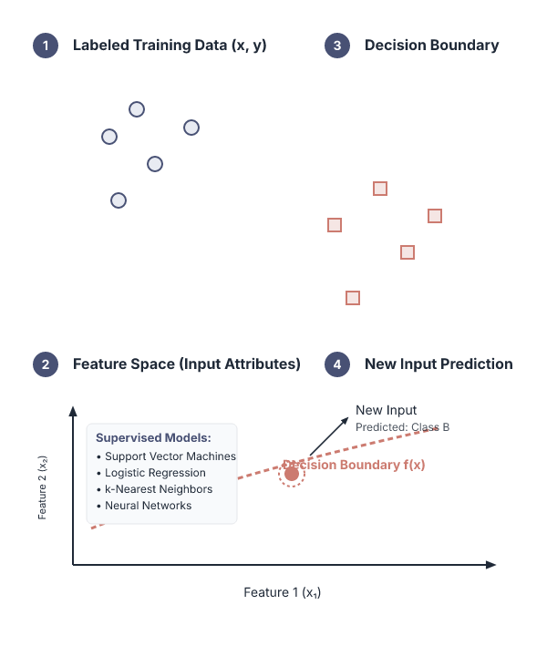


Supervised machine learning encompasses multiple classification algorithms
METHODS: SUPERVISED
Any kind of classifier
Naive Bayes
Logistic regression
Neural Networks
Support-vector machines
ALSO ON THIS SLIDE
k-Nearest Neighbors Supervised methods include various algorithms used to build classifiers. These approaches analyze training data to predict outcomes for new inputs. Example: Using Naive Bayes or Support-vector machines for classification tasks.
Key terms: Naive Bayes — A supervised machine learning classification algorithm. · Support-vector machines — A supervised machine learning method used for classification.
Learnova
64 / 114
Notes:
Reveal, one click at a time:
1. METHODS: SUPERVISED
2. Any kind of classifier
3. Naive Bayes
4. Logistic regression
5. Neural Networks
6. Support-vector machines
7. k-Nearest Neighbors
Say what these mean, in your own words:
- Naive Bayes: A supervised machine learning classification algorithm.
- Support-vector machines: A supervised machine learning method used for classification.
Pause: ask the class what they already know about “Supervised machine learning encompasses multiple classification algorithms” before revealing the slide.
~61s
Ask the class: Explain this slide in your own words, in one sentence.

Slide 66
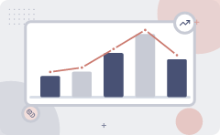
Applying naive bayes to WSD relies on prior and conditional probabilities from corpora
We get both of these from a tagged corpus like SemCor
P(c) is the prior probability of that sense
Counting in a labeled training set.
P(w|c) conditional probability of a word given a particular sense
P(w|c) = count(w,c)/count(c)
Can also generalize to look at other features besides words.
Then it would be P(f|c)
  Conditional probability of a feature given a sense
IN PLAIN WORDS
For example, calculating P(w|c) as the count of a word given a sense divided by the total sense count.
Key terms: Prior probability — The probability of a specific sense calculated by counting in a labeled training set. · Conditional probability — The probability of a word or feature given a particular sense.
Learnova
65 / 114
Notes:
Reveal, one click at a time:
1. P(c) is the prior probability of that sense
2. Counting in a labeled training set.
3. P(w|c) conditional probability of a word given a particular sense
4. P(w|c) = count(w,c)/count(c)
5. We get both of these from a tagged corpus like SemCor
6. Can also generalize to look at other features besides words.
7. Then it would be P(f|c)
Read these exactly (do not paraphrase):
- Applying naive bayes to WSD relies on prior and conditional probabilities from corpora P(c) is the prior probability of that sense Counting in a labeled training set.
- P(w|c) conditional probability of a word given a particular sense P(w|c) = count(w,c)/count(c) We get both of these from a tagged corpus like SemCor Can also generalize to look at other features besides words.
- Then it would be P(f|c) Conditional probability of a feature given a sense
Say what these mean, in your own words:
- Prior probability: The probability of a specific sense calculated by counting in a labeled training set.
- Conditional probability: The probability of a word or feature given a particular sense.
Pause: ask the class what they already know about “Applying naive bayes to WSD relies on prior and conditional probabilities from corpora” before revealing the slide.
Wording matters here — slow down, keep it precise.
~61s
Ask the class: Explain this slide in your own words, in one sentence.

Slide 67
Checkpoint 11
QUESTION · UNDERSTAND
Which term matches this description: “The probability of a specific sense calculated by counting in a labeled training set.”?
Choosing a class
Conditional probability
A
B
Prior probability
Lexeme
C
D
Answer: C
Prior probability: The probability of a specific sense calculated by counting in a labeled training set.
Learnova
66 / 114
Notes:
KEY POINT TO LAND: Answer, then check your reasoning.
Pause: ask the class what they already know about “Checkpoint 11” before revealing the slide.
~44s

Slide 68

Choosing a class with naive bayes involves calculating conditional probabilities and class counts
CHOOSING A CLASS WITH NAIVE BAYES INVOLVES CALCULATING CONDITIONAL PROBABILITIES AND CLASS COUNTS
Pˆ(C) = NC Pˆ(w | c) = count(w,c)+1 V = {fish, smoked, line, haul, guitar, jazz} Choosing a class: 3/4 * 2/14 * (1/14) * 1/14 ConditionalProbabilities: P(line|f) =
$$V=fish$$
IN PLAIN WORDS
For example, multiplying probabilities like 3/4 * 2/14 * (1/14) * 1/14 to choose a class.
Key takeaway: Remember: V = {fish
Key terms: ConditionalProbabilities — Probabilities of features given a specific class, adjusted with counts. · Choosing a class — The final computation step multiplying prior and conditional probabilities.
Learnova
67 / 114
Notes:
Reveal, one click at a time:
1. Pˆ(C) = NC
2. Pˆ(w | c) = count(w,c)+1
3. V = {fish, smoked, line, haul, guitar, jazz}
4. Choosing a class:
5. 3/4 * 2/14 * (1/14) * 1/14
6. ConditionalProbabilities: P(line|f) =
Read these exactly (do not paraphrase):
- Choosing a class with naive bayes involves calculating conditional probabilities and class counts Pˆ(C) = NC Pˆ(w | c) = count(w,c)+1 V = {fish, smoked, line, haul, guitar, jazz} Choosing a class: 3/4 * 2/14 * (1/14) * 1/14 ConditionalProbabilities: P(line|f) =
Say what these mean, in your own words:
- ConditionalProbabilities: Probabilities of features given a specific class, adjusted with counts.
- Choosing a class: The final computation step multiplying prior and conditional probabilities.
Pause: ask the class what they already know about “Choosing a class with naive bayes involves calculating conditional probabilities and class counts” before revealing the slide.
Wording matters here — slow down, keep it precise.
~54s
Ask the class: What happens to the result if one of the inputs doubles?

Slide 69
Applying naive bayes to WSD (2/2): 1+1) / (8+6)
(1+1) / (8+6) = 2/14
P(guitar|f) = (0+1) / (8+6) = 1/14
IN PLAIN WORDS
For example, calculating P(guitar|f) as (0+1) / (8+6) = 1/14.
Key terms: Probability — A calculated fraction representing the likelihood of a feature occurring within a sense. · Feature — A specific word or context checked against a sense.
Learnova
68 / 114
Notes:
Reveal, one click at a time:
1. (1+1) / (8+6) = 2/14
2. P(guitar|f) = (0+1) / (8+6) = 1/14
3. 1/4 * 2/9 * (2/9)2 * 2/9
4. (0+1) / (8+6) = 1/14
5. (1+1) / (3+6) = 2/9
6. P(guitar|g) = (1+1) / (3+6) = 2/9 P(jazz|g)
Read these exactly (do not paraphrase):
- Applying naive bayes to WSD (2/2): 1+1) / (8+6) (1+1) / (8+6) = 2/14 P(guitar|f) = (0+1) / (8+6) = 1/14 1/4 * 2/9 * (2/9)2 * 2/9 (0+1) / (8+6) = 1/14 (1+1) / (3+6) = 2/9 P(guitar|g) = (1+1) / (3+6) = 2/9 P(jazz|g)
Say what these mean, in your own words:
- Probability: A calculated fraction representing the likelihood of a feature occurring within a sense.
- Feature: A specific word or context checked against a sense.
Pause: ask the class what they already know about “Applying naive bayes to WSD (2/2): 1+1) / (8+6)” before revealing the slide.
Wording matters here — slow down, keep it precise.
~54s
Ask the class: Explain this slide in your own words, in one sentence.

Slide 70

APPLYING NAIVE BAYES TO WSD (2/2)
 | Doc | Words | Class
Training | 1 | fish smoked fish | f
 | 2 | fish line | f
 | 3 | fish haul smoked | f
 | 4 | guitar jazz line | g
Test | 5 | line guitar jazz jazz | ?
Key takeaway: 5 rows · Doc, Words, Class
Learnova
69 / 114
Notes:
Read these exactly (do not paraphrase):
- APPLYING NAIVE BAYES TO WSD (2/2)
Full detail (from the source):
[TABLE DATA] | | Doc | Words | Class | | --- | --- | --- | --- | | Training | 1 | fish smoked fish | f | | | 2 | fish line | f | | | 3 | fish haul smoked | f | | | 4 | guitar jazz line | g | | Test | 5 | line guitar jazz jazz | ?
|
Wording matters here — slow down, keep it precise.
~19s

Slide 71
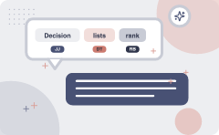
Decision lists rank scored yes-no questions to determine word senses
1
A decision list is an ordered list of yes-no questions bass1 = fish vs. bass2 = music:
2
Does ‘fish’ occur in window? - Yes. => bass1 2. Is the previous word ‘striped ’? - Yes. => bass1 3. Does ‘guitar’ occur in window? - Yes. => bass2 4. Is the following word ‘player’? - Yes. => bass2
3
Learning a decision list for a word with two senses:
4
Define a feature set: what kind of questions do you want to ask?
5
Enumerate all features (questions) the training data gives answers for
6
Score each feature:
7
P(sense
f
8
1 i
IN PLAIN WORDS
For example, asking 'Does fish occur in window?' to decide if bass means fish.
Key terms: Decision list — An ordered list of yes-no questions used to classify word senses. · Feature set — The collection of defined questions asked about the context.
Learnova
70 / 114
Notes:
Reveal, one click at a time:
1. A decision list is an ordered list of yes-no questions bass1 = fish vs. bass2 = music:
2. 1. Does ‘fish’ occur in window? - Yes. => bass1 2. Is the previous word ‘striped ’? - Yes. => bass1 3. Does ‘guitar’ occ
3. Learning a decision list for a word with two senses:
4. Define a feature set: what kind of questions do you want to ask?
5. Enumerate all features (questions) the training data gives answers for
6. Score each feature:
7. P(sense | f)
8. 1 i
9. score( f) = log
10. P(sense2| fi)
11. Rank all features by their score
Read these exactly (do not paraphrase):
- Decision lists rank scored yes-no questions to determine word senses A decision list is an ordered list of yes-no questions bass1 = fish vs.
- bass2 = music: 1.
- => bass1 2.
- => bass1 3.
Say what these mean, in your own words:
- Decision list: An ordered list of yes-no questions used to classify word senses.
- Feature set: The collection of defined questions asked about the context.
Pause: ask the class what they already know about “Decision lists rank scored yes-no questions to determine word senses” before revealing the slide.
Wording matters here — slow down, keep it precise.
~89s
Ask the class: Explain this slide in your own words, in one sentence.

Slide 72
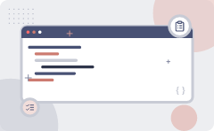
WSD evaluations use extrinsic task-based tests or intrinsic accuracy metrics against baselines
Best evaluation: extrinsic (‘end-to-end’, `task-based’) evaluation
Embed WSD algorithm in a task and see if you can do the task better!
What we often do for convenience: intrinsic evaluation
Exact match sense accuracy
  % of words tagged identically with the human-manual sense tags
Usually evaluate using held-out data from same labeled corpus
Baselines
Most frequent sense
The Lesk algorithm
IN PLAIN WORDS
For example, using exact match sense accuracy to measure the percentage of identically tagged words.
Key terms: wsd — Word Sense Disambiguation · Extrinsic evaluation — Task-based evaluation embedding a WSD algorithm into a larger task. · Intrinsic evaluation — Convenience evaluation measuring exact match sense accuracy against manual tags.
Learnova
71 / 114
Notes:
Reveal, one click at a time:
1. Best evaluation: extrinsic (‘end-to-end’, `task-based’) evaluation
2. Embed WSD algorithm in a task and see if you can do the task better!
3. What we often do for convenience: intrinsic evaluation
4. Exact match sense accuracy
5. % of words tagged identically with the human-manual sense tags
6. Usually evaluate using held-out data from same labeled corpus
7. Baselines
Read these exactly (do not paraphrase):
- WSD evaluations use extrinsic task-based tests or intrinsic accuracy metrics against baselines Best evaluation: extrinsic (‘end-to-end’, `task-based’) evaluation Embed WSD algorithm in a task and see if you can do the task better!
Say what these mean, in your own words:
- wsd: Word Sense Disambiguation
- Extrinsic evaluation: Task-based evaluation embedding a WSD algorithm into a larger task.
- Intrinsic evaluation: Convenience evaluation measuring exact match sense accuracy against manual tags.
Pause: ask the class what they already know about “WSD evaluations use extrinsic task-based tests or intrinsic accuracy metrics against baselines” before revealing the slide.
Wording matters here — slow down, keep it precise.
~61s
Ask the class: Explain this slide in your own words, in one sentence.

Slide 73
Checkpoint 12
QUESTION · UNDERSTAND
Which term matches this description: “Task-based evaluation embedding a WSD algorithm into a larger task.”?
high-density component
Polysemy
A
B
Extrinsic evaluation
Sentiment analysis
C
D
Answer: C
Extrinsic evaluation: Task-based evaluation embedding a WSD algorithm into a larger task.
Learnova
72 / 114
Notes:
KEY POINT TO LAND: Answer, then check your reasoning.
Pause: ask the class what they already know about “Checkpoint 12” before revealing the slide.
~44s

Slide 74

The most frequent sense baseline takes the first WordNet sense derived from SemCor
1
2
3
So “most frequent sense”
in WordNet = “take the first sense”
Most frequent sense method acts
as a standard baseline by taking the first sense listed in WordNet
Example
Example: Choosing the first sense of a word in WordNet as the default prediction
ALSO ON THIS SLIDE
WordNet senses are ordered in frequency order Sense frequencies come from the SemCor corpus WordNet senses are ordered by frequency using data from the SemCor corpus.
Key takeaway: 3 steps — from “So “most frequent sense”” to “Example”.
Key terms: Most frequent sense — The strategy of taking the first, most common sense from WordNet. · SemCor corpus — The text collection providing sense frequencies for WordNet.
Learnova
73 / 114
Notes:
Reveal, one click at a time:
1. WordNet senses are ordered in frequency order
2. So “most frequent sense” in WordNet = “take the first sense”
3. Sense frequencies come from the SemCor corpus
4. The most frequent sense method acts as a standard baseline by taking the first sense listed in WordNet.
5. WordNet senses are ordered by frequency using data from the SemCor corpus.
6. Example: Choosing the first sense of a word in WordNet as the default prediction.
Read these exactly (do not paraphrase):
- The most frequent sense baseline takes the first WordNet sense derived from SemCor WordNet senses are ordered in frequency order So “most frequent sense” in WordNet = “take the first sense” Sense frequencies come from the SemCor corpus The most frequent sense method acts as a standard baseline by taking the first sense listed in WordNet.
Say what these mean, in your own words:
- Most frequent sense: The strategy of taking the first, most common sense from WordNet.
- SemCor corpus: The text collection providing sense frequencies for WordNet.
Pause: ask the class what they already know about “The most frequent sense baseline takes the first WordNet sense derived from SemCor” before revealing the slide.
~54s
Ask the class: Explain this slide in your own words, in one sentence.

Slide 75
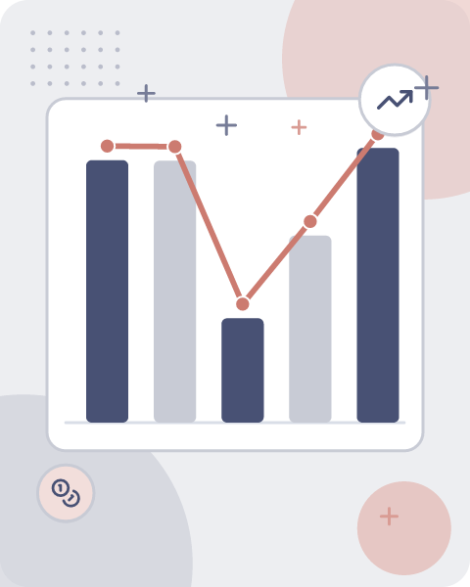




Human interannotator agreement establishes a ceiling for word sense annotation accuracy
Human inter-annotator agreement
Compare annotations of two humans
Same data
On same data
Given same tagging guidelines
Human agreements on all-wordscorpora with WordNet style senses
Human inter-annotator agreement measures how consistently two humans compare annotations on the same data using tagging guidelines
ALSO ON THIS SLIDE
CEILING This agreement provides a performance ceiling for all-words corpora with WordNet-style senses. Example: Two annotators comparing word tags on the same text.
Key terms: Inter-annotator agreement — A comparison of annotations made by two humans on the same data using tagging guidelines. · WordNet — A lexical database providing style senses used to measure human agreements on all-words corpora.
Also in this lecture: Choose sense with most word overlap between gloss and context (not counting function words) The bank can guarantee ill eventually cover future tuition costs because it invests in adjustable-rate’ securities.
Learnova
▶ Open the interactive lab: POS Tagging (HMM) Lab
74 / 114
Notes:
Reveal, one click at a time:
1. CEILING
2. Human inter-annotator agreement
3. Compare annotations of two humans
4. On same data
5. Given same tagging guidelines
6. Human agreements on all-wordscorpora with WordNet style senses
7. Human inter-annotator agreement measures how consistently two humans compare annotations on the same data using tagging
Read these exactly (do not paraphrase):
- This agreement provides a performance ceiling for all-words corpora with WordNet-style senses.
Say what these mean, in your own words:
- Inter-annotator agreement: A comparison of annotations made by two humans on the same data using tagging guidelines.
- WordNet: A lexical database providing style senses used to measure human agreements on all-words corpora.
Pause: ask the class what they already know about “Human interannotator agreement establishes a ceiling for word sense annotation accuracy” before revealing the slide.
~61s
Ask the class: Explain this slide in your own words, in one sentence.

Slide 76
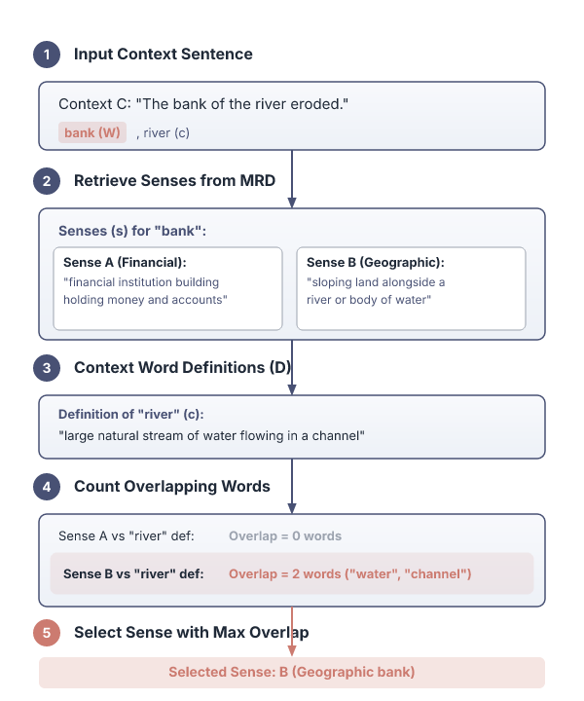
Dictionary based approaches select word senses with the most overlap with context
Rely on machine readable dictionaries.
BECAUSE Initial implementation of this kind of approach is due to Michael Lesk (1986) e “Lesk algorithm”.
Given a word W to be disambiguated in context C.
Retrieve all of the sense definitions, S, for W from the MRD Compare each s in S to the dictionary definitions D of all the remaining words c in the context C Select the sense s with the most overlap with D (the definitions of the context words C).
Key terms: Lesk algorithm — An initial machine-readable dictionary approach comparing sense definitions with context word definitions. · Context — The remaining words surrounding a word to be disambiguated.
Learnova
75 / 114
Notes:
Reveal, one click at a time:
1. Rely on machine readable dictionaries
2. Initial implementation of this kind of approach is due to Michael Lesk (1986) e “Lesk algorithm”
3. Given a word W to be disambiguated in context C
4. Retrieve all of the sense definitions, S, for W from the MRD Compare each s in S to the dictionary definitions D of all
Read these exactly (do not paraphrase):
- Dictionary based approaches select word senses with the most overlap with context Rely on machine readable dictionaries Initial implementation of this kind of approach is due to Michael Lesk (1986) e “Lesk algorithm” Given a word W to be disambiguated in context C Retrieve all of the sense definitions, S, for W from the MRD Compare each s in S to the dictionary definitions D of all the remaining words c in the context C Select the sense s with the most overlap with D (the definitions of the context words C)
Say what these mean, in your own words:
- Lesk algorithm: An initial machine-readable dictionary approach comparing sense definitions with context word definitions.
- Context: The remaining words surrounding a word to be disambiguated.
Pause: ask the class what they already know about “Dictionary based approaches select word senses with the most overlap with context” before revealing the slide.
Wording matters here — slow down, keep it precise.
~40s
Ask the class: Explain this slide in your own words, in one sentence.

Slide 77
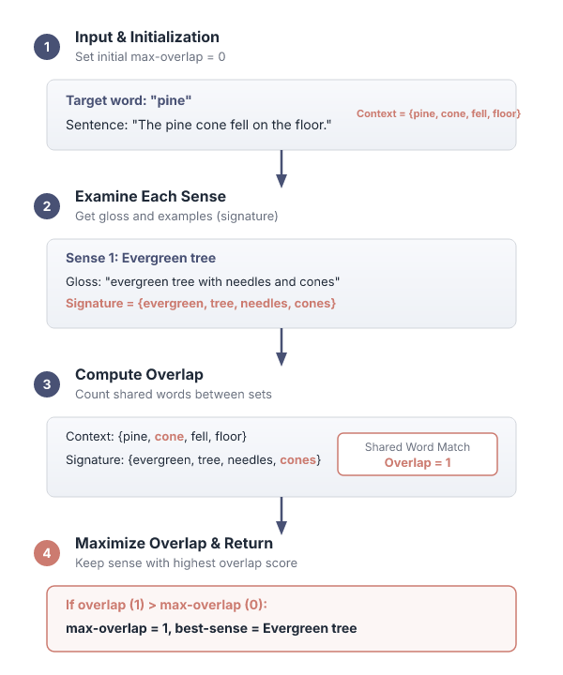
The simplified Lesk algorithm finds the best sense by maximizing word overlap
function SIMPLIFIED LESK(word, sentence) returns best sense of word.
best-sense — most frequent sense for word max-overlap —0 context — set of words in sentence for each sezse in senses of word do signature — set of words in the gloss and examples of overlap — COMPUTEOVERLAP(signiature, context) if overlap > max-overlap then.
max-overlap — overlap best-sense — sense.
end return(best-sense).
Key terms: Signature — The set of words in the gloss and examples of a word sense. · Best sense — The sense that yields the maximum overlap with the sentence context.
Learnova
76 / 114
Notes:
Reveal, one click at a time:
1. function SIMPLIFIED LESK(word, sentence) returns best sense of word
2. best-sense — most frequent sense for word max-overlap —0 context — set of words in sentence for each sezse in senses of
3. max-overlap — overlap best-sense — sense
4. end return(best-sense)
Read these exactly (do not paraphrase):
- The simplified Lesk algorithm finds the best sense by maximizing word overlap function SIMPLIFIED LESK(word, sentence) returns best sense of word best-sense — most frequent sense for word max-overlap —0 context — set of words in sentence for each sezse in senses of word do signature — set of words in the gloss and examples of overlap — COMPUTEOVERLAP(signiature, context) if overlap > max-overlap then max-overlap — overlap best-sense — sense end return(best-sense)
Say what these mean, in your own words:
- Signature: The set of words in the gloss and examples of a word sense.
- Best sense: The sense that yields the maximum overlap with the sentence context.
Pause: ask the class what they already know about “The simplified Lesk algorithm finds the best sense by maximizing word overlap” before revealing the slide.
Wording matters here — slow down, keep it precise.
~40s
Ask the class: Explain this slide in your own words, in one sentence.

Slide 78
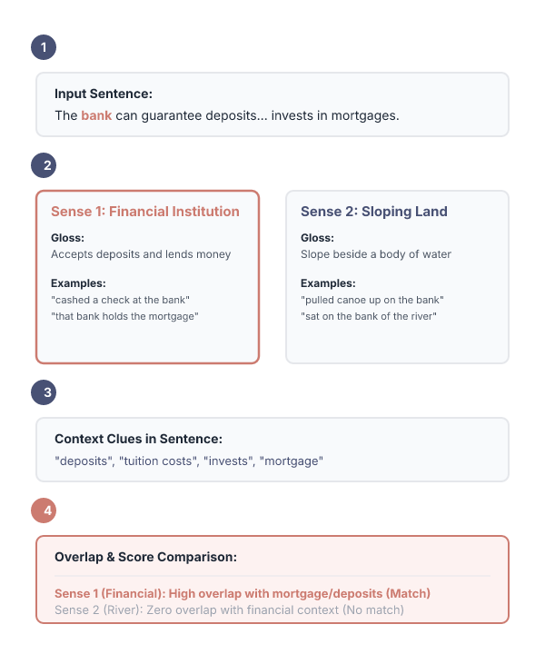

WordNet senses illustrate how to disambiguate bank using glosses and examples
Gloss
a financial institution that accepts deposits and channels the
Examples
“he cashed a check at the bank”, “that bank holds the mortgage
Gloss
sloping land (especially the slope beside a body of water)
Examples
“they pulled the canoe up on the bank”, “he sat on the bank of
ALSO ON THIS SLIDE
Let’s disambiguate “bank” in this sentence: The bank can guarantee deposits will eventually cover future tuition costs because it invests in adjustable-rate mortgage securities. given the following two WordNet senses: money into lending activities the river and watched the currents”
Key terms: Gloss — A dictionary definition explaining the meaning of a specific word sense. · Disambiguate — To determine the correct meaning of a word based on its context.
Learnova
77 / 114
Notes:
Reveal, one click at a time:
1. Let’s disambiguate “bank” in this sentence: The bank can guarantee deposits will eventually cover future tuition costs b
2. given the following two WordNet senses:
3. bank! Gloss: a financial institution that accepts deposits and channels the
4. money into lending activities
5. Examples: “he cashed a check at the bank”, “that bank holds the mortgage
6. bank? Gloss: sloping land (especially the slope beside a body of water)
7. Examples: “they pulled the canoe up on the bank”, “he sat on the bank of
Read these exactly (do not paraphrase):
- Gloss: a financial institution that accepts deposits and channels the money into lending activities Examples: “he cashed a check at the bank”, “that bank holds the mortgage bank?
- Gloss: sloping land (especially the slope beside a body of water) Examples: “they pulled the canoe up on the bank”, “he sat on the bank of the river and watched the currents”
Say what these mean, in your own words:
- Gloss: A dictionary definition explaining the meaning of a specific word sense.
- Disambiguate: To determine the correct meaning of a word based on its context.
Pause: ask the class what they already know about “WordNet senses illustrate how to disambiguate bank using glosses and examples” before revealing the slide.
Wording matters here — slow down, keep it precise.
~61s
Ask the class: Explain this slide in your own words, in one sentence.

Slide 79
Checkpoint 13
QUESTION · UNDERSTAND
Which term matches this description: “A dictionary definition explaining the meaning of a specific word sense.”?
minimum spanning tree
Gloss
A
B
SemCor corpus
Definition sensitivity
C
D
Answer: B
Gloss: A dictionary definition explaining the meaning of a specific word sense.
Learnova
78 / 114
Notes:
KEY POINT TO LAND: Answer, then check your reasoning.
Pause: ask the class what they already know about “Checkpoint 13” before revealing the slide.
~44s

Slide 80
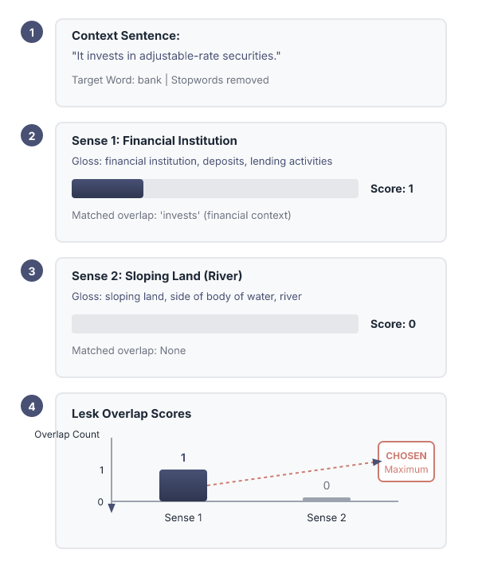
The Simplified Lesk algorithm: Choose sense
Gloss
a financial institution that deposits} and channels the
Examples
“he cashed a check at the bank”, “that bank holds
Gloss
sloping land (especially the slope beside a body of water)
Examples
“they pulled the canoe up on the bank”, “he sat on the bank of
ALSO ON THIS SLIDE
Choose sense with most word overlap between gloss and context (not counting function words) The bank can guarantee ill eventually cover future tuition costs because it invests in adjustable-rate’ securities. money into lending activities
Learnova
▶ Open the interactive lab: The Simplified Lesk algorithm: Choose sense — step-through
79 / 114
Notes:
Reveal, one click at a time:
1. Choose sense with most word overlap between gloss and context
2. (not counting function words)
3. The bank can guarantee ill eventually cover future tuition costs because it invests in adjustable-rate’ securities.
4. Gloss: a financial institution that deposits} and channels the
5. money into lending activities
6. Examples: “he cashed a check at the bank”, “that bank holds
7. bank? Gloss: sloping land (especially the slope beside a body of water)
Read these exactly (do not paraphrase):
- The Simplified Lesk algorithm: Choose sense Choose sense with most word overlap between gloss and context (not counting function words) The bank can guarantee ill eventually cover future tuition costs because it invests in adjustable-rate’ securities.
- Gloss: a financial institution that deposits} and channels the money into lending activities Examples: “he cashed a check at the bank”, “that bank holds bank?
- Gloss: sloping land (especially the slope beside a body of water) Examples: “they pulled the canoe up on the bank”, “he sat on the bank of the river and watched the currents”
Pause: ask the class what they already know about “The Simplified Lesk algorithm: Choose sense” before revealing the slide.
Wording matters here — slow down, keep it precise.
~61s
Ask the class: Explain this slide in your own words, in one sentence.

Slide 81

The Lesk algorithm assigns senses by comparing context to dictionary definitions
Basic idea: Compare the context with the dictionary definition of the sense.
Assign the dictionary sense whose gloss and examples are most similar to the context in which the word occurs.
Compare the signature of a word in context with the signatures of its senses in the dictionary Assign the sense that is most similar to the context
Signature = set of content words (in examples/gloss or in context) Similarity = size of intersection of context signature and sense signature
Key terms: Signature — The set of content words found in examples, glosses, or context. · Similarity — The size of the intersection between the context signature and the sense signature.
Learnova
80 / 114
Notes:
Reveal, one click at a time:
1. Basic idea: Compare the context with the dictionary definition of the sense.
2. Assign the dictionary sense whose gloss and examples are most similar to the context in which the word occurs.
3. Compare the signature of a word in context with the signatures of its senses in the dictionary Assign the sense that is
4. Signature = set of content words (in examples/gloss or in context) Similarity = size of intersection of context signatur
Read these exactly (do not paraphrase):
- Compare the signature of a word in context with the signatures of its senses in the dictionary Assign the sense that is most similar to the context Signature = set of content words (in examples/gloss or in context) Similarity = size of intersection of context signature and sense signature
Say what these mean, in your own words:
- Signature: The set of content words found in examples, glosses, or context.
- Similarity: The size of the intersection between the context signature and the sense signature.
Pause: ask the class what they already know about “The Lesk algorithm assigns senses by comparing context to dictionary definitions” before revealing the slide.
~40s
Ask the class: Explain this slide in your own words, in one sentence.

Slide 82

Sense signatures compile words from dictionary glosses and examples for different meanings
bank1: Gloss: a financial institution that accepts deposits and channels the money into lending activities Examples: “he cashed the check at the bank”, “that bank holds the mortgage on my home” Signature(bank1) = {financial, institution, accept, deposit, channel, money, lend, activity, cash, check, hold, mortgage, home}.
Gloss: sloping land (especially the slope beside a body of water) Examples: “they pulled the canoe up on the bank”, “he sat on the bank of the river and watched the current” Signature(bank2) = {slope, land, body, water, pull, canoe, sit, river, watch, current}.
Key terms: Signature — The set of content words derived from a sense's gloss and examples. · Gloss — The descriptive definition of a specific dictionary sense.
Learnova
81 / 114
Notes:
Reveal, one click at a time:
1. bank1: Gloss: a financial institution that accepts deposits and channels the money into lending activities Examples: “he
2. Gloss: sloping land (especially the slope beside a body of water) Examples: “they pulled the canoe up on the bank”, “he
Read these exactly (do not paraphrase):
- Sense signatures compile words from dictionary glosses and examples for different meanings bank1: Gloss: a financial institution that accepts deposits and channels the money into lending activities Examples: “he cashed the check at the bank”, “that bank holds the mortgage on my home” Signature(bank1) = {financial, institution, accept, deposit, channel, money, lend, activity, cash, check, hold, mortgage, home} Gloss: sloping land (especially the slope beside a body of water) Examples: “they pulled the canoe up on the bank”, “he sat on the bank of the river and watched the current” Signature(bank2) = {slope, land, body, water, pull, canoe, sit, river, watch, current}
Say what these mean, in your own words:
- Signature: The set of content words derived from a sense's gloss and examples.
- Gloss: The descriptive definition of a specific dictionary sense.
Pause: ask the class what they already know about “Sense signatures compile words from dictionary glosses and examples for different meanings” before revealing the slide.
Wording matters here — slow down, keep it precise.
~26s
Ask the class: Explain this slide in your own words, in one sentence.

Slide 83

Sense signatures (dictionary) (continued)
Learnova
82 / 114
Notes:
Read these exactly (do not paraphrase):
- Sense signatures (dictionary) (continued)
Pause: ask the class what they already know about “Sense signatures (dictionary) (continued)” before revealing the slide.
Wording matters here — slow down, keep it precise.
~19s
Text in the figure: Signature of target word Test sentence: “The bank refused to give me a loan.” Simplified Lesk: Overlap between sense signature and (simple) signature of the target word: Target signature = words in context: {refuse, give, loan} Original Lesk: Overlap between sense signature and augmented signature of the target word Augmented target signature with signatures of words in context {refuse, reject, request,... , give, gift, donate,... loan, money, borrow,...}
Ask the class: What might explain these numbers?

Slide 84

Simple dictionary approaches avoid needing training data but remain sensitive to definitions
ADVANTAGES
TRADE-OFFS
Pros
E Does not require (human-annotated) training data
Cons e Very sensitive to the definition of words
Words used in definition might not overlap with the context
Even if there is a human annotated training data, it does not learn from the data
This simple method requires no human-annotated training data to function
It is very sensitive to word definitions because words used in a definition might not overlap with the context, and it fails to learn from available data
Example: A dictionary definition lacking words present in the surrounding sentence
Key takeaway: 2 advantages to weigh against 6 trade-offs.
Key terms: Training data — Human-annotated data that this simple algorithmic approach does not require or learn from. · Definition sensitivity — Vulnerability to mismatched words between dictionary definitions and sentence contexts.
Learnova
83 / 114
Notes:
Reveal, one click at a time:
1. Reveal 1
2. Reveal 2
Read these exactly (do not paraphrase):
- Simple dictionary approaches avoid needing training data but remain sensitive to definitions Pros e Does not require (human-annotated) training data Cons e Very sensitive to the definition of words Words used in definition might not overlap with the context.
Say what these mean, in your own words:
- Training data: Human-annotated data that this simple algorithmic approach does not require or learn from.
- Definition sensitivity: Vulnerability to mismatched words between dictionary definitions and sentence contexts.
Pause: ask the class what they already know about “Simple dictionary approaches avoid needing training data but remain sensitive to definitions” before revealing the slide.
~26s
Ask the class: Do the advantages outweigh the trade-offs? Argue both sides.

Slide 85
Checkpoint 14
QUESTION · UNDERSTAND
Which term matches this description: “Human-annotated data that this simple algorithmic approach does not require or learn from.”?
Lesk algorithm
Training data
A
B
Sense inventory
Synset
C
D
Answer: B
Training data: Human-annotated data that this simple algorithmic approach does not require or learn from.
Learnova
84 / 114
Notes:
KEY POINT TO LAND: Answer, then check your reasoning.
Pause: ask the class what they already know about “Checkpoint 14” before revealing the slide.
~44s

Slide 86

The corpus Lesk algorithm incorporates sense labeled data into word signatures
Assumes we have some sense-labeled data (like SemCor).
Take all the sentences with the relevant word sense: These short, "streamlined" meetings usually are sponsored by local banks1, Chambers of Commerce, trade associations, or other civic organizations.
Now add these to the gloss + examples for each sense, call it the “signature” of a sense.
Choose sense with most word overlap between context and signature.
Key terms: SemCor — A source of sense-labeled data used to provide additional sentences for word senses. · Signature — The combined set of glosses, examples, and sense-labeled corpus sentences for a word.
Learnova
85 / 114
Notes:
Reveal, one click at a time:
1. Assumes we have some sense-labeled data (like SemCor)
2. Take all the sentences with the relevant word sense: These short, "streamlined" meetings usually are sponsored by local
3. Now add these to the gloss + examples for each sense, call it the “signature” of a sense.
4. Choose sense with most word overlap between context and signature.
Read these exactly (do not paraphrase):
- The corpus Lesk algorithm incorporates sense labeled data into word signatures Assumes we have some sense-labeled data (like SemCor) Take all the sentences with the relevant word sense: These short, "streamlined" meetings usually are sponsored by local banks1, Chambers of Commerce, trade associations, or other civic organizations.
Say what these mean, in your own words:
- SemCor: A source of sense-labeled data used to provide additional sentences for word senses.
- Signature: The combined set of glosses, examples, and sense-labeled corpus sentences for a word.
Pause: ask the class what they already know about “The corpus Lesk algorithm incorporates sense labeled data into word signatures” before revealing the slide.
~40s
Ask the class: Explain this slide in your own words, in one sentence.

Slide 87

Inverse document frequency weighting improves corpus Lesk by reducing common word impact
Instead of just removing function words.
Weigh each word by its `promiscuity’ across documents.
Down-weightswords that occur in every `document’(gloss, example, etc).
These are generally function words, but is a more fine-grained measure.
Weigh each overlapping word by inverse document frequency.
BUT Instead of simply removing function words, this approach weighs each word by its promiscuity across documents.
It down-weights words that occur in every document to provide a more fine-grained measure using inverse document frequency.
Example: Lowering the weight of frequently occurring words like 'the' or 'and'.
Key terms: Inverse document frequency — A measure used to down-weight words that occur universally across documents. · Promiscuity — The tendency of a word to appear frequently across many different documents.
Learnova
86 / 114
Notes:
Reveal, one click at a time:
1. Instead of just removing function words
2. Weigh each word by its `promiscuity’ across documents
3. Down-weightswords that occur in every `document’(gloss, example, etc)
4. These are generally function words, but is a more fine-grained measure
5. Weigh each overlapping word by inverse document frequency
6. Instead of simply removing function words, this approach weighs each word by its promiscuity across documents.
7. It down-weights words that occur in every document to provide a more fine-grained measure using inverse document frequen
Read these exactly (do not paraphrase):
- Inverse document frequency weighting improves corpus Lesk by reducing common word impact Instead of just removing function words Weigh each word by its `promiscuity’ across documents Down-weightswords that occur in every `document’(gloss, example, etc) These are generally function words, but is a more fine-grained measure Weigh each overlapping word by inverse document frequency Instead of simply removing function words, this approach weighs each word by its promiscuity across documents.
Say what these mean, in your own words:
- Inverse document frequency: A measure used to down-weight words that occur universally across documents.
- Promiscuity: The tendency of a word to appear frequently across many different documents.
Pause: ask the class what they already know about “Inverse document frequency weighting improves corpus Lesk by reducing common word impact” before revealing the slide.
~61s
Ask the class: Explain this slide in your own words, in one sentence.

Slide 88

Inverse document frequency weighting calculates scores using document frequencies
1
Weigh each overlapping word by inverse document frequency
2
N is the total number of documents
3
idf = log N
4
dfi = “document frequency of word i”
5
df
6
= # of documents with word I
7
score(sense, contextj) =
8
idfw
Key terms: Inverse document frequency — The log of the total document count divided by the document frequency. · Document frequency — The number of documents containing a specific word i.
Learnova
87 / 114
Notes:
Reveal, one click at a time:
1. Weigh each overlapping word by inverse document frequency
2. N is the total number of documents
3. idf = log N
4. dfi = “document frequency of word i”
5. df
6. = # of documents with word I
7. score(sense, contextj) =
8. idfw
9. w  overlap(signature, context)
10. This weighting scheme computes scores by dividing the total number of documents by the document frequency of a word.
11. The resulting inverse document frequency is summed across overlapping signature and context words to score each sense.
12. Example: Calculating log(N / df) for an overlapping keyword.
Read these exactly (do not paraphrase):
- Inverse document frequency weighting calculates scores using document frequencies Weigh each overlapping word by inverse document frequency N is the total number of documents idf = log N dfi = “document frequency of word i” df = # of documents with word I score(sense, contextj) = idfw w  overlap(signature, context) This weighting scheme computes scores by dividing the total number of documents by the document frequency of a word.
- Example: Calculating log(N / df) for an overlapping keyword.
Say what these mean, in your own words:
- Inverse document frequency: The log of the total document count divided by the document frequency.
- Document frequency: The number of documents containing a specific word i.
Pause: ask the class what they already know about “Inverse document frequency weighting calculates scores using document frequencies” before revealing the slide.
Wording matters here — slow down, keep it precise.
~96s
Ask the class: Explain this slide in your own words, in one sentence.

Slide 89

GRAPH-BASED METHODS • First, WordNet can be viewed as a graph
ALSO ON THIS SLIDE
senses are nodes relations (hypernymy, meronymy) are edges Also add edge between word and unambiguous gloss words supv1
Key takeaway: Highest: Toastn (4).
Learnova
88 / 114
Notes:
Reveal, one click at a time:
1. senses are nodes
2. relations (hypernymy, meronymy) are edges
3. Also add edge between word and unambiguous gloss words
4. foodn1
5. liquidn1
6. helpingn1
7. beveragen1
Read these exactly (do not paraphrase):
- GRAPH-BASED METHODS • First, WordNet can be viewed as a graph senses are nodes relations (hypernymy, meronymy) are edges Also add edge between word and unambiguous gloss words foodn1 liquidn1 helpingn1 beveragen1 milk 1 toastn4 drinkn1 sipv1 supv1 consume 1 sip 1 drinkv drinkingn1 consumern1 drinkern1 potationn1 consumptionn1
Pause: ask the class what they already know about “GRAPH-BASED METHODS • First, WordNet can be viewed as a graph” before revealing the slide.
Wording matters here — slow down, keep it precise.
~61s
Ask the class: Explain this slide in your own words, in one sentence.

Slide 90

How to use the graph forwsd
1
Insert words and senses — Target word and context → Graph
First, place the target word ("drink") and its context word ("milk") into the graph along with their…
2
Choose the most central sense — PageRank → Central Sense
Next, we run an algorithm called PageRank on the graph to find which word senses are the most central or…
3
Add probabilities — Weights → Graph Edges
Then, we assign probabilities or weights to the connections between the words and their specific…
4
Compute node scores — Compute → Node Scores
After setting up the weighted graph, we calculate the final PageRank score for every node (both words…
5
Find highest PageRank — Max Score → Selected Sense
Finally, we look at the scores and pick the sense of "drink" with the highest PageRank as the correct…
Answer: The most central sense of 'drink' based on PageRank in the context of 'milk'.
Learnova
89 / 114
Notes:
Reveal, one click at a time:
1. Insert target word and words in its sentential context into the graph, with directed edges to their senses
2. “She drank some milk”
3. Now choose the
4. drinkv
5. milkn
6. drinkn1
7. beveragen1
Read these exactly (do not paraphrase):
- How to use the graph forwsd Insert target word and words in its sentential context into the graph, with directed edges to their senses “She drank some milk” Now choose the drinkv milkn drinkn1 beveragen1 most central sense drinkern1 foodn1 Add some probability to drink 3 boozing 1 nutrimentn1 “drink” and “milk” and compute node with milk 4 highest “pagerank” drink 5 “drink” “milk”
Pause: ask the class what they already know about “How to use the graph forwsd” before revealing the slide.
Wording matters here — slow down, keep it precise.
~61s
Ask the class: Explain this slide in your own words, in one sentence.

Slide 91
Checkpoint 15
QUESTION · RECALL
What is the value for Drinkn?
3
1
A
B
0
2
C
D
Answer: B
Drinkn: 1
Learnova
90 / 114
Notes:
KEY POINT TO LAND: Answer, then check your reasoning.
Pause: ask the class what they already know about “Checkpoint 15” before revealing the slide.
~44s

Slide 92


SEMI-SUPERVISEDLEARNING
PROBLEM: Supervised and dictionary-based approaches require large hand-built resources
What if you don’t have so much training data?
Solution: Bootstrapping
Generalize from a very small hand-labeledseed-set
Learnova
91 / 114
Notes:
Reveal, one click at a time:
1. PROBLEM: Supervised and dictionary-based approaches require large hand-built resources
2. What if you don’t have so much training data?
3. Solution: Bootstrapping
4. Generalize from a very small hand-labeledseed-set.
Pause: ask the class what they already know about “SEMI-SUPERVISEDLEARNING” before revealing the slide.
~40s
Ask the class: Explain this slide in your own words, in one sentence.

Slide 93

Boot strapping
Bass
For bass
Rely on “One sense per collocation” rule
Word reoccurring
A word reoccurring in collocation with the same word will almost surely have the same sense
Word play occurs
the word play occurs with the music sense of bass
Learnova
▶ Open the interactive lab: Boot strapping — step-through
92 / 114
Notes:
Reveal, one click at a time:
1. For bass
2. Rely on “One sense per collocation” rule
3. A word reoccurring in collocation with the same word will almost surely have the same sense.
4. the word play occurs with the music sense of bass
5. the word fish occurs with the fish sense of bass
Read these exactly (do not paraphrase):
- Boot strapping For bass Rely on “One sense per collocation” rule A word reoccurring in collocation with the same word will almost surely have the same sense.
Pause: ask the class what they already know about “Boot strapping” before revealing the slide.
Wording matters here — slow down, keep it precise.
~47s
Ask the class: Explain this slide in your own words, in one sentence.

Slide 94

Sentences extracting using “FISH” and “PLAY”
We need more good teachers – right now, there are only a half a dozen who can play the free bass with ease.
An electric guitar and bass player stand off to one side, not really part of the scene, just as a sort of nod to gringo expectations perhaps.
The researchers said the worms spend part of their life cycle in such fish as Pacific salmon and striped bass and Pacific rockfish or snapper.
And it all started when fishermen decided the striped bass in Lake Mead were too skinny.
Learnova
93 / 114
Notes:
Reveal, one click at a time:
1. We need more good teachers – right now, there are only a half a dozen who can play the free bass with ease.
2. An electric guitar and bass player stand off to one side, not really part of the scene, just as a sort of nod to gringo
3. The researchers said the worms spend part of their life cycle in such fish as Pacific salmon and striped bass and Pacifi
4. And it all started when fishermen decided the striped bass in Lake Mead were too skinny.
Pause: ask the class what they already know about “Sentences extracting using “FISH” and “PLAY”” before revealing the slide.
~40s
Ask the class: Explain this slide in your own words, in one sentence.

Slide 95


Algorithm
Collocations
“plant life”, “manufacturing plant”
Assumption 1
One-sense-per-collocation
Assumption 2
One-sense-per-discourse
ALSO ON THIS SLIDE
SEMI-SUPERVISED:YAROWSKY The task: Learn a decision list classifier for each ambiguous word (e.g. “plant”: living/factory?) from lots of unlabeled sentences.
Key terms: A decision list — ordered list of yes-no questions bass1 = fish vs. bass2 = music
Learnova
▶ Open the interactive lab: Algorithm — step-through
94 / 114
Notes:
Reveal, one click at a time:
1. SEMI-SUPERVISED:YAROWSKY
2. The task:
3. Learn a decision list classifier for each ambiguous word (e.g. “plant”: living/factory?) from lots of unlabeled sentence
4. Features used by the classifier:
5. Collocations: “plant life”, “manufacturing plant”
6. Nearby (± 2-10) words: “animal ”, “automate”
7. Assumption 1: One-sense-per-collocation
Read these exactly (do not paraphrase):
- Algorithm SEMI-SUPERVISED:YAROWSKY The task: Learn a decision list classifier for each ambiguous word (e.g.
- “plant”: living/factory?)
- Features used by the classifier: Collocations: “plant life”, “manufacturing plant” Nearby (± 2-10) words: “animal ”, “automate” Assumption 1: One-sense-per-collocation “plant” in “plant life” always refers to living plants Assumption 2: One-sense-per-discourse A text talks either about living plants or about factories.
Say what these mean, in your own words:
- A decision list: ordered list of yes-no questions bass1 = fish vs. bass2 = music
Pause: ask the class what they already know about “Algorithm” before revealing the slide.
Wording matters here — slow down, keep it precise.
~61s
Ask the class: Explain this slide in your own words, in one sentence.

Slide 96

YAROWSKY’S training regime
4. Repeat 2. and 3. until convergence.
1. Initialization
Label a few seed examples.
Train an initial classifier on these seed examples
2. Relabel
Label all examples with current classifier.
Put all examples that are labeled with high confidence into a new labeled data set.
Optional: apply one-sense-per-discourse to correct mistakes and get additional labels
3. Retrain
Train a new classifier on the new labeled data set.
Learnova
▶ Open the interactive lab: YAROWSKY’S training regime — step-through
95 / 114
Notes:
Reveal, one click at a time:
1. 1. Initialization:
2. Label a few seed examples.
3. Train an initial classifier on these seed examples
4. 2. Relabel:
5. Label all examples with current classifier.
6. Put all examples that are labeled with high confidence into a new labeled data set.
7. Optional: apply one-sense-per-discourse to correct mistakes and get additional labels
Pause: ask the class what they already know about “YAROWSKY’S training regime” before revealing the slide.
~61s
Ask the class: Explain this slide in your own words, in one sentence.

Slide 97
Checkpoint 16
QUESTION · RECALL
Fill in the blank: “Put all examples that are labeled with high _____ into a new labeled data set.”
confidence
languages
A
B
hand-built
target
C
D
Answer: A
“Put all examples that are labeled with high confidence into a new labeled data set.”
Learnova
96 / 114
Notes:
KEY POINT TO LAND: Answer, then check your reasoning.
Pause: ask the class what they already know about “Checkpoint 16” before revealing the slide.
~44s

Slide 98

Initial STATE: few labels
Learnova
97 / 114
Notes:
Pause: ask the class what they already know about “Initial STATE: few labels” before revealing the slide.
~19s
Ask the class: Explain this slide in your own words, in one sentence.

Slide 99

The initial decision list
Learnova
98 / 114
Notes:
Pause: ask the class what they already know about “The initial decision list” before revealing the slide.
~19s
Ask the class: Explain this slide in your own words, in one sentence.

Slide 100

Labels
Learnova
99 / 114
Notes:
Pause: ask the class what they already know about “Labels” before revealing the slide.
~19s
Ask the class: Explain this slide in your own words, in one sentence.

Slide 101

Final STATE: almost everything labeled
Learnova
100 / 114
Notes:
Pause: ask the class what they already know about “Final STATE: almost everything labeled” before revealing the slide.
~19s
Ask the class: Explain this slide in your own words, in one sentence.

Slide 102

INITIALVS. final decision lists
Learnova
101 / 114
Notes:
Pause: ask the class what they already know about “INITIALVS. final decision lists” before revealing the slide.
~19s
Ask the class: Explain this slide in your own words, in one sentence.

Slide 103
Checkpoint 17
QUESTION · RECALL
Fill in the blank: “The slide lists four _____ semantic components that the word “barrage” can belong to.”
classes
stroll
A
B
distinct
antonyms
C
D
Answer: C
“The slide lists four distinct semantic components that the word “barrage” can belong to.”
Learnova
102 / 114
Notes:
KEY POINT TO LAND: Answer, then check your reasoning.
Pause: ask the class what they already know about “Checkpoint 17” before revealing the slide.
~44s

Slide 104

Stages intheyarowsky boot strapping algorithm for the word “PLANT”
0
V
V0
1
V
V1
ALSO ON THIS SLIDE
MICROSCOPIC
Key takeaway: Headline: 0 — v.
Learnova
103 / 114
Notes:
Reveal, one click at a time:
1. LIFE
2. LIFE
3. ? ?
4. ? ?
5. ? ?
6. ? ?
7. ? ?
Full detail (from the source):
- LIFE - LIFE - ?
?
- ?
?
- ?
?
- ?
?
~61s
Ask the class: What might explain these numbers?

Slide 105

SUMMARY: generating seeds
1) Hand labeling 2) “One sense per collocation”
A word reoccurring in collocation with the same word will almost surely have the same sense.
3) “One sense per discourse”
The sense of a word is highly consistent within a document --Yarowsky (1995)
(At least for non-functionwords, and especially topic-specific words)
Learnova
▶ Open the interactive lab: Yarowsky's Seed Generation Lab
104 / 114
Notes:
Reveal, one click at a time:
1. 1) Hand labeling 2) “One sense per collocation”:
2. A word reoccurring in collocation with the same word will almost surely have the same sense.
3. 3) “One sense per discourse”:
4. The sense of a word is highly consistent within a document --Yarowsky (1995)
5. (At least for non-functionwords, and especially topic-specific words)
Read these exactly (do not paraphrase):
- SUMMARY: generating seeds 1) Hand labeling 2) “One sense per collocation”: A word reoccurring in collocation with the same word will almost surely have the same sense.
- 3) “One sense per discourse”: The sense of a word is highly consistent within a document --Yarowsky (1995) (At least for non-functionwords, and especially topic-specific words)
Pause: ask the class what they already know about “SUMMARY: generating seeds” before revealing the slide.
Wording matters here — slow down, keep it precise.
~47s
Ask the class: Explain this slide in your own words, in one sentence.

Slide 106

Hyperlex
KEY IDEA.
BUT Instead of using “dictionary defined senses” extract the “senses from the corpus” itself.
These “corpus senses” or “uses” correspond to clusters of similar contexts for a word.
Learnova
105 / 114
Notes:
Reveal, one click at a time:
1. KEY IDEA
2. Instead of using “dictionary defined senses” extract the “senses from the corpus” itself
3. These “corpus senses” or “uses” correspond to clusters of similar contexts for a word.
4. (river)
5. (victory)
6. (electricity)
7. (world)
Read these exactly (do not paraphrase):
- Hyperlex KEY IDEA Instead of using “dictionary defined senses” extract the “senses from the corpus” itself These “corpus senses” or “uses” correspond to clusters of similar contexts for a word.
- (river) (victory) (electricity) (world) (water) (flow) (cup) (team)
Pause: ask the class what they already know about “Hyperlex” before revealing the slide.
Wording matters here — slow down, keep it precise.
~61s
Ask the class: Explain this slide in your own words, in one sentence.

Slide 107

Detecting root hubs by iteratively removing highest-degree nodes
ALGORITHM
1
Different uses of a target word form highly interconnected bundles (or high density components)
2
In each high density component one of the nodes (hub) has a higher degree than the others.
3
Step 1: Construct co-occurrence graph, G.
4
Step 2: Arrange nodes in G in decreasing order of in-degree.
5
Step 3: Select the node from G which has the highest frequency. This node will be the hub of the first high density component.
6
Step 4:Delete this hub and all its neighbors from G.
7
Step 5:Repeat Step 3 and 4 to detect the hubs of other high density components
Key terms: co-occurrence graph — a graph where nodes represent words and edges connect words that appear together · high-density component — a tightly connected subgraph where one node has a markedly higher degree
Learnova
106 / 114
Notes:
Reveal, one click at a time:
1. Different uses of a target word form highly interconnected bundles (or high density components)
2. In each high density component one of the nodes (hub) has a higher degree than the others.
3. Step 1: Construct co-occurrence graph, G.
4. Step 2: Arrange nodes in G in decreasing order of in-degree.
5. Step 3: Select the node from G which has the highest frequency. This node will be the hub of the first high density comp
6. Step 4:Delete this hub and all its neighbors from G.
7. Step 5:Repeat Step 3 and 4 to detect the hubs of other high density components
Read these exactly (do not paraphrase):
- Detecting root hubs by iteratively removing highest-degree nodes Different uses of a target word form highly interconnected bundles (or high density components) In each high density component one of the nodes (hub) has a higher degree than the others.
Say what these mean, in your own words:
- co-occurrence graph: a graph where nodes represent words and edges connect words that appear together
- high-density component: a tightly connected subgraph where one node has a markedly higher degree
Pause: ask the class what they already know about “Detecting root hubs by iteratively removing highest-degree nodes” before revealing the slide.
~61s
Ask the class: Explain this slide in your own words, in one sentence.

Slide 108


Characterizing the four components for the target word “barrage”
Four components
The four components for “barrage” can be characterized as
Slide lists four
The slide lists four distinct semantic components that the word “barrage” can belong to
Each component groups related senses such as water control, military fortification, or a type of barrier
Understanding these groups helps in selecting the correct meaning in context
Learnova
107 / 114
Notes:
Reveal, one click at a time:
1. The four components for “barrage” can be characterized as:
2. The slide lists four distinct semantic components that the word “barrage” can belong to.
3. Each component groups related senses such as water control, military fortification, or a type of barrier.
4. Understanding these groups helps in selecting the correct meaning in context.
Pause: ask the class what they already know about “Characterizing the four components for the target word “barrage”” before revealing the slide.
~40s
Ask the class: Explain this slide in your own words, in one sentence.

Slide 109
Checkpoint 18
QUESTION · UNDERSTAND
Which term matches this description: “important method of NLP by which the meaning of a word is determined, which is used in a…”?
Semantic concordance
Word sense disambiguation
A
B
Prior probability
Inter-annotator agreement
C
D
Answer: B
Word sense disambiguation: important method of NLP by which the meaning of a word is determined, which is used in a particular context
Learnova
108 / 114
Notes:
KEY POINT TO LAND: Answer, then check your reasoning.
Pause: ask the class what they already know about “Checkpoint 18” before revealing the slide.
~44s

Slide 110

Assigning nodes to the nearest root hub using a minimum spanning tree
Add target word to graph — G ← G ∪ {t}
Insert the target word as a new vertex in the graph so it can participate in the MST.
1
Compute MST with target as root — MST ← Prim(G, start=t)
Run Prim’s algorithm starting from the target word to build a minimum spanning tree that connects all vertices with minimal total weight.
2
Determine nearest root hub for each node
For every node, find the root hub that is closest in the MST by measuring the path weight between the node and each hub.
3
Attach node to its nearest hub — attach(v, hub(v))
Create an edge or record that links the node to the hub identified in the previous step.
4
Answer: Each node is now linked to the root hub that is closest to it in the minimum spanning tree.
Learnova
109 / 114
Notes:
Reveal, one click at a time:
1. Attach each node to the root hub closest to it.
2. The distance between two nodes is measured as the smallest sum of the weights of the edges on the paths linking them.
3. Step 1:
4. Add the target word to the graph G.
5. Step 2:
6. Compute a Minimum Spanning Tree (MST) over G taking the target word as the root.
Read these exactly (do not paraphrase):
- Step 2: Compute a Minimum Spanning Tree (MST) over G taking the target word as the root.
Say what these mean, in your own words:
- minimum spanning tree: a tree connecting all nodes with the smallest possible total edge weight
Pause: ask the class what they already know about “Assigning nodes to the nearest root hub using a minimum spanning tree” before revealing the slide.
~54s
Ask the class: Explain this slide in your own words, in one sentence.

Slide 111

Scoring MST nodes with component vectors for sense selection
Spluei = (0
0.82
E.g. pluei(rain) belongs to the component EAU(water) and d(eau, pluie) = 0.82, spluei = (0.55, 0, 0, 0)
ALSO ON THIS SLIDE
Each node in the MST is assigned a score vector with as many dimensions as there are components. Step 1: For a given context, add the score vectors of all words in that context. Step 2: Select the component that receives the highest weight.
Key takeaway: From 0.82 spluei = (0 down to 0.
Key terms: mst — Compute a Minimum Spanning Tree · eau — winner in this case · score vector — a numeric representation indicating a node’s association strength with each component
Learnova
110 / 114
Notes:
Reveal, one click at a time:
1. Each node in the MST is assigned a score vector with as many dimensions as there are components.
2. E.g. pluei(rain) belongs to the component EAU(water) and d(eau, pluie) = 0.82, spluei = (0.55, 0, 0, 0)
3. Step 1: For a given context, add the score vectors of all words in that context.
4. Step 2: Select the component that receives the highest weight.
Read these exactly (do not paraphrase):
- pluei(rain) belongs to the component EAU(water) and d(eau, pluie) = 0.82, spluei = (0.55, 0, 0, 0) Step 1: For a given context, add the score vectors of all words in that context.
Say what these mean, in your own words:
- mst: Compute a Minimum Spanning Tree
- eau: winner in this case
- score vector: a numeric representation indicating a node’s association strength with each component
Pause: ask the class what they already know about “Scoring MST nodes with component vectors for sense selection” before revealing the slide.
~40s
Ask the class: Where do you lose the most — and what could you change there?

Slide 112


Calculating a reliability coefficient from the best and second best scores
Le barrage recueille l’eau a la saison des plueis. The dam collects water during the rainy season
EAU is the winner in this case
Reliability coefficient (ρ)
A reliability coefficient (ρ) can be calculated as the difference (δ) between the best score and the second best score
ρ = 1 – (1/(1+ δ))
IN PLAIN WORDS
After scoring, the highest-scoring component wins. The reliability coefficient ρ measures confidence by comparing the top score to the runner-up. A larger difference δ yields a ρ closer to 1, indicating higher certainty.
Key terms: reliability coefficient — a value between 0 and 1 expressing confidence in the chosen sense
Learnova
111 / 114
Notes:
Reveal, one click at a time:
1. Le barrage recueille l’eau a la saison des plueis. The dam collects water during the rainy season.
2. EAU is the winner in this case.
3. A reliability coefficient (ρ) can be calculated as the difference (δ) between the best score and the second best score.
4. ρ = 1 – (1/(1+ δ))
Read these exactly (do not paraphrase):
- A reliability coefficient (ρ) can be calculated as the difference (δ) between the best score and the second best score.
- ρ = 1 – (1/(1+ δ))
Say what these mean, in your own words:
- reliability coefficient: a value between 0 and 1 expressing confidence in the chosen sense
Pause: ask the class what they already know about “Calculating a reliability coefficient from the best and second best scores” before revealing the slide.
Wording matters here — slow down, keep it precise.
~40s
Ask the class: Explain this slide in your own words, in one sentence.

Slide 113

Word sense disambiguation selects the correct meaning using context
Word Sense Disambiguation
choosing correct sense in context
Applications
MT, QA, etc
Supervised Machine Learning
Naive Bayes classifier
IN PLAIN WORDS
Word sense disambiguation (WSD) chooses the appropriate sense of a word in a given context. It is essential for applications like machine translation and question answering. Methods include supervised learning, dictionary-based approaches, and semi-supervised techniques that exploit contextual word counts.
Three classes of Methods Thesaurus/Dictionary Methods Semi-Supervised Learning Main intuition
Key terms: Word sense disambiguation — important method of NLP by which the meaning of a word is determined, which is used in a particular context · supervised machine learning — learning from labeled examples to predict word senses
Learnova
112 / 114
Notes:
Reveal, one click at a time:
1. Word Sense Disambiguation: choosing correct sense in context
2. Applications: MT, QA, etc.
3. Three classes of Methods
4. Supervised Machine Learning: Naive Bayes classifier
5. Thesaurus/Dictionary Methods
6. Semi-Supervised Learning
7. Main intuition
Say what these mean, in your own words:
- Word sense disambiguation: important method of NLP by which the meaning of a word is determined, which is used in a particular context
- supervised machine learning: learning from labeled examples to predict word senses
Pause: ask the class what they already know about “Word sense disambiguation selects the correct meaning using context” before revealing the slide.
~61s
Ask the class: Explain this slide in your own words, in one sentence.

Slide 114



Match the terms
Eau
winner in this case
A decision list
ordered list of yes-no questions bass1 = fish vs
Mst
Compute a Minimum Spanning Tree
Carpet
lemma for carpets Dormir is the lemma for duermes
Semantic analysis
process of finding the meaning from text
Learnova
113 / 114
Notes:
Reveal, one click at a time:
1. Eau: winner in this case
2. A decision list: ordered list of yes-no questions bass1 = fish vs. bass2 = music
3. Mst: Compute a Minimum Spanning Tree
4. Carpet: lemma for carpets Dormir is the lemma for duermes
5. Semantic analysis: process of finding the meaning from text
Read these exactly (do not paraphrase):
- Match the terms Eau: winner in this case A decision list: ordered list of yes-no questions bass1 = fish vs.
- bass2 = music Mst: Compute a Minimum Spanning Tree Carpet: lemma for carpets Dormir is the lemma for duermes Semantic analysis: process of finding the meaning from text
Pause: ask the class what they already know about “Match the terms” before revealing the slide.
Wording matters here — slow down, keep it precise.
~47s

Slide 115


Key takeaways
MODULE 4
Introduction, Meaning Representation
HIERARCHICAL SYNSET RELATIONS
NOUNS: Hypernym/hyponym (between concepts) The more general ‘meal’ is a hypernym of
SEMCOR
wf pos=PRP>He</wf>
MACHINE LEARNING
METHODS: SUPERVISED
The Lesk algorithm
Basic idea: Compare the context with the dictionary definition of the sense
ALGORITHM
SEMI-SUPERVISED:YAROWSKY
ALSO ON THIS SLIDE
Homonymy (2/2): S: S: (n) position, place (the particular portion of space occupied by something) "he put the lamp back in its place"…
Learnova
114 / 114
Notes:
Reveal, one click at a time:
1. MODULE 4: Introduction, Meaning Representation
2. Homonymy (2/2): S: S: (n) position, place (the particular portion of space occupied by something) "he put the lamp back
3. HIERARCHICAL SYNSET RELATIONS: NOUNS: Hypernym/hyponym (between concepts) The more general ‘meal’ is a hypernym of
4. SEMCOR: wf pos=PRP>He</wf>
5. MACHINE LEARNING: METHODS: SUPERVISED
6. The Lesk algorithm: Basic idea: Compare the context with the dictionary definition of the sense.
7. ALGORITHM: SEMI-SUPERVISED:YAROWSKY
Read these exactly (do not paraphrase):
- Key takeaways MODULE 4: Introduction, Meaning Representation Homonymy (2/2): S: S: (n) position, place (the particular portion of space occupied by something) "he put the lamp back in its place"… HIERARCHICAL SYNSET RELATIONS: NOUNS: Hypernym/hyponym (between concepts) The more general ‘meal’ is a hypernym of SEMCOR: wf pos=PRP>He</wf> MACHINE LEARNING: METHODS: SUPERVISED The Lesk algorithm: Basic idea: Compare the context with the dictionary definition of the sense.
Pause: ask the class what they already know about “Key takeaways” before revealing the slide.
Wording matters here — slow down, keep it precise.
~61s

Slide 116
Thank you
Questions?

