Slide 1

SYNTAX ANALYSIS
MODULE NO 3 · Compiled By : Mrs. Angelin Florence A • 229 slides

Slide 2
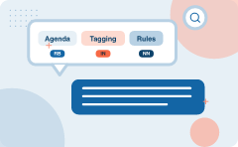
Agenda
POS Tagging
SYNTACTIC ANALYSIS
1
2
PART-OF-SPEECH TAGGING
RULE BASED POS TAGGING (POS)
3
4
Rules has to be updated based on language ch
The/DT can/MD was/VBD rusted/VBD
5
6
1) Generative Model
7
Learnova
1 / 229
Notes:
Read these exactly (do not paraphrase):
- Agenda POS Tagging SYNTACTIC ANALYSIS PART-OF-SPEECH TAGGING RULE BASED POS TAGGING (POS) TAGGING Rules has to be updated based on language change.
- The/DT can/MD was/VBD rusted/VBD 1) Generative Model
Pause: ask the class what they already know about “Agenda” before revealing the slide.
Wording matters here — slow down, keep it precise.
~19s

Slide 3


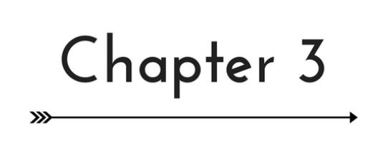
Parsers for part of speech tagging come in various types
Sentence Analysis
Part of speech tagging uses different parsers to analyze sentence structure and assign grammatical categories.
Processing Accuracy
These parsers help process text accurately by understanding word roles, such as determining if 'run' is a noun or a verb.
ALSO ON THIS SLIDE
Types of POS Tagging Example: A parser determines if 'run' is a noun or a verb.
Key takeaway: Part of speech tagging parsers analyze sentence structure and assign grammatical categories.
Key terms: pos — Parts of Speech Tagging · POS Tagging — Assigning grammatical parts of speech to each word in a text.
Learnova
▶ Open the interactive lab: POS Tagging (HMM) Lab
2 / 229
Notes:
Reveal, one click at a time:
1. Types of POS Tagging
2. Parsers
3. Part of speech tagging uses different parsers to analyze sentence structure and assign grammatical categories.
4. These parsers help process text accurately by understanding word roles.
5. Example: A parser determines if 'run' is a noun or a verb.
Say what these mean, in your own words:
- pos: Parts of Speech Tagging
- POS Tagging: Assigning grammatical parts of speech to each word in a text.
Pause: ask the class what they already know about “Parsers for part of speech tagging come in various types” before revealing the slide.
~47s
Ask the class: Explain this slide in your own words, in one sentence.

Slide 4




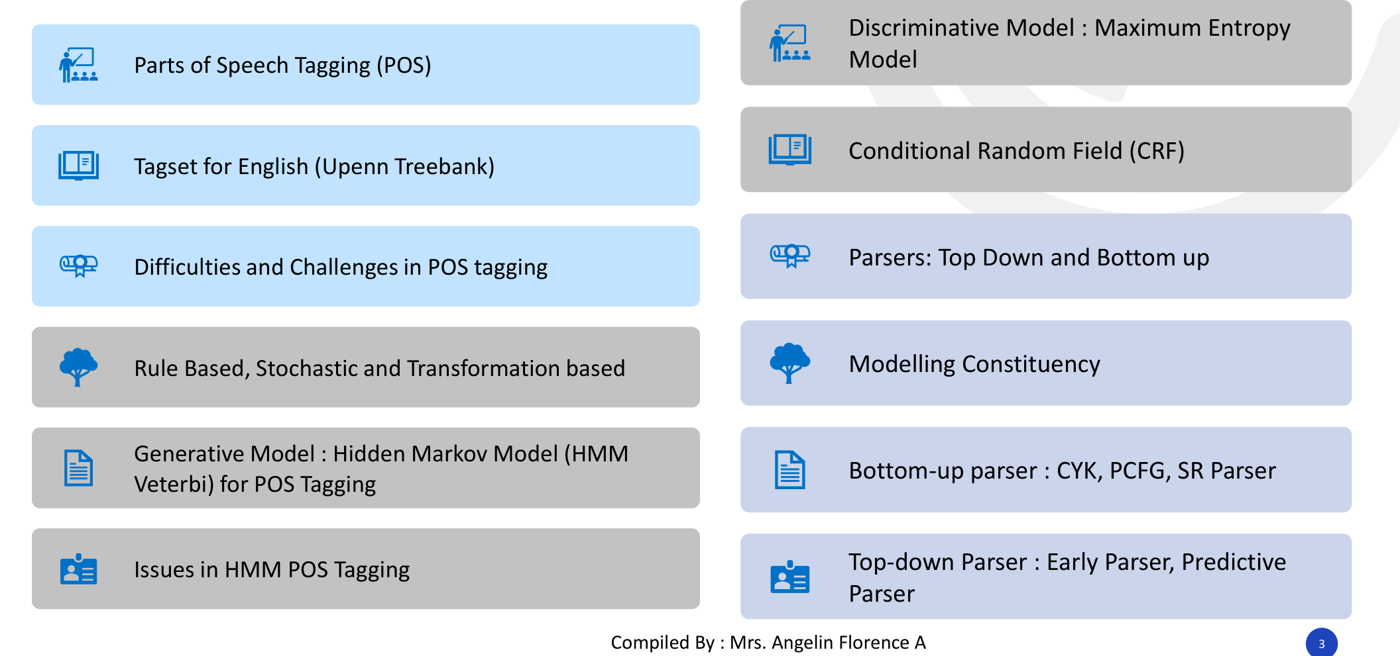

Syntactic analysis encompasses models parsers and challenges for POS tagging
Discriminative Model
Maximum Entropy
Parsers
Top Down and Bottom up
Generative Model
Hidden Markov Model (HMM
Bottom-up parser
CYK, PCFG, SR Parser
Top-down Parser
Early Parser, Predictive
IN PLAIN WORDS
Syntactic analysis involves diverse models like hidden Markov models and conditional random fields. It utilizes top-down and bottom-up parsers to address tagging difficulties. For example, using a CYK parser for grammar analysis.
Parts of Speech Tagging (POS) Conditional Random Field (CRF) Tagset for English (Upenn Treebank) Difficulties and Challenges in POS tagging
Key takeaway: Syntactic analysis encompasses top-down and bottom-up parsers, generative models, and discriminative models.
Key terms: hmm — Hidden Markov Model · Discriminative Model — A model that directly calculates the conditional probability of classes given observations.
Learnova
▶ Open the interactive lab: POS Tagging (HMM) Lab
3 / 229
Notes:
Reveal, one click at a time:
1. Discriminative Model : Maximum Entropy
2. Model
3. Parts of Speech Tagging (POS)
4. Conditional Random Field (CRF)
5. Tagset for English (Upenn Treebank)
6. Parsers: Top Down and Bottom up
7. Difficulties and Challenges in POS tagging
Read these exactly (do not paraphrase):
- Syntactic analysis encompasses models parsers and challenges for POS tagging Discriminative Model : Maximum Entropy Model Parts of Speech Tagging (POS) Conditional Random Field (CRF) Tagset for English (Upenn Treebank) Parsers: Top Down and Bottom up Difficulties and Challenges in POS tagging Modelling Constituency Rule Based, Stochastic and Transformation based Generative Model : Hidden Markov Model (HMM Bottom-up parser : CYK, PCFG, SR Parser Veterbi) for POS Tagging Top-down Parser : Early Parser, Predictive Issues in HMM POS Tagging Parser
Say what these mean, in your own words:
- hmm: Hidden Markov Model
- Discriminative Model: A model that directly calculates the conditional probability of classes given observations.
Pause: ask the class what they already know about “Syntactic analysis encompasses models parsers and challenges for POS tagging” before revealing the slide.
Wording matters here — slow down, keep it precise.
~61s
Ask the class: Explain this slide in your own words, in one sentence.

Slide 5

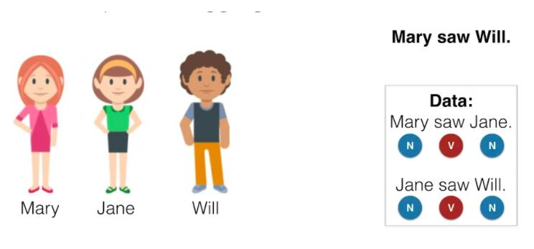

Various approaches define the types of POS tagging
Categories & Classes
Different categories of part of speech tagging exist to process and assign word classes effectively.
Algorithm Approaches
These types organize how algorithms approach natural language understanding, such as rule-based versus stochastic methods.
Key takeaway: Different types of POS tagging categorize how algorithms approach natural language understanding.
Key terms: POS Tagging — The process of marking up a word in a text as corresponding to a particular part of speech.
Learnova
4 / 229
Notes:
Reveal, one click at a time:
1. TYPES OF POS TAGGING
2. Different categories of part of speech tagging exist to process and assign word classes effectively.
3. These types organize how algorithms approach natural language understanding.
4. Example: Rule-based versus stochastic tagging methods.
Say what these mean, in your own words:
- POS Tagging: The process of marking up a word in a text as corresponding to a particular part of speech.
Pause: ask the class what they already know about “Various approaches define the types of POS tagging” before revealing the slide.
~40s
Ask the class: Explain this slide in your own words, in one sentence.

Slide 6
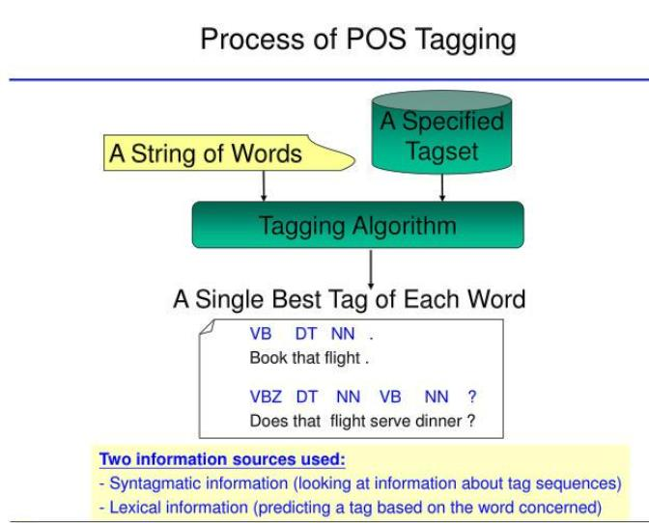
Syntactic analysis (continued)
Learnova
5 / 229
Notes:
Read these exactly (do not paraphrase):
- Syntactic analysis (continued)
Pause: ask the class what they already know about “Syntactic analysis (continued)” before revealing the slide.
Wording matters here — slow down, keep it precise.
~19s
Text in the figure: Process of POS Tagging
A Single Best Tag of Each Word
J VB DT NN.
Book that flight .
VBZ DT NN VB NN ?
Does that flight serve dinner ?
_~ Syntagmalic information (lookin at information about tag sequences)
= Lexical information (predicting a tag based on the word concerned)
Ask the class: What might explain these numbers?

Slide 7
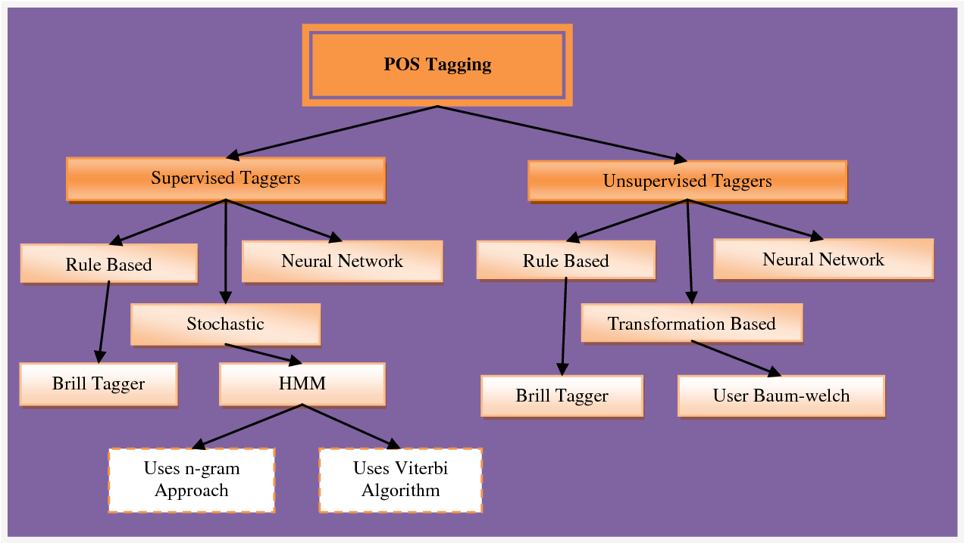
Syntactic analysis (continued)
Learnova
6 / 229
Notes:
Read these exactly (do not paraphrase):
- Syntactic analysis (continued)
Pause: ask the class what they already know about “Syntactic analysis (continued)” before revealing the slide.
Wording matters here — slow down, keep it precise.
~19s
Ask the class: What might explain these numbers?

Slide 8
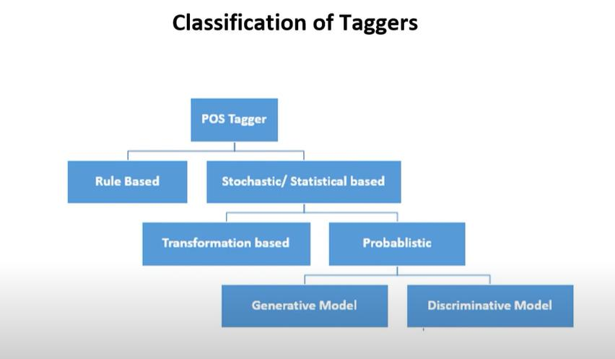
Syntactic analysis (continued)
Classification of Taggers Rule Based Stochastic/ Statistical based i
Learnova
7 / 229
Notes:
Read these exactly (do not paraphrase):
- Syntactic analysis (continued)
Pause: ask the class what they already know about “Syntactic analysis (continued)” before revealing the slide.
Wording matters here — slow down, keep it precise.
~19s
Text in the figure: Classification of Taggers Rule Based Stochastic/ Statistical based Transformation based Probablistic Generative Model Discriminative Model
Ask the class: What might explain these numbers?

Slide 9
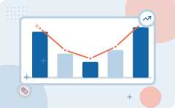
Part of speech tagging utilizes rule based and stochastic tagger architectures
Rule-based taggers
Stochastic taggers
Involve a large database of hand-written
Resolve tagging ambiguities by using a
Disambiguation rule specifying, for
training corpus to count the probability of
Example, that an ambiguous word is a
a given word having a given tag in each
Noun rather than a verb if it follows a
context.
Determiner.
The Brill tagger, called the transformation-based tagger, shares features of both tagging architecture.
IN PLAIN WORDS
Part of speech tagging methods combine hand-written rules with corpus-based probability counts. The Brill tagger successfully merges both rule-based and stochastic approaches for better accuracy. For example, using a rule that a determiner is followed by a noun.
Key takeaway: Transformation-based taggers combine rule-based databases and stochastic training corpora features.
Key terms: Rule-based tagger — A tagger that uses a large database of hand-written disambiguation rules.
Learnova
8 / 229
Notes:
Reveal, one click at a time:
1. Rule-based taggers
2. Stochastic taggers
3. Involve a large database of hand-written
4. Resolve tagging ambiguities by using a
5. disambiguation rule specifying, for
6. training corpus to count the probability of
7. example, that an ambiguous word is a
Say what these mean, in your own words:
- Rule-based tagger: A tagger that uses a large database of hand-written disambiguation rules.
Pause: ask the class what they already know about “Part of speech tagging utilizes rule based and stochastic tagger architectures” before revealing the slide.
~61s
Ask the class: Explain this slide in your own words, in one sentence.

Slide 10
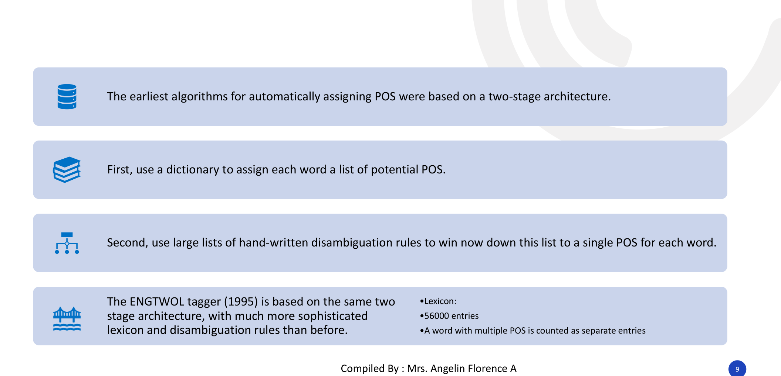
Rule based POS tagging uses a dictionary and disambiguation rules
The earliest algorithms for automatically assigning POS were based on a two-stage architecture.
THEN First, use a dictionary to assign each word a list of potential POS.
THEN Second, use large lists of hand-written disambiguation rules to win now down this list to a single POS for each word.
The ENGTWOL tagger (1995) is based on the same two.
stage architecture, with much more sophisticated.
•56000 entries.
lexicon and disambiguation rules than before.
IN PLAIN WORDS
Early part of speech tagging relied on a two-stage architecture. It first assigned potential parts of speech using a dictionary and then applied hand-written rules to narrow down the correct tag. For example, the ENGTWOL tagger using a 56000 entry lexicon.
•A word with multiple POS is counted as separate entries.
Key terms: Lexicon — A dictionary containing words and their potential parts of speech entries.
Learnova
9 / 229
Notes:
Reveal, one click at a time:
1. The earliest algorithms for automatically assigning POS were based on a two-stage architecture.
2. First, use a dictionary to assign each word a list of potential POS.
3. Second, use large lists of hand-written disambiguation rules to win now down this list to a single POS for each word.
4. The ENGTWOL tagger (1995) is based on the same two
5. •Lexicon:
6. stage architecture, with much more sophisticated
7. •56000 entries
Read these exactly (do not paraphrase):
- The ENGTWOL tagger (1995) is based on the same two •Lexicon: stage architecture, with much more sophisticated •56000 entries lexicon and disambiguation rules than before.
Say what these mean, in your own words:
- Lexicon: A dictionary containing words and their potential parts of speech entries.
Pause: ask the class what they already know about “Rule based POS tagging uses a dictionary and disambiguation rules” before revealing the slide.
~61s
Ask the class: Explain this slide in your own words, in one sentence.

Slide 11
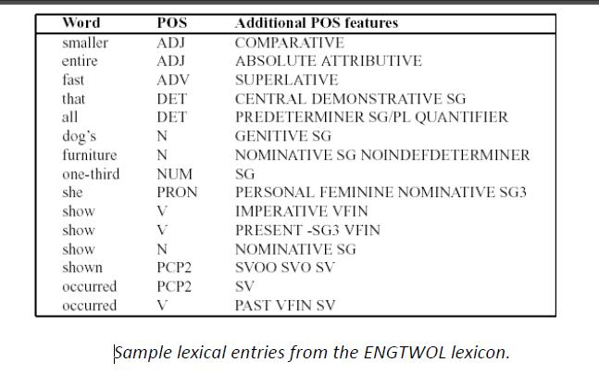
Rule based POS tagging (POS) (continued)
Learnova
10 / 229
Notes:
Read these exactly (do not paraphrase):
- Rule based POS tagging (POS) (continued)
Pause: ask the class what they already know about “Rule based POS tagging (POS) (continued)” before revealing the slide.
Wording matters here — slow down, keep it precise.
~19s
Text in the figure: Additional POS features smaller COMPARATIVE entire ABSOLUTE ATTRIBUTIVE fast SUPERLATIVE that CENTRAL DEMONSTRATIVE SG all PREDETERMINER SG/PL QUANTIFIER dog’s GENITIVE SG furniture NOMINATIVE SG NOINDEFDETERMINER one-third NUM SG she PRON PERSONAL FEMININE NOMINATIVE SG3 show V IMPERATIVE VFIN show Vv PRESENT -SG3 VFIN show N NOMINATIVE SG shown PCP2 SVOO SVO SV occurred PCP2 SV occurred V PAST VFIN SV sample lexical entries from the ENGTWOL lexicon.
Ask the class: Explain this slide in your own words, in one sentence.

Slide 12
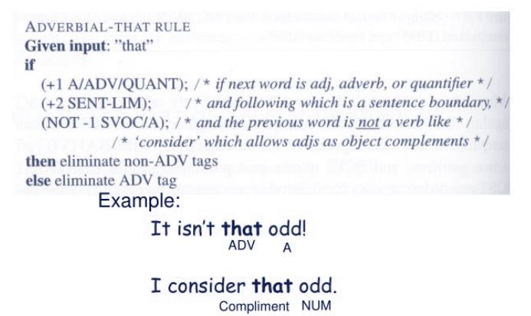
Rule based POS tagging (POS) (continued)
Learnova
11 / 229
Notes:
Read these exactly (do not paraphrase):
- Rule based POS tagging (POS) (continued)
Pause: ask the class what they already know about “Rule based POS tagging (POS) (continued)” before revealing the slide.
Wording matters here — slow down, keep it precise.
~19s
Text in the figure: ADVERBIAL-THAT RULE Given input: “that” if (+1 A/ADV/QUANT); /* if next word is adj, adverb, or quantifier * / (+2 SENT-LIM); /* and following which is a sentence boundary, */ (NOT -1 SVOC/A); /* and the previous word is not a verb like * / /* ‘consider’ which allows adjs as object complements * / then eliminate non-ADV tags else eliminate ADV tag Example: It isn't that odd! ADV A I consider that odd. Compliment NUM
Ask the class: Explain this slide in your own words, in one sentence.

Slide 13
Checkpoint 1
QUESTION · UNDERSTAND
Which term matches this description: “A dictionary containing words and their potential parts of speech entries.”?
Maximum likelihood estimation
Hmms
A
B
Backpointer
Lexicon
C
D
Answer: D
Lexicon: A dictionary containing words and their potential parts of speech entries.
Learnova
12 / 229
Notes:
KEY POINT TO LAND: Answer, then check your reasoning.
Pause: ask the class what they already know about “Checkpoint 1” before revealing the slide.
~44s

Slide 14
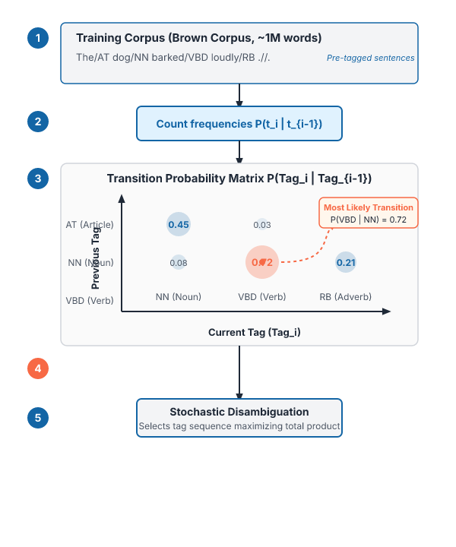

Stochastic POS tagging relies on probabilities derived from training corpora
Probability Based
Based on probability of a certain tag occurring, given various possibilities.
Training Corpus
Necessitates a training corpus, such as the Brown Corpus with about 1,000,000 words from wide sources.
IN PLAIN WORDS
Stochastic tagging calculates the likelihood of a specific tag occurring based on surrounding contexts. This method requires a training corpus, which is a collection of pre-tagged sentences. For example, the Brown Corpus containing about one million tagged words.
STOCHASTIC POS A collection of sentences that have already been tagged Several such corpora exist Standard Corpus of Present-Day American English (or just the Brown Corpus)
Key takeaway: Stochastic POS tagging uses the 1,000,000-word Brown Corpus to calculate tag probabilities.
Key terms: Training Corpus — A collection of pre-tagged sentences used to compute statistical probabilities.
Learnova
13 / 229
Notes:
Reveal, one click at a time:
1. STOCHASTIC POS
2. Based on probability of certain tag occurring, given various possibilities
3. Necessitates a training corpus
4. A collection of sentences that have already been tagged
5. Several such corpora exist
6. Standard Corpus of Present-Day American English (or just the Brown Corpus)
7. about 1,000,000 words from a wide variety of sources
Read these exactly (do not paraphrase):
- Stochastic POS tagging relies on probabilities derived from training corpora STOCHASTIC POS Based on probability of certain tag occurring, given various possibilities Necessitates a training corpus A collection of sentences that have already been tagged Several such corpora exist Standard Corpus of Present-Day American English (or just the Brown Corpus) about 1,000,000 words from a wide variety of sources POS tags assigned to each
Say what these mean, in your own words:
- Training Corpus: A collection of pre-tagged sentences used to compute statistical probabilities.
Pause: ask the class what they already know about “Stochastic POS tagging relies on probabilities derived from training corpora” before revealing the slide.
Wording matters here — slow down, keep it precise.
~61s
Ask the class: Explain this slide in your own words, in one sentence.

Slide 15

Rules has to be updated based on language change
Limitations of Rule-based Approach
Hard coded rule are required.
It needs to check lexicon every time which is not efficient approach
Strong language experts team is required.
2) Stochastic/ Statistical based Approach
It is based on concept of probability and machine learning.
Training and Test corpus are used.
Two approaches are there
a) Transformation based Tagger b) Probabilistic based Tagger
Learnova
14 / 229
Notes:
Reveal, one click at a time:
1. Limitations of Rule-based Approach
2. Hard coded rule are required.
3. It needs to check lexicon every time which is not efficient approach
4. Strong language experts team is required.
5. 2) Stochastic/ Statistical based Approach
6. It is based on concept of probability and machine learning.
7. Training and Test corpus are used.
Read these exactly (do not paraphrase):
- 2) Stochastic/ Statistical based Approach It is based on concept of probability and machine learning.
- Two approaches are there a) Transformation based Tagger b) Probabilistic based Tagger
Pause: ask the class what they already know about “Rules has to be updated based on language change” before revealing the slide.
Wording matters here — slow down, keep it precise.
~61s
Ask the class: Explain this slide in your own words, in one sentence.

Slide 16



Transformation based tagging combines rule based and stochastic learning approaches
Transformation-Based Learning (TBL)
Uses supervised learning and assumes a pre-tagged training corpus.
Combined Architecture
Combines rule-based specific tags with stochastic machine learning where rules are automatically induced from data.
IN PLAIN WORDS
Transformation-based learning uses supervised learning with a pre-tagged corpus to assign tags. It merges rule-based logic with stochastic machine learning by automatically inducing rules from data. For example, automatically generating error-correction rules from a tagged corpus.
a) Transformation based Tagger This tagger is based on concept of Transformation-Based Learning (TBL) approach. Like the rule based taggers, TBL is based on rules that specify what tags should be assigned to what words.
Key takeaway: Transformation-based learning uses supervised learning to automatically induce rules from pre-tagged corpora.
Key terms: Transformation-Based Learning — A supervised machine learning approach that automatically induces correction rules from data.
Learnova
15 / 229
Notes:
Reveal, one click at a time:
1. a) Transformation based Tagger
2. This tagger is based on concept of Transformation-Based Learning (TBL) approach.
3. TBL uses supervised learning.
4. There is assumption of pre-tagged training corpus.
5. It combines idea of the rule-based and stochastic taggers.
6. Like the rule based taggers, TBL is based on rules that specify what tags should
7. be assigned to what words.
Read these exactly (do not paraphrase):
- Transformation based tagging combines rule based and stochastic learning approaches a) Transformation based Tagger This tagger is based on concept of Transformation-Based Learning (TBL) approach.
Say what these mean, in your own words:
- Transformation-Based Learning: A supervised machine learning approach that automatically induces correction rules from data.
Pause: ask the class what they already know about “Transformation based tagging combines rule based and stochastic learning approaches” before revealing the slide.
~61s
Ask the class: Explain this slide in your own words, in one sentence.

Slide 17
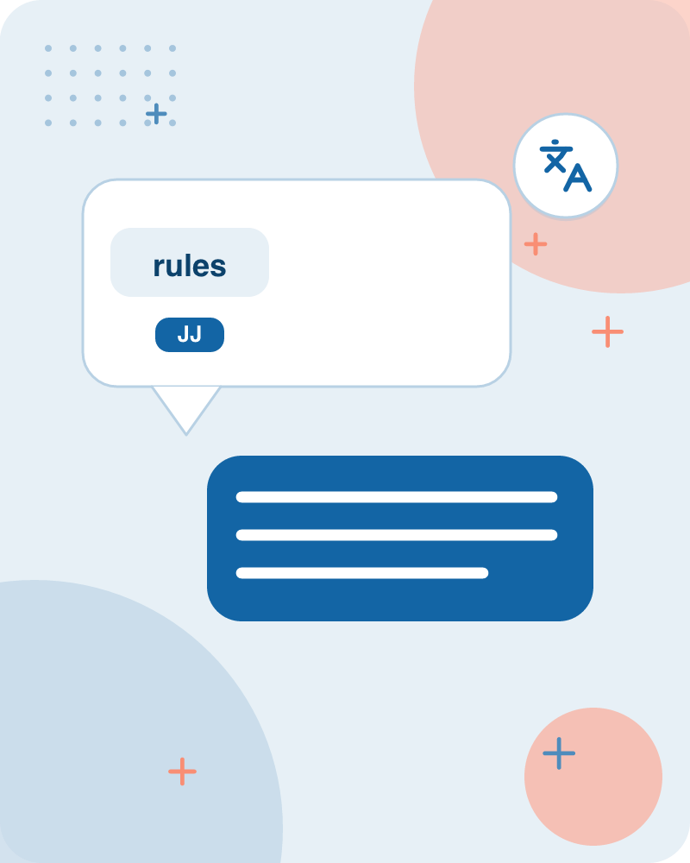
Transformation rules and grammar constraints resolve ambiguous word tags
Label the training set with most frequent tags.
e.g. The can was rusted.
Add transformation rules to reduce training mistakes.
Explanation: ‘can’ can be noun as well as modal verb also.
It uses machine learning as well as grammar rules.
1) Model verb is never preceded by determiner.
ALSO 2) Also in corpus (training data) possibility of ‘determiner model verb’ pair is zero.
SO Therefore can is replaced as Noun tag.
Explanation: ‘rusted’ can be VBD as well as VBN also.
IN PLAIN WORDS
Training sets start with most frequent tags and apply transformation rules to fix errors. Grammar constraints and corpus statistics help correctly identify words that can act as multiple parts of speech. For example, replacing an incorrect modal verb tag with a noun tag based on grammar rules.
1) In grammar rule, VBN is preceded by VBD.
ALSO 2) Also in corpus, possibility of “VBD-VBD’ pair is negligible.
Key takeaway: Grammar rules and corpus probabilities resolve ambiguous tags like modal verbs and nouns.
Key terms: Training Set — Labeled data used to teach a machine learning model correct tagging.
Learnova
16 / 229
Notes:
Reveal, one click at a time:
1. Label the training set with most frequent tags
2. e.g. The can was rusted.
3. Add transformation rules to reduce training mistakes.
4. Explanation: ‘can’ can be noun as well as modal verb also.
5. It uses machine learning as well as grammar rules.
6. 1) Model verb is never preceded by determiner.
7. 2) Also in corpus (training data) possibility of ‘determiner model verb’ pair is zero.
Read these exactly (do not paraphrase):
- 1) Model verb is never preceded by determiner.
- 2) Also in corpus (training data) possibility of ‘determiner model verb’ pair is zero.
- 1) In grammar rule, VBN is preceded by VBD 2) Also in corpus, possibility of “VBD-VBD’ pair is negligible.
Say what these mean, in your own words:
- Training Set: Labeled data used to teach a machine learning model correct tagging.
Pause: ask the class what they already know about “Transformation rules and grammar constraints resolve ambiguous word tags” before revealing the slide.
~61s
Ask the class: Explain this slide in your own words, in one sentence.

Slide 18
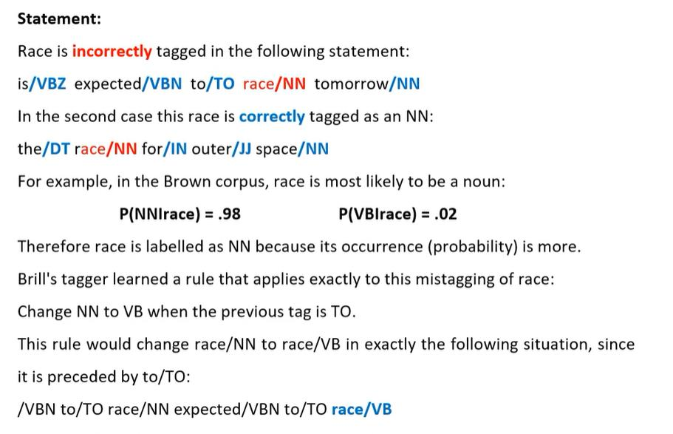
The/DT can/MD was/VBD rusted/VBD (continued)
Learnova
17 / 229
Notes:
Read these exactly (do not paraphrase):
- The/DT can/MD was/VBD rusted/VBD (continued)
Pause: ask the class what they already know about “The/DT can/MD was/VBD rusted/VBD (continued)” before revealing the slide.
Wording matters here — slow down, keep it precise.
~19s
Text in the figure: Statement: Race is incorrectly tagged in the following statement: is/VBZ expected/VBN to/TO race/NN tomorrow/NN In the second case this race is correctly tagged as an NN: the/DT race/NN for/IN outer/JJ space/NN For example, in the Brown corpus, race is most likely to be a noun: P(NNirace) = .98 P(VBirace) = .02 Therefore race is labelled as NN because its occurrence (probability) is more. Brill's tagger learned a rule that applies exactly to this mistagging of race: Change NN to VB when the previous tag is TO. This rule would change race/NN to race/VB in exactly the following situation, since
Ask the class: What might explain these numbers?

Slide 19

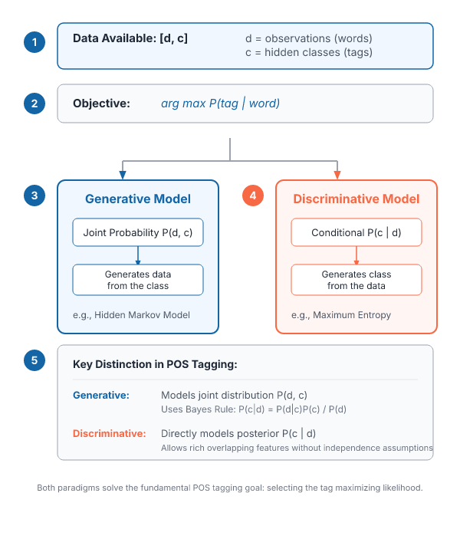



POS tagging approaches pick the most likely tag using generative or discriminative models
Approach is to "pick the most-likely tag for this word"
Two approaches are there whether you generate the data from the class or the
Problem statement: Data available of the form [d, c]
where d is observations and c is hidden classes
Two types of Model are there
IN PLAIN WORDS
Tagging approaches aim to find the most likely tag for a given observation. They deal with observable data and hidden classes by utilizing either generative or discriminative models. For example, finding whether a word sequence was generated by a specific class.
i) Generative Model ii) Discriminative Model
Key takeaway: POS tagging approaches select the most likely tag using generative or discriminative models.
Key terms: Generative Model — A model that assumes classes generate observable data.
Learnova
18 / 229
Notes:
Reveal, one click at a time:
1. Approach is to "pick the most-likely tag for this word".
2. Two approaches are there whether you generate the data from the class or the
3. class from the data.
4. Problem statement: Data available of the form [d, c]
5. where d is observations and c is hidden classes.
6. Two types of Model are there
7. i) Generative Model
Read these exactly (do not paraphrase):
- POS tagging approaches pick the most likely tag using generative or discriminative models Approach is to "pick the most-likely tag for this word".
- Two types of Model are there i) Generative Model ii) Discriminative Model
Say what these mean, in your own words:
- Generative Model: A model that assumes classes generate observable data.
Pause: ask the class what they already know about “POS tagging approaches pick the most likely tag using generative or discriminative models” before revealing the slide.
Wording matters here — slow down, keep it precise.
~61s
Ask the class: Explain this slide in your own words, in one sentence.

Slide 20
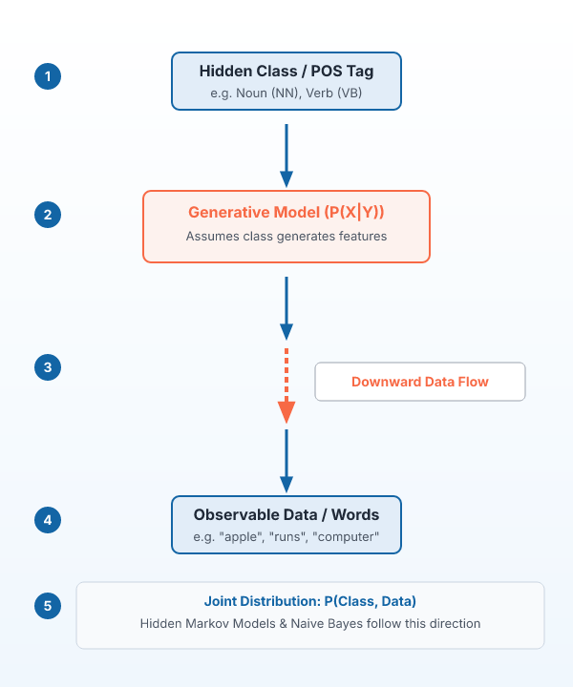

Generative models assume classes generate observable data with downward data flow
Downward Data Flow
Assumes classes generate observable data (e.g., POS tags generate words).
Examples
Hidden Markov Model, Naive Bayes Classifier.
IN PLAIN WORDS
In a generative model, you assume that predefined classes generate the observed data. For part of speech tagging, POS tags act as classes that generate the actual words. For example, hidden Markov Models generating words from hidden POS tags.
In generative model, we assume that class is there and it generates data. For e.g. class is given (subjects), and all words are generated from subject.
Key takeaway: Generative models assume classes generate observable data with a downward flow.
Key terms: pos — Parts of Speech Tagging · Generative Model — A statistical model where classes generate the observable data.
Learnova
19 / 229
Notes:
Reveal, one click at a time:
1. In generative model, we assume that
2. class is there and it generates data.
3. For e.g. class is given (subjects), and all
4. words are generated from subject.
5. For e.g. Part- of- Speech Tagging: POS
6. tags are there and words are
7. generated from that.
Read these exactly (do not paraphrase):
- class is given (subjects), and all words are generated from subject.
- Example are Hidden Markov * Here flow is downward (Classes Model, Naive Bayes Classifier generates data)
Say what these mean, in your own words:
- pos: Parts of Speech Tagging
- Generative Model: A statistical model where classes generate the observable data.
Pause: ask the class what they already know about “Generative models assume classes generate observable data with downward data flow” before revealing the slide.
~61s
Ask the class: Explain this slide in your own words, in one sentence.

Slide 21
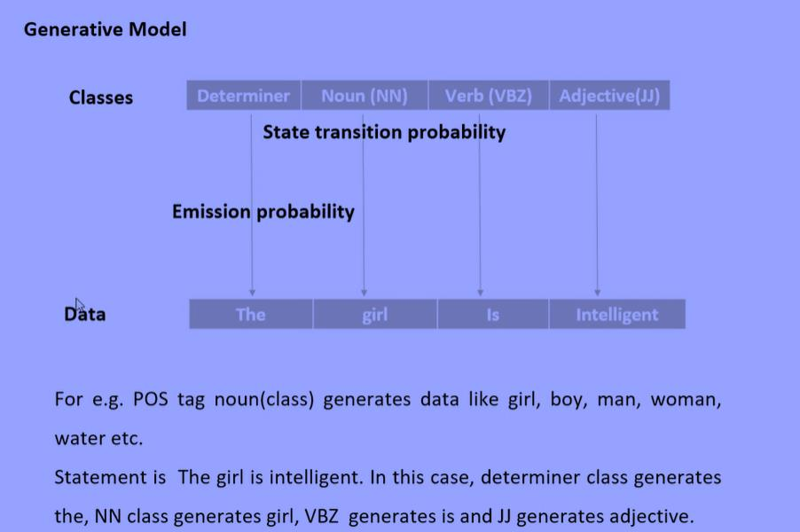
1) Generative Model (continued)
Learnova
20 / 229
Notes:
Read these exactly (do not paraphrase):
- 1) Generative Model (continued)
Pause: ask the class what they already know about “1) Generative Model (continued)” before revealing the slide.
Wording matters here — slow down, keep it precise.
~19s
Text in the figure: Generative Model Classes State transition probability Emission probability ts | For e.g. POS tag noun(class) generates data like girl, boy, man, woman, water etc. Statement is The girl is intelligent. In this case, determiner class generates the, NN class generates girl, VBZ generates is and JJ generates adjective.
Ask the class: What might explain these numbers?

Slide 22
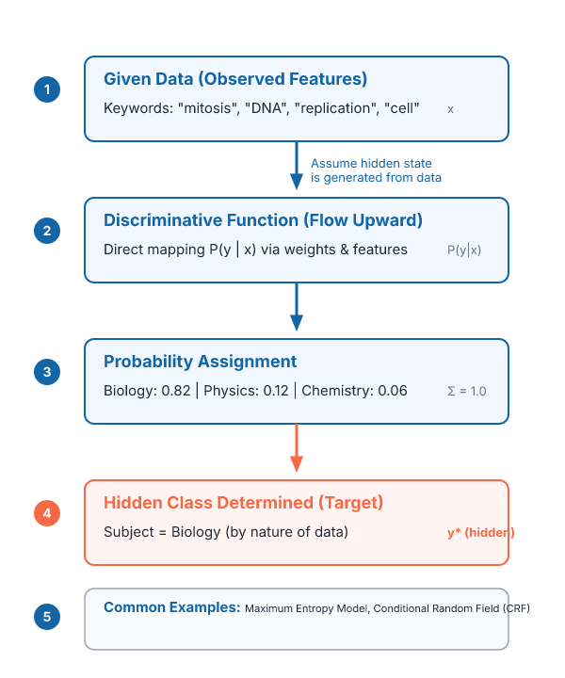

Discriminative models assign class probabilities upward from given data
Upward Data Flow
Data is observed and hidden state/class is determined from it, assigning probabilities based on data nature.
Examples
Maximum entropy model, Conditional Random Field.
IN PLAIN WORDS
For example, keywords are given as data to determine the subject class.
In the discriminative model, data is there and you assume that hidden state is a generated from the data. (that data identifies class) For e.g. keywords of the subjects are given(data) and from the keywords we determine subject.
Key takeaway: Discriminative models assign upward probabilities assuming hidden states are generated from data.
Key terms: Discriminative model — A model where hidden states are generated from observed data. · Maximum entropy model — An example of a discriminative probabilistic model.
Learnova
21 / 229
Notes:
Reveal, one click at a time:
1. In the discriminative model, data is there and you assume that hidden state is a generated from the data. Here flow is u
2. For e.g. keywords of the subjects are given(data) and from the keywords we
3. determine subject. Keywords are data and subject is class. Class is hidden. By seeing nature of data, we can assign prob
4. Example are Maximum entropy model, Conditional Random field.
Read these exactly (do not paraphrase):
- (that data identifies class) For e.g.
- keywords of the subjects are given(data) and from the keywords we determine subject.
Say what these mean, in your own words:
- Discriminative model: A model where hidden states are generated from observed data.
- Maximum entropy model: An example of a discriminative probabilistic model.
Pause: ask the class what they already know about “Discriminative models assign class probabilities upward from given data” before revealing the slide.
~40s
Ask the class: Explain this slide in your own words, in one sentence.

Slide 23
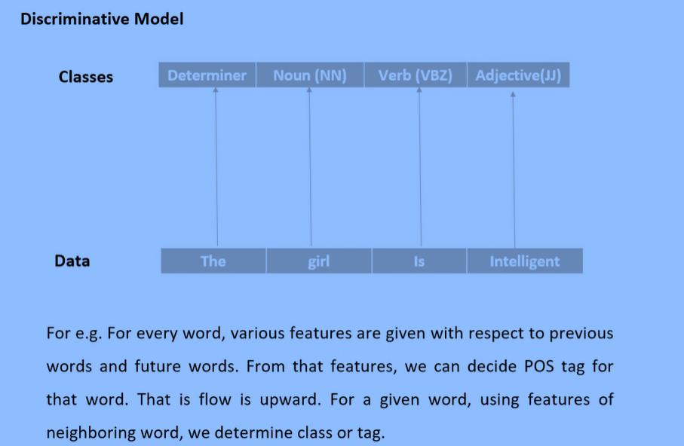
2)Discriminative Model (continued)
Learnova
22 / 229
Notes:
Read these exactly (do not paraphrase):
- 2)Discriminative Model (continued)
Pause: ask the class what they already know about “2)Discriminative Model (continued)” before revealing the slide.
Wording matters here — slow down, keep it precise.
~19s
Text in the figure: Discriminative Model casses | | | | | Data | the =| girl _| For e.g. For every word, various features are given with respect to previous words and future words. From that features, we can decide POS tag for that word. That is flow is upward. For a given word, using features of neighboring word, we determine class or tag.
Ask the class: What might explain these numbers?

Slide 24
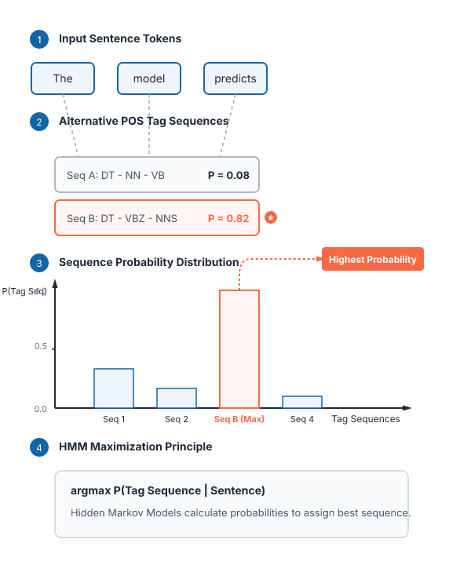


Stochastic tagging calculates probabilities to assign the best POS tag sequence
Probabilistic Approach
Calculates probabilities of various tag sequences for a sentence and assigns POS tags from the sequence with the highest probability.
Hidden Markov Models
HMMs are probabilistic approaches used to assign POS tags while accounting for sequence grammar rules.
IN PLAIN WORDS
For example, calculating probabilities of various tag sequences to select the highest probability.
Stochastic (Probabilistic) tagging: A stochastic approach includes frequency, probability or statistics. The simplest stochastic approach finds out the most frequently used tag for a specific word in the annotated training data and uses this information to tag that word in the unannotated text. But sometimes this approach comes up with sequences of tags for sentences that are not acceptable according to the grammar rules of a language.
Key takeaway: Stochastic tagging calculates the highest probability sequence of tags for a given sentence.
Key terms: Stochastic tagging — An approach using frequency, probability, or statistics to assign tags. · Hidden Markov Models — Probabilistic approaches used to assign part of speech tags.
Learnova
23 / 229
Notes:
Reveal, one click at a time:
1. Stochastic (Probabilistic) tagging: A stochastic approach includes frequency, probability or statistics.
2. The simplest stochastic approach finds out the most frequently used tag for a specific word in the annotated training da
3. But sometimes this approach comes up with sequences of tags for sentences that are not acceptable according to the gramm
4. One such approach is to calculate the probabilities of various tag sequences that are possible for a sentence and assign
5. POS tags from the sequence with the highest probability.
6. Hidden Markov Models (HMMs) are probabilistic approaches to assign a POS Tag.
Read these exactly (do not paraphrase):
- Stochastic tagging calculates probabilities to assign the best POS tag sequence Stochastic (Probabilistic) tagging: A stochastic approach includes frequency, probability or statistics.
- Hidden Markov Models (HMMs) are probabilistic approaches to assign a POS Tag.
Say what these mean, in your own words:
- Stochastic tagging: An approach using frequency, probability, or statistics to assign tags.
- Hidden Markov Models: Probabilistic approaches used to assign part of speech tags.
Pause: ask the class what they already know about “Stochastic tagging calculates probabilities to assign the best POS tag sequence” before revealing the slide.
Wording matters here — slow down, keep it precise.
~54s
Ask the class: Explain this slide in your own words, in one sentence.

Slide 25
Checkpoint 2
QUESTION · UNDERSTAND
Which term matches this description: “An approach using frequency, probability, or statistics to assign tags.”?
Arguments
N-gram
A
B
Maximum likelihood estimation
Stochastic tagging
C
D
Answer: D
Stochastic tagging: An approach using frequency, probability, or statistics to assign tags.
Learnova
24 / 229
Notes:
KEY POINT TO LAND: Answer, then check your reasoning.
Pause: ask the class what they already know about “Checkpoint 2” before revealing the slide.
~44s

Slide 26
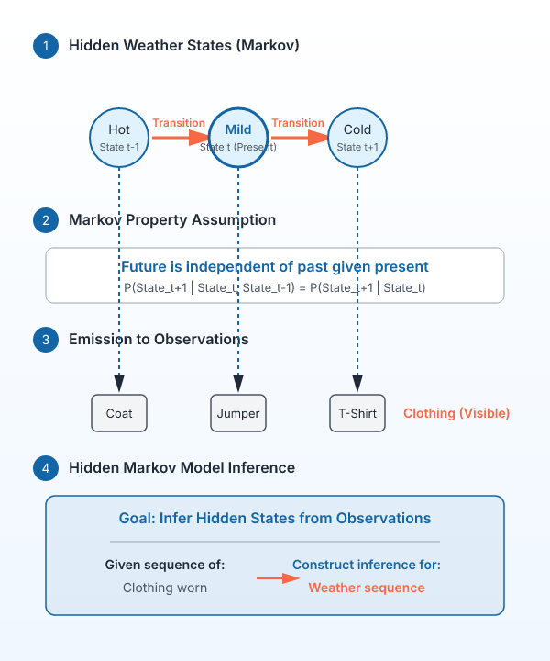
Hidden Markov Models construct inference based on Markov process assumptions
The reason it is called a Hidden Markov Model is because an inference model is constructed based on the assumptions of a Markov process.
The Markov process assumption is simply that the “future is independent of the past given the present”.
To make this point clear, let us consider the scenario below where the weather, the hidden variable, can be hot, mild or cold and the observed variables are the type of clothing worn.
The arrows represent transitions from a hidden state to another hidden state or from a hidden state to an observed variable.
The Markov assumption, each state only depends on the previous state and not on any other prior states.
IN PLAIN WORDS
For example, weather is the hidden variable while clothing worn is the observed variable.
Key takeaway: Hidden Markov Models assume the future is independent of the past given the present.
Key terms: Markov process assumption — The assumption that the future is independent of the past given the present. · Hidden variable — A state that cannot be directly observed, such as weather.
Learnova
25 / 229
Notes:
Reveal, one click at a time:
1. The reason it is called a Hidden Markov Model is because an inference model is constructed based on the assumptions of a
2. The Markov process assumption is simply that the “future is independent of the past given the present”.
3. To make this point clear, let us consider the scenario below where the weather, the hidden variable, can be hot, mild or
4. The arrows represent transitions from a hidden state to another hidden state or from a hidden state to an observed varia
5. The Markov assumption, each state only depends on the previous state and not on any other prior states.
Read these exactly (do not paraphrase):
- The Markov process assumption is simply that the “future is independent of the past given the present”.
Say what these mean, in your own words:
- Markov process assumption: The assumption that the future is independent of the past given the present.
- Hidden variable: A state that cannot be directly observed, such as weather.
Pause: ask the class what they already know about “Hidden Markov Models construct inference based on Markov process assumptions” before revealing the slide.
~47s
Ask the class: Explain this slide in your own words, in one sentence.

Slide 27
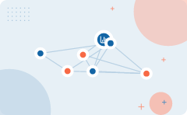
N-gram models and conditional probability define state transition probabilities
1
State Transition Probability: Based on Markov Model
2
N-gram Model: An n-gram is a contiguous sequence of n items from a given
3
base pairs according to the application. The n-grams typically are collected from a
4
text or speech corpus.
5
Conditional Probability: P(B|A)= P(A, B) = P(A)P(B| A)
6
More variables: P(A,B,C,D) = P(A)P(B| A)P(C| A, B)P(D| A,B,C)
IN PLAIN WORDS
State transition probabilities rely on n-gram models to collect contiguous sequences from text or speech corpora. Conditional probability formulas help calculate the likelihood of multiple variables occurring together or sequentially. These mathematical foundations allow models to evaluate how items follow one another in a sequence. For example, calculating P(B|A) as the probability of B given A.
Key takeaway: N-gram models collect contiguous sequences of items to determine state transition probabilities.
Key terms: N-gram — A contiguous sequence of n items from a given text or speech corpus. · Conditional Probability — The probability of an event occurring given that another event has already occurred.
Learnova
▶ Open the interactive lab: Bigram Language Model Lab
26 / 229
Notes:
Reveal, one click at a time:
1. State Transition Probability: Based on Markov Model
2. N-gram Model: An n-gram is a contiguous sequence of n items from a given
3. base pairs according to the application. The n-grams typically are collected from a
4. text or speech corpus.
5. Conditional Probability: P(B|A)= P(A, B) = P(A)P(B| A)
6. More variables: P(A,B,C,D) = P(A)P(B| A)P(C| A, B)P(D| A,B,C)
Read these exactly (do not paraphrase):
- Conditional Probability: P(B|A)= P(A, B) = P(A)P(B| A) More variables: P(A,B,C,D) = P(A)P(B| A)P(C| A, B)P(D| A,B,C)
Say what these mean, in your own words:
- N-gram: A contiguous sequence of n items from a given text or speech corpus.
- Conditional Probability: The probability of an event occurring given that another event has already occurred.
Pause: ask the class what they already know about “N-gram models and conditional probability define state transition probabilities” before revealing the slide.
~54s
Ask the class: Explain this slide in your own words, in one sentence.

Slide 28
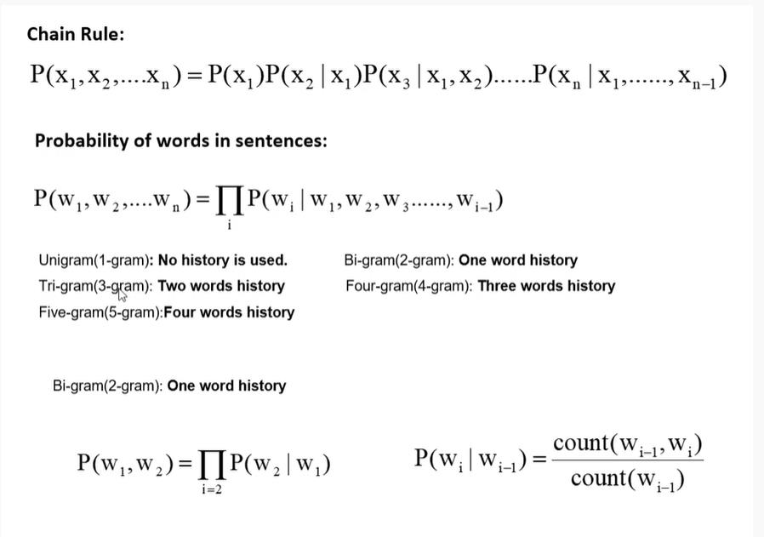
sample of text or speech. The items can be phonemes, syllables, letters, words or (continued)
Learnova
27 / 229
Notes:
Read these exactly (do not paraphrase):
- The items can be phonemes, syllables, letters, words or (continued)
Pause: ask the class what they already know about “sample of text or speech. The items can be phonemes, syllables, letters, words or (continued)” before revealing the slide.
Wording matters here — slow down, keep it precise.
~19s
Text in the figure: Chain Rule: = [SP (Ry | POR, | By Probability of words in sentences: | [P(w, | i Unigram(1-gram): No history is used. Bi-gram(2-gram): One word history Tri-gram(3-gram): Two words history Four-gram(4-gram): Three words history Five-gram(5-gram):Four words history Bi-gram(2-gram): One word history P(w,,w,)=] P(w,| W,_,) = I] count(w, ,)
Ask the class: What might explain these numbers?

Slide 29
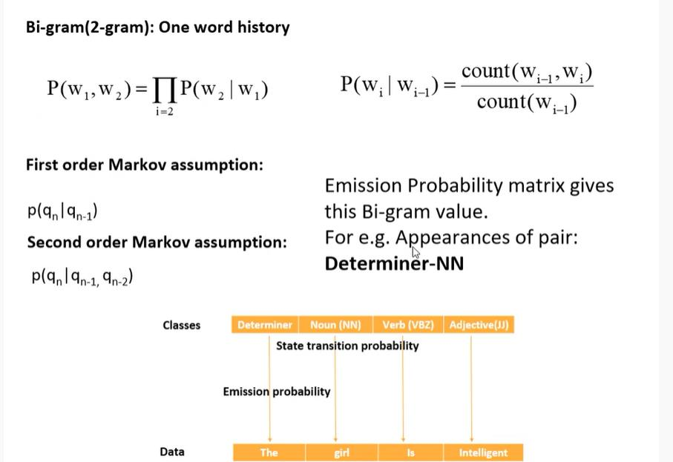
sample of text or speech. The items can be phonemes, syllables, letters, words or (continued)
Learnova
28 / 229
Notes:
Read these exactly (do not paraphrase):
- The items can be phonemes, syllables, letters, words or (continued)
Pause: ask the class what they already know about “sample of text or speech. The items can be phonemes, syllables, letters, words or (continued)” before revealing the slide.
Wording matters here — slow down, keep it precise.
~19s
Text in the figure: Bi-gram(2-gram): One word history count(Ww,_,,W;) First order Markov assumption: Emission Probability matrix gives this Bi-gram value. Second order Markov assumption: For e.g. Appearances of pair: Determiner-NN 1 In-a) Classes Determiner | Noun(NN) | | Adjective(J)) State transition probability Emission probability + + +
Ask the class: What might explain these numbers?

Slide 30
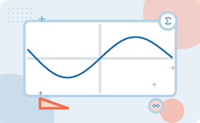
Emission probability derives from Bayes rule of conditional probability
Emission Probability: Based on Bayes rule of conditional probability
Classes Determiner | Noun(NN) | Verb(VBZ) | Adjective(J))
State transition probability
Emission probability
Data The girl Is Intelligent
This value, we calculate from Emission Probability Matrix
ALSO ON THIS SLIDE
Emission probability connects observed data tokens to their corresponding hidden classes using Bayes rule. By organizing parts of speech alongside words, the emission probability matrix supplies the necessary values for calculations. This helps determine the likelihood that a specific word is emitted by a hidden state. Example: Calculating the probability that the word 'intelligent' is an adjective.
Key takeaway: Emission probability matrices connect observed data tokens to hidden classes using Bayes rule.
Key terms: Emission Probability — The probability that a specific token is emitted from a hidden state. · Determiner — A part of speech category used in tagging text data.
Learnova
29 / 229
Notes:
Reveal, one click at a time:
1. Emission Probability: Based on Bayes rule of conditional probability
2. Classes Determiner | Noun(NN) | Verb(VBZ) | Adjective(J))
3. State transition probability
4. Emission probability
5. Data The girl Is Intelligent
6. This value, we calculate from Emission Probability Matrix
7. Emission probability connects observed data tokens to their corresponding hidden classes using Bayes rule.
Read these exactly (do not paraphrase):
- Emission probability derives from Bayes rule of conditional probability Emission Probability: Based on Bayes rule of conditional probability Classes Determiner | Noun(NN) | Verb(VBZ) | Adjective(J)) State transition probability Emission probability Data The girl Is Intelligent This value, we calculate from Emission Probability Matrix Emission probability connects observed data tokens to their corresponding hidden classes using Bayes rule.
Say what these mean, in your own words:
- Emission Probability: The probability that a specific token is emitted from a hidden state.
- Determiner: A part of speech category used in tagging text data.
Pause: ask the class what they already know about “Emission probability derives from Bayes rule of conditional probability” before revealing the slide.
~61s
Ask the class: Explain this slide in your own words, in one sentence.

Slide 31
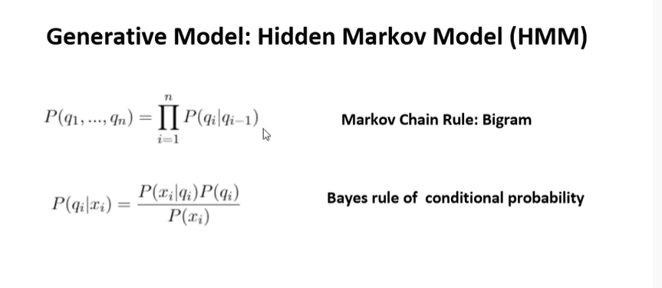
Conditional Probability: P(B|A)= P(A, B) = P(A)P(B| A) (continued)
Learnova
30 / 229
Notes:
Read these exactly (do not paraphrase):
- Conditional Probability: P(B|A)= P(A, B) = P(A)P(B| A) (continued)
Pause: ask the class what they already know about “Conditional Probability: P(B|A)= P(A, B) = P(A)P(B| A) (continued)” before revealing the slide.
Wording matters here — slow down, keep it precise.
~19s
Text in the figure: Generative Model: Hidden Markov Model (HMM) P(q1, ++) In) = II P(qi\qi-1 Markov Chain Rule: Bigram i=1 Bayes rule of conditional probability
Ask the class: Explain this slide in your own words, in one sentence.

Slide 32
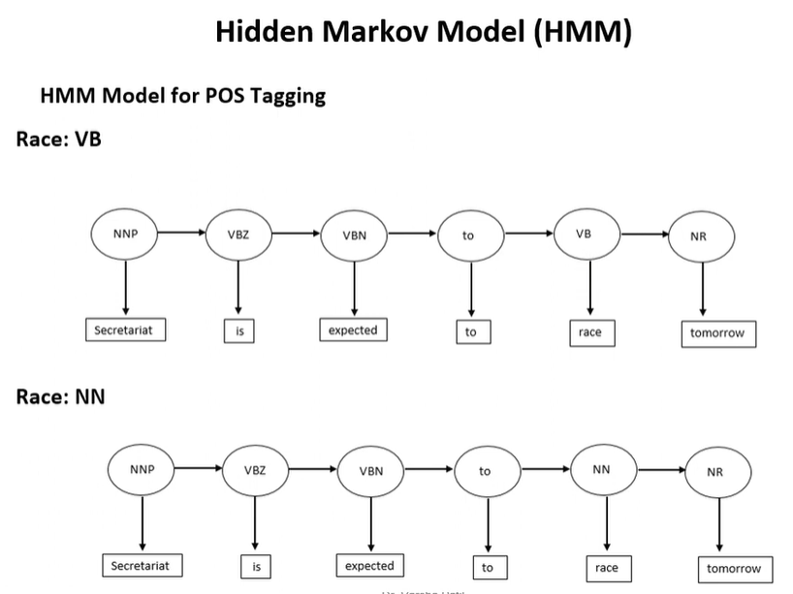
Conditional Probability: P(B|A)= P(A, B) = P(A)P(B| A) (continued)
Learnova
31 / 229
Notes:
Read these exactly (do not paraphrase):
- Conditional Probability: P(B|A)= P(A, B) = P(A)P(B| A) (continued)
Pause: ask the class what they already know about “Conditional Probability: P(B|A)= P(A, B) = P(A)P(B| A) (continued)” before revealing the slide.
Wording matters here — slow down, keep it precise.
~19s
Text in the figure: Hidden Markov Model (HMM) HMM Model for POS Tagging Race: VB [ secretariat | [ expected | Race: NN [expected | [ tomorrow |
Ask the class: Explain this slide in your own words, in one sentence.

Slide 33
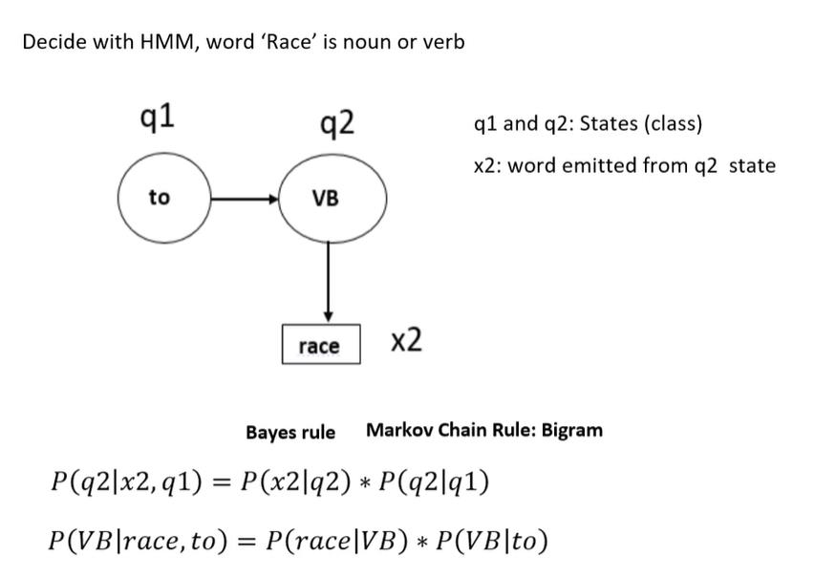
Conditional Probability: P(B|A)= P(A, B) = P(A)P(B| A) (continued)
Learnova
32 / 229
Notes:
Read these exactly (do not paraphrase):
- Conditional Probability: P(B|A)= P(A, B) = P(A)P(B| A) (continued)
Pause: ask the class what they already know about “Conditional Probability: P(B|A)= P(A, B) = P(A)P(B| A) (continued)” before revealing the slide.
Wording matters here — slow down, keep it precise.
~19s
Text in the figure: Decide with HMM, word ‘Race’ is noun or verb ql q2 qi and q2: States (class) ) ) x2: word emitted from q2 state [ race | x2 Bayesrule Markov Chain Rule: Bigram P(q2|x2,q1) = P(x2|q2) * P(q2|q1) P(VB|race, to) = P(race|VB) * P(VB|to)
Ask the class: Explain this slide in your own words, in one sentence.

Slide 34
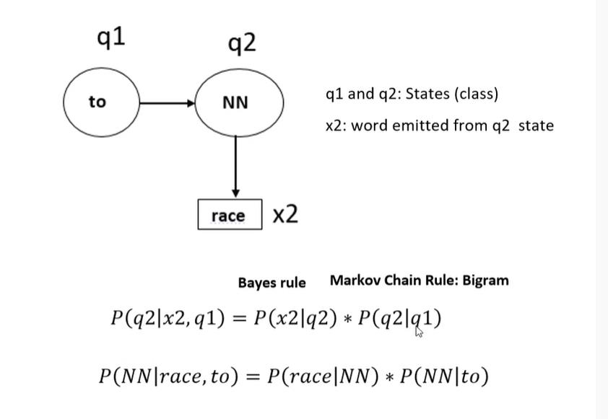
Conditional Probability: P(B|A)= P(A, B) = P(A)P(B| A) (continued)
Learnova
33 / 229
Notes:
Read these exactly (do not paraphrase):
- Conditional Probability: P(B|A)= P(A, B) = P(A)P(B| A) (continued)
Pause: ask the class what they already know about “Conditional Probability: P(B|A)= P(A, B) = P(A)P(B| A) (continued)” before revealing the slide.
Wording matters here — slow down, keep it precise.
~19s
Text in the figure: ql q2 ql and q2: States (class) x2: word emitted from q2 state [ race | x2 Bayesrule Markov Chain Rule: Bigram = P(x2|q2) * P(NN\|race, to) = P(race|NN) « P(NN|to)
Ask the class: Explain this slide in your own words, in one sentence.

Slide 35
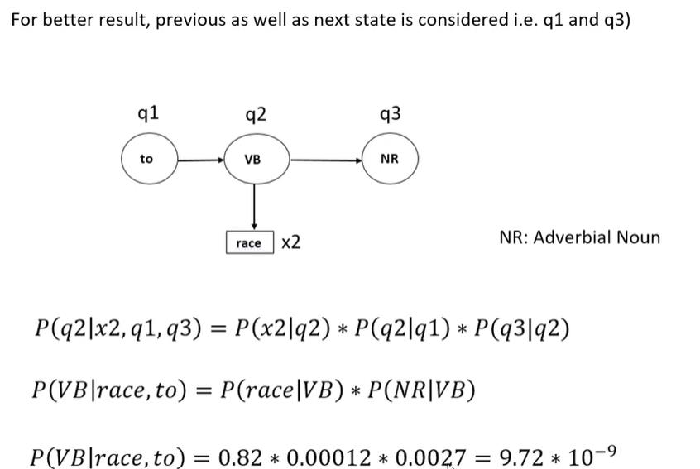
Conditional Probability: P(B|A)= P(A, B) = P(A)P(B| A) (continued)
Learnova
34 / 229
Notes:
Read these exactly (do not paraphrase):
- Conditional Probability: P(B|A)= P(A, B) = P(A)P(B| A) (continued)
Pause: ask the class what they already know about “Conditional Probability: P(B|A)= P(A, B) = P(A)P(B| A) (continued)” before revealing the slide.
Wording matters here — slow down, keep it precise.
~19s
Text in the figure: For better result, previous as well as next state is considered i.e. q1 and q3) ql q2 q3 NR: Adverbial Noun x2 P(q2|x2,q1,q3) = P(x2|q2) * P(q2|q1) « P(q3|q2) P(VB|race,to) = P(race|VB) « P(NR|VB) = 0.82 « 0.00012 « 0.0027 = 9.72 * 107?
Ask the class: Explain this slide in your own words, in one sentence.

Slide 36
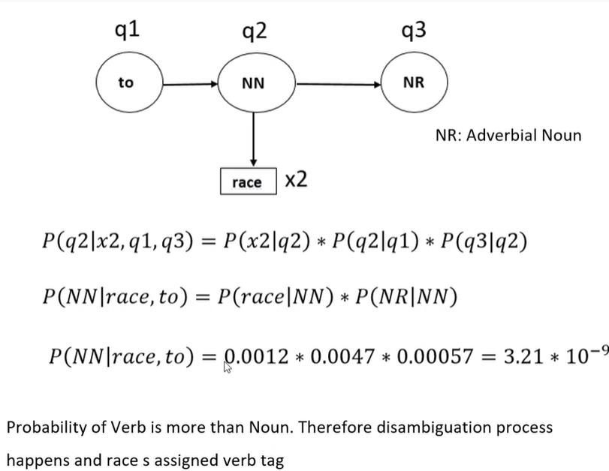
Conditional Probability: P(B|A)= P(A, B) = P(A)P(B| A) (continued)
Learnova
35 / 229
Notes:
Read these exactly (do not paraphrase):
- Conditional Probability: P(B|A)= P(A, B) = P(A)P(B| A) (continued)
Pause: ask the class what they already know about “Conditional Probability: P(B|A)= P(A, B) = P(A)P(B| A) (continued)” before revealing the slide.
Wording matters here — slow down, keep it precise.
~19s
Text in the figure: qi q2 q3 NR: Adverbial Noun x2 P(q2|x2,q1,q3) = P(x2|q2) « P(q2|q1) * P(q3|q2) P(NN|race, to) = P(race|NN) * P(NR|NN) P(NN|race, to) = 0.0012 * 0.0047 * 0.00057 = 3.21 * 107° Probability of Verb is more than Noun. Therefore disambiguation process happens and race s assigned verb tag
Ask the class: Explain this slide in your own words, in one sentence.

Slide 37
Checkpoint 3
QUESTION · UNDERSTAND
Which term matches this description: “An algorithm that returns the state-path assigning maximum likelihood to an observation sequence.”?
Feature
State Transition Matrix
A
B
Evidence
Viterbi algorithm
C
D
Answer: D
Viterbi algorithm: An algorithm that returns the state-path assigning maximum likelihood to an observation sequence.
Learnova
36 / 229
Notes:
KEY POINT TO LAND: Answer, then check your reasoning.
Pause: ask the class what they already know about “Checkpoint 3” before revealing the slide.
~44s

Slide 38
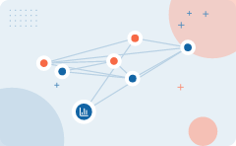
Hidden Markov models utilize emission and state transition matrices
Hidden | State
Markov models combine states and emitted words using Bayes rule | X2: word emitted from q2 state
This structure links hidden classes to observed words | Obtained from State Transition Matrix
 | Data for emission comes from the emission probability matrix, whereas bigram data is obtained from the state transition matrix
 | Example: Using state q2 to emit word x2 based on Bayes rule
Key takeaway: Hidden Markov models combine emission matrices and state transition matrices using Bayes rule.
Key terms: Emission Probability Matrix — A table providing data obtained for Bayes rule emission probability. · State Transition Matrix — A table providing bigram data for state transition probabilities.
Learnova
▶ Open the interactive lab: Bigram Language Model Lab
37 / 229
Notes:
Reveal, one click at a time:
1. qi q2 ql and q2: States (class)
2. x2: word emitted from q2 state
3. Bayes Rule Bigram
4. Bayes Rule data obtained from Emission Probability matrix while Bigram data is
5. obtained from State Transition Matrix
6. Hidden Markov models combine states and emitted words using Bayes rule.
7. Data for emission comes from the emission probability matrix, whereas bigram data is obtained from the state transition
Read these exactly (do not paraphrase):
- Hidden Markov models utilize emission and state transition matrices qi q2 ql and q2: States (class) x2: word emitted from q2 state Bayes Rule Bigram Bayes Rule data obtained from Emission Probability matrix while Bigram data is obtained from State Transition Matrix Hidden Markov models combine states and emitted words using Bayes rule.
Say what these mean, in your own words:
- Emission Probability Matrix: A table providing data obtained for Bayes rule emission probability.
- State Transition Matrix: A table providing bigram data for state transition probabilities.
Pause: ask the class what they already know about “Hidden Markov models utilize emission and state transition matrices” before revealing the slide.
~61s
Ask the class: Explain this slide in your own words, in one sentence.

Slide 39
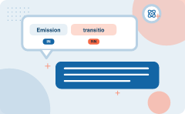
Emission and transition matrices are constructed from corpus tokens and tags
Emission | Transition
Probability Matrix | State Transition Probability
This will provide data for Bayes rule emission probability | This will provide data for state transition probability
For N token, M part of speech tags, size of the emission matrix will be NxM
Use part of speech tags found from emission probability matrix
IN PLAIN WORDS
For example, arranging N tokens horizontally and M part of speech tags vertically to create an NxM matrix.
From a given corpus, identify unique tokens. Also identify total part of speech tags present in corpus. Assign correct Part of Speech (POS) tag for every token.
Key takeaway: 4 emissions compared on transition.
Key terms: pos — Parts of Speech Tagging · Emission Probability Matrix — An NxM matrix mapping unique tokens to part of speech tags. · Bigram concept — A method using adjacent part of speech tags to fill an MxM transition table.
Learnova
38 / 229
Notes:
Reveal, one click at a time:
1. Emission Probability Matrix:
2. From a given corpus, identify unique tokens. Also identify total part of speech
3. tags present in corpus.
4. Assign correct Part of Speech (POS) tag for every token.
5. Arrange tokens in horizontal and Part of Speech (POS) tag in vertical fashion.
6. Wecan change this order also.
7. This will provide data for Bayes rule emission probability.
Read these exactly (do not paraphrase):
- Assign correct Part of Speech (POS) tag for every token.
- Arrange tokens in horizontal and Part of Speech (POS) tag in vertical fashion.
Say what these mean, in your own words:
- pos: Parts of Speech Tagging
- Emission Probability Matrix: An NxM matrix mapping unique tokens to part of speech tags.
- Bigram concept: A method using adjacent part of speech tags to fill an MxM transition table.
Pause: ask the class what they already know about “Emission and transition matrices are constructed from corpus tokens and tags” before revealing the slide.
~61s
Ask the class: Explain this slide in your own words, in one sentence.

Slide 40
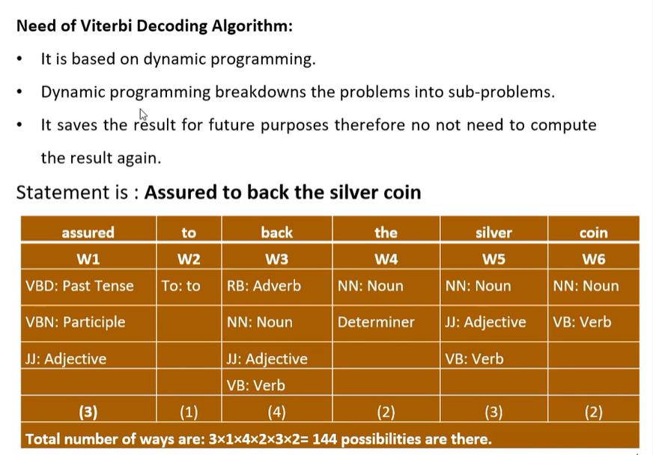
Generative Model: Hidden Markov Model (HMM) (continued)
Learnova
▶ Open the interactive lab: Viterbi / HMM Lab
39 / 229
Notes:
Read these exactly (do not paraphrase):
- Generative Model: Hidden Markov Model (HMM) (continued)
Pause: ask the class what they already know about “Generative Model: Hidden Markov Model (HMM) (continued)” before revealing the slide.
Wording matters here — slow down, keep it precise.
~19s
Text in the figure: Need of Viterbi Decoding Algorithm: Itis based on dynamic programming. Dynamic programming breakdowns the problems into sub-problems. It saves the sult for future purposes therefore no not need to compute the result again. Statement is : Assured to back the silver coin VBD: Past Tense ee | | Tl Total number of ways are: 3x1x4x2x3x2= 144 possibilities are there.
Ask the class: What might explain these numbers?

Slide 41
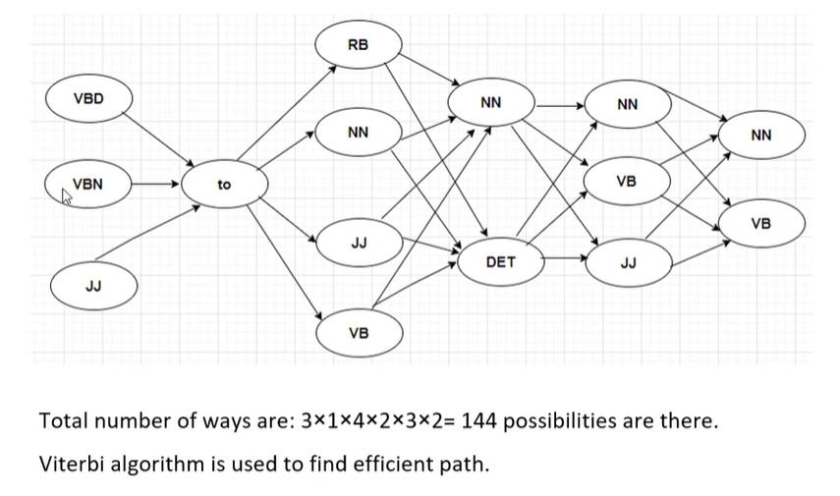
Generative Model: Hidden Markov Model (HMM) (continued)
Learnova
40 / 229
Notes:
Read these exactly (do not paraphrase):
- Generative Model: Hidden Markov Model (HMM) (continued)
Pause: ask the class what they already know about “Generative Model: Hidden Markov Model (HMM) (continued)” before revealing the slide.
Wording matters here — slow down, keep it precise.
~19s
Text in the figure: Total number of ways are: 144 possibilities are there. Viterbi algorithm is used to find efficient path.
Ask the class: What might explain these numbers?

Slide 42
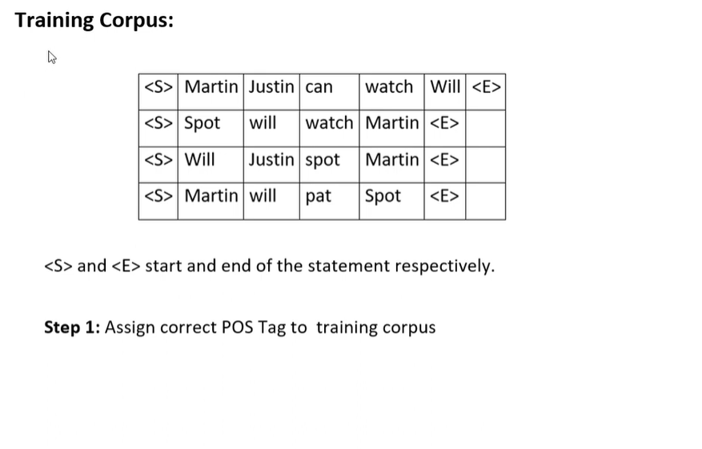
Generative Model: Hidden Markov Model (HMM) (continued)
Learnova
41 / 229
Notes:
Read these exactly (do not paraphrase):
- Generative Model: Hidden Markov Model (HMM) (continued)
Pause: ask the class what they already know about “Generative Model: Hidden Markov Model (HMM) (continued)” before revealing the slide.
Wording matters here — slow down, keep it precise.
~19s
Text in the figure: Training Corpus: watch | <E> | Martin| <E> <S>|Martin| will |pat |Spot <S> and <E> start and end of the statement respectively. Step 1: Assign correct POS Tag to training corpus
Ask the class: What might explain these numbers?

Slide 43
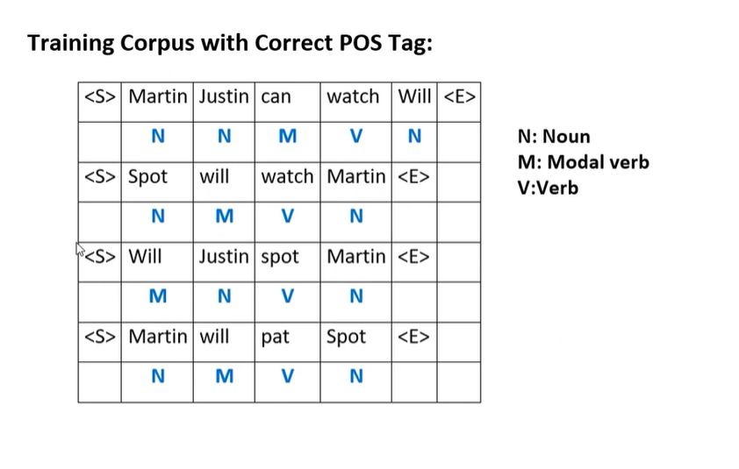
Generative Model: Hidden Markov Model (HMM) (continued)
Learnova
42 / 229
Notes:
Read these exactly (do not paraphrase):
- Generative Model: Hidden Markov Model (HMM) (continued)
Pause: ask the class what they already know about “Generative Model: Hidden Markov Model (HMM) (continued)” before revealing the slide.
Wording matters here — slow down, keep it precise.
~19s
Text in the figure: Training Corpus with Correct POS Tag: M: Modal verb | watch} Martin| <E> V:Verb N M Vv N ar
Ask the class: What might explain these numbers?

Slide 44
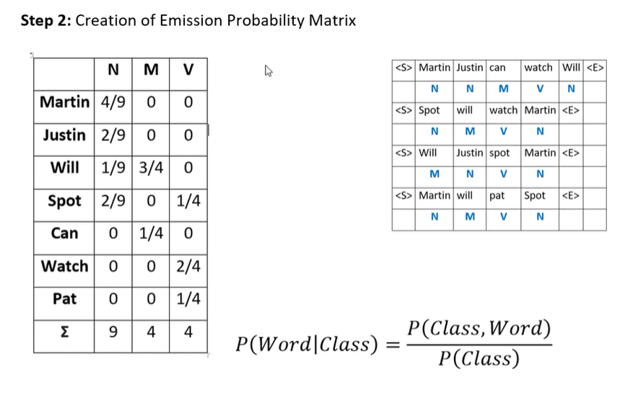
Generative Model: Hidden Markov Model (HMM) (continued)
Learnova
43 / 229
Notes:
Read these exactly (do not paraphrase):
- Generative Model: Hidden Markov Model (HMM) (continued)
Pause: ask the class what they already know about “Generative Model: Hidden Markov Model (HMM) (continued)” before revealing the slide.
Wording matters here — slow down, keep it precise.
~19s
Text in the figure: Step 2: Creation of Emission Probability Matrix | NM IN <S>|Martin|Justin|can | watch | Will| <E> N N M Vv N Martin 4/9 | Martin| <E> Justin | 2/9 0 | wa 5 0 Will |Justin| spot | Martin| <E> Spot 2/9 | 0 | 4/4 <S>|Martin| will N M Vv N can | 0 [va] 0 | JWatch] 0 | 0 [2/4 Pat | 0 | 0 | P(Word|Class) = P(Class, Word) P(Class)
Ask the class: What might explain these numbers?

Slide 45
Generative Model: Hidden Markov Model (HMM) (continued)
Learnova
44 / 229
Notes:
Read these exactly (do not paraphrase):
- Generative Model: Hidden Markov Model (HMM) (continued)
Pause: ask the class what they already know about “Generative Model: Hidden Markov Model (HMM) (continued)” before revealing the slide.
Wording matters here — slow down, keep it precise.
~19s
Text in the figure: Step 2: Creation of Emission Probability Matrix | NM IN <S>|Martin|Justin|can | watch | Will| <E> N N M Vv N Martin 4/9 | Martin| <E> Justin | 2/9 0 | wa 5 0 Will |Justin| spot | Martin| <E> Spot 2/9 | 0 | 4/4 <S>|Martin| will N M Vv N can | 0 [va] 0 | JWatch] 0 | 0 [2/4 Pat | 0 | 0 | P(Word|Class) = P(Class, Word) P(Class)
Ask the class: What might explain these numbers?

Slide 46
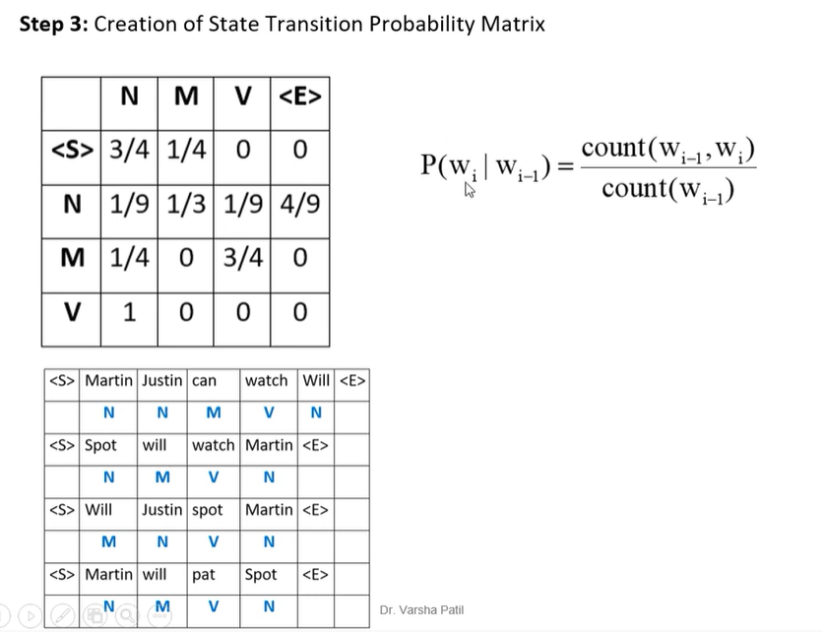
Generative Model: Hidden Markov Model (HMM) (continued)
Learnova
45 / 229
Notes:
Read these exactly (do not paraphrase):
- Generative Model: Hidden Markov Model (HMM) (continued)
Pause: ask the class what they already know about “Generative Model: Hidden Markov Model (HMM) (continued)” before revealing the slide.
Wording matters here — slow down, keep it precise.
~19s
Text in the figure: Step 3: Creation of State Transition Probability Matrix Y |< 0 15/4) 0 | | watch | Will| <E> N N Spot | will N M will <S>|Martin| will N M Vv N Dr. Varsha Patil = |
Ask the class: What might explain these numbers?

Slide 47
Generative Model: Hidden Markov Model (HMM) (continued)
Learnova
46 / 229
Notes:
Read these exactly (do not paraphrase):
- Generative Model: Hidden Markov Model (HMM) (continued)
Pause: ask the class what they already know about “Generative Model: Hidden Markov Model (HMM) (continued)” before revealing the slide.
Wording matters here — slow down, keep it precise.
~19s
Text in the figure: Step 3: Creation of State Transition Probability Matrix Y |< 0 15/4) 0 | | watch | Will| <E> N N Spot | will N M will <S>|Martin| will N M Vv N Dr. Varsha Patil = |
Ask the class: What might explain these numbers?

Slide 48
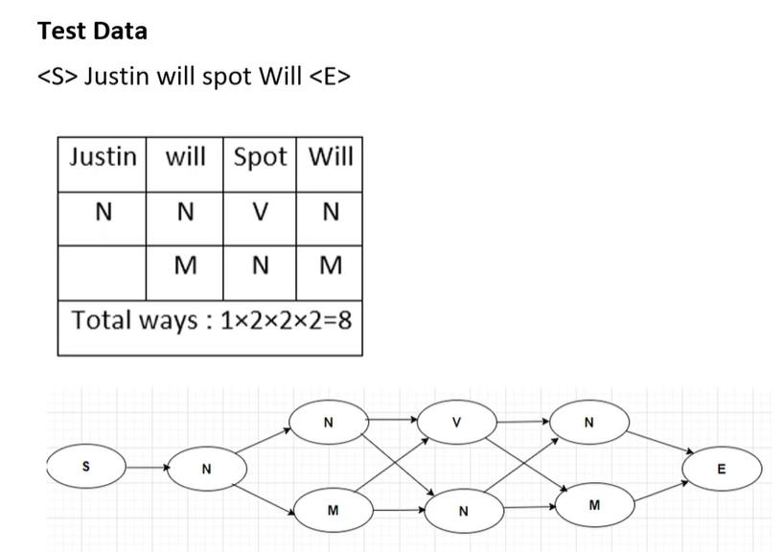
Generative Model: Hidden Markov Model (HMM) (continued)
Learnova
47 / 229
Notes:
Read these exactly (do not paraphrase):
- Generative Model: Hidden Markov Model (HMM) (continued)
Pause: ask the class what they already know about “Generative Model: Hidden Markov Model (HMM) (continued)” before revealing the slide.
Wording matters here — slow down, keep it precise.
~19s
Text in the figure: Test Data <S> Justin will spot Will <E> PN Total ways : 1x2x2x2=8
Ask the class: What might explain these numbers?

Slide 49
Checkpoint 4
QUESTION · UNDERSTAND
Which term matches this description: “A classical machine learning task used for predicting categories and outcomes.”?
Discriminative Model
Stochastic tagging
A
B
MaxEnt classification
Dynamic programming
C
D
Answer: C
MaxEnt classification: A classical machine learning task used for predicting categories and outcomes.
Learnova
48 / 229
Notes:
KEY POINT TO LAND: Answer, then check your reasoning.
Pause: ask the class what they already know about “Checkpoint 4” before revealing the slide.
~44s

Slide 50
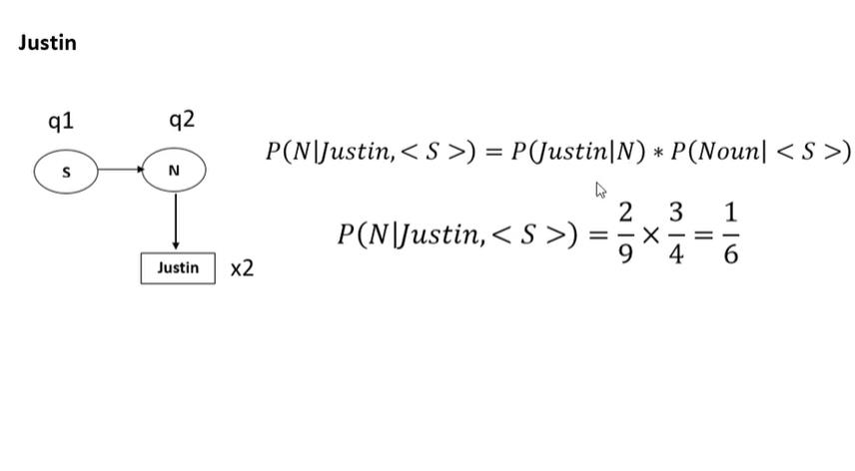
Generative Model: Hidden Markov Model (HMM) (continued)
Learnova
49 / 229
Notes:
Read these exactly (do not paraphrase):
- Generative Model: Hidden Markov Model (HMM) (continued)
Pause: ask the class what they already know about “Generative Model: Hidden Markov Model (HMM) (continued)” before revealing the slide.
Wording matters here — slow down, keep it precise.
~19s
Text in the figure: Justin q2 Cs >" ) P(N\|Justin, < >) = P(Justin|N) * P(Noun| < S >) | S >) 2 3 1 [sn] 32 9°46
Ask the class: What might explain these numbers?

Slide 51
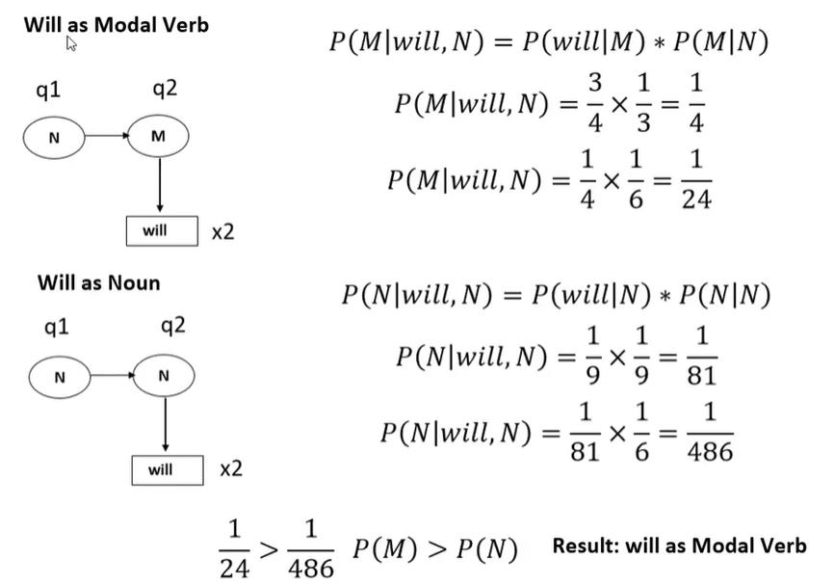
Generative Model: Hidden Markov Model (HMM) (continued)
Learnova
50 / 229
Notes:
Read these exactly (do not paraphrase):
- Generative Model: Hidden Markov Model (HMM) (continued)
Pause: ask the class what they already know about “Generative Model: Hidden Markov Model (HMM) (continued)” before revealing the slide.
Wording matters here — slow down, keep it precise.
~19s
Text in the figure: sis P(M|will, N) = P(will|M) * 311 a ae P(M|will,N) x2 Nowe P(N|will, N) = P(will|N) * P(N|N) qi @ 11 1 11 1 1 | > — P(M)> P(N Result: will as Modal Verb 24 = 486 (M)
Ask the class: What might explain these numbers?

Slide 52
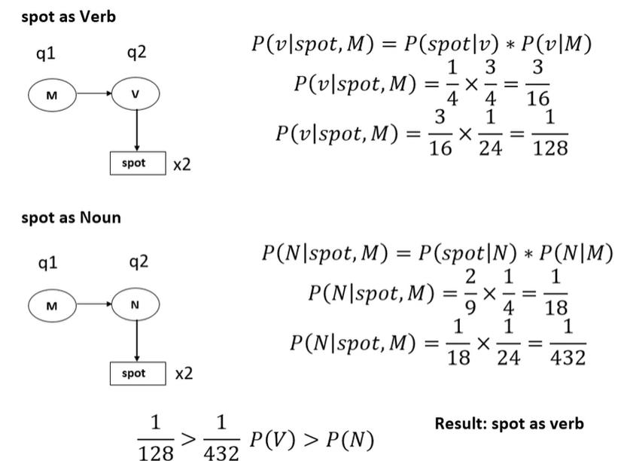
Generative Model: Hidden Markov Model (HMM) (continued)
Learnova
51 / 229
Notes:
Read these exactly (do not paraphrase):
- Generative Model: Hidden Markov Model (HMM) (continued)
Pause: ask the class what they already know about “Generative Model: Hidden Markov Model (HMM) (continued)” before revealing the slide.
Wording matters here — slow down, keep it precise.
~19s
Text in the figure: spot as Verb P(v|spot, M) = P(spot|v) * P(v|M) ql q2 3 P(v|spot, M) = — J 16 3 11 fe” 24 128 v|spo [ spot] x2 spot as Noun P(N|spot,M) = P(spot|N) *« P(N|M) ql q2 1 SPO) = 78 P(N| 4 1824 432 | spot | x2 P(V P(N Result: spot as verb Ton gag
Ask the class: What might explain these numbers?

Slide 53
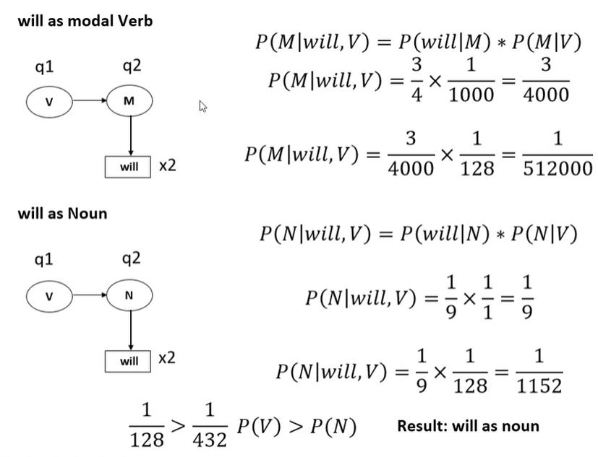
Generative Model: Hidden Markov Model (HMM) (continued)
Learnova
52 / 229
Notes:
Read these exactly (do not paraphrase):
- Generative Model: Hidden Markov Model (HMM) (continued)
Pause: ask the class what they already know about “Generative Model: Hidden Markov Model (HMM) (continued)” before revealing the slide.
Wording matters here — slow down, keep it precise.
~19s
Text in the figure: will as modal Verb P(M|will, V) = P(will|M) * P(M|V) ql q2 3 1 3 ) =-x—— = —_ = P(M|will, V) = x = : x2 = 4000 128 512000 will as Noun P(N|will, V) = P(will|N) * P(N|V) ql q2 P(N|will, V) = 1 9 x2 V) = 5X = 432 P(V) > P(N) Result: will as noun
Ask the class: What might explain these numbers?

Slide 54
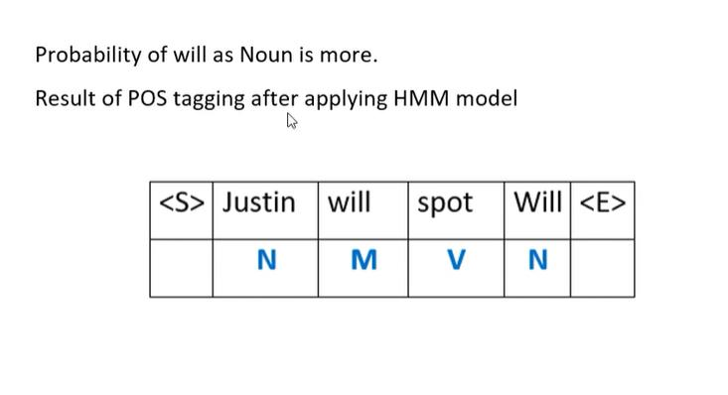
Generative Model: Hidden Markov Model (HMM) (continued)
Learnova
53 / 229
Notes:
Read these exactly (do not paraphrase):
- Generative Model: Hidden Markov Model (HMM) (continued)
Pause: ask the class what they already know about “Generative Model: Hidden Markov Model (HMM) (continued)” before revealing the slide.
Wording matters here — slow down, keep it precise.
~19s
Text in the figure: Probability of will as Noun is more.
Result of POS tagging after applying HMM model
&
Justin | will |spot | Will
BRALILAL
Ask the class: What might explain these numbers?

Slide 55

Transition and emission probabilities measure the likelihood of sequences
The transition probability is the likelihood of a particular sequence for example, Eg: “ Ted will spot Will ” how likely is that a noun is followed by a model and a model by a verb and a verb by a noun.
This probability is known as Transition probability.
It should be high for a particular sequence to be correct.
what is the probability that the word Ted is a noun, will is a model, spot is a verb and Will is a noun.
These sets of probabilities are Emission probabilities and should be high.
IN PLAIN WORDS
For example, checking how likely a noun is followed by a model in the sentence Ted will spot Will.
Key terms: Transition probability — The likelihood of a particular sequence of part of speech tags. · Emission probability — The likelihood that a specific word corresponds to a specific part of speech.
Learnova
54 / 229
Notes:
Reveal, one click at a time:
1. The transition probability is the likelihood of a particular sequence for example, Eg: “ Ted will spot Will ” how likely
2. This probability is known as Transition probability.
3. It should be high for a particular sequence to be correct.
4. what is the probability that the word Ted is a noun, will is a model, spot is a verb and Will is a noun.
5. These sets of probabilities are Emission probabilities and should be high.
Read these exactly (do not paraphrase):
- Transition and emission probabilities measure the likelihood of sequences The transition probability is the likelihood of a particular sequence for example, Eg: “ Ted will spot Will ” how likely is that a noun is followed by a model and a model by a verb and a verb by a noun.
- This probability is known as Transition probability.
Say what these mean, in your own words:
- Transition probability: The likelihood of a particular sequence of part of speech tags.
- Emission probability: The likelihood that a specific word corresponds to a specific part of speech.
Pause: ask the class what they already know about “Transition and emission probabilities measure the likelihood of sequences” before revealing the slide.
Wording matters here — slow down, keep it precise.
~47s
Ask the class: Explain this slide in your own words, in one sentence.

Slide 56
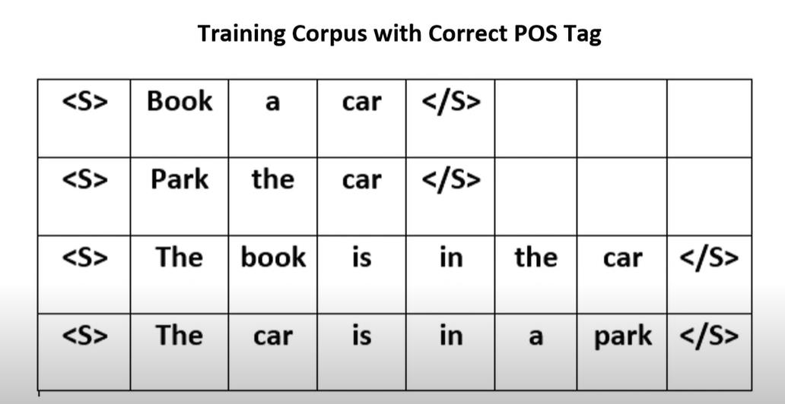
Transition probability & emission probability (continued)
Learnova
55 / 229
Notes:
Read these exactly (do not paraphrase):
- Transition probability & emission probability (continued)
Pause: ask the class what they already know about “Transition probability & emission probability (continued)” before revealing the slide.
Wording matters here — slow down, keep it precise.
~19s
Text in the figure: Training Corpus with Correct POS Tag im | peek
Ask the class: What might explain these numbers?

Slide 57
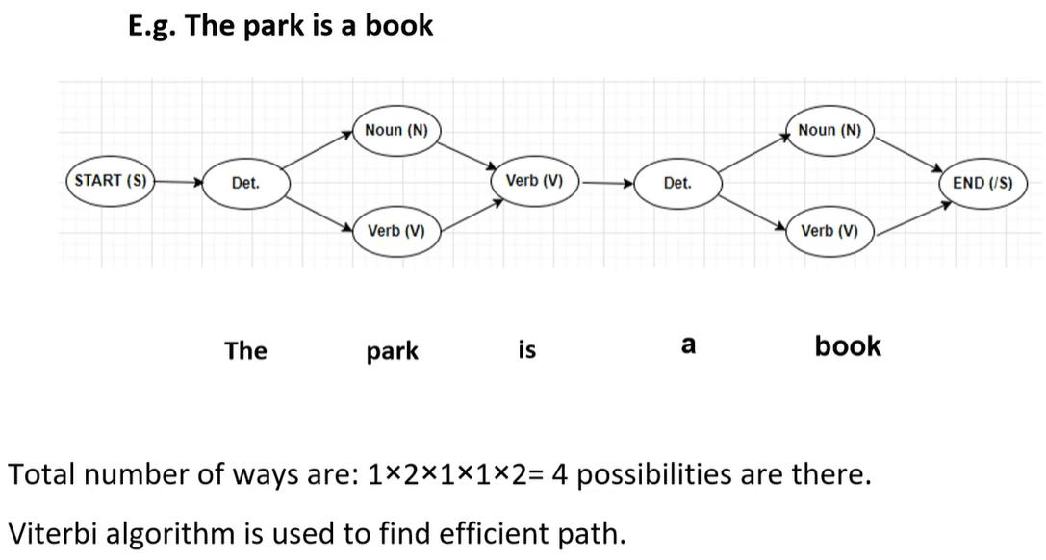
Transition probability & emission probability (continued)
Learnova
56 / 229
Notes:
Read these exactly (do not paraphrase):
- Transition probability & emission probability (continued)
Pause: ask the class what they already know about “Transition probability & emission probability (continued)” before revealing the slide.
Wording matters here — slow down, keep it precise.
~19s
Text in the figure: E.g. The park is a book
The park is a book
Total number of ways are: 1%2*1*1x2= 4 possibilities are there.
Viterbi algorithm is used to find efficient path.
Ask the class: What might explain these numbers?

Slide 58
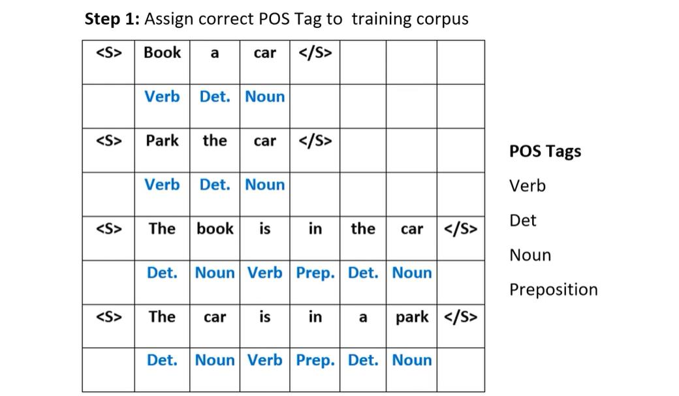
Transition probability & emission probability (continued)
Learnova
57 / 229
Notes:
Read these exactly (do not paraphrase):
- Transition probability & emission probability (continued)
Pause: ask the class what they already know about “Transition probability & emission probability (continued)” before revealing the slide.
Wording matters here — slow down, keep it precise.
~19s
Text in the figure: Step 1: Assign correct POS Tag to training corpus
Sfistetel |
permet LL | rostas
pfepepery | tt |
er
Noun
Verb
Preposition
SPEER =
Ask the class: What might explain these numbers?

Slide 59
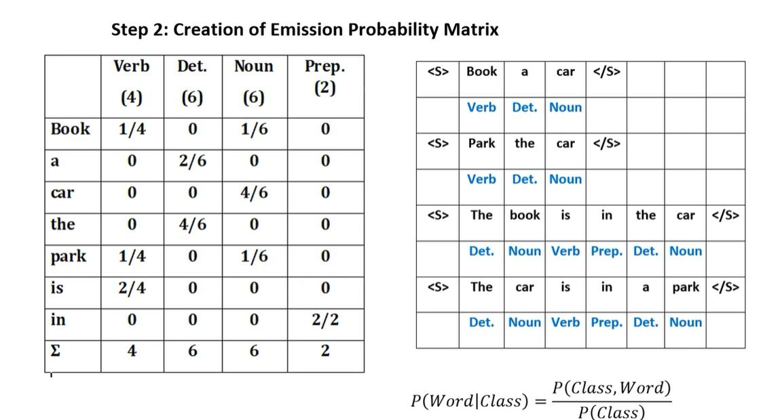
Transition probability & emission probability (continued)
Learnova
58 / 229
Notes:
Read these exactly (do not paraphrase):
- Transition probability & emission probability (continued)
Pause: ask the class what they already know about “Transition probability & emission probability (continued)” before revealing the slide.
Wording matters here — slow down, keep it precise.
~19s
Text in the figure: Step 2: Creation of Emission Probability Matrix Verb | Det. | Noun Prep. <S> | Book| a | car | </S> (2) (4) (6) (6) Verb | Det. | Noun 1/4 0 1/6 0 <S> | Park | the | car | </S> 0 2/6 0 0 Verb | Det. 0 0 4/6 0 0 4 ] 6 0 0 <S> | The | book! is in | the | car | </S> 1/4 0 1/6 0 Det. |Noun| Verb | Prep.| Det. | Noun 2/4 0 0 0 <S> | The | car | is in park | </S> 0 0 0 2/2 Det. |Noun| Verb | Prep.| Det. | Noun 4 6 6 Z P(Class, Word) P(Word|Class) =
Ask the class: What might explain these numbers?

Slide 60
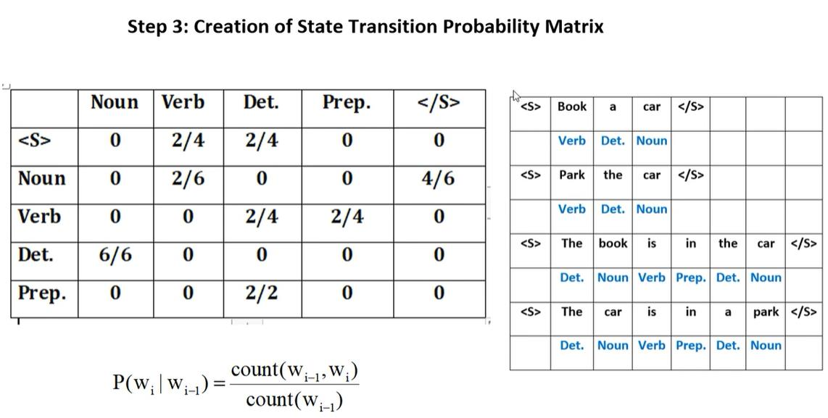
Transition probability & emission probability (continued)
Learnova
59 / 229
Notes:
Read these exactly (do not paraphrase):
- Transition probability & emission probability (continued)
Pause: ask the class what they already know about “Transition probability & emission probability (continued)” before revealing the slide.
Wording matters here — slow down, keep it precise.
~19s
Text in the figure: Step 3: Creation of State Transition Probability Matrix Noun | Det. | Prep. </S> [Book] a | car [</> Verb | Det. | Noun <S> | Park | the | car | </S> 2/4 2/4 | Verb | Det. [Noun 0 <S> | The | book} is in | the | car | </S> Det. |Noun| Verb | Prep.| Det. | Noun <S> | The | car is in a | park | </S> Det. |Noun| Verb | Prep.| Det. | Noun count(w,_,,W;) P(w; | =
Ask the class: What might explain these numbers?

Slide 61
Checkpoint 5
QUESTION · UNDERSTAND
Which term matches this description: “A discriminative probabilistic classifier that uses sentence level normalization.”?
Noun phrase
Rule-based tagger
A
B
CFG
Conditional Random Field (CRF)
C
D
Answer: D
Conditional Random Field (CRF): A discriminative probabilistic classifier that uses sentence level normalization.
Learnova
60 / 229
Notes:
KEY POINT TO LAND: Answer, then check your reasoning.
Pause: ask the class what they already know about “Checkpoint 5” before revealing the slide.
~44s

Slide 62

Transition probability & emission probability (continued)
Learnova
61 / 229
Notes:
Read these exactly (do not paraphrase):
- Transition probability & emission probability (continued)
Pause: ask the class what they already know about “Transition probability & emission probability (continued)” before revealing the slide.
Wording matters here — slow down, keep it precise.
~19s
Text in the figure: Test Data <S>The park is a book </S> | park | a | book | | |e | || vere 1*2*1x1x2=4 ways are there
Ask the class: What might explain these numbers?

Slide 63

Transition probability & emission probability (continued)
Learnova
62 / 229
Notes:
Read these exactly (do not paraphrase):
- Transition probability & emission probability (continued)
Pause: ask the class what they already know about “Transition probability & emission probability (continued)” before revealing the slide.
Wording matters here — slow down, keep it precise.
~19s
Text in the figure: P(q2|x2, q1) = P(x2|q2) * P(q2|q1) rants) (on) P(Det|The, < $ >) = P(The|Det) « P(Det| < $ >) P(Det|The, <S> (Det|The,
Ask the class: What might explain these numbers?

Slide 64

Transition probability & emission probability (continued)
Learnova
63 / 229
Notes:
Read these exactly (do not paraphrase):
- Transition probability & emission probability (continued)
Pause: ask the class what they already know about “Transition probability & emission probability (continued)” before revealing the slide.
Wording matters here — slow down, keep it precise.
~19s
Text in the figure: Park as Noun Previous Probability is 1/3 [a | P(q2|x2, q1) = P(x2|q2) x P(q2|q1) <> Coun >) P(Noun|Park, Det) = P(Park|Noun) x P(Noun|Det.) 2 P(Noun|Park, Det.) = x : 4 P(Noun|Park, Det.) = Det) = P(ParkiVerb) x P(Verb|Det.) 1 0 Park as verb P(Verb|Park, Det.) = 0 11 14 = P(Verb|Park, Det.) = 5 1 1 1 P(Verb|Park, Det.) = 400 1200 1 1 Pak») Ie 1200 Result: park as noun
Ask the class: What might explain these numbers?

Slide 65

Transition probability & emission probability (continued)
Learnova
64 / 229
Notes:
Read these exactly (do not paraphrase):
- Transition probability & emission probability (continued)
Pause: ask the class what they already know about “Transition probability & emission probability (continued)” before revealing the slide.
Wording matters here — slow down, keep it precise.
~19s
Text in the figure: is as Verb Previous Probability is 1/18 qa q2 P(Verb|is, Noun) = p(is|Verb) x P(Verb|Noun) 2.2 1 P(Verb|is, Noun) = _1 1 1 Oye 108 Previous Probability is 1/108 aas Det P(Det.|a, Verb) = P(a|Det.) x P(Det.|Verb) 221 P(Det|a, Verb) = 1 | P(Det.|a, Verb) = — Ca a 648
Ask the class: What might explain these numbers?

Slide 66

Transition probability & emission probability (continued)
Learnova
65 / 229
Notes:
Read these exactly (do not paraphrase):
- Transition probability & emission probability (continued)
Pause: ask the class what they already know about “Transition probability & emission probability (continued)” before revealing the slide.
Wording matters here — slow down, keep it precise.
~19s
Text in the figure: book as Noun Previous Probability is 1/648 P(Noun|book, Det.) = P(book|Noun) x P(Noun|Det) 161 P(Noun|book, Det.) = 1 1 P(Noun|book, Det.) = 6* 648 3808 book as Verb P(Noun|Verb, Det.) = P(book|Verb) x P(Verb|Det) 1 P(Verb|book, Det.) = — 0=0 (vet. <> P(Noun|book, Det.) = 4% 100 400 1, 1 1 1 1 P(Noun|book, Det.) = 400 * 648 259200 z 1 [2] 3888 259200 Result: book as Noun 008 © @
Ask the class: What might explain these numbers?

Slide 67

Transition probability & emission probability (continued)
Learnova
66 / 229
Notes:
Read these exactly (do not paraphrase):
- Transition probability & emission probability (continued)
Pause: ask the class what they already know about “Transition probability & emission probability (continued)” before revealing the slide.
Wording matters here — slow down, keep it precise.
~19s
Ask the class: What might explain these numbers?

Slide 68

Sequence labeling using HMM
Learnova
▶ Open the interactive lab: Viterbi / HMM Lab
67 / 229
Notes:
Pause: ask the class what they already know about “Sequence labeling using HMM” before revealing the slide.
~19s
Ask the class: Explain this slide in your own words, in one sentence.

Slide 69

Sample sentences provide data for calculating sequence probabilities
Mary Jane can see Will
Mary will pat Spot
IN PLAIN WORDS
For example, calculating probabilities for the sentence Mary Jane can see Will.
Key terms: Sentence set — A collection of sentences used for calculating language probabilities. · Spot — A word used as a verb or noun in the sample sentences.
Learnova
68 / 229
Notes:
Reveal, one click at a time:
1. Mary Jane can see Will
2. Spot will see Mary
3. Will Jane spot Mary?
4. Mary will pat Spot
Say what these mean, in your own words:
- Sentence set: A collection of sentences used for calculating language probabilities.
- Spot: A word used as a verb or noun in the sample sentences.
Pause: ask the class what they already know about “Sample sentences provide data for calculating sequence probabilities” before revealing the slide.
~40s
Ask the class: Explain this slide in your own words, in one sentence.

Slide 70

Emission probability matrix
Words Noun Model Verb Mary 4 0 o Jane 2 0 o will 1 3 o Spot 2 0 1 can o 1 o see o 0 2 pat o 0 1
Learnova
69 / 229
Notes:
Pause: ask the class what they already know about “Emission probability matrix” before revealing the slide.
~19s
Text in the figure: Words Noun Model Verb
Mary 4 0 o
Jane 2 0 o
will 1 3 o
Spot 2 0 1
can o 1 o
see o 0 2
pat o 0 1
Ask the class: What might explain these numbers?

Slide 71

Emission probability matrix (continued)
Words Noun Model Verb Mary 4/9 O 0 Jane 2/9 O 0 will 9 3/4 0 Spot 2/9 O 4 Can 0 4 0 See (o) O 2/4 pat o 0 1
Learnova
70 / 229
Notes:
Read these exactly (do not paraphrase):
- Emission probability matrix (continued)
Pause: ask the class what they already know about “Emission probability matrix (continued)” before revealing the slide.
Wording matters here — slow down, keep it precise.
~19s
Text in the figure: Words Noun Model Verb
Mary 4/9 O 0
Jane 2/9 O 0
will 9 3/4 0
Spot 2/9 O 4
Can 0 4 0
See (o) O 2/4
pat o 0 1
Ask the class: What might explain these numbers?

Slide 72

Emission probability matrix (continued)
Learnova
71 / 229
Notes:
Read these exactly (do not paraphrase):
- Emission probability matrix (continued)
Pause: ask the class what they already know about “Emission probability matrix (continued)” before revealing the slide.
Wording matters here — slow down, keep it precise.
~19s
Text in the figure: Mary can See Will Spot will see Mary wil Jane spot Mary ? Mary willl pat Spot
Ask the class: What might explain these numbers?

Slide 73
Checkpoint 6
QUESTION · UNDERSTAND
Which term matches this description: “Finding tables and extracting information from text documents.”?
Table extraction
Sentence structure
A
B
MaxEnt classification
Postmodifier
C
D
Answer: A
Table extraction: Finding tables and extracting information from text documents.
Learnova
72 / 229
Notes:
KEY POINT TO LAND: Answer, then check your reasoning.
Pause: ask the class what they already know about “Checkpoint 6” before revealing the slide.
~44s

Slide 74

Transition probability matrix
Learnova
73 / 229
Notes:
Pause: ask the class what they already know about “Transition probability matrix” before revealing the slide.
~19s
Ask the class: What might explain these numbers?

Slide 75

Transition probability matrix (continued)
Learnova
74 / 229
Notes:
Read these exactly (do not paraphrase):
- Transition probability matrix (continued)
Pause: ask the class what they already know about “Transition probability matrix (continued)” before revealing the slide.
Wording matters here — slow down, keep it precise.
~19s
Text in the figure: N M Vv <B> <> 3/4 0 0 N 1/9 3/9 4/9 M 1/4 3/4 (0)
Ask the class: What might explain these numbers?

Slide 76

Hidden Markov models determine appropriate tag sequences using probability tables
How does the HMM determine the appropriate sequence of tags for a particular sentence from the above tables?
Take a new sentence and tag them with wrong tags
Let the sentence, ‘ Will can spot Mary’ be tagged as-
IN PLAIN WORDS
Hidden Markov models evaluate alternative tag assignments for a sentence by referencing probability tables. Even when initial tags are incorrect, the model computes scores to find the optimal sequence. This process demonstrates how statistical tables correct and assign proper tags to new text. For example, testing alternative tags for the sentence 'Will can spot Mary'.
Key terms: hmm — Hidden Markov Model · Transition probability matrix — A table used by HMM to determine appropriate tag sequences for a sentence. · Tagging — Assigning parts of speech like nouns or verbs to words in a sentence.
Learnova
75 / 229
Notes:
Reveal, one click at a time:
1. How does the HMM determine the appropriate sequence of tags for a particular sentence from the above tables?
2. Take a new sentence and tag them with wrong tags.
3. Let the sentence, ‘ Will can spot Mary’ be tagged as-
4. Will as a model
5. Can as a verb
6. Spot as a noun
7. Mary as a noun
Say what these mean, in your own words:
- hmm: Hidden Markov Model
- Transition probability matrix: A table used by HMM to determine appropriate tag sequences for a sentence.
- Tagging: Assigning parts of speech like nouns or verbs to words in a sentence.
Pause: ask the class what they already know about “Hidden Markov models determine appropriate tag sequences using probability tables” before revealing the slide.
~61s
Ask the class: Explain this slide in your own words, in one sentence.

Slide 77

Transition probability matrix (continued)
; can y spot Mary ‘i9i@ eee
Learnova
76 / 229
Notes:
Read these exactly (do not paraphrase):
- Transition probability matrix (continued)
Pause: ask the class what they already know about “Transition probability matrix (continued)” before revealing the slide.
Wording matters here — slow down, keep it precise.
~19s
Text in the figure: can spot Mary \/
Ask the class: What might explain these numbers?

Slide 78

Two paths lead to this vertex with known probabilities
There are two paths leading to this vertex as shown below along with the probabilities of the two mini-paths.
When multiple paths reach a single vertex, each path carries its own specific probability.
Understanding these individual mini-path probabilities is essential for calculating the likelihood of larger sequences.
We use these values to determine how likely each incoming route is.
Example: Path A has a probability of 0.3 and Path B has 0.7.
Key terms: Transition probability — The likelihood of moving from one specific state to another.
Learnova
77 / 229
Notes:
Reveal, one click at a time:
1. There are two paths leading to this vertex as shown below along with the probabilities of the two mini-paths.
2. When multiple paths reach a single vertex, each path carries its own specific probability.
3. Understanding these individual mini-path probabilities is essential for calculating the likelihood of larger sequences.
4. We use these values to determine how likely each incoming route is.
5. Example: Path A has a probability of 0.3 and Path B has 0.7.
Say what these mean, in your own words:
- Transition probability: The likelihood of moving from one specific state to another.
Pause: ask the class what they already know about “Two paths lead to this vertex with known probabilities” before revealing the slide.
~47s
Ask the class: Explain this slide in your own words, in one sentence.

Slide 79

After Computing probabilities of all paths
Learnova
78 / 229
Notes:
Pause: ask the class what they already know about “After Computing probabilities of all paths” before revealing the slide.
~19s
Ask the class: What might explain these numbers?

Slide 80

Tracing backward from the end yields an optimal path
To get an optimal path, start from the end and trace backward, since each state has only one incoming edge, This gives a path as shown below.
An optimal path is found by starting at the final state and working backward.
BECAUSE Because each state features a single incoming edge, this reverse tracing process clearly reveals the best sequence of states that led to the end.
Example: Tracing back from the final destination node to the start node.
Key terms: Optimal path — The best or most likely sequence of states through a network.
Learnova
79 / 229
Notes:
Reveal, one click at a time:
1. To get an optimal path, start from the end and trace backward, since each state has only one incoming edge, This gives a
2. An optimal path is found by starting at the final state and working backward.
3. Because each state features a single incoming edge, this reverse tracing process clearly reveals the best sequence of st
4. Example: Tracing back from the final destination node to the start node.
Read these exactly (do not paraphrase):
- Because each state features a single incoming edge, this reverse tracing process clearly reveals the best sequence of states that led to the end.
Say what these mean, in your own words:
- Optimal path: The best or most likely sequence of states through a network.
Pause: ask the class what they already know about “Tracing backward from the end yields an optimal path” before revealing the slide.
~40s
Ask the class: Explain this slide in your own words, in one sentence.

Slide 81

Problem in which matrix is GIVEN/ not training data
Learnova
80 / 229
Notes:
Pause: ask the class what they already know about “Problem in which matrix is GIVEN/ not training data” before revealing the slide.
~19s
Text in the figure: step 1: Assign correct POS Tag to training corpus
Step 2: Creation of Emission Probability Matrix
| oT NN | vB
_That | 0.40 | 0.00 | 0.00_
_Girl_| 0.00 | 0.015 | 0.0031
Smiles | 0.00 |0.0004| 0.20 _
Ask the class: What might explain these numbers?

Slide 82

Problem in which matrix is GIVEN/ not training data (continued)
Learnova
81 / 229
Notes:
Read these exactly (do not paraphrase):
- Problem in which matrix is GIVEN/ not training data (continued)
Pause: ask the class what they already know about “Problem in which matrix is GIVEN/ not training data (continued)” before revealing the slide.
Wording matters here — slow down, keep it precise.
~19s
Ask the class: What might explain these numbers?

Slide 83

Problem in which matrix is GIVEN/ not training data (continued)
Learnova
82 / 229
Notes:
Read these exactly (do not paraphrase):
- Problem in which matrix is GIVEN/ not training data (continued)
Pause: ask the class what they already know about “Problem in which matrix is GIVEN/ not training data (continued)” before revealing the slide.
Wording matters here — slow down, keep it precise.
~19s
Text in the figure: Test Data <s> That girl smiles </S> That _| Girl_| Smiles | | NN |
Ask the class: What might explain these numbers?

Slide 84

Problem in which matrix is GIVEN/ not training data (continued)
Learnova
83 / 229
Notes:
Read these exactly (do not paraphrase):
- Problem in which matrix is GIVEN/ not training data (continued)
Pause: ask the class what they already know about “Problem in which matrix is GIVEN/ not training data (continued)” before revealing the slide.
Wording matters here — slow down, keep it precise.
~19s
Text in the figure: = x P(DT|that, < § >) = P(that|DT) x P(DT| < S>) S> P(DT|that, < >) = 0.40 x 0.50 = 0.2 | Cw >) P(NN|that, < $ >) = P(that|NN) x P(NN| < $ >) P(NN|that, < >) = 0.00 x 0.40 = 0 [2] P(VB|that, < $ >) = P(that|VB) x P(VB| < S$ >) Con Coe) P(VB|that, < $>) = 0.00x0.1=0 Com) Probability of “that “ word is large for DT Part of Speech Tag 9 Dr. Varsha Patil
Ask the class: What might explain these numbers?

Slide 85
Checkpoint 7
QUESTION · UNDERSTAND
Which term matches this description: “The arrangement of words into bigger units to communicate complex ideas.”?
Transition probability matrix
N-gram
A
B
Lexicon
Sentence structure
C
D
Answer: D
Sentence structure: The arrangement of words into bigger units to communicate complex ideas.
Learnova
84 / 229
Notes:
KEY POINT TO LAND: Answer, then check your reasoning.
Pause: ask the class what they already know about “Checkpoint 7” before revealing the slide.
~44s

Slide 86

Problem in which matrix is GIVEN/ not training data (continued)
Learnova
85 / 229
Notes:
Read these exactly (do not paraphrase):
- Problem in which matrix is GIVEN/ not training data (continued)
Pause: ask the class what they already know about “Problem in which matrix is GIVEN/ not training data (continued)” before revealing the slide.
Wording matters here — slow down, keep it precise.
~19s
Text in the figure: Previous Probability is 0.2 [at a2 P(DT|girl, DT) = P(girl|DT x P(DT|DT) P(DT|girl, DT) = 0 x 0.01 = 0 [2] P(NN|girl, DT) = P(girl|NN) x P(NN|DT) Cr Cw) P(NN|girl, DT) = 0.015 x 0.99 = 0.01485 = 0.01458 x 0.2 = 0.00297 ~ 0.003 Coin) [el P(VB|girl, DT) = P(girl|VB) x P(VB|DT) DT) = 0.0031 x 0.00 = 0 [2] Result: Girl is noun
Ask the class: What might explain these numbers?

Slide 87

Problem in which matrix is GIVEN/ not training data (continued)
Learnova
86 / 229
Notes:
Read these exactly (do not paraphrase):
- Problem in which matrix is GIVEN/ not training data (continued)
Pause: ask the class what they already know about “Problem in which matrix is GIVEN/ not training data (continued)” before revealing the slide.
Wording matters here — slow down, keep it precise.
~19s
Text in the figure: Previous Probability is 0.003 at a2 Cu Cr) P(DT|smiles, NN) = x P(DT|NN) P(DT|smiles, NN) = 0 x 0.30 x2 | a a P(NN|smiles, NN) = P(smiles|NN) x P(NN|NN) Con Coe) P(NN|smiles, NN) = 0.0004 x 0.30 = 0.00012 = 0.00012 x 0.003 = 0.00000036 [a2 Co P(VB|smiles, NN) = P(smiles|VB) x P(VB|NN) P(VB|smiles, NN) = 0.2 x 0.4 = 0.08 = 0.08 x 0.003 = 0.00024 =) £ Dd Result: Smiles is verb Dr. Varsha Patil
Ask the class: What might explain these numbers?

Slide 88

Problem in which matrix is GIVEN/ not training data (continued)
Learnova
87 / 229
Notes:
Read these exactly (do not paraphrase):
- Problem in which matrix is GIVEN/ not training data (continued)
Pause: ask the class what they already know about “Problem in which matrix is GIVEN/ not training data (continued)” before revealing the slide.
Wording matters here — slow down, keep it precise.
~19s
Ask the class: What might explain these numbers?

Slide 89

Problem in which matrix is GIVEN/ not training data (continued)
Learnova
88 / 229
Notes:
Read these exactly (do not paraphrase):
- Problem in which matrix is GIVEN/ not training data (continued)
Pause: ask the class what they already know about “Problem in which matrix is GIVEN/ not training data (continued)” before revealing the slide.
Wording matters here — slow down, keep it precise.
~19s
Text in the figure: Step 1: Assign correct POS Tag to training corpus Step 2: Creation of Emission Probability Matrix |like [an | arrow, VB | 0.1 | 0 NN | 0.1 | 0.1 | 0 | 0 | 01 | IN | 0 | 0 0 oT} o | 0 | 0 oO |
Ask the class: What might explain these numbers?

Slide 90

Problem in which matrix is GIVEN/ not training data (continued)
Learnova
89 / 229
Notes:
Read these exactly (do not paraphrase):
- Problem in which matrix is GIVEN/ not training data (continued)
Pause: ask the class what they already know about “Problem in which matrix is GIVEN/ not training data (continued)” before revealing the slide.
Wording matters here — slow down, keep it precise.
~19s
Text in the figure: Step 3: Creation of State Transition Probability Matrix count(w,_,,W;) P(w; | = count(w,_,)
Ask the class: What might explain these numbers?

Slide 91

Problem in which matrix is GIVEN/ not training data (continued)
Learnova
90 / 229
Notes:
Read these exactly (do not paraphrase):
- Problem in which matrix is GIVEN/ not training data (continued)
Pause: ask the class what they already know about “Problem in which matrix is GIVEN/ not training data (continued)” before revealing the slide.
Wording matters here — slow down, keep it precise.
~19s
Text in the figure: Test Data’ <s> Time flies like an arraow </S> an | ve | ve | nn | | ee 2x2x2x1x1=8 ways
Ask the class: What might explain these numbers?

Slide 92

Problem in which matrix is GIVEN/ not training data (continued)
Learnova
91 / 229
Notes:
Read these exactly (do not paraphrase):
- Problem in which matrix is GIVEN/ not training data (continued)
Pause: ask the class what they already know about “Problem in which matrix is GIVEN/ not training data (continued)” before revealing the slide.
Wording matters here — slow down, keep it precise.
~19s
Text in the figure: P(q2|x2, q1) = P(x2|q2) x P(q2|q1) P(NNitime, < $ > P(time|NN) x P(NN| < S>) P(NN|time, <S >) = 0.1 x 0.8 = 0.08 P(VB|time, < S >) = P(time|VB) x P(VB| < S>) P(VB|time, < S$ >) = 0.2 = 0.02 [=] 0.08 > 0.02 Ptobability of “time “ large for NN Part of Speech Tag
Ask the class: What might explain these numbers?

Slide 93

Problem in which matrix is GIVEN/ not training data (continued)
Learnova
92 / 229
Notes:
Read these exactly (do not paraphrase):
- Problem in which matrix is GIVEN/ not training data (continued)
Pause: ask the class what they already know about “Problem in which matrix is GIVEN/ not training data (continued)” before revealing the slide.
Wording matters here — slow down, keep it precise.
~19s
Text in the figure: Previous Probability is 0.08 [«] [=] NN) = P(flies|NN) x P(NN|NN) P(NN|flies, NN) = 0.1 x 0.5 = 0.05 = 0.05 x 0.08 = 0.0040 [x | P(VB|flies, NN) = P(flies|VB) x P(VB|NN) CuO) P(VB|flies, NN) = 0.2 x 0.4 = 0.08 = 0.08 x 0.08 = 0.0064 0.0064 > 0.0040 Result: flies is verb
Ask the class: What might explain these numbers?

Slide 94

Problem in which matrix is GIVEN/ not training data (continued)
Learnova
93 / 229
Notes:
Read these exactly (do not paraphrase):
- Problem in which matrix is GIVEN/ not training data (continued)
Pause: ask the class what they already know about “Problem in which matrix is GIVEN/ not training data (continued)” before revealing the slide.
Wording matters here — slow down, keep it precise.
~19s
Text in the figure: Previous Probability is 0.0064 Ce Cm) P(In|like, VB) = P(like|In) x P(In|VB) P(IN|like, VB) = 0.25 x 0.2 = 0.05 = 0.05 x 0.0064 = 0.00032 P(VB|like, VB) = P(like|VB) x P(VB|VB) P(IN|like, VB) = 0.2 x 0=0 ) = 0.2 x 0.01 = 0.002 = 0.002 x 0.0064 = [2] Result: like is preposition € @
Ask the class: What might explain these numbers?

Slide 95

Problem in which matrix is GIVEN/ not training data (continued)
Learnova
94 / 229
Notes:
Read these exactly (do not paraphrase):
- Problem in which matrix is GIVEN/ not training data (continued)
Pause: ask the class what they already know about “Problem in which matrix is GIVEN/ not training data (continued)” before revealing the slide.
Wording matters here — slow down, keep it precise.
~19s
Text in the figure: Previous Probability ts 0.00032 Cm —>Cor ») IN) = P(a|DT) x P(DT|a, IN) = 0.5 x 0.25 = 0.125 = 0.125 x 0.00032 = & Result: an is DT Previous Probability is 0.00004 P(NN{arrow, DT) = P(arrow|NN) x P(NN|DT) Cor =01x1=01 = 0.1 x 0.00004 = 0.000004 ») Result:arrow is noun £ © [2] or
Ask the class: What might explain these numbers?

Slide 96

Problem in which matrix is GIVEN/ not training data (continued)
Learnova
95 / 229
Notes:
Read these exactly (do not paraphrase):
- Problem in which matrix is GIVEN/ not training data (continued)
Pause: ask the class what they already know about “Problem in which matrix is GIVEN/ not training data (continued)” before revealing the slide.
Wording matters here — slow down, keep it precise.
~19s
Ask the class: What might explain these numbers?

Slide 97
Checkpoint 8
QUESTION · UNDERSTAND
Which term matches this description: “Constraints holding among constituents, such as matching number between determiners and head nouns.”?
Nominal
Agreement
A
B
Spot
Dynamic programming
C
D
Answer: B
Agreement: Constraints holding among constituents, such as matching number between determiners and head nouns.
Learnova
96 / 229
Notes:
KEY POINT TO LAND: Answer, then check your reasoning.
Pause: ask the class what they already know about “Checkpoint 8” before revealing the slide.
~44s

Slide 98

Problem in which matrix is GIVEN/ not training data: O=4192..-9N a set
O=4192..-9N a set of N states
1
a transition probability matrix 4, each a;; rep- resenting the probability of moving from state i to state j, s.t. =1 Vi a sequence of T observations, each one drawn from a vocabulary V = vr.
2
B=b5,(0;) a sequence of observation likelihoods:, also
3
called emission probabilities, each expressing the probability of an observation 0; being gen- erated from a state 7. a special start state and end (final) state which are not associated with observations, together with transition probabilities out of the start state and ito the end state |
4
Learnova
97 / 229
Notes:
Reveal, one click at a time:
1. O=4192..-9N a set of N states
2. a transition probability matrix 4, each a;; rep- resenting the probability of moving from state i to state j, s.t. =1 Vi
3. B=b5,(0;) a sequence of observation likelihoods:, also
4. called emission probabilities, each expressing the probability of an observation 0; being gen- erated from a state 7. a
Read these exactly (do not paraphrase):
- Problem in which matrix is GIVEN/ not training data: O=4192..-9N a set O=4192..-9N a set of N states a transition probability matrix 4, each a;; rep- resenting the probability of moving from state i to state j, s.t.
- =1 Vi a sequence of T observations, each one drawn from a vocabulary V = vr.
- B=b5,(0;) a sequence of observation likelihoods:, also called emission probabilities, each expressing the probability of an observation 0; being gen- erated from a state 7.
- a special start state and end (final) state which are not associated with observations, together with transition probabilities out of the start state and ito the end state |
Pause: ask the class what they already know about “Problem in which matrix is GIVEN/ not training data: O=4192..-9N a set” before revealing the slide.
Wording matters here — slow down, keep it precise.
~40s
Ask the class: What happens to the result if one of the inputs doubles?

Slide 99

First-order Hidden Markov models rely on two simplifying assumptions
A first-order Hidden Markov Model instantiates two simplifying assumptions. First, as with a first-orderMarkov chain, the probability of a particular state is dependent only on the previous state:
1
Markov Assumption: P(qi|q1..qi−1) = P(qi|qi−1)
2
Second, the probability of an output observation oi is dependent only on the state that produced the observation qi, and not on any other states or any other observations:
3
Output Independence: P(oi|q1...qi,...,qT,o1,...,oi,...,oT) = P(oi|qi)
4
Key terms: Markov Assumption — The probability of a state depends only on the immediately preceding state. · Output Independence — The probability of an observation depends only on its corresponding state.
Learnova
98 / 229
Notes:
Reveal, one click at a time:
1. A first-order Hidden Markov Model instantiates two simplifying assumptions. First, as with a first-orderMarkov chain, th
2. Markov Assumption: P(qi|q1..qi−1) = P(qi|qi−1)
3. Second, the probability of an output observation oi is dependent only on the state that produced the observation qi, and
4. Output Independence: P(oi|q1...qi,...,qT,o1,...,oi,...,oT) = P(oi|qi)
Read these exactly (do not paraphrase):
- First, as with a first-orderMarkov chain, the probability of a particular state is dependent only on the previous state: Markov Assumption: P(qi|q1..qi−1) = P(qi|qi−1) Second, the probability of an output observation oi is dependent only on the state that produced the observation qi, and not on any other states or any other observations: Output Independence: P(oi|q1...qi,...,qT,o1,...,oi,...,oT) = P(oi|qi)
Say what these mean, in your own words:
- Markov Assumption: The probability of a state depends only on the immediately preceding state.
- Output Independence: The probability of an observation depends only on its corresponding state.
Pause: ask the class what they already know about “First-order Hidden Markov models rely on two simplifying assumptions” before revealing the slide.
Wording matters here — slow down, keep it precise.
~40s
Ask the class: Which step would break the whole process if it failed — and why?

Slide 100

Problem in which matrix is GIVEN/ not training data (continued)
Learnova
99 / 229
Notes:
Read these exactly (do not paraphrase):
- Problem in which matrix is GIVEN/ not training data (continued)
Pause: ask the class what they already know about “Problem in which matrix is GIVEN/ not training data (continued)” before revealing the slide.
Wording matters here — slow down, keep it precise.
~19s
Text in the figure: Fig. 6.3 shows a sample HMM for the ice cream task. The two hidden states (H and C) correspond to hot and cold weather, while the observations (drawn from the alphabet O = {1,2,3}) correspond to the number of ice creams eaten by Jason on a given day. A Hidden Markov Model for relating numbers of ice creams eaten by Jason (the observations) to the weather (H or C, the hidden variables). For this example we are not using an end-state, instead allowing both states 1 and 2 to be a final (accepting) state.
Ask the class: What might explain these numbers?

Slide 101

Problem in which matrix is GIVEN/ not training data (continued)
Learnova
100 / 229
Notes:
Read these exactly (do not paraphrase):
- Problem in which matrix is GIVEN/ not training data (continued)
Pause: ask the class what they already know about “Problem in which matrix is GIVEN/ not training data (continued)” before revealing the slide.
Wording matters here — slow down, keep it precise.
~19s
Text in the figure: Now that we have seen the structure of an HMM, we tum to algorithms for com-
puting things with them. An influential tutorial by Rabiner (1989), based on tutorials
by Jack Ferguson in the 1960s, introduced the idea that Hidden Markov Models should
be characterized by three fundamental problems:
Problem 1 (Likelihood): Given an HMM A = (4,B) and an observation se-
quence O, determine the likelihood P(O|A).
Problem 2 (Decoding): Given an observation sequence O and an HMM A =
(4,B). discover the best hidden state sequence Q.
Problem 3 (Learning): Given an observation sequence O and the set of
Ask the class: What might explain these numbers?

Slide 102

Problem in which matrix is GIVEN/ not training data (continued)
Learnova
101 / 229
Notes:
Read these exactly (do not paraphrase):
- Problem in which matrix is GIVEN/ not training data (continued)
Pause: ask the class what they already know about “Problem in which matrix is GIVEN/ not training data (continued)” before revealing the slide.
Wording matters here — slow down, keep it precise.
~19s
Text in the figure: (9) P(31 3|hothot cold) = P(3|hot) x P(1{hot) x P(3|cold)
4 2 A
3 1 3
‘The computation of the observation likelihood for the ice-cream events 3 J 3 given
the hidden state sequence hot hot cold.
Ask the class: What might explain these numbers?

Slide 103

Problem in which matrix is GIVEN/ not training data (continued)
Learnova
102 / 229
Notes:
Read these exactly (do not paraphrase):
- Problem in which matrix is GIVEN/ not training data (continued)
Pause: ask the class what they already know about “Problem in which matrix is GIVEN/ not training data (continued)” before revealing the slide.
Wording matters here — slow down, keep it precise.
~19s
Text in the figure: P(HIH) * P(1IH) a7 Cry “fy 77 5 Moy & (1) = 02 = 82°15 *+ = a> 2 ~ a; co *P(tIC) oO 675 H i — : es { stan | start } 0; The forward trellis for computing the total observation likelihood for the ice-cream events 3 ] 3. Hidden states are in circles, observations in squares. White (unfilled) circles indicate illegal transitions. The figure shows the computation of o;(j) for two states at two time steps. The computation in each cell follows Eq. 6.15: = The resulting probability expressed in each cell is Eq. 6.14: = =
Ask the class: What might explain these numbers?

Slide 104

Problem in which matrix is GIVEN/ not training data (continued)
Learnova
103 / 229
Notes:
Read these exactly (do not paraphrase):
- Problem in which matrix is GIVEN/ not training data (continued)
Pause: ask the class what they already know about “Problem in which matrix is GIVEN/ not training data (continued)” before revealing the slide.
Wording matters here — slow down, keep it precise.
~19s
Text in the figure: oy P(HIH) * P(1IH) fy 42 ik} x ! a > va=o2 ou) = = .048 as owt, 2 a ws a, Se P(CIC) * oO 65 oot do {stan | { | {start } 0, Oo 03 t The Viterbi trellis for computing the best path through the hidden state space for the ice-cream eating events 3 J 3. Hidden states are in circles, observations in squares. White (unfilled) circles indicate illegal transitions. The figure shows the computation of v;(j) for two states at two time steps. The computation in each cell follows Eq. 6.20: v¢(j) = The resulting probability expressed in each cell is Eq. 6.19: = =
Ask the class: What might explain these numbers?

Slide 105

Problem in which matrix is GIVEN/ not training data (continued)
Learnova
104 / 229
Notes:
Read these exactly (do not paraphrase):
- Problem in which matrix is GIVEN/ not training data (continued)
Pause: ask the class what they already know about “Problem in which matrix is GIVEN/ not training data (continued)” before revealing the slide.
Wording matters here — slow down, keep it precise.
~19s
Text in the figure: Ip ae ay 8 x PAA) “On \ & -- \ an \ do {stan | {start | {amr} woe’ 0, 03 t The Viterbi backtrace. As we extend each path to a new state account for the next observation, we keep a backpointer (shown with broken blue lines) to the best path that led us to this state.
Ask the class: What might explain these numbers?

Slide 106

The Viterbi algorithm finds the optimal sequence of hidden states
function VITERBI(observations of len T, state-graph of len N) returns best-path.
for each state s from 1 to N do sinitialization step.
backpointer[s,1]— 0 for each time step ¢ from 2 to T do srecursion step for each state s from lto Ndo viterbi[s.t]— max viterbils’ * ay; *.
backpointer{s,t]—argmax * ays.
viterbi[gr,T]— max *; termination step.
backpointer[qr,T]— argmax * ds.g;; termination step.
return the backtrace path by following backpointers to states back in time from backpointer[qr,T].
Viterbi algorithm for finding optimal sequence of hidden states. Given an obser-.
vation sequence and an HMM A = (4,8), the algorithm returns the state-path through the HMM which assigns maximum likelihood to the observation sequence. Note that states 0 and gp are non-emittine.
Key terms: hmm — Hidden Markov Model · Viterbi algorithm — An algorithm that returns the state-path assigning maximum likelihood to an observation sequence. · Backpointer — A pointer stored during recursion to trace back the optimal path.
Learnova
105 / 229
Notes:
Reveal, one click at a time:
1. function VITERBI(observations of len T, state-graph of len N) returns best-path
2. for each state s from 1 to N do sinitialization step
3. backpointer[s,1]— 0 for each time step ¢ from 2 to T do srecursion step for each state s from lto Ndo viterbi[s.t]— max
4. backpointer{s,t]—argmax * ays
5. viterbi[gr,T]— max *; termination step
6. backpointer[qr,T]— argmax * ds.g;; termination step
7. return the backtrace path by following backpointers to states back in time from backpointer[qr,T]
Read these exactly (do not paraphrase):
- The Viterbi algorithm finds the optimal sequence of hidden states function VITERBI(observations of len T, state-graph of len N) returns best-path for each state s from 1 to N do sinitialization step backpointer[s,1]— 0 for each time step ¢ from 2 to T do srecursion step for each state s from lto Ndo viterbi[s.t]— max viterbils’ * ay; * backpointer{s,t]—argmax * ays viterbi[gr,T]— max *; termination step backpointer[qr,T]— argmax * ds.g;; termination step return the backtrace path by following backpointers to states back in time from backpointer[qr,T] Viterbi algorithm for finding optimal sequence of hidden states.
- Given an obser- vation sequence and an HMM A = (4,8), the algorithm returns the state-path through the HMM which assigns maximum likelihood to the observation sequence.
Say what these mean, in your own words:
- hmm: Hidden Markov Model
- Viterbi algorithm: An algorithm that returns the state-path assigning maximum likelihood to an observation sequence.
- Backpointer: A pointer stored during recursion to trace back the optimal path.
Pause: ask the class what they already know about “The Viterbi algorithm finds the optimal sequence of hidden states” before revealing the slide.
Wording matters here — slow down, keep it precise.
~61s
Ask the class: Explain this slide in your own words, in one sentence.

Slide 107

create a path probability matrix viterbi{N+2,T] (continued)
Learnova
106 / 229
Notes:
Read these exactly (do not paraphrase):
- create a path probability matrix viterbi{N+2,T] (continued)
Pause: ask the class what they already know about “create a path probability matrix viterbi{N+2,T] (continued)” before revealing the slide.
Wording matters here — slow down, keep it precise.
~19s
Text in the figure: Exercise: Janet will back the bill NNP 0.000032 0 0 0 MD 0 0.308431 0 0 0 VB 0 0.000028 0.000672 0 0.000028 Emission Probabilities: iJ 0 0 0.000340 0 0 NN 0 0.000200 0.000223 0 0.002337 RB 0 0 0.010446 0 0 DT 0 0 0 0.506099 0 Transition Probabilities: NNP MD NN RB DT <s> 0.2767 0.0031 0.0453 0.0449 0.0510 0.2026 NNP 0.3777 0.0009 0.0084 0.0584 0.0090 0.0025 MD 0.0008 0.0002 0.7968 0.0005 0.0008 0.1698 0.0041 VB 0.0322 0.0005 0.0050 0.0837 0.0615 0.0514 0.2231 JJ 0.0366 0.0004 0.0001 0.0733 0.4509 0.0036 0.0036 NN 0.0096 0.0176 0.0014 0.0086 0.1216 0.0177 0.0068 RB 0.0068 0.0102 0.1011 0.1012 0
Ask the class: What might explain these numbers?

Slide 108

create a path probability matrix viterbi{N+2,T] (continued)
Learnova
107 / 229
Notes:
Read these exactly (do not paraphrase):
- create a path probability matrix viterbi{N+2,T] (continued)
Pause: ask the class what they already know about “create a path probability matrix viterbi{N+2,T] (continued)” before revealing the slide.
Wording matters here — slow down, keep it precise.
~19s
Text in the figure: NNP | Janet will back the bill A sketch of the lattice for Janet will back the bill, showing the possible tags (q;) for each word and highlighting the path corresponding to the correct tag sequence through the hidden states. States (parts of speech) which have a zero probability of generating a particular word according to the B matrix (such as the probability that a determiner DT will be realized as Janet) are greyed out.
Ask the class: What might explain these numbers?

Slide 109
Checkpoint 9
QUESTION · UNDERSTAND
Which term matches this description: “The process of analyzing a sentence to determine its grammatical structure.”?
Syntactic parsing
Emission Probability
A
B
Tagging
Dynamic programming
C
D
Answer: A
Syntactic parsing: The process of analyzing a sentence to determine its grammatical structure.
Learnova
108 / 229
Notes:
KEY POINT TO LAND: Answer, then check your reasoning.
Pause: ask the class what they already know about “Checkpoint 9” before revealing the slide.
~44s

Slide 110

create a path probability matrix viterbi{N+2,T] (continued)
Learnova
109 / 229
Notes:
Read these exactly (do not paraphrase):
- create a path probability matrix viterbi{N+2,T] (continued)
Pause: ask the class what they already know about “create a path probability matrix viterbi{N+2,T] (continued)” before revealing the slide.
Wording matters here — slow down, keep it precise.
~19s
Text in the figure: The first few entries in the individual state columns for the Viterbi algorithm. Each cell keeps the probability of the best path so far and a pointer to the previous cell along that path. We have only filled out columns 1 and 2; to avoid clutter most cells with value 0 are left empty. The rest is left as an exercise for the reader. After the cells are filled in, backtracing from the end state, we should be able to reconstruct the correct state sequence NNP MD VB DT NN.
Ask the class: What might explain these numbers?

Slide 111

create a path probability matrix viterbi{N+2,T] (continued)
Learnova
110 / 229
Notes:
Read these exactly (do not paraphrase):
- create a path probability matrix viterbi{N+2,T] (continued)
Pause: ask the class what they already know about “create a path probability matrix viterbi{N+2,T] (continued)” before revealing the slide.
Wording matters here — slow down, keep it precise.
~19s
Text in the figure: Apply Viterbi Algorithm to assign POS in effiecient way iN 1x3x4x2x2=48 ways
Ask the class: What might explain these numbers?

Slide 112




Hidden Markov Models require known emission and transition probabilities
Limitations of HMM POS Tagging
Emission probabilities
The emission probabilities and state transition probabilities of the corpus are
explicitly used in the HMM model
Is, it worked
That is, it worked with a dataset that was labelled (i.e. whose emission and state transition probabilities known)
Baum Welch Algorithm is one way to tackle the challenge of working
HMM POS tagging for unlabeled data sets
ALSO ON THIS SLIDE
The EM algorithm, which uses a forward and backward approach to get the maximum likelihood estimate of the parameters of a hidden markov model.
Key terms: pos — Parts of Speech Tagging · Baum Welch Algorithm — An EM algorithm used to estimate parameters of a hidden Markov model for unlabeled data. · Emission probability — The probability of generating a particular observation from a given state.
Learnova
111 / 229
Notes:
Reveal, one click at a time:
1. Limitations of HMM POS Tagging
2. The emission probabilities and state transition probabilities of the corpus are
3. explicitly used in the HMM model.
4. That is, it worked with a dataset that was labelled (i.e. whose emission and state transition probabilities known)
5. Baum Welch Algorithm is one way to tackle the challenge of working
6. HMM POS tagging for unlabeled data sets.
7. The EM algorithm, which uses a forward and backward approach to get the
Read these exactly (do not paraphrase):
- That is, it worked with a dataset that was labelled (i.e.
- whose emission and state transition probabilities known) Baum Welch Algorithm is one way to tackle the challenge of working HMM POS tagging for unlabeled data sets.
Say what these mean, in your own words:
- pos: Parts of Speech Tagging
- Baum Welch Algorithm: An EM algorithm used to estimate parameters of a hidden Markov model for unlabeled data.
- Emission probability: The probability of generating a particular observation from a given state.
Pause: ask the class what they already know about “Hidden Markov Models require known emission and transition probabilities” before revealing the slide.
Wording matters here — slow down, keep it precise.
~61s
Ask the class: Explain this slide in your own words, in one sentence.

Slide 113

Unknown words at runtime prevent standard Viterbi decoding
1) Unknown Words
We might get some unknown words at runtime that aren't in the corpus.
If the word has the suffix 'ed,' it could be past tense or past participle.
Asaresult, Viterbi decoding is not possible.
  use morphological signals to determine whether a word is a proper noun if
the first character is capital.
IN PLAIN WORDS
When encountering words not present in the training corpus, the model lacks emission probabilities. Morphological signals like capitalization or suffixes help address this limitation. For example, a capitalized unknown word is guessed to be a proper noun.
Issues of HUM That word has no emission probability
Key terms: Unknown word — A runtime word missing from the training corpus lacking emission probabilities. · Morphological signal — Word features like prefixes or suffixes used to infer grammatical properties.
Learnova
112 / 229
Notes:
Reveal, one click at a time:
1. Issues of HUM
2. 1) Unknown Words:
3. We might get some unknown words at runtime that aren't in the corpus.
4. That word has no emission probability
5. Asaresult, Viterbi decoding is not possible.
6. use morphological signals to determine whether a word is a proper noun if
7. the first character is capital.
Read these exactly (do not paraphrase):
- Unknown words at runtime prevent standard Viterbi decoding Issues of HUM 1) Unknown Words: We might get some unknown words at runtime that aren't in the corpus.
Say what these mean, in your own words:
- Unknown word: A runtime word missing from the training corpus lacking emission probabilities.
- Morphological signal: Word features like prefixes or suffixes used to infer grammatical properties.
Pause: ask the class what they already know about “Unknown words at runtime prevent standard Viterbi decoding” before revealing the slide.
~61s
Ask the class: Explain this slide in your own words, in one sentence.

Slide 114

Limited context in first-order Markov models requires higher-order n-grams
Identify the Problem
A standard bigram hidden Markov model (HMM) only considers the immediately preceding tag to predict the current tag.
1
Recognize the Limitation — Insufficient context = incorrect POS tagging
Sometimes looking back at just one word is not enough to understand the correct part of speech for ambiguous words.
2
Apply the Solution — Use higher-order n-grams (e.g., trigrams)
By looking at two or more previous words, the model gains a wider background context to make the correct POS tag decision.
3
Answer: Use higher-order n-grams to provide more background context for accurate POS tagging.
Learnova
113 / 229
Notes:
Reveal, one click at a time:
1. 2. Limited Context:
2. Markov model in Viterbi decoding, which acts as a bigram in state
3. However, as seen in the example below, sometimes preceding background is insufficient.
4. e.g. correctly idetified by HMM (First order Markov] is [Verb, Past Participle] she passed [Verb, Past Tense] is absolut
5. Solution: To determine the correct POS tag, use higher order n-grams to assess the
6. POS of previous words.
Read these exactly (do not paraphrase):
- correctly idetified by HMM (First order Markov] is [Verb, Past Participle] she passed [Verb, Past Tense] is absolutely passed she absolutely passed Solution: To determine the correct POS tag, use higher order n-grams to assess the POS of previous words.
Say what these mean, in your own words:
- Bigram: A sequence of two adjacent elements used to model context.
- POS tag: A label indicating the part of speech for a word.
Pause: ask the class what they already know about “Limited context in first-order Markov models requires higher-order n-grams” before revealing the slide.
~54s
Ask the class: Explain this slide in your own words, in one sentence.

Slide 115



Maximum entropy models address limited features in big sentences
4. Word features are limited
Use a feature-rich classifier as a solution
Maximum Entropy Model (MaxEnt)
Standard Markov models have restricted features when handling large sentences
Transitioning to a feature-rich classifier like the Maximum Entropy Model provides a better solution for observing word characteristics
ALSO ON THIS SLIDE
Example: Using word endings and surrounding context as features in a MaxEnt model.
Key terms: Feature-rich classifier — A model that incorporates many diverse input properties to make decisions.
Also in this lecture: But sometimes this approach comes up with sequences of tags for sentences that are not acceptable according to the grammar rules of a language.
Learnova
114 / 229
Notes:
Reveal, one click at a time:
1. 4. Word features are limited.
2. Use a feature-rich classifier as a solution.
3. Maximum Entropy Model (MaxEnt)
4. Observed word
5. Standard Markov models have restricted features when handling large sentences.
6. Transitioning to a feature-rich classifier like the Maximum Entropy Model provides a better solution for observing word
7. Example: Using word endings and surrounding context as features in a MaxEnt model.
Read these exactly (do not paraphrase):
- Maximum Entropy Model (MaxEnt) Observed word Standard Markov models have restricted features when handling large sentences.
Say what these mean, in your own words:
- Feature-rich classifier: A model that incorporates many diverse input properties to make decisions.
Pause: ask the class what they already know about “Maximum entropy models address limited features in big sentences” before revealing the slide.
~61s
Ask the class: What might explain these numbers?

Slide 116



Maximum Entropy Models combine heterogeneous features in a probabilistic framework
Maximum Entropy Model (MEM or MaxEnt)
POS disambiguation, HMM
For POS disambiguation, HMM POS tagging uses restricted features
Both the tag and the observed word in HMM are dependent on the previous tag
Establish the POS
To establish the POS tag for an observed word, further features must
Does POS tagging
It does POS tagging for a given sentence by combining several heterogeneous features in a probabilistic framework
Key terms: Discriminatory model — A model that performs classification by combining multiple features directly. · POS disambiguation — The process of determining the correct part of speech for a word in context.
Learnova
115 / 229
Notes:
Reveal, one click at a time:
1. Maximum Entropy Model (MEM or MaxEnt)
2. For POS disambiguation, HMM POS tagging uses restricted features.
3. Both the tag and the observed word in HMM are dependent on the previous tag.
4. To establish the POS tag for an observed word, further features must
5. A discriminatory model is the Maximum Entropy Model.
6. It does POS tagging for a given sentence by combining several heterogeneous features in a probabilistic framework.
Read these exactly (do not paraphrase):
- Maximum Entropy Models combine heterogeneous features in a probabilistic framework Maximum Entropy Model (MEM or MaxEnt) For POS disambiguation, HMM POS tagging uses restricted features.
Say what these mean, in your own words:
- Discriminatory model: A model that performs classification by combining multiple features directly.
- POS disambiguation: The process of determining the correct part of speech for a word in context.
Pause: ask the class what they already know about “Maximum Entropy Models combine heterogeneous features in a probabilistic framework” before revealing the slide.
~54s
Ask the class: Explain this slide in your own words, in one sentence.

Slide 117

3. For big sentences, go slowly: MaxEnt is based
The MaxEnt is based on the Principle of Maximum Entropy, which states.
that of all models that match training data, the one with the highest.
entropy should be chosen.
When the conditional independence of the features cannot be assumed.
the Maximum Entropy classifier is utilised.
This means that features are interdependent.
This is especially evident in problems involving text categorization.
BECAUSE because the characteristics are words and they are not independent.
Learnova
116 / 229
Notes:
Reveal, one click at a time:
1. The MaxEnt is based on the Principle of Maximum Entropy, which states
2. that of all models that match training data, the one with the highest
3. entropy should be chosen.
4. When the conditional independence of the features cannot be assumed,
5. the Maximum Entropy classifier is utilised.
6. This means that features are interdependent.
7. This is especially evident in problems involving text categorization,
Read these exactly (do not paraphrase):
- For big sentences, go slowly: MaxEnt is based The MaxEnt is based on the Principle of Maximum Entropy, which states that of all models that match training data, the one with the highest entropy should be chosen.
- This means that features are interdependent.
Pause: ask the class what they already know about “3. For big sentences, go slowly: MaxEnt is based” before revealing the slide.
Wording matters here — slow down, keep it precise.
~61s
Ask the class: Explain this slide in your own words, in one sentence.

Slide 118




Classification is the problem of taking a single observation, extracting some useful
Maximum Entropy Modeling (MaxEnt) is a machine learning framework
features describing the observation, and then classifying the observation into one of a
set of discrete classes depending on these features
Probabilistic classifier: Indicates the likelihood that the observation belongs to that
Non-sequential categorization — When it comes to text classification, we may need to
evaluate whether or not an email should be categorised as spam. We must assess
ALSO ON THIS SLIDE
whether a statement or document represents a favourable or negative attitude in sentiment analysis. A period character (V) must be classified as a sentence boundary or
Learnova
117 / 229
Notes:
Reveal, one click at a time:
1. Maximum Entropy Modeling (MaxEnt) is a machine learning framework.
2. features describing the observation, and then classifying the observation into one of a
3. set of discrete classes depending on these features.
4. Probabilistic classifier: Indicates the likelihood that the observation belongs to that
5. Non-sequential categorization — When it comes to text classification, we may need to
6. evaluate whether or not an email should be categorised as spam. We must assess
7. whether a statement or document represents a favourable or negative attitude in
Read these exactly (do not paraphrase):
- Classification is the problem of taking a single observation, extracting some useful Maximum Entropy Modeling (MaxEnt) is a machine learning framework.
- A period character (V) must be classified as a sentence boundary or
Pause: ask the class what they already know about “Classification is the problem of taking a single observation, extracting some useful” before revealing the slide.
Wording matters here — slow down, keep it precise.
~61s
Ask the class: Explain this slide in your own words, in one sentence.

Slide 119

MaxEnt classifiers combine input features linearly using exponents
MaxEnt belongs to the family of classifiers known as the exponential or log-linear
MaxEnt works by extracting some set of features from the input, combining them
linearly (multiply each feature by a weight and then add them up), and then using
this sum as an exponent.
Example: tagging — A feature for tagging might be this word ends in ed or the
previous word was adverb
Key terms: Log-linear — A model family combining input features linearly within an exponential function. · Feature extraction — The process of identifying useful properties from raw input data.
Learnova
118 / 229
Notes:
Reveal, one click at a time:
1. MaxEnt belongs to the family of classifiers known as the exponential or log-linear
2. MaxEnt works by extracting some set of features from the input, combining them
3. linearly (multiply each feature by a weight and then add them up), and then using
4. this sum as an exponent.
5. Example: tagging — A feature for tagging might be this word ends in ed or the
6. previous word was adverb
Read these exactly (do not paraphrase):
- MaxEnt classifiers combine input features linearly using exponents MaxEnt belongs to the family of classifiers known as the exponential or log-linear MaxEnt works by extracting some set of features from the input, combining them linearly (multiply each feature by a weight and then add them up), and then using this sum as an exponent.
Say what these mean, in your own words:
- Log-linear: A model family combining input features linearly within an exponential function.
- Feature extraction: The process of identifying useful properties from raw input data.
Pause: ask the class what they already know about “MaxEnt classifiers combine input features linearly using exponents” before revealing the slide.
Wording matters here — slow down, keep it precise.
~54s
Ask the class: Explain this slide in your own words, in one sentence.

Slide 120

Applications
Sentiment analysis (for example, what does a product reviewer like and dislike about the product?)
Preferences (for example, who will a person vote for based on their demographics?
Would they rather have Superman, Batman, or the Teenage Mutant Ninja Turtles, for example?
Diagnosis (e.g., what medical disease is a person at risk of getting based on the
characteristics of many medical imaging and the patient's history?)
IN PLAIN WORDS
MaxEnt classification is a classical machine learning technique applied to various predictive tasks. It helps determine outcomes such as product review sentiments, voter preferences, or medical disease risks based on specific input characteristics and history. For example, determining if a product reviewer likes an item based on their text.
MaxEnt classification is one of the classical machine learning tasks.
Key terms: MaxEnt classification — A classical machine learning task used for predicting categories and outcomes. · Sentiment analysis — A task determining whether text expresses positive or negative opinions.
Learnova
119 / 229
Notes:
Reveal, one click at a time:
1. MaxEnt classification is one of the classical machine learning tasks.
2. Sentiment analysis (for example, what does a product reviewer like and dislike about the product?)
3. Preferences (for example, who will a person vote for based on their demographics?
4. Would they rather have Superman, Batman, or the Teenage Mutant Ninja Turtles, for example?
5. Diagnosis (e.g., what medical disease is a person at risk of getting based on the
6. characteristics of many medical imaging and the patient's history?)
Read these exactly (do not paraphrase):
- Sentiment analysis (for example, what does a product reviewer like and dislike about the product?)
- Preferences (for example, who will a person vote for based on their demographics?
- Diagnosis (e.g., what medical disease is a person at risk of getting based on the characteristics of many medical imaging and the patient's history?)
Say what these mean, in your own words:
- MaxEnt classification: A classical machine learning task used for predicting categories and outcomes.
- Sentiment analysis: A task determining whether text expresses positive or negative opinions.
Pause: ask the class what they already know about “Applications” before revealing the slide.
Wording matters here — slow down, keep it precise.
~54s
Ask the class: Explain this slide in your own words, in one sentence.

Slide 121
Checkpoint 10
QUESTION · UNDERSTAND
Which term matches this description: “A restricted format where all grammar rules produce either two non-terminals or one terminal.”?
Chomsky Normal Form
Emission Probability
A
B
Training Set
Bigram concept
C
D
Answer: A
Chomsky Normal Form: A restricted format where all grammar rules produce either two non-terminals or one terminal.
Learnova
120 / 229
Notes:
KEY POINT TO LAND: Answer, then check your reasoning.
Pause: ask the class what they already know about “Checkpoint 10” before revealing the slide.
~44s

Slide 122


Email spam detection uses specific features like address details grammar and subject lines
F1
Look at who the email is addressed to
F2
Check the “from” email address
F5
Your domain is forwarded to another domain
F6
Bad Grammar and Spelling
ALSO ON THIS SLIDE
Some of the features of the emails that might be useful to determine spam or not spam. Features of Spam Mail: F7: No phone number in the signature
Learnova
121 / 229
Notes:
Reveal, one click at a time:
1. Some of the features of the emails that might be useful to determine spam or not spam.
2. Features of Spam Mail:
3. F1: Look at who the email is addressed to
4. F2: Check the “from” email address
5. F3: Check the greeting
6. F4: Look at the Subject of the Email
7. F5: Your domain is forwarded to another domain
Pause: ask the class what they already know about “Email spam detection uses specific features like address details grammar and subject lines” before revealing the slide.
~61s
Ask the class: Explain this slide in your own words, in one sentence.

Slide 123

Example of Spam/Not Spam Mail Detection (continued)
Learnova
122 / 229
Notes:
Read these exactly (do not paraphrase):
- Example of Spam/Not Spam Mail Detection (continued)
Pause: ask the class what they already know about “Example of Spam/Not Spam Mail Detection (continued)” before revealing the slide.
Wording matters here — slow down, keep it precise.
~19s
Text in the figure: Some of these features are more inclined towards spam than the others. We can assign weight to each features depending on the priority. Weight vary from -1 to 1 Features Weight Weight Weight (Not Spam) (Spam) F1: Look at who the email is addressed to -0.2 0.5 F2: Check the “from” email address W2 -0.2 0.6 F3: Check the greeting W3 -0.3 0.7 F4: Look at the Subject of the Email 0.6 -0.3 F5: Email content are money, lottery, win, prizes WS 0.7 -0.4 F6: Bad Grammar and Spelling W6 0.5 -0.2 F7: No phone number in the signature W7 -0.2 0.5
Ask the class: What might explain these numbers?

Slide 124

Example of Spam/Not Spam Mail Detection (continued)
Learnova
123 / 229
Notes:
Read these exactly (do not paraphrase):
- Example of Spam/Not Spam Mail Detection (continued)
Pause: ask the class what they already know about “Example of Spam/Not Spam Mail Detection (continued)” before revealing the slide.
Wording matters here — slow down, keep it precise.
~19s
Text in the figure: Using the following approach, we can predict decision(d) [Spam/Non Spam] for the given input x. The input x has N binary features that are either 0 or 1. 1. For each feature, determine whether f,(x) is 1 or 0. 2. Multiply each feature by the weight associated with it, w;(d), i.e. fi(x)*w; (d) 3. For N features, add the total of fi(x)*wi(d). Formula N fi@) x i=1 4. Take the exponent of summation. N Numerator = exp( f,(x) x wi(d)) i=1 If two classes are there we can obtain two numerators one for spam and other for non-spam.
Ask the class: What might explain these numbers?

Slide 125

Calculates probabilities by dividing a decision numerator by the sum of all numerators
5. Divide the numerator by sum of the numerators for every possible decision d (i.e.for all
_ Numerator
P(clx) = Denominator exp( De, fi(x) x wi(d))
Learnova
124 / 229
Notes:
Reveal, one click at a time:
1. 5. Divide the numerator by sum of the numerators for every possible decision d (i.e.for all
2. _ Numerator
3. P(clx) = Denominator exp( De, fi(x) x wi(d))
Read these exactly (do not paraphrase):
- Divide the numerator by sum of the numerators for every possible decision d (i.e.for all _ Numerator P(clx) = Denominator exp( De, fi(x) x wi(d))
Pause: ask the class what they already know about “Calculates probabilities by dividing a decision numerator by the sum of all numerators” before revealing the slide.
Wording matters here — slow down, keep it precise.
~33s
Ask the class: Explain this slide in your own words, in one sentence.

Slide 126

possible classes) (continued)
Learnova
125 / 229
Notes:
Read these exactly (do not paraphrase):
- possible classes) (continued)
Pause: ask the class what they already know about “possible classes) (continued)” before revealing the slide.
Wording matters here — slow down, keep it precise.
~19s
Text in the figure: exp( x w,(d)) = 00) x 1 p(clx) = For NLP,c is POS tag and x is observed word For Email example, c is Soam or Non Spam, x is email input Demonimator (Z) is normalizing constant
Ask the class: What might explain these numbers?

Slide 127

Email classification calculates separate scores for spam and non spam classes using weights
Email | Non
Example: Email as input x, d as two classes Spam | Spam
F1: Look at who the email is addressed to F | We will calcuate two scores, one for Spam and other for Non Spam
F2: Check the “from” email address F
F4: Look at the Subject of the Email T 0.6 -0.3
F5: Email content are money, lottery, win, prizes T 0.7 -0.4
Key takeaway: 5 emails compared on non.
Learnova
126 / 229
Notes:
Reveal, one click at a time:
1. Example: Email as input x, d as two classes Spam and Non Spam
2. Present (Spam)
3. F1: Look at who the email is addressed to F
4. F2: Check the “from” email address F
5. F3: Check the greeting F
6. F4: Look at the Subject of the Email T 0.6 -0.3
7. F5: Email content are money, lottery, win, prizes T 0.7 -0.4
Read these exactly (do not paraphrase):
- Email classification calculates separate scores for spam and non spam classes using weights Example: Email as input x, d as two classes Spam and Non Spam Present (Spam) F1: Look at who the email is addressed to F F2: Check the “from” email address F F3: Check the greeting F F4: Look at the Subject of the Email T 0.6 -0.3 F5: Email content are money, lottery, win, prizes T 0.7 -0.4 F6: Bad Grammar and Spelling T 0.5 -0.2 F7: No phone number in the signature F We will calcuate two scores, one for Spam and other for Non Spam
Pause: ask the class what they already know about “Email classification calculates separate scores for spam and non spam classes using weights” before revealing the slide.
Wording matters here — slow down, keep it precise.
~61s
Ask the class: Explain this slide in your own words, in one sentence.

Slide 128

Features | Weight (Not Spam) (continued)
Learnova
127 / 229
Notes:
Read these exactly (do not paraphrase):
- Features | Weight (Not Spam) (continued)
Pause: ask the class what they already know about “Features | Weight (Not Spam) (continued)” before revealing the slide.
Wording matters here — slow down, keep it precise.
~19s
Text in the figure: exp( f(x) x wi(d)) = X Exponential function has a graph that gets very close to the x- axis as the graph extends to the left (as x becomes more negative), but never really touches the x-axis. exp(0.6 x 1+0.7 x 1+0.5 x 1) p(SPAM|x) = exp(0.6 X 1+ 0.7 x 1+0.5 x 1-0.4x1-0.2x 1) exp(0.18) exp(0.18) + exp( — 0.9) P(SPAMIX) = SPAM|x) = =0.75
Ask the class: Explain this slide in your own words, in one sentence.

Slide 129

Features | Weight (Not Spam) (continued)
Learnova
128 / 229
Notes:
Read these exactly (do not paraphrase):
- Features | Weight (Not Spam) (continued)
Pause: ask the class what they already know about “Features | Weight (Not Spam) (continued)” before revealing the slide.
Wording matters here — slow down, keep it precise.
~19s
Text in the figure: exp(— 03 X 04X1-02x1) x1) exp( — 0.9) p(Non ~ SPAMIx) = = (0.18) + exp(—0.9) 2 p(Non — = =0.25 1.20+0.41 Email spam score (0.77) is higher than the Non-SPAM score (0.25). Therfore given email is SPAM.
Ask the class: Explain this slide in your own words, in one sentence.

Slide 130

Features | Weight (Not Spam) (continued)
Learnova
129 / 229
Notes:
Read these exactly (do not paraphrase):
- Features | Weight (Not Spam) (continued)
Pause: ask the class what they already know about “Features | Weight (Not Spam) (continued)” before revealing the slide.
Wording matters here — slow down, keep it precise.
~19s
Text in the figure: Feature Weight e.g. correctly idetified by HMM (First order Markov] F1:T,..=Adverb 0.7 is passed [Verb, Past Participle] she passed [Verb, Past Tense] F2:T=Past Tense 0.4 is absolutely passed F3:T,=Past Participle 0.4 she absolutely passed F4: T,..=Auxiliary Verb 0.3 F5:T,..=Third person singular 0.3 0.1 F7:Wj,,=conjunction 0.2 “passed” is observed word 7 F8:W,,,=preposition 0.5 F9:W,,,=determiner 0.4
Ask the class: Explain this slide in your own words, in one sentence.

Slide 131

Features | Weight (Not Spam) (continued)
Learnova
130 / 229
Notes:
Read these exactly (do not paraphrase):
- Features | Weight (Not Spam) (continued)
Pause: ask the class what they already know about “Features | Weight (Not Spam) (continued)” before revealing the slide.
Wording matters here — slow down, keep it precise.
~19s
Text in the figure: The complex record Stentence is: “The complex record” Det. Verb Verb Noun Adj. Noun Context/Features: POS Tags | Tj, T; Word Wi4 W; Wisi Assumption: All features having same weight which is equal to 1. Beam Size=2
Ask the class: Explain this slide in your own words, in one sentence.

Slide 132

Features | Weight (Not Spam) (continued)
Learnova
131 / 229
Notes:
Read these exactly (do not paraphrase):
- Features | Weight (Not Spam) (continued)
Pause: ask the class what they already know about “Features | Weight (Not Spam) (continued)” before revealing the slide.
Wording matters here — slow down, keep it precise.
~19s
Text in the figure: Features are taken as below. Observed word(W;). Its previous word (W;.,) and POS Tag stentence is: “The complex record” Feature The The Complex | Complex Record Record (Det.) | (Noun) (Verb) (Adj.) (Verb) (Noun) F1:T,.,=Det and T=Adj 1 and T=Verb 1 And T=Noun F4: W,.,=the and 1 F5:W,.,=the & W,,,=record and T;=Adj 1 F6=:W,.,=complex and T;=Noun 1 F7:Wj,,=complex and 1 F8:W,..=NULL and 1
Ask the class: Explain this slide in your own words, in one sentence.

Slide 133
Checkpoint 11
QUESTION · UNDERSTAND
Which term matches this description: “Rules specifying how grammar variables can be replaced by sequences of symbols.”?
Rule-based tagger
Production rules
A
B
Chomsky Normal Form
Shallow parsing
C
D
Answer: B
Production rules: Rules specifying how grammar variables can be replaced by sequences of symbols.
Learnova
132 / 229
Notes:
KEY POINT TO LAND: Answer, then check your reasoning.
Pause: ask the class what they already know about “Checkpoint 11” before revealing the slide.
~44s

Slide 134

Features | Weight (Not Spam) (continued)
Learnova
133 / 229
Notes:
Read these exactly (do not paraphrase):
- Features | Weight (Not Spam) (continued)
Pause: ask the class what they already know about “Features | Weight (Not Spam) (continued)” before revealing the slide.
Wording matters here — slow down, keep it precise.
~19s
Text in the figure: The Word The (Det) F7 feature is present The(Noun) F8 feature is present exp(1 * 1) = p(Noun|The) = oan) exp(1 * 1)+ exp(1 * 1)
Ask the class: Explain this slide in your own words, in one sentence.

Slide 135


Observed word features change depending on the part of speech and context
Observed Word is complex Word
The(Det)
For The(Det)
complex(Verb) No feature is present
The(Noun)
For The(Noun)
ALSO ON THIS SLIDE
Features change based on whether a word functions as a determiner, verb, noun, or adjective. Different feature sets apply depending on the grammatical role observed in the text. Example: The word complex acts as a noun, verb, or adjective with different features.
Key terms: Observed Word — A specific word identified in the input data text. · Feature — A measurable characteristic used to help classify data instances.
Learnova
134 / 229
Notes:
Reveal, one click at a time:
1. Observed Word is complex Word
2. For The(Det)
3. complex(Verb) No feature is present
4. complex (Adj.) F1,F4,F5 feature is present
5. For The(Noun)
6. complex(Verb) F2 feature is present
7. complex (Adj.) F4,F5 feature is present
Read these exactly (do not paraphrase):
- Observed word features change depending on the part of speech and context Observed Word is complex Word For The(Det) complex(Verb) No feature is present complex (Adj.)
- F1,F4,F5 feature is present For The(Noun) complex(Verb) F2 feature is present complex (Adj.)
Say what these mean, in your own words:
- Observed Word: A specific word identified in the input data text.
- Feature: A measurable characteristic used to help classify data instances.
Pause: ask the class what they already know about “Observed word features change depending on the part of speech and context” before revealing the slide.
Wording matters here — slow down, keep it precise.
~61s
Ask the class: Explain this slide in your own words, in one sentence.

Slide 136

Features | Weight (Not Spam) (continued)
Learnova
135 / 229
Notes:
Read these exactly (do not paraphrase):
- Features | Weight (Not Spam) (continued)
Pause: ask the class what they already know about “Features | Weight (Not Spam) (continued)” before revealing the slide.
Wording matters here — slow down, keep it precise.
~19s
Text in the figure: For The(Det) : complex(Verb) No feature is present complex (Adj.) F1, F4, F5 feature is present exp(0) 1) + = 1) + exp = 1) + expo) p(Verb|complex) = =0.11x0.5 exp(1 *« 1) + exp(1 * 1) + exp(1 * 1) = am [exp(1 = exp(1 « 1) + exp(1 « 1)] + exp(0) =0.89 x 0.5= 0.455
Ask the class: Explain this slide in your own words, in one sentence.

Slide 137

Features | Weight (Not Spam) (continued)
Learnova
136 / 229
Notes:
Read these exactly (do not paraphrase):
- Features | Weight (Not Spam) (continued)
Pause: ask the class what they already know about “Features | Weight (Not Spam) (continued)” before revealing the slide.
Wording matters here — slow down, keep it precise.
~19s
Text in the figure: For The(Noun) complex(Verb) F2 feature is present complex (Adj.) F4,F5 feature is present exp(1) p(Verb|complex) = 1) + exp(1* 1)]+ ae x 0.5= 0.165 (Adj. |complex) = ee = 1)-+ = 0.66 x 0.5 = 0.33
Ask the class: Explain this slide in your own words, in one sentence.

Slide 138

Features | Weight (Not Spam) (continued)
Learnova
137 / 229
Notes:
Read these exactly (do not paraphrase):
- Features | Weight (Not Spam) (continued)
Pause: ask the class what they already know about “Features | Weight (Not Spam) (continued)” before revealing the slide.
Wording matters here — slow down, keep it precise.
~19s
Text in the figure: First Word: The Second Word:Complex Answer
Det Verb 0.055
Det Adj. 0.455
Noun Verb 0.165
Noun Adj. 0.330
b
Beam Size=2
First Word: The Second Word:Complex Answer
Det Adj. 0.455
Noun Adj. 0.330
Ask the class: Explain this slide in your own words, in one sentence.

Slide 139

Features | Weight (Not Spam) (continued)
Learnova
138 / 229
Notes:
Read these exactly (do not paraphrase):
- Features | Weight (Not Spam) (continued)
Pause: ask the class what they already know about “Features | Weight (Not Spam) (continued)” before revealing the slide.
Wording matters here — slow down, keep it precise.
~19s
Text in the figure: First Word: The Second Word:Complex Answer Det Adj. 0.455 For record: record(Verb) No feature is present record (Noun) F3, feature is present exp(0) p(Verbjrecord) = 1] ~ 21° x 0.455 = 0.0728 p(Noun|record) = —— 0.85 11 [exp(1 + 1) + exp(1 * 1)] + exp(0) x 0.455 = 0.387
Ask the class: Explain this slide in your own words, in one sentence.

Slide 140

Features | Weight (Not Spam) (continued)
Learnova
139 / 229
Notes:
Read these exactly (do not paraphrase):
- Features | Weight (Not Spam) (continued)
Pause: ask the class what they already know about “Features | Weight (Not Spam) (continued)” before revealing the slide.
Wording matters here — slow down, keep it precise.
~19s
Text in the figure: First Word: The Second Word:Complex Answer Noun Adj. 0.330 For record: record(Verb) No feature is present record (Noun) F3, feature is present exp(0) p(Verbjrecord) = 1) + exp(1 * 1)] + Outs = 0.16 x 0.330 = 0.0528 p(Noun|record) = _o ge [exp(1 * 1) + exp(1 * 1)] + exp(0) = 0.85 x 0.281
Ask the class: Explain this slide in your own words, in one sentence.

Slide 141

Features | Weight (Not Spam) (continued)
Learnova
140 / 229
Notes:
Read these exactly (do not paraphrase):
- Features | Weight (Not Spam) (continued)
Pause: ask the class what they already know about “Features | Weight (Not Spam) (continued)” before revealing the slide.
Wording matters here — slow down, keep it precise.
~19s
Ask the class: Explain this slide in your own words, in one sentence.

Slide 142

Features | Weight (Not Spam) (continued)
Learnova
141 / 229
Notes:
Read these exactly (do not paraphrase):
- Features | Weight (Not Spam) (continued)
Pause: ask the class what they already know about “Features | Weight (Not Spam) (continued)” before revealing the slide.
Wording matters here — slow down, keep it precise.
~19s
Text in the figure: Problems with Maximum Entropy Models Per-state normalization: Bias Label Problem All the mass that arrives at a state must be distributed among the possible successor states. First Word Second Word The Complex Det Adj. (0.550) Noun Adj. (0.150) For Third word ‘Record’, Four features gets mapped. Two from Det Adj and Two from Noun Adj. ax
Ask the class: Explain this slide in your own words, in one sentence.

Slide 143

Features | Weight (Not Spam) (continued)
Learnova
142 / 229
Notes:
Read these exactly (do not paraphrase):
- Features | Weight (Not Spam) (continued)
Pause: ask the class what they already know about “Features | Weight (Not Spam) (continued)” before revealing the slide.
Wording matters here — slow down, keep it precise.
~19s
Ask the class: Explain this slide in your own words, in one sentence.

Slide 144

Conditional Random Fields use sentence level normalization instead of per state normalization
CRF
CRF is a Discriminative Probabilistic Classifiers
It
It is same as Maximum Entropy model only per
State normalization
state normalization is not used
Normalization
Normalization at the sentence level is used
Conditional Random Fields
Conditional Random Fields act as discriminative probabilistic classifiers similar to Maximum Entropy models
They differ
They differ by normalizing at the entire sentence level rather than per individual state
ALSO ON THIS SLIDE
Solution is Conditional Random Field (CRF)
Key takeaway: 6 levels, from crf to they differ.
Key terms: crf — Conditional Random Field · Conditional Random Field (CRF) — A discriminative probabilistic classifier that uses sentence level normalization. · Discriminative Probabilistic Classifiers — Models that directly learn the conditional probability for classification tasks.
Learnova
143 / 229
Notes:
Reveal, one click at a time:
1. Solution is Conditional Random Field (CRF)
2. CRF is a Discriminative Probabilistic Classifiers.
3. It is same as Maximum Entropy model only per
4. state normalization is not used.
5. Normalization at the sentence level is used
6. Conditional Random Fields act as discriminative probabilistic classifiers similar to Maximum Entropy models.
7. They differ by normalizing at the entire sentence level rather than per individual state.
Read these exactly (do not paraphrase):
- Conditional Random Fields use sentence level normalization instead of per state normalization Solution is Conditional Random Field (CRF) CRF is a Discriminative Probabilistic Classifiers.
Say what these mean, in your own words:
- crf: Conditional Random Field
- Conditional Random Field (CRF): A discriminative probabilistic classifier that uses sentence level normalization.
- Discriminative Probabilistic Classifiers: Models that directly learn the conditional probability for classification tasks.
Pause: ask the class what they already know about “Conditional Random Fields use sentence level normalization instead of per state normalization” before revealing the slide.
~61s
Ask the class: Explain this slide in your own words, in one sentence.

Slide 145
Checkpoint 12
QUESTION · APPLY
Which statement describes Ø?
{A, C}
{S, A}
A
B
RULE BASED POS TAGGING (POS)
{B}
C
D
Answer: B
Ø: {S, A}. {B}: {B}.
Learnova
144 / 229
Notes:
KEY POINT TO LAND: Answer, then check your reasoning.
Pause: ask the class what they already know about “Checkpoint 12” before revealing the slide.
~44s

Slide 146

Conditional random fields (CRF)
This is also a sequence modelling algorithm
This not only assumes that features are dependent on each other, but also considers the future observations while learning a pattern
This combines the best of both HMM and MEMM
In terms of performance, it is considered to be the best method for entity recognition problem
Key takeaway: What the two sets share — and what is unique to each.
Key terms: hmm — Hidden Markov Model
Learnova
145 / 229
Notes:
Reveal, one click at a time:
1. Reveal 1
2. Reveal 2
Read these exactly (do not paraphrase):
- Conditional random fields (CRF) This is also a sequence modelling algorithm.
Say what these mean, in your own words:
- hmm: Hidden Markov Model
Pause: ask the class what they already know about “Conditional random fields (CRF)” before revealing the slide.
~26s
Ask the class: Name one more thing that belongs in the overlap.

Slide 147

Conditional random fields (CRF) (continued)
Learnova
146 / 229
Notes:
Read these exactly (do not paraphrase):
- Conditional random fields (CRF) (continued)
Pause: ask the class what they already know about “Conditional random fields (CRF) (continued)” before revealing the slide.
Wording matters here — slow down, keep it precise.
~19s
Ask the class: What might explain these numbers?

Slide 148

Classification of ML Methods
Generative Methods
“Generative” since sampling can generate synthetic data points
Popular models
  Naive Bayes, Mixtures of multinomials
  Mixtures of Gaussians, Hidden Markov Models Bayesian networks, Markov random fields
Discriminative Methods
Focus on given task— better performance
  Logistic regression, SVMs
  Traditional neural networks, Nearest neighbor
  Conditional Random Fields (CRF)
Learnova
▶ Open the interactive lab: Classification of ML Methods Lab
147 / 229
Notes:
Reveal, one click at a time:
1. Generative Methods
2. “Generative” since sampling can generate synthetic data points
3. Popular models
4. Naive Bayes, Mixtures of multinomials
5. Mixtures of Gaussians, Hidden Markov Models Bayesian networks, Markov random fields
6. Discriminative Methods
7. Focus on given task— better performance
Read these exactly (do not paraphrase):
- Classification of ML Methods Generative Methods “Generative” since sampling can generate synthetic data points Popular models Naive Bayes, Mixtures of multinomials Mixtures of Gaussians, Hidden Markov Models Bayesian networks, Markov random fields Discriminative Methods Focus on given task— better performance Logistic regression, SVMs Traditional neural networks, Nearest neighbor Conditional Random Fields (CRF)
Pause: ask the class what they already know about “Classification of ML Methods” before revealing the slide.
Wording matters here — slow down, keep it precise.
~61s
Ask the class: Explain this slide in your own words, in one sentence.

Slide 149




Hidden Markov models use structured networks to model joint distributions of observed sequences
X is observed data sequence to be labeled, y y Y is the random variable over the label sequences HMM is a distribution that models p(Y X) Joint distribution is po
Highly structured network indicates conditional independences
past states independent of future states
Conditional independence of observed
given its state
Learnova
148 / 229
Notes:
Reveal, one click at a time:
1. X is observed data sequence to be labeled, y y Y is the random variable over the label sequences HMM is a distribution t
2. Highly structured network indicates conditional independences,
3. past states independent of future states
4. Conditional independence of observed
5. given its state.
Read these exactly (do not paraphrase):
- Hidden Markov models use structured networks to model joint distributions of observed sequences X is observed data sequence to be labeled, y y Y is the random variable over the label sequences HMM is a distribution that models p(Y X) Joint distribution is po, Highly structured network indicates conditional independences, past states independent of future states Conditional independence of observed given its state.
Pause: ask the class what they already know about “Hidden Markov models use structured networks to model joint distributions of observed sequences” before revealing the slide.
Wording matters here — slow down, keep it precise.
~47s
Ask the class: Explain this slide in your own words, in one sentence.

Slide 150

Conditional random fields model conditional distributions globally conditioned on observations
CRF models the conditional distribution p(Y/X)
CREF is a random field globally conditioned observation X
Conditional distribution P(Y|X)
The conditional distribution P(Y|X) that follows from the joint distribution p(Y,X) can be rewritten as a Markov Random Field 20
Learnova
149 / 229
Notes:
Reveal, one click at a time:
1. CRF models the conditional distribution p(Y/X)
2. CREF is a random field globally conditioned observation X
3. The conditional distribution P(Y|X) that follows from the joint distribution p(Y,X) can be rewritten as a Markov Random
Read these exactly (do not paraphrase):
- Conditional random fields model conditional distributions globally conditioned on observations CRF models the conditional distribution p(Y/X) CREF is a random field globally conditioned observation X The conditional distribution P(Y|X) that follows from the joint distribution p(Y,X) can be rewritten as a Markov Random Field 20
Pause: ask the class what they already know about “Conditional random fields model conditional distributions globally conditioned on observations” before revealing the slide.
Wording matters here — slow down, keep it precise.
~33s
Ask the class: Explain this slide in your own words, in one sentence.

Slide 151

Discriminative Model for Sequential Data (continued)
Learnova
150 / 229
Notes:
Read these exactly (do not paraphrase):
- Discriminative Model for Sequential Data (continued)
Pause: ask the class what they already know about “Discriminative Model for Sequential Data (continued)” before revealing the slide.
Wording matters here — slow down, keep it precise.
~19s
Text in the figure: Graphical Model Relationship Naive Bayes Classifier Hidden Markov Model y Y : @ @ 6» x Pan x) Xu x; [| CONDITION CONDITION NZ NZ pW) Pee Logistic Regression Conditional Random Field _
Ask the class: What might explain these numbers?

Slide 152

Discriminative Model for Sequential Data (continued)
Learnova
151 / 229
Notes:
Read these exactly (do not paraphrase):
- Discriminative Model for Sequential Data (continued)
Pause: ask the class what they already know about “Discriminative Model for Sequential Data (continued)” before revealing the slide.
Wording matters here — slow down, keep it precise.
~19s
Text in the figure: Functional Models Hidden Markov Model Naive Bayes Classifier @ x) Xu M N = m=1 n=l “he Fon M exp fe »)| Eyer] P(Y |x) ay eee Logistic Regression Conditional Random Field
Ask the class: What might explain these numbers?

Slide 153

Conditional random fields flexibly incorporate arbitrary non-independent observation features
Include a wide variety of arbitrary, non-independent features of the observations.
Hidden Markov Model (HMM)
HMMs
Conditional Random Fields (CRF) CONDITIDNAL
ply|x exp 2. Yt-1, Xt Cy
A key advantage of CRF is their great flexibility to
Linear-chain CRFs
ALSO ON THIS SLIDE
Sequence Models Conditional Random Fields are flexible sequence models that handle arbitrary, non-independent features of observations. They improve upon models like Hidden Markov Models by allowing overlapping features without strict independence assumptions. Example: A CRF can look at capitalization, surrounding words, and suffixes simultaneously to label text.
Key terms: Hmms — Hidden Markov Models · Conditional Random Field — A sequence model that includes a wide variety of arbitrary, non-independent observation features. · Linear-chain CRF — A specific CRF architecture used for sequential data labeling tasks.
Learnova
152 / 229
Notes:
Reveal, one click at a time:
1. Sequence Models
2. Hidden Markov Model (HMM)
3. HMMs
4. Conditional Random Fields (CRF) CONDITIDNAL
5. ply|x exp 2. Yt-1, Xt Cy
6. A key advantage of CRF is their great flexibility to
7. Linear-chain CRFs
Read these exactly (do not paraphrase):
- Conditional random fields flexibly incorporate arbitrary non-independent observation features Sequence Models Hidden Markov Model (HMM) HMMs Conditional Random Fields (CRF) CONDITIDNAL ply|x exp 2.
Say what these mean, in your own words:
- Hmms: Hidden Markov Models
- Conditional Random Field: A sequence model that includes a wide variety of arbitrary, non-independent observation features.
- Linear-chain CRF: A specific CRF architecture used for sequential data labeling tasks.
Pause: ask the class what they already know about “Conditional random fields flexibly incorporate arbitrary non-independent observation features” before revealing the slide.
~61s
Ask the class: Explain this slide in your own words, in one sentence.

Slide 154

T TTY Y (continued)
Learnova
153 / 229
Notes:
Read these exactly (do not paraphrase):
- T TTY Y (continued)
Pause: ask the class what they already know about “T TTY Y (continued)” before revealing the slide.
Wording matters here — slow down, keep it precise.
~19s
Text in the figure: CRE definition A linear chain CREF is a distribution that takes the form l M Y|X)= Az p(Y|X) ZH infu Where Z(X) is an instance specific normalization function M Z(X) = > exp ? Vn-l > x, y m=1
Ask the class: What might explain these numbers?

Slide 155

Part of speech tagging assigns syntactic labels to a sequence of words
W= The quick brown fox jumped over the lazy dog
DET VERB ADJ NOUN-S VERB-P PREP DET ADJ NOUN-S
Baseline is already 90%
Model | Error
Tag every word with its most frequent tag
5.69% * Tag unknown words as nouns
Per-word error rates for POS tagging on the Penn treebank
IN PLAIN WORDS
For example, mapping 'The quick brown fox' to 'DET ADJ ADJ NOUN'.
For a sequence of words w = {W,,W>,..W,} find syntactic labels s for each word:
Key terms: pos — Parts of Speech Tagging · POS Tagging — Finding syntactic labels for each word in a sequence of words. · Baseline model — Tagging every word with its most frequent tag to achieve basic accuracy.
Learnova
154 / 229
Notes:
Reveal, one click at a time:
1. For a sequence of words w = {W,,W>,..W,} find syntactic labels s for each word:
2. w= The quick brown fox jumped over the lazy dog
3. DET VERB ADJ NOUN-S VERB-P PREP DET ADJ NOUN-S
4. Baseline is already 90%
5. Model | Error
6. Tag every word with its most frequent tag
7. 5.69% * Tag unknown words as nouns
Read these exactly (do not paraphrase):
- Part of speech tagging assigns syntactic labels to a sequence of words For a sequence of words w = {W,,W>,..W,} find syntactic labels s for each word: w= The quick brown fox jumped over the lazy dog DET VERB ADJ NOUN-S VERB-P PREP DET ADJ NOUN-S Baseline is already 90% Model | Error Tag every word with its most frequent tag 5.69% * Tag unknown words as nouns Per-word error rates for POS tagging on the Penn treebank
Say what these mean, in your own words:
- pos: Parts of Speech Tagging
- POS Tagging: Finding syntactic labels for each word in a sequence of words.
- Baseline model: Tagging every word with its most frequent tag to achieve basic accuracy.
Pause: ask the class what they already know about “Part of speech tagging assigns syntactic labels to a sequence of words” before revealing the slide.
Wording matters here — slow down, keep it precise.
~61s
Ask the class: Explain this slide in your own words, in one sentence.

Slide 156



Table extraction identifies table lines and roles for data mining and IR
Label lines
To label lines of text document
Whether part of table and its role in table
Finding tables and extracting information is necessary component of data mining, question- answering and IR tasks
Table extraction determines whether text lines belong to a table and defines their roles
Example: Extracting financial figures from an annual report PDF table
Key terms: Table extraction — Finding tables and extracting information from text documents. · Data mining — The practice of examining large datasets to discover patterns.
Learnova
155 / 229
Notes:
Reveal, one click at a time:
1. To label lines of text document:
2. Whether part of table and its role in table.
3. Finding tables and extracting information is necessary component of data mining, question- answering and IR tasks.
4. Table extraction determines whether text lines belong to a table and defines their roles.
5. This process is a necessary component for data mining, question-answering, and information retrieval tasks.
6. Example: Extracting financial figures from an annual report PDF table.
Say what these mean, in your own words:
- Table extraction: Finding tables and extracting information from text documents.
- Data mining: The practice of examining large datasets to discover patterns.
Pause: ask the class what they already know about “Table extraction identifies table lines and roles for data mining and IR” before revealing the slide.
~54s
Ask the class: Explain this slide in your own words, in one sentence.

Slide 157

Shallow parsing identifies non-recursive phrase cores using BIO labeling
Input: words in a sentence annotated automatically with POS tags
Rockwell International Corp. |’s Tulsa unit] — said it] signed agreement] extending its contract with] Boeing Co. to provide } structural parts | for] Boeing |} ’s 747 jetliners
Precursor to full parsing or information extraction
Identifies non-recursive cores of various phrase types in text
Task: label each word with a label indicating
word is outside a chunk (O), starts a chunk (B), continues a chunk (1) NP chunks
CRFs beat all reported single-model NP chunking results on standard evaluation dataset
  Model
Voted perceptron 94.09%
IN PLAIN WORDS
For example, labeling 'Rockwell International Corp.' as a noun phrase chunk using B and I tags.
Key terms: Shallow parsing — Precursor to full parsing that identifies non-recursive cores of phrase types. · BIO labeling — Labeling words as outside a chunk, starting a chunk, or continuing a chunk.
Learnova
156 / 229
Notes:
Reveal, one click at a time:
1. Precursor to full parsing or information extraction
2. Identifies non-recursive cores of various phrase types in text
3. Input: words in a sentence annotated automatically with POS tags
4. Task: label each word with a label indicating
5. word is outside a chunk (O), starts a chunk (B), continues a chunk (1) NP chunks
6. Rockwell International Corp. |’s Tulsa unit] — said it] signed agreement] extending its contract with] Boeing Co. to pro
7. CRFs beat all reported single-model NP chunking results on standard evaluation dataset
Read these exactly (do not paraphrase):
- Shallow parsing identifies non-recursive phrase cores using BIO labeling Precursor to full parsing or information extraction Identifies non-recursive cores of various phrase types in text Input: words in a sentence annotated automatically with POS tags Task: label each word with a label indicating word is outside a chunk (O), starts a chunk (B), continues a chunk (1) NP chunks Rockwell International Corp.
- to provide } structural parts | for] Boeing |} ’s 747 jetliners CRFs beat all reported single-model NP chunking results on standard evaluation dataset Model Voted perceptron 94.09%
Say what these mean, in your own words:
- Shallow parsing: Precursor to full parsing that identifies non-recursive cores of phrase types.
- BIO labeling: Labeling words as outside a chunk, starting a chunk, or continuing a chunk.
Pause: ask the class what they already know about “Shallow parsing identifies non-recursive phrase cores using BIO labeling” before revealing the slide.
Wording matters here — slow down, keep it precise.
~61s
Ask the class: Explain this slide in your own words, in one sentence.

Slide 158

Handwritten word recognition maximizes lexical and segment grouping probabilities
1
Given word image and lexicon, find most probable lexical entry Algorithm Outline
2
Oversegment image
3
segment combinations are potential characters
4
Given y = a word in lexicon, s = grouping of segments,
5
x = input word image features
6
Find word in lexicon and segment grouping that maximizes
7
x),
Description
8
CRF Model
IN PLAIN WORDS
For example, matching messy cursive strokes to the correct dictionary word 'cat'.
Key terms: crf — Conditional Random Field · Lexicon — A vocabulary or list of valid words used during recognition. · Interaction Potential — A component evaluating relationships between states in a model.
Learnova
157 / 229
Notes:
Reveal, one click at a time:
1. Given word image and lexicon, find most probable lexical entry Algorithm Outline
2. Oversegment image
3. segment combinations are potential characters
4. Given y = a word in lexicon, s = grouping of segments,
5. x = input word image features
6. Find word in lexicon and segment grouping that maximizes
7. x), — Description
8. CRF Model
9. eV x8) m Height difference
10. Association Potential (state term) J —— AG. A
11. Interaction Potential
12. WR Rank
Read these exactly (do not paraphrase):
- Handwritten word recognition maximizes lexical and segment grouping probabilities Given word image and lexicon, find most probable lexical entry Algorithm Outline Oversegment image segment combinations are potential characters Given y = a word in lexicon, s = grouping of segments, x = input word image features Find word in lexicon and segment grouping that maximizes x), — Description CRF Model eV x8) m Height difference Association Potential (state term) J —— AG.
Say what these mean, in your own words:
- crf: Conditional Random Field
- Lexicon: A vocabulary or list of valid words used during recognition.
- Interaction Potential: A component evaluating relationships between states in a model.
Pause: ask the class what they already know about “Handwritten word recognition maximizes lexical and segment grouping probabilities” before revealing the slide.
Wording matters here — slow down, keep it precise.
~96s
Ask the class: Explain this slide in your own words, in one sentence.

Slide 159

Handwritten Word Recognition (continued)
Learnova
158 / 229
Notes:
Read these exactly (do not paraphrase):
- Handwritten Word Recognition (continued)
Pause: ask the class what they already know about “Handwritten Word Recognition (continued)” before revealing the slide.
Wording matters here — slow down, keep it precise.
~19s
Text in the figure: Document Zoning (labeling regions) error rates Neural Naive Network /|Bayes 2.35% 11.54% 20.90% 25.04% Noise |10.20% Total 7.04% 12.58%
Ask the class: What might explain these numbers?

Slide 160

Normalization uses a partition function to ensure outputs represent probabilities
You may have observed that there are no probabilities on the right side of the equation where we have the weights and features.
BUT However, the output is expected to be a probability and hence there is a need for normalization.
The normalization constant Z(x) is a sum of all possible state sequences such that the total becomes 1.
2.Weights and Features.
This component can be thought of as the logistic regression formula with weights and the corresponding features.
The weight estimation is performed by maximum likelihood estimation and the features are defined by us.
IN PLAIN WORDS
Raw feature weights do not naturally sum to one, so normalization is required. The normalization constant Z(x) sums all possible state sequences to ensure valid probabilities. For example, dividing individual exponentiated scores by the total sum of all possible sequence scores.
Key terms: Normalization constant — A sum of all possible state sequences ensuring total probability equals one. · Maximum likelihood estimation — A method used for weight estimation in models.
Learnova
159 / 229
Notes:
Reveal, one click at a time:
1. You may have observed that there are no probabilities on the right side of the equation where we have the weights and fe
2. However, the output is expected to be a probability and hence there is a need for normalization.
3. The normalization constant Z(x) is a sum of all possible state sequences such that the total becomes 1.
4. 2.Weights and Features:
5. This component can be thought of as the logistic regression formula with weights and the corresponding features.
6. The weight estimation is performed by maximum likelihood estimation and the features are defined by us.
Read these exactly (do not paraphrase):
- The normalization constant Z(x) is a sum of all possible state sequences such that the total becomes 1.
Say what these mean, in your own words:
- Normalization constant: A sum of all possible state sequences ensuring total probability equals one.
- Maximum likelihood estimation: A method used for weight estimation in models.
Pause: ask the class what they already know about “Normalization uses a partition function to ensure outputs represent probabilities” before revealing the slide.
~54s
Ask the class: Explain this slide in your own words, in one sentence.

Slide 161

Constituency groups word sequences into single functional units like phrases
A sequence of words that acts as a single unit
Noun phrases
Verb phrases
These units form coherent classes that behave in similar ways
For example, we can say that noun phrases can come before verbs
Key terms: Constituency — A sequence of words that acts as a single unit. · Noun phrase — A phrase that functions as a noun, often coming before verbs.
Learnova
160 / 229
Notes:
Reveal, one click at a time:
1. A sequence of words that acts as a single unit
2. Noun phrases
3. Verb phrases
4. These units form coherent classes that behave in similar ways
5. For example, we can say that noun phrases can come before verbs
6. Sequences of words can act as single units called constituents, such as noun phrases or verb phrases.
7. These units form coherent classes that behave in similar ways within sentences.
Say what these mean, in your own words:
- Constituency: A sequence of words that acts as a single unit.
- Noun phrase: A phrase that functions as a noun, often coming before verbs.
Pause: ask the class what they already know about “Constituency groups word sequences into single functional units like phrases” before revealing the slide.
~61s
Ask the class: Explain this slide in your own words, in one sentence.

Slide 162
English noun phrases demonstrate constituency through shared grammatical behavior
For example, following are all noun phrases in English.
Why? One piece of evidence is that they can all.
BECAUSE Specific word sequences in English act as noun phrases because they share common distributional behaviors and syntactic roles.
They serve as concrete examples of constituency principles in natural language.
Example: Phrases like 'the book' and 'a very clever student' functioning as noun phrases.
Key terms: Noun phrases — Constituents that act as single noun units in English. · Evidence — Proof that phrases share similar grammatical behaviors.
Learnova
161 / 229
Notes:
Reveal, one click at a time:
1. For example, following are all noun phrases in English...
2. Why? One piece of evidence is that they can all
3. Specific word sequences in English act as noun phrases because they share common distributional behaviors and syntactic
4. They serve as concrete examples of constituency principles in natural language.
5. Example: Phrases like 'the book' and 'a very clever student' functioning as noun phrases.
Say what these mean, in your own words:
- Noun phrases: Constituents that act as single noun units in English.
- Evidence: Proof that phrases share similar grammatical behaviors.
Pause: ask the class what they already know about “English noun phrases demonstrate constituency through shared grammatical behavior” before revealing the slide.
~47s
Ask the class: Explain this slide in your own words, in one sentence.

Slide 163

Constituents consist of heads and dependents which form various phrase types
Noun phrases
the man, a girl with glasses, Illinois
Prepositional phrases
with glasses, in the garden
Verb phrases
eat sushi, sleep, sleep soundly
IN PLAIN WORDS
Constituents come in different types like noun phrases, prepositional phrases, and verb phrases. Every phrase contains a head word along with other parts called dependents, which are split into arguments or adjuncts. For example, in 'eat sushi', 'eat' is the head and 'sushi' is the dependent.
There are different kinds of constituents: Every phrase has a head: The other parts are its dependents. Dependents are either arguments or adjuncts
Key terms: Head — The core element of a phrase that determines its category. · Dependents — The other parts of a phrase that are either arguments or adjuncts.
Learnova
162 / 229
Notes:
Reveal, one click at a time:
1. There are different kinds of constituents:
2. Noun phrases: the man, a girl with glasses, Illinois
3. Prepositional phrases: with glasses, in the garden
4. Verb phrases: eat sushi, sleep, sleep soundly
5. Every phrase has a head:
6. The other parts are its dependents.
7. Dependents are either arguments or adjuncts
Say what these mean, in your own words:
- Head: The core element of a phrase that determines its category.
- Dependents: The other parts of a phrase that are either arguments or adjuncts.
Pause: ask the class what they already know about “Constituents consist of heads and dependents which form various phrase types” before revealing the slide.
~61s
Ask the class: Explain this slide in your own words, in one sentence.

Slide 164

Constituency structure organizes words into nested recursive phrase categories
Phrase structure organizes words into nested constituents
Starting units: words are given a category: part-of-speech tags
the, cuddly, cat, by, the, door Det, Adj, N, P, Det, N
Words combine into phrases with categories
the cuddly cat, by the door NP—Det NP
Phrases can combine into bigger phrases recursively
the cuddly cat by the door NP— NP PP
IN PLAIN WORDS
Phrase structure builds sentences by organizing words into part-of-speech categories and combining them into phrases. These phrases can then combine recursively into larger structures like noun phrases containing prepositional phrases. For example, combining Det, Adj, and N into 'the cuddly cat' and adding a PP.
Key terms: Constituency structure — The organization of words into nested constituents and phrase categories. · Recursive — The ability of phrases to combine into bigger phrases repeatedly.
Learnova
163 / 229
Notes:
Reveal, one click at a time:
1. Phrase structure organizes words into nested constituents
2. Starting units: words are given a category: part-of-speech tags
3. the, cuddly, cat, by, the, door Det, Adj, N, P, Det, N
4. Words combine into phrases with categories
5. the cuddly cat, by the door NP—Det NP
6. Phrases can combine into bigger phrases recursively
7. the cuddly cat by the door NP— NP PP
Say what these mean, in your own words:
- Constituency structure: The organization of words into nested constituents and phrase categories.
- Recursive: The ability of phrases to combine into bigger phrases repeatedly.
Pause: ask the class what they already know about “Constituency structure organizes words into nested recursive phrase categories” before revealing the slide.
~61s
Ask the class: Explain this slide in your own words, in one sentence.

Slide 165

Is string Α a CONSTITUENT?
Learnova
164 / 229
Notes:
Pause: ask the class what they already know about “Is string Α a CONSTITUENT?” before revealing the slide.
~19s
Text in the figure: He talks [in class].
Substitution test:
Can a be replaced by a single word?
He talks [there].
Movement test:
Can a be moved around in the sentence?
[In class], he talks.
Answer test:
Can a be the answer to a question?
Where does he talk? - [In class].
Ask the class: What might explain these numbers?

Slide 166

Is string Α a CONSTITUENT? (continued)
Learnova
165 / 229
Notes:
Read these exactly (do not paraphrase):
- (continued)
Pause: ask the class what they already know about “Is string Α a CONSTITUENT? (continued)” before revealing the slide.
Wording matters here — slow down, keep it precise.
~19s
Text in the figure: This Thursday Dependency structure Dependency structure shows which words depend on (modify or are arguments of) which other words. nmod nsubj dobj case Satellites spot whales from space Satellites spot whales from space
Ask the class: What might explain these numbers?

Slide 167

Sentence structure is necessary to interpret language correctly and understand connections
Sentence | Understand
Structure in order to be able to interpret language correctly | We need to understand
Structure is necessary to interpret language correctly because humans communicate complex ideas by composing words together into bigger units | We need to know what is connected to what to properly understand the intended meaning
Key takeaway: Key difference — Sentence: Structure in order to be able to interpret language correctly | Understand: We need to understand
Key terms: Sentence structure — The arrangement of words into bigger units to communicate complex ideas.
Learnova
166 / 229
Notes:
Reveal, one click at a time:
1. We need to understand sentence structure in order to be able to interpret language correctly
2. Human communicate complex ideas by composing words together into bigger units
3. We need to know what is connected to what
4. Sentence structure is necessary to interpret language correctly because humans communicate complex ideas by composing wo
5. We need to know what is connected to what to properly understand the intended meaning.
6. Example: Grouping words together lets us know which modifier connects to which noun.
Say what these mean, in your own words:
- Sentence structure: The arrangement of words into bigger units to communicate complex ideas.
Pause: ask the class what they already know about “Sentence structure is necessary to interpret language correctly and understand connections” before revealing the slide.
~54s
Ask the class: Explain this slide in your own words, in one sentence.

Slide 168

A context-free grammar defines a formal language of grammatical sentences
A CFG defines a formal language = the set of all sentences (strings of words) that can be derived by the grammar.
Sentences in this set said to be grammatical.
Sentences outside this set said to be ungrammatical.
A context-free grammar defines a formal language by establishing the set of all sentences that can be derived by the grammar.
BUT Sentences generated within this set are grammatical, while sentences outside of it are ungrammatical.
BUT Example: Valid word combinations form grammatical sentences, while random sequences are ungrammatical.
Key terms: CFG — A grammar that defines a formal language through a set of derivable sentences.
Learnova
167 / 229
Notes:
Reveal, one click at a time:
1. A CFG defines a formal language = the set of all sentences (strings of words) that can be derived by the grammar.
2. Sentences in this set said to be grammatical.
3. Sentences outside this set said to be ungrammatical
4. A context-free grammar defines a formal language by establishing the set of all sentences that can be derived by the gra
5. Sentences generated within this set are grammatical, while sentences outside of it are ungrammatical.
6. Example: Valid word combinations form grammatical sentences, while random sequences are ungrammatical.
Read these exactly (do not paraphrase):
- A context-free grammar defines a formal language of grammatical sentences A CFG defines a formal language = the set of all sentences (strings of words) that can be derived by the grammar.
Say what these mean, in your own words:
- CFG: A grammar that defines a formal language through a set of derivable sentences.
Pause: ask the class what they already know about “A context-free grammar defines a formal language of grammatical sentences” before revealing the slide.
~54s
Ask the class: Explain this slide in your own words, in one sentence.

Slide 169

Why do we need sentence structure?: T is set
T is set of terminals (lexicon).
N is set of non-terminals For NLP, we usually distinguish out a set P CN of preterminals which always rewrite as terminals.
S is start symbol (one of the nonterminals).
R is rules/productions of the form X — where X is a nonterminal and 7 is a sequence of terminals and nonterminals (may be empty).
A grammar G generates a language L.
Learnova
168 / 229
Notes:
Reveal, one click at a time:
1. T is set of terminals (lexicon)
2. N is set of non-terminals For NLP, we usually distinguish out a set P CN of preterminals which always rewrite as termina
3. S is start symbol (one of the nonterminals)
4. R is rules/productions of the form X — where X is a nonterminal and 7 is a sequence of terminals and nonterminals (may b
5. A grammar G generates a language L.
Read these exactly (do not paraphrase):
- Why do we need sentence structure?: T is set T is set of terminals (lexicon) N is set of non-terminals For NLP, we usually distinguish out a set P CN of preterminals which always rewrite as terminals.
- S is start symbol (one of the nonterminals) R is rules/productions of the form X — where X is a nonterminal and 7 is a sequence of terminals and nonterminals (may be empty).
Pause: ask the class what they already know about “Why do we need sentence structure?: T is set” before revealing the slide.
Wording matters here — slow down, keep it precise.
~47s
Ask the class: Explain this slide in your own words, in one sentence.

Slide 170

An example CONTEXT-FREE grammar
Learnova
169 / 229
Notes:
Pause: ask the class what they already know about “An example CONTEXT-FREE grammar” before revealing the slide.
~19s
Text in the figure: G =(T,N,S,R) T = {that, this, a, the, man, book, flight, meal, include, read, does} N = {S, NP, NOM, VP, Det, Noun, Verb, Aux} S=S R={ S — NP VP Det — that | a| the S — Aux NP VP Noun — book | flight | meal | man S— VP Verb — book | include | read NP — Det NOM Aux — does NOM — Noun NOM — Noun NOM VP — Verb VP — Verb NP
Ask the class: What might explain these numbers?

Slide 171

An example CONTEXT-FREE grammar (continued)
Learnova
170 / 229
Notes:
Read these exactly (do not paraphrase):
- An example CONTEXT-FREE grammar (continued)
Pause: ask the class what they already know about “An example CONTEXT-FREE grammar (continued)” before revealing the slide.
Wording matters here — slow down, keep it precise.
~19s
Text in the figure: A Context-Free Grammar for English N = {S, NP, VP, PP, DT, Vi, Vt, NN, IN} S=S = {sleeps, saw, man, woman, telescope, the, with, in} R= Vi sleeps Vt — = saw NN — man NN — woman NN —_ telescope NP — DT NN NN — dog NP -— PP DT — the PP — IN NP IN — with IN — in Grammar Lexicon S:sentence, VP:verb phrase, NP: noun phrase, PP:prepositional phrase, DT:determiner, Vi:intransitive verb, Vt:transitive verb, NN: noun, IN:preposition
Ask the class: What might explain these numbers?

Slide 172

Application of grammar rewrite rules
Learnova
171 / 229
Notes:
Pause: ask the class what they already know about “Application of grammar rewrite rules” before revealing the slide.
~19s
Text in the figure: S — NP VP Det — that | a| the S — Aux NP VP Noun — book | flight | meal | man S— VP Verb — book | include | read NP — Det NOM Aux — does NOM —} Noun NOM — Noun NOM VP — Verb VP — Verb NP S — NP VP Det NOM VP The NOM VP The Noun VP The man VP The man Verb NP The man read NP The man read Det NOM The man read this NOM The man read this Noun The man read this book
Ask the class: Explain this slide in your own words, in one sentence.

Slide 173

L0 grammar
Learnova
172 / 229
Notes:
Pause: ask the class what they already know about “L0 grammar” before revealing the slide.
~19s
Ask the class: What might explain these numbers?

Slide 174

Noun phrase structure centers around a head noun with surrounding modifiers
All the morning flights from Denver to Tampa leaving before 10.
Clearly this NP is really about flights. That’s the central critical noun in this NP. Such word is called as the head.
We can dissect this kind of NP into the stuff that can come before the head, and the stuff that can come after it.
IN PLAIN WORDS
For example, the phrase 'flights from Denver' centers on the head noun 'flights'.
Key terms: Head — The central critical noun that an entire noun phrase is really about. · NP — A noun phrase that can be dissected into material coming before and after the head.
Learnova
173 / 229
Notes:
Reveal, one click at a time:
1. All the morning flights from Denver to Tampa leaving before 10
2. Clearly this NP is really about flights. That’s the central critical noun in this NP. Such word is called as the head.
3. We can dissect this kind of NP into the stuff that can come before the head, and the stuff that can come after it.
Say what these mean, in your own words:
- Head: The central critical noun that an entire noun phrase is really about.
- NP: A noun phrase that can be dissected into material coming before and after the head.
Pause: ask the class what they already know about “Noun phrase structure centers around a head noun with surrounding modifiers” before revealing the slide.
~33s
Ask the class: Explain this slide in your own words, in one sentence.

Slide 175

Determiners start noun phrases as simple items, possessives, or recursive versions
Determiners | Recursive
Noun phrases can start with determiners | Or complex recursive versions of that
Noun phrases can start with determiners, which range from simple lexical items like 'the' and 'a' to simple possessives or complex | Versions
 | Example: John's sister's car features a complex recursive possessive determiner
Key takeaway: 3 determiners compared on recursive.
Key terms: Determiner — An introductory element of a noun phrase like an article or possessive.
Learnova
174 / 229
Notes:
Reveal, one click at a time:
1. Noun phrases can start with determiners...
2. Determiners can be
3. Simple lexical items: the, this, a, an, etc.
4. A car
5. Or simple possessives
6. John’s car
7. Or complex recursive versions of that
Say what these mean, in your own words:
- Determiner: An introductory element of a noun phrase like an article or possessive.
Pause: ask the class what they already know about “Determiners start noun phrases as simple items, possessives, or recursive versions” before revealing the slide.
~61s
Ask the class: Explain this slide in your own words, in one sentence.

Slide 176




Nominals contain the head noun and its various pre- and post-modifiers
Contains the head and any pre- and post- modifiers of the head
Quantifiers, cardinals, ordinals
Three cars
Adjectives and Aps
Ordering constraints
ALSO ON THIS SLIDE
Nominals contain the head along with any pre- and post-modifiers. Pre-modifiers include quantifiers, cardinals, ordinals, and adjectives, and they must follow strict ordering constraints. Example: Saying 'three large cars' works, but '?large three cars' violates ordering constraints.
Key terms: Nominal — The part of a noun phrase containing the head and its modifiers.
Learnova
175 / 229
Notes:
Reveal, one click at a time:
1. Contains the head and any pre- and post- modifiers of the head.
2. Pre-
3. Quantifiers, cardinals, ordinals...
4. Three cars
5. Adjectives and Aps
6. large cars
7. Ordering constraints
Say what these mean, in your own words:
- Nominal: The part of a noun phrase containing the head and its modifiers.
Pause: ask the class what they already know about “Nominals contain the head noun and its various pre- and post-modifiers” before revealing the slide.
~61s
Ask the class: Explain this slide in your own words, in one sentence.

Slide 177

Postmodifiers expand nominals using prepositional phrases, non-finite clauses, or relative clauses
Three kinds
Prepositional phrases
  Flights from Seattle
Non-finite clauses
  Flights arriving before noon
Relative clauses
  Flights that serve breakfast
Same general (recursive) rule to handle these
Nominal →Nominal PP
Nominal →Nominal GerundVP
Nominal →Nominal RelClause
ALSO ON THIS SLIDE
Postmodifiers come after the head and add more detail using prepositional phrases, non-finite clauses, or relative clauses. A general recursive rule allows nominals to expand into larger nominal structures. Example: The phrase 'flights that serve breakfast' uses a relative clause postmodifier.
Key terms: Postmodifier — A phrase or clause that follows the head noun inside a nominal.
Learnova
176 / 229
Notes:
Reveal, one click at a time:
1. Three kinds
2. Prepositional phrases
3. Flights from Seattle
4. Non-finite clauses
5. Flights arriving before noon
6. Relative clauses
7. Flights that serve breakfast
Read these exactly (do not paraphrase):
- Postmodifiers expand nominals using prepositional phrases, non-finite clauses, or relative clauses Three kinds Prepositional phrases Flights from Seattle Non-finite clauses Flights arriving before noon Relative clauses Flights that serve breakfast Same general (recursive) rule to handle these Nominal →Nominal PP Nominal →Nominal GerundVP Nominal →Nominal RelClause Postmodifiers come after the head and add more detail using prepositional phrases, non-finite clauses, or relative clauses.
Say what these mean, in your own words:
- Postmodifier: A phrase or clause that follows the head noun inside a nominal.
Pause: ask the class what they already know about “Postmodifiers expand nominals using prepositional phrases, non-finite clauses, or relative clauses” before revealing the slide.
~61s
Ask the class: Explain this slide in your own words, in one sentence.

Slide 178

Basic NP rules fail because determiners and head nouns require number agreement
Constraints that hold among various constituents.
For example, in English, determiners and the head nouns in NPs have to agree in their number.
This rule does not handle agreement! (The rule does not detect whether the agreement is correct or not.)
(O) This flight
  (X) This flights
(O) Those flights
  (X) Those flight
IN PLAIN WORDS
For example, 'This flight' matches in number, whereas 'this flights' fails agreement constraints.
Which of the following cannot be parsed by the rule NP →Det Nominal?
Key terms: Agreement — Constraints holding among constituents, such as matching number between determiners and head nouns.
Learnova
177 / 229
Notes:
Reveal, one click at a time:
1. Constraints that hold among various constituents.
2. For example, in English, determiners and the head nouns in NPs have to agree in their number.
3. Which of the following cannot be parsed by the rule
4. NP →Det Nominal?
5. This rule does not handle agreement! (The rule does not detect whether the agreement is correct or not.)
6. (O) This flight
7. (X) This flights
Read these exactly (do not paraphrase):
- (The rule does not detect whether the agreement is correct or not.)
- (O) This flight (X) This flights (O) Those flights (X) Those flight
Say what these mean, in your own words:
- Agreement: Constraints holding among constituents, such as matching number between determiners and head nouns.
Pause: ask the class what they already know about “Basic NP rules fail because determiners and head nouns require number agreement” before revealing the slide.
~61s
Ask the class: Explain this slide in your own words, in one sentence.

Slide 179

Early noun phrase rules overgenerate by accepting incorrect number agreement examples
Our earlier NP rules are clearly deficient since they don’t capture the agreement constraint.
NP →Det Nominal.
Accepts, and assigns correct structures, to grammatical examples (this flight).
BUT But its also happy with incorrect examples (*these flight).
Such a rule is said to overgenerate.
We’ll come back to this in a bit.
IN PLAIN WORDS
For example, accepting 'these flight' demonstrates how a rule improperly overgenerates incorrect examples.
Key terms: Overgeneration — The property of a grammar rule accepting incorrect examples alongside grammatical ones.
Learnova
178 / 229
Notes:
Reveal, one click at a time:
1. Our earlier NP rules are clearly deficient since they don’t capture the agreement constraint
2. NP →Det Nominal
3. Accepts, and assigns correct structures, to grammatical examples (this flight)
4. But its also happy with incorrect examples (*these flight)
5. Such a rule is said to overgenerate.
6. We’ll come back to this in a bit
Read these exactly (do not paraphrase):
- Early noun phrase rules overgenerate by accepting incorrect number agreement examples Our earlier NP rules are clearly deficient since they don’t capture the agreement constraint NP →Det Nominal Accepts, and assigns correct structures, to grammatical examples (this flight) But its also happy with incorrect examples (*these flight) Such a rule is said to overgenerate.
Say what these mean, in your own words:
- Overgeneration: The property of a grammar rule accepting incorrect examples alongside grammatical ones.
Pause: ask the class what they already know about “Early noun phrase rules overgenerate by accepting incorrect number agreement examples” before revealing the slide.
Wording matters here — slow down, keep it precise.
~54s
Ask the class: Explain this slide in your own words, in one sentence.

Slide 180

English verb phrases consist of a head verb and following arguments
English VPs consist of a head verb along with 0 or more following constituents which we’ll call arguments.
English VPs consist of a head verb along with zero or more following constituents called arguments.
These arguments complete or modify the action expressed by the verb.
Example: A verb followed by a direct object forms a verb phrase with an argument.
Key terms: Arguments — Constituents that follow the head verb in a verb phrase.
Learnova
179 / 229
Notes:
Reveal, one click at a time:
1. English VPs consist of a head verb along with 0 or more following constituents which we’ll call arguments.
2. English VPs consist of a head verb along with zero or more following constituents called arguments.
3. These arguments complete or modify the action expressed by the verb.
4. Example: A verb followed by a direct object forms a verb phrase with an argument.
Say what these mean, in your own words:
- Arguments: Constituents that follow the head verb in a verb phrase.
Pause: ask the class what they already know about “English verb phrases consist of a head verb and following arguments” before revealing the slide.
~40s
Ask the class: What might explain these numbers?

Slide 181

Verbs are subcategorized based on the specific verb phrase rules they follow
But, even though there are many valid VP rules in English, not all verbs are allowed to participate in all those VP rules.
We can subcategorize the verbs in a language according to the sets of VP rules that they participate in.
This is a modern take on the traditional notion of transitive/intransitive.
Modern grammars may have 100s or such classes.
IN PLAIN WORDS
Not all verbs are allowed to participate in all verb phrase rules, even though many valid rules exist. Modern grammars group verbs into hundreds of classes based on the sets of VP rules they follow. For example, transitive verbs take a direct object argument, while intransitive verbs do not.
Key terms: Subcategorization — Classifying verbs according to the sets of verb phrase rules they participate in.
Learnova
180 / 229
Notes:
Reveal, one click at a time:
1. But, even though there are many valid VP rules in English, not all verbs are allowed to participate in all those VP rule
2. We can subcategorize the verbs in a language according to the sets of VP rules that they participate in.
3. This is a modern take on the traditional notion of transitive/intransitive.
4. Modern grammars may have 100s or such classes.
Say what these mean, in your own words:
- Subcategorization: Classifying verbs according to the sets of verb phrase rules they participate in.
Pause: ask the class what they already know about “Verbs are subcategorized based on the specific verb phrase rules they follow” before revealing the slide.
~40s
Ask the class: Explain this slide in your own words, in one sentence.

Slide 182




Subcategorization: Sneeze
Sneeze
John sneezed
Find
Please find [a flight to NY]NP
Give [me]NP[a cheaper fare]NP
Help
Can you help [me]NP[with a flight]PP
Prefer
I prefer [to leave earlier]TO-VP
Told
I was told [United has a flight]S
IN PLAIN WORDS
For example, give requires a noun phrase and another noun phrase.
Key terms: Subcategorization — The classification of verbs based on the specific types of syntactic arguments they require.
Learnova
▶ Open the interactive lab: Subcategorization: Sneeze — step-through
181 / 229
Notes:
Reveal, one click at a time:
1. Sneeze: John sneezed
2. Find: Please find [a flight to NY]NP
3. Give: Give [me]NP[a cheaper fare]NP
4. Help: Can you help [me]NP[with a flight]PP
5. Prefer: I prefer [to leave earlier]TO-VP
6. Told: I was told [United has a flight]S
7. ⚫…
Say what these mean, in your own words:
- Subcategorization: The classification of verbs based on the specific types of syntactic arguments they require.
Pause: ask the class what they already know about “Subcategorization: Sneeze” before revealing the slide.
~61s
Ask the class: Explain this slide in your own words, in one sentence.

Slide 183

Grammars require formal constraints to prevent ungrammatical verb combinations
⚫*John sneezed the book ⚫*I prefer United has a flight ⚫*Give with a flight.
As with agreement phenomena, we need a way to formally express the constraints!
Certain verb and argument combinations are ungrammatical and must be restricted by formal constraints.
E.G. Just like agreement phenomena, language systems need rules to rule out invalid structures.
This prevents verbs from pairing with incompatible phrases.
Example: Writing *John sneezed the book violates the verb's subcategorization frame.
Key terms: Constraint — A formal rule that restricts allowable combinations in a grammar to ensure grammaticality.
Learnova
182 / 229
Notes:
Reveal, one click at a time:
1. ⚫*John sneezed the book ⚫*I prefer United has a flight ⚫*Give with a flight
2. As with agreement phenomena, we need a way to formally express the constraints!
3. Certain verb and argument combinations are ungrammatical and must be restricted by formal constraints.
4. Just like agreement phenomena, language systems need rules to rule out invalid structures.
5. This prevents verbs from pairing with incompatible phrases.
6. Example: Writing *John sneezed the book violates the verb's subcategorization frame.
Say what these mean, in your own words:
- Constraint: A formal rule that restricts allowable combinations in a grammar to ensure grammaticality.
Pause: ask the class what they already know about “Grammars require formal constraints to prevent ungrammatical verb combinations” before revealing the slide.
~54s
Ask the class: Explain this slide in your own words, in one sentence.

Slide 184

Basic verb phrase rules overgenerate invalid argument combinations
1
WHY?
2
Right now
the various rules for VPs overgenerate
3
They permit the presence
of strings containing verbs and arguments that don’t go together
4
For example
5
VP -> V NP therefore
Sneezed the book is a VP since “sneeze” is a verb and “the book” is a valid NP
IN PLAIN WORDS
Standard context-free rules overgenerate by permitting verbs and arguments that do not belong together. For example, a general rule allowing a verb and noun phrase creates incorrect structures for intransitive verbs. This happens because the rule does not check specific verb classes. For example, sneezed the book is incorrectly parsed as a VP because the rule ignores verb types.
Key takeaway: One trigger sets off a chain of 5 effects.
Key terms: Overgeneration — When a grammar incorrectly produces ungrammatical sentences or invalid structures.
Learnova
▶ Open the interactive lab: Basic verb phrase rules overgenerate invalid argument combinations — step-through
183 / 229
Notes:
Reveal, one click at a time:
1. WHY?
2. Right now, the various rules for VPs overgenerate.
3. They permit the presence of strings containing verbs and arguments that don’t go together
4. For example
5. VP -> V NP therefore Sneezed the book is a VP since “sneeze” is a verb and “the book” is a valid NP
Say what these mean, in your own words:
- Overgeneration: When a grammar incorrectly produces ungrammatical sentences or invalid structures.
Pause: ask the class what they already know about “Basic verb phrase rules overgenerate invalid argument combinations” before revealing the slide.
~47s
Ask the class: Where could you break this chain of events?

Slide 185

Context-free grammar rules can enforce agreement and verb classes
Possible solution for
  PlS -> PlNp PlVP
agreement.
  SgNP -> SgDet SgNom
Can use the same trick for
  PlNP -> PlDet PlNom
all the verb/VP classes.
  PlVP -> PlV NP
  SgVP ->SgV Np
  ⚫…
ALSO ON THIS SLIDE
We can expand context-free grammar rules to encode agreement features and specific verb classes. By splitting non-terminals into singular and plural categories, the grammar tracks constraints. This same indexing trick applies to all verb and verb phrase classes. Example: SgNP combines with SgVP to maintain proper singular agreement.
Key terms: Context-Free Grammar — A set of recursive rules used to generate possible phrase structures in a language.
Learnova
184 / 229
Notes:
Reveal, one click at a time:
1. SgS -> SgNP SgVP
2. Possible solution for
3. PlS -> PlNp PlVP
4. agreement.
5. SgNP -> SgDet SgNom
6. Can use the same trick for
7. PlNP -> PlDet PlNom
Say what these mean, in your own words:
- Context-Free Grammar: A set of recursive rules used to generate possible phrase structures in a language.
Pause: ask the class what they already know about “Context-free grammar rules can enforce agreement and verb classes” before revealing the slide.
~61s
Ask the class: Explain this slide in your own words, in one sentence.

Slide 186

Multiplying context-free grammar rules causes severe scalability issues
It works and stays within
the power of CFGs
And it doesn’t scale all
that well because of the interaction among the various constraints explodes the number of rules in our grammar
While splitting non-terminals works within
the power of context-free grammars, it does not scale well
1
2
3
The grammar becomes too large
and complex to manage easily
Example
Example: Adding every feature combination multiplies grammar rules into the thousands
4
5
Key takeaway: One trigger sets off a chain of 6 effects.
Key terms: Scalability — The ability of a grammar system to handle growing complexity without exploding in size.
Learnova
▶ Open the interactive lab: Multiplying context-free grammar rules causes severe scalability issues — step-through
185 / 229
Notes:
Reveal, one click at a time:
1. It works and stays within the power of CFGs
2. And it doesn’t scale all that well because of the interaction among the various constraints explodes the number of rules
3. While splitting non-terminals works within the power of context-free grammars, it does not scale well.
4. The interaction among various linguistic constraints causes an explosion in the number of rules.
5. Consequently, the grammar becomes too large and complex to manage easily.
6. Example: Adding every feature combination multiplies grammar rules into the thousands.
Say what these mean, in your own words:
- Scalability: The ability of a grammar system to handle growing complexity without exploding in size.
Pause: ask the class what they already know about “Multiplying context-free grammar rules causes severe scalability issues” before revealing the slide.
~54s
Ask the class: Explain this slide in your own words, in one sentence.

Slide 187

CFG solution for agreement (continued)
Learnova
186 / 229
Notes:
Read these exactly (do not paraphrase):
- CFG solution for agreement (continued)
Pause: ask the class what they already know about “CFG solution for agreement (continued)” before revealing the slide.
Wording matters here — slow down, keep it precise.
~19s
Text in the figure: Syntactic parsing Used as intermediate representation for downstream applications English word order: subject — verb — object Japanese word order: subject — object — verb HE ADORES LISTENING TO MUSIC (ve) ve) —— \~—_ (Vell PRA (vez) ivan \ Ny (ve) (To) va) / \ (TO) (TO) UM 1 —— | To nase 70 ve INPUT SYNTAX TREE "troy REORDERING rene io WORD INSERTING we Ww Neu KARE HA ONGAKU WO KIKU NO GA DAISUK! DESU RESULT TRANSLATION
Ask the class: What might explain these numbers?

Slide 188

Syntactic parsing serves as an intermediate representation for downstream applications
Used as intermediate representation for downstream applications.
AT A GLANCE
175
Payments of at least
E.G. Relation: per:city_of death Relation: per:employee_of Relation: org:founded_by Benoit B. Mandelbrot, a maverick In a career that spanned seven decades, Ginzburg Anil Kumar, a former director at the consulting mathematician who developed an innovative authored several groundbreaking studies in various firm McKinsey & Co, pleaded guilty on theory of roughness and applied it to physics, fields -- such as quantum theory, astrophysics, Thursday to providing inside information to Raj biology, finance and many other fields, died radio-astronomy and diffusion of cosmic radiation Rajaratnam, the founder of the Galleon Group, Thursday in Cambridge, Mass. in the Earth's atmosphere -- that were of “Nobel in exchange for payments of at least 175.
IN PLAIN WORDS
Syntactic parsing analyzes the grammatical structure of a sentence to help downstream text processing applications. These parsed trees reveal relationships like organizational founding or employment. This structural insight is crucial for advanced information extraction tasks. For example, extracting that someone is a former director of a consulting firm.
Prize calib id Gennady Mesyats, the director million from 2004 through 2009. of the Lebedev Physics Institute in Moscow, where.
Key terms: Syntactic parsing — The process of analyzing a sentence to determine its grammatical structure.
died Ginzburg worked. Rajaratnam.
Institute ma.
Thursday Cambridge = a ¥ es.
Learnova
187 / 229
the Lebedev Physics Moscow worked the Group.
Benoit B. in Mass where Ginzburg of the Galleon.
Notes:
Reveal, one click at a time:
1. Used as intermediate representation for downstream applications
2. Relation: per:city_of death Relation: per:employee_of Relation: org:founded_by Benoit B. Mandelbrot, a maverick In a car
3. Prize calib id Gennady Mesyats, the director million from 2004 through 2009. of the Lebedev Physics Institute in Moscow,
4. died Ginzburg worked. Rajaratnam
5. Institute ma
6. Thursday Cambridge = a ¥ es
7. the Lebedev Physics Moscow worked the Group
Read these exactly (do not paraphrase):
- Rajaratnam Institute ma Thursday Cambridge = a ¥ es the Lebedev Physics Moscow worked the Group Benoit B.
Say what these mean, in your own words:
- Syntactic parsing: The process of analyzing a sentence to determine its grammatical structure.
Pause: ask the class what they already know about “Syntactic parsing serves as an intermediate representation for downstream applications” before revealing the slide.
~61s
Ask the class: Explain this slide in your own words, in one sentence.

Slide 189

Syntactic parsing (continued)
Learnova
188 / 229
Notes:
Read these exactly (do not paraphrase):
- Syntactic parsing (continued)
Pause: ask the class what they already know about “Syntactic parsing (continued)” before revealing the slide.
Wording matters here — slow down, keep it precise.
~19s
Text in the figure: Syntactic parsing Syntactic parsing is the task of recognizing a sentence and assigning a structure to it. Beoing is located in Seattle. S NP VP | V VP Boeing Vv Bp | ——. located P NP | | in N | Seattle
Ask the class: What might explain these numbers?

Slide 190



Noun phrases contain a single central most important word
ALL THE MORNING FLIGHTS FROM DENVER TO TAMPA
Word is central
Which word is central (most important)?
Complex noun phrases contain modifiers and specifiers surrounding a central word that determines the phrase's core meaning
Identifying this central word helps understand the phrase's primary category and reference
Every phrase relies on this main lexical anchor
Example: In a flight to NY, flight is the central word
Key terms: Central word — The primary head word that determines the core meaning and category of a phrase.
Learnova
189 / 229
Notes:
Reveal, one click at a time:
1. ALL THE MORNING FLIGHTS FROM DENVER TO TAMPA
2. Which word is central (most important)?
3. Complex noun phrases contain modifiers and specifiers surrounding a central word that determines the phrase's core meani
4. Identifying this central word helps understand the phrase's primary category and reference.
5. Every phrase relies on this main lexical anchor.
6. Example: In a flight to NY, flight is the central word.
Read these exactly (do not paraphrase):
- Noun phrases contain a single central most important word ALL THE MORNING FLIGHTS FROM DENVER TO TAMPA Which word is central (most important)?
Say what these mean, in your own words:
- Central word: The primary head word that determines the core meaning and category of a phrase.
Pause: ask the class what they already know about “Noun phrases contain a single central most important word” before revealing the slide.
~54s
Ask the class: Explain this slide in your own words, in one sentence.

Slide 191
Noun phrase elements include determiners and modifiers around a central head
ALL THE MORNING FLIGHTS FROM DENVER TO TAMPA
Word is central
Which word is central (most important)?
Noun phrases bundle determiners, adjectives, and modifiers together around a central head noun
Identifying the central word reveals what entity the entire phrase refers to
Surrounding modifiers provide
The surrounding modifiers provide descriptive details about that central element
Example: In morning flights, flights is the central word modified by morning
Key terms: Head word — The central word of a phrase that dictates its grammatical properties.
Learnova
190 / 229
Notes:
Reveal, one click at a time:
1. ALL THE MORNING FLIGHTS FROM DENVER TO TAMPA
2. Which word is central (most important)?
3. Noun phrases bundle determiners, adjectives, and modifiers together around a central head noun.
4. Identifying the central word reveals what entity the entire phrase refers to.
5. The surrounding modifiers provide descriptive details about that central element.
6. Example: In morning flights, flights is the central word modified by morning.
Read these exactly (do not paraphrase):
- Noun phrase elements include determiners and modifiers around a central head ALL THE MORNING FLIGHTS FROM DENVER TO TAMPA Which word is central (most important)?
- Identifying the central word reveals what entity the entire phrase refers to.
Say what these mean, in your own words:
- Head word: The central word of a phrase that dictates its grammatical properties.
Pause: ask the class what they already know about “Noun phrase elements include determiners and modifiers around a central head” before revealing the slide.
Wording matters here — slow down, keep it precise.
~54s
Ask the class: Explain this slide in your own words, in one sentence.

Slide 192

Parse tree
Learnova
191 / 229
Notes:
Pause: ask the class what they already know about “Parse tree” before revealing the slide.
~19s
Ask the class: What might explain these numbers?

Slide 193

Parse tree (continued)
Learnova
192 / 229
Notes:
Read these exactly (do not paraphrase):
- Parse tree (continued)
Pause: ask the class what they already know about “Parse tree (continued)” before revealing the slide.
Wording matters here — slow down, keep it precise.
~19s
Text in the figure: (Left-most) Derivations = NP VP VP => Vi DENN VP S VP — Vt NP VP VP PP 54 = the NN VP NP vP PP Ss = the man VP DT NN Vi S¢ = the man Vi | | | 6 the man sleeps we woman S7 = the man sleeps NN telescope NN — _ dog A derivation can be represented as a parse tree! Astring s € &* is in the language defined by the CFG if there is at least one derivation whose yield is s The set of possible derivations may be finite or infinite
Ask the class: What might explain these numbers?

Slide 194

Parse tree (continued)
Learnova
193 / 229
Notes:
Read these exactly (do not paraphrase):
- Parse tree (continued)
Pause: ask the class what they already know about “Parse tree (continued)” before revealing the slide.
Wording matters here — slow down, keep it precise.
~19s
Text in the figure: Ambiguity Some strings may have more than one derivations more than one parse trees!). DT NN NP ve | | ve NP DT NN oN the man | | vp PP saw NP PP the man oo ~ oe IN NP DT NN w NP | a | the dog with DT | NN | | | | | | the dog the telescope the telescope
Ask the class: What might explain these numbers?

Slide 195

Parse tree (continued)
Learnova
194 / 229
Notes:
Read these exactly (do not paraphrase):
- Parse tree (continued)
Pause: ask the class what they already know about “Parse tree (continued)” before revealing the slide.
Wording matters here — slow down, keep it precise.
~19s
Text in the figure: Statistical parsing Learning from data: treebanks Adding probabilities to the rules: probabilistic CFGs (PCFGs) Treebanks: a collection of sentences paired with their parse trees «cs (NP-SBJ (DT That) Cs (JJ cold) ¢, ,) CNP-SBJ The/DT flight/NN ) (JJ empty) (NN sky) ) (VP should/MD (VP (VBD was) (VP arrive/VB (ADJP-PRD (JJ full) (PP-TMP at/IN (PP CIN of) (NP eleven/CD a.m/RB )) (NP (NN fire) (NP-TMP tomorrow/NN ))))) ccc and) (NN light) )))) C2) (a) (b) The Penn Treebank Project (Marcus et al, 1993)
Ask the class: What might explain these numbers?

Slide 196

Parse tree (continued)
Learnova
195 / 229
Notes:
Read these exactly (do not paraphrase):
- Parse tree (continued)
Pause: ask the class what they already know about “Parse tree (continued)” before revealing the slide.
Wording matters here — slow down, keep it precise.
~19s
Text in the figure: Probabilistic context-free grammars (PCFGs) S => NP VP 1.0 Vi = sleeps 1.0 vP => Vi 0.4 Vt => saw 1.0 VP => Vt NP 0.4 NN = man 0.7 vP = VP PP NN => woman | 0.2 NP = DT NN 03 NN telescope | 0.1 DT = the 1.0 NP = NP PP 0.7 - IN => in 0.5 A probabilistic context-free grammar (PCFG) consists of: Acontext-free grammar: G = (N, x, R, S) Foreachrulea > € R, there is a parameter g(a > f) > 0. For any X € N,
Ask the class: What might explain these numbers?

Slide 197

Parse tree (continued)
Learnova
196 / 229
Notes:
Read these exactly (do not paraphrase):
- Parse tree (continued)
Pause: ask the class what they already know about “Parse tree (continued)” before revealing the slide.
Wording matters here — slow down, keep it precise.
~19s
Text in the figure: Probabilistic context-free grammars (PCFGs) For any derivation (parse tree) containing rules: a > A > fy, > the probability of the parse is: l S => NP VP [10 A vP => Vi 0.4 i=1 Ss VP => Vt NP 0.4 vP = VP PP |0.2 NP => DT NN NP = NP PP DT NN vi PP => P NP | | | the man sleeps Vi sleeps 1.0 Vt => = saw 1.0 P(t) = q(S NP VP) x g(NP > DT NN) x q(DT = the) NN => man 0.7 NN = woman 0.2 x q(NN > man) x q(VP > Vi) x q(Vi > sleeps) NN => telescope | 0.1 DT = the 1.0 = 1.0x0.3x 1.0x0.7 x 0.4x 1.0 = 0.084 IN => with 0.5 IN => in 0.5 Why do we want ¥ p)=1?
Ask the class: What might explain these numbers?

Slide 198

Maximum likelihood estimation derives probabilistic rules from treebanks
Training data: a set of parse trees ft),....t,,
Nis the set of all non-terminals seen in the trees
Is the set of all words seen in the trees
The maximum-likelihood parameter estimates are
If we have seen the rule VP — Vt NP 105 times, and the the non-terminal VP 1000 times, g(VP — Vt NP) = 0.105
IN PLAIN WORDS
We can derive a probabilistic context-free grammar directly from a set of parsed training data trees. The process counts how often specific rules appear relative to their parent non-terminal. Maximum likelihood estimation then computes the probability for each grammar rule. For example, if VP expands to a verb and NP 105 out of 1000 times, its probability is 0.105.
Sis taken to be S. R is taken to be the set of all rules a > seen in the trees
Key terms: Treebank — A parsed corpus of text containing annotated syntactic trees used as training data.
Learnova
▶ Open the interactive lab: Maximum Likelihood Estimation for Probabilistic Context-Free Grammars
197 / 229
Notes:
Reveal, one click at a time:
1. Training data: a set of parse trees ft),....t,,
2. Nis the set of all non-terminals seen in the trees
3. is the set of all words seen in the trees
4. Sis taken to be S.
5. R is taken to be the set of all rules a > seen in the trees
6. The maximum-likelihood parameter estimates are:
7. If we have seen the rule VP — Vt NP 105 times, and the the non-terminal VP 1000 times, g(VP — Vt NP) = 0.105
Read these exactly (do not paraphrase):
- Maximum likelihood estimation derives probabilistic rules from treebanks Training data: a set of parse trees ft),....t,, Nis the set of all non-terminals seen in the trees is the set of all words seen in the trees Sis taken to be S.
- R is taken to be the set of all rules a > seen in the trees The maximum-likelihood parameter estimates are: If we have seen the rule VP — Vt NP 105 times, and the the non-terminal VP 1000 times, g(VP — Vt NP) = 0.105
Say what these mean, in your own words:
- Treebank: A parsed corpus of text containing annotated syntactic trees used as training data.
Pause: ask the class what they already know about “Maximum likelihood estimation derives probabilistic rules from treebanks” before revealing the slide.
Wording matters here — slow down, keep it precise.
~61s
Ask the class: Explain this slide in your own words, in one sentence.

Slide 199

The CKY algorithm finds the highest scoring parse tree in Chomsky normal form
Given a sentence s and a PCFG, how to find the highest scoring parse tree for s?
The CKY algorithm: applies to a PCFG in Chomsky normal form (CNF)
It is possible to convert any PCFG into an equivalent grammar in CNF!
Chomsky Normal Form (CNF): all the rules take one of the two following forms
X—> YwhereX ENYEX
IN PLAIN WORDS
The CKY algorithm efficiently finds the highest scoring parse tree for a sentence using a probabilistic context-free grammar. It requires the grammar to be in Chomsky normal form, where rules split into two non-terminals or a terminal. Any grammar can be converted into this form and later reversed. For example, parsing a sentence by filling a chart with valid binary constituent spans.
However, the trees will look differently; It is possible to do “reverse transformation”
Key terms: Chomsky Normal Form — A restricted format where all grammar rules produce either two non-terminals or one terminal.
Learnova
▶ Open the interactive lab: CYK Parsing Lab
198 / 229
Notes:
Reveal, one click at a time:
1. Given a sentence s and a PCFG, how to find the highest scoring parse tree for s?
2. The CKY algorithm: applies to a PCFG in Chomsky normal form (CNF)
3. Chomsky Normal Form (CNF): all the rules take one of the two following forms:
4. X—> YwhereX ENYEX
5. It is possible to convert any PCFG into an equivalent grammar in CNF!
6. However, the trees will look differently; It is possible to do “reverse transformation”
Read these exactly (do not paraphrase):
- The CKY algorithm: applies to a PCFG in Chomsky normal form (CNF) Chomsky Normal Form (CNF): all the rules take one of the two following forms: X—> YwhereX ENYEX It is possible to convert any PCFG into an equivalent grammar in CNF!
- However, the trees will look differently; It is possible to do “reverse transformation”
Say what these mean, in your own words:
- Chomsky Normal Form: A restricted format where all grammar rules produce either two non-terminals or one terminal.
Pause: ask the class what they already know about “The CKY algorithm finds the highest scoring parse tree in Chomsky normal form” before revealing the slide.
Wording matters here — slow down, keep it precise.
~54s
Ask the class: Explain this slide in your own words, in one sentence.

Slide 200

Parsing with PCFGs (continued)
Learnova
199 / 229
Notes:
Read these exactly (do not paraphrase):
- Parsing with PCFGs (continued)
Pause: ask the class what they already know about “Parsing with PCFGs (continued)” before revealing the slide.
Wording matters here — slow down, keep it precise.
~19s
Text in the figure: Converting PCFGs into a CNF grammar n-ary rules (n > 2): NP DT NNP VBG NN NP NP a DT @NP-> DT DT NNP VBG NN tle | | | @NP->_DT_NNP the Dutch publishing group | Dutch VBG NN | | publishing group Unary rules: VP Vi, Vi > sleeps Eliminate all the unary rules recursively by adding VP — sleeps We will come back to this later!
Ask the class: What might explain these numbers?

Slide 201

The CYK algorithm determines if a given string belongs to a language
The membership problem
Problem
Given a context-free grammar G and a string w
  G = (V, ∑,P, S) where
  V finite set of variables
  » ∑(the alphabet) finite set of terminal symbols
  P finite set of rules
  S start symbol (distinguished element of V)
+2 more
Question
Is w in L(G)?
IN PLAIN WORDS
For example, checking if the string w can be generated by grammar G.
Key terms: Membership problem — Determining whether a specific string can be generated by a given context-free grammar. · Context-free grammar — A formal grammar defined by variables, terminals, production rules, and a start symbol.
Learnova
▶ Open the interactive lab: CYK Parsing Lab
200 / 229
Notes:
Reveal, one click at a time:
1. The membership problem:
2. Problem:
3. Given a context-free grammar G and a string w
4. G = (V, ∑,P, S) where
5. V finite set of variables
6. » ∑(the alphabet) finite set of terminal symbols
7. P finite set of rules
Read these exactly (do not paraphrase):
- The CYK algorithm determines if a given string belongs to a language The membership problem: Problem: Given a context-free grammar G and a string w G = (V, ∑,P, S) where V finite set of variables » ∑(the alphabet) finite set of terminal symbols P finite set of rules S start symbol (distinguished element of V) V and ∑ are assumed to be disjoint G is used to generate the string of a language Question: Is w in L(G)?
Say what these mean, in your own words:
- Membership problem: Determining whether a specific string can be generated by a given context-free grammar.
- Context-free grammar: A formal grammar defined by variables, terminals, production rules, and a start symbol.
Pause: ask the class what they already know about “The CYK algorithm determines if a given string belongs to a language” before revealing the slide.
Wording matters here — slow down, keep it precise.
~61s
Ask the class: Explain this slide in your own words, in one sentence.

Slide 202


Cocke Younger and Kasami independently developed the CYK algorithm
J. Cocke
D. Younger
T. Kasami
Independently developed an algorithm to answer this question
Kasami independently created this method
Answers whether
It answers whether a string belongs to a specific grammar language
ALSO ON THIS SLIDE
Example: Three researchers independently solved the same parsing problem.
Key terms: CYK algorithm — An algorithm named after its creators to solve the membership problem.
Learnova
201 / 229
Notes:
Reveal, one click at a time:
1. J. Cocke
2. D. Younger,
3. T. Kasami
4. Independently developed an algorithm to answer this question.
5. Kasami independently created this method.
6. It answers whether a string belongs to a specific grammar language.
7. Example: Three researchers independently solved the same parsing problem.
Say what these mean, in your own words:
- CYK algorithm: An algorithm named after its creators to solve the membership problem.
Pause: ask the class what they already know about “Cocke Younger and Kasami independently developed the CYK algorithm” before revealing the slide.
~61s
Ask the class: Explain this slide in your own words, in one sentence.

Slide 203

The CYK algorithm uses dynamic programming and Chomsky Normal Form rules
The | Chomsky
Structure of the rules in a | Normal Form grammar
It requires the grammar rules to follow a very specific structure known as | Normal Form
Key takeaway: Key difference — The: Structure of the rules in a | Chomsky: Normal Form grammar
Key terms: Dynamic programming — An algorithmic technique that solves complex problems by breaking them down into simpler subproblems. · Chomsky Normal Form — A standardized format for context-free grammar rules.
Also in this lecture: The CYK Algorithm correctly computes X i jfor all i and j; thus w is in L(G) if and only if S is in X1n.
Learnova
202 / 229
Notes:
Reveal, one click at a time:
1. The Structure of the rules in a Chomsky Normal Form grammar
2. Uses a “dynamic programming” or “table-filling algorithm”
3. This method relies on table-filling techniques.
4. It requires the grammar rules to follow a very specific structure known as Chomsky Normal Form.
5. Example: Filling out a matrix cell by cell using previously solved subproblems.
Read these exactly (do not paraphrase):
- The CYK algorithm uses dynamic programming and Chomsky Normal Form rules The Structure of the rules in a Chomsky Normal Form grammar Uses a “dynamic programming” or “table-filling algorithm” This method relies on table-filling techniques.
Say what these mean, in your own words:
- Dynamic programming: An algorithmic technique that solves complex problems by breaking them down into simpler subproblems.
- Chomsky Normal Form: A standardized format for context-free grammar rules.
Pause: ask the class what they already know about “The CYK algorithm uses dynamic programming and Chomsky Normal Form rules” before revealing the slide.
~47s
Ask the class: Explain this slide in your own words, in one sentence.

Slide 204


Chomsky normal form restricts grammar rules to specific production types
Normal Form is described by a set of conditions that each rule in the grammar must satisfy
Context-free grammar is in CNF if each rule has one of the following forms
→ BC
A → BC
Most 2 symbols
at most 2 symbols on right side
terminal symbol
IN PLAIN WORDS
For example, rule A -> BC converts a variable into two other variables.
null string where B, C Є V – {S}
Key terms: cnf — PCFG in Chomsky normal form · Terminal symbol — An elementary symbol of a language that cannot be changed by production rules. · Null string — The empty string represented by lambda.
Learnova
203 / 229
Notes:
Reveal, one click at a time:
1. Normal Form is described by a set of conditions that each rule in the grammar must satisfy
2. Context-free grammar is in CNF if each rule has one of the following forms:
3. A → BC
4. at most 2 symbols on right side
5. A → a, or
6. terminal symbol
7. S → λ
Read these exactly (do not paraphrase):
- Chomsky normal form restricts grammar rules to specific production types Normal Form is described by a set of conditions that each rule in the grammar must satisfy Context-free grammar is in CNF if each rule has one of the following forms: A → BC at most 2 symbols on right side A → a, or terminal symbol S → λ null string where B, C Є V – {S}
Say what these mean, in your own words:
- cnf: PCFG in Chomsky normal form
- Terminal symbol: An elementary symbol of a language that cannot be changed by production rules.
- Null string: The empty string represented by lambda.
Pause: ask the class what they already know about “Chomsky normal form restricts grammar rules to specific production types” before revealing the slide.
Wording matters here — slow down, keep it precise.
~61s
Ask the class: Explain this slide in your own words, in one sentence.

Slide 205

The CYK algorithm builds a triangular table where each row represents substring lengths
Bottom Row –
Bottom Row – Strings of length 1
Top Row –
Top Row – string ‘w’
The table organizes
The table organizes intermediate results systematically
The bottom row
The bottom row handles length-one substrings, while the top row tests the full string
Example
Example: A pyramid-shaped table where the peak represents the full input string
ALSO ON THIS SLIDE
Each row corresponds to one length of substrings
Key takeaway: 5 levels, from bottom row – to example.
Key terms: Triangular table — A tabular structure used in CYK parsing to store sets of variables for substrings.
Learnova
204 / 229
Notes:
Reveal, one click at a time:
1. Each row corresponds to one length of substrings
2. Bottom Row – Strings of length 1
3. Second from Bottom Row – Strings of length 2
4. Top Row – string ‘w’
5. The table organizes intermediate results systematically.
6. The bottom row handles length-one substrings, while the top row tests the full string.
7. Example: A pyramid-shaped table where the peak represents the full input string.
Say what these mean, in your own words:
- Triangular table: A tabular structure used in CYK parsing to store sets of variables for substrings.
Pause: ask the class what they already know about “The CYK algorithm builds a triangular table where each row represents substring lengths” before revealing the slide.
~61s
Ask the class: What might explain these numbers?

Slide 206



Table construction compares pairs of previously computed sets using grammar productions
CONSTRUCT A TRIANGULAR TABLE
Xi, i is the set of variables A such that
Compare at most n pairs of previously computed sets: (Xi, i, Xi+1, j), (Xi, i+1, Xi+2, j) … (Xi, j-1, Xj, j)
Each table entry stores variables that generate specific substrings
Algorithm compares pairs
The algorithm compares pairs of earlier sets to find matching production rules
Example: Combining sets from smaller adjacent spans to test a larger span
Key terms: Production — A rewrite rule in a formal grammar that replaces variables with other symbols.
Learnova
205 / 229
Notes:
Reveal, one click at a time:
1. CONSTRUCT A TRIANGULAR TABLE
2. Xi, i is the set of variables A such that
3. Compare at most n pairs of previously computed sets: (Xi, i, Xi+1, j), (Xi, i+1, Xi+2, j) … (Xi, j-1, Xj, j)
4. Each table entry stores variables that generate specific substrings.
5. The algorithm compares pairs of earlier sets to find matching production rules.
6. Example: Combining sets from smaller adjacent spans to test a larger span.
Read these exactly (do not paraphrase):
- Table construction compares pairs of previously computed sets using grammar productions CONSTRUCT A TRIANGULAR TABLE Xi, i is the set of variables A such that Compare at most n pairs of previously computed sets: (Xi, i, Xi+1, j), (Xi, i+1, Xi+2, j) … (Xi, j-1, Xj, j) Each table entry stores variables that generate specific substrings.
Say what these mean, in your own words:
- Production: A rewrite rule in a formal grammar that replaces variables with other symbols.
Pause: ask the class what they already know about “Table construction compares pairs of previously computed sets using grammar productions” before revealing the slide.
~54s
Ask the class: Explain this slide in your own words, in one sentence.

Slide 207

CONSTRUCT A TRIANGULAR TABLE (1/2)
X 1, 5
X 1, 4 | X 2, 5
X 1, 3 | X 2, 4 | X 3, 5
X 1, 2 | X 2, 3 | X 3, 4 | X 4, 5
X 1, 1 | X 2, 2 | X 3, 3 | X 4, 4 | X 5, 5
Key takeaway: 4 rows · X 1, 5
Learnova
206 / 229
Notes:
Read these exactly (do not paraphrase):
- CONSTRUCT A TRIANGULAR TABLE (1/2)
Full detail (from the source):
- w1 - w2 - w3 - w4 - w5 - Table for string ‘w’ that has length 5 [TABLE DATA] | X 1, 5 | | | | | | --- | --- | --- | --- | --- | | X 1, 4 | X 2, 5 | | | | | X 1, 3 | X 2, 4 | X 3, 5 | | | | X 1, 2 | X 2, 3 | X 3, 4 | X 4, 5 | | | X 1, 1 | X 2, 2 | X 3, 3 | X 4, 4 | X 5, 5 |
Wording matters here — slow down, keep it precise.
~19s

Slide 208

CONSTRUCT A TRIANGULAR TABLE (2/2)
X 1, 5
X 1, | 4 | X 2, 5
X 1, | 3 | X 2, 4 | X 3, 5
X 1, | 2 | X 2, 3 | X 3, 4 | X 4, 5
X 1, 1 |  | X 2, 2 | X 3, 3 | X 4, 4 | X 5, 5
Key takeaway: 4 rows · X 1, 5
Learnova
207 / 229
Notes:
Read these exactly (do not paraphrase):
- CONSTRUCT A TRIANGULAR TABLE (2/2)
Full detail (from the source):
- w1 - w2 - w3 - w4 - w5 - Looking for pairs to compare [TABLE DATA] | X 1, 5 | | | | | | | --- | --- | --- | --- | --- | --- | | X 1, | 4 | X 2, 5 | | | | | X 1, | 3 | X 2, 4 | X 3, 5 | | | | X 1, | 2 | X 2, 3 | X 3, 4 | X 4, 5 | | | X 1, 1 | | X 2, 2 | X 3, 3 | X 4, 4 | X 5, 5 |
Wording matters here — slow down, keep it precise.
~19s

Slide 209

An example grammar tests whether the string baaba belongs to the language
Show the CYK Algorithm with the following example
CNF grammar G
S → AB | BC
IN PLAIN WORDS
For example, testing if 'baaba' can be formed using grammar rules S -> AB | BC.
w is baaba Question Is baaba in L(G)?
Key terms: Grammar — A set of production rules that define valid sentences in a language.
Learnova
208 / 229
Notes:
Reveal, one click at a time:
1. Show the CYK Algorithm with the following example:
2. CNF grammar G
3. S → AB | BC
4. A → BA | a
5. B → CC | b
6. C → AB | a
7. w is baaba
Read these exactly (do not paraphrase):
- An example grammar tests whether the string baaba belongs to the language Show the CYK Algorithm with the following example: CNF grammar G S → AB | BC A → BA | a B → CC | b C → AB | a w is baaba Question Is baaba in L(G)?
Say what these mean, in your own words:
- Grammar: A set of production rules that define valid sentences in a language.
Pause: ask the class what they already know about “An example grammar tests whether the string baaba belongs to the language” before revealing the slide.
Wording matters here — slow down, keep it precise.
~61s
Ask the class: Explain this slide in your own words, in one sentence.

Slide 210

The bottom row of the triangular table evaluates single character terminals
S → AB
S → AB | BC
IN PLAIN WORDS
For example, matching terminal 'b' to variable set {B}.
Calculating the Bottom ROW
Key terms: Bottom row — The base layer of the CYK table representing substrings of length one.
Learnova
209 / 229
Notes:
Reveal, one click at a time:
1. S → AB | BC
2. A → BA | a
3. B → CC | b
4. C → AB | a
5. {B}
6. {A, C}
7. {A, C}
Read these exactly (do not paraphrase):
- The bottom row of the triangular table evaluates single character terminals S → AB | BC A → BA | a B → CC | b C → AB | a {B} {A, C} {A, C} {B} {A, C} Calculating the Bottom ROW
Say what these mean, in your own words:
- Bottom row: The base layer of the CYK table representing substrings of length one.
Pause: ask the class what they already know about “The bottom row of the triangular table evaluates single character terminals” before revealing the slide.
Wording matters here — slow down, keep it precise.
~61s
Ask the class: Explain this slide in your own words, in one sentence.

Slide 211

Combining adjacent table sets identifies higher level production rule matches
1
CONSTRUCTING THE TRIANGULAR TABLE
2
X1, 2 = (Xi, i,Xi+1, j) = (X1, 1
3
X2, 2)
4
➔ {B}{A,C} = {BA, BC}
5
Steps:
6
Look for production rules to generate BA or BC
7
There are two: S and A
8
X1, 2= {S, A}
IN PLAIN WORDS
For example, combining sets {B} and {A,C} to search for rules generating BA or BC.
Key terms: Production rules — Rules specifying how grammar variables can be replaced by sequences of symbols.
Learnova
210 / 229
Notes:
Reveal, one click at a time:
1. CONSTRUCTING THE TRIANGULAR TABLE
2. X1, 2 = (Xi, i,Xi+1, j) = (X1, 1
3. X2, 2)
4. ➔ {B}{A,C} = {BA, BC}
5. Steps:
6. Look for production rules to generate BA or BC
7. There are two: S and A
8. X1, 2= {S, A}
9. S → AB | BC A → BA | a B → CC | b C → AB | a
Read these exactly (do not paraphrase):
- Combining adjacent table sets identifies higher level production rule matches CONSTRUCTING THE TRIANGULAR TABLE X1, 2 = (Xi, i,Xi+1, j) = (X1, 1 X2, 2) ➔ {B}{A,C} = {BA, BC} Steps: Look for production rules to generate BA or BC There are two: S and A X1, 2= {S, A} S → AB | BC A → BA | a B → CC | b C → AB | a
Say what these mean, in your own words:
- Production rules: Rules specifying how grammar variables can be replaced by sequences of symbols.
Pause: ask the class what they already know about “Combining adjacent table sets identifies higher level production rule matches” before revealing the slide.
Wording matters here — slow down, keep it precise.
~75s
Ask the class: Explain this slide in your own words, in one sentence.

Slide 212

CONSTRUCTING THE TRIANGULAR TABLE (3/15)
{S, A}
{B} | {A, C} | {A, C} | {B} | {A, C}
Key takeaway: 1 rows · {S, A}
Learnova
211 / 229
Notes:
Read these exactly (do not paraphrase):
- CONSTRUCTING THE TRIANGULAR TABLE (3/15)
Pause: ask the class what they already know about “CONSTRUCTING THE TRIANGULAR TABLE” before revealing the slide.
Wording matters here — slow down, keep it precise.
~19s

Slide 213

Subsequent table entries combine adjacent sets to find matching grammar productions
1
CONSTRUCTING THE TRIANGULAR TABLE
2
X2, 3 = (Xi, i,Xi+1, j) = (X2, 2, X3, 3)
3
➔ {A, C}{A,C} = {AA, AC, CA, CC} = Y
4
Steps:
5
Look for production rules to generate Y
6
There is one: B
7
S → AB
BC
8
= {B}
IN PLAIN WORDS
For example, combining {A, C} and {A, C} to check for matching production rules.
Learnova
212 / 229
Notes:
Reveal, one click at a time:
1. CONSTRUCTING THE TRIANGULAR TABLE
2. X2, 3 = (Xi, i,Xi+1, j) = (X2, 2, X3, 3)
3. ➔ {A, C}{A,C} = {AA, AC, CA, CC} = Y
4. Steps:
5. Look for production rules to generate Y
6. There is one: B
7. S → AB | BC
8. = {B}
9. A → BA | a B → CC | b C → AB | a
Read these exactly (do not paraphrase):
- Subsequent table entries combine adjacent sets to find matching grammar productions CONSTRUCTING THE TRIANGULAR TABLE X2, 3 = (Xi, i,Xi+1, j) = (X2, 2, X3, 3) ➔ {A, C}{A,C} = {AA, AC, CA, CC} = Y Steps: Look for production rules to generate Y There is one: B S → AB | BC = {B} A → BA | a B → CC | b C → AB | a
Pause: ask the class what they already know about “Subsequent table entries combine adjacent sets to find matching grammar productions” before revealing the slide.
Wording matters here — slow down, keep it precise.
~75s
Ask the class: Explain this slide in your own words, in one sentence.

Slide 214

CONSTRUCTING THE TRIANGULAR TABLE (5/15)
{S, A} | {B}
{B} | {A, C} | {A, C} | {B} | {A, C}
Key takeaway: 1 rows · {S, A}, {B}
Learnova
213 / 229
Notes:
Read these exactly (do not paraphrase):
- CONSTRUCTING THE TRIANGULAR TABLE (5/15)
Pause: ask the class what they already know about “CONSTRUCTING THE TRIANGULAR TABLE” before revealing the slide.
Wording matters here — slow down, keep it precise.
~19s

Slide 215

Constructing the triangular table: X3, 4 =
1
CONSTRUCTING THE TRIANGULAR TABLE
2
X3, 4 = (Xi, i,Xi+1, j) = (X3, 3
3
X4, 4)
4
➔ {A, C}{B} = {AB, CB} = Y
5
Steps:
6
Look for production rules to generate Y
7
There are two: S and C
8
S → AB
BC
Learnova
214 / 229
Notes:
Reveal, one click at a time:
1. CONSTRUCTING THE TRIANGULAR TABLE
2. X3, 4 = (Xi, i,Xi+1, j) = (X3, 3
3. X4, 4)
4. ➔ {A, C}{B} = {AB, CB} = Y
5. Steps:
6. Look for production rules to generate Y
7. There are two: S and C
8. S → AB | BC
9. = {S, C}
10. A → BA | a B → CC | b C → AB | a
Read these exactly (do not paraphrase):
- Constructing the triangular table: X3, 4 = CONSTRUCTING THE TRIANGULAR TABLE X3, 4 = (Xi, i,Xi+1, j) = (X3, 3 X4, 4) ➔ {A, C}{B} = {AB, CB} = Y Steps: Look for production rules to generate Y There are two: S and C S → AB | BC = {S, C} A → BA | a B → CC | b C → AB | a
Pause: ask the class what they already know about “Constructing the triangular table: X3, 4 =” before revealing the slide.
Wording matters here — slow down, keep it precise.
~82s
Ask the class: Explain this slide in your own words, in one sentence.

Slide 216

CONSTRUCTING THE TRIANGULAR TABLE (7/15)
{S, A} | {B} | {S, C}
{B} | {A, C} | {A, C} | {B} | {A, C}
Key takeaway: 1 rows · {S, A}, {B}, {S, C}
Learnova
215 / 229
Notes:
Read these exactly (do not paraphrase):
- CONSTRUCTING THE TRIANGULAR TABLE (7/15)
Pause: ask the class what they already know about “CONSTRUCTING THE TRIANGULAR TABLE” before revealing the slide.
Wording matters here — slow down, keep it precise.
~19s

Slide 217

Constructing the triangular table: X4, 5 =
1
CONSTRUCTING THE TRIANGULAR TABLE
2
X4, 5 = (Xi, i,Xi+1, j) = (X4, 4
3
X5, 5)
4
➔ {B}{A, C} = {BA, BC} = Y
5
Steps:
6
Look for production rules to generate Y
7
There are two: S and A
8
S → AB
BC
Learnova
216 / 229
Notes:
Reveal, one click at a time:
1. CONSTRUCTING THE TRIANGULAR TABLE
2. X4, 5 = (Xi, i,Xi+1, j) = (X4, 4
3. X5, 5)
4. ➔ {B}{A, C} = {BA, BC} = Y
5. Steps:
6. Look for production rules to generate Y
7. There are two: S and A
8. S → AB | BC
9. = {S, A}
10. A → BA | a B → CC | b C → AB | a
Read these exactly (do not paraphrase):
- Constructing the triangular table: X4, 5 = CONSTRUCTING THE TRIANGULAR TABLE X4, 5 = (Xi, i,Xi+1, j) = (X4, 4 X5, 5) ➔ {B}{A, C} = {BA, BC} = Y Steps: Look for production rules to generate Y There are two: S and A S → AB | BC = {S, A} A → BA | a B → CC | b C → AB | a
Pause: ask the class what they already know about “Constructing the triangular table: X4, 5 =” before revealing the slide.
Wording matters here — slow down, keep it precise.
~82s
Ask the class: Explain this slide in your own words, in one sentence.

Slide 218

CONSTRUCTING THE TRIANGULAR TABLE (9/15)
{S, A} | {B} | {S, C} | {S, A}
{B} | {A, C} | {A, C} | {B} | {A, C}
Key takeaway: 1 rows · {S, A}, {B}, {S, C}, {S, A}
Learnova
217 / 229
Notes:
Read these exactly (do not paraphrase):
- CONSTRUCTING THE TRIANGULAR TABLE (9/15)
Full detail (from the source):
[TABLE DATA] | {S, A} | {B} | {S, C} | {S, A} | | | --- | --- | --- | --- | --- | | {B} | {A, C} | {A, C} | {B} | {A, C} |
Wording matters here — slow down, keep it precise.
~19s

Slide 219

Constructing the triangular table: X1, 3
1
CONSTRUCTING THE TRIANGULAR TABLE
2
X1, 3
3
= (Xi, i,Xi+1, j) (Xi, i+1,Xi+2, j) = (X1, 1, X2, 3), (X1, 2, X3, 3)
4
➔ {B}{B} U {S, A}{A, C}= {BB, SA, SC, AA, AC} = Y
5
Steps:
6
Look for production rules to generate Y
7
S → AB
BC
8
There are NONE: S and A
Learnova
218 / 229
Notes:
Reveal, one click at a time:
1. CONSTRUCTING THE TRIANGULAR TABLE
2. X1, 3
3. = (Xi, i,Xi+1, j) (Xi, i+1,Xi+2, j) = (X1, 1, X2, 3), (X1, 2, X3, 3)
4. ➔ {B}{B} U {S, A}{A, C}= {BB, SA, SC, AA, AC} = Y
5. Steps:
6. Look for production rules to generate Y
7. S → AB | BC
8. There are NONE: S and A
9. A → BA | a
10. B → CC | b C → AB | a
11. no elements in this set (empty set)
Read these exactly (do not paraphrase):
- Constructing the triangular table: X1, 3 CONSTRUCTING THE TRIANGULAR TABLE X1, 3 = (Xi, i,Xi+1, j) (Xi, i+1,Xi+2, j) = (X1, 1, X2, 3), (X1, 2, X3, 3) ➔ {B}{B} U {S, A}{A, C}= {BB, SA, SC, AA, AC} = Y Steps: Look for production rules to generate Y S → AB | BC There are NONE: S and A A → BA | a B → CC | b C → AB | a no elements in this set (empty set)
Pause: ask the class what they already know about “Constructing the triangular table: X1, 3” before revealing the slide.
Wording matters here — slow down, keep it precise.
~89s
Ask the class: Explain this slide in your own words, in one sentence.

Slide 220

CONSTRUCTING THE TRIANGULAR TABLE (11/15)
Ø
{S, A} | {B} | {S, C} | {S, A}
{B} | {A, C} | {A, C} | {B} | {A, C}
Key takeaway: 2 rows · Ø
Learnova
219 / 229
Notes:
Read these exactly (do not paraphrase):
- CONSTRUCTING THE TRIANGULAR TABLE (11/15)
Full detail (from the source):
[TABLE DATA] | Ø | | | | | | --- | --- | --- | --- | --- | | {S, A} | {B} | {S, C} | {S, A} | | | {B} | {A, C} | {A, C} | {B} | {A, C} |
Wording matters here — slow down, keep it precise.
~19s

Slide 221

Constructing the triangular table: X2, 4
1
CONSTRUCTING THE TRIANGULAR TABLE
2
X2, 4
3
= (Xi, i,Xi+1, j) (Xi, i+1,Xi+2, j) = (X2, 2, X3, 4), (X2, 3, X4, 4)
4
➔ {A, C}{S, C} U {B}{B}= {AS, AC, CS, CC, BB} = Y
5
Steps:
6
Look for production rules to generate Y
7
S → AB
BC
8
There is one: B
Learnova
220 / 229
Notes:
Reveal, one click at a time:
1. CONSTRUCTING THE TRIANGULAR TABLE
2. X2, 4
3. = (Xi, i,Xi+1, j) (Xi, i+1,Xi+2, j) = (X2, 2, X3, 4), (X2, 3, X4, 4)
4. ➔ {A, C}{S, C} U {B}{B}= {AS, AC, CS, CC, BB} = Y
5. Steps:
6. Look for production rules to generate Y
7. S → AB | BC
8. There is one: B
9. A → BA | a
10. X2, 4= {B}
11. B → CC | b C → AB | a
Read these exactly (do not paraphrase):
- Constructing the triangular table: X2, 4 CONSTRUCTING THE TRIANGULAR TABLE X2, 4 = (Xi, i,Xi+1, j) (Xi, i+1,Xi+2, j) = (X2, 2, X3, 4), (X2, 3, X4, 4) ➔ {A, C}{S, C} U {B}{B}= {AS, AC, CS, CC, BB} = Y Steps: Look for production rules to generate Y S → AB | BC There is one: B A → BA | a X2, 4= {B} B → CC | b C → AB | a
Pause: ask the class what they already know about “Constructing the triangular table: X2, 4” before revealing the slide.
Wording matters here — slow down, keep it precise.
~89s
Ask the class: Explain this slide in your own words, in one sentence.

Slide 222

CONSTRUCTING THE TRIANGULAR TABLE (13/15)
Ø | {B}
{S, A} | {B} | {S, C} | {S, A}
{B} | {A, C} | {A, C} | {B} | {A, C}
Key takeaway: 2 rows · Ø, {B}
Learnova
221 / 229
Notes:
Read these exactly (do not paraphrase):
- CONSTRUCTING THE TRIANGULAR TABLE (13/15)
Full detail (from the source):
[TABLE DATA] | Ø | {B} | | | | | --- | --- | --- | --- | --- | | {S, A} | {B} | {S, C} | {S, A} | | | {B} | {A, C} | {A, C} | {B} | {A, C} |
Wording matters here — slow down, keep it precise.
~19s

Slide 223

Constructing the triangular table: X3, 5
1
CONSTRUCTING THE TRIANGULAR TABLE
2
X3, 5
3
= (Xi, i,Xi+1, j) (Xi, i+1,Xi+2, j) = (X3, 3, X4, 5), (X3, 4, X5, 5)
4
➔ {A,C}{S,A} U {S,C}{A,C}
5
= {AS, AA, CS, CA, SA, SC, CA, CC} = Y
6
Steps:
7
Look for production rules to generate Y
8
S → AB
BC
Learnova
222 / 229
Notes:
Reveal, one click at a time:
1. CONSTRUCTING THE TRIANGULAR TABLE
2. X3, 5
3. = (Xi, i,Xi+1, j) (Xi, i+1,Xi+2, j) = (X3, 3, X4, 5), (X3, 4, X5, 5)
4. ➔ {A,C}{S,A} U {S,C}{A,C}
5. = {AS, AA, CS, CA, SA, SC, CA, CC} = Y
6. Steps:
7. Look for production rules to generate Y
8. S → AB | BC
9. There is one: B
10. A → BA | a
11. B → CC | b
12. = {B}
13. C → AB | a
Read these exactly (do not paraphrase):
- Constructing the triangular table: X3, 5 CONSTRUCTING THE TRIANGULAR TABLE X3, 5 = (Xi, i,Xi+1, j) (Xi, i+1,Xi+2, j) = (X3, 3, X4, 5), (X3, 4, X5, 5) ➔ {A,C}{S,A} U {S,C}{A,C} = {AS, AA, CS, CA, SA, SC, CA, CC} = Y Steps: Look for production rules to generate Y S → AB | BC There is one: B A → BA | a B → CC | b = {B} C → AB | a
Pause: ask the class what they already know about “Constructing the triangular table: X3, 5” before revealing the slide.
Wording matters here — slow down, keep it precise.
~103s
Ask the class: Explain this slide in your own words, in one sentence.

Slide 224

CONSTRUCTING THE TRIANGULAR TABLE (15/15)
Ø | {B} | {B}
{S, A} | {B} | {S, C} | {S, A}
{B} | {A, C} | {A, C} | {B} | {A, C}
Key takeaway: 2 rows · Ø, {B}, {B}
Learnova
223 / 229
Notes:
Read these exactly (do not paraphrase):
- CONSTRUCTING THE TRIANGULAR TABLE (15/15)
Full detail (from the source):
[TABLE DATA] | Ø | {B} | {B} | | | | --- | --- | --- | --- | --- | | {S, A} | {B} | {S, C} | {S, A} | | | {B} | {A, C} | {A, C} | {B} | {A, C} |
Wording matters here — slow down, keep it precise.
~19s

Slide 225

FINAL TRIANGULAR TABLE
{S, A, C}
Ø | {S, A, C}
Ø | {B} | {B}
{S, A} | {B} | {S, C} | {S, A}
{B} | {A, C} | {A, C} | {B} | {A, C}
Key takeaway: 4 rows · {S, A, C}
Learnova
224 / 229
Notes:
Full detail (from the source):
- - Table for string ‘w’ that has length 5 - - The algorithm populates the triangular table [TABLE DATA] | {S, A, C} | | | | | | --- | --- | --- | --- | --- | | Ø | {S, A, C} | | | | | Ø | {B} | {B} | | | | {S, A} | {B} | {S, C} | {S, A} | | | {B} | {A, C} | {A, C} | {B} | {A, C} |
~19s

Slide 226

Example (RESULT)
Is baaba in L(G)?
We can see the S in the set X1n where ‘n’ = 5 We can see the table the cell X15 = (S, A, C) then if S Є X15 then baaba Є L(G).
Learnova
225 / 229
Notes:
Reveal, one click at a time:
1. Is baaba in L(G)?
2. Yes
3. We can see the S in the set X1n where ‘n’ = 5 We can see the table the cell X15 = (S, A, C) then if S Є X15 then baaba Є
Read these exactly (do not paraphrase):
- Example (RESULT) Is baaba in L(G)?
- Yes We can see the S in the set X1n where ‘n’ = 5 We can see the table the cell X15 = (S, A, C) then if S Є X15 then baaba Є L(G)
Pause: ask the class what they already know about “Example (RESULT)” before revealing the slide.
Wording matters here — slow down, keep it precise.
~33s
Ask the class: Explain this slide in your own words, in one sentence.

Slide 227

Theorem
“The CYK Algorithm correctly computes X i jfor all i and j; thus w is in L(G) if and only if S is in X1n”
— Theorem
Learnova
226 / 229
Notes:
Read these exactly (do not paraphrase):
- Theorem The CYK Algorithm correctly computes X i jfor all i and j; thus w is in L(G) if and only if S is in X1n.
- The running time of the algorithm is O(n3).
Pause: ask the class what they already know about “Theorem” before revealing the slide.
Wording matters here — slow down, keep it precise.
~19s
Ask the class: Explain this slide in your own words, in one sentence.

Slide 228

Glossary
Pos
Parts of Speech Tagging
Hmm
Hidden Markov Model
Crf
Conditional Random Field
Cnf
PCFG in Chomsky normal form
Hmms
Hidden Markov Models
The transition probability
likelihood of a particular sequence for example, Eg: “ Ted will spot Will ” how likely is that a noun…
Learnova
227 / 229
Notes:
Reveal, one click at a time:
1. Pos: Parts of Speech Tagging
2. Hmm: Hidden Markov Model
3. Crf: Conditional Random Field
4. Cnf: PCFG in Chomsky normal form
5. Hmms: Hidden Markov Models
6. The transition probability: likelihood of a particular sequence for example, Eg: “ Ted will spot Will ” how likely is th
Read these exactly (do not paraphrase):
- Glossary Pos: Parts of Speech Tagging Hmm: Hidden Markov Model Crf: Conditional Random Field Cnf: PCFG in Chomsky normal form Hmms: Hidden Markov Models The transition probability: likelihood of a particular sequence for example, Eg: “ Ted will spot Will ” how likely is that a noun…
Pause: ask the class what they already know about “Glossary” before revealing the slide.
Wording matters here — slow down, keep it precise.
~54s

Slide 229

Glossary: Such word
Such word
as the head
Reason it
a Hidden Markov Model is because an inference model is constructed based on the assumptions of a Markov process
Cref
random field globally conditioned observation X
A discriminatory model
Maximum Entropy Model
Learnova
228 / 229
Notes:
Reveal, one click at a time:
1. Such word: as the head
2. Reason it: a Hidden Markov Model is because an inference model is constructed based on the assumptions of a Markov proce
3. Cref: random field globally conditioned observation X
4. A discriminatory model: Maximum Entropy Model
Pause: ask the class what they already know about “Glossary: Such word” before revealing the slide.
~40s

Slide 230

Key takeaways
POS Tagging
Types of POS Tagging
CONSTITUENTS
HEADS AND DEPENDENTS: There are different kinds of constituents
SUBCATEGORIZATION
Sneeze: John sneezed
CHOMSKY NORMAL FORM
Normal Form is described by a set of conditions that each rule in the grammar must satisfy
ALSO ON THIS SLIDE
WHY HIDDEN, MARKOV MODEL?: The reason it is called a Hidden Markov Model is because an inference model is constructed based on the assumptions… create a path probability matrix viter: Limitations of HMM POS Tagging Features Features | Weight Weight (Not: Solution is Conditional Random Field (CRF)
Learnova
229 / 229
Notes:
Reveal, one click at a time:
1. POS Tagging: Types of POS Tagging
2. WHY HIDDEN, MARKOV MODEL?: The reason it is called a Hidden Markov Model is because an inference model is constructed ba
3. create a path probability matrix viter: Limitations of HMM POS Tagging
4. Features Features | Weight Weight (Not: Solution is Conditional Random Field (CRF)
5. CONSTITUENTS: HEADS AND DEPENDENTS: There are different kinds of constituents:
6. SUBCATEGORIZATION: Sneeze: John sneezed
7. CHOMSKY NORMAL FORM: Normal Form is described by a set of conditions that each rule in the grammar must satisfy
Read these exactly (do not paraphrase):
- Key takeaways POS Tagging: Types of POS Tagging WHY HIDDEN, MARKOV MODEL?: The reason it is called a Hidden Markov Model is because an inference model is constructed based on the assumptions… create a path probability matrix viter: Limitations of HMM POS Tagging Features Features | Weight Weight (Not: Solution is Conditional Random Field (CRF) CONSTITUENTS: HEADS AND DEPENDENTS: There are different kinds of constituents: SUBCATEGORIZATION: Sneeze: John sneezed CHOMSKY NORMAL FORM: Normal Form is described by a set of conditions that each rule in the grammar must satisfy
Pause: ask the class what they already know about “Key takeaways” before revealing the slide.
Wording matters here — slow down, keep it precise.
~61s

Slide 231
Thank you
Questions?

