Slide 1

The Haber Process
13 slides • made with Learnova

Slide 2
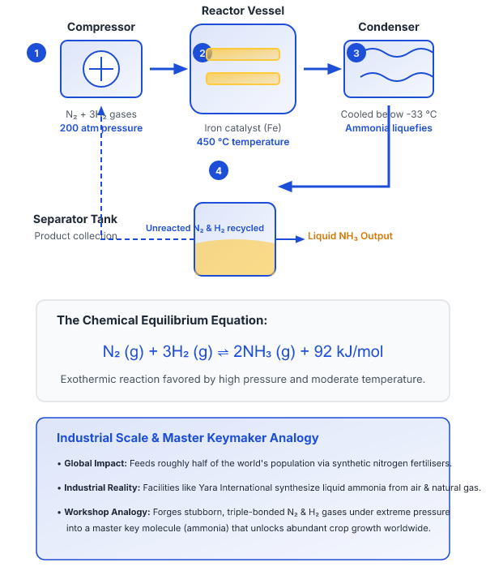
The Haber Process
The Haber Process
The industrial method for making ammonia from nitrogen and hydrogen.
Ammonia is the main ingredient of nitrogen fertilisers
Feeds roughly half of the world's population
Key takeaway: The Haber process synthesizes liquid ammonia from atmospheric nitrogen and natural gas-derived hydrogen to feed half the world.
Learnova
▶ Open the interactive lab: Haber Process Stoichiometry Lab
1 / 13
Notes:
KEY POINT TO LAND: The Haber process produces ammonia from nitrogen and hydrogen, enabling fertilisers that feed roughly half the world.
Reveal, one click at a time:
1. Reveal 1
2. The Haber process produces ammonia from nitrogen and hydrogen, enabling fertilisers that feed roughly half the world.
Pause: ask the class what they already know about “The Haber Process” before revealing the slide.
~26s

Slide 3




Why it matters
Plant Nutrition
Plants need nitrogen to build proteins, but they cannot use the nitrogen gas in air.
Historical Context
Before 1913 fertiliser came from guano and saltpetre, which were running out.
Pioneers & Scale
Fritz Haber found the chemistry and Carl Bosch scaled it into a plant, producing about 150 million tonnes of ammonia every year today.
ALSO ON THIS SLIDE
Example: Before 1913, nations fought over South American islands just to mine bird droppings, known as guano, for agricultural fertiliser. Analogy: The Haber-Bosch process for making fertilizer is like a global kitchen because it takes raw, inedible ingredients straight from the air and cooks them into the massive amounts of food needed to feed billions of people.
Key takeaway: The Haber-Bosch process produces roughly 150 million tonnes of ammonia annually to sustain global agricultural food production.
Learnova
▶ Open the interactive lab: Haber-Bosch Process Lab
2 / 13
Notes:
KEY POINT TO LAND: The Haber-Bosch process solved the global nitrogen limitation by synthesizing ammonia from atmospheric nitrogen, enabling modern agriculture and sustaining billions of lives.
Reveal, one click at a time:
1. Plants need nitrogen to build proteins, but they cannot use the nitrogen gas in air.
2. Before 1913 fertiliser came from guano and saltpetre, which were running out.
3. Fritz Haber found the chemistry and Carl Bosch scaled it into a plant, and today about 150 million tonnes of ammonia are
4. Example: Before 1913, nations fought over South American islands just to mine bird droppings, known as guano, for agricu
5. Analogy: The Haber-Bosch process for making fertilizer is like a global kitchen because it takes raw, inedible ingredien
6. The Haber-Bosch process solved the global nitrogen limitation by synthesizing ammonia from atmospheric nitrogen, enablin
Pause: ask the class what they already know about “Why it matters” before revealing the slide.
~54s

Slide 4
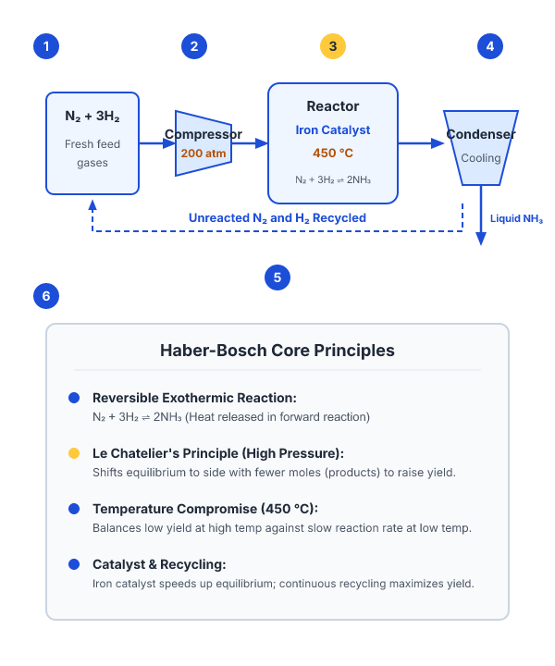
The core ideas
THE CORE IDEAS
High pressure and recycling raise the yield; an iron catalyst raises the rate
THE REACTION IS , REVERSIBLE AND EXOTHERMIC
N₂ + 3H₂ ⇌ 2NH₃
450 degrees Celsius is a compromise between yield and speed
Le Chatelier's principle predicts how each change shifts the equilibrium
The chemical reaction is represented as N2 + 3H2 <-> 2NH3, which is both reversible and exothermic in nature
High operating pressure and continuous recycling significantly raise the overall yield, while an iron catalyst effectively raises the reaction rate
Key takeaway: The reaction uses 450 degrees Celsius, high pressure, and an iron catalyst to balance yield, rate, and equilibrium.
Learnova
3 / 13
Notes:
KEY POINT TO LAND: The Haber process balances thermodynamic yield and kinetic speed through optimal temperature, pressure, recycling, and catalysis.
Reveal, one click at a time:
1. The chemical reaction is represented as N2 + 3H2 <-> 2NH3, which is both reversible and exothermic in nature.
2. High operating pressure and continuous recycling significantly raise the overall yield, while an iron catalyst effective
3. Operating at 450 degrees Celsius serves as a practical compromise between achieving a high yield and maintaining an acce
4. Le Chatelier's principle predicts how each specific change shifts the position of the equilibrium to counteract the dist
5. The reaction is N2 + 3H2 <-> 2NH3, reversible and exothermic High pressure and recycling raise the yield; an iron cataly
6. Example: In the Haber-Bosch process used by BASF, engineers apply pressures around 200 atmospheres to drive the reversib
7. In practice: In chemical manufacturing, the Haber-Bosch process applies Le Chatelier's principle and the 450 degrees Cel
Read these exactly (do not paraphrase):
- The reaction is N2 + 3H2 <-> 2NH3, reversible and exothermic High pressure and recycling raise the yield; an iron catalyst raises the rate 450 degrees Celsius is a compromise between yield and speed Le Chatelier's principle predicts how each change shifts the equilibrium Example: In the Haber-Bosch process used by BASF, engineers apply pressures around 200 atmospheres to drive the reversible nitrogen and hydrogen reaction toward a higher ammonia yield.
Pause: ask the class what they already know about “The core ideas” before revealing the slide.
~61s

Slide 5

The reaction
THE REACTION
It is reversible and exothermic, which means it releases 92 kJ of heat per mole of nitrogen converted
N₂ + 3H₂ ⇌ 2NH₃
Because it is reversible, the mixture never converts completely, so the plant has to choose conditions that give a good yield at a useful rate
The chemical reaction equation is N2 + 3H2 <-> 2NH3, showing how nitrogen and hydrogen combine to form ammonia
Key takeaway: The reversible exothermic reaction releases 92 kJ of heat per mole of nitrogen converted into ammonia.
Learnova
4 / 13
Notes:
KEY POINT TO LAND: The reversible and exothermic Haber-Bosch reaction requires balancing yield and reaction rate.
Reveal, one click at a time:
1. The chemical reaction equation is N2 + 3H2 <-> 2NH3, showing how nitrogen and hydrogen combine to form ammonia.
2. It is reversible and exothermic, which means it releases 92 kJ of heat per mole of nitrogen converted.
3. Because it is reversible, the mixture never converts completely, so the plant has to choose conditions that give a good
4. The reaction is N2 + 3H2 <-> 2NH3. It is reversible and exothermic, which means it releases 92 kJ of heat per mole of ni
5. The reversible and exothermic Haber-Bosch reaction requires balancing yield and reaction rate.
Pause: ask the class what they already know about “The reaction” before revealing the slide.
~47s

Slide 6
Checkpoint 1
QUESTION · APPLY
Which expression gives The reaction?
The reaction
Choosing Conditions for Ammonia
A
B
N₂ × 3H₂ ⇌ 2NH₃
N₂ + 3H₂ ⇌ 2NH₃
C
D
Answer: D
N₂ + 3H₂ ⇌ 2NH₃
Learnova
5 / 13
Notes:
KEY POINT TO LAND: Answer, then check your reasoning.
Pause: ask the class what they already know about “Checkpoint 1” before revealing the slide.
~44s

Slide 7
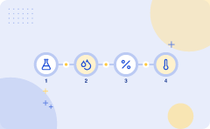
How it works, step by step
Nitrogen taken from the air
Nitrogen is taken from the air and hydrogen is made from natural gas
Gases mixed in a 1
The gases are mixed in a 1 : 3 ratio and compressed to about 200 atmospheres
Mixture passes over an iron
catalyst at about 450 degrees Celsius
1
2
3
Hot gases cooled
The hot gases are cooled so that ammonia liquefies and is removed
Unreacted nitrogen and hydrogen recycled
Unreacted nitrogen and hydrogen are recycled back to the reactor
4
5
ALSO ON THIS SLIDE
Finally, unreacted nitrogen and hydrogen are recycled back to the reactor to ensure maximum efficiency and prevent waste. Example: Air separation units at CF Industries cryogenically capture atmospheric nitrogen, while steam methane reformers strip hydrogen from natural gas to supply the Haber-Bosch reactor. Analogy: The Haber-Bosch chemical synthesis is like running a bustling neighborhood bakery where raw flour and sugar are meticulously measured, kneaded together under immense pressure in a heavy-duty mixer, baked at a precise oven temperature, and finally, the freshly baked bread is sliced off while the leftover crumbs and flour are swept back into the hopper to be used in the very next batch.
Key takeaway: Gases are compressed to 200 atmospheres, passed over an iron catalyst, cooled, and unreacted materials are recycled.
Learnova
▶ Open the interactive lab: Haber-Bosch Synthesis Lab
6 / 13
Notes:
KEY POINT TO LAND: Ammonia is produced industrially by reacting nitrogen and hydrogen over an iron catalyst under high pressure and temperature, with unreacted gases being recycled.
Reveal, one click at a time:
1. First, nitrogen is taken from the air and hydrogen is made from natural gas so that we have the necessary chemical feeds
2. Then, the gases are mixed in a 1 : 3 ratio and compressed to about 200 atmospheres to increase the reaction rate.
3. Next, the mixture passes over an iron catalyst at about 450 degrees Celsius to help the gases react efficiently.
4. After that, the hot gases are cooled so that ammonia liquefies and can be easily removed from the system.
5. Finally, unreacted nitrogen and hydrogen are recycled back to the reactor to ensure maximum efficiency and prevent waste
6. Nitrogen is taken from the air and hydrogen is made from natural gas The gases are mixed in a 1 : 3 ratio and compressed
7. Example: Air separation units at CF Industries cryogenically capture atmospheric nitrogen, while steam methane reformers
8. Analogy: The Haber-Bosch chemical synthesis is like running a bustling neighborhood bakery where raw flour and sugar are
9. Ammonia is produced industrially by reacting nitrogen and hydrogen over an iron catalyst under high pressure and tempera
Pause: ask the class what they already know about “How it works, step by step” before revealing the slide.
~75s

Slide 8

Choosing Conditions for Ammonia Production
A high pressure favours ammonia
because there are fewer gas molecules on the right-hand side
A low temperature
favours the exothermic forward reaction, but it makes the reaction too slow
The 450 degree compromise
gives a yield of about 15 percent per pass, and recycling raises the overall conversion above 95 percent
1
2
3
Very high pressure would give
more ammonia, but thick pipes and powerful compressors make it too expensive and dangerous
Example
Example: Yara International operates its giant ammonia plant in Sluiskil, Netherlands, at a high pressure of around 200 atmospheres to drive the equilibrium toward maximum ammonia yield
Analogy
Analogy: Choosing the temperature for ammonia production is like baking a slow-cooking casserole where you must balance the oven heat to get the best flavor without waiting forever
4
5
6
Key takeaway: A 450 degree compromise gives a 15 percent per-pass yield, while recycling pushes total conversion above 95 percent.
Learnova
▶ Open the interactive lab: Ammonia Production Conditions Lab
7 / 13
Notes:
KEY POINT TO LAND: Industrial ammonia synthesis relies on optimized compromises in temperature, pressure, and recycling to balance yield, reaction rate, and economic safety.
Reveal, one click at a time:
1. A high pressure favours ammonia because there are fewer gas molecules on the right-hand side.
2. A low temperature favours the exothermic forward reaction, but it makes the reaction too slow.
3. The 450 degree compromise gives a yield of about 15 percent per pass, and recycling raises the overall conversion above
4. Very high pressure would give more ammonia, but thick pipes and powerful compressors make it too expensive and dangerous
5. Example: Yara International operates its giant ammonia plant in Sluiskil, Netherlands, at a high pressure of around 200
6. Analogy: Choosing the temperature for ammonia production is like baking a slow-cooking casserole where you must balance
7. Industrial ammonia synthesis relies on optimized compromises in temperature, pressure, and recycling to balance yield, r
Pause: ask the class what they already know about “Choosing Conditions for Ammonia Production” before revealing the slide.
~61s

Slide 9

Effect of Changing Conditions
Increasing pressure shifts the equilibrium towards ammonia and increases yield because it favors the side with fewer moles of gas.
Increasing temperature shifts it towards the reactants and reduces yield, but speeds up the reaction by providing more thermal energy to the molecules.
Adding a catalyst does not change the yield, but it makes equilibrium arrive faster by lowering the activation energy for both forward and reverse reactions.
BECAUSE Removing ammonia as it forms pulls the equilibrium to the right because continuously depleting products forces the system to produce more to compensate.
Increasing pressure shifts the equilibrium towards ammonia and increases yield Increasing temperature shifts it towards the reactants and reduces yield, but speeds up the reaction Adding a catalyst does not change the yield, but it makes equilibrium arrive faster Removing ammonia as it forms pulls the equilibrium to the right.
Example: BASF operates giant industrial chemical plants that pump nitrogen and hydrogen gases under extreme pressure to maximize ammonia production for synthetic fertilizers.
Analogy: Think of chemical equilibrium under changing conditions as a crowded subway car at rush hour, where increasing pressure is like a transit worker physically shoving more passengers inside to force everyone to pack tighter into the available space.
Key takeaway: Increasing pressure shifts equilibrium toward ammonia, while a catalyst speeds up the reaction without changing yield.
Learnova
8 / 13
Notes:
KEY POINT TO LAND: Altering pressure, temperature, catalysts, or reactant concentrations dynamically shifts chemical equilibrium and reaction rates.
Reveal, one click at a time:
1. Increasing pressure shifts the equilibrium towards ammonia and increases yield because it favors the side with fewer mol
2. Increasing temperature shifts it towards the reactants and reduces yield, but speeds up the reaction by providing more t
3. Adding a catalyst does not change the yield, but it makes equilibrium arrive faster by lowering the activation energy fo
4. Removing ammonia as it forms pulls the equilibrium to the right because continuously depleting products forces the syste
5. Increasing pressure shifts the equilibrium towards ammonia and increases yield Increasing temperature shifts it towards
6. Example: BASF operates giant industrial chemical plants that pump nitrogen and hydrogen gases under extreme pressure to
7. Analogy: Think of chemical equilibrium under changing conditions as a crowded subway car at rush hour, where increasing
Pause: ask the class what they already know about “Effect of Changing Conditions” before revealing the slide.
~61s

Slide 10

A Worked Example
Identify mass of nitrogen — 28 tonnes N₂
We start with the feed rate of nitrogen gas into the chemical plant per hour.
1
Scale up molar mass ratio — 28 g N₂ → 34 g NH₃
One mole of nitrogen gas yields two moles of ammonia based on the balanced chemical equation.
2
Calculate theoretical yield — 34 tonnes NH₃
Because 28 tonnes of N2 matches 28 grams scaled up, complete 100% conversion produces 34 tonnes of ammonia.
3
Apply recycling efficiency — 34 × 0.97 = 32.98 tonnes NH₃
The plant operates at 97% overall conversion due to recycling unreacted gases back into the reactor.
4
Answer: 33 tonnes of ammonia per hour
Learnova
9 / 13
Notes:
KEY POINT TO LAND: A plant feeding 28 tonnes of nitrogen per hour achieves 97 percent overall conversion with recycling to yield about 33 tonnes of ammonia per hour.
Reveal, one click at a time:
1. A plant feeds 28 tonnes of nitrogen per hour into the reactor so that we can calculate the theoretical yield.
2. One mole of N2 (28 g) gives two moles of NH3 (34 g), so complete conversion would give 34 tonnes of ammonia.
3. With recycling the plant reaches 97 percent overall conversion, giving about 33 tonnes of ammonia per hour because unrea
4. Example: Calculating the exact mass of aspirin produced in a pharmaceutical lab by scaling up molar masses from a small
5. Analogy: A worked example in chemical engineering is like following a completed puzzle on the box lid because it shows y
6. A plant feeding 28 tonnes of nitrogen per hour achieves 97 percent overall conversion with recycling to yield about 33 t
Read these exactly (do not paraphrase):
- One mole of N2 (28 g) gives two moles of NH3 (34 g), so complete conversion would give 34 tonnes of ammonia.
Pause: ask the class what they already know about “A Worked Example” before revealing the slide.
~54s

Slide 11
Checkpoint 2
QUESTION · RECALL
Fill in the blank: “A plant feeds 28 tonnes of nitrogen per hour into the reactor so that we can calculate the _____ yield.”
lowering
mistakenly
A
B
atmospheric
theoretical
C
D
Answer: D
“A plant feeds 28 tonnes of nitrogen per hour into the reactor so that we can calculate the theoretical yield.”
Learnova
10 / 13
Notes:
KEY POINT TO LAND: Answer, then check your reasoning.
Pause: ask the class what they already know about “Checkpoint 2” before revealing the slide.
~44s

Slide 12

Where People Go Wrong
Students often make the mistake of thinking a catalyst increases the yield, when in reality it only increases the rate of the reaction.
You must remember that the reaction is fully reversible, meaning some ammonia always breaks down again instead of staying as product.
BUT Many mistakenly assume the lowest temperature is best because while the yield is higher, the reaction rate is far too slow to be practical.
Thinking a catalyst increases the yield: it only increases the rate Forgetting that the reaction is reversible, so some ammonia always breaks down again Assuming the lowest temperature is best: the yield is higher but the rate is far too slow.
Analogy: Thinking a catalyst increases the yield is like a store manager thinking that adding more checkout lanes will somehow order more items from the warehouse, when cashiers only make the checkout process faster.
In practice: In chemical manufacturing: Plant operators often miscalculate production quotas by assuming that adding more iron catalysts to the Haber-Bosch process will increase total ammonia output, when catalysts only accelerate the rate at which equilibrium is reached without shifting the equilibrium position itself.
Key takeaway: A catalyst increases the reaction rate but does not change the yield of the reversible reaction.
Learnova
11 / 13
Notes:
KEY POINT TO LAND: Common chemical reaction misconceptions involve confusing yield with rate, ignoring reversibility, and misjudging temperature trade-offs.
Reveal, one click at a time:
1. Students often make the mistake of thinking a catalyst increases the yield, when in reality it only increases the rate o
2. You must remember that the reaction is fully reversible, meaning some ammonia always breaks down again instead of stayin
3. Many mistakenly assume the lowest temperature is best because while the yield is higher, the reaction rate is far too sl
4. Thinking a catalyst increases the yield: it only increases the rate Forgetting that the reaction is reversible, so some
5. Analogy: Thinking a catalyst increases the yield is like a store manager thinking that adding more checkout lanes will s
6. In practice: In chemical manufacturing: Plant operators often miscalculate production quotas by assuming that adding mor
7. Common chemical reaction misconceptions involve confusing yield with rate, ignoring reversibility, and misjudging temper
Pause: ask the class what they already know about “Where People Go Wrong” before revealing the slide.
~61s

Slide 13

Key Terms
Equilibrium is the state where forward and reverse reactions occur at the same rate.
A catalyst is a substance that speeds up a reaction without being used up.
Le Chatelier's principle states that a system at equilibrium shifts to oppose any change imposed on it.
Yield is the amount of product obtained compared with the maximum possible.
Example: In the Haber process for making ammonia, iron acts as a catalyst by speeding up the reaction between nitrogen and hydrogen gases without being consumed in the process.
BECAUSE Analogy: A catalyst is like a revolving door at a busy store entrance because it helps people move through the process much faster without ever becoming part of the shopping transaction itself.
Key takeaway: Equilibrium balances forward and reverse rates, while Le Chatelier's principle predicts how systems oppose imposed changes.
Learnova
12 / 13
Notes:
KEY POINT TO LAND: Understanding core chemical terms like equilibrium, catalysts, Le Chatelier's principle, and yield is essential for analyzing reaction behavior.
Reveal, one click at a time:
1. Equilibrium is the state where forward and reverse reactions occur at the same rate.
2. A catalyst is a substance that speeds up a reaction without being used up.
3. Le Chatelier's principle states that a system at equilibrium shifts to oppose any change imposed on it.
4. Yield is the amount of product obtained compared with the maximum possible.
5. Example: In the Haber process for making ammonia, iron acts as a catalyst by speeding up the reaction between nitrogen a
6. Analogy: A catalyst is like a revolving door at a busy store entrance because it helps people move through the process m
7. Understanding core chemical terms like equilibrium, catalysts, Le Chatelier's principle, and yield is essential for anal
Read these exactly (do not paraphrase):
- Le Chatelier's principle states that a system at equilibrium shifts to oppose any change imposed on it.
- Yield is the amount of product obtained compared with the maximum possible.
Pause: ask the class what they already know about “Key Terms” before revealing the slide.
~61s

Slide 14



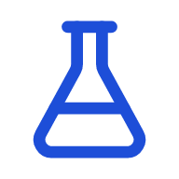
The Haber Process
Yield & Pressure
High pressure and recycling push the yield up.
Rate & Temperature
450 degrees Celsius keeps the reaction fast enough to be economic.
Catalyst
An iron catalyst is used to maintain economic reaction rates.
ALSO ON THIS SLIDE
Example: Yara International operates massive chemical plants that use the Haber process to combine atmospheric nitrogen with natural gas-derived hydrogen to produce essential agricultural fertilizers. Analogy: Think of the Haber process as a bustling bakery running a tight schedule, where the iron catalyst is the master chef who speeds up the bread-making so customers don't wait forever.
Key takeaway: The Haber process balances yield, rate, and cost using high pressure, recycling, 450 degrees Celsius, and an iron catalyst.
Learnova
13 / 13
Notes:
KEY POINT TO LAND: The Haber process balances yield, rate and cost through optimized pressure, temperature, and catalysts.
Reveal, one click at a time:
1. The Haber process balances yield, rate and cost: high pressure and recycling push the yield up, while 450 degrees Celsiu
2. Example: Yara International operates massive chemical plants that use the Haber process to combine atmospheric nitrogen
3. Analogy: Think of the Haber process as a bustling bakery running a tight schedule, where the iron catalyst is the master
4. The Haber process balances yield, rate and cost through optimized pressure, temperature, and catalysts.
Pause: ask the class what they already know about “The Haber Process” before revealing the slide.
~40s

Slide 15
Thank you
Questions?

