Slide 1

WSD
32 slides • made with Learnova

Slide 2
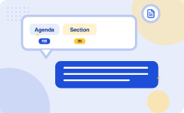
Agenda
Section 1
WSD
1
2
WSD: Lexical ambiguity
WSD: In first sentence
3
4
WSD: All-words − This kind
Dictionary-based or Knowledge-based Methods
5
6
Learnova
1 / 32
Notes:
Reveal, one click at a time:
1. Section 1
2. WSD
3. WSD: Lexical ambiguity
4. WSD: In first sentence
5. WSD: All-words − This kind
6. Dictionary-based or Knowledge-based Methods
7. Dictionary-based or Knowledge-based Methods: Text1 = 'I went
8. Dictionary-based or Knowledge-based Methods: Two (or more)
Read these exactly (do not paraphrase):
- Agenda Section 1 WSD WSD: Lexical ambiguity WSD: In first sentence WSD: All-words − This kind Dictionary-based or Knowledge-based Methods Dictionary-based or Knowledge-based Methods: Text1 = 'I went Dictionary-based or Knowledge-based Methods: Two (or more)
Pause: ask the class what they already know about “Agenda” before revealing the slide.
Wording matters here — slow down, keep it precise.
~68s

Slide 3
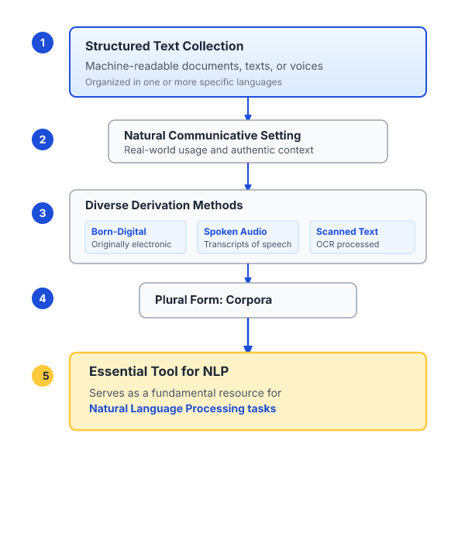




A corpus serves as a fundamental resource for natural language processing
Corpus A corpus
Large and structured set of machine-readable texts that have been produced in a natural communicative setting
Its plural
Corpora
A corpus
Essential tool for Natural Language Processing (NLP), serving as a fundamental resource
A corpus
Significant, organized collection of text or audio data that often includes a wide range of documents, texts, or voices in one or more specific languages
ALSO ON THIS SLIDE
They can be derived in different ways like text that was originally electronic, transcripts of spoken language and optical character recognition, etc.
Key takeaway: A corpus is a large, structured set of machine-readable texts serving as an essential NLP resource.
Key terms: Corpus — A large and structured set of machine-readable texts produced in natural communicative settings.
Learnova
2 / 32
Notes:
Reveal, one click at a time:
1. Corpus A corpus is a large and structured set of machine-readable texts that have been produced in a natural communicati
2. Its plural is corpora.
3. They can be derived in different ways like text that was originally electronic, transcripts of spoken language and optic
4. A corpus is an essential tool for Natural Language Processing (NLP), serving as a fundamental resource.
5. A corpus is a significant, organized collection of text or audio data that often includes a wide range of documents, tex
Read these exactly (do not paraphrase):
- A corpus is an essential tool for Natural Language Processing (NLP), serving as a fundamental resource.
Say what these mean, in your own words:
- Corpus: A large and structured set of machine-readable texts produced in natural communicative settings.
Pause: ask the class what they already know about “A corpus serves as a fundamental resource for natural language processing” before revealing the slide.
~47s
Ask the class: Explain this slide in your own words, in one sentence.

Slide 4
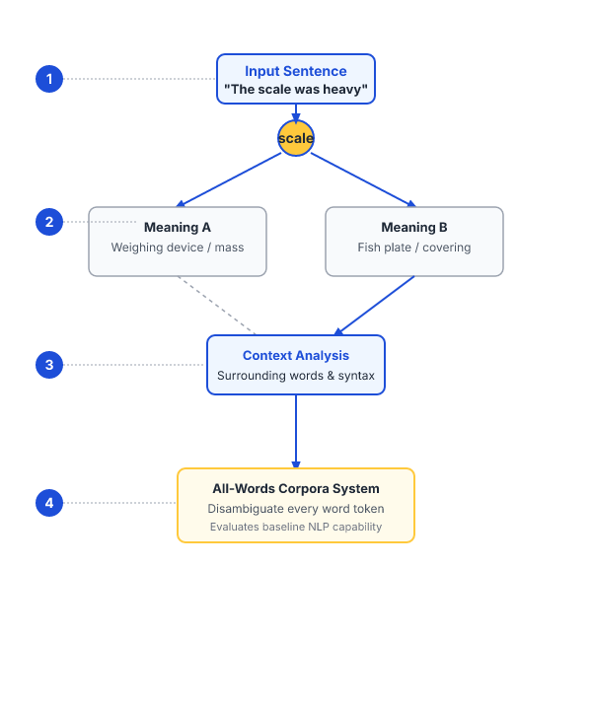


Lexical ambiguity presents an initial problem for natural language processing systems
We understand that words
have different meanings based on the context of its usage in the
Lexical ambiguity
syntactic or semantic, is one of the very first problem that any NLP system
In first sentence
it means frequency and in second, it means fish
IN PLAIN WORDS
Words often have different meanings depending on their context. Lexical ambiguity is an early challenge for NLP systems, requiring context to determine the correct interpretation of terms. For example, a word like frequency or fish changes its meaning entirely based on the surrounding sentence.
All-words − This kind: All-words − This kind of corpora is used in the system, where it is expected to
Key takeaway: Lexical ambiguity, whether syntactic or semantic, is an initial problem for any NLP system.
Key terms: nlp — Natural Language Processing · Lexical ambiguity — When a word has multiple syntactic or semantic interpretations depending on context.
Learnova
3 / 32
Notes:
Reveal, one click at a time:
1. We understand that words: We understand that words have different meanings based on the context of its usage in the
2. Lexical ambiguity: Lexical ambiguity, syntactic or semantic, is one of the very first problem that any NLP system
3. In first sentence: In first sentence, it means frequency and in second, it means fish.
4. All-words − This kind: All-words − This kind of corpora is used in the system, where it is expected to
Say what these mean, in your own words:
- nlp: Natural Language Processing
- Lexical ambiguity: When a word has multiple syntactic or semantic interpretations depending on context.
Pause: ask the class what they already know about “Lexical ambiguity presents an initial problem for natural language processing systems” before revealing the slide.
~40s
Ask the class: Explain this slide in your own words, in one sentence.

Slide 5
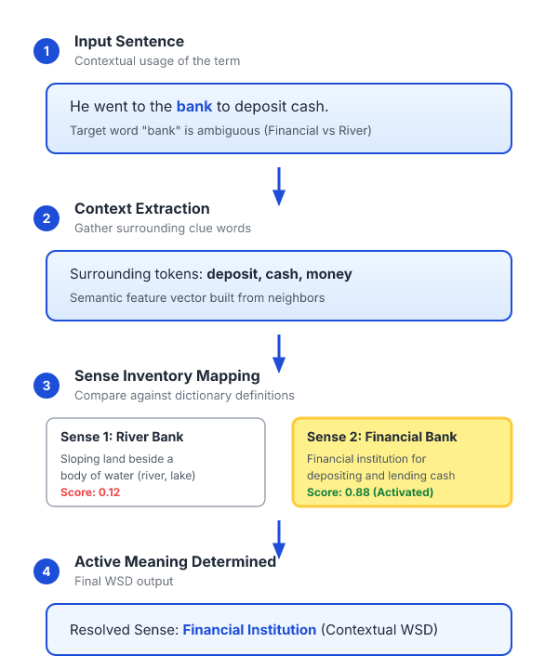
Word sense disambiguation determines the active meaning of a term in context
We understand that words have different meanings based on the context of its usage in the sentence.
BECAUSE If we talk about human languages, then they are ambiguous too because many words can be interpreted in multiple ways depending upon the context of their occurrence.
Word sense disambiguation, in natural language processing (NLP), may be defined as the ability to determine which meaning of word is activated by the use of word in a particular context.
IN PLAIN WORDS
Human languages are inherently ambiguous because words can be interpreted in multiple ways. Word sense disambiguation identifies which specific meaning of a word is active in a particular context. For example, determining whether 'bank' refers to a financial institution or a river edge.
Key takeaway: Word sense disambiguation determines which meaning of a word is activated in a particular context.
Key terms: Word sense disambiguation — The ability to determine which word meaning is activated in a particular context.
Learnova
▶ Open the interactive lab: Naive Bayes WSD Lab
4 / 32
Notes:
Reveal, one click at a time:
1. We understand that words have different meanings based on the context of its usage in the sentence.
2. If we talk about human languages, then they are ambiguous too because many words can be interpreted in multiple ways dep
3. Word sense disambiguation, in natural language processing (NLP), may be defined as the ability to determine which meanin
Read these exactly (do not paraphrase):
- Word sense disambiguation, in natural language processing (NLP), may be defined as the ability to determine which meaning of word is activated by the use of word in a particular context.
Say what these mean, in your own words:
- Word sense disambiguation: The ability to determine which word meaning is activated in a particular context.
Pause: ask the class what they already know about “Word sense disambiguation determines the active meaning of a term in context” before revealing the slide.
~33s
Ask the class: Explain this slide in your own words, in one sentence.

Slide 6
Checkpoint 1
QUESTION · UNDERSTAND
Which term matches this description: “The ability to determine which word meaning is activated in a particular context.”?
Bootstrapping
Word sense disambiguation
A
B
Word sense induction
Lesk algorithm
C
D
Answer: B
Word sense disambiguation: The ability to determine which word meaning is activated in a particular context.
Learnova
5 / 32
Notes:
KEY POINT TO LAND: Answer, then check your reasoning.
Pause: ask the class what they already know about “Checkpoint 1” before revealing the slide.
~44s

Slide 7
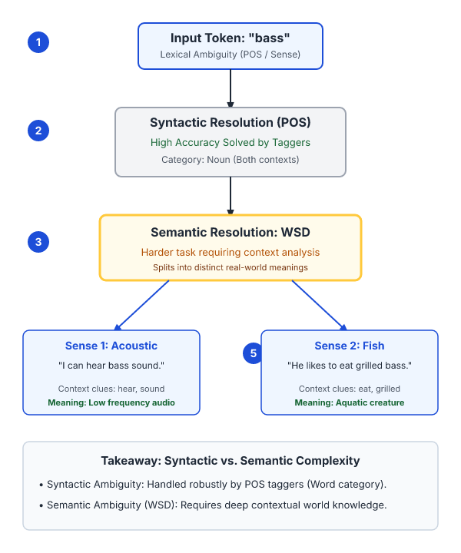
Resolving semantic ambiguity is harder than solving syntactic ambiguity
Lexical ambiguity, syntactic or semantic, is one of the very first problem that any NLP system faces.
Part-of-speech (POS) taggers with high level of accuracy can solve Word’s syntactic ambiguity.
BUT On the other hand, the problem of resolving semantic ambiguity is called WSD (word sense disambiguation).
Resolving semantic ambiguity is harder than resolving syntactic ambiguity.
E.G. For example, consider the two examples of the distinct sense that exist for the word “bass” −.
I can hear bass sound.
He likes to eat grilled bass.
The occurrence of the word bass clearly denotes the distinct meaning.
Key terms: wsd — Methods to Word Sense Disambiguation · WSD — The process of resolving semantic ambiguity in natural language processing.
Learnova
6 / 32
Notes:
Reveal, one click at a time:
1. Lexical ambiguity, syntactic or semantic, is one of the very first problem that any NLP system faces.
2. Part-of-speech (POS) taggers with high level of accuracy can solve Word’s syntactic ambiguity.
3. On the other hand, the problem of resolving semantic ambiguity is called WSD (word sense disambiguation).
4. Resolving semantic ambiguity is harder than resolving syntactic ambiguity.
5. For example, consider the two examples of the distinct sense that exist for the word “bass” −
6. I can hear bass sound.
7. He likes to eat grilled bass.
Read these exactly (do not paraphrase):
- Part-of-speech (POS) taggers with high level of accuracy can solve Word’s syntactic ambiguity.
- On the other hand, the problem of resolving semantic ambiguity is called WSD (word sense disambiguation).
Say what these mean, in your own words:
- wsd: Methods to Word Sense Disambiguation
- WSD: The process of resolving semantic ambiguity in natural language processing.
Pause: ask the class what they already know about “Resolving semantic ambiguity is harder than solving syntactic ambiguity” before revealing the slide.
~61s
Ask the class: Explain this slide in your own words, in one sentence.

Slide 8
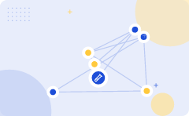

Evaluation of word sense disambiguation requires a dictionary and test corpora
1
2
3
In first sentence
it means frequency and in second, it means fish
If it would be disambiguated
by WSD then the correct meaning to the above sentences can be assigned as follows − I can hear bass/frequency sound
Evaluation of WSD The evaluation
of WSD requires the following two inputs − A Dictionary The very first input for evaluation of WSD is dictionary, which is used to specify the senses to be disambiguated
ALSO ON THIS SLIDE
He likes to eat grilled bass/fish. Test Corpus Another input required by WSD is the high-annotated test corpus that has the target or correct-senses. The test corpora can be of two types &minsu; Lexical sample − This kind of corpora is used in the system, where it is required to disambiguate a small sample of words.
Key takeaway: 3 steps — from “In first sentence” to “Evaluation of WSD The evaluation”.
Key terms: Following — simplified pictorial representation of the same.. · Test Corpus — A high-annotated corpus containing target or correct senses used for evaluation.
Learnova
▶ Open the interactive lab: Naive Bayes WSD Lab
7 / 32
Notes:
Reveal, one click at a time:
1. In first sentence, it means frequency and in second, it means fish.
2. Hence, if it would be disambiguated by WSD then the correct meaning to the above sentences can be assigned as follows −
3. I can hear bass/frequency sound.
4. He likes to eat grilled bass/fish.
5. Evaluation of WSD The evaluation of WSD requires the following two inputs − A Dictionary The very first input for evalua
6. Test Corpus Another input required by WSD is the high-annotated test corpus that has the target or correct-senses.
7. The test corpora can be of two types &minsu;
8. Lexical sample − This kind of corpora is used in the system, where it is required to disambiguate a small sample of word
Read these exactly (do not paraphrase):
- The test corpora can be of two types &minsu; Lexical sample − This kind of corpora is used in the system, where it is required to disambiguate a small sample of words.
Say what these mean, in your own words:
- Following: simplified pictorial representation of the same..
- Test Corpus: A high-annotated corpus containing target or correct senses used for evaluation.
Pause: ask the class what they already know about “Evaluation of word sense disambiguation requires a dictionary and test corpora” before revealing the slide.
~68s
Ask the class: Which step would break the whole process if it failed — and why?

Slide 9

All-words corpora are used to disambiguate every term in running text
All-words − This kind of corpora is used in the system, where it is expected to disambiguate all the words in a piece of running text.
Approaches and Methods to Word Sense Disambiguation (WSD) Approaches and methods to WSD are classified according to the source of knowledge used in word disambiguation.
Let us now see the four conventional methods to WSD −.
Key terms: All-words corpora — Corpora used to disambiguate all words in a piece of running text.
Learnova
8 / 32
Notes:
Reveal, one click at a time:
1. All-words − This kind of corpora is used in the system, where it is expected to disambiguate all the words in a piece of
2. Approaches and Methods to Word Sense Disambiguation (WSD) Approaches and methods to WSD are classified according to the
3. Let us now see the four conventional methods to WSD −
Read these exactly (do not paraphrase):
- Approaches and Methods to Word Sense Disambiguation (WSD) Approaches and methods to WSD are classified according to the source of knowledge used in word disambiguation.
Say what these mean, in your own words:
- All-words corpora: Corpora used to disambiguate all words in a piece of running text.
Pause: ask the class what they already know about “All-words corpora are used to disambiguate every term in running text” before revealing the slide.
~33s
Ask the class: Explain this slide in your own words, in one sentence.

Slide 10
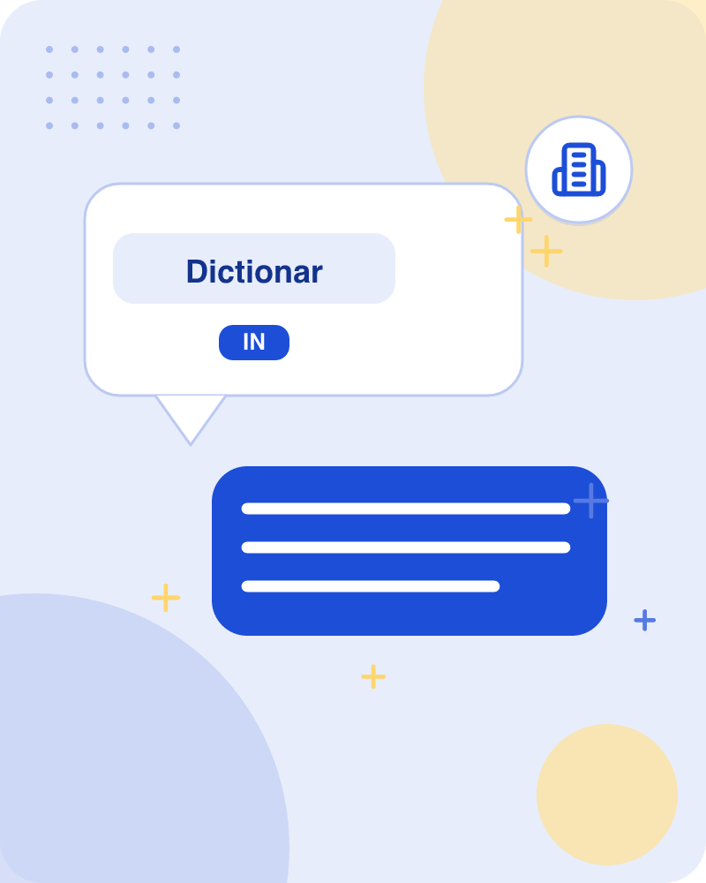
Dictionary-based methods rely on lexical knowledge bases without using corpora
As the name suggests, for disambiguation, these methods primarily rely on dictionaries, treasures and lexical knowledge base.
They do not use corpora evidences for disambiguation.
The Lesk method is the seminal dictionary-based method introduced by Michael Lesk in 1986.
The Lesk definition, on which the Lesk algorithm is based is “measure overlap between sense definitions for all words in context”.
BUT However, in 2000, Kilgarriff and Rosensweig gave the simplified Lesk definition as “measure overlap between sense definitions of word and current context”, which further means identify the correct sense for one word at a time.
Here the current context is the set of words in surrounding sentence or paragraph.
Key takeaway: Dictionary-based methods rely on lexical knowledge bases without using corpora evidences.
Key terms: Lesk method — A seminal dictionary-based method that measures overlap between sense definitions.
Learnova
9 / 32
Notes:
Reveal, one click at a time:
1. As the name suggests, for disambiguation, these methods primarily rely on dictionaries, treasures and lexical knowledge
2. They do not use corpora evidences for disambiguation.
3. The Lesk method is the seminal dictionary-based method introduced by Michael Lesk in 1986.
4. The Lesk definition, on which the Lesk algorithm is based is “measure overlap between sense definitions for all words in
5. However, in 2000, Kilgarriff and Rosensweig gave the simplified Lesk definition as “measure overlap between sense defini
6. Here the current context is the set of words in surrounding sentence or paragraph.
Read these exactly (do not paraphrase):
- The Lesk definition, on which the Lesk algorithm is based is “measure overlap between sense definitions for all words in context”.
- However, in 2000, Kilgarriff and Rosensweig gave the simplified Lesk definition as “measure overlap between sense definitions of word and current context”, which further means identify the correct sense for one word at a time.
Say what these mean, in your own words:
- Lesk method: A seminal dictionary-based method that measures overlap between sense definitions.
Pause: ask the class what they already know about “Dictionary-based methods rely on lexical knowledge bases without using corpora” before revealing the slide.
~54s
Ask the class: Explain this slide in your own words, in one sentence.

Slide 11
Checkpoint 2
QUESTION · UNDERSTAND
Which term matches this description: “A seminal dictionary-based method that measures overlap between sense definitions.”?
Supervised learning
Lesk method
A
B
Word clustering
Bootstrapping
C
D
Answer: B
Lesk method: A seminal dictionary-based method that measures overlap between sense definitions.
Learnova
10 / 32
Notes:
KEY POINT TO LAND: Answer, then check your reasoning.
Pause: ask the class what they already know about “Checkpoint 2” before revealing the slide.
~44s

Slide 12

The Lesk algorithm assumes related words share overlapping dictionary definitions
Text1 = 'I went to the bank to deposit my money' Text2 = 'The river bank was full of dead fishes' The Lesk algorithm is the seminal dictionary-based method.
This is the definition from Wikipedia: "It is based on the hypothesis that words used together in text are related to each other and that the relation can be observed in the definitions of the words and their senses.
Key takeaway: The Lesk algorithm assumes words used together are related through overlapping dictionary sense definitions.
Key terms: Lesk algorithm — An algorithm based on the hypothesis that words used together share related definitions.
Learnova
11 / 32
Notes:
Reveal, one click at a time:
1. Text1 = 'I went to the bank to deposit my money' Text2 = 'The river bank was full of dead fishes' The Lesk algorithm is
2. This is the definition from Wikipedia: "It is based on the hypothesis that words used together in text are related to ea
Read these exactly (do not paraphrase):
- The Lesk algorithm assumes related words share overlapping dictionary definitions Text1 = 'I went to the bank to deposit my money' Text2 = 'The river bank was full of dead fishes' The Lesk algorithm is the seminal dictionary-based method.
Say what these mean, in your own words:
- Lesk algorithm: An algorithm based on the hypothesis that words used together share related definitions.
Pause: ask the class what they already know about “The Lesk algorithm assumes related words share overlapping dictionary definitions” before revealing the slide.
Wording matters here — slow down, keep it precise.
~26s
Ask the class: Explain this slide in your own words, in one sentence.

Slide 13

Disambiguation finds dictionary sense pairs with the greatest word overlap
Two (or more).
words are disambiguated by finding the pair of dictionary senses with the greatest word overlap in their dictionary definitions.
It searches for the shortest path between two words: the second word is iteratively searched among the definitions of every semantic variant of the first word, then among the definitions of every semantic variant of each word in the previous definitions and so on.Finally, the first word is disambiguated by selecting the semantic variant which minimizes the distance from the first to the second word." Basically, the context is chosen from meaning of the nearest words.
Following is the simplified pictorial representation of the same.
Refer the ppt chapter18.wsd.ppt.
Key terms: Semantic variant — A specific dictionary sense or meaning associated with a particular word.
Learnova
12 / 32
Notes:
Reveal, one click at a time:
1. Two (or more)
2. words are disambiguated by finding the pair of dictionary senses with the greatest word overlap in their dictionary defi
3. It searches for the shortest path between two words: the second word is iteratively searched among the definitions of ev
4. Following is the simplified pictorial representation of the same...
5. Refer the ppt chapter18.wsd.ppt
Read these exactly (do not paraphrase):
- Disambiguation finds dictionary sense pairs with the greatest word overlap Two (or more) words are disambiguated by finding the pair of dictionary senses with the greatest word overlap in their dictionary definitions.
Say what these mean, in your own words:
- Semantic variant: A specific dictionary sense or meaning associated with a particular word.
Pause: ask the class what they already know about “Disambiguation finds dictionary sense pairs with the greatest word overlap” before revealing the slide.
~47s
Ask the class: Explain this slide in your own words, in one sentence.

Slide 14
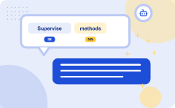
Supervised methods make use of sense-annotated corpora to train models
For disambiguation
machine learning methods make use of sense-annotated corpora to train
These methods assume
that the context can provide enough evidence on its own to disambiguate the sense
In these methods
the words knowledge and reasoning are deemed unnecessary
Context represented as a set
The context is represented as a set of “features” of the words
1
2
3
4
It includes the information about
the surrounding words also
Support vector machine and memory-based
learning are the most successful supervised learning approaches to WSD
These methods rely on substantial
amount of manually sense-tagged corpora, which is very expensive to create. ----Refer the ppt chapter18.wsd.ppt
5
6
7
Key takeaway: 7 steps — from “For disambiguation” to “These methods rely on substantial”.
Key terms: Supervised learning — Methods that use sense-annotated corpora and feature sets to train disambiguation models.
Learnova
13 / 32
Notes:
Reveal, one click at a time:
1. For disambiguation, machine learning methods make use of sense-annotated corpora to train.
2. These methods assume that the context can provide enough evidence on its own to disambiguate the sense.
3. In these methods, the words knowledge and reasoning are deemed unnecessary.
4. The context is represented as a set of “features” of the words.
5. It includes the information about the surrounding words also.
6. Support vector machine and memory-based learning are the most successful supervised learning approaches to WSD.
7. These methods rely on substantial amount of manually sense-tagged corpora, which is very expensive to create. ----Refer
Say what these mean, in your own words:
- Supervised learning: Methods that use sense-annotated corpora and feature sets to train disambiguation models.
Pause: ask the class what they already know about “Supervised methods make use of sense-annotated corpora to train models” before revealing the slide.
~61s
Ask the class: Explain this slide in your own words, in one sentence.

Slide 15






Semi-supervised bootstrapping algorithms overcome training corpus shortages in disambiguation
Due to the lack
of training corpus, most of the word sense disambiguation algorithms use semi-supervised
Bootstrapping Algorithms
While there is great variation between implementations, bootstrapping approaches in natural language processing all
Repeat from step 3
The core feature
of a bootstrapping algorithm is that each iteration is fed the same type
Unsupervised Methods
These methods assume that similar senses occur in similar context
Performance of unsupervised
method is always been lower than that of the other method used
Key takeaway: Semi-supervised bootstrapping algorithms overcome training corpus shortages for word sense disambiguation.
Key terms: Bootstrapping Algorithms — Iterative approaches that start with seed data to find and score more items from corpora. · Word Sense Disambiguation — Algorithms that determine the intended meaning of words in context.
Learnova
14 / 32
Notes:
Reveal, one click at a time:
1. Due to the lack: Due to the lack of training corpus, most of the word sense disambiguation algorithms use semi-supervise
2. Bootstrapping Algorithms: Bootstrapping Algorithms: While there is great variation between implementations, bootstrappin
3. Repeat from step 3: Repeat from step 3.
4. The core feature: The core feature of a bootstrapping algorithm is that each iteration is fed the same type
5. Unsupervised Methods: Unsupervised Methods These methods assume that similar senses occur in similar context.
6. Performance of unsupervised: The performance of unsupervised method is always been lower than that of the other method u
Say what these mean, in your own words:
- Bootstrapping Algorithms: Iterative approaches that start with seed data to find and score more items from corpora.
- Word Sense Disambiguation: Algorithms that determine the intended meaning of words in context.
Pause: ask the class what they already know about “Semi-supervised bootstrapping algorithms overcome training corpus shortages in disambiguation” before revealing the slide.
~54s
Ask the class: Explain this slide in your own words, in one sentence.

Slide 16
Checkpoint 3
QUESTION · UNDERSTAND
Which term matches this description: “Iterative approaches that start with seed data to find and score more items from corpora.”?
Test Corpus
Bootstrapping Algorithms
A
B
wsd
Iteration
C
D
Answer: B
Bootstrapping Algorithms: Iterative approaches that start with seed data to find and score more items from corpora.
Learnova
15 / 32
Notes:
KEY POINT TO LAND: Answer, then check your reasoning.
Pause: ask the class what they already know about “Checkpoint 3” before revealing the slide.
~44s

Slide 17

Semi-supervised learning methods combine small annotated text with large unannotated corpora
1
2
3
4
Due to the lack
of training corpus, most of the word sense disambiguation algorithms use semi-supervised learning methods
It is because semi-supervised methods us
It is because semi-supervised methods use both labelled as well as unlabeled data
These methods require very small
amount of annotated text and large amount of plain unannotated text
The technique that is used
by semi-supervised methods is bootstrapping from seed data
IN PLAIN WORDS
Semi-supervised methods use both labeled and unlabeled data to tackle the lack of training corpora. They require very small amounts of annotated text alongside large amounts of plain text, applying bootstrapping techniques starting from initial seed data. For example, using a few labeled beverage examples to find thousands of unlabeled drink mentions in plain text.
Key takeaway: Semi-supervised methods combine a small amount of annotated text with large unannotated corpora.
Key terms: Semi-supervised learning — Methods that use a combination of a small amount of labeled data and large unannotated data. · Bootstrapping — A technique using initial seed data to iteratively find and grow a dataset.
Learnova
16 / 32
Notes:
Reveal, one click at a time:
1. Due to the lack of training corpus, most of the word sense disambiguation algorithms use semi-supervised learning method
2. It is because semi-supervised methods use both labelled as well as unlabeled data.
3. These methods require very small amount of annotated text and large amount of plain unannotated text.
4. The technique that is used by semi-supervised methods is bootstrapping from seed data.
Say what these mean, in your own words:
- Semi-supervised learning: Methods that use a combination of a small amount of labeled data and large unannotated data.
- Bootstrapping: A technique using initial seed data to iteratively find and grow a dataset.
Pause: ask the class what they already know about “Semi-supervised learning methods combine small annotated text with large unannotated corpora” before revealing the slide.
~40s
Ask the class: Where could you break this chain of events?

Slide 18




Bootstrapping algorithms iteratively expand initial seed lists using training corpora
Bootstrapping Algorithms: While there is great variation between implementations, bootstrapping approaches in natural language processing all follow the same general format
Start with an empty list of things
Initialize this list with carefully chosen seeds
Leverage the things in the list to find more things from a training corpus
Score those newly found things; add the best ones to the list
IN PLAIN WORDS
Bootstrapping algorithms follow a general format starting with an empty list and initializing it with carefully chosen seeds. They leverage these items to find more matches from a training corpus, score the newly found items, and add the best ones back to the list. For example, starting with 'water', finding 'soda', scoring them, and adding both to a beverage category list.
Key takeaway: Bootstrapping algorithms iteratively expand initial seed lists using training corpora and scoring.
Key terms: Seeds — Carefully chosen initial data items used to start the bootstrapping process. · Training Corpus — A large body of text used to extract and find more target items.
Learnova
17 / 32
Notes:
Reveal, one click at a time:
1. Bootstrapping Algorithms: While there is great variation between implementations, bootstrapping approaches in natural la
2. Start with an empty list of things.
3. Initialize this list with carefully chosen seeds.
4. Leverage the things in the list to find more things from a training corpus.
5. Score those newly found things; add the best ones to the list.
Read these exactly (do not paraphrase):
- Score those newly found things; add the best ones to the list.
Say what these mean, in your own words:
- Seeds: Carefully chosen initial data items used to start the bootstrapping process.
- Training Corpus: A large body of text used to extract and find more target items.
Pause: ask the class what they already know about “Bootstrapping algorithms iteratively expand initial seed lists using training corpora” before revealing the slide.
~47s
Ask the class: Explain this slide in your own words, in one sentence.

Slide 19

Semantic category bootstrapping relies on words appearing in similar patterns and contexts
Repeat from step 3.
Stop after a set number of iterations or some other stop condition.
The intuition for bootstrapping stems from the observation that words from the semantic category tend to appear in similar patterns and similar contexts.
E.G. For example, the words “water” and “soda” are both in the semantic BEVERAGE category, and in a large text they will likely both be found in phrases containing drank or imbibed.
The core intuition is that by searching for patterns like that we can find other BEVERAGEs, and then by finding patterns that contain those, we can find even more.
Key takeaway: Words from the same semantic category tend to appear in similar patterns and contexts.
Key terms: Semantic category — A group of words that share a similar meaning or domain, such as beverages. · Context — The surrounding words and phrases that help reveal a word's meaning or category.
Learnova
18 / 32
Notes:
Reveal, one click at a time:
1. Repeat from step 3.
2. Stop after a set number of iterations or some other stop condition.
3. The intuition for bootstrapping stems from the observation that words from the semantic category tend to appear in simil
4. For example, the words “water” and “soda” are both in the semantic BEVERAGE category, and in a large text they will like
5. The core intuition is that by searching for patterns like that we can find other BEVERAGEs, and then by finding patterns
Say what these mean, in your own words:
- Semantic category: A group of words that share a similar meaning or domain, such as beverages.
- Context: The surrounding words and phrases that help reveal a word's meaning or category.
Pause: ask the class what they already know about “Semantic category bootstrapping relies on words appearing in similar patterns and contexts” before revealing the slide.
~47s
Ask the class: Which step would break the whole process if it failed — and why?

Slide 20
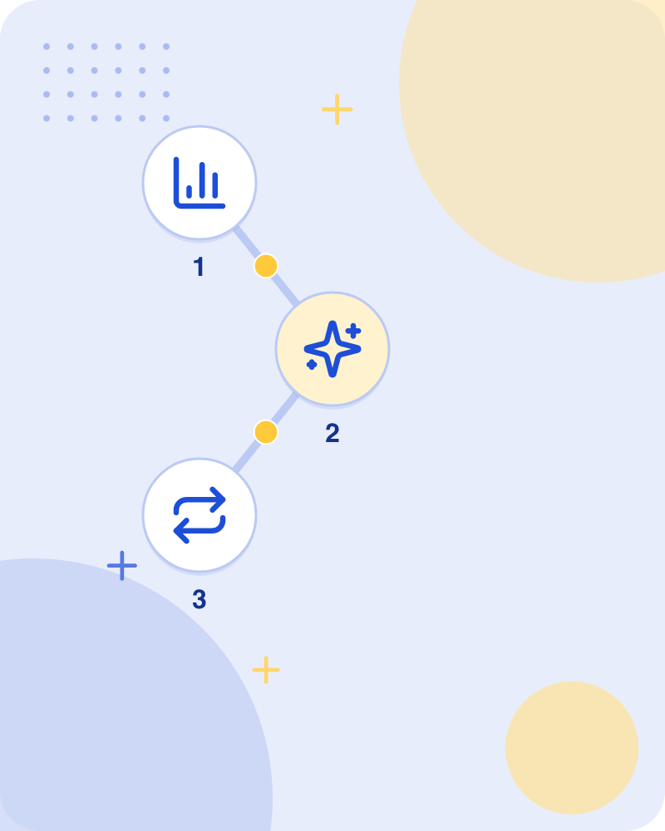
Semi-supervised Methods: The core feature
The core feature of a bootstrapping algorithm is that each iteration is fed the same type of data as its input that it produces as its output.
The output of the first iteration is used as the input of the second iteration, and so on.
It should not be surprising that choosing the initial set of data (the seeds) from which all other data is “grown” is a critical factor (arguably the most critical factor) in the performance of the algorithm.
Key takeaway: Choosing the initial seed data is a critical factor in bootstrapping algorithm performance.
Key terms: Iteration — A single repetition of a process where output feeds into the next step as input. · Seeds — The critical initial set of data from which all other data is grown.
Learnova
19 / 32
Notes:
Reveal, one click at a time:
1. The core feature of a bootstrapping algorithm is that each iteration is fed the same type of data as its input that it p
2. The output of the first iteration is used as the input of the second iteration, and so on.
3. It should not be surprising that choosing the initial set of data (the seeds) from which all other data is “grown” is a
Read these exactly (do not paraphrase):
- It should not be surprising that choosing the initial set of data (the seeds) from which all other data is “grown” is a critical factor (arguably the most critical factor) in the performance of the algorithm.
Say what these mean, in your own words:
- Iteration: A single repetition of a process where output feeds into the next step as input.
- Seeds: The critical initial set of data from which all other data is grown.
Pause: ask the class what they already know about “Semi-supervised Methods: The core feature” before revealing the slide.
~33s
Ask the class: Explain this slide in your own words, in one sentence.

Slide 21
Checkpoint 4
QUESTION · UNDERSTAND
Which term matches this description: “A single repetition of a process where output feeds into the next step as input.”?
Lesk method
Inter-judge variance
A
B
Semantic category
Iteration
C
D
Answer: D
Iteration: A single repetition of a process where output feeds into the next step as input.
Learnova
20 / 32
Notes:
KEY POINT TO LAND: Answer, then check your reasoning.
Pause: ask the class what they already know about “Checkpoint 4” before revealing the slide.
~44s

Slide 22
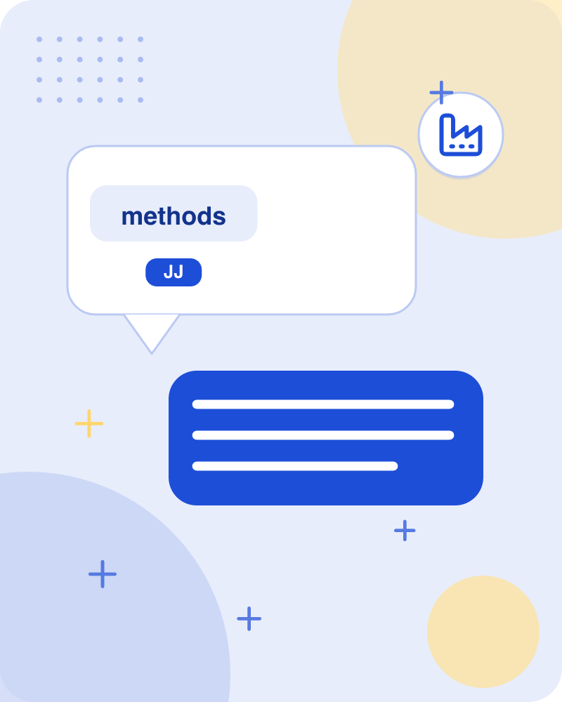
Unsupervised methods induce word senses by clustering occurrences in similar contexts
Unsupervised Methods These methods assume that similar senses occur in similar context.
That is why the senses can be induced from text by clustering word occurrences by using some measure of similarity of the context.
This task is called word sense induction or discrimination.
BECAUSE Unsupervised methods have great potential to overcome the knowledge acquisition bottleneck due to non-dependency on manual efforts.
Unsupervised methods overcome the problem of knowledge acquisition bottleneck.
Key takeaway: Unsupervised methods induce word senses by clustering occurrences in similar contexts.
Key terms: Word sense induction — Clustering word occurrences by context similarity to discover word senses without manual effort. · Knowledge acquisition bottleneck — The limitation caused by the reliance on manual efforts to gather training knowledge.
Learnova
21 / 32
Notes:
Reveal, one click at a time:
1. Unsupervised Methods These methods assume that similar senses occur in similar context.
2. That is why the senses can be induced from text by clustering word occurrences by using some measure of similarity of th
3. This task is called word sense induction or discrimination.
4. Unsupervised methods have great potential to overcome the knowledge acquisition bottleneck due to non-dependency on manu
5. Unsupervised methods overcome the problem of knowledge acquisition bottleneck.
Say what these mean, in your own words:
- Word sense induction: Clustering word occurrences by context similarity to discover word senses without manual effort.
- Knowledge acquisition bottleneck: The limitation caused by the reliance on manual efforts to gather training knowledge.
Pause: ask the class what they already know about “Unsupervised methods induce word senses by clustering occurrences in similar contexts” before revealing the slide.
~47s
Ask the class: Explain this slide in your own words, in one sentence.

Slide 23
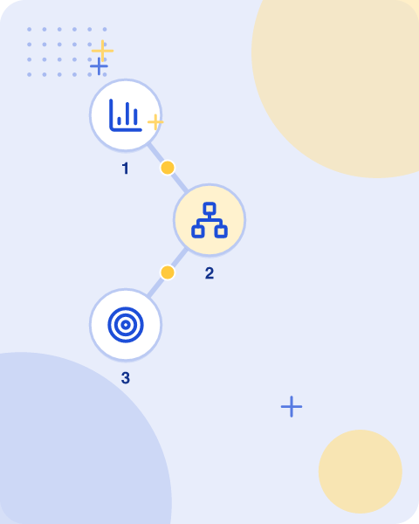
Unsupervised methods achieve lower performance but utilize clustering and graph-based techniques
The performance of unsupervised method is always been lower than that of the other method used for disambiguation.
Different methods in unsupervised approach are word clustering method in which words are clustered according to the semantic similarity based on single feature (e.g., subject-verb, adjective-noun, etc.) i.e. they are similar to that of target word.
In another context clustering method the clusters are formed by finding the co-occurrence of word (not target) with the target word and then the centroid is calculated of the vector of words occurring in the same context.
In another method called graph based method in which a graph is built on some grammatical relationship, in graph weights are assign to the edge according to the relatedness.
IN PLAIN WORDS
Unsupervised methods typically score lower than other disambiguation techniques. They employ word clustering based on single features, context clustering via word co-occurrence vectors and centroids, and graph-based methods built on grammatical relationships with weighted edges. For example, clustering adjectives that frequently precede a target noun to discover its semantic category.
Key takeaway: Unsupervised methods yield lower performance through word clustering, context clustering, and graph-based techniques.
Key terms: Word clustering — Grouping words according to semantic similarity based on features like subject-verb or adjective-noun. · Graph based method — Building a graph on grammatical relationships with edge weights assigned according to relatedness.
Learnova
22 / 32
Notes:
Reveal, one click at a time:
1. The performance of unsupervised method is always been lower than that of the other method used for disambiguation.
2. Different methods in unsupervised approach are word clustering method in which words are clustered according to the sema
3. In another context clustering method the clusters are formed by finding the co-occurrence of word (not target) with the
4. In another method called graph based method in which a graph is built on some grammatical relationship, in graph weights
Read these exactly (do not paraphrase):
- Different methods in unsupervised approach are word clustering method in which words are clustered according to the semantic similarity based on single feature (e.g., subject-verb, adjective-noun, etc.)
- In another context clustering method the clusters are formed by finding the co-occurrence of word (not target) with the target word and then the centroid is calculated of the vector of words occurring in the same context.
Say what these mean, in your own words:
- Word clustering: Grouping words according to semantic similarity based on features like subject-verb or adjective-noun.
- Graph based method: Building a graph on grammatical relationships with edge weights assigned according to relatedness.
Pause: ask the class what they already know about “Unsupervised methods achieve lower performance but utilize clustering and graph-based techniques” before revealing the slide.
~40s
Ask the class: Explain this slide in your own words, in one sentence.

Slide 24
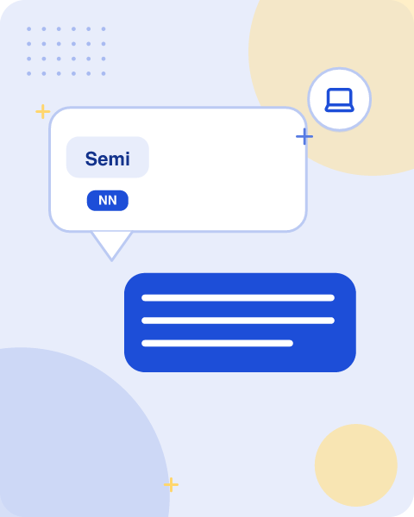
Semi-supervised Methods: An iterative algorithm is applied
An iterative algorithm is applied to get the word with highest degree node and finally minimum spanning tree is applied to disambiguate instance of target word.
Problems with Unsupervised Approach are the instances in training data may not be assigned the correct sense.
Clusters are heterogeneous.
Number of cluster may differ from the number of senses of target word to be disambiguated.
Applications of Word Sense Disambiguation (WSD) Word sense disambiguation (WSD) is applied in almost every application of language technology.
Let us now see the scope of WSD − Machine Translation Machine translation or MT is the most obvious application of WSD.
In MT, Lexical choice for the words that have distinct translations for different senses, is done by WSD.
Learnova
23 / 32
Notes:
Reveal, one click at a time:
1. An iterative algorithm is applied to get the word with highest degree node and finally minimum spanning tree is applied
2. Problems with Unsupervised Approach are the instances in training data may not be assigned the correct sense.
3. Clusters are heterogeneous.
4. Number of cluster may differ from the number of senses of target word to be disambiguated.
5. Applications of Word Sense Disambiguation (WSD) Word sense disambiguation (WSD) is applied in almost every application o
6. Let us now see the scope of WSD − Machine Translation Machine translation or MT is the most obvious application of WSD.
7. In MT, Lexical choice for the words that have distinct translations for different senses, is done by WSD.
Read these exactly (do not paraphrase):
- Applications of Word Sense Disambiguation (WSD) Word sense disambiguation (WSD) is applied in almost every application of language technology.
Pause: ask the class what they already know about “Semi-supervised Methods: An iterative algorithm is applied” before revealing the slide.
~61s
Ask the class: Explain this slide in your own words, in one sentence.

Slide 25
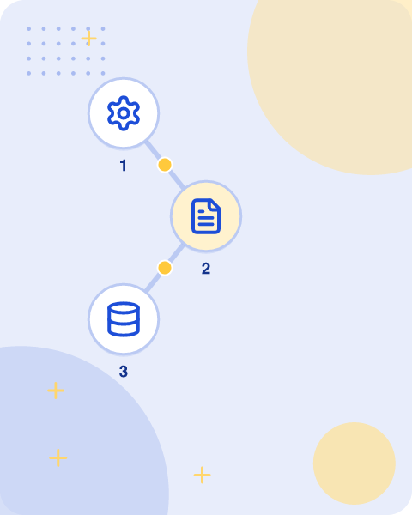
Semi-supervised Methods: The senses in MT
The senses in MT are represented as words in the target language.
Most of the machine translation systems do not use explicit WSD module.
Information Retrieval (IR) Information retrieval (IR) may be defined as a software program that deals with the organization, storage, retrieval and evaluation of information from document repositories particularly textual information.
The system basically assists users in finding the information they required but it does not explicitly return the answers of the questions.
WSD is used to resolve the ambiguities of the queries provided to IR system.
E.G. As like MT, current IR systems do not explicitly use WSD module and they rely on the concept that user would type enough context in the query to only retrieve relevant documents.
IN PLAIN WORDS
In machine translation, senses are target language words, while information retrieval organizes and retrieves text documents. Neither system typically uses an explicit word sense disambiguation module, relying instead on target word selection or user context within queries. For example, an information retrieval system relying on the user typing enough query context to fetch relevant documents.
Key takeaway: Machine translation and information retrieval systems currently do not explicitly use WSD modules.
Key terms: Information Retrieval — Software dealing with the organization, storage, retrieval, and evaluation of textual information. · Target Language — The language into which text is translated in machine translation systems.
Learnova
24 / 32
Notes:
Reveal, one click at a time:
1. The senses in MT are represented as words in the target language.
2. Most of the machine translation systems do not use explicit WSD module.
3. Information Retrieval (IR) Information retrieval (IR) may be defined as a software program that deals with the organizat
4. The system basically assists users in finding the information they required but it does not explicitly return the answer
5. WSD is used to resolve the ambiguities of the queries provided to IR system.
6. As like MT, current IR systems do not explicitly use WSD module and they rely on the concept that user would type enough
Read these exactly (do not paraphrase):
- Information Retrieval (IR) Information retrieval (IR) may be defined as a software program that deals with the organization, storage, retrieval and evaluation of information from document repositories particularly textual information.
- The system basically assists users in finding the information they required but it does not explicitly return the answers of the questions.
Say what these mean, in your own words:
- Information Retrieval: Software dealing with the organization, storage, retrieval, and evaluation of textual information.
- Target Language: The language into which text is translated in machine translation systems.
Pause: ask the class what they already know about “Semi-supervised Methods: The senses in MT” before revealing the slide.
~54s
Ask the class: Explain this slide in your own words, in one sentence.

Slide 26
Checkpoint 5
QUESTION · UNDERSTAND
Which term matches this description: “Software dealing with the organization, storage, retrieval, and evaluation of textual information.”?
Knowledge acquisition bottleneck
Corpus
A
B
Word-sense discreteness
Information Retrieval
C
D
Answer: D
Information Retrieval: Software dealing with the organization, storage, retrieval, and evaluation of textual information.
Learnova
25 / 32
Notes:
KEY POINT TO LAND: Answer, then check your reasoning.
Pause: ask the class what they already know about “Checkpoint 5” before revealing the slide.
~44s

Slide 27
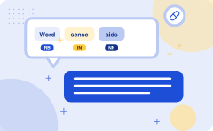
Word sense disambiguation aids text mining, information extraction, and corpus-based lexicography
1
Text Mining and Information Extraction
(IE) In most of the applications, WSD is necessary to do accurate analysis of text
2
For example
WSD helps intelligent gathering system to do flagging of the correct words
3
For example
medical intelligent system might need flagging of “illegal drugs” rather than “medical drugs” Lexicography WSD and lexicography can work together in loop because modern lexicography is corpus based
4
With lexicography
WSD provides rough empirical sense groupings as well as statistically significant contextual indicators of sense
5
Difficulties in Word Sense Disambiguation
(WSD) Followings are some difficulties faced by word sense disambiguation (WSD) − Differences between dictionaries The major problem of WSD is to decide the sense of the word because different senses can be very closely related
↺ and the effect feeds back into the cause
IN PLAIN WORDS
Word sense disambiguation enables accurate text analysis, helping intelligent systems flag correct concepts like illegal versus medical drugs. It also collaborates with corpus-based lexicography to provide empirical sense groupings and contextual indicators, despite challenges like closely related senses. For example, a medical intelligent system flagging 'illegal drugs' instead of 'medical drugs'.
Key takeaway: WSD aids text mining, information extraction, and corpus-based lexicography by enabling accurate text analysis.
Key terms: Information Extraction — Automated extraction of structured information from unstructured text documents. · Lexicography — The work of compiling dictionaries, which benefits from corpus-based empirical sense groupings.
Learnova
26 / 32
Notes:
Reveal, one click at a time:
1. Text Mining and Information Extraction (IE) In most of the applications, WSD is necessary to do accurate analysis of tex
2. For example, WSD helps intelligent gathering system to do flagging of the correct words.
3. For example, medical intelligent system might need flagging of “illegal drugs” rather than “medical drugs” Lexicography
4. With lexicography, WSD provides rough empirical sense groupings as well as statistically significant contextual indicato
5. Difficulties in Word Sense Disambiguation (WSD) Followings are some difficulties faced by word sense disambiguation (WSD
Read these exactly (do not paraphrase):
- Word sense disambiguation aids text mining, information extraction, and corpus-based lexicography Text Mining and Information Extraction (IE) In most of the applications, WSD is necessary to do accurate analysis of text.
- For example, medical intelligent system might need flagging of “illegal drugs” rather than “medical drugs” Lexicography WSD and lexicography can work together in loop because modern lexicography is corpus based.
- Difficulties in Word Sense Disambiguation (WSD) Followings are some difficulties faced by word sense disambiguation (WSD) − Differences between dictionaries The major problem of WSD is to decide the sense of the word because different senses can be very closely related.
Say what these mean, in your own words:
- Information Extraction: Automated extraction of structured information from unstructured text documents.
- Lexicography: The work of compiling dictionaries, which benefits from corpus-based empirical sense groupings.
Pause: ask the class what they already know about “Word sense disambiguation aids text mining, information extraction, and corpus-based lexicography” before revealing the slide.
Wording matters here — slow down, keep it precise.
~47s
Ask the class: Where could you break this chain of events?

Slide 28

Word sense disambiguation faces challenges from dictionary variations and inter-judge variance
Even different dictionaries and thesauruses can provide different divisions of words into senses.
Different algorithms for different applications Another problem of WSD is that completely different algorithm might be needed for different applications.
E.G. For example, in machine translation, it takes the form of target word selection; and in information retrieval, a sense inventory is not required.
Inter-judge variance Another problem of WSD is that WSD systems are generally tested by having their results on a task compared against the task of human beings.
This is called the problem of interjudge variance.
Word-sense discreteness Another difficulty in WSD is that words cannot be easily divided into discrete sub meanings.
Key takeaway: WSD faces challenges including dictionary variations, application-specific algorithms, and inter-judge variance.
Key terms: Inter-judge variance — Discrepancies that occur when system results are compared against the varied judgments of human beings. · Word-sense discreteness — The difficulty of clearly and easily dividing words into distinct sub-meanings.
Learnova
27 / 32
Notes:
Reveal, one click at a time:
1. Even different dictionaries and thesauruses can provide different divisions of words into senses.
2. Different algorithms for different applications Another problem of WSD is that completely different algorithm might be n
3. For example, in machine translation, it takes the form of target word selection; and in information retrieval, a sense i
4. Inter-judge variance Another problem of WSD is that WSD systems are generally tested by having their results on a task c
5. This is called the problem of interjudge variance.
6. Word-sense discreteness Another difficulty in WSD is that words cannot be easily divided into discrete sub meanings.
Read these exactly (do not paraphrase):
- For example, in machine translation, it takes the form of target word selection; and in information retrieval, a sense inventory is not required.
Say what these mean, in your own words:
- Inter-judge variance: Discrepancies that occur when system results are compared against the varied judgments of human beings.
- Word-sense discreteness: The difficulty of clearly and easily dividing words into distinct sub-meanings.
Pause: ask the class what they already know about “Word sense disambiguation faces challenges from dictionary variations and inter-judge variance” before revealing the slide.
~54s
Ask the class: Explain this slide in your own words, in one sentence.

Slide 29
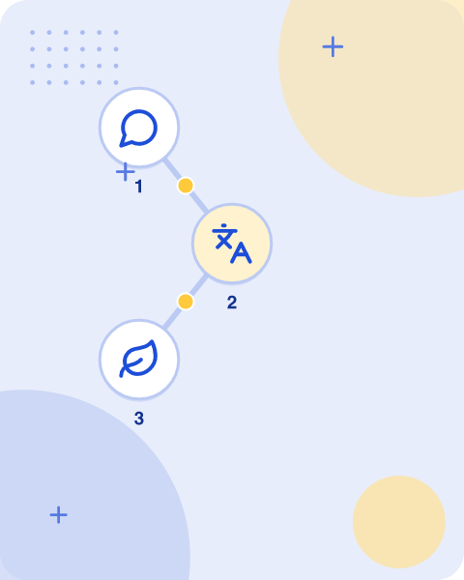

Glossary
Wsd
Methods to Word Sense Disambiguation
Ie
Text Mining and Information Extraction
Nlp
Natural Language Processing
Following
simplified pictorial representation of the same
A corpus
essential tool for Natural Language Processing (NLP), serving as a fundamental resource
ALSO ON THIS SLIDE
problems with unsupervised app: instances in training data may not be assigned the correct sense
Key takeaway: WSD denotes word sense disambiguation and IE denotes text mining and information extraction.
Learnova
28 / 32
Notes:
Reveal, one click at a time:
1. Wsd: Methods to Word Sense Disambiguation
2. Ie: Text Mining and Information Extraction
3. Nlp: Natural Language Processing
4. Following: simplified pictorial representation of the same..
5. A corpus: essential tool for Natural Language Processing (NLP), serving as a fundamental resource
6. problems with unsupervised app: instances in training data may not be assigned the correct sense
Read these exactly (do not paraphrase):
- A corpus: essential tool for Natural Language Processing (NLP), serving as a fundamental resource problems with unsupervised app: instances in training data may not be assigned the correct sense
Pause: ask the class what they already know about “Glossary” before revealing the slide.
Wording matters here — slow down, keep it precise.
~54s

Slide 30
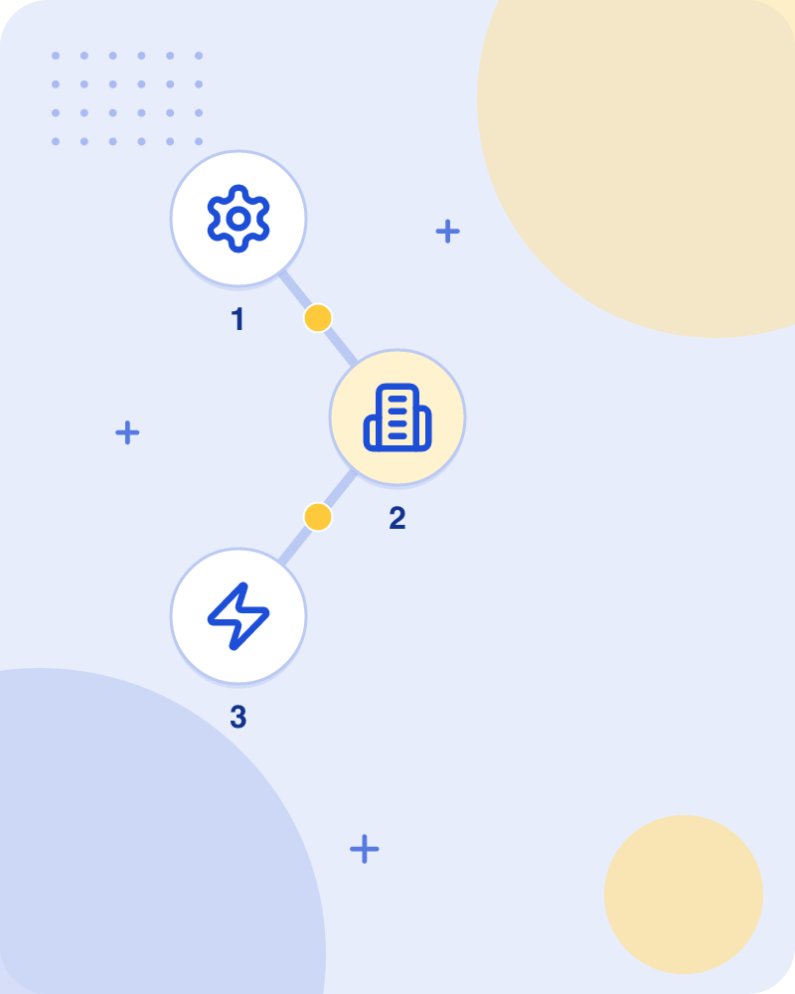

Glossary: Lesk method
Lesk method
seminal dictionary-based method introduced by Michael Lesk in 1986
Here the current context
set of words in surrounding sentence or paragraph
Corpus a corpus
large and structured set of machine-readable texts that have been produced in a natural communicative setting
Key takeaway: Michael Lesk introduced the seminal dictionary-based Lesk method in 1986.
Learnova
29 / 32
Notes:
Reveal, one click at a time:
1. Lesk method: seminal dictionary-based method introduced by Michael Lesk in 1986
2. Here the current context: set of words in surrounding sentence or paragraph
3. Corpus a corpus: large and structured set of machine-readable texts that have been produced in a natural communicative s
Pause: ask the class what they already know about “Glossary: Lesk method” before revealing the slide.
~33s

Slide 31
Checkpoint 6
QUESTION · UNDERSTAND
Which term matches this description: “Discrepancies that occur when system results are compared against the varied judgments of human beings.”?
Word sense induction
Inter-judge variance
A
B
Semantic category
Lexical ambiguity
C
D
Answer: B
Inter-judge variance: Discrepancies that occur when system results are compared against the varied judgments of human beings.
Learnova
30 / 32
Notes:
KEY POINT TO LAND: Answer, then check your reasoning.
Pause: ask the class what they already know about “Checkpoint 6” before revealing the slide.
~44s

Slide 32
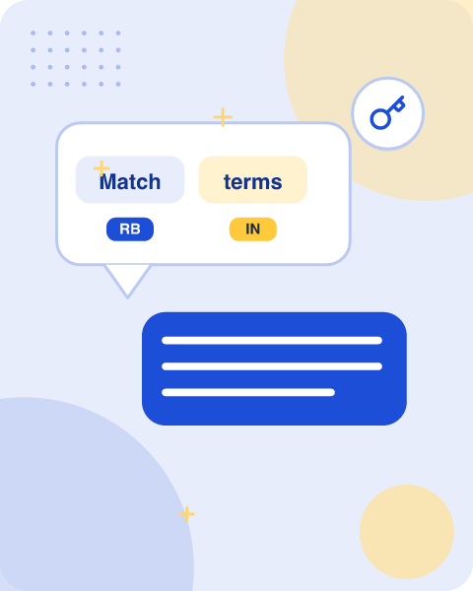

Match the terms
Wsd
Methods to Word Sense Disambiguation
Ie
Text Mining and Information Extraction
A corpus
essential tool for Natural Language Processing (NLP), serving as a fundamental resource
Following
simplified pictorial representation of the same
Lesk method
seminal dictionary-based method introduced by Michael Lesk in 1986
Key takeaway: WSD, IE, and the Lesk method are core terms defining natural language processing tasks.
Learnova
31 / 32
Notes:
Reveal, one click at a time:
1. Wsd: Methods to Word Sense Disambiguation
2. Ie: Text Mining and Information Extraction
3. A corpus: essential tool for Natural Language Processing (NLP), serving as a fundamental resource
4. Following: simplified pictorial representation of the same..
5. Lesk method: seminal dictionary-based method introduced by Michael Lesk in 1986
Read these exactly (do not paraphrase):
- Match the terms Wsd: Methods to Word Sense Disambiguation Ie: Text Mining and Information Extraction A corpus: essential tool for Natural Language Processing (NLP), serving as a fundamental resource Following: simplified pictorial representation of the same..
Pause: ask the class what they already know about “Match the terms” before revealing the slide.
Wording matters here — slow down, keep it precise.
~47s

Slide 33
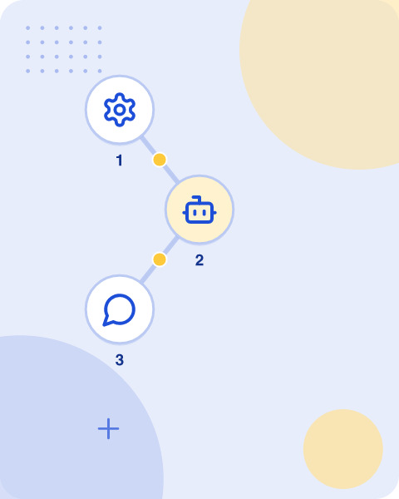

Key takeaways
Section 1
Corpus A corpus is a large and structured set of machine-readable texts that have been produced in a natural communicative…
WSD
Lexical ambiguity: Lexical ambiguity, syntactic or semantic, is one of the very first problem that any NLP system faces
Supervised Methods
For disambiguation, machine learning methods make use of sense-annotated corpora to train
Semi-supervised Methods
Bootstrapping: Bootstrapping Algorithms: While there is great variation between implementations, bootstrapping approaches in natural language processing all follow the same general…
Semi-supervised Methods
Unsupervised : Unsupervised Methods These methods assume that similar senses occur in similar context
Semi-supervised Methods
The senses in: The senses in MT are represented as words in the target language
ALSO ON THIS SLIDE
Dictionary-based or Knowledge-based Me: As the name suggests, for disambiguation, these methods primarily rely on dictionaries, treasures and lexical knowledge base.
Key takeaway: NLP methods range from corpus analysis and lexical ambiguity resolution to supervised and semi-supervised bootstrapping.
Learnova
32 / 32
Notes:
Reveal, one click at a time:
1. Section 1: Corpus A corpus is a large and structured set of machine-readable texts that have been produced in a natural
2. WSD: Lexical ambiguity: Lexical ambiguity, syntactic or semantic, is one of the very first problem that any NLP system f
3. Dictionary-based or Knowledge-based Me: As the name suggests, for disambiguation, these methods primarily rely on dictio
4. Supervised Methods: For disambiguation, machine learning methods make use of sense-annotated corpora to train.
5. Semi-supervised Methods: Bootstrapping: Bootstrapping Algorithms: While there is great variation between implementations
6. Semi-supervised Methods: Unsupervised : Unsupervised Methods These methods assume that similar senses occur in similar c
7. Semi-supervised Methods: The senses in: The senses in MT are represented as words in the target language.
Read these exactly (do not paraphrase):
- Key takeaways Section 1: Corpus A corpus is a large and structured set of machine-readable texts that have been produced in a natural communicative… WSD: Lexical ambiguity: Lexical ambiguity, syntactic or semantic, is one of the very first problem that any NLP system faces.
Pause: ask the class what they already know about “Key takeaways” before revealing the slide.
~61s

Slide 34
Thank you
Questions?

