Slide 1
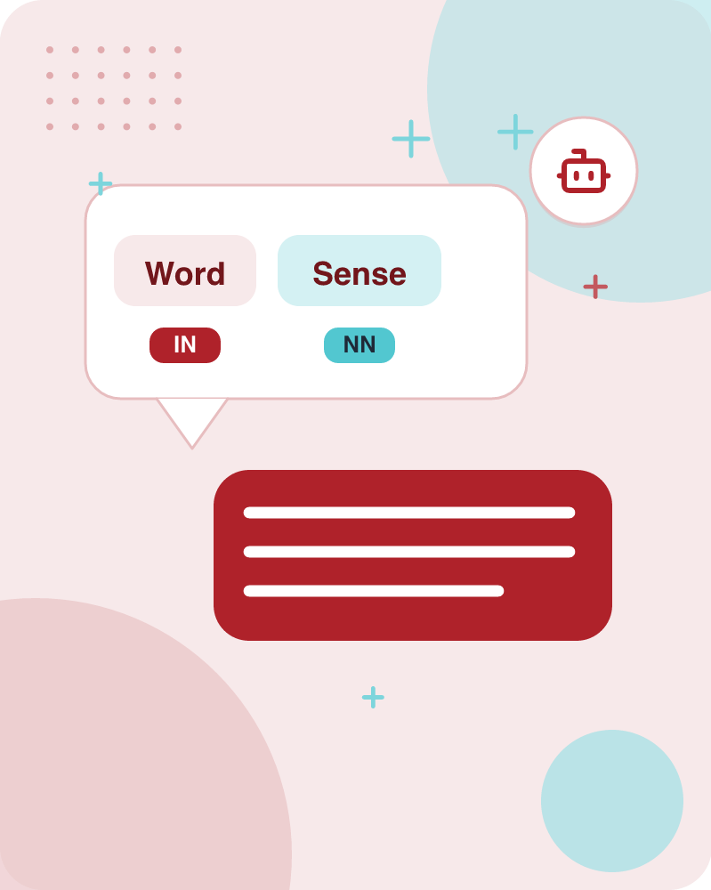
Word Sense Disambiguation
58 slides • made with Learnova

Slide 2
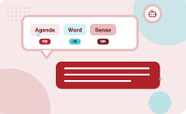
Agenda
Word Sense Disambiguation (WSD)
Two variants of WSD task
1
2
Supervised Machine Learning Approaches
Supervised WSD 1: WSD Tags
3
4
8 senses of “bass” in WordNet
Inventory of sense tags for bass
5
6
Learnova
1 / 58
Notes:
Reveal, one click at a time:
1. Word Sense Disambiguation (WSD)
2. Two variants of WSD task
3. WSD Methods
4. Word Sense Disambiguation
5. Supervised Machine Learning Approaches
6. Supervised WSD 1: WSD Tags
7. 8 senses of “bass” in WordNet
8. Inventory of sense tags for bass
Read these exactly (do not paraphrase):
- Agenda Word Sense Disambiguation (WSD) Two variants of WSD task WSD Methods Word Sense Disambiguation Supervised Machine Learning Approaches Supervised WSD 1: WSD Tags 8 senses of “bass” in WordNet Inventory of sense tags for bass
Pause: ask the class what they already know about “Agenda” before revealing the slide.
Wording matters here — slow down, keep it precise.
~68s

Slide 3
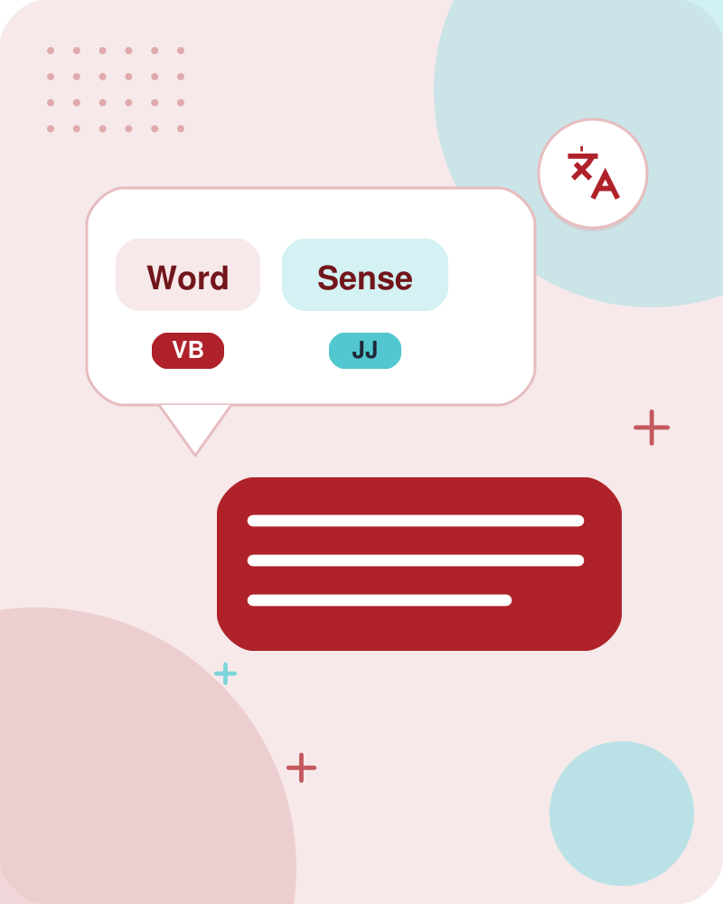



Word Sense Disambiguation (WSD)
English-to-Spanish MT
set of Spanish translations
Speech Synthesis
homographs like bass and bow
In general
the senses in a thesaurus like WordNet
IN PLAIN WORDS
Word sense disambiguation determines the intended meaning of a word by analyzing its context. It uses fixed sense inventories like WordNet to help applications like machine translation and speech synthesis correctly interpret ambiguous words. For example, choosing whether 'bass' means a fish or a musical instrument based on surrounding words.
Given A word in context A fixed inventory of potential word senses Decide which sense of the word this is
Key terms: Word Sense Disambiguation (WSD) — The task of deciding which sense of a word is intended in a given context. · Sense inventory — A fixed set of potential word meanings derived from sources like a thesaurus.
Learnova
▶ Open the interactive lab: Naive Bayes WSD Lab
2 / 58
Notes:
Reveal, one click at a time:
1. Given
2. A word in context
3. A fixed inventory of potential word senses
4. Decide which sense of the word this is
5. Why? Machine translation, QA, speech synthesis
6. What set of senses?
7. English-to-Spanish MT: set of Spanish translations
Read these exactly (do not paraphrase):
- Word Sense Disambiguation (WSD) Given A word in context A fixed inventory of potential word senses Decide which sense of the word this is Why?
Say what these mean, in your own words:
- Word Sense Disambiguation (WSD): The task of deciding which sense of a word is intended in a given context.
- Sense inventory: A fixed set of potential word meanings derived from sources like a thesaurus.
Pause: ask the class what they already know about “Word Sense Disambiguation (WSD)” before revealing the slide.
~61s
Ask the class: Explain this slide in your own words, in one sentence.

Slide 4

Two main variants of the WSD task address either preselected target words or entire texts
Lexical Sample task
Small pre-selected set of target words (line, plant)
And inventory of senses for each word
Supervised machine learning: train a classifier for each word
All-words task
Every word in an entire text
A lexicon with senses for each word
Data sparseness: can’t train word-specific classifiers
IN PLAIN WORDS
The lexical sample task focuses on a small set of preselected target words using supervised classifiers. The all-words task evaluates every word in an entire text using a lexicon, avoiding data sparseness issues by not requiring word-specific training. For example, classifying the word 'plant' in a specific sentence versus tagging every single word in an article.
Key terms: Lexical Sample task — WSD focused on a small pre-selected set of target words with supervised classifiers. · All-words task — WSD applied to every word in an entire text using a lexicon of senses.
Learnova
▶ Open the interactive lab: Naive Bayes WSD Lab
3 / 58
Notes:
Reveal, one click at a time:
1. Lexical Sample task
2. Small pre-selected set of target words (line, plant)
3. And inventory of senses for each word
4. Supervised machine learning: train a classifier for each word
5. All-words task
6. Every word in an entire text
7. A lexicon with senses for each word
Read these exactly (do not paraphrase):
- Two main variants of the WSD task address either preselected target words or entire texts Lexical Sample task Small pre-selected set of target words (line, plant) And inventory of senses for each word Supervised machine learning: train a classifier for each word All-words task Every word in an entire text A lexicon with senses for each word Data sparseness: can’t train word-specific classifiers
Say what these mean, in your own words:
- Lexical Sample task: WSD focused on a small pre-selected set of target words with supervised classifiers.
- All-words task: WSD applied to every word in an entire text using a lexicon of senses.
Pause: ask the class what they already know about “Two main variants of the WSD task address either preselected target words or entire texts” before revealing the slide.
Wording matters here — slow down, keep it precise.
~61s
Ask the class: Explain this slide in your own words, in one sentence.

Slide 5
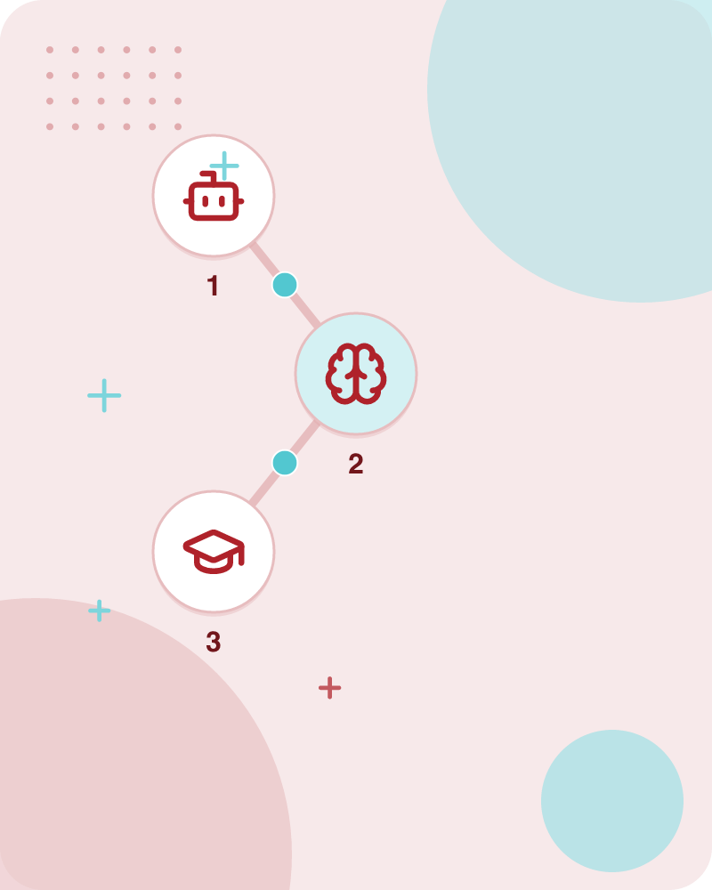




WSD Methods
Supervised Machine Learning
Thesaurus/Dictionary Methods
Word sense disambiguation relies on different methodological strategies to categorize word meanings
Include supervised machine
These include supervised machine learning, dictionary or thesaurus methods, and semi-supervised learning techniques
Key terms: Supervised Machine Learning — Using labeled training data to learn classifiers for predicting word senses. · Thesaurus/Dictionary Methods — Using structured lexical resources to determine word meanings without training data.
Learnova
4 / 58
Notes:
Reveal, one click at a time:
1. Supervised Machine Learning
2. Thesaurus/Dictionary Methods
3. Semi-Supervised Learning
4. Word sense disambiguation relies on different methodological strategies to categorize word meanings.
5. These include supervised machine learning, dictionary or thesaurus methods, and semi-supervised learning techniques.
Say what these mean, in your own words:
- Supervised Machine Learning: Using labeled training data to learn classifiers for predicting word senses.
- Thesaurus/Dictionary Methods: Using structured lexical resources to determine word meanings without training data.
Pause: ask the class what they already know about “WSD Methods” before revealing the slide.
~47s
Ask the class: Explain this slide in your own words, in one sentence.

Slide 6
Checkpoint 1
QUESTION · UNDERSTAND
Which term matches this description: “Using labeled training data to learn classifiers for predicting word senses.”?
Supervised Machine Learning
Dictionary methods
A
B
Part of Speech (POS)
SemCor corpus
C
D
Answer: A
Supervised Machine Learning: Using labeled training data to learn classifiers for predicting word senses.
Learnova
5 / 58
Notes:
KEY POINT TO LAND: Answer, then check your reasoning.
Pause: ask the class what they already know about “Checkpoint 1” before revealing the slide.
~44s

Slide 7
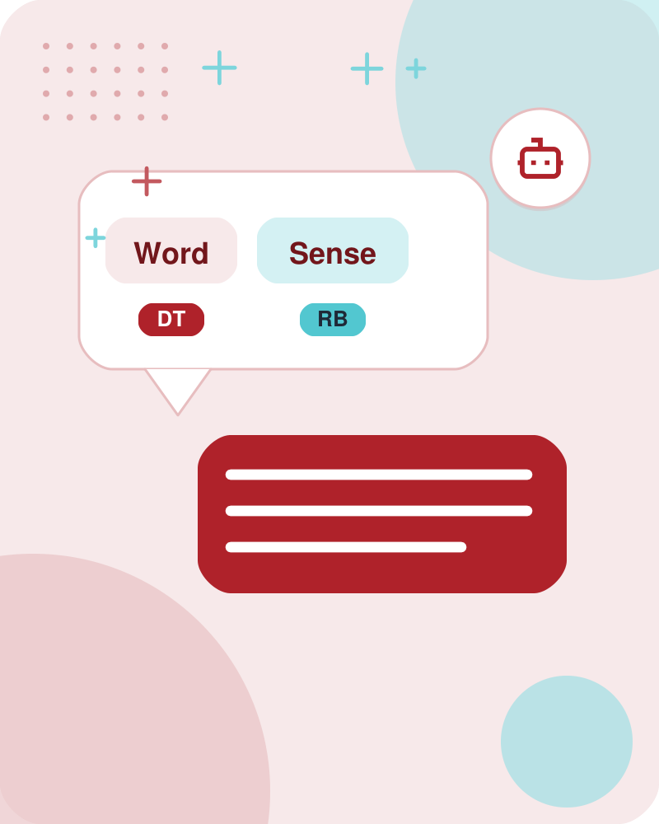
Word Sense Disambiguation
Supervised.
Machine Learning.
Also in this lecture: Given A word in context A fixed inventory of potential word senses Decide which sense of the word this is Why?
Learnova
6 / 58
Notes:
Reveal, one click at a time:
1. Supervised
2. Machine Learning
Pause: ask the class what they already know about “Word Sense Disambiguation” before revealing the slide.
~26s
Ask the class: Explain this slide in your own words, in one sentence.

Slide 8

Supervised Machine Learning Approaches
Supervised machine learning approach
a training corpus of words tagged in context with their sense
used to train a classifier that can tag words in new text
Summary of what we need
the tag set (“sense inventory”)
the training corpus
A set of features extracted from the training corpus
A classifier
IN PLAIN WORDS
This supervised approach uses a training corpus of context-tagged words to build a classifier. The process requires a sense inventory, a training corpus, extracted features, and the classifier itself. For example, training a model on sentences where 'bank' is tagged as either a financial institution or a river edge.
Key terms: Supervised learning approach — Training a classifier on sense-tagged text to automatically tag words in new text. · Training corpus — A collection of texts where words are tagged in context with their correct sense.
Learnova
▶ Open the interactive lab: Supervised Word Sense Disambiguation Lab
7 / 58
Notes:
Reveal, one click at a time:
1. Supervised machine learning approach:
2. a training corpus of words tagged in context with their sense
3. used to train a classifier that can tag words in new text
4. Summary of what we need:
5. the tag set (“sense inventory”)
6. the training corpus
7. A set of features extracted from the training corpus
Read these exactly (do not paraphrase):
- Supervised Machine Learning Approaches Supervised machine learning approach: a training corpus of words tagged in context with their sense used to train a classifier that can tag words in new text Summary of what we need: the tag set (“sense inventory”) the training corpus A set of features extracted from the training corpus A classifier
Say what these mean, in your own words:
- Supervised learning approach: Training a classifier on sense-tagged text to automatically tag words in new text.
- Training corpus: A collection of texts where words are tagged in context with their correct sense.
Pause: ask the class what they already know about “Supervised Machine Learning Approaches” before revealing the slide.
Wording matters here — slow down, keep it precise.
~61s
Ask the class: Explain this slide in your own words, in one sentence.

Slide 9

Supervised WSD tags use dictionary senses to label word instances in text
What’s a tag?
A dictionary sense?
E.G. For example, for WordNet an instance of “bass” in a text has 8 possible tags or labels (bass1 through bass8).
A tag represents a specific dictionary sense assigned to a word in context.
E.G. For example, an instance of the word bass in a text can have eight distinct labels.
Example: Labeling the word 'bass' with one of eight possible WordNet sense tags.
Key terms: Tag — A label representing a dictionary sense assigned to a word in context. · WordNet — A lexical database providing multiple numbered sense definitions for words.
Learnova
8 / 58
Notes:
Reveal, one click at a time:
1. What’s a tag?
2. A dictionary sense?
3. For example, for WordNet an instance of “bass” in a text has 8 possible tags or labels (bass1 through bass8).
4. A tag represents a specific dictionary sense assigned to a word in context.
5. For example, an instance of the word bass in a text can have eight distinct labels.
6. Example: Labeling the word 'bass' with one of eight possible WordNet sense tags.
Read these exactly (do not paraphrase):
- For example, for WordNet an instance of “bass” in a text has 8 possible tags or labels (bass1 through bass8).
Say what these mean, in your own words:
- Tag: A label representing a dictionary sense assigned to a word in context.
- WordNet: A lexical database providing multiple numbered sense definitions for words.
Pause: ask the class what they already know about “Supervised WSD tags use dictionary senses to label word instances in text” before revealing the slide.
~54s
Ask the class: What might explain these numbers?

Slide 10
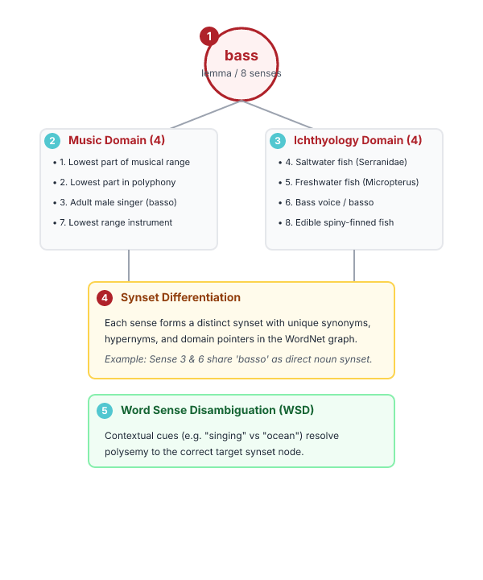



WordNet provides eight distinct senses for the ambiguous word bass
1
1. BASS -- (THE LOWEST PART
1. bass -- (the lowest part of the musical range) 2. bass, bass part -- (the lowest part in polyphonic music) 3. bass, basso -- (an adult male singer with the lowest voice) 4. sea bass, bass -- (flesh of lean-fleshed saltwater fish of the family
2
1. BASS -- (THE LOWEST PART
3
1. BASS -- (THE LOWEST PART
4
1. BASS -- (THE LOWEST PART
IN PLAIN WORDS
For example, distinguishing between a musical bass singer and a saltwater sea bass.
Key takeaway: Headline: 1 — 1. bass -- (the lowest part.
Key terms: WordNet — A lexical database that organizes word meanings into distinct numbered senses. · Sense — A discrete, specific definition or meaning of a word.
Learnova
9 / 58
Notes:
Reveal, one click at a time:
1. 1. bass -- (the lowest part of the musical range) 2. bass, bass part -- (the lowest part in polyphonic music) 3. bass, b
2. Serranidae)
3. 5. freshwater bass, bass -- (any of various North American lean-fleshed freshwater fishes especially of the genus Microp
Read these exactly (do not paraphrase):
- bass -- (the lowest part of the musical range) 2.
- bass, bass part -- (the lowest part in polyphonic music) 3.
- bass, basso -- (an adult male singer with the lowest voice) 4.
- sea bass, bass -- (flesh of lean-fleshed saltwater fish of the family Serranidae) 5.
Say what these mean, in your own words:
- WordNet: A lexical database that organizes word meanings into distinct numbered senses.
- Sense: A discrete, specific definition or meaning of a word.
Pause: ask the class what they already know about “WordNet provides eight distinct senses for the ambiguous word bass” before revealing the slide.
Wording matters here — slow down, keep it precise.
~33s
Ask the class: What might explain these numbers?

Slide 11
Checkpoint 2
QUESTION · UNDERSTAND
Which term matches this description: “A lexical database that organizes word meanings into distinct numbered senses.”?
Word overlap
Ceiling
A
B
WordNet
POS
C
D
Answer: C
WordNet: A lexical database that organizes word meanings into distinct numbered senses.
Learnova
10 / 58
Notes:
KEY POINT TO LAND: Answer, then check your reasoning.
Pause: ask the class what they already know about “Checkpoint 2” before revealing the slide.
~44s

Slide 12

Sense tag inventories map words to translations and categories across different resources
WordNet Spanish
Roget
Sense
Translation Category
  Target Word in Context
Bass4
  ... ﬁsh as Paciﬁc salmon and striped bass and...
lubina
+2 more
Bass7
  ... exciting jazz bass player since Ray Brown...
bajo
+2 more
IN PLAIN WORDS
For example, mapping the fourth sense of bass to the Spanish translation 'lubina' and the category FISH/INSECT.
Key terms: Sense Translation — Equivalent meaning in another language, such as Spanish for WordNet senses. · Category — A broader semantic domain or classification for a specific word sense.
Learnova
11 / 58
Notes:
Reveal, one click at a time:
1. WordNet Spanish
2. Roget
3. Sense
4. Translation Category
5. Target Word in Context
6. bass4
7. ... ﬁsh as Paciﬁc salmon and striped bass and...
Say what these mean, in your own words:
- Sense Translation: Equivalent meaning in another language, such as Spanish for WordNet senses.
- Category: A broader semantic domain or classification for a specific word sense.
Pause: ask the class what they already know about “Sense tag inventories map words to translations and categories across different resources” before revealing the slide.
~61s
Ask the class: Explain this slide in your own words, in one sentence.

Slide 13

Supervised WSD requires specialized corpora like SemCor for training and evaluation
IN PLAIN WORDS
Supervised tasks use dedicated corpora containing thousands of examples or manually tagged sense instances. SemCor provides hundreds of thousands of words manually tagged with WordNet senses from the Brown Corpus. For example, using SemCor's manually tagged text to train a system to recognize WordNet senses.
Lexical sample task: Line-hard-serve corpus -- 4000 examples of each Interest corpus -- 2369 sense-tagged examples All words:
Key takeaway: Highest: SemCor: (234000).
Key terms: Semantic concordance — A corpus where each open-class word is labeled with a dictionary or thesaurus sense. · SemCor — A manually tagged subset of the Brown Corpus using WordNet senses.
Learnova
12 / 58
Notes:
Reveal, one click at a time:
1. Lexical sample task:
2. Line-hard-serve corpus -- 4000 examples of each
3. Interest corpus -- 2369 sense-tagged examples
4. All words:
5. Semantic concordance: a corpus in which each open-class word is labeled with a sense from a specific dictionary/thesauru
6. SemCor: 234,000 words from Brown Corpus, manually tagged with WordNet senses
7. SENSEVAL-3 competition corpora -- 2081 tagged word tokens
Say what these mean, in your own words:
- Semantic concordance: A corpus where each open-class word is labeled with a dictionary or thesaurus sense.
- SemCor: A manually tagged subset of the Brown Corpus using WordNet senses.
Pause: ask the class what they already know about “Supervised WSD requires specialized corpora like SemCor for training and evaluation” before revealing the slide.
~61s
Ask the class: Explain this slide in your own words, in one sentence.

Slide 14

SemCor explicitly encodes part of speech and lemma information for words in context
MARKUP EXAMPLE
1
wf pos=PRP>He</wf>
2
wf pos=VB lemma=recognize wnsn=4 lexsn=2:31:00::>recognized</wf>
3
wf pos=DT>the</wf>
4
wf pos=NN lemma=gesture wnsn=1 lexsn=1:04:00::>gesture</wf>
5
punc>.</punc>
IN PLAIN WORDS
For example, tagging the word 'recognize' with its specific part of speech and lemma within a sentence.
Key terms: Lemma — The base dictionary form of a word. · Part of Speech (POS) — The grammatical category of a word, such as pronoun, verb, or noun.
Learnova
13 / 58
Notes:
Reveal, one click at a time:
1. wf pos=PRP>He</wf>
2. wf pos=VB lemma=recognize wnsn=4 lexsn=2:31:00::>recognized</wf>
3. wf pos=DT>the</wf>
4. wf pos=NN lemma=gesture wnsn=1 lexsn=1:04:00::>gesture</wf>
5. punc>.</punc>
Read these exactly (do not paraphrase):
- SemCor explicitly encodes part of speech and lemma information for words in context wf pos=PRP>He</wf> wf pos=VB lemma=recognize wnsn=4 lexsn=2:31:00::>recognized</wf> wf pos=DT>the</wf> wf pos=NN lemma=gesture wnsn=1 lexsn=1:04:00::>gesture</wf> punc>.</punc>
Say what these mean, in your own words:
- Lemma: The base dictionary form of a word.
- Part of Speech (POS): The grammatical category of a word, such as pronoun, verb, or noun.
Pause: ask the class what they already know about “SemCor explicitly encodes part of speech and lemma information for words in context” before revealing the slide.
Wording matters here — slow down, keep it precise.
~47s
Ask the class: Explain this slide in your own words, in one sentence.

Slide 15
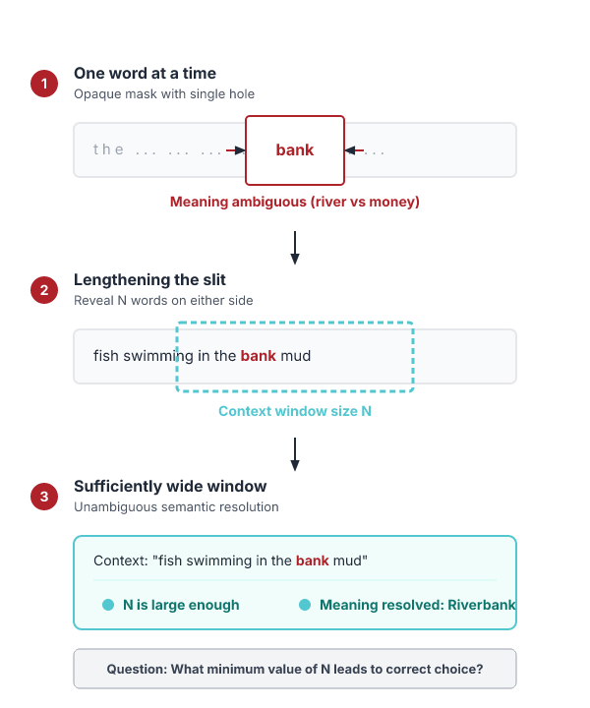
Surrounding context words in a sufficiently wide window reveal the meaning of a central word
“If one examines the words in a book, one at a time as through an opaque mask with a hole in it one word wide, then it is obviously impossible to determine, one at a time, the meaning of the words… But if one lengthens the slit in the opaque mask, until one can see not only the central word in question but also say N words on either side, then if N is large enough one can unambiguously decide the meaning of the central word… The practical question is: ``What minimum value of N will, at least in a tolerable fraction of cases, lead to the correct choice of meaning for the central word?”.
IN PLAIN WORDS
For example, looking at several words to the left and right of 'bass' to determine if it relates to music or fishing.
Key terms: Context window — A span of N words on either side of a central word used for disambiguation. · Feature vector — A set of extracted contextual features used to train a word sense classifier.
Learnova
14 / 58
Notes:
Read these exactly (do not paraphrase):
- Surrounding context words in a sufficiently wide window reveal the meaning of a central word “If one examines the words in a book, one at a time as through an opaque mask with a hole in it one word wide, then it is obviously impossible to determine, one at a time, the meaning of the words… But if one lengthens the slit in the opaque mask, until one can see not only the central word in question but also say N words on either side, then if N is large enough one can unambiguously decide the meaning of the central word… The practical question is: ``What minimum value of N will, at least in a tolerable fraction of cases, lead to the correct choice of meaning for the central word?”
Say what these mean, in your own words:
- Context window: A span of N words on either side of a central word used for disambiguation.
- Feature vector: A set of extracted contextual features used to train a word sense classifier.
Pause: ask the class what they already know about “Surrounding context words in a sufficiently wide window reveal the meaning of a central word” before revealing the slide.
Wording matters here — slow down, keep it precise.
~19s
Ask the class: Explain this slide in your own words, in one sentence.

Slide 16
Checkpoint 3
QUESTION · UNDERSTAND
Which term matches this description: “A span of N words on either side of a central word used for disambiguation.”?
Dictionary methods
Naive Bayes
A
B
Lexical Sample task
Context window
C
D
Answer: D
Context window: A span of N words on either side of a central word used for disambiguation.
Learnova
15 / 58
Notes:
KEY POINT TO LAND: Answer, then check your reasoning.
Pause: ask the class what they already know about “Checkpoint 3” before revealing the slide.
~44s

Slide 17
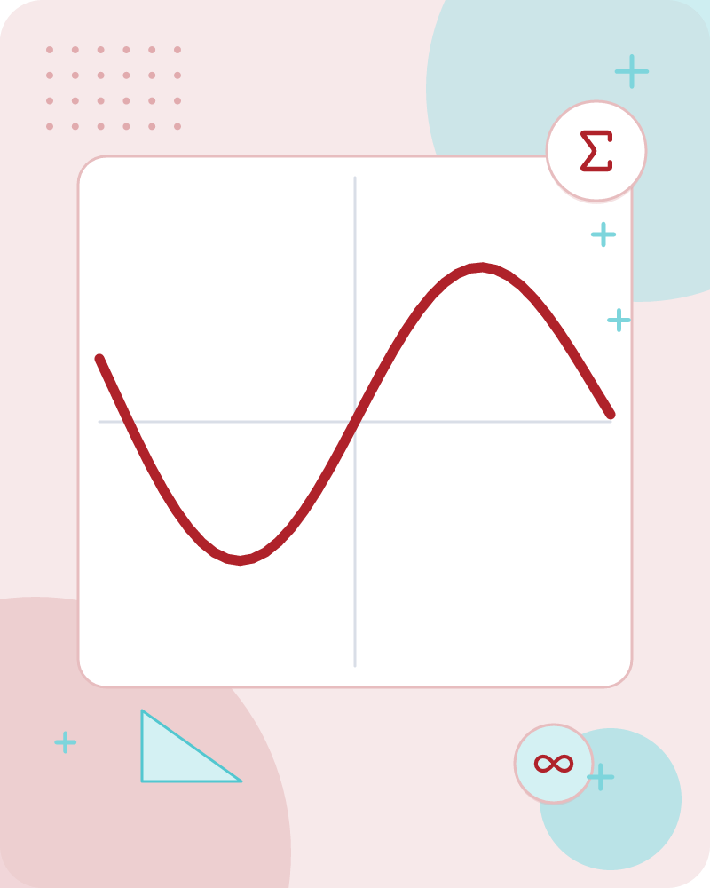
Feature vectors encode each target word by ordered values
A simple representation for each observation (each instance of a target word).
Vectors of sets of feature/value pairs.
Represented as a ordered list of values.
These vectors represent, e.g., the window of words around the target.
Feature vectors represent an observation as a list of values.
E.G. Each value corresponds to a feature such as a word or part-of-speech tag.
The order of values reflects the feature’s position in the vector.
This simple structure allows machine learning models to process linguistic data.
Example: A window of words around "bass" becomes a vector of 10 numbers.
Key terms: feature vector — An ordered list of numeric values representing attributes of an observation.
Learnova
16 / 58
Notes:
Reveal, one click at a time:
1. A simple representation for each observation (each instance of a target word)
2. Vectors of sets of feature/value pairs
3. Represented as a ordered list of values
4. These vectors represent, e.g., the window of words around the target
5. Feature vectors represent an observation as a list of values.
6. Each value corresponds to a feature such as a word or part-of-speech tag.
7. The order of values reflects the feature’s position in the vector.
Read these exactly (do not paraphrase):
- Feature vectors encode each target word by ordered values A simple representation for each observation (each instance of a target word) Vectors of sets of feature/value pairs Represented as a ordered list of values These vectors represent, e.g., the window of words around the target Feature vectors represent an observation as a list of values.
Say what these mean, in your own words:
- feature vector: An ordered list of numeric values representing attributes of an observation.
Pause: ask the class what they already know about “Feature vectors encode each target word by ordered values” before revealing the slide.
~61s
Ask the class: Explain this slide in your own words, in one sentence.

Slide 18
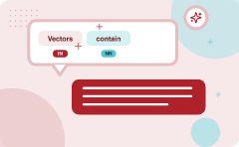
Vectors contain collocational and bag-of-words features
Collocational features and bag-of-words features
Collocational
Features about words at specific positions near target word
  Often limited to just word identity and POS
Bag-of-words
Features about words that occur anywhere in the window (regardless of position)
  Typically limited to frequency counts
ALSO ON THIS SLIDE
Both types help describe the context of the target word.
Key terms: collocational feature — A feature that records a word at a specific position relative to the target. · bag-of-words feature — A feature that counts word occurrences regardless of position.
Learnova
▶ Open the interactive lab: Vectors with Collocational and Bag‑of‑Words Features
17 / 58
Notes:
Reveal, one click at a time:
1. Collocational features and bag-of-words features
2. Collocational
3. Features about words at specific positions near target word
4. Often limited to just word identity and POS
5. Bag-of-words
6. Features about words that occur anywhere in the window (regardless of position)
7. Typically limited to frequency counts
Read these exactly (do not paraphrase):
- Vectors contain collocational and bag-of-words features Collocational features and bag-of-words features Collocational Features about words at specific positions near target word Often limited to just word identity and POS Bag-of-words Features about words that occur anywhere in the window (regardless of position) Typically limited to frequency counts Collocational features capture words at specific positions near the target, often using word identity and part-of-speech.
Say what these mean, in your own words:
- collocational feature: A feature that records a word at a specific position relative to the target.
- bag-of-words feature: A feature that counts word occurrences regardless of position.
Pause: ask the class what they already know about “Vectors contain collocational and bag-of-words features” before revealing the slide.
~61s
Ask the class: Explain this slide in your own words, in one sentence.

Slide 19
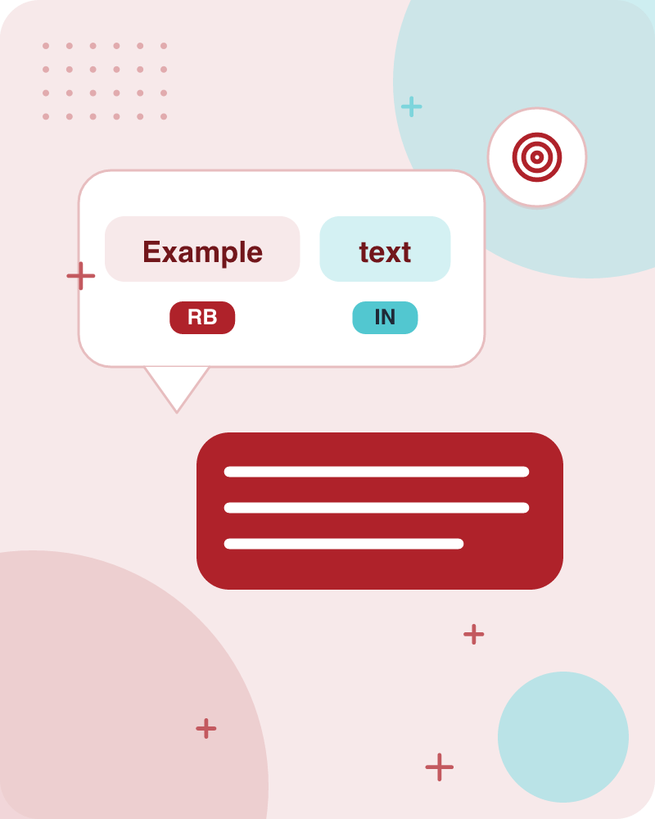
Example text illustrates a 5-word window around a target
Example text (WSJ): An electric guitar and bass player stand off to one side not really part of the scene.
Assume a window of +/-- 2 from the target.
The sentence "An electric guitar and bass player stand off to one side not really part of the scene" is used.
A window of ±2 words around the target word is assumed.
This demonstrates how context is extracted for feature creation.
Learnova
18 / 58
Notes:
Reveal, one click at a time:
1. Example text (WSJ): An electric guitar and bass player stand off to one side not really part of the scene
2. Assume a window of +/-- 2 from the target
3. The sentence "An electric guitar and bass player stand off to one side not really part of the scene" is used.
4. A window of ±2 words around the target word is assumed.
5. This demonstrates how context is extracted for feature creation.
Read these exactly (do not paraphrase):
- Example text illustrates a 5-word window around a target Example text (WSJ): An electric guitar and bass player stand off to one side not really part of the scene Assume a window of +/-- 2 from the target The sentence "An electric guitar and bass player stand off to one side not really part of the scene" is used.
- A window of ±2 words around the target word is assumed.
Pause: ask the class what they already know about “Example text illustrates a 5-word window around a target” before revealing the slide.
Wording matters here — slow down, keep it precise.
~47s
Ask the class: What might explain these numbers?

Slide 20


Same example text repeats to emphasize window selection
2
ASSUME A WINDOW OF +/--
Assume a window of +/-- 2 from the target
Key takeaway: Headline: 2 — assume a window of +/--.
Key terms: wsj — Example text
Learnova
19 / 58
Notes:
Reveal, one click at a time:
1. Example text (WSJ) An electric guitar and bass player stand off to one side not really part of the scene,
2. Assume a window of +/-- 2 from the target
Read these exactly (do not paraphrase):
- Same example text repeats to emphasize window selection Example text (WSJ) An electric guitar and bass player stand off to one side not really part of the scene, Assume a window of +/-- 2 from the target
Say what these mean, in your own words:
- wsj: Example text
Pause: ask the class what they already know about “Same example text repeats to emphasize window selection” before revealing the slide.
Wording matters here — slow down, keep it precise.
~26s
Ask the class: What might explain these numbers?

Slide 21
Checkpoint 4
QUESTION · RECALL
What was the figure for “Assume a window of +/--”?
6
4
A
B
2
3
C
D
Answer: C
Assume a window of +/-- 2 from the target
Learnova
20 / 58
Notes:
KEY POINT TO LAND: Answer, then check your reasoning.
Pause: ask the class what they already know about “Checkpoint 4” before revealing the slide.
~44s

Slide 22
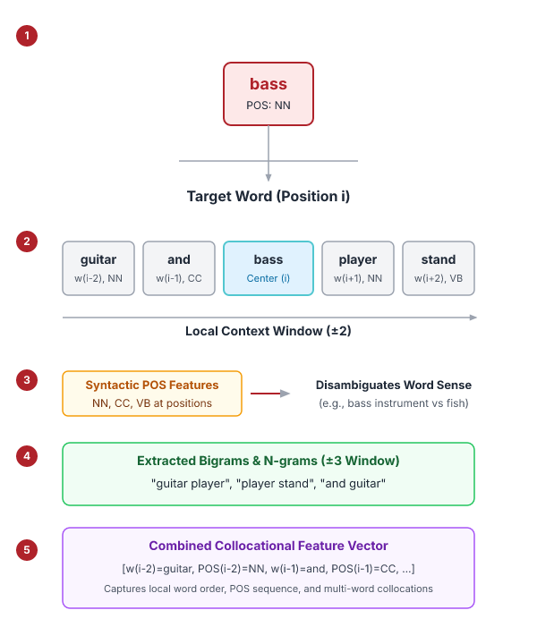
Collocational features list words and POS at each position
Position-specific information about the words and collocations in window.
guitar and bass player stand.
i−2,wi+1 ].
[guitar, NN, and, CC, player, NN, stand, VB, and guitar, player stand].
word 1,2,3 grams in window of ±3 is common.
For the window "guitar and bass player stand", the vector includes words and their part-of-speech tags at positions -2, -1, +1, +2.
ALSO It also includes bigrams like "guitar player".
This captures local word order and collocations.
Key terms: POS — Part-of-speech tag indicating grammatical category of a word.
Learnova
21 / 58
Notes:
Reveal, one click at a time:
1. Position-specific information about the words and collocations in window
2. guitar and bass player stand
3. [wi−2,POSi−2,wi−1,POSi−1,wi+1,POSi+1,wi+2,POSi+2,wi−1
4. i−2,wi+1 ]
5. [guitar, NN, and, CC, player, NN, stand, VB, and guitar, player stand]
6. word 1,2,3 grams in window of ±3 is common
7. For the window "guitar and bass player stand", the vector includes words and their part-of-speech tags at positions -2,
Read these exactly (do not paraphrase):
- Collocational features list words and POS at each position Position-specific information about the words and collocations in window guitar and bass player stand [wi−2,POSi−2,wi−1,POSi−1,wi+1,POSi+1,wi+2,POSi+2,wi−1 i−2,wi+1 ] [guitar, NN, and, CC, player, NN, stand, VB, and guitar, player stand] word 1,2,3 grams in window of ±3 is common For the window "guitar and bass player stand", the vector includes words and their part-of-speech tags at positions -2, -1, +1, +2.
- It also includes bigrams like "guitar player".
Say what these mean, in your own words:
- POS: Part-of-speech tag indicating grammatical category of a word.
Pause: ask the class what they already know about “Collocational features list words and POS at each position” before revealing the slide.
Wording matters here — slow down, keep it precise.
~61s
Ask the class: What might explain these numbers?

Slide 23
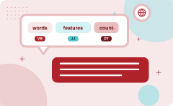
Bag-of-words features count unordered words in the window
“an unordered set of words” – position ignored
Counts of words occur within the window.
Then count how often each of those terms occurs in a given window
sometimes just a binary “indicator” 1 or 0
ALSO ON THIS SLIDE
First choose a vocabulary The vector ignores word order and records how many times each vocabulary word appears in the window. After choosing a vocabulary, each term gets a count or a binary indicator. This simplifies the representation for many classifiers.
Key terms: vocabulary — The set of distinct words used to build the feature vector.
Learnova
▶ Open the interactive lab: Bag-of-Words Feature Extraction Lab
22 / 58
Notes:
Reveal, one click at a time:
1. “an unordered set of words” – position ignored
2. Counts of words occur within the window.
3. First choose a vocabulary
4. Then count how often each of those terms occurs in a given window
5. sometimes just a binary “indicator” 1 or 0
6. The vector ignores word order and records how many times each vocabulary word appears in the window.
7. After choosing a vocabulary, each term gets a count or a binary indicator.
Read these exactly (do not paraphrase):
- Bag-of-words features count unordered words in the window “an unordered set of words” – position ignored Counts of words occur within the window.
Say what these mean, in your own words:
- vocabulary: The set of distinct words used to build the feature vector.
Pause: ask the class what they already know about “Bag-of-words features count unordered words in the window” before revealing the slide.
~61s
Ask the class: Explain this slide in your own words, in one sentence.

Slide 24
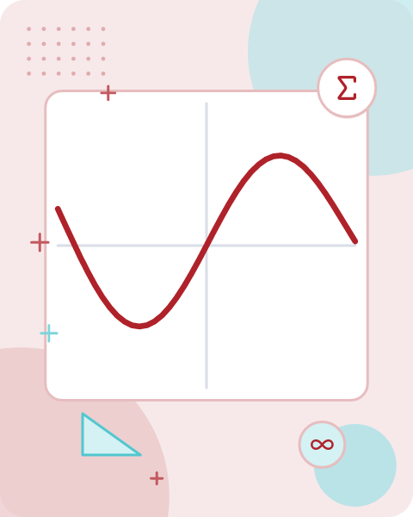


Co-occurrence example shows a binary vector for a target window
Assume we’ve settled on a possible vocabulary of 12 words in “bass” sentences
[fishing, big, sound, player, fly, rod, pound, double, runs, playing, guitar, band]
Vector
The vector for
guitar and bass player stand [0,0,0,1,0,0,0,0,0,0,1,0]
12-word vocabulary,
With a 12-word vocabulary, the window "guitar and bass player stand" yields a vector of zeros and ones
Each position indicates whether the corresponding vocabulary word appears in the window
ALSO ON THIS SLIDE
This binary representation is a simple bag-of-words feature.
Key terms: binary vector — A vector of 0s and 1s indicating presence or absence of features.
Learnova
23 / 58
Notes:
Reveal, one click at a time:
1. Assume we’ve settled on a possible vocabulary of 12 words in “bass” sentences:
2. [fishing, big, sound, player, fly, rod, pound, double, runs, playing, guitar, band]
3. The vector for:
4. guitar and bass player stand [0,0,0,1,0,0,0,0,0,0,1,0]
5. With a 12-word vocabulary, the window "guitar and bass player stand" yields a vector of zeros and ones.
6. Each position indicates whether the corresponding vocabulary word appears in the window.
7. This binary representation is a simple bag-of-words feature.
Read these exactly (do not paraphrase):
- Co-occurrence example shows a binary vector for a target window Assume we’ve settled on a possible vocabulary of 12 words in “bass” sentences: [fishing, big, sound, player, fly, rod, pound, double, runs, playing, guitar, band] The vector for: guitar and bass player stand [0,0,0,1,0,0,0,0,0,0,1,0] With a 12-word vocabulary, the window "guitar and bass player stand" yields a vector of zeros and ones.
Say what these mean, in your own words:
- binary vector: A vector of 0s and 1s indicating presence or absence of features.
Pause: ask the class what they already know about “Co-occurrence example shows a binary vector for a target window” before revealing the slide.
~61s
Ask the class: Explain this slide in your own words, in one sentence.

Slide 25
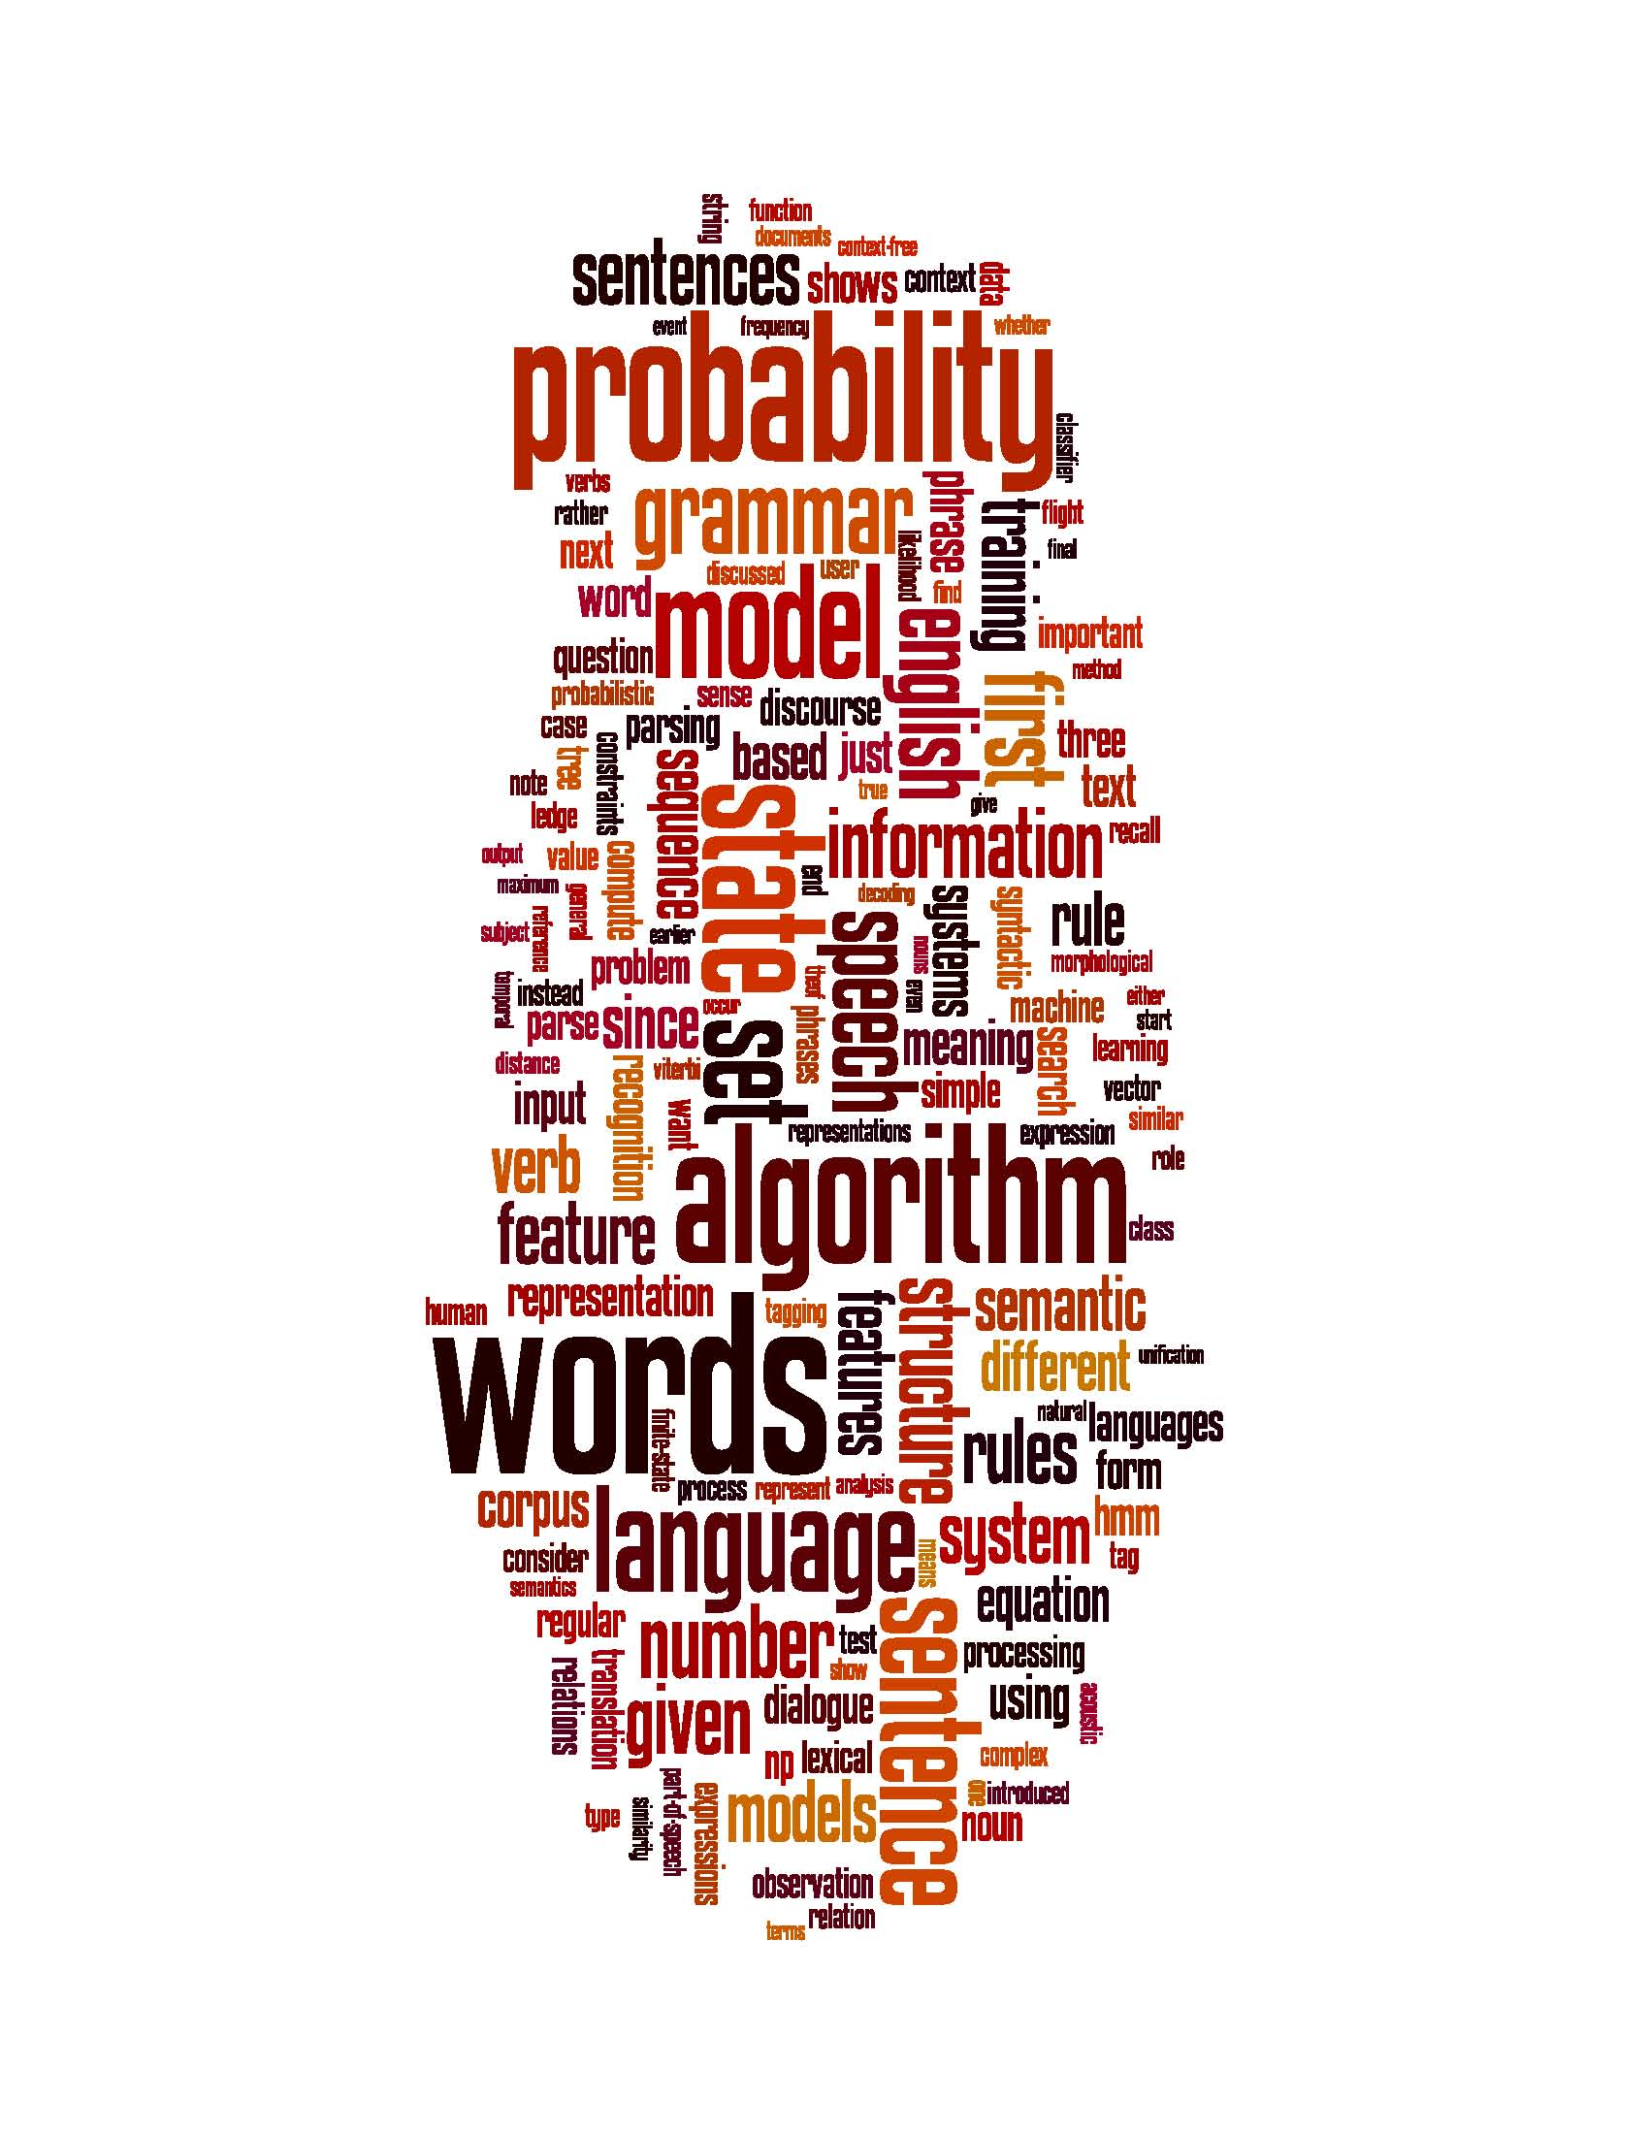
Word Sense Disambiguation (2)
Learnova
24 / 58
Notes:
Read these exactly (do not paraphrase):
- Word Sense Disambiguation (2) Classification
Pause: ask the class what they already know about “Word Sense Disambiguation (2)” before revealing the slide.
Wording matters here — slow down, keep it precise.
~19s
Text in the figure: probability a ha Ps i= rather =| = Bea = ay: ma lone & no nin nt oe rule roblem cD _— i gor a3 par | haan d gol £2 semantic. = different" NE. = rules ag age sen represent analysis = = ven np lsical Ge a models = roan CES terms lation
Ask the class: Explain this slide in your own words, in one sentence.

Slide 26
Checkpoint 5
QUESTION · UNDERSTAND
Which term matches this description: “A vector of 0s and 1s indicating presence or absence of features.”?
one-sense-per-discourse
Conditional Probabilities
A
B
binary vector
vocabulary
C
D
Answer: C
binary vector: A vector of 0s and 1s indicating presence or absence of features.
Learnova
25 / 58
Notes:
KEY POINT TO LAND: Answer, then check your reasoning.
Pause: ask the class what they already know about “Checkpoint 5” before revealing the slide.
~44s

Slide 27
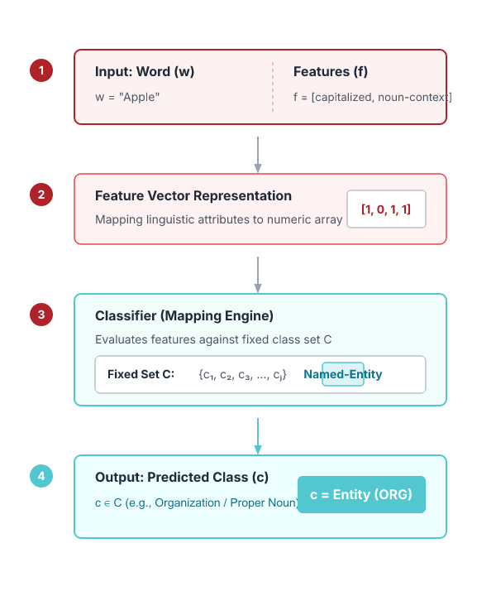





Classification maps a word and its features to a class
Word w
a word w and some features f
Fixed set
a fixed set of classes C = {c1, c2,…, cJ}
Output: a predicted class c∈C
Given a word w and its feature vector f, the classifier outputs a predicted class c from a fixed set C
Process transforms linguistic
The process transforms linguistic input into categorical labels such as part-of-speech tags or named-entity types
Key terms: classifier — A function that assigns a class label to an input based on its features.
Learnova
26 / 58
Notes:
Reveal, one click at a time:
1. Input:
2. a word w and some features f
3. a fixed set of classes C = {c1, c2,…, cJ}
4. Output: a predicted class c∈C
5. Given a word w and its feature vector f, the classifier outputs a predicted class c from a fixed set C.
6. The process transforms linguistic input into categorical labels such as part-of-speech tags or named-entity types.
Read these exactly (do not paraphrase):
- Classification maps a word and its features to a class Input: a word w and some features f a fixed set of classes C = {c1, c2,…, cJ} Output: a predicted class c∈C Given a word w and its feature vector f, the classifier outputs a predicted class c from a fixed set C.
Say what these mean, in your own words:
- classifier: A function that assigns a class label to an input based on its features.
Pause: ask the class what they already know about “Classification maps a word and its features to a class” before revealing the slide.
Wording matters here — slow down, keep it precise.
~54s
Ask the class: What happens to the result if one of the inputs doubles?

Slide 28

Supervised learning trains a classifier from labeled windows
Input
a word w in a text window d (which we’ll call a “document”)
a fixed set of classes C = {c1, c2,…, cJ}
A training set of m hand-labeled text windows again called
  “documents” (d1,c1),....,(dm,cm)
Output
a learned classifier γ:d à→c
ALSO ON THIS SLIDE
“documents” (d1,c1),....,(dm,cm) Training data consists of m labeled windows (documents) with known classes. A learning algorithm learns a mapping γ from a window d to its class c. After training, the model can predict classes for new, unseen windows.
Key terms: training set — A collection of labeled examples used to train a model.
Learnova
▶ Open the interactive lab: Supervised Text Window Classification Lab
27 / 58
Notes:
Reveal, one click at a time:
1. Input:
2. a word w in a text window d (which we’ll call a “document”)
3. a fixed set of classes C = {c1, c2,…, cJ}
4. A training set of m hand-labeled text windows again called
5. “documents” (d1,c1),....,(dm,cm)
6. Output:
7. a learned classifier γ:d à→c
Read these exactly (do not paraphrase):
- Supervised learning trains a classifier from labeled windows Input: a word w in a text window d (which we’ll call a “document”) a fixed set of classes C = {c1, c2,…, cJ} A training set of m hand-labeled text windows again called “documents” (d1,c1),....,(dm,cm) Output: a learned classifier γ:d à→c Training data consists of m labeled windows (documents) with known classes.
Say what these mean, in your own words:
- training set: A collection of labeled examples used to train a model.
Pause: ask the class what they already know about “Supervised learning trains a classifier from labeled windows” before revealing the slide.
~61s
Ask the class: Explain this slide in your own words, in one sentence.

Slide 29
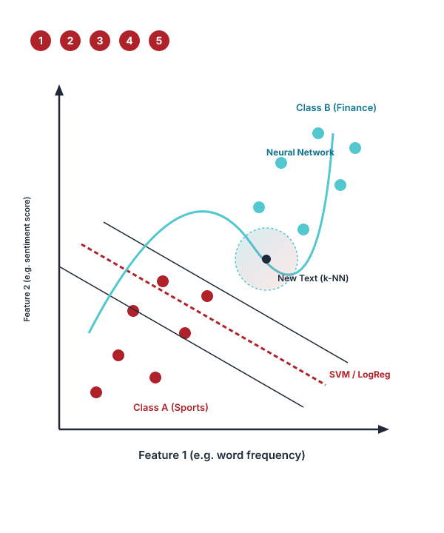

Many classifiers can be used for supervised text classification
Any kind of classifier
Naive Bayes
Logistic regression
Neural Networks
Support-vector machines
k-Nearest Neighbors
Key terms: Naive Bayes — A probabilistic classifier assuming feature independence. · Support-vector machine — A classifier that finds a hyperplane separating classes with maximum margin.
Learnova
28 / 58
Notes:
Reveal, one click at a time:
1. Any kind of classifier
2. Naive Bayes
3. Logistic regression
4. Neural Networks
5. Support-vector machines
6. k-Nearest Neighbors
Say what these mean, in your own words:
- Naive Bayes: A probabilistic classifier assuming feature independence.
- Support-vector machine: A classifier that finds a hyperplane separating classes with maximum margin.
Pause: ask the class what they already know about “Many classifiers can be used for supervised text classification” before revealing the slide.
~54s
Ask the class: Explain this slide in your own words, in one sentence.

Slide 30
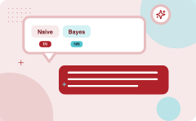
Naive Bayes calculates prior and conditional probabilities from a tagged training set
We get both of these from a tagged corpus like SemCor
P(c) is the prior probability of that sense
Counting in a labeled training set.
P(w|c) conditional probability of a word given a particular sense
P(w|c) = count(w,c)/count(c)
Can also generalize to look at other features besides words.
Then it would be P(f|c)
  Conditional probability of a feature given a sense
IN PLAIN WORDS
Naive Bayes uses prior probabilities and conditional probabilities to apply statistical learning to word sense disambiguation. You get these probabilities by counting occurrences in a labeled training corpus. This method can also generalize to evaluate other features besides just words. For example, calculating the probability of a word given a specific word sense from SemCor.
Key terms: Prior probability — The probability of a particular sense occurring in a labeled training set. · Conditional probability — The probability of a word or feature given a particular sense.
Learnova
29 / 58
Notes:
Reveal, one click at a time:
1. P(c) is the prior probability of that sense
2. Counting in a labeled training set.
3. P(w|c) conditional probability of a word given a particular sense
4. P(w|c) = count(w,c)/count(c)
5. We get both of these from a tagged corpus like SemCor
6. Can also generalize to look at other features besides words.
7. Then it would be P(f|c)
Read these exactly (do not paraphrase):
- Naive Bayes calculates prior and conditional probabilities from a tagged training set P(c) is the prior probability of that sense Counting in a labeled training set.
- P(w|c) conditional probability of a word given a particular sense P(w|c) = count(w,c)/count(c) We get both of these from a tagged corpus like SemCor Can also generalize to look at other features besides words.
- Then it would be P(f|c) Conditional probability of a feature given a sense
Say what these mean, in your own words:
- Prior probability: The probability of a particular sense occurring in a labeled training set.
- Conditional probability: The probability of a word or feature given a particular sense.
Pause: ask the class what they already know about “Naive Bayes calculates prior and conditional probabilities from a tagged training set” before revealing the slide.
Wording matters here — slow down, keep it precise.
~61s
Ask the class: Explain this slide in your own words, in one sentence.

Slide 31
Checkpoint 6
QUESTION · UNDERSTAND
Which term matches this description: “The probability of a particular sense occurring in a labeled training set.”?
Feature vector
Prior probability
A
B
Extrinsic evaluation
Supervised Machine Learning
C
D
Answer: B
Prior probability: The probability of a particular sense occurring in a labeled training set.
Learnova
30 / 58
Notes:
KEY POINT TO LAND: Answer, then check your reasoning.
Pause: ask the class what they already know about “Checkpoint 6” before revealing the slide.
~44s

Slide 32

Naive Bayes calculates class choices using smoothed counts and vocabulary sizes
NAIVE BAYES CALCULATES CLASS CHOICES USING SMOOTHED COUNTS AND VOCABULARY SIZES
ˆP(c) = Nc ˆP(w | c) = count(w,c)+1 count(c)+ |V | V = {fish, smoked, line, haul, guitar, jazz} Choosing a class: 3/4 * 2/14 * (1/14)2 * 1/14
$$V=fish$$
Key takeaway: Remember: V = {fish
Key terms: V — The vocabulary set including words like fish, smoked, line, haul, guitar, and jazz. · Class — The targeted category or sense being chosen during evaluation.
Learnova
31 / 58
Notes:
Reveal, one click at a time:
1. ˆP(c) = Nc
2. ˆP(w | c) = count(w,c)+1
3. count(c)+ |V |
4. V = {fish, smoked, line, haul, guitar, jazz}
5. Choosing a class:
6. 3/4 * 2/14 * (1/14)2 * 1/14
Read these exactly (do not paraphrase):
- Naive Bayes calculates class choices using smoothed counts and vocabulary sizes ˆP(c) = Nc ˆP(w | c) = count(w,c)+1 count(c)+ |V | V = {fish, smoked, line, haul, guitar, jazz} Choosing a class: 3/4 * 2/14 * (1/14)2 * 1/14
Say what these mean, in your own words:
- V: The vocabulary set including words like fish, smoked, line, haul, guitar, and jazz.
- Class: The targeted category or sense being chosen during evaluation.
Pause: ask the class what they already know about “Naive Bayes calculates class choices using smoothed counts and vocabulary sizes” before revealing the slide.
Wording matters here — slow down, keep it precise.
~54s
Ask the class: What happens to the result if one of the inputs doubles?

Slide 33

Conditional probabilities use smoothed counts to compute specific feature likelihoods
Count everything — 9 p + 9 p = 18 in total
Probability compares the outcomes we want with all the outcomes that could happen. So first count all of them.
1
Write the probability — P(p) = favourable ÷ total = 18/18
Probability = (number of favourable outcomes) ÷ (total number of outcomes).
2
Simplify — 18/18 = 1/1 ≈ 1.000 = 100.0%
Divide top and bottom by the same number until you cannot any more. A probability is always between 0 and 1.
3
Answer: 1/1 (100.0%)
Learnova
32 / 58
Notes:
Reveal, one click at a time:
1. Conditional Probabilities: P(line|f) =
2. (1+1) / (8+6) = 2/14 (0+1) / (8+6) = 1/14
3. 1/4 * 2/9 * (2/9)2 * 2/9
4. (0+1) / (8+6) = 1/14
5. (1+1) / (3+6) = 2/9
6. P(guitar|g) = (1+1) / (3+6) = 2/9 P(jazz|g) =
Read these exactly (do not paraphrase):
- Conditional probabilities use smoothed counts to compute specific feature likelihoods Conditional Probabilities: P(line|f) = (1+1) / (8+6) = 2/14 (0+1) / (8+6) = 1/14 1/4 * 2/9 * (2/9)2 * 2/9 (0+1) / (8+6) = 1/14 (1+1) / (3+6) = 2/9 P(guitar|g) = (1+1) / (3+6) = 2/9 P(jazz|g) =
Say what these mean, in your own words:
- Conditional Probabilities: The likelihood of a specific feature occurring given a certain class or sense.
- P(line|f): The calculated probability of the word line given a specific context.
Pause: ask the class what they already know about “Conditional probabilities use smoothed counts to compute specific feature likelihoods” before revealing the slide.
Wording matters here — slow down, keep it precise.
~54s
Ask the class: Explain this slide in your own words, in one sentence.

Slide 34

Applying Naive Bayes to WSD (2/2)
 | Doc | Words | Class
Training | 1 | fish s moked f ish | f
 | 2 | fish l ine | f
 | 3 | fish h aul s moked | f
 | 4 | guitar j azz line | g
Test | 5 | line g uitar j azz jazz | ?
Key takeaway: 5 rows · Doc, Words, Class
Learnova
33 / 58
Notes:
Read these exactly (do not paraphrase):
- Applying Naive Bayes to WSD (2/2)
Full detail (from the source):
[TABLE DATA] | | Doc | Words | Class | | --- | --- | --- | --- | | Training | 1 | fish s moked f ish | f | | | 2 | fish l ine | f | | | 3 | fish h aul s moked | f | | | 4 | guitar j azz line | g | | Test | 5 | line g uitar j azz jazz | ?
|
Wording matters here — slow down, keep it precise.
~19s

Slide 35
Word Sense Disambiguation (3)
Learnova
34 / 58
Notes:
Reveal, one click at a time:
1. Evaluations and
2. Baselines
Read these exactly (do not paraphrase):
- Word Sense Disambiguation (3) Evaluations and Baselines
Pause: ask the class what they already know about “Word Sense Disambiguation (3)” before revealing the slide.
Wording matters here — slow down, keep it precise.
~26s
Text in the figure: probability a ha Ps i= rather =| = Bea = ay: ma lone & no nin nt oe rule roblem cD _— i gor a3 par | haan d gol £2 semantic. = different" NE. = rules ag age sen represent analysis = = ven np lsical Ge a models = roan CES terms lation
Ask the class: Explain this slide in your own words, in one sentence.

Slide 36
Checkpoint 7
QUESTION · APPLY
Which statement describes ?
Word Sense Disambiguation (WSD)
5
A
B
Supervised Machine Learning Approaches
Training
C
D
Answer: D
: Training. Doc: 1.
Learnova
35 / 58
Notes:
KEY POINT TO LAND: Answer, then check your reasoning.
Pause: ask the class what they already know about “Checkpoint 7” before revealing the slide.
~44s

Slide 37

Extrinsic evaluation provides the best test while intrinsic evaluation measures exact matches
Best evaluation: extrinsic (‘end-to-end’, `task-based’) evaluation
Embed WSD algorithm in a task and see if you can do the task better!
What we often do for convenience: intrinsic evaluation
Exact match sense accuracy
  % of words tagged identically with the human-manual sense tags
Usually evaluate using held-out data from same labeled corpus
Baselines
Most frequent sense
The Lesk algorithm
IN PLAIN WORDS
Extrinsic evaluation embeds the word sense disambiguation algorithm into a larger task to measure performance improvement. Intrinsic evaluation measures exact match sense accuracy against human manual tags using held-out data. Common baselines include the most frequent sense and the Lesk algorithm. For example, embedding a WSD algorithm in a translation task to see if overall translation improves.
Key terms: Extrinsic evaluation — An end-to-end task-based assessment of an algorithm's performance. · Intrinsic evaluation — Measuring exact match sense accuracy against human manual sense tags.
Learnova
36 / 58
Notes:
Reveal, one click at a time:
1. Best evaluation: extrinsic (‘end-to-end’, `task-based’) evaluation
2. Embed WSD algorithm in a task and see if you can do the task better!
3. What we often do for convenience: intrinsic evaluation
4. Exact match sense accuracy
5. % of words tagged identically with the human-manual sense tags
6. Usually evaluate using held-out data from same labeled corpus
7. Baselines
Read these exactly (do not paraphrase):
- Extrinsic evaluation provides the best test while intrinsic evaluation measures exact matches Best evaluation: extrinsic (‘end-to-end’, `task-based’) evaluation Embed WSD algorithm in a task and see if you can do the task better!
Say what these mean, in your own words:
- Extrinsic evaluation: An end-to-end task-based assessment of an algorithm's performance.
- Intrinsic evaluation: Measuring exact match sense accuracy against human manual sense tags.
Pause: ask the class what they already know about “Extrinsic evaluation provides the best test while intrinsic evaluation measures exact matches” before revealing the slide.
Wording matters here — slow down, keep it precise.
~61s
Ask the class: Explain this slide in your own words, in one sentence.

Slide 38
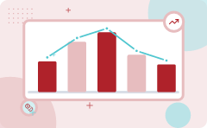
WordNet orders senses by frequency using data from the SemCor corpus
1
2
3
So “most frequent sense”
in WordNet = “take the first sense”
WordNet organizes its senses
in frequency order so that taking the first sense corresponds to the most frequent sense
Example
Example: Selecting the first listed sense in WordNet for a frequently used word
ALSO ON THIS SLIDE
Sense frequencies come from the SemCor corpus These sense frequencies are derived directly from the SemCor corpus. This provides a straightforward baseline for word sense disambiguation.
Key takeaway: 3 steps — from “So “most frequent sense”” to “Example”.
Key terms: Most frequent sense — The primary sense of a word based on WordNet frequency order. · SemCor corpus — The tagged corpus used to supply sense frequencies.
Learnova
37 / 58
Notes:
Reveal, one click at a time:
1. WordNet senses are ordered in frequency order
2. So “most frequent sense” in WordNet = “take the first sense”
3. Sense frequencies come from the SemCor corpus
4. WordNet organizes its senses in frequency order so that taking the first sense corresponds to the most frequent sense.
5. These sense frequencies are derived directly from the SemCor corpus.
6. This provides a straightforward baseline for word sense disambiguation.
7. Example: Selecting the first listed sense in WordNet for a frequently used word.
Read these exactly (do not paraphrase):
- WordNet orders senses by frequency using data from the SemCor corpus WordNet senses are ordered in frequency order So “most frequent sense” in WordNet = “take the first sense” Sense frequencies come from the SemCor corpus WordNet organizes its senses in frequency order so that taking the first sense corresponds to the most frequent sense.
Say what these mean, in your own words:
- Most frequent sense: The primary sense of a word based on WordNet frequency order.
- SemCor corpus: The tagged corpus used to supply sense frequencies.
Pause: ask the class what they already know about “WordNet orders senses by frequency using data from the SemCor corpus” before revealing the slide.
~61s
Ask the class: Explain this slide in your own words, in one sentence.

Slide 39
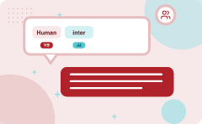
Human inter-annotator agreement provides a ceiling of seventy five to eighty percent
Human inter-annotator agreement
Compare annotations of two humans
On same data
Given same tagging guidelines
Human agreements on all-words corpora with WordNet style senses
75%--80%
ALSO ON THIS SLIDE
On all-words corpora with WordNet-style senses, human agreement typically ranges from seventy five to eighty percent. This serves as a performance ceiling for algorithms. Example: Two humans independently tagging a corpus to measure how often they agree.
Key terms: Human inter-annotator agreement — A comparison of annotations made by different humans on the same data. · Ceiling — The performance limit set by human agreement levels at 75% to 80%.
Learnova
▶ Open the interactive lab: POS Tagging (HMM) Lab
38 / 58
Notes:
Reveal, one click at a time:
1. Human inter-annotator agreement
2. Compare annotations of two humans
3. On same data
4. Given same tagging guidelines
5. Human agreements on all-words corpora with WordNet style senses
6. 75%--80%
7. Human inter-annotator agreement compares annotations made by two humans using the same data and tagging guidelines.
Say what these mean, in your own words:
- Human inter-annotator agreement: A comparison of annotations made by different humans on the same data.
- Ceiling: The performance limit set by human agreement levels at 75% to 80%.
Pause: ask the class what they already know about “Human inter-annotator agreement provides a ceiling of seventy five to eighty percent” before revealing the slide.
~61s
Ask the class: What might explain these numbers?

Slide 40
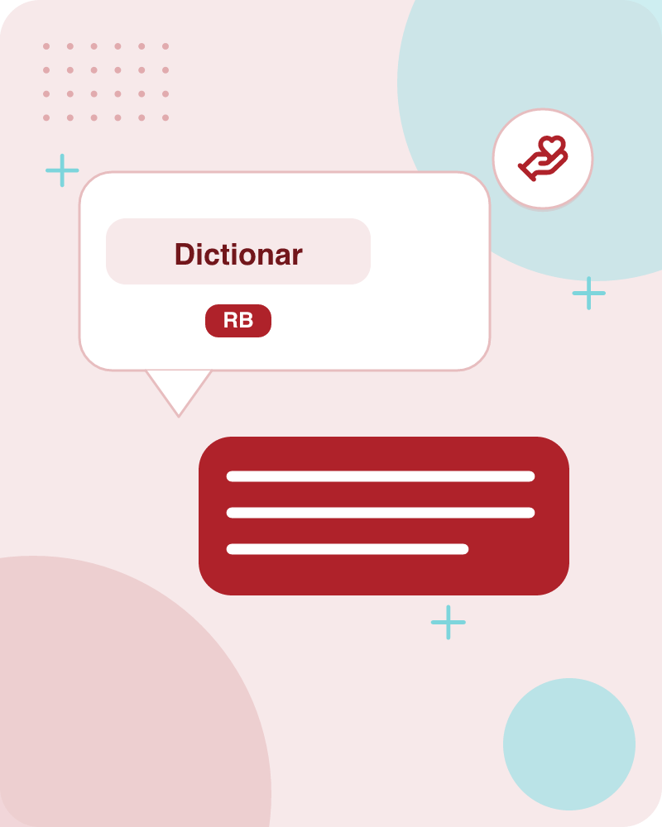
Dictionary and thesaurus methods support word sense disambiguation
Dictionary and.
Thesaurus Methods.
Dictionary and Thesaurus Methods provide foundational lexical resources for disambiguating word senses.
These approaches leverage definitions, examples, and semantic relations found in standard reference texts.
They help determine the correct meaning of a word in context without requiring large training corpora.
Example: Using a dictionary definition to match a word's context.
Key terms: Dictionary methods — Techniques that use lexical definitions to determine word meanings. · Thesaurus methods — Approaches utilizing semantic relations and groupings of synonyms.
Also in this lecture: Choose sense with most word overlap between gloss and context (not counting function words) The bank can guarantee deposits will eventually cover future tuition costs because it invests in adjustable-rate mortgage securities.
Learnova
39 / 58
Notes:
Reveal, one click at a time:
1. Dictionary and
2. Thesaurus Methods
3. Dictionary and Thesaurus Methods provide foundational lexical resources for disambiguating word senses.
4. These approaches leverage definitions, examples, and semantic relations found in standard reference texts.
5. They help determine the correct meaning of a word in context without requiring large training corpora.
6. Example: Using a dictionary definition to match a word's context.
Say what these mean, in your own words:
- Dictionary methods: Techniques that use lexical definitions to determine word meanings.
- Thesaurus methods: Approaches utilizing semantic relations and groupings of synonyms.
Pause: ask the class what they already know about “Dictionary and thesaurus methods support word sense disambiguation” before revealing the slide.
~54s
Ask the class: Explain this slide in your own words, in one sentence.

Slide 41
Checkpoint 8
QUESTION · UNDERSTAND
Which term matches this description: “Techniques that use lexical definitions to determine word meanings.”?
Intrinsic evaluation
Dictionary methods
A
B
Support-vector machine
P(line|f)
C
D
Answer: B
Dictionary methods: Techniques that use lexical definitions to determine word meanings.
Learnova
40 / 58
Notes:
KEY POINT TO LAND: Answer, then check your reasoning.
Pause: ask the class what they already know about “Checkpoint 8” before revealing the slide.
~44s

Slide 42

The simplified Lesk algorithm disambiguates word senses using dictionary glosses and examples
Let’s disambiguate “bank” in this sentence
The bank can guarantee deposits will eventually cover future tuition costs because it invests in adjustable-rate mortgage securities.
Given the following two WordNet senses: bank1
  Gloss:
  a ﬁnancial institution that accepts deposits and channels the money into lending activities
  Examples:
  “he cashed a check at the bank”, “that bank holds the mortgage on my home”
+3 more
IN PLAIN WORDS
The simplified Lesk algorithm helps determine the correct meaning of a word in a sentence by comparing the surrounding context against dictionary glosses and examples. For instance, it can distinguish whether bank refers to a financial institution or sloping land. It evaluates word overlap to select the most appropriate sense. For example, matching words in a sentence about tuition costs to the financial definition of bank.
Key terms: Gloss — The dictionary definition provided for a specific word sense. · Bank — A word with multiple distinct meanings like a financial institution or sloping land.
Learnova
41 / 58
Notes:
Reveal, one click at a time:
1. Let’s disambiguate “bank” in this sentence:
2. The bank can guarantee deposits will eventually cover future tuition costs because it invests in adjustable-rate mortgag
3. given the following two WordNet senses: bank1
4. Gloss:
5. a ﬁnancial institution that accepts deposits and channels the money into lending activities
6. Examples:
7. “he cashed a check at the bank”, “that bank holds the mortgage on my home”
Read these exactly (do not paraphrase):
- given the following two WordNet senses: bank1 Gloss: a ﬁnancial institution that accepts deposits and channels the money into lending activities Examples: “he cashed a check at the bank”, “that bank holds the mortgage on my home” bank2 sloping land (especially the slope beside a body of water) “they pulled the canoe up on the bank”, “he sat on the bank of the river and watched the currents”
Say what these mean, in your own words:
- Gloss: The dictionary definition provided for a specific word sense.
- Bank: A word with multiple distinct meanings like a financial institution or sloping land.
Pause: ask the class what they already know about “The simplified Lesk algorithm disambiguates word senses using dictionary glosses and examples” before revealing the slide.
Wording matters here — slow down, keep it precise.
~61s
Ask the class: Explain this slide in your own words, in one sentence.

Slide 43

The Simplified Lesk algorithm: Choose sense
Bank1
Gloss:
a ﬁnancial institution that accepts deposits and channels the money into lending activities
Examples:
“he cashed a check at the bank”, “that bank holds the mortgage on my home”
Bank2
sloping land (especially the slope beside a body of water)
“they pulled the canoe up on the bank”, “he sat on the bank of the river and watched the currents”
ALSO ON THIS SLIDE
Choose sense with most word overlap between gloss and context (not counting function words) The bank can guarantee deposits will eventually cover future tuition costs because it invests in adjustable-rate mortgage securities.
Learnova
▶ Open the interactive lab: Simplified Lesk Sense‑Selection Lab
42 / 58
Notes:
Reveal, one click at a time:
1. Choose sense with most word overlap between gloss and context
2. (not counting function words)
3. The bank can guarantee deposits will eventually cover future tuition costs because it invests in adjustable-rate mortgag
4. bank1
5. Gloss:
6. a ﬁnancial institution that accepts deposits and channels the money into lending activities
7. Examples:
Read these exactly (do not paraphrase):
- The Simplified Lesk algorithm: Choose sense Choose sense with most word overlap between gloss and context (not counting function words) The bank can guarantee deposits will eventually cover future tuition costs because it invests in adjustable-rate mortgage securities.
- bank1 Gloss: a ﬁnancial institution that accepts deposits and channels the money into lending activities Examples: “he cashed a check at the bank”, “that bank holds the mortgage on my home” bank2 sloping land (especially the slope beside a body of water) “they pulled the canoe up on the bank”, “he sat on the bank of the river and watched the currents”
Pause: ask the class what they already know about “The Simplified Lesk algorithm: Choose sense” before revealing the slide.
Wording matters here — slow down, keep it precise.
~61s
Ask the class: Explain this slide in your own words, in one sentence.

Slide 44

The corpus Lesk algorithm combines sense-labeled data into a signature for overlap
Assumes we have some sense-labeled data (like SemCor)
Now add these to the gloss + examples for each sense, call it the “signature” of a sense.
Choose sense with most word overlap between context and signature.
Take all the sentences with the relevant word sense
These short, "streamlined" meetings usually are sponsored by local banks1, Chambers of Commerce, trade associations, or other civic organizations.
IN PLAIN WORDS
The corpus Lesk algorithm uses sense-labeled data to gather all sentences associated with a specific word sense. It adds these sentences to the dictionary gloss and examples to create a comprehensive signature for that sense. The algorithm then chooses the sense with the most word overlap between the context and the signature. For example, combining meeting sentences with dictionary glosses to form a sense signature.
Key terms: Signature — The combined set of glosses, examples, and labeled sentences for a word sense. · Word overlap — The count of shared words between a sentence context and a sense signature.
Learnova
43 / 58
Notes:
Reveal, one click at a time:
1. Assumes we have some sense-labeled data (like SemCor)
2. Take all the sentences with the relevant word sense:
3. These short, "streamlined" meetings usually are sponsored by local banks1, Chambers of Commerce, trade associations, or
4. Now add these to the gloss + examples for each sense, call it the “signature” of a sense.
5. Choose sense with most word overlap between context and signature.
Read these exactly (do not paraphrase):
- The corpus Lesk algorithm combines sense-labeled data into a signature for overlap Assumes we have some sense-labeled data (like SemCor) Take all the sentences with the relevant word sense: These short, "streamlined" meetings usually are sponsored by local banks1, Chambers of Commerce, trade associations, or other civic organizations.
Say what these mean, in your own words:
- Signature: The combined set of glosses, examples, and labeled sentences for a word sense.
- Word overlap: The count of shared words between a sentence context and a sense signature.
Pause: ask the class what they already know about “The corpus Lesk algorithm combines sense-labeled data into a signature for overlap” before revealing the slide.
~47s
Ask the class: Explain this slide in your own words, in one sentence.

Slide 45
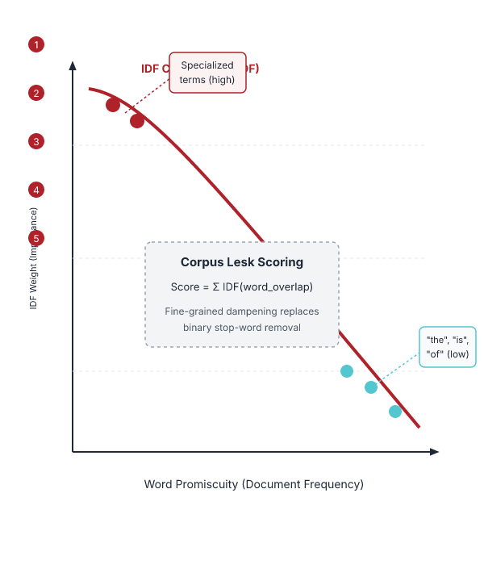
Inverse document frequency weighting improves word overlap calculations in corpus Lesk
Instead of just removing function words.
Weigh each word by its `promiscuity’ across documents.
Down-weights words that occur in every `document’ (gloss, example, etc).
These are generally function words, but is a more fine-grained measure.
Weigh each overlapping word by inverse document frequency.
Corpus Lesk uses inverse document frequency to weigh overlapping words rather than simply removing function words.
This fine-grained measure down-weights promiscuous words that appear in every document or gloss.
SO Consequently, important content words receive higher emphasis during sense disambiguation.
Example: Down-weighting common words that appear across all glosses and examples.
Key terms: Inverse document frequency — A measure that weighs overlapping words by their promiscuity across documents. · Promiscuity — The tendency of certain words to occur frequently across every document or gloss.
Learnova
44 / 58
Notes:
Reveal, one click at a time:
1. Instead of just removing function words
2. Weigh each word by its `promiscuity’ across documents
3. Down-weights words that occur in every `document’ (gloss, example, etc)
4. These are generally function words, but is a more fine-grained measure
5. Weigh each overlapping word by inverse document frequency
6. Corpus Lesk uses inverse document frequency to weigh overlapping words rather than simply removing function words.
7. This fine-grained measure down-weights promiscuous words that appear in every document or gloss.
Read these exactly (do not paraphrase):
- Inverse document frequency weighting improves word overlap calculations in corpus Lesk Instead of just removing function words Weigh each word by its `promiscuity’ across documents Down-weights words that occur in every `document’ (gloss, example, etc) These are generally function words, but is a more fine-grained measure Weigh each overlapping word by inverse document frequency Corpus Lesk uses inverse document frequency to weigh overlapping words rather than simply removing function words.
Say what these mean, in your own words:
- Inverse document frequency: A measure that weighs overlapping words by their promiscuity across documents.
- Promiscuity: The tendency of certain words to occur frequently across every document or gloss.
Pause: ask the class what they already know about “Inverse document frequency weighting improves word overlap calculations in corpus Lesk” before revealing the slide.
~61s
Ask the class: Explain this slide in your own words, in one sentence.

Slide 46
Checkpoint 9
QUESTION · UNDERSTAND
Which term matches this description: “A measure that weighs overlapping words by their promiscuity across documents.”?
Inverse document frequency
POS
A
B
wsj
Sense Translation
C
D
Answer: A
Inverse document frequency: A measure that weighs overlapping words by their promiscuity across documents.
Learnova
45 / 58
Notes:
KEY POINT TO LAND: Answer, then check your reasoning.
Pause: ask the class what they already know about “Checkpoint 9” before revealing the slide.
~44s

Slide 47
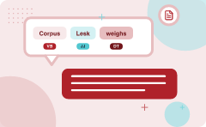
Corpus Lesk weighs overlapping words by inverse document frequency
1
Weigh each overlapping word by inverse document frequency
2
N is the total number of documents
3
idfi = log N
4
dfi = “document frequency of word i”
5
= # of documents with word I
6
dfi
7
score(sensei, contextj) =
8
idfw
Key terms: inverse document frequency — A measure of how common a word is across documents, higher for rarer words. · sense signature — A set of words that typically appear with a particular sense of a target word.
Learnova
46 / 58
Notes:
Reveal, one click at a time:
1. Weigh each overlapping word by inverse document frequency
2. N is the total number of documents
3. idfi = log N
4. dfi = “document frequency of word i”
5. = # of documents with word I
6. dfi
7. score(sensei, contextj) =
8. idfw
9. w ∈ overlap(signaturei, contextj)
10. The method assigns a weight to each word that appears in both the sense signature and the context.
11. The weight is the inverse document frequency, calculated as the logarithm of the total number of documents divided by th
12. This gives higher importance to rare words that better distinguish senses.
13. Example: If the word "bank" appears in a context about finance but not in many documents, it receives a high weight.
Read these exactly (do not paraphrase):
- Corpus Lesk weighs overlapping words by inverse document frequency Weigh each overlapping word by inverse document frequency N is the total number of documents idfi = log N dfi = “document frequency of word i” = # of documents with word I dfi score(sensei, contextj) = idfw w ∈ overlap(signaturei, contextj) The method assigns a weight to each word that appears in both the sense signature and the context.
Say what these mean, in your own words:
- inverse document frequency: A measure of how common a word is across documents, higher for rarer words.
- sense signature: A set of words that typically appear with a particular sense of a target word.
Pause: ask the class what they already know about “Corpus Lesk weighs overlapping words by inverse document frequency” before revealing the slide.
~103s
Ask the class: Explain this slide in your own words, in one sentence.

Slide 48
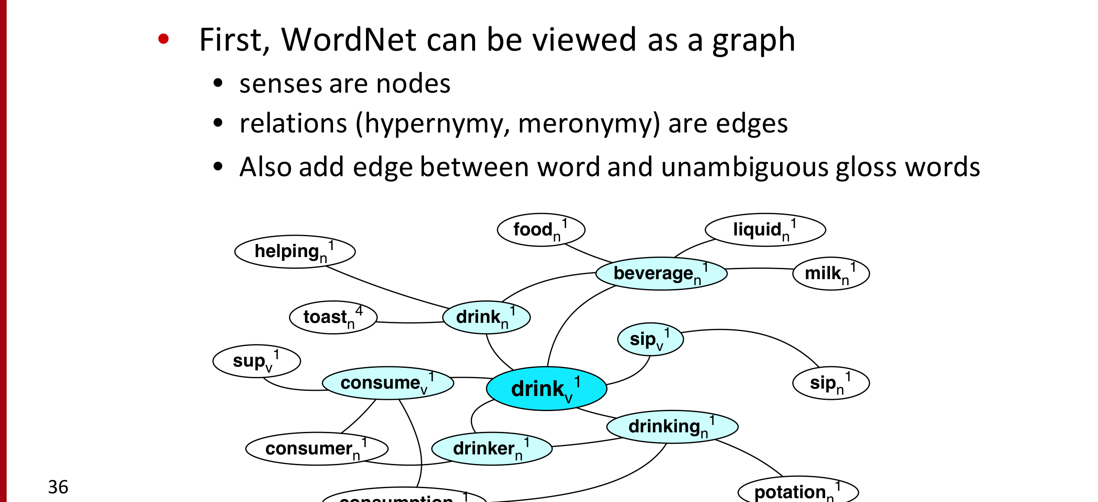
Graph-based methods represent WordNet as a graph of senses and relations
First, WordNet can be viewed as a graph.
senses are nodes.
relations (hypernymy, meronymy) are edges.
ALSO Also add edge between word and unambiguous gloss words.
E.G. WordNet can be modeled as a graph where each node is a sense and edges encode semantic relations such as hypernymy and meronymy.
Additional edges connect a word to unambiguous gloss words, linking senses to concrete terms.
This structure allows algorithms to traverse and analyze semantic relationships.
Example: The sense of "drink" is connected to the gloss word "consume" through a direct edge.
Key terms: hypernymy — A 'is-a' relationship where one concept is a more general category of another. · meronymy — A part-whole relationship between two concepts.
Learnova
47 / 58
Notes:
Reveal, one click at a time:
1. First, WordNet can be viewed as a graph
2. senses are nodes
3. relations (hypernymy, meronymy) are edges
4. Also add edge between word and unambiguous gloss words
5. foodn
6. liquidn
7. helpingn
Read these exactly (do not paraphrase):
- Graph-based methods represent WordNet as a graph of senses and relations First, WordNet can be viewed as a graph senses are nodes relations (hypernymy, meronymy) are edges Also add edge between word and unambiguous gloss words foodn liquidn helpingn beveragen milkn toastn drinkn sipv supv consumev sipn drinkv drinkingn consumern drinkern potationn consumptionn WordNet can be modeled as a graph where each node is a sense and edges encode semantic relations such as hypernymy and meronymy.
- Example: The sense of "drink" is connected to the gloss word "consume" through a direct edge.
Say what these mean, in your own words:
- hypernymy: A 'is-a' relationship where one concept is a more general category of another.
- meronymy: A part-whole relationship between two concepts.
Pause: ask the class what they already know about “Graph-based methods represent WordNet as a graph of senses and relations” before revealing the slide.
Wording matters here — slow down, keep it precise.
~61s
Ask the class: Explain this slide in your own words, in one sentence.

Slide 49

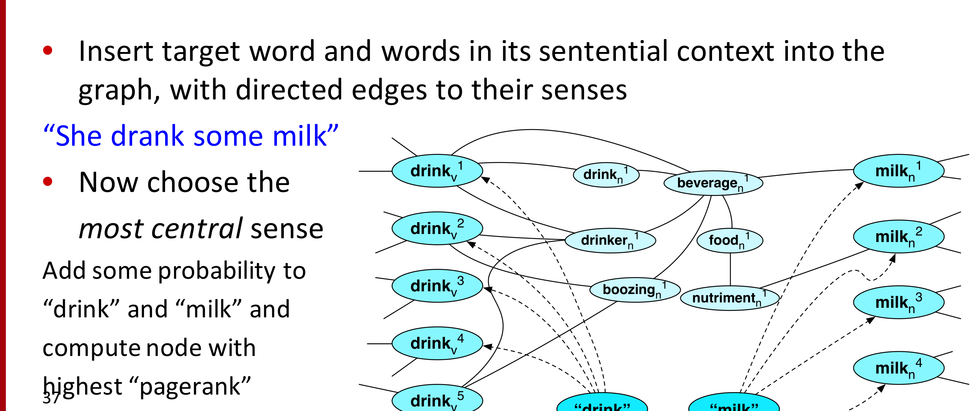

Using the graph for WSD by inserting context and computing centrality
Insert target word and words in its sentential context into the
graph, with directed edges to their senses
“She drank some milk”
Now choose the
most central sense
Add some probability to
IN PLAIN WORDS
To disambiguate a target word, its senses and the words from the sentence are added to the graph with directed edges to their senses. The algorithm then calculates a centrality score, such as PageRank, for each sense. The sense with the highest score is chosen as the most likely meaning. For example, in "She drank some milk", the sense of "drink" linked to "milk" receives the highest PageRank.
drinkv milkn drinkn beveragen
Key terms: PageRank — A centrality measure that ranks nodes based on incoming link importance.
Learnova
48 / 58
Notes:
Reveal, one click at a time:
1. Insert target word and words in its sentential context into the
2. graph, with directed edges to their senses
3. “She drank some milk”
4. Now choose the
5. drinkv
6. milkn
7. drinkn
Read these exactly (do not paraphrase):
- Using the graph for WSD by inserting context and computing centrality Insert target word and words in its sentential context into the graph, with directed edges to their senses “She drank some milk” Now choose the drinkv milkn drinkn beveragen most central sense drinkv milkn drinkern foodn Add some probability to drinkv boozingn “drink” and “milk” and nutrimentn milkn compute node with drinkv milkn highest “pagerank” drinkv “drink” “milk”
Say what these mean, in your own words:
- PageRank: A centrality measure that ranks nodes based on incoming link importance.
Pause: ask the class what they already know about “Using the graph for WSD by inserting context and computing centrality” before revealing the slide.
Wording matters here — slow down, keep it precise.
~61s
Ask the class: Which step would break the whole process if it failed — and why?

Slide 50
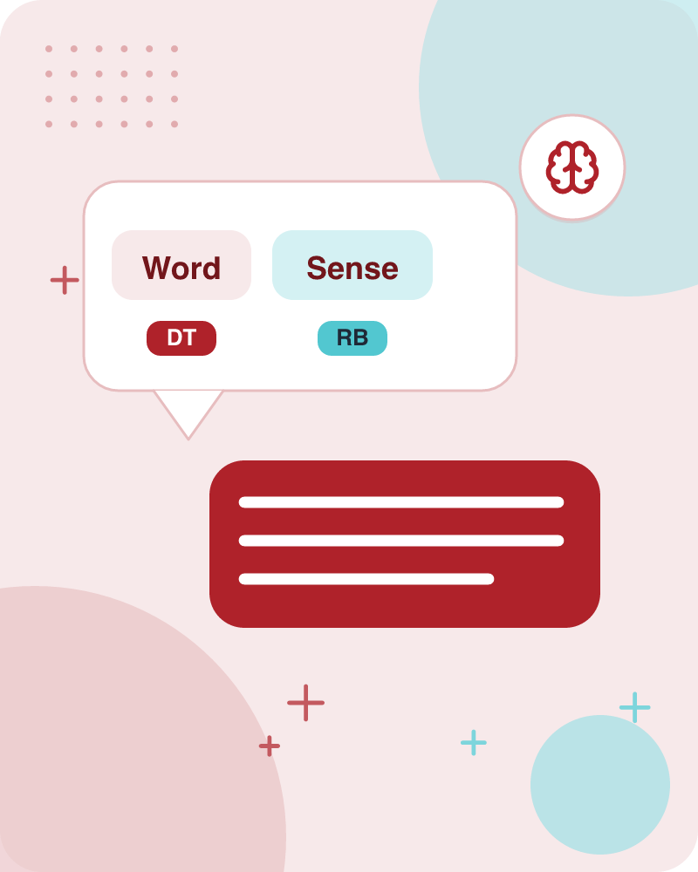
Word Sense Disambiguation (5)
Semi-Supervised.
Learning.
Also in this lecture: For bass Rely on “One sense per collocation” rule A word reoccurring in collocation with the same word will almost surely have the same sense.
Learnova
49 / 58
Notes:
Reveal, one click at a time:
1. Semi-Supervised
2. Learning
Read these exactly (do not paraphrase):
- Word Sense Disambiguation (5) Semi-Supervised Learning
Pause: ask the class what they already know about “Word Sense Disambiguation (5)” before revealing the slide.
Wording matters here — slow down, keep it precise.
~26s
Ask the class: Explain this slide in your own words, in one sentence.

Slide 51
Checkpoint 10
QUESTION · UNDERSTAND
Which term matches this description: “A centrality measure that ranks nodes based on incoming link importance.”?
training set
Human inter-annotator agreement
A
B
bag-of-words feature
PageRank
C
D
Answer: D
PageRank: A centrality measure that ranks nodes based on incoming link importance.
Learnova
50 / 58
Notes:
KEY POINT TO LAND: Answer, then check your reasoning.
Pause: ask the class what they already know about “Checkpoint 10” before revealing the slide.
~44s

Slide 52

Semi-supervised learning bootstraps WSD from a small seed set
Problem
supervised and dictionary-based approaches require large hand-built resources
Solution
Bootstrapping
Example
A seed set containing the sense of "bass" in music can be expanded to include other musical contexts
ALSO ON THIS SLIDE
What if you don’t have so much training data? Generalize from a very small hand-labeled seed-set. When large labeled corpora are unavailable, semi-supervised learning starts with a tiny hand-labeled seed set. The algorithm iteratively expands this set by applying rules and patterns, gradually improving its coverage without requiring extensive manual annotation.
Key terms: bootstrapping — A learning approach that builds larger datasets from a small initial labeled set.
Learnova
51 / 58
Notes:
Reveal, one click at a time:
1. Problem: supervised and dictionary-based approaches require large hand-built resources
2. What if you don’t have so much training data?
3. Solution: Bootstrapping
4. Generalize from a very small hand-labeled seed-set.
5. When large labeled corpora are unavailable, semi-supervised learning starts with a tiny hand-labeled seed set.
6. The algorithm iteratively expands this set by applying rules and patterns, gradually improving its coverage without requ
7. Example: A seed set containing the sense of "bass" in music can be expanded to include other musical contexts.
Say what these mean, in your own words:
- bootstrapping: A learning approach that builds larger datasets from a small initial labeled set.
Pause: ask the class what they already know about “Semi-supervised learning bootstraps WSD from a small seed set” before revealing the slide.
~61s
Ask the class: Explain this slide in your own words, in one sentence.

Slide 53
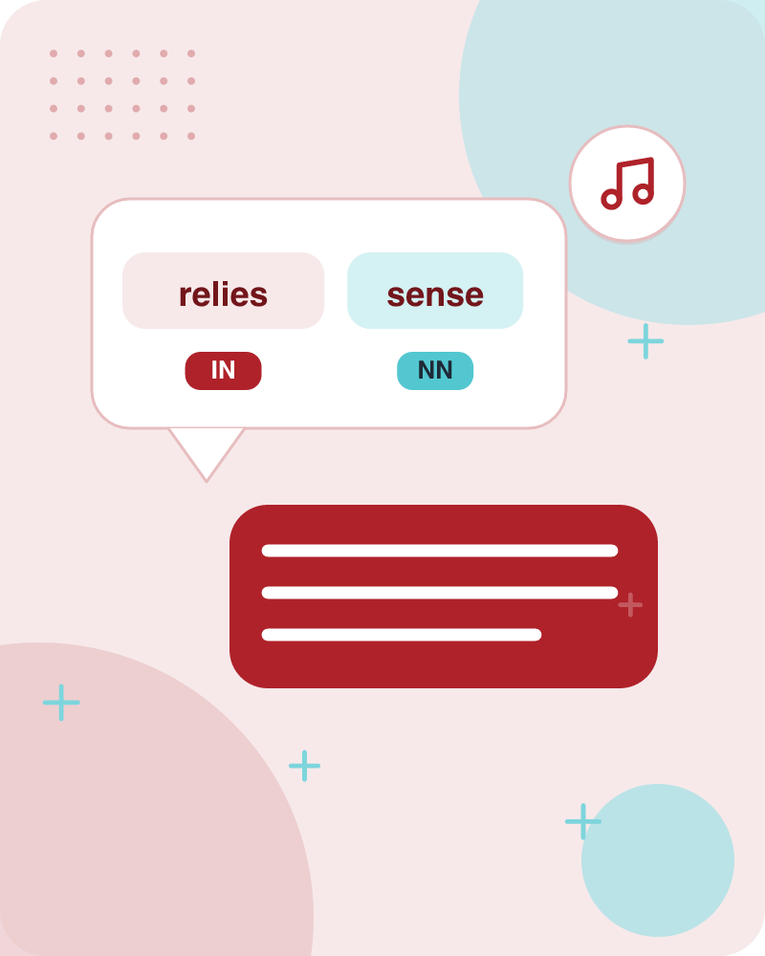
Bootstrapping relies on the one-sense-per-collocation rule
Bass
For bass
Rely on “One sense per collocation” rule
Word reoccurring
A word reoccurring in collocation with the same word will almost surely have the same sense
Word play occurs
the word play occurs with the music sense of bass
IN PLAIN WORDS
The rule states that a word appearing in the same collocation with another word will almost always have the same sense. By identifying frequent collocations, the algorithm can assign senses to new occurrences with high confidence. For example, the word "bass" collocates with "music" to indicate the musical sense, not the fish sense.
Key terms: collocation — A pair or group of words that frequently appear together.
Learnova
▶ Open the interactive lab: Bootstrapping relies on the one-sense-per-collocation rule — step-through
52 / 58
Notes:
Reveal, one click at a time:
1. For bass
2. Rely on “One sense per collocation” rule
3. A word reoccurring in collocation with the same word will almost surely have the same sense.
4. the word play occurs with the music sense of bass
5. the word fish occurs with the fish sense of bass
Read these exactly (do not paraphrase):
- Bootstrapping relies on the one-sense-per-collocation rule For bass Rely on “One sense per collocation” rule A word reoccurring in collocation with the same word will almost surely have the same sense.
Say what these mean, in your own words:
- collocation: A pair or group of words that frequently appear together.
Pause: ask the class what they already know about “Bootstrapping relies on the one-sense-per-collocation rule” before revealing the slide.
Wording matters here — slow down, keep it precise.
~47s
Ask the class: Explain this slide in your own words, in one sentence.

Slide 54

Sentences containing "fish" and "play" illustrate collocation-based sense assignment
We need more good teachers – right now, there are only a half a dozen who can play the free bass with ease.
An electric guitar and bass player stand off to one side, not really part of the scene, just as a sort of nod to gringo expectations perhaps.
The researchers said the worms spend part of their life cycle in such ﬁsh as Paciﬁc salmon and striped bass and Paciﬁc rockﬁsh or snapper.
And it all started when ﬁshermen decided the striped bass in Lake Mead were too skinny.
IN PLAIN WORDS
These sentences show how the word "fish" appears in contexts related to music and biology. By observing the collocated words, one can infer whether "fish" refers to the animal or the musical instrument. This demonstrates the practical application of the one-sense-per-collocation rule. For example, "The bass player played the fish" could be interpreted as a musical reference.
Learnova
53 / 58
Notes:
Reveal, one click at a time:
1. We need more good teachers – right now, there are only a half a dozen who can play the free bass with ease.
2. An electric guitar and bass player stand off to one side, not really part of the scene, just as a sort of nod to gringo
3. The researchers said the worms spend part of their life cycle in such ﬁsh as Paciﬁc salmon and striped bass and Paciﬁc r
4. And it all started when ﬁshermen decided the striped bass in Lake Mead were too skinny.
Pause: ask the class what they already know about “Sentences containing "fish" and "play" illustrate collocation-based sense assignment” before revealing the slide.
~40s
Ask the class: Explain this slide in your own words, in one sentence.

Slide 55

Generating seeds combines hand labeling with collocation and discourse rules
1) Hand labeling 2) “One sense per collocation”
A word reoccurring in collocation with the same word will almost surely have the same sense.
3) “One sense per discourse”
The sense of a word is highly consistent within a document -- Yarowsky (1995)
(At least for non-function words, and especially topic-specific words)
IN PLAIN WORDS
Seed sets are created by manually labeling a few instances, then applying the one-sense-per-collocation rule and the one-sense-per-discourse rule. The latter assumes a word maintains the same sense throughout a document, especially for content words. These combined methods produce a robust initial dataset. For example, in a news article about fishing, all occurrences of "bass" are likely the fish sense.
Key terms: one-sense-per-discourse — Assumption that a word keeps the same sense within a single document.
Learnova
54 / 58
Notes:
Reveal, one click at a time:
1. 1) Hand labeling 2) “One sense per collocation”:
2. A word reoccurring in collocation with the same word will almost surely have the same sense.
3. 3) “One sense per discourse”:
4. The sense of a word is highly consistent within a document -- Yarowsky (1995)
5. (At least for non-function words, and especially topic-specific words)
Read these exactly (do not paraphrase):
- Generating seeds combines hand labeling with collocation and discourse rules 1) Hand labeling 2) “One sense per collocation”: A word reoccurring in collocation with the same word will almost surely have the same sense.
- 3) “One sense per discourse”: The sense of a word is highly consistent within a document -- Yarowsky (1995) (At least for non-function words, and especially topic-specific words)
Say what these mean, in your own words:
- one-sense-per-discourse: Assumption that a word keeps the same sense within a single document.
Pause: ask the class what they already know about “Generating seeds combines hand labeling with collocation and discourse rules” before revealing the slide.
Wording matters here — slow down, keep it precise.
~47s
Ask the class: Explain this slide in your own words, in one sentence.

Slide 56
Checkpoint 11
QUESTION · UNDERSTAND
Which term matches this description: “Assumption that a word keeps the same sense within a single document.”?
classifier
Class
A
B
one-sense-per-discourse
Gloss
C
D
Answer: C
one-sense-per-discourse: Assumption that a word keeps the same sense within a single document.
Learnova
55 / 58
Notes:
KEY POINT TO LAND: Answer, then check your reasoning.
Pause: ask the class what they already know about “Checkpoint 11” before revealing the slide.
~44s

Slide 57
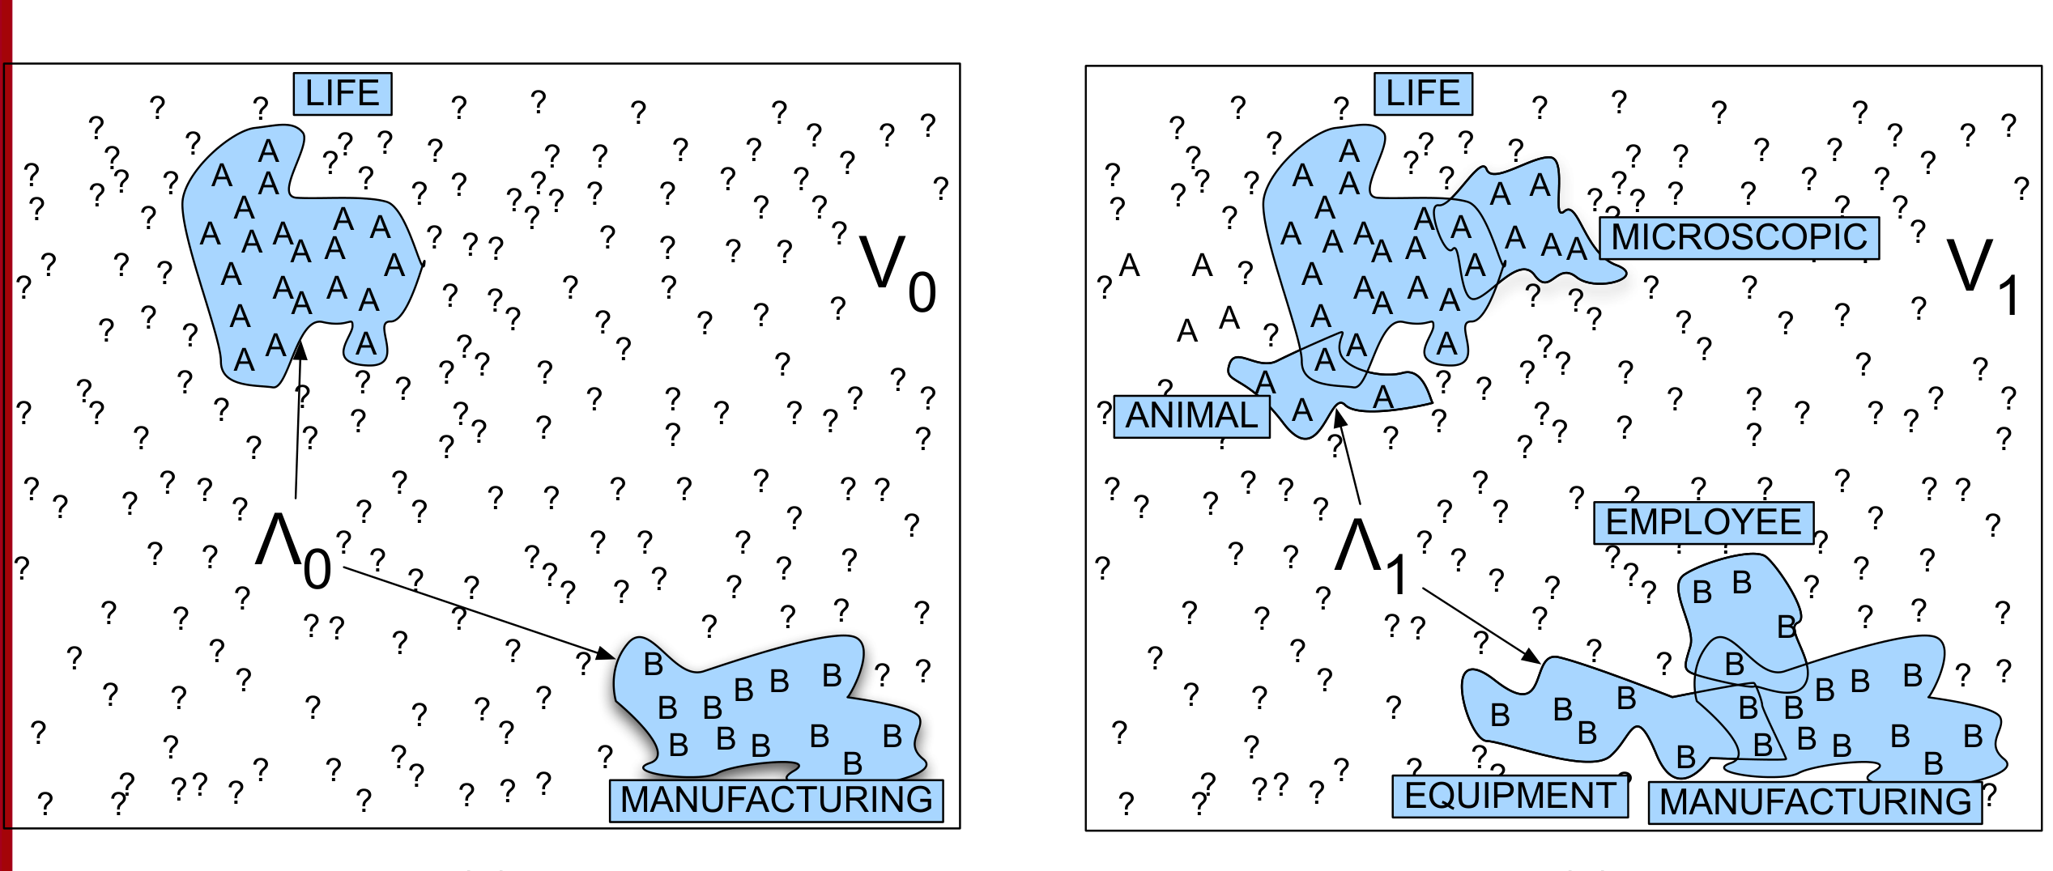
Yarowsky bootstrapping stages for the word "plant" illustrate iterative sense expansion
0
V
V0
1
V
V1
IN PLAIN WORDS
The algorithm alternates between labeling new instances and updating sense assignments. Starting from a seed set, it expands by applying rules, then revises labels based on newly added data. This iterative process gradually builds a comprehensive sense inventory for the target word. For example, initially labeling "plant" as a living organism, then adding new contexts like "plant a seed".
ANIMAL EMPLOYEE
Key takeaway: Headline: 0 — v.
Key terms: Yarowsky algorithm — A semi-supervised bootstrapping method for word sense disambiguation.
Learnova
56 / 58
Notes:
Reveal, one click at a time:
1. LIFE
2. LIFE
3. ? ?
4. ? ?
5. MICROSCOPIC
6. V0
7. V1
Full detail (from the source):
- LIFE - LIFE - ?
?
- ?
?
- MICROSCOPIC - V0 - V1 - ?
?
- ?
?
Say what these mean, in your own words:
- Yarowsky algorithm: A semi-supervised bootstrapping method for word sense disambiguation.
~61s
Ask the class: What might explain these numbers?

Slide 58
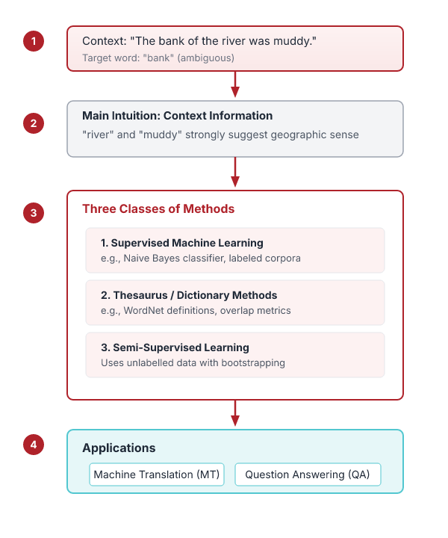

Word Sense Disambiguation
Word Sense Disambiguation
choosing correct sense in context
Applications
MT, QA, etc
Supervised Machine Learning
Naive Bayes classifier
IN PLAIN WORDS
WSD selects the correct sense of a word in context. Supervised methods use labeled data, dictionary-based methods rely on lexical resources, and semi-supervised methods start with a small seed set and expand it. Simple count-based algorithms can perform surprisingly well. For example, a Naive Bayes classifier can disambiguate "bank" as financial or riverbank using word counts.
Three classes of Methods Thesaurus/Dictionary Methods Semi-Supervised Learning Main intuition
Key terms: Naive Bayes classifier — A probabilistic model that predicts sense based on word frequency.
Learnova
57 / 58
Notes:
Reveal, one click at a time:
1. Word Sense Disambiguation: choosing correct sense in context
2. Applications: MT, QA, etc.
3. Three classes of Methods
4. Supervised Machine Learning: Naive Bayes classifier
5. Thesaurus/Dictionary Methods
6. Semi-Supervised Learning
7. Main intuition
Say what these mean, in your own words:
- Naive Bayes classifier: A probabilistic model that predicts sense based on word frequency.
Pause: ask the class what they already know about “Word Sense Disambiguation” before revealing the slide.
~61s
Ask the class: Explain this slide in your own words, in one sentence.

Slide 59

Key takeaways
Word Sense Disambiguation (WSD): Given
8 senses of “bass” in WordNet: 1. bass -- (the lowest part of the musical range) 2
Two kinds of features in the vectors: Collocational features and bag-of-words features
Simplified Lesk algorithm:
The Simplified Lesk algorithm: Choose sense with most word overlap between gloss and context
Learnova
58 / 58
Notes:
Reveal, one click at a time:
1. Word Sense Disambiguation (WSD): Given
2. 8 senses of “bass” in WordNet: 1. bass -- (the lowest part of the musical range) 2.
3. Two kinds of features in the vectors: Collocational features and bag-of-words features
4. Word Sense Disambiguation (2): Classification
5. Word Sense Disambiguation (3): Evaluations and
6. The Simplified Lesk algorithm: Choose sense with most word overlap between gloss and context
7. Word Sense Disambiguation (5): Semi-Supervised
Read these exactly (do not paraphrase):
- Key takeaways Word Sense Disambiguation (WSD): Given 8 senses of “bass” in WordNet: 1.
- bass -- (the lowest part of the musical range) 2.
- Two kinds of features in the vectors: Collocational features and bag-of-words features Word Sense Disambiguation (2): Classification Word Sense Disambiguation (3): Evaluations and The Simplified Lesk algorithm: Choose sense with most word overlap between gloss and context Word Sense Disambiguation (5): Semi-Supervised
Pause: ask the class what they already know about “Key takeaways” before revealing the slide.
Wording matters here — slow down, keep it precise.
~61s

Slide 60
Thank you
Questions?

