Slide 1
Regression
Dr. Mrunal Rane

Slide 2
Syllabus
Linear Regression
Gradient Descent
Lasso and Ridge Regression
Polynomial Regression
Logistic Regression
Maximum Likelihood Function

Slide 3
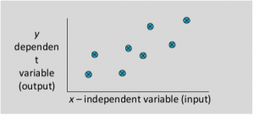
Regression
Is Supervised or Unsupervised?
What is the basic requirement of Supervised learning?
What is Regression?
  Regression is a supervised machine learning technique which is used to predict continuous values.
  Regression analysis is a set of statistical methods used for the estimation of relationships between a dependent variable and one or more independent variables.
  It can be utilized to assess the strength of the relationship between variables and for modeling the future relationship between them.

Slide 4
Which of the following is a regression task?ch of the following is a regression task?
1
2
3
Predict age of a person
Predict the country from where the person comes from
Predicting whether stock price of a company will increase tomorrow

Slide 5
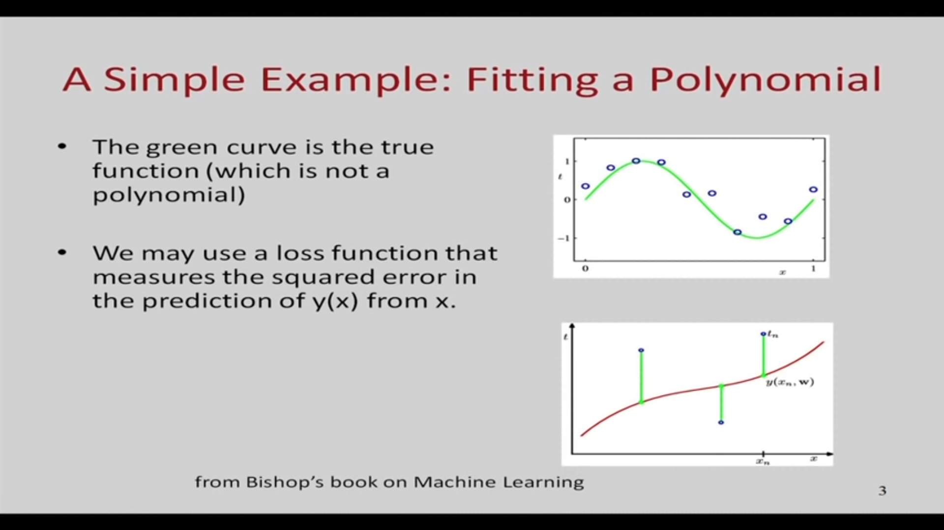

Slide 6
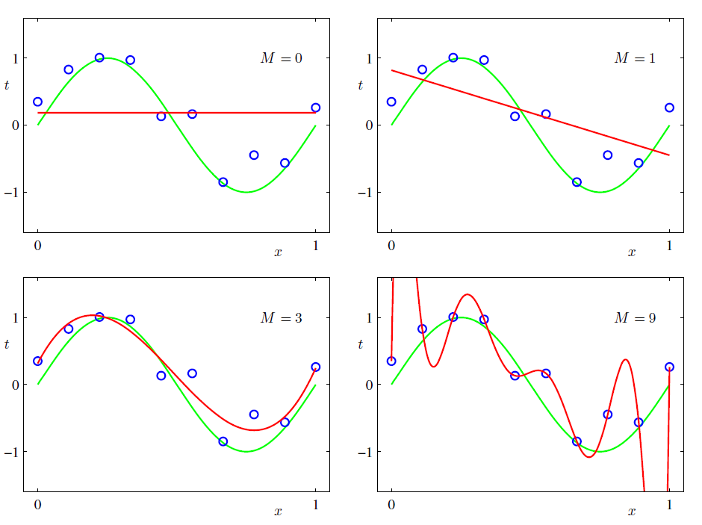
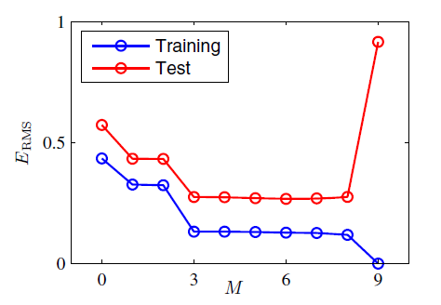
Some fits to the data : which is the best?

Slide 7
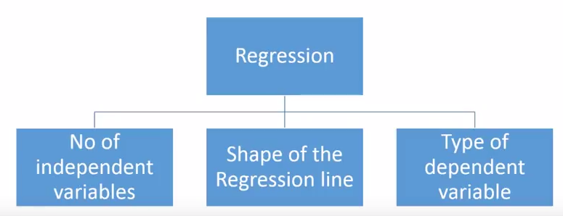
Types of regression models

Slide 8
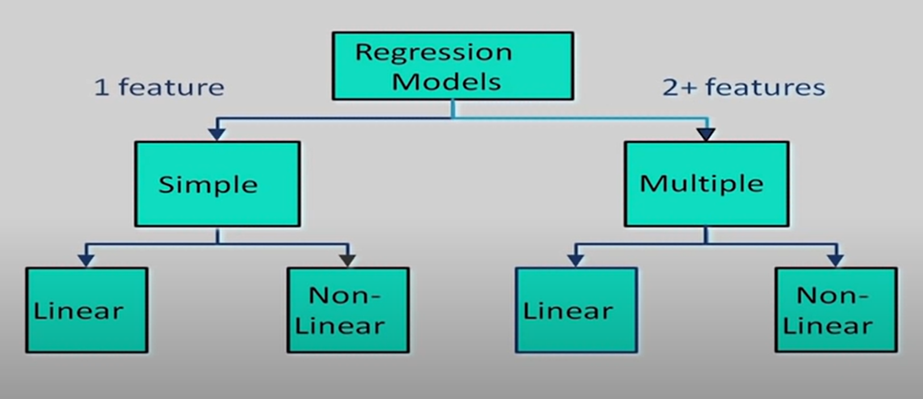
Types of regression models

Slide 9
Housing Prices
Price
Size (feet²)
Supervised Learning
Given the “right answer” for each example in the data.
Regression Problem
Predict real-valued output

Slide 10
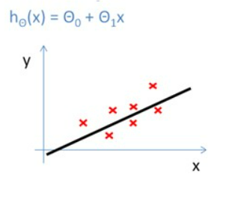
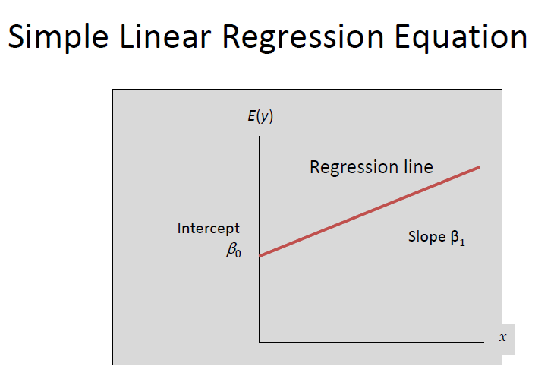
Training Set
How do we represent h ?
Learning Algorithm
Size of house
h
Estimated price
Linear regression with one variable.
Univariate linear regression.

Slide 11
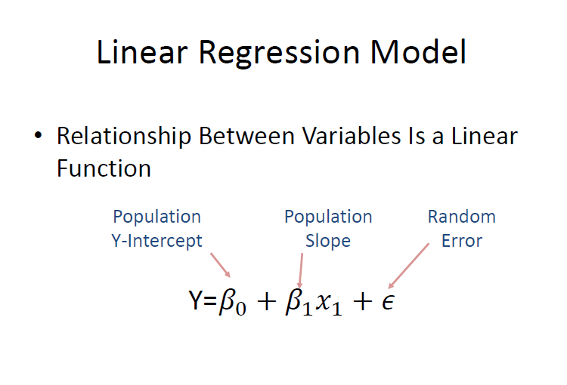

Slide 12
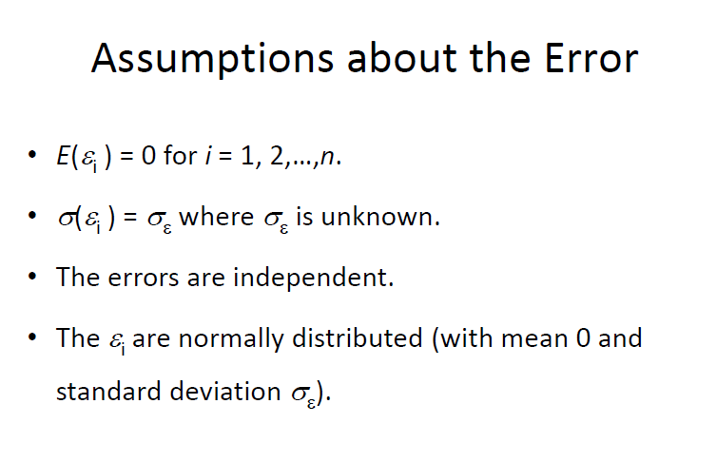
Assumptions about the error

Slide 13
Training Set
Size in feet² (x) | Price ($) in 1000's (y)
2104 | 460
1416 | 232
1534 | 315
852 | 178
… | …
Hypothesis:
h_{b,w}(x)= b+wx
b,w
‘s: Parameters
How to choose ‘s ?
b,w

Slide 14
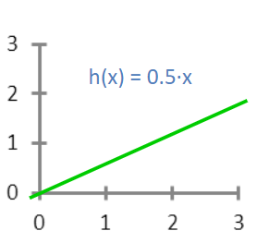
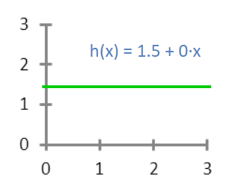
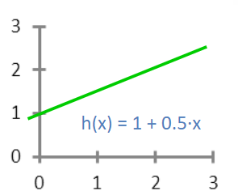
h_{b,w}(x)= b+wx
b = 1.5
w = 0
b = 0
w = 0.5
b = 1
w = 0.5

Slide 15
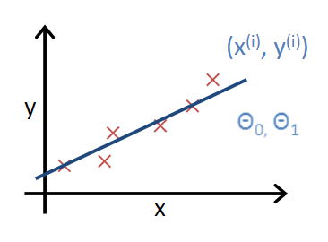
y
x
Choose b, w so that h_{b,w}(x) is close to y for training examples (x,y)

Slide 16
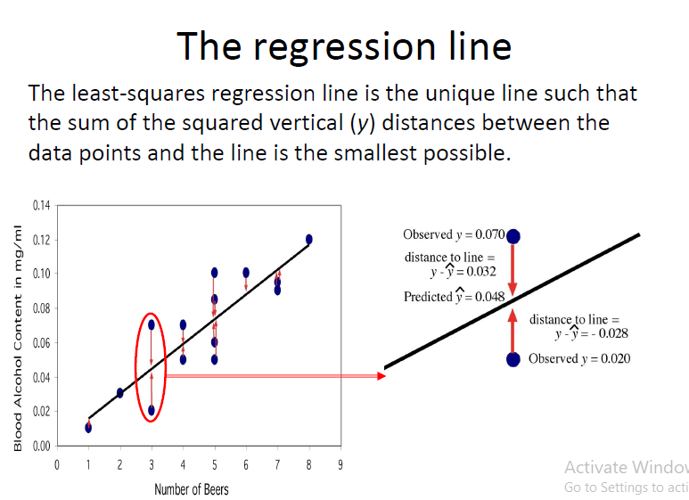

Slide 17
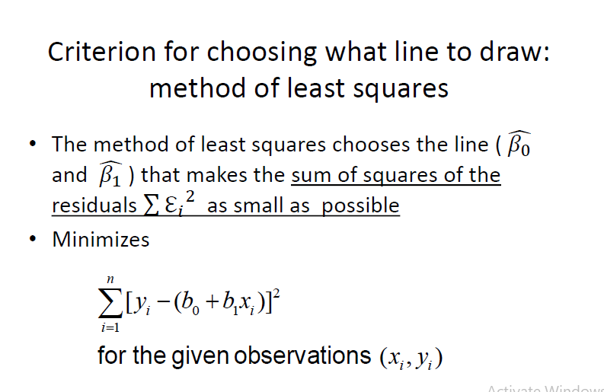

Slide 18
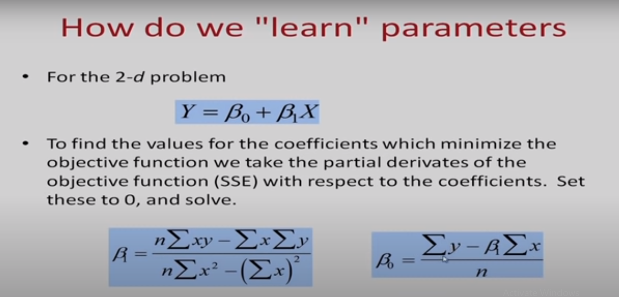
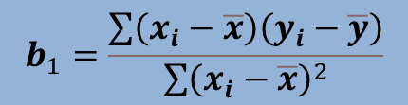
$$b_{1}=\frac{\sum{\left(x_{i}−\overline{x}\right)\left(y_{i}−\overline{y}\right)}}{\sum{{\left(x_{i}−\overline{x}\right)}^{2}}}$$

Slide 19
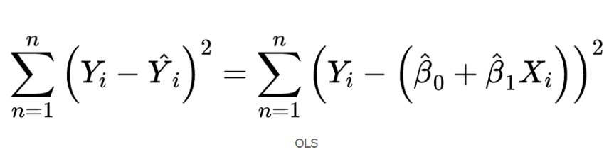
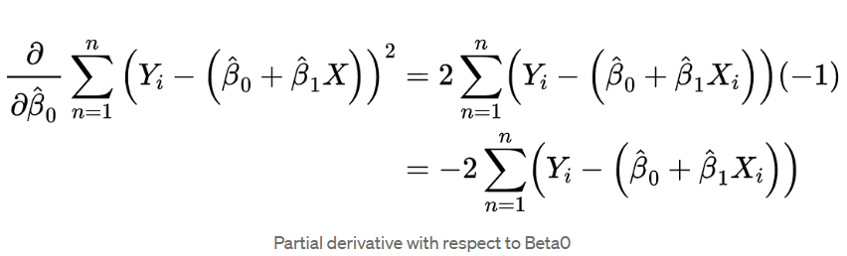
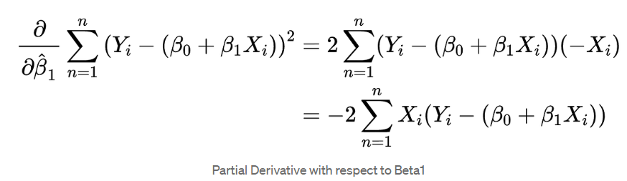

Slide 20
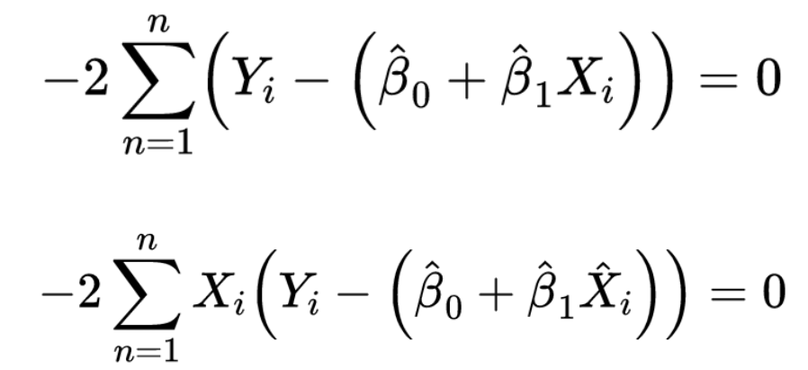
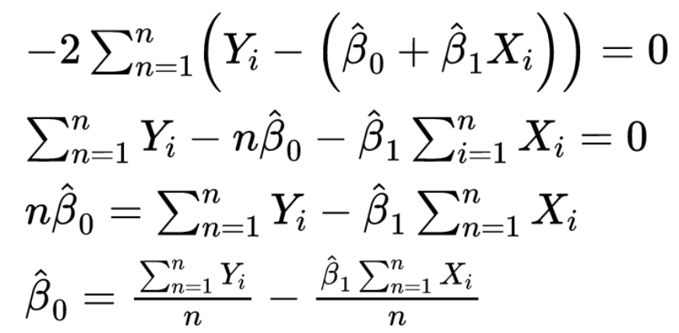

Slide 21
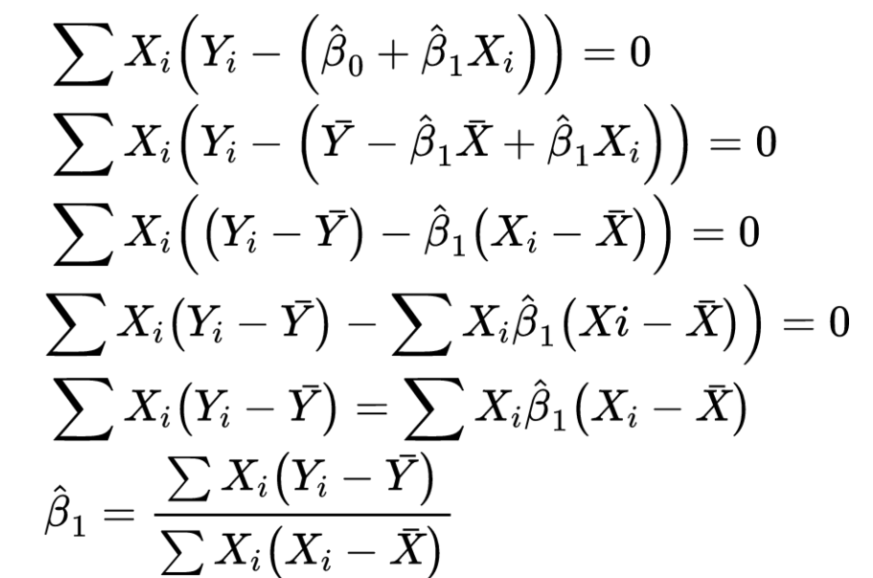

Slide 22
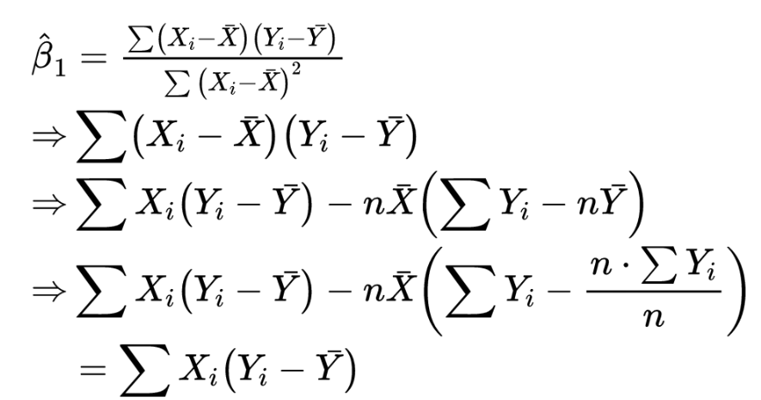

Slide 23
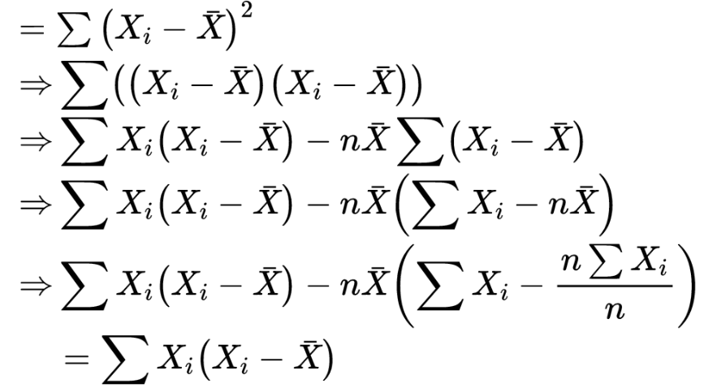

Slide 24
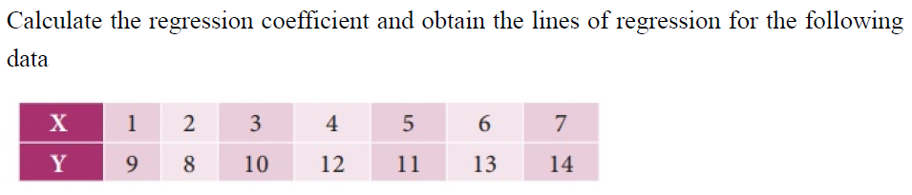
Example

Slide 25
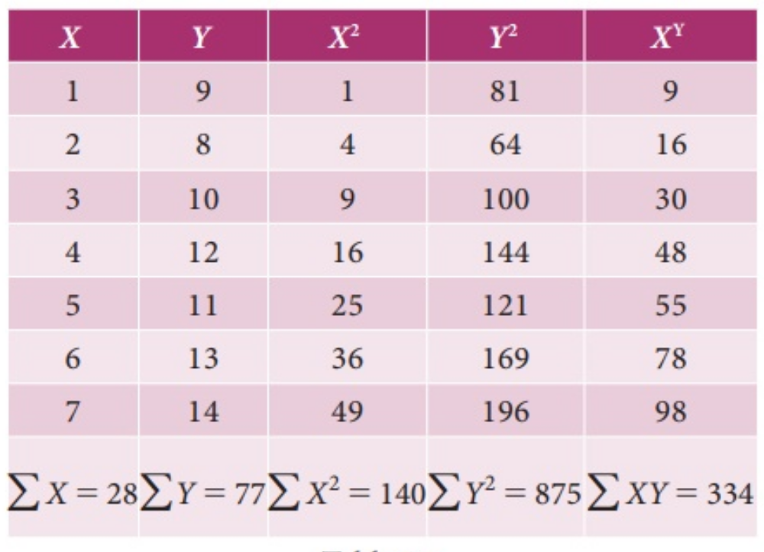
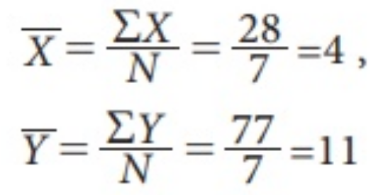
XY

Slide 26
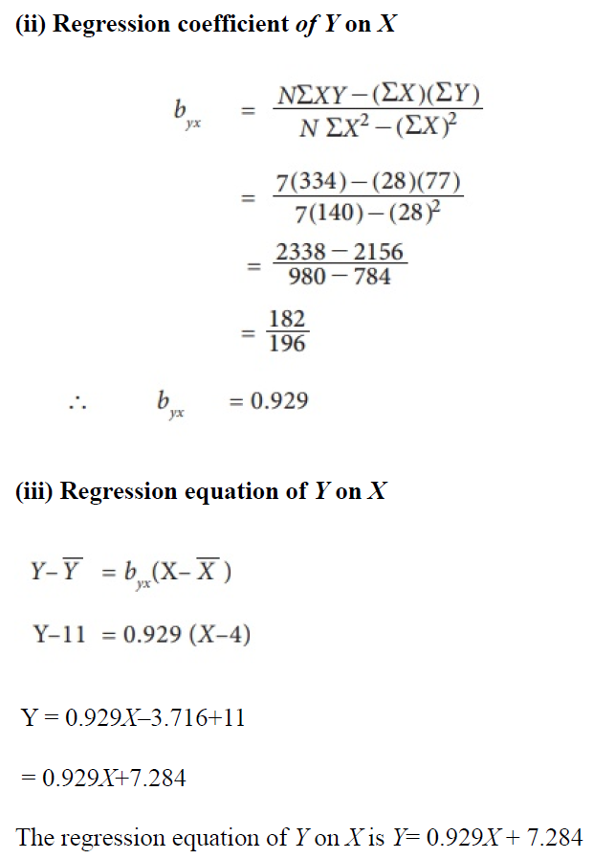
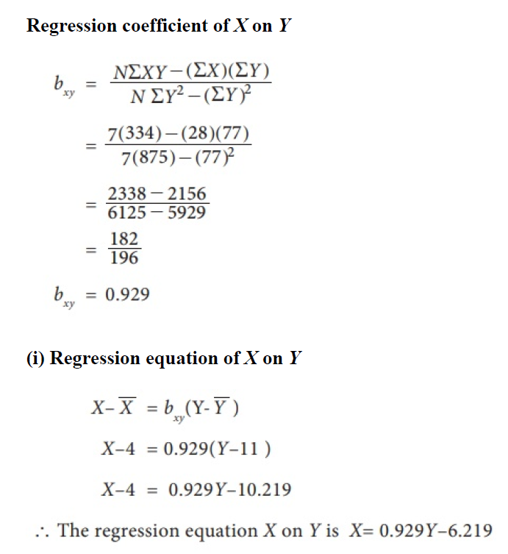

Slide 27
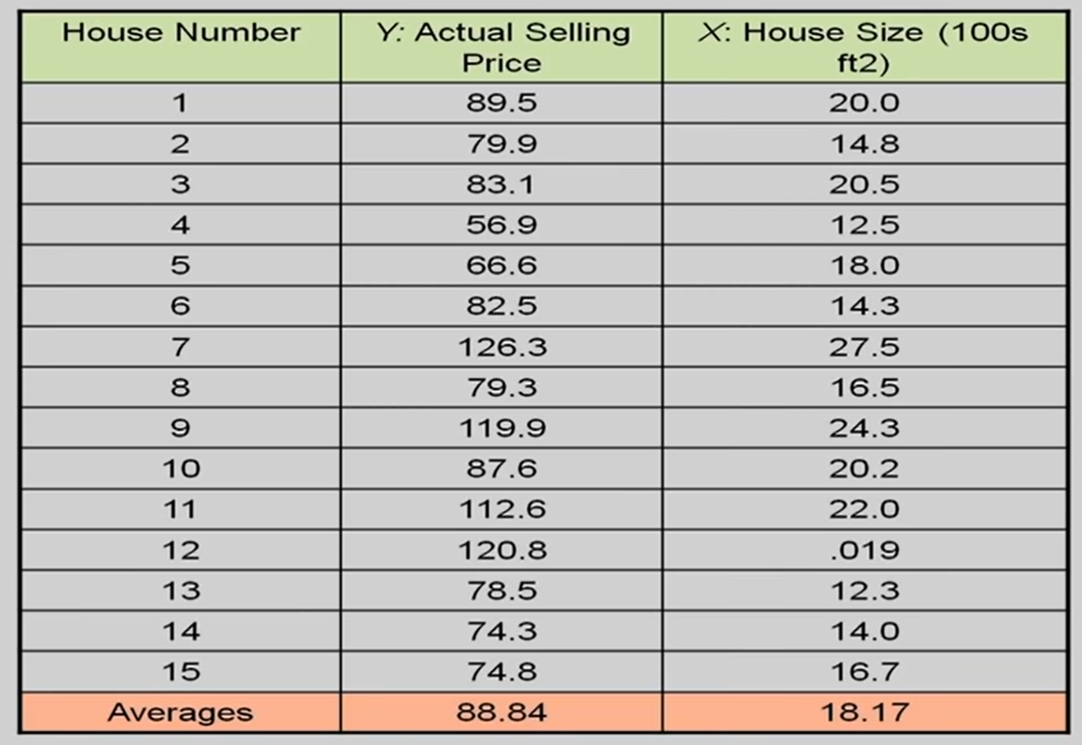

Slide 28
Important points about LR
more susceptible to outliers hence;
it should not be used in the case of big-size data.
There should be a linear relationship between independent and dependent variables.
There is only one independent and dependent variable.
The type of regression line: a best fit straight line.

Slide 29
Advantages And Disadvantages of LR
Advantages | Disadvantages
Linear regression performs exceptionally well for linearly separable data | The assumption of linearity between dependent and independent variables

Slide 30
Advantages And Disadvantages of LR
Advantages | Disadvantages
Linear regression performs exceptionally well for linearly separable data | The assumption of linearity between dependent and independent variables
Easier to implement, interpret and efficient to train | It is often quite prone to noise and overfitting

Slide 31
Advantages and Disadvantages of LR
Advantages | Disadvantages
Linear regression performs exceptionally well for linearly separable data | The assumption of linearity between dependent and independent variables
Easier to implement, interpret and efficient to train | It is often quite prone to noise and overfitting
It handles overfitting pretty well using dimensionally reduction techniques, regularization, and cross-validation | Linear regression is quite sensitive to outliers Hence, it should not be used in the case of big-size data.

Slide 32
Multiple linear regression
is used to estimate the relationship between two or more independent variables and one dependent variable
Example:
The selling price of a house can depend on the desirability of the location, the number of bedrooms, the number of bathrooms, the year the house was built, the square footage of the lot and a number of other factors
The height of a child can depend on the height of the mother, the height of the father, nutrition, and environmental factors.
Notes:
Example You are a public health researcher interested in social factors that influence heart disease. You survey 500 towns and gather data on the percentage of people in each town who smoke, the percentage of people in each town who bike to work, and the percentage of people in each town who have heart disease.
Because you have two independent variables and one dependent variable, and all your variables are quantitative, you can use multiple linear regression to analyze the relationship between them.

Slide 33
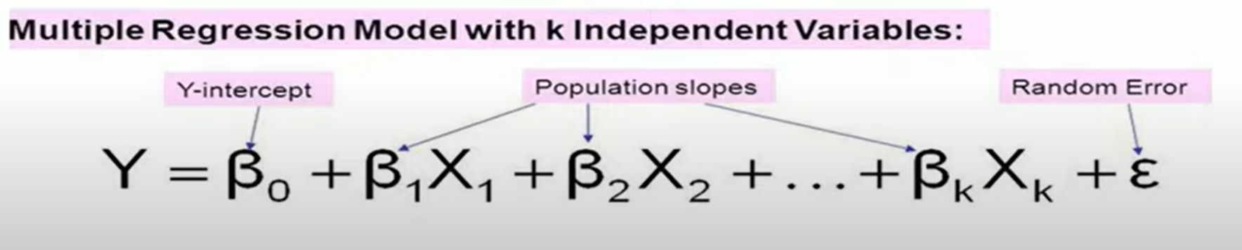
Multiple linear regression model

Slide 34
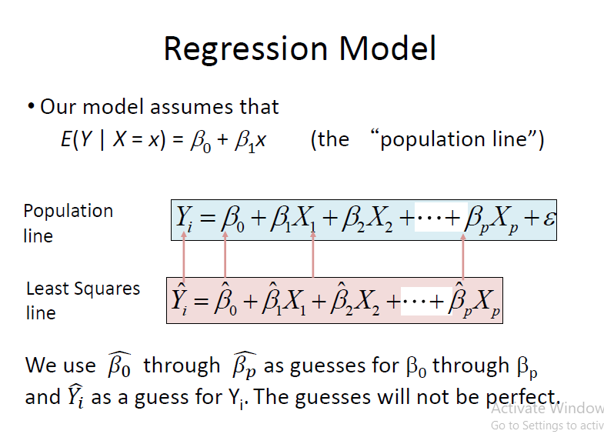
Regression Model
Actual line from which the examples are drawn.
Estimated equation we want to create.

Slide 35
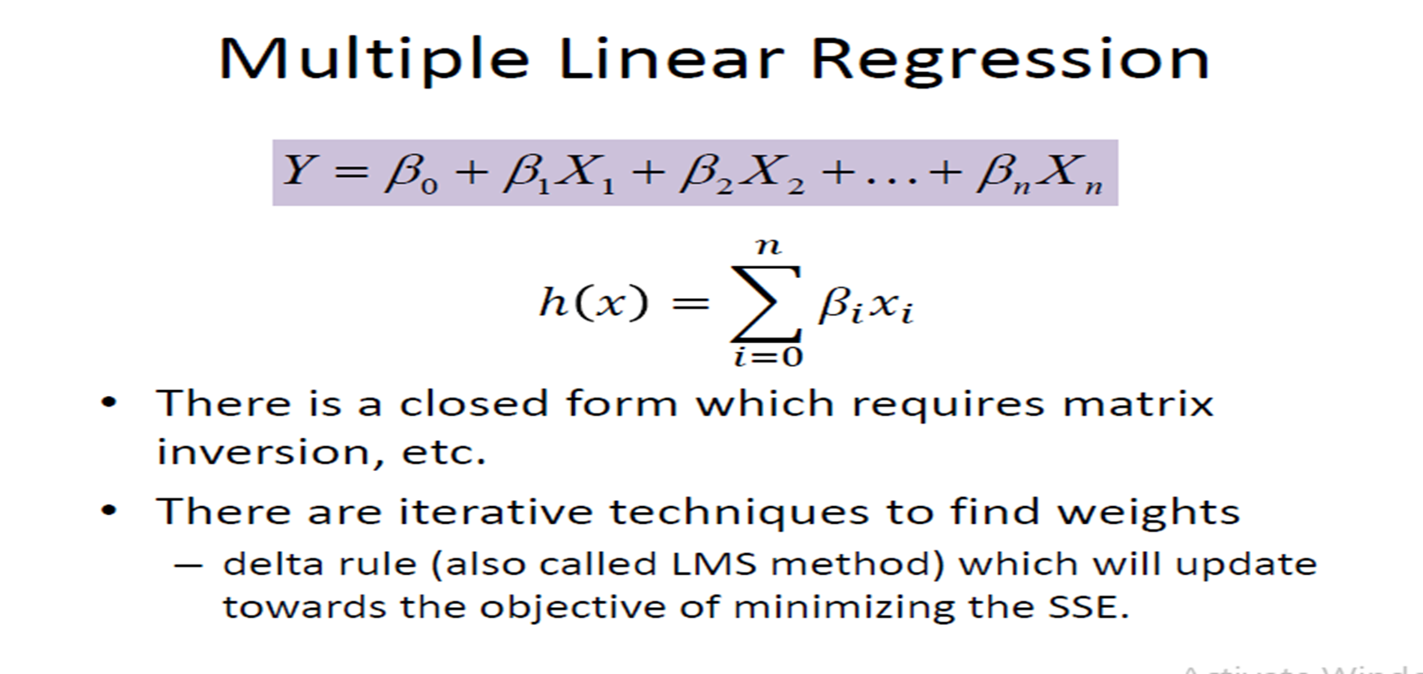
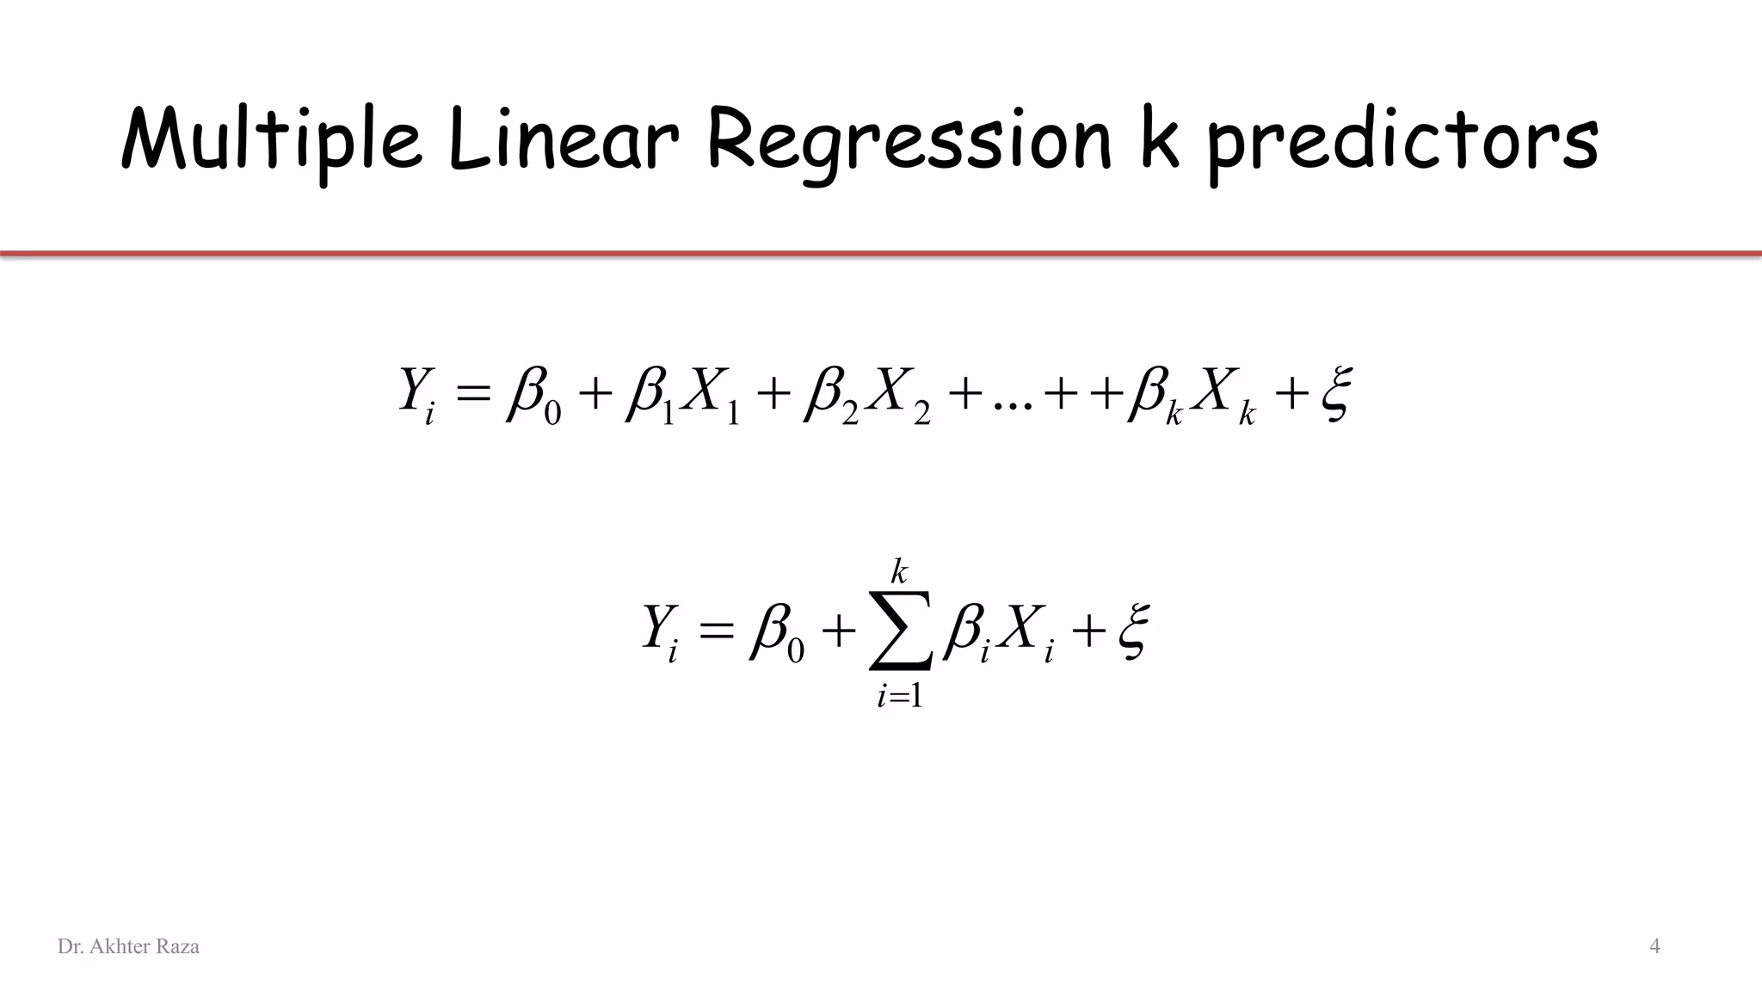
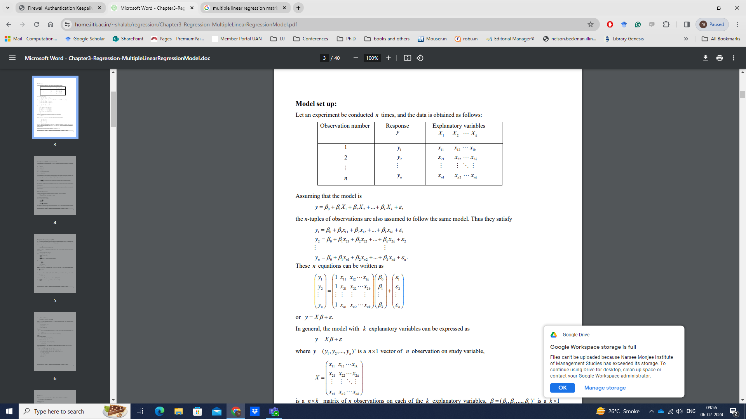
Multiple linear regression model

Slide 36
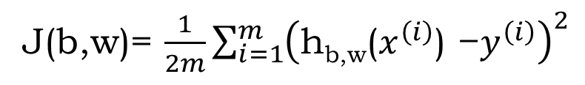

Cost Function
Find b and w to minimize J ( )

Slide 37

Have some function
J(b,w)
Want
$$\min_{b,w}{J(b,w)}$$
Outline:
  Start with some
  Keep changing to reduce until we hopefully end up at a minimum
b,w
b,w
J(b,w)
Notes:
J in any function…not necessarily cost function

Slide 38
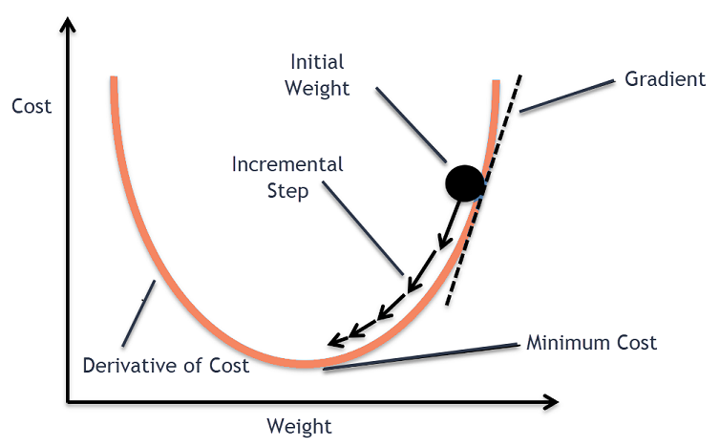
Gradient descent/delta rule/LMS method

Slide 39

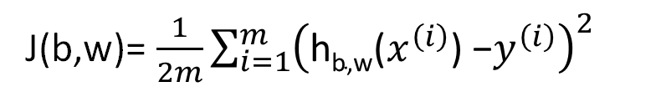

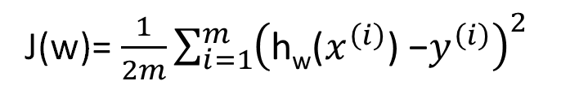
Simplified
Hypothesis:
h_{b,w}(x)= b+wx
h_{w}(x)= wx
b=0
Parameters:
b, w
w
Cost Function:
J(b,w)= $\frac{1}{2m}\sum_{i=1}^{m}{{\left(\text{h}\text{b}\text{,}\text{w}\text{(}x^{\left(i\right)}\text{) −}y^{\left(i\right)}\right)}^{2}}$
J(w)= $\frac{1}{2m}\sum_{i=1}^{m}{{\left(\text{h}\text{w}\text{(}x^{\left(i\right)}\text{) −}y^{\left(i\right)}\right)}^{2}}$
Goal:
$$\min_{w}{J(w)}$$
$$\min_{b,w}{J(b,w)}$$

Slide 40
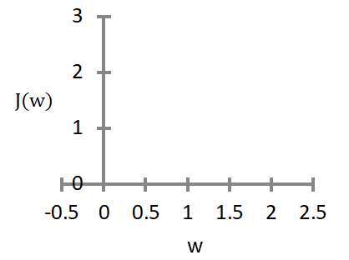
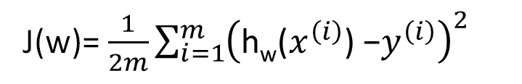
h_{w}(x)
J(w)
w
w
(for fixed , this is a function of x)
(function of the parameter )
h_{w}(x)
w = 1
y
x
J(w)= $\frac{1}{2m}\sum_{i=1}^{m}{{\left(\text{h}\text{w}\text{(}x^{\left(i\right)}\text{) −}y^{\left(i\right)}\right)}^{2}}$

Slide 41
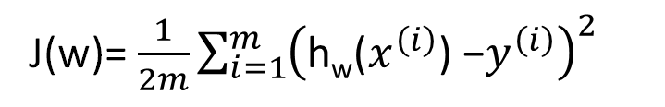
h_{w}(x)
J(w)
w
w
(function of the parameter )
(for fixed , this is a function of x)
h_{w}(x)
y
w = 0.5
x
J(w)= $\frac{1}{2m}\sum_{i=1}^{m}{{\left(\text{h}\text{w}\text{(}x^{\left(i\right)}\text{) −}y^{\left(i\right)}\right)}^{2}}$

Slide 42
h_{w}(x)
J(w)
w
w
(function of the parameter )
(for fixed , this is a function of x)
h_{w}(x)
w = 0
y
x
J(w)= $\frac{1}{2m}\sum_{i=1}^{m}{{\left(\text{h}\text{w}\text{(}x^{\left(i\right)}\text{) −}y^{\left(i\right)}\right)}^{2}}$

Slide 43


h_{b,w}(x)
J(b,w)
b, w
b,w
(for fixed , this is a function of x)
(function of the parameters )
Price ($)
in 1000’s
Size in feet² (x)
h_{b,w}(x) = 50 + 0.06x

Slide 44
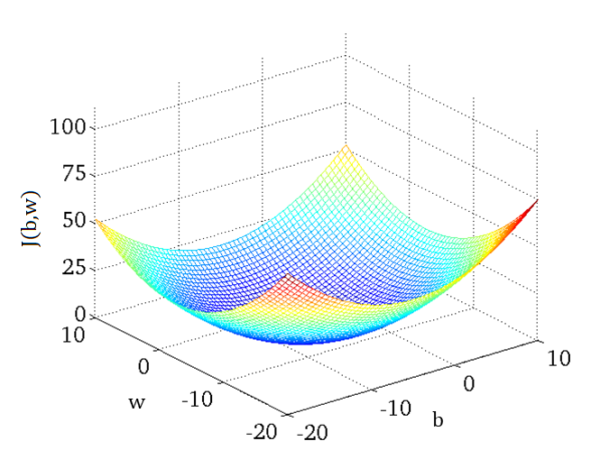

Slide 45
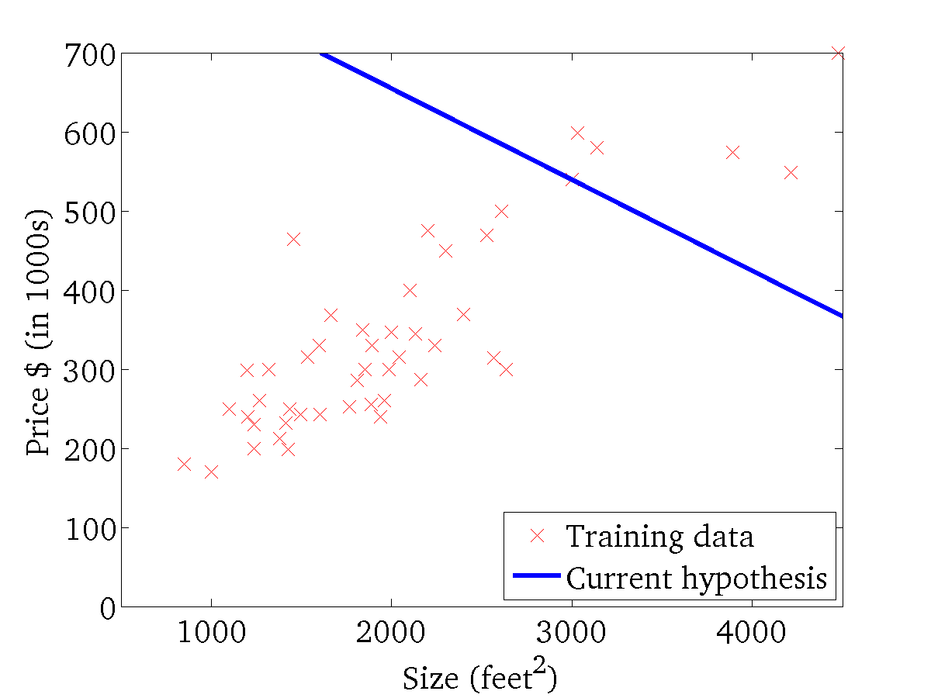
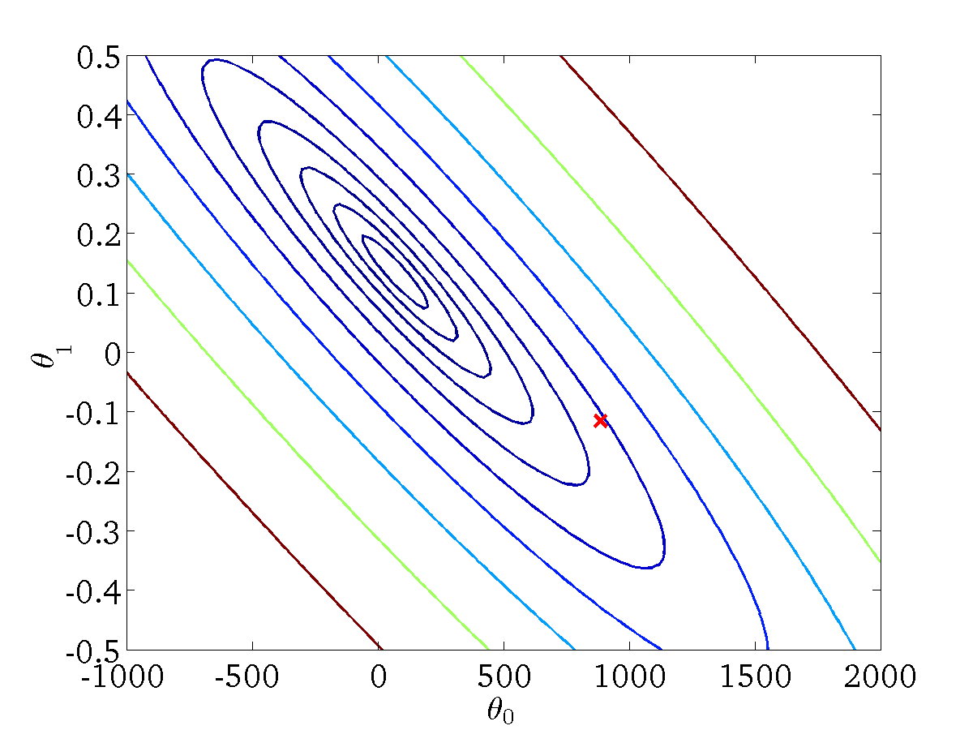


h_{b,w}(x)
$$J\left(b,w\right)$$
(for fixed , this is a function of x)
$$b,w$$
(function of the parameters )
$$b,w$$

Slide 46
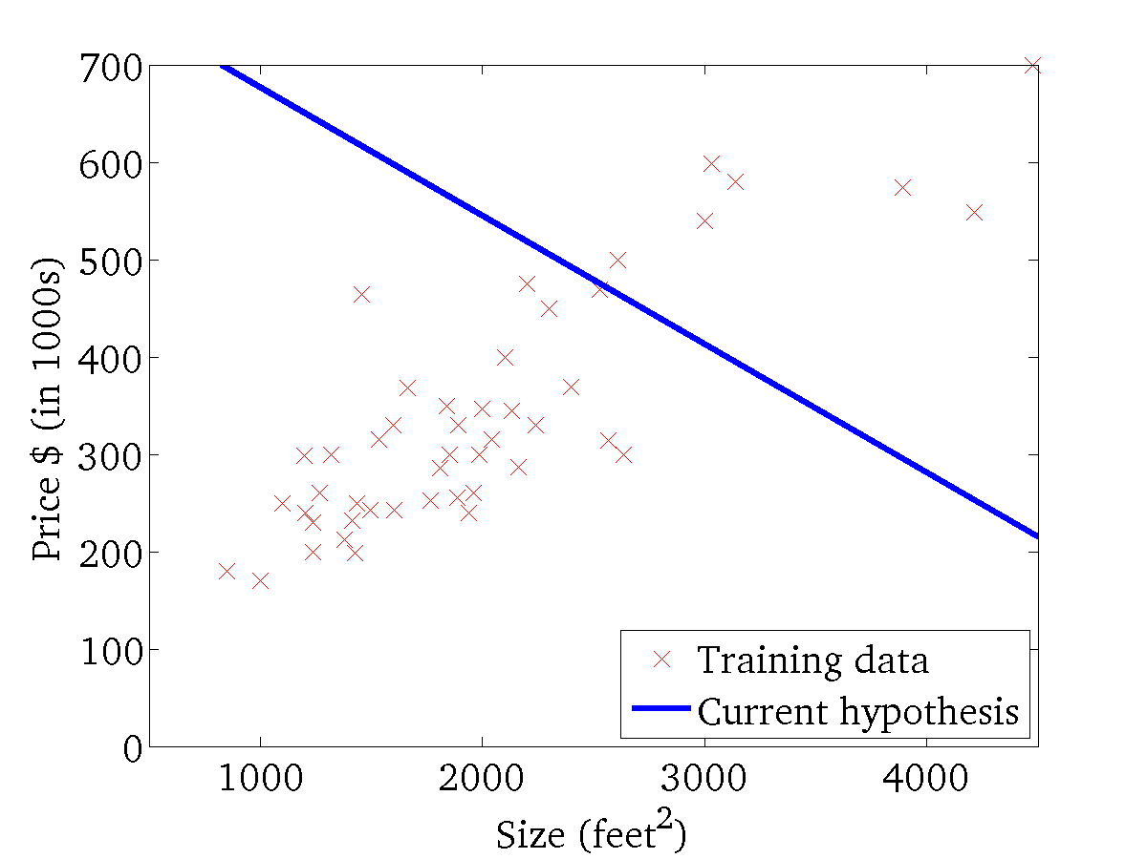

h_{b,w}(x)
$$J\left(b,w\right)$$
(for fixed , this is a function of x)
$$b,w$$
(function of the parameters )
$$b,w$$

Slide 47
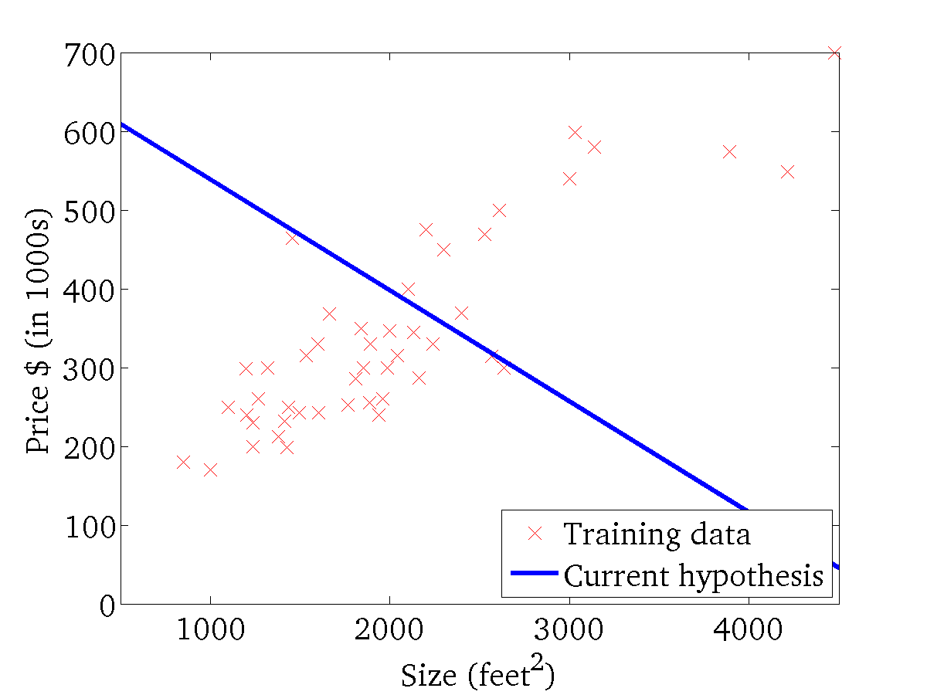
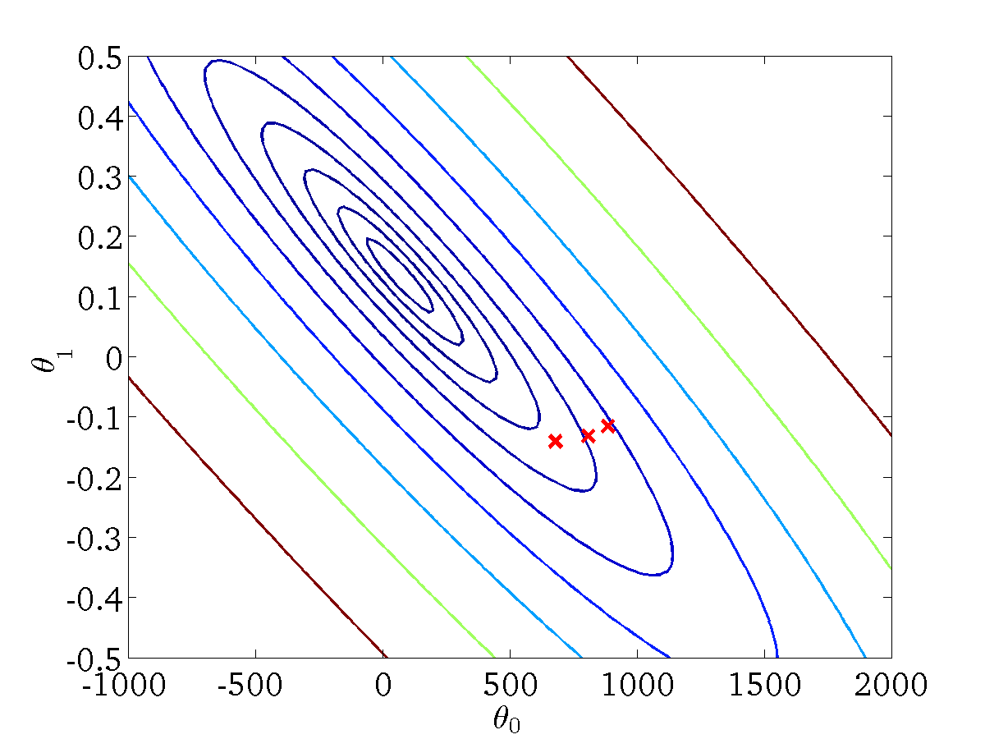
h_{b,w}(x)
$$J\left(b,w\right)$$
(for fixed , this is a function of x)
$$b,w$$
(function of the parameters )
$$b,w$$

Slide 48


h_{b,w}(x)
$$J\left(b,w\right)$$
(for fixed , this is a function of x)
$$b,w$$
(function of the parameters )
$$b,w$$

Slide 49


h_{b,w}(x)
$$J\left(b,w\right)$$
(for fixed , this is a function of x)
$$b,w$$
(function of the parameters )
$$b,w$$

Slide 50


h_{b,w}(x)
$$J\left(b,w\right)$$
(for fixed , this is a function of x)
$$b,w$$
(function of the parameters )
$$b,w$$

Slide 51


h_{b,w}(x)
$$J\left(b,w\right)$$
(for fixed , this is a function of x)
$$b,w$$
(function of the parameters )
$$b,w$$

Slide 52


h_{b,w}(x)
$$J\left(b,w\right)$$
(for fixed , this is a function of x)
$$b,w$$
(function of the parameters )
$$b,w$$

Slide 53


h_{b,w}(x)
$$J\left(b,w\right)$$
(for fixed , this is a function of x)
$$b,w$$
(function of the parameters )
$$b,w$$

Slide 54
1. Batch Gradient Descent
Batch: Each step of gradient descent uses all the training examples.
2. Stochastic Gradient Descent (SGD)
Uses one training sample at a time.
Parameters are updated after every sample.
3. Mini-Batch Gradient Descent (MBGD)
This is a compromise between Batch GD and SGD.
Instead of using:
all samples (Batch),
or one sample (SGD),
it uses a small group (mini-batch).

Slide 55


w
b

Slide 56
Property of gradient descent
w
b
Notes:
Two different starting points reaching to two different local optimum…local minima

Slide 57



Gradient descent algorithm
Notes:
The term $\left({\hat{y}}_{i}−y_{i}\right)$is the prediction error.
If the prediction is too high, the error is positive, and gradient descent decreases the parameter values.
If the prediction is too low, the error is negative, and gradient descent increases the parameter values.
The algorithm repeatedly adjusts $a_{0}$and $a_{1}$in the direction that reduces the overall prediction error until the cost function reaches (or gets very close to) its minimum.

Slide 58



Gradient descent algorithm
repeat until convergence {
b = b – α $\frac{∂}{∂b}J(b,w)$
w = w – α $\frac{∂}{∂w}J(b,w)$
}
Simultaneous update
Correct: Simultaneous update
Incorrect:
temp_b = b – α $\frac{∂}{∂b}J(b,w)$
temp_w = w – α $\frac{∂}{∂w}J\left(b,w\right)$
b = temp_b
w = temp_w
temp_b = b – α $\frac{∂}{∂b}J(b,w)$
b = temp_b
temp_w = w – α $\frac{∂}{∂w}J\left(b,w\right)$
w = temp_w

Slide 59


w = w – α $\frac{∂}{∂w}J(w)$
If α is too small, gradient descent can be slow.
w
If α is too large, gradient descent can overshoot the minimum. It may fail to converge, or even diverge.
w

Slide 60

w
at local optima
w
Current value of
w
w = w – α $\frac{∂}{∂w}J(w)$

Slide 61



Gradient descent can converge to a local minimum, even with the learning rate α fixed.
w = w – α $\frac{∂}{∂w}J(w)$
As we approach a local minimum, gradient descent will automatically take smaller steps. So, no need to decrease α over time.
$$J(w)$$
$$w$$

Slide 62
Benefits of Regression Analysis
Establishes a functional relationship between one dependent variable and one or more independent variables.
Predicts and forecasts future values based on historical data.
Identifies the effect of independent variables on the dependent variable: Identifies significant factors influencing the target variable.
Supports data-driven decision making in business, healthcare, finance, and engineering.
Measures the strength and direction of relationships between variables.
Improves planning and resource allocation by identifying trends and patterns.
Helps evaluate model performance by analysing prediction errors (e.g., MSE, RMSE, MAE) and improving the model.
Discovers trends and opportunities for business growth and optimisation.

Slide 63
Limitations of Regression Analysis
Assumes a linear and stable relationship between variables.
Sensitive to outliers and noisy data.
Requires statistical assumptions to be satisfied.
Does not imply causation.
Standard linear regression cannot predict categorical outcomes.
Prediction accuracy depends on data quality and feature selection.
Notes:
Requires assumptions to be satisfied, such as linearity, independence of observations, homoscedasticity (constant variance of errors), normality of residuals, and low multicollinearity. Violating these assumptions can reduce the model's reliability.

