Slide 1
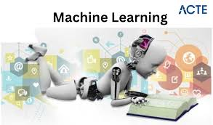
Module No. 1
Introduction to Machine Learning
Dr. Mrunal Rane

Slide 2
Syllabus :
Introduction to Machine Learning:
  Types of Machine Learning, Issues in Machine Learning,
  Application of Machine Learning,
  Steps involved in developing a Machine Learning Application.
  Hypothesis and Inductive Bias

Slide 3
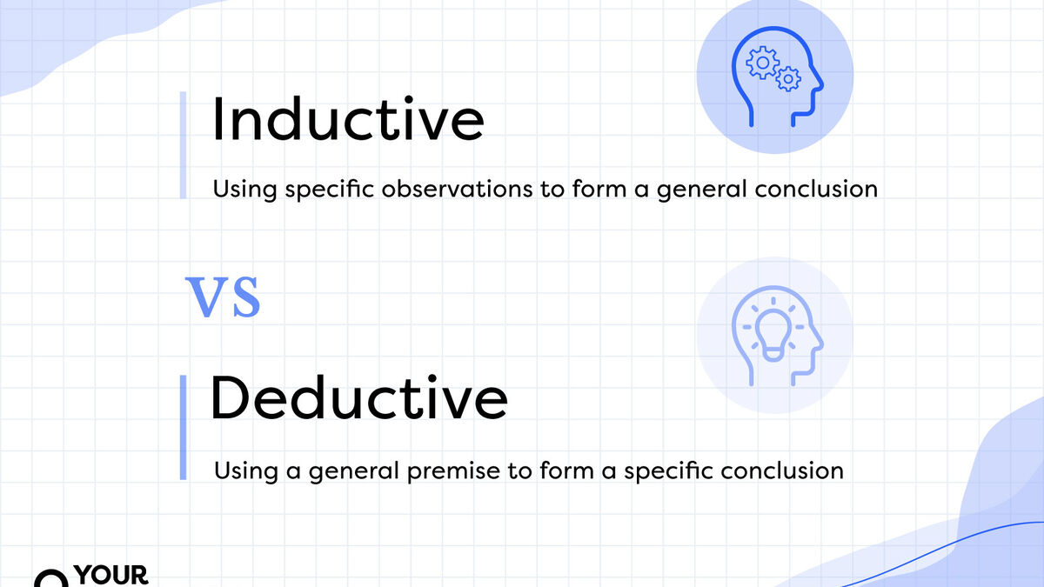

Slide 4
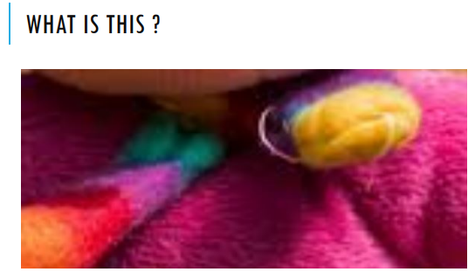
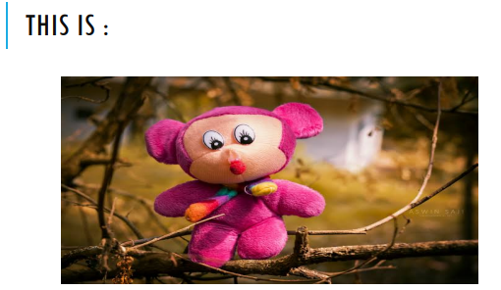
Training data
→ Incomplete information
→ Model makes assumptions
→ Prediction

Slide 5
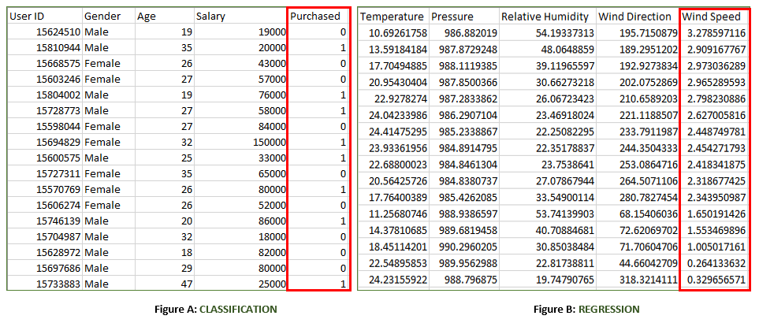
Supervised Learning
Features (X)
Features (X)
Output (Y)
Output (Y)
Instances
Discrete
Continuous

Slide 6
Feature space

Slide 7
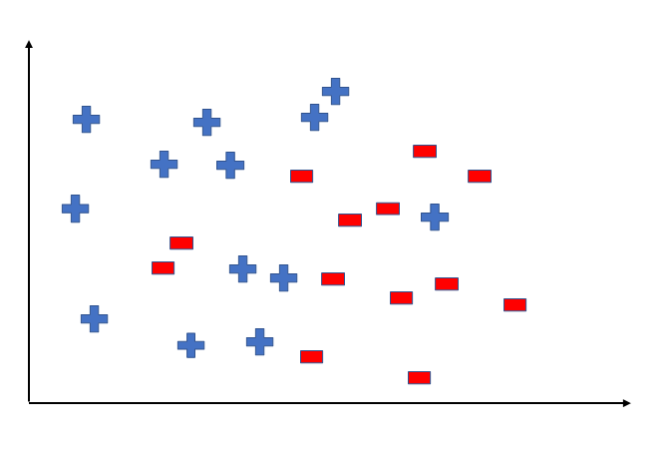
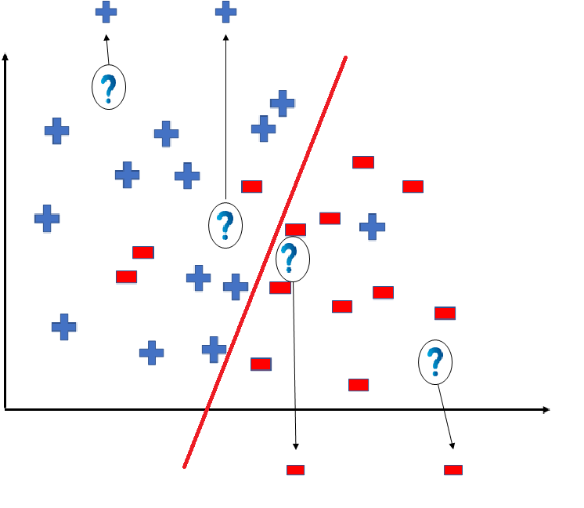
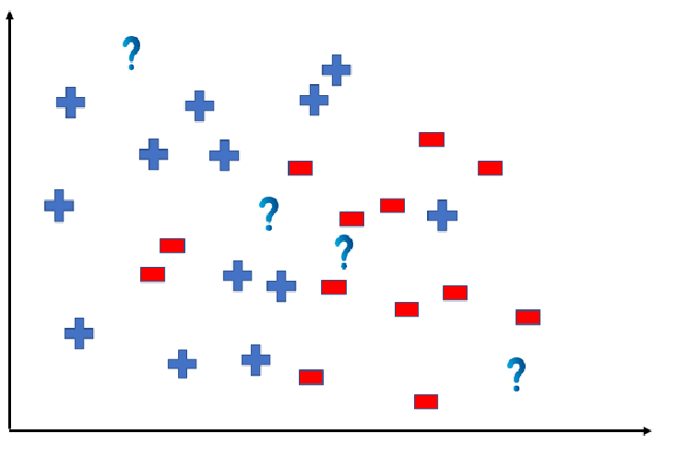
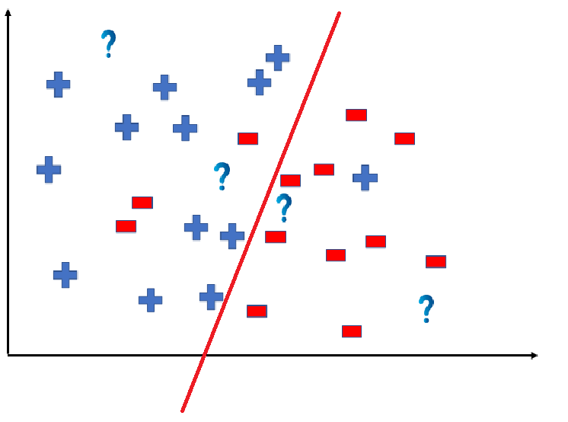
Hypothesis
Hypothesis (h)
  A hypothesis is a function that best describes the target in supervised machine learning. The hypothesis that an algorithm would come up depends upon the data and also depends upon the restrictions and bias that we have imposed on the data.

Slide 8
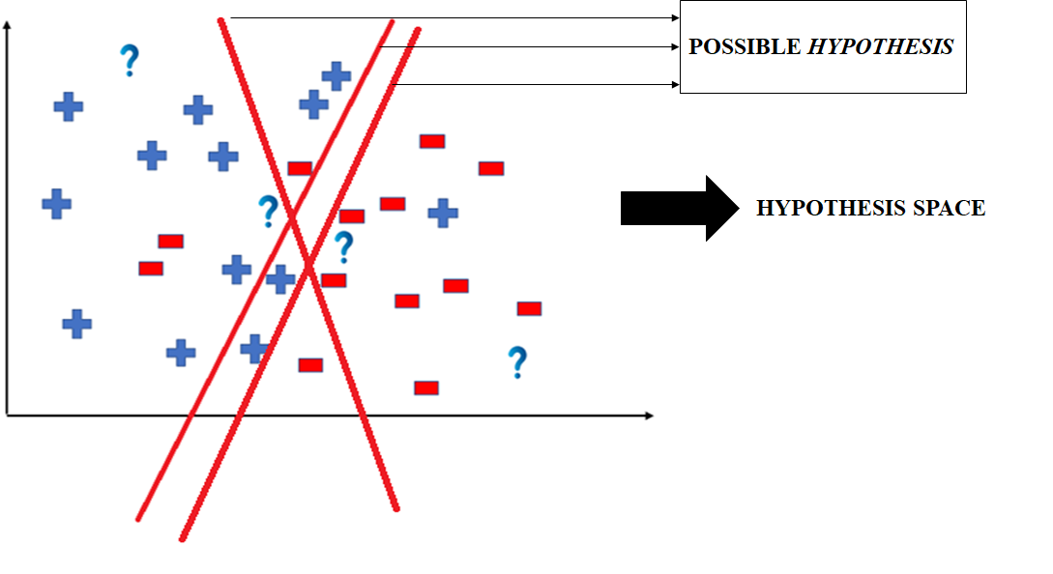

Slide 9
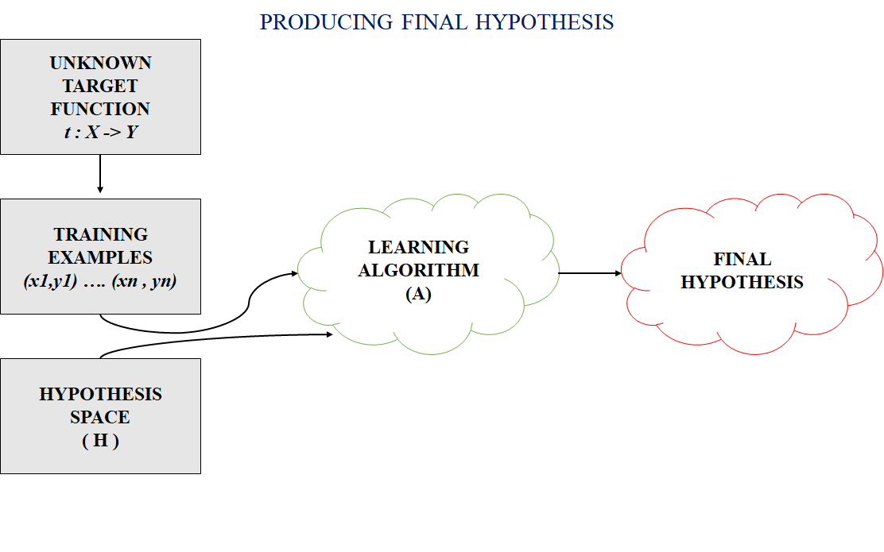
Hypothesis
Hypothesis Space (H)
  Hypothesis space is the set of all the possible legal hypothesis. This is the set from which the machine learning algorithm would determine the best possible (only one) which would best describe the target function or the outputs.

Slide 10
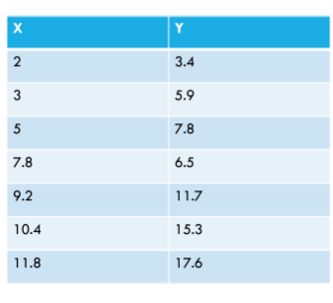
Data:
Model?
Hypothesis?

Slide 11
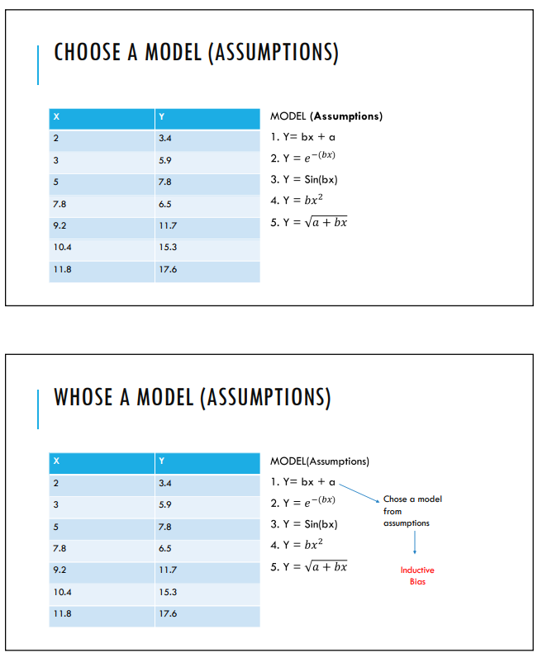
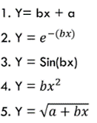
Data
Hypothesis?
Inductive
bias

Slide 12
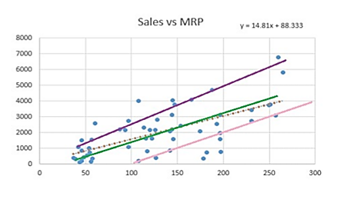
Inductive bias
The inductive bias (also known as learning bias) of a learning algorithm is the set of assumptions that the learner uses to predict outputs.
Y = a + b*X

Slide 13
X 27 15 23 20 25 17 12 30 6
Class 1 0 1 1 1 0 0 1 0
Rule for Labelling
h ′: IF x ≥ 20 THEN “1” ELSE “0”.
h ′ is consistent with the training examples in the table.
For example,
h ′ (27) = 1, c(27) = 1, h′ (27) = c(27) h ′ (15) = 0, c(15) = 0, h′ (15) = c(15)
for x = 5 and x = 28 (not in training data),
h ′ (5) = 0, h′ (28) = 1.
The following proposition also explains the data:
h ′′: IF x ≥ 19 THEN “0” ELSE “1”.

Slide 14
It is not enough that the hypothesis explains the given data; it must also predict correctly the class label of future observations.
So, consider a set of such hypotheses and choose the “best” one.
The set of hypotheses can be defined using a parameter, say m, as given below: hm : IF x ≥ m THEN “1” ELSE ”0”.

Slide 15
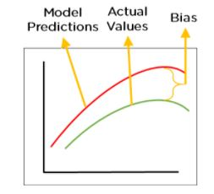
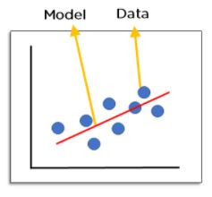
Bias and variance
used in supervised machine learning
The correct balance of bias and variance is vital
bias-variance trade-off
Bias
High bias = underfitting

Slide 16
Low Bias:
  means fewer assumptions are taken to build the target function.
  the model will closely match the training dataset.
High Bias:
  means more assumptions are taken to build the target function.
  the model will not match the training dataset closely.

Slide 17
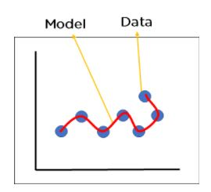
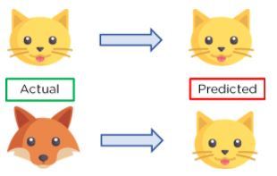
Variance
High variance = overfitting
the measure of spread in data from its mean position.
is the amount by which the performance of a predictive model changes when it is trained on different subsets of the training data.
is the variability of the model that how much it is sensitive to another subset of the training dataset. i.e. how much it can adjust on the new subset of the training dataset.

Slide 18
Low variance:
  means that the model is less sensitive to changes in the training data and can produce consistent estimates of the target function with different subsets of data from the same distribution.
  This is the case of underfitting when the model fails to generalize on both training and test data.

Slide 19
High variance:
  means that the model is very sensitive to changes in the training data and can result in significant changes in the estimate of the target function when trained on different subsets of data from the same distribution.
  This is the case of overfitting when the model performs well on the training data but poorly on new, unseen test data. It fits the training data too closely that it fails on the new training dataset.

Slide 20
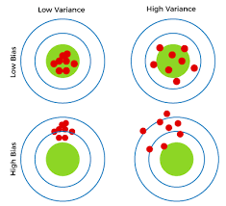
Combinations of
Bias-Variance :
Low-Bias, Low-Variance: The combination of low bias and low variance shows an ideal machine learning model. However, it is not possible practically.
Low-Bias, High-Variance: With low bias and high variance, model predictions are inconsistent and accurate on average. This case occurs when the model learns with a large number of parameters and hence leads to an overfitting
High-Bias, Low-Variance: With High bias and low variance, predictions are consistent but inaccurate on average. This case occurs when a model does not learn well with the training dataset or uses few numbers of the parameter. It leads to underfitting problems in the model.
High-Bias, High-Variance: With high bias and high variance, predictions are inconsistent and also inaccurate on average.

Slide 21
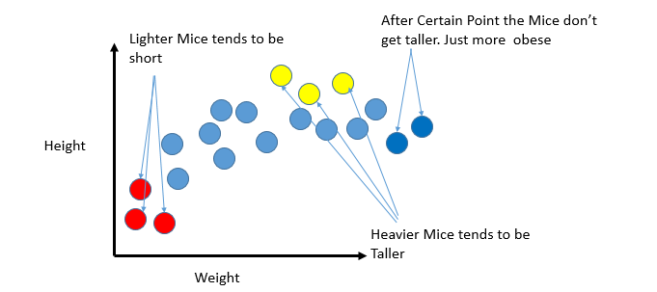

Slide 22
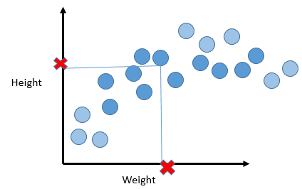

Slide 23
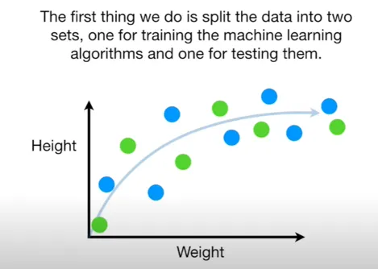

Slide 24
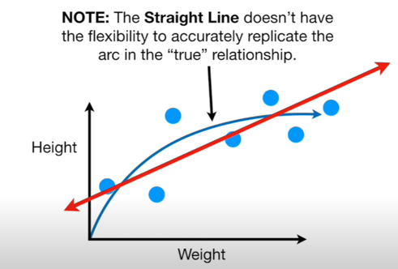

Slide 25
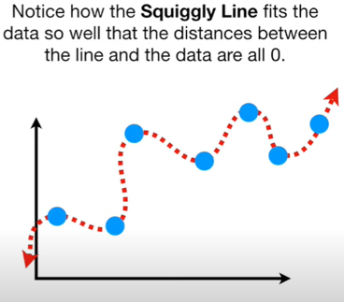

Slide 26
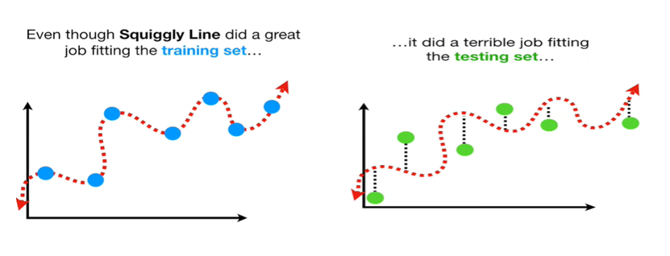

Slide 27
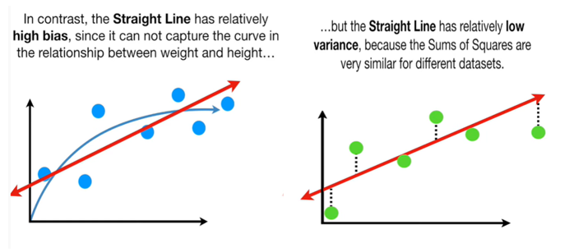

Slide 28
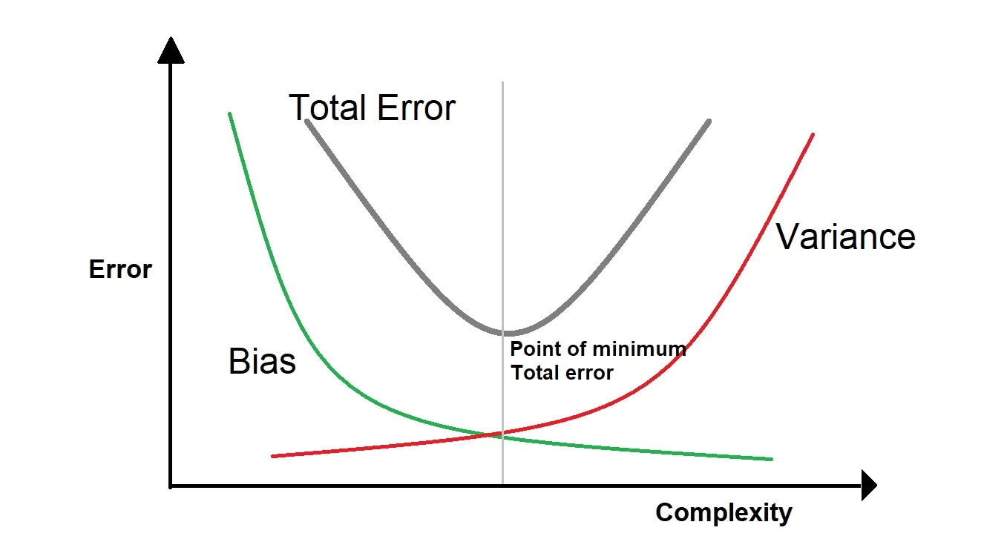
Trade-off

