Slide 1
Innovative Product Development
Group Members:
Kawaljeet Singh Bharaj
S004 · 60018240016
Jeevesh Bharat Bodhani
S005 · 60018240096
Rishit Pankajkumar Lahoti
S026 · 6001840101
Swayam Devendra Panchal
S029 · 60018240013
Mentor:
________________
Title: Learnova — AI-powered redesign of outdated lecture slides into illustrated, interactive teaching decks
Domain: Education Technology · Artificial Intelligence · Document Understanding
Group No. 1 · Department of Artificial Intelligence and Data Science, DJSCE · Interdisciplinary Project Review, Odd Sem 2026

Slide 2




IDEA & PROPOSED SOLUTION
LEARNOVA · Group 1
IPD Review · AI & DS, DJSCE
From text walls to teaching decks — without losing a single point the teacher wrote
In five real course decks (306 slides) we found 83 untitled slides, equations pasted as pictures, and not one diagram, quiz or interactive element
Proposed solution: Faculty reuse the same slide decks for years, and students revise from them before every examination. Learnova is a web platform that takes the deck a teacher already has — a PowerPoint, a slide PDF, Word notes or a typed topic — and rebuilds it as an editable PowerPoint, an interactive web deck and a study pack. Every point of the original is kept; what changes is how it is shown: a visual for every idea, an illustration on every slide, and quizzes, solved problems and labs that let students work with the material instead of only reading it.
Detailed explanation of the solution
How it addresses the problem
Innovation and uniqueness
• Slide reader: PDF/PPTX read page by page — titles, bullet levels, tables, figures; OCR for picture-only slides.
• Decision engine: 27 detectors choose process, timeline, comparison, definition, chart or cards — with a reason.
• Assertion titles: every title states the slide's point (AI with key, rules without).
• Illustrations: AI-written diagram, teacher's figure or offline scene on every slide, each with an HTML link.
• Interaction: checkpoint quizzes, exact step-by-step solvers, labs for NLP, ML and IPCV topics.
• Outputs: editable PPTX, Reveal.js web deck, flashcards, Anki, quiz bank, share link, tutor.
• Text walls → one idea per slide, drawn as a visual at a readable density.
• Untitled slides → 83 → 0; split parts are named after what they cover.
• Pictures of equations → kept as full-size figures; never replaced by OCR noise.
• Passive reading → quizzes, steppers and labs on the slide itself.
• Hours of redesign → a finished deck in about 10–60 s, fully editable.
• Unreliable AI → source text kept verbatim; 98–100% of facts retained.
• Redesign, not generate: starts from the teacher's deck; Gamma, Copilot and Canva start from a prompt.
• Faithful by construction: every AI output is checked against the slide; numbers are computed.
• Explainable design: each visual choice comes with its rule and confidence.
• Glyph-measured layout: no overflow and no word ever broken across lines.
• Two fallbacks: 5-key Gemini pool → Groq/NVIDIA → full offline logic.
• Built-in labs: Region Growing, Split & Merge, CYK, Viterbi, NB-WSD, HMM tagging.
PHASE 1 · Sep–Dec 2025
PHASE 2 · Jan–Mar 2026
PHASE 3 · Apr–Jul 2026
PHASE 4 · Aug–Oct 2026
LIVE CODE
Full source, 755 tests, papers and demo decks on GitHub
SDP42/LearnovaV2
Research & design
Literature survey, competitor study, problem statement, architecture, UI plan
Prototype V1
Parsing, AI rewriting, engagement score, quiz generation, Streamlit demo
Learnova V2 platform
FastAPI + React, decision engine, PPTX & web builders, OTP accounts, library
Real lecture decks
Slide reader + OCR, illustrations, explainers, labs, AI keys, papers
Learnova — redesigning outdated lecture slides into illustrated, interactive teaching decks
2

Slide 3

LITERATURE REVIEW / EXISTING SYSTEMS
LEARNOVA · Group 1
IPD Review · AI & DS, DJSCE
What research and today's tools do — and the gap Learnova fills
# | Reference / existing system | Method & key findings | Gap / scope for improvement
1 | Hu & Wan, “PPSGen”, IEEE TKDE 27(4), 2015 | Learns sentence importance with regression; ILP selects sentences into slides for academic papers. | Papers only; summarises so content is lost; no visuals; cannot redesign existing slides.
2 | Fu et al., “DOC2PPT”, AAAI 36, 2022 | Hierarchical neural summariser + figure selection + layout prediction from paper–slide pairs. | Needs training pairs; abstractive text can alter facts; input must be a scientific paper.
3 | Sun et al., “D2S”, NAACL 2021 | Slide titles used as queries; retrieval + QA-style summarisation fills each slide. | Text only; no figures, quizzes or interaction; not for an existing lecture deck.
4 | Maynez et al., “Faithfulness in abstractive summarization”, ACL 2020 | Abstractive models hallucinate and omit content in a large share of outputs. | Motivates keeping source text verbatim and checking every AI output.
5 | Garner & Alley, assertion–evidence, IJEE 29(6), 2013; Mayer, Multimedia Learning, 2009 | Sentence headlines + visual evidence beat bullet lists; one idea per slide, words near pictures. | Design guidance only — no tool applies it automatically to old decks.
6 | Sweller & Cooper 1985; Hundhausen et al. 2002 (worked examples, algorithm visualisation) | Studying solved steps and interacting with a visual simulation improves learning. | Lecture slides show finished answers; no step-by-step or interactive layer.
7 | Gamma, MS Copilot in PowerPoint, Gemini in Slides, Canva Magic Design (2026) | LLM writes an outline, then fills a template; attractive new decks from a prompt. | Rewrite/merge the teacher's points, drop figures, no labs/solvers, need internet & paid plans.
Gap → how Learnova closes it
Generates new decks
Redesigns the existing deck
Paraphrases, drops items
Verbatim content + fact check
Loses figures/equations
Keeps every figure; OCR only when reliable
No visuals by meaning
27-detector decision engine
No illustration
AI diagram / own figure / offline scene
No interaction
Quizzes, solvers, labs
Cloud & paid only
Offline mode, free keys optional
Common limitations found: research systems summarise scientific papers rather than lecture decks, and they trade faithfulness for brevity; commercial tools produce attractive slides but cannot be checked against the source, ignore picture-only and equation slides, add no interaction and require a connection and a subscription. None of them redesigns the deck a teacher already uses — which is exactly the gap Learnova targets.
Learnova — redesigning outdated lecture slides into illustrated, interactive teaching decks
3

Slide 4






























TECHNICAL APPROACH — ARCHITECTURE
LEARNOVA · Group 1
IPD Review · AI & DS, DJSCE
Input → processing workflow → output; every AI step has an offline fallback
System architecture and data flow
Technologies to be used
INPUT
INGEST
ENGINES
AI SERVICE
OUTPUT
PowerPoint (.pptx)
LibreOffice convert
Planner
LLM router
Editable PPTX
teacher's existing deck
PPTX → PDF, cached by hash
split · merge · agenda · glossary
Gemini ×5 → Groq → NVIDIA
native shapes, linked pictures
React
Vite
Tailwind
Reveal.js
Slide PDF
Slide reader
Decision engine
AI polish
Web deck
exported lecture slides
titles · bullet levels · tables
27 detectors, reason + score
assertion titles, explanations
Reveal.js, reveals, overlays
Python
FastAPI
SQLite
PyMuPDF
Word / notes
IR
OCR decision
plan
Layout engine
calls
Topic diagrams
assets
Study pack
LibreOffice
Tesseract
Gemini
Groq
.docx, markdown, text
Tesseract when text is reliable
glyph-measured, no broken words
validated SVG + HTML page
flashcards · Anki · quiz bank
Typed topic
Repair
Explainer solvers
AI labs
Share link
SymPy
pytest
GitHub
Docker
a prompt or syllabus line
furniture, glued titles, split words
exact step-by-step (SymPy)
JS checked with node --check
view-only, no login
• Frontend: React 18 · Vite · Tailwind CSS · Reveal.js web deck · PWA (manifest + service worker)
• Backend: Python 3.12 · FastAPI · Pydantic · background job queue · SQLite · OTP auth
• Documents: python-pptx · PyMuPDF · LibreOffice headless · python-docx · Tesseract OCR
• AI / NLP: Gemini (pool of 5 keys, per-key pacing) · Groq · NVIDIA NIM · failover router
• Maths & labs: SymPy exact solvers · JavaScript lab engine · SVG via MuPDF
• Quality & DevOps: pytest (755) · layout audit · gold sets · GitHub · Docker
Teacher labs
Colour DNA
Quiz + lab selector
Offline fallback
Deck tutor
own HTML labs via API
source palette → theme
checkpoints, one lab per topic
rules, scenes, structure labs
answers from the deck only
DEPLOYMENT AND OPERATIONS · open-source / free tier
GitHub
source · 755 tests
Vercel / Netlify
React static build
Docker on Render
FastAPI + LibreOffice + OCR
SQLite volume
users · decks · caches
Monitoring
health · audit · logs
1 · Read faithfully
every page, every figure kept
2 · Decide with rules
explainable visual per slide
3 · Enrich with AI
checked titles, diagrams, labs
4 · Build and audit
PPTX + web deck, no breaks
Learnova — redesigning outdated lecture slides into illustrated, interactive teaching decks
4

Slide 5
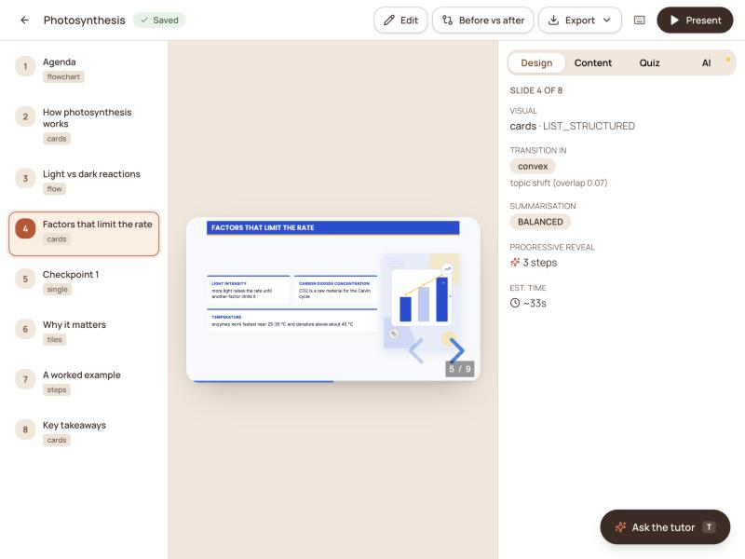
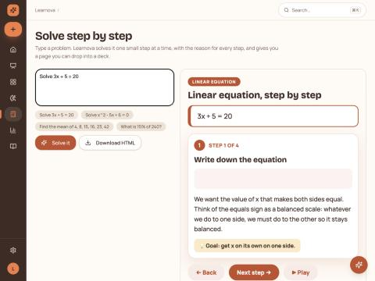
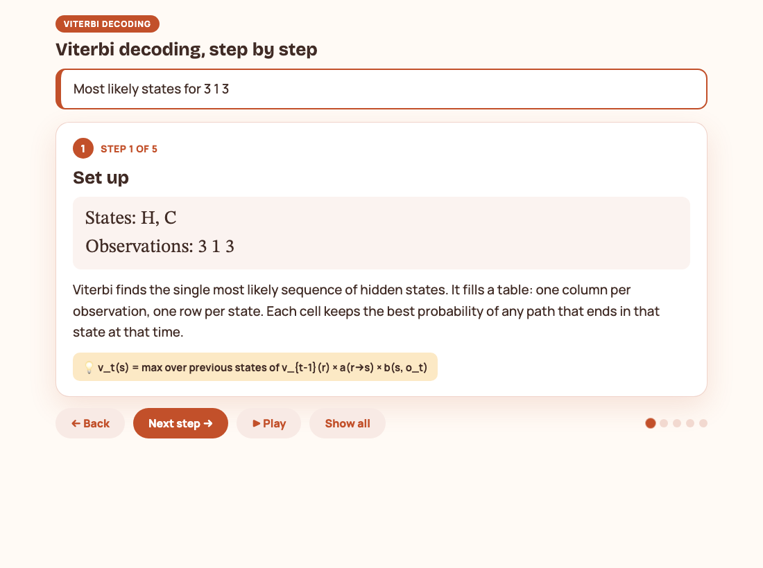
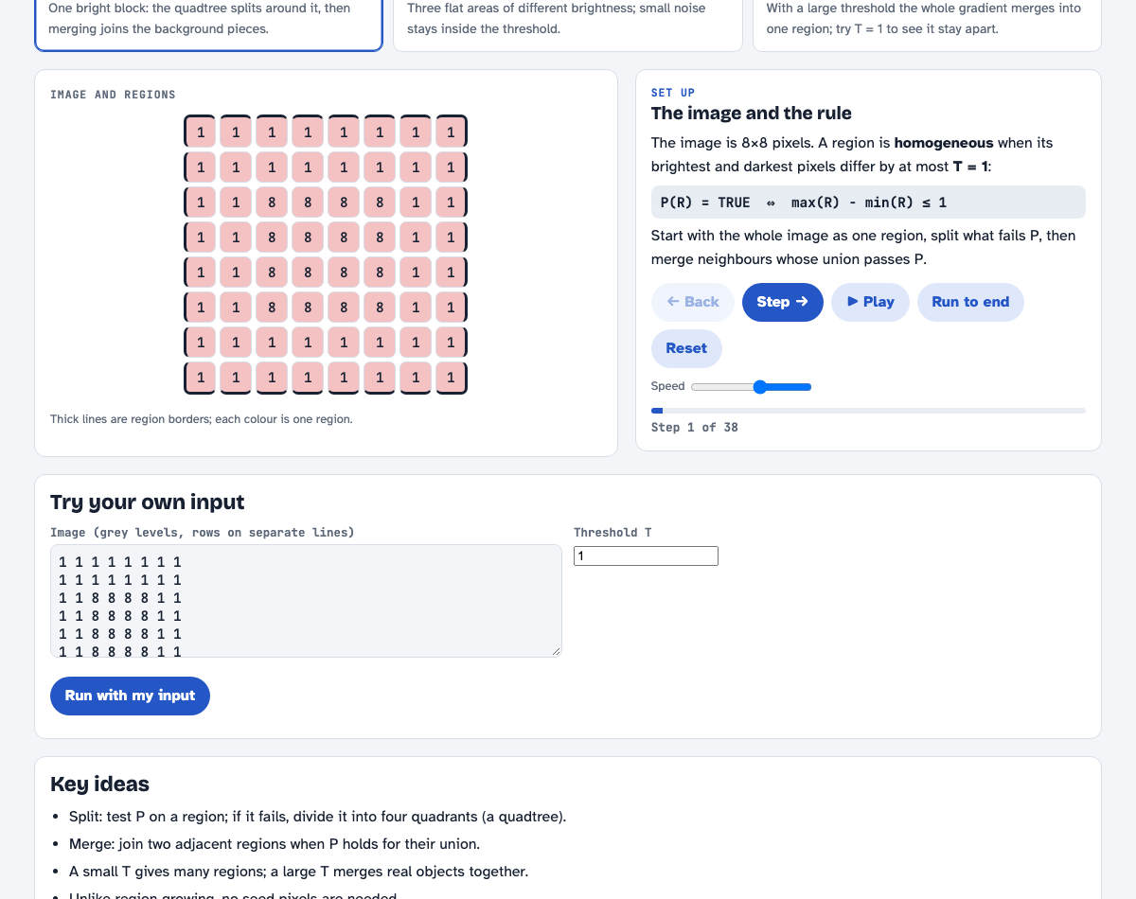
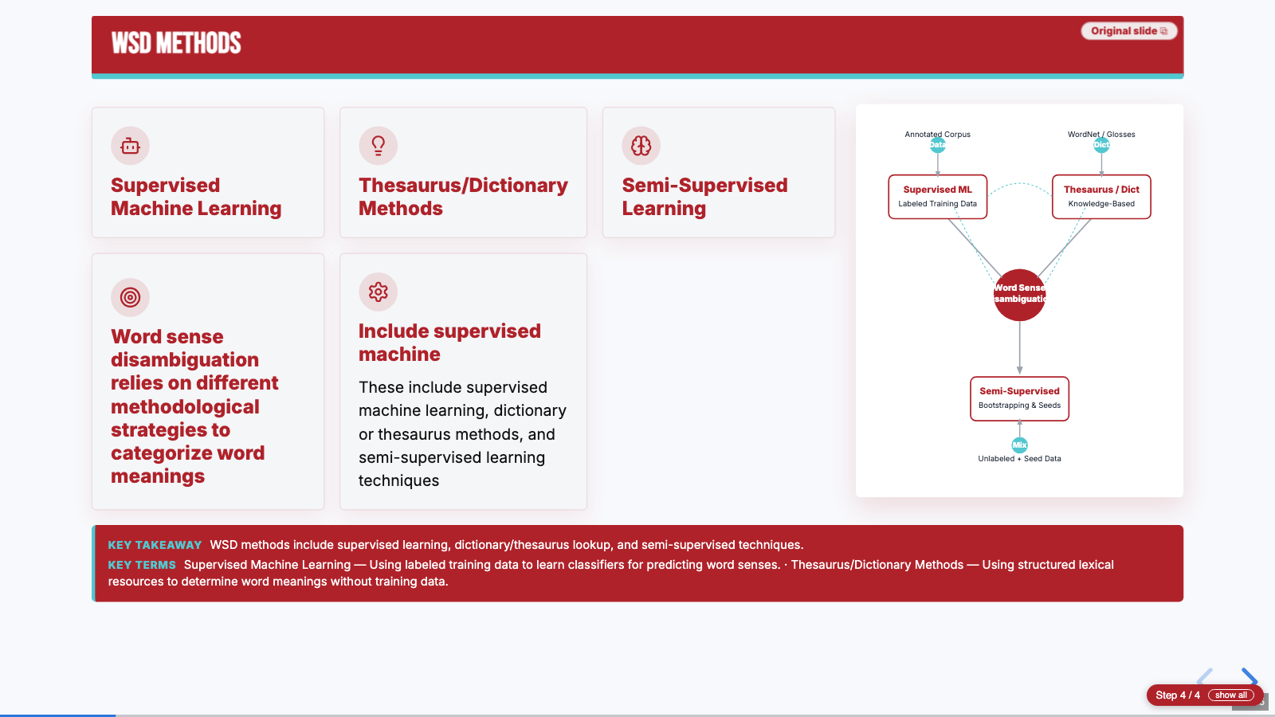
TECHNICAL APPROACH — METHODOLOGY
LEARNOVA · Group 1
IPD Review · AI & DS, DJSCE
Nine stages from upload to audited deck, with the algorithm behind each
Convert
PPTX → PDF (LibreOffice), DOCX/text → Markdown IR; colour palette of the source kept.
Read slides
Furniture = text on ≥ max(3, 0.3n) pages; bullet level ℓ(x) = argmin |x − aₖ|; glued titles split by DP.
OCR decision
γ = |ink ∖ text| / |ink|; OCR used only if conf ≥ 62, γ ≤ 0.42, < 15% symbol lines.
1
2
3
Plan
Split overloaded slides at logical boundaries; merge thin parts; agenda, glossary, quizzes.
Decide visual
27 detectors → (family, confidence, data, reason); d* = argmax c after exclusion rules.
AI polish
Assertion titles, explanations, key terms — accepted only if grounded in the slide's words.
4
5
6
Illustrate
LLM SVG → whitelist + ≥ 6 shapes + render check → cache; else own figure / offline scene.
Lay out & build
s* = largest size that fits (≥ 11 pt); σ = min(1, W / w(longest word)); PPTX + web deck.
Audit
Overflow, broken words, sparse slides; fact retention R = |F_src ∩ F_deck| / |F_src|.
7
8
9
WORKING PROTOTYPE · real screens from the running application
Deck preview — visual chosen and why
Web deck — AI diagram beside the content
Solve step by step
Viterbi explainer, exact
Split & Merge lab (IPCV)
Learnova — redesigning outdated lecture slides into illustrated, interactive teaching decks
5

Slide 6
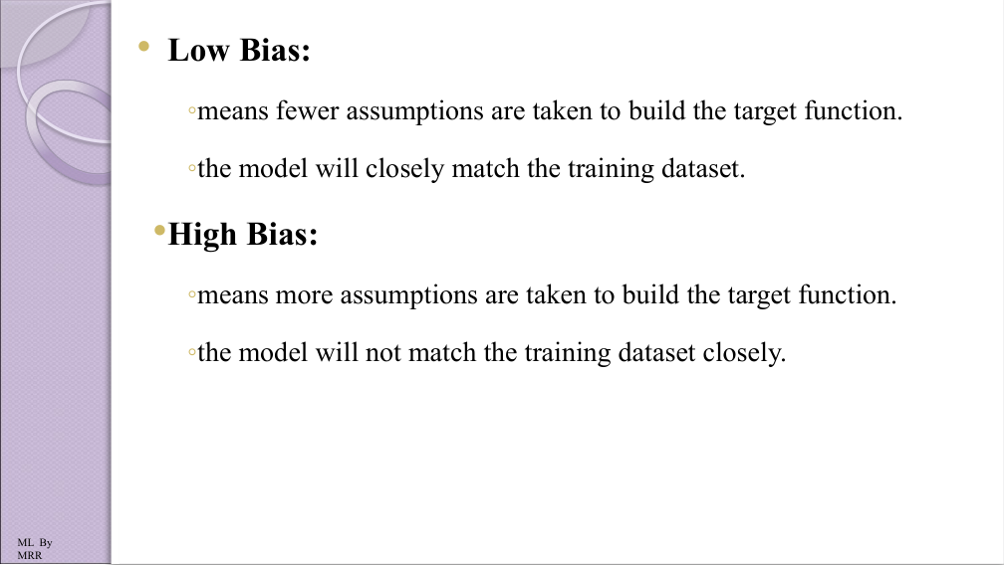
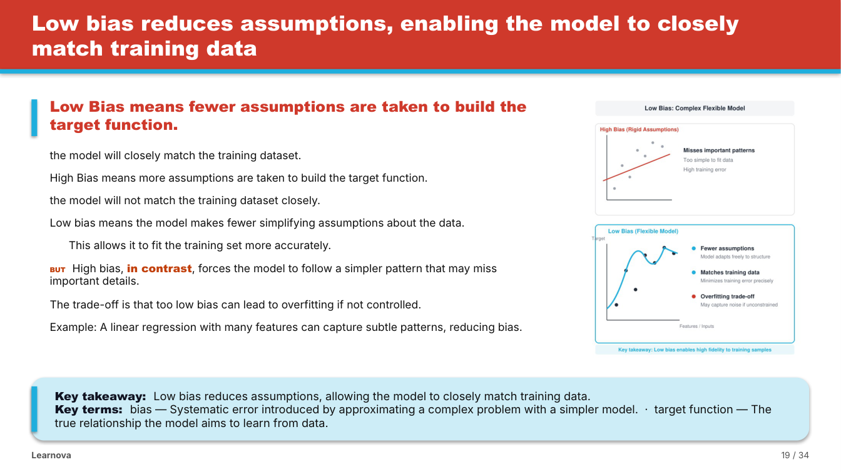
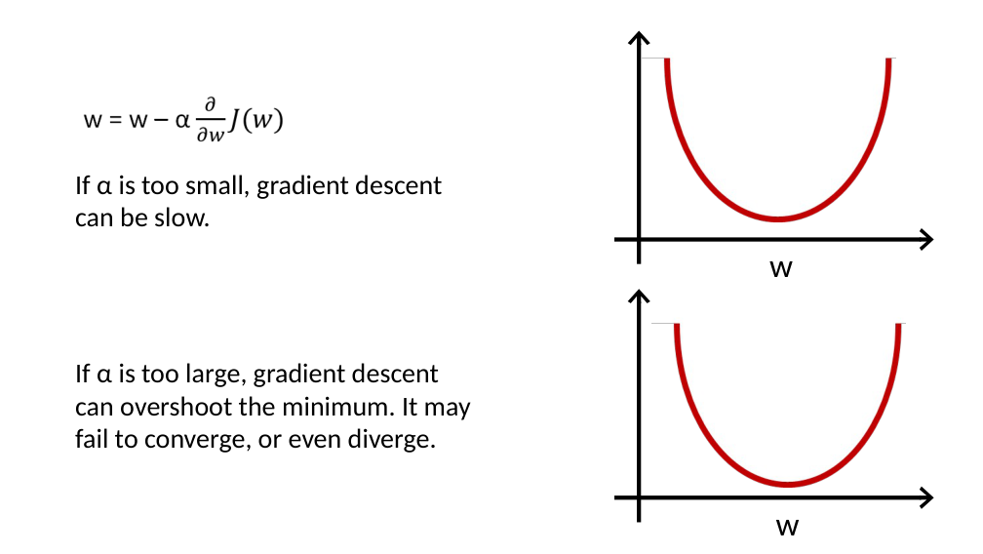
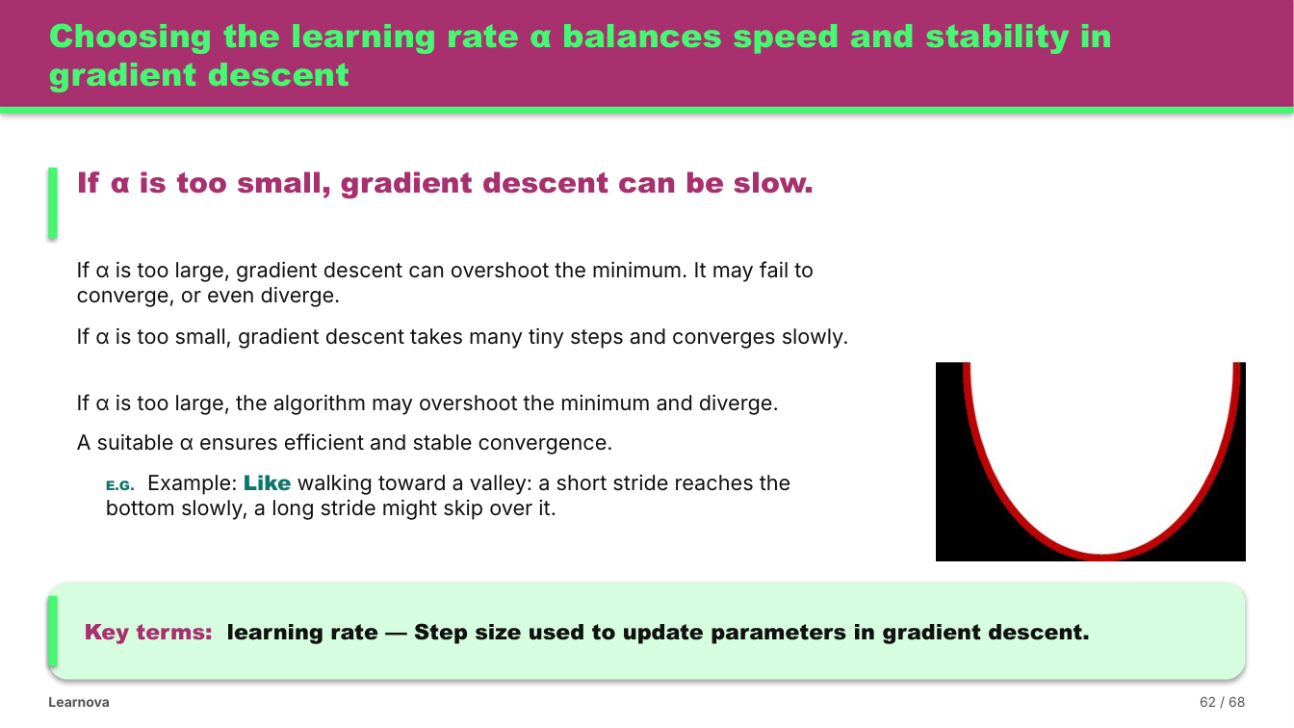
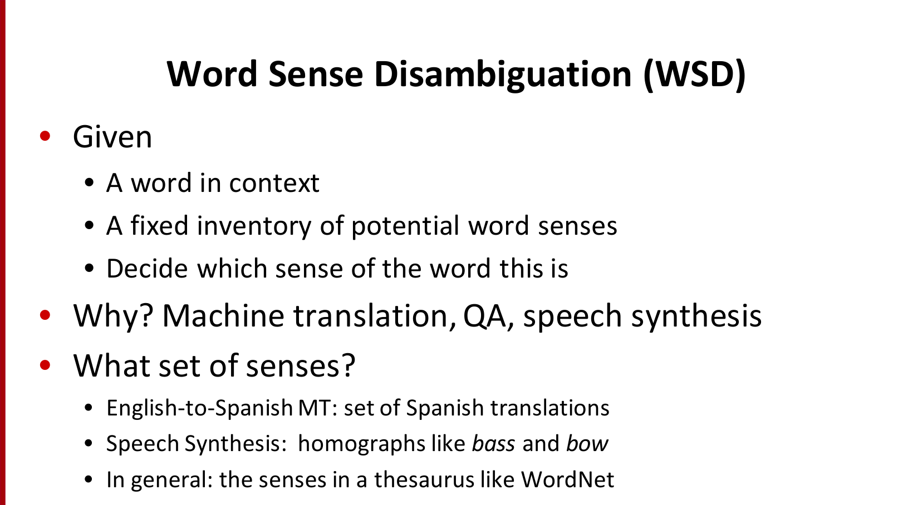
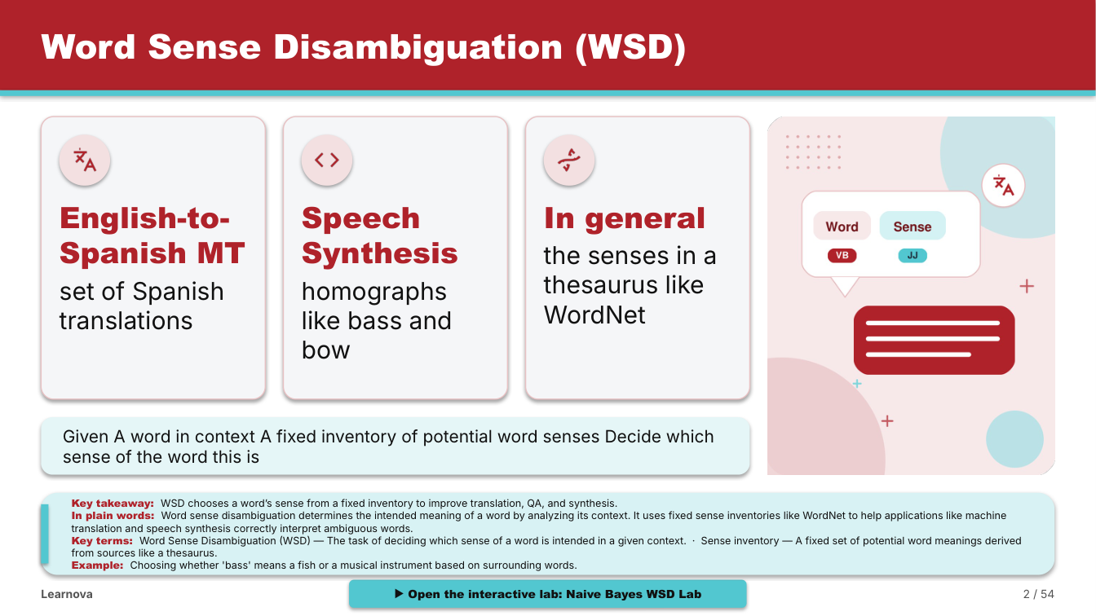
BEFORE vs AFTER
LEARNOVA · Group 1
IPD Review · AI & DS, DJSCE
The problems teachers and students faced — and what Learnova now achieves
Area | BEFORE — problem faced | AFTER — with Learnova
Text-heavy slides | ✘ 100+ words on a slide; students skim and miss points | ✔ One idea per slide, drawn as a visual at a readable density
Pictures of equations | ✘ Content locked in images; tools drop these slides | ✔ Kept full size as figures; OCR only when reliable
Untitled / generic titles | ✘ “Slide 9”, “Hypothesis (2/5)” says nothing | ✔ Assertion titles; 83 untitled slides → 0
No diagrams | ✘ Plain text with nothing to explain the idea | ✔ Illustration on every topic slide + HTML link
No interaction | ✘ Solved problems shown as finished tables | ✔ Quizzes, step-by-step solvers, labs
AI changes content | ✘ Paraphrased, merged, invented facts | ✔ Verbatim + checked: 98–100% facts kept
Redesign takes hours | ✘ An evening per lecture, needs design skill | ✔ ≈10–60 s per deck, fully editable
Needs internet / paid AI | ✘ Cloud-only, subscriptions, quotas | ✔ Offline mode; 5 free keys rotate
ORIGINAL → LEARNOVA
ML · Bias & variance (PPTX)
ML · Linear regression (PPTX)
Reading the comparison
The left column lists the problems we saw in our own courses: decks that are hard to read, half their content locked in pictures and no way for a student to check understanding. The right column is what Learnova does to the same material, measured on five real decks (two machine-learning PowerPoints and three NLP PDFs). The slide pairs show the same source slide before and after; the counters on the right sum the changes across all five decks.
The content itself does not change: fact retention stayed between 98% and 100% for every deck, and the layout audit found no overflowing text and no broken words.
NLP · WSD (PDF)
83 → 0
untitled slides
251
slides drawn as visuals
190
linked illustrations
64
quizzes + labs added
Learnova — redesigning outdated lecture slides into illustrated, interactive teaching decks
6

Slide 7



RESULTS, IMPACT & BENEFITS
LEARNOVA · Group 1
IPD Review · AI & DS, DJSCE
Measured on real course material — not on promises
97%
visual chosen correctly
101 gold slides, 3 sets
98–100%
facts kept
7 real decks
0
broken words / overflow
layout audit
26/26
problems solved right
held-out benchmark
< 1 ms
decision per slide
rule engine
~35 s
216-page PDF → deck
no API key
Students
Faculty
Institution
Society · SDG 4
✔ One clear idea per slide with a picture
✔ Steps with reasons for every solved problem
✔ Quizzes, labs and flashcards to practise
✔ Revise on a phone, even offline
✔ Old decks modernised in about a minute
✔ Their own words and figures kept
✔ Editable PowerPoint, ready to teach
✔ Quizzes and labs with no extra work
✔ Consistent, accessible course material
✔ No paid AI licence needed
✔ Supports flipped and remote classes
✔ Reusable lab library across subjects
✔ Quality education with low-cost tools
✔ Works where internet is unreliable
✔ Plain-language help for first-generation learners
✔ Open formats, easy to share
Use cases: a teacher uploads last year's PPT the night before a lecture and presents the redesigned deck; a student opens the shared web deck to revise with quizzes and labs; an IPCV class explores region growing and split-and-merge in the browser; a college without paid AI tools uses the offline mode. Next: a classroom study of learning outcomes with our own batch.
Learnova — redesigning outdated lecture slides into illustrated, interactive teaching decks
7

Slide 8





FEASIBILITY & VIABILITY
LEARNOVA · Group 1
IPD Review · AI & DS, DJSCE
Running today on a laptop · pilot-ready for a department · every risk has a named safeguard
TECHNICAL
Already working end to end: FastAPI back end, React front end, 755 automated tests, layout audit. Each stage is a separate module, so features are added without rework.
Challenges / risks → our safeguard
Adoption path
1
Messy lecture PDFs
symbol bullets, glued titles, picture slides → page reader, DP title split, OCR decision
1 · Pilot
AI & DS department: our own courses this semester, feedback from 3–4 faculty
DATA
Input is the college's own lecture material (PPTX, PDF, DOCX). Tested on seven real decks of 15 to 216 slides from NLP, ML and IPCV.
2
AI hallucination
paraphrase, invented facts → grounded checks, verbatim source, SymPy numbers
2 · Department
shared server, deck library per teacher, labs library grows with faculty labs
3
API quota / cost
free-tier limits → 5-key pool, per-key pacing, failover, offline mode, cache
3 · College / LMS
Moodle / Google Classroom export, regional languages, analytics
ECONOMIC
Free to run offline; Gemini free-tier keys (pool of 5) are optional. Hosting a department server costs less than a single paid AI-presentation licence per year.
4
Broken layout
overflow, split words → glyph-measured fitting, 11 pt floor, continuation slides
Deployment plan
OPERATIONAL
Teachers keep control: every slide stays editable and every automatic choice shows its reason. Students need only a browser.
5
Slow large decks
216 pages, many diagrams → parallel generation, content-hash caching
• Front end: static React build on Vercel / Netlify.
• Back end: Docker container (FastAPI + LibreOffice + Tesseract) on Render, Railway or Google Cloud Run with a persistent volume.
• Config: API URL for the front end; LEARNOVA_PUBLIC_URL so PowerPoint lab and illustration links resolve.
• Why not all on Vercel: long jobs, system binaries and on-disk storage do not fit serverless functions.
6
Unsafe generated code
scripts in SVG/labs → element whitelist, node --check, no network APIs
SECURITY
OTP sign-in, hashed codes, rate limits; AI-written SVG and lab code are whitelisted and statically checked; share links are view-only.
7
Wrong visual choice
rule misfires → alternatives shown in the editor; slide stays editable
Learnova — redesigning outdated lecture slides into illustrated, interactive teaching decks
8

Slide 9




RESEARCH & REFERENCES
LEARNOVA · Group 1
IPD Review · AI & DS, DJSCE
Papers we built on · tools we compared · our own publications and code
SLIDE GENERATION
FAITHFULNESS
LEARNING SCIENCE
WORKED EXAMPLES & LABS
▸ Hu & Wan, PPSGen, IEEE TKDE 27(4):1085–1097, 2015
▸ Fu et al., DOC2PPT, AAAI 36:634–642, 2022
▸ Sun et al., D2S, NAACL 2021, pp. 1405–1418
▸ Maynez et al., ACL 2020, pp. 1906–1919
▸ Ji et al., Survey of hallucination, ACM CSUR 55(12), 2023
▸ Mayer, Multimedia Learning, CUP, 2009
▸ Sweller, Cognitive Science 12(2), 1988
▸ Garner & Alley, IJEE 29(6), 2013
▸ Sweller & Cooper, Cogn. & Instr. 2(1), 1985
▸ Hundhausen et al., JVLC 13(3), 2002
▸ Wieman et al., PhET, Science 322, 2008
LAYOUT & VISUALS
NLP & OCR
TOOLS COMPARED
OUR PAPERS
▸ Knuth & Plass, Breaking paragraphs into lines, SPE 11(11), 1981
▸ Mackinlay, APT, ACM TOG 5(2), 1986
▸ Moritz et al., Draco, IEEE TVCG 25(1), 2019
▸ Jurafsky & Martin, Speech and Language Processing, 3rd ed. draft
▸ Smith, Tesseract OCR, ICDAR 2007
▸ Meurer et al., SymPy, PeerJ CS 3:e103, 2017
▸ Gamma (gamma.app)
▸ Microsoft Copilot in PowerPoint
▸ Gemini in Google Slides · Canva Magic Design
▸ IEEE conf. paper: Rebuilding lecture slide decks into visually structured, interactive presentations
▸ Springer LNCS paper: Computed step-by-step explainers and generated labs
Scan to verify: left — full source code, tests and demo decks (github.com/SDP42/LearnovaV2); right — both research papers (IEEE and Springer LNCS), gold sets and the measurement scripts used for every number on these slides. Web resources: revealjs.com · python-pptx · PyMuPDF · LibreOffice · Tesseract · ai.google.dev
Learnova — redesigning outdated lecture slides into illustrated, interactive teaching decks
9

Slide 10
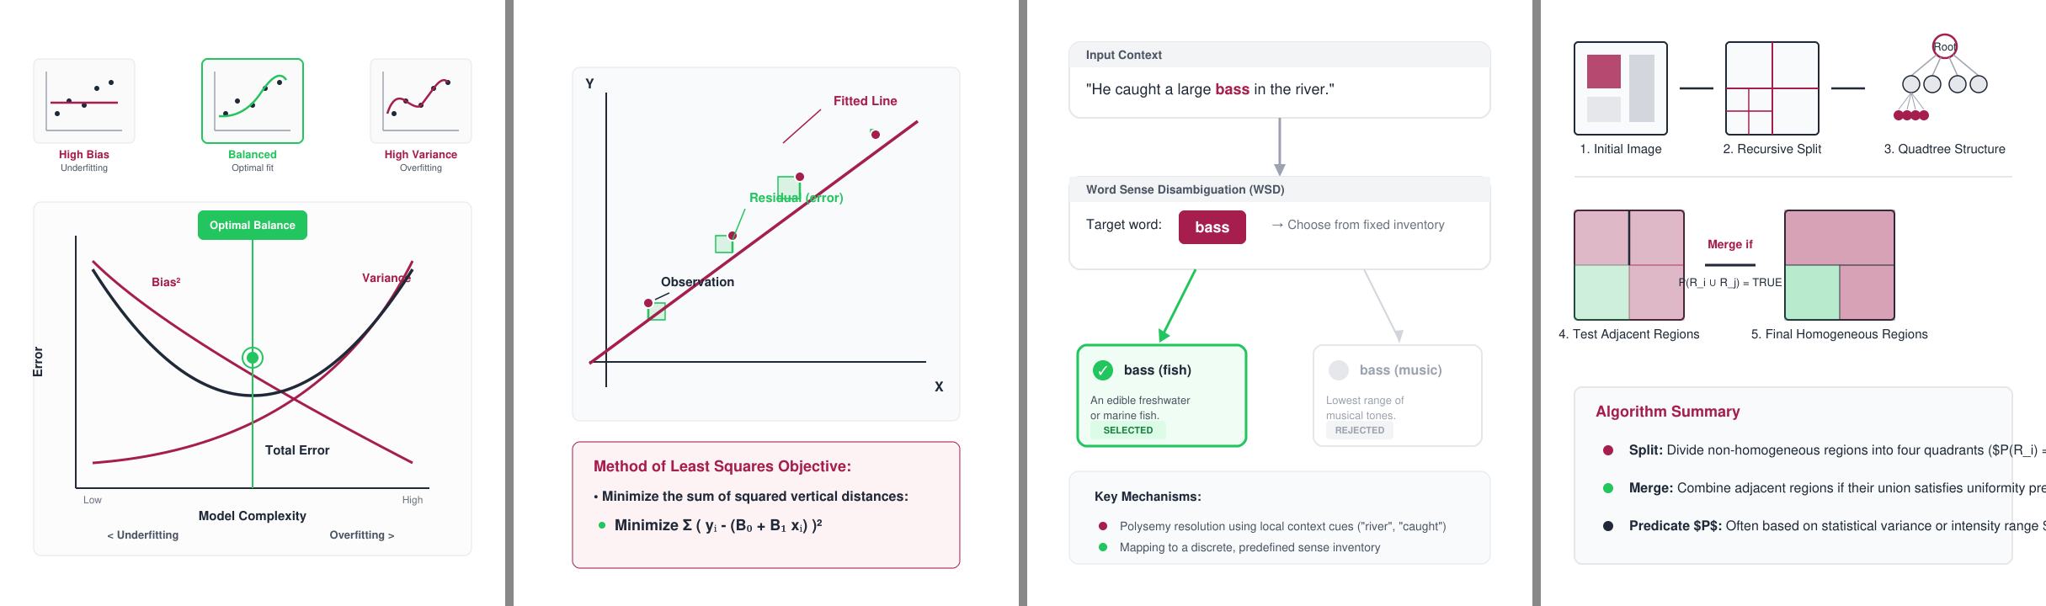
Thank You
Questions, feedback — and a live demo of Learnova
Upload any lecture deck and watch it become an illustrated, interactive teaching deck.
Diagrams drawn by Learnova for real lecture slides
TEAM · GROUP 1
Kawaljeet Singh Bharaj · 60018240016
Jeevesh Bharat Bodhani · 60018240096
Rishit Pankajkumar Lahoti · 6001840101
Swayam Devendra Panchal · 60018240013
Department of Artificial Intelligence and Data Science, DJSCE, Mumbai
Scan for
code, papers & demo decks
github.com/SDP42/LearnovaV2
LEARNOVA · Read · Redesign · Illustrate · Engage · Deliver

