Slide 1
Functions
Numerical Methods

Slide 2
Topics to be Covered
Concept of function
Operations of functions
Inverse function
Polynomials function
Logarithmic function
Exponent function
Trigonometric function
Slide <number> (of 41)

Slide 3
Learning Outcomes
On completion of this subject you should be able to:
  Understand the concept of function
  Perform operations on functions
  Find the inverse functions
  Understand different types of function
Slide <number> (of 41)

Slide 4
Key Terms you must be able to use
If you have mastered this topic, you should be able to understand the following terms:
Slide <number> (of 41)

Slide 5
Main Teaching Points
Functions
  A function is an association of exactly one object from one set (the range) with each object from another set (the domain).
  f is a function from A to B if and only if each element x of A appears one and only one pair (x, y) ∈ f, it is possible to write y = f(x) whenever x ∈ A.
  The unique element y = f(x) of B assign to x ∈ A by f is called the image of x under f.
  We write f: A → B to indicate that f is a function from A to B.
  The set A is called the domain of f and the set B is called the codomain of f.
Slide <number> (of 41)

Slide 6
Introduction
  Independent variable: A symbol represents the input numbers.
  Dependent variable: A symbol represents the output numbers.
  Arrow diagram for f
x
f(x)
a
f(a)
f
Domain
Range
Slide <number> (of 41)

Slide 7
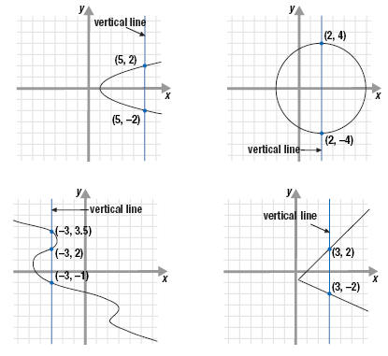
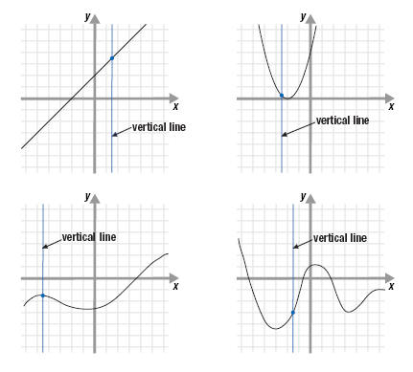
Introduction
Vertical Line Test
A curve in the xy-plane is the graph of a function of x if and only if no vertical line intersects the curve more than once.
Slide <number> (of 41)

Slide 8
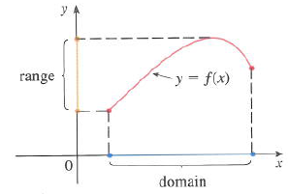
Introduction
  Graph of a function f
Slide <number> (of 41)

Slide 9
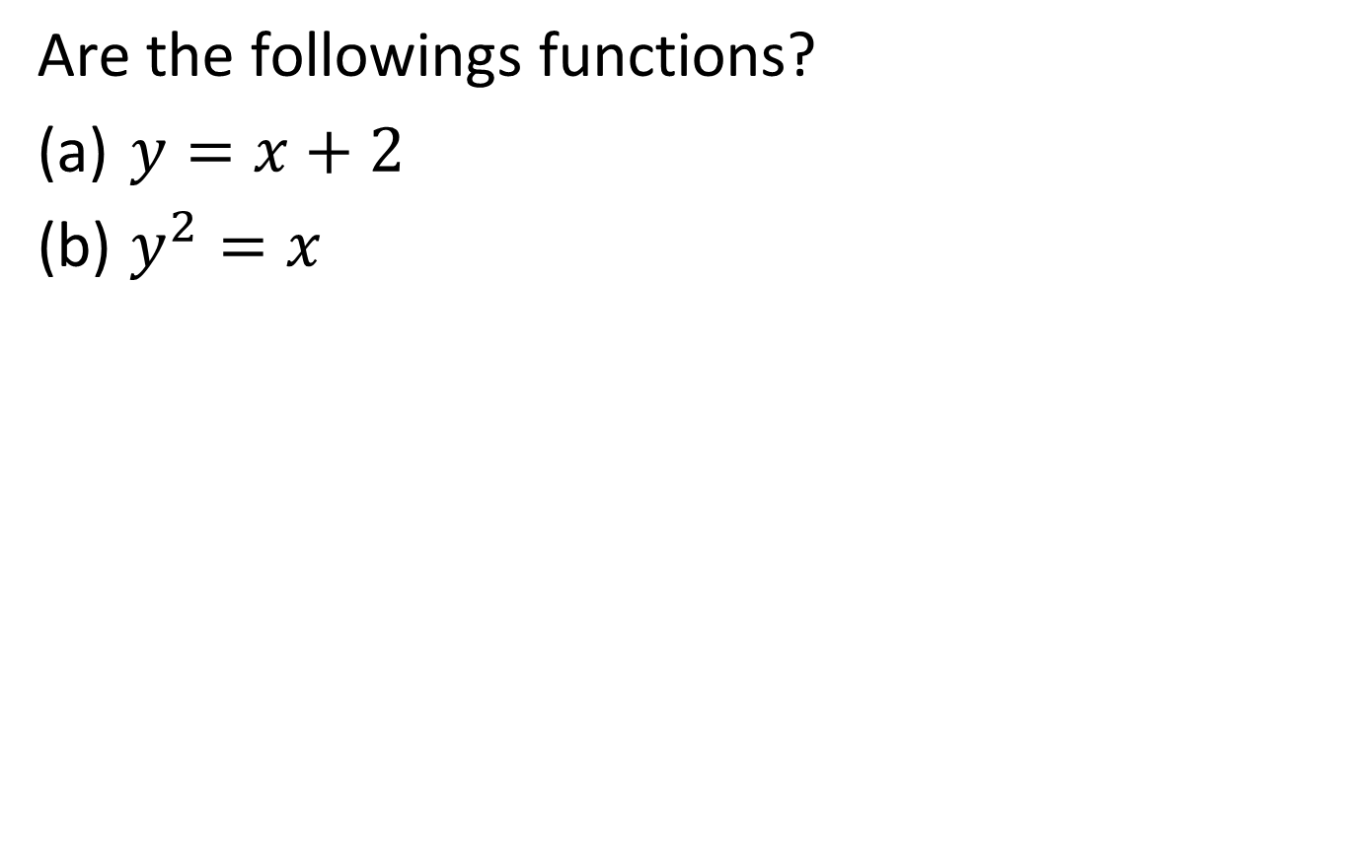
Example 1
y is a function of x
y is not a function of x
Slide <number> (of 41)
Notes:
Y is a function of x because f assigns each input value with exactly 1 output value, e.g. f(1) = 3, f(-1) = 1 etc.
Y is not a function of x because f assigns each input value with more than 1 output value, e.g. x = 1, y = -1 or 1; x = 4, y = -2 or 2 etc.

Slide 10
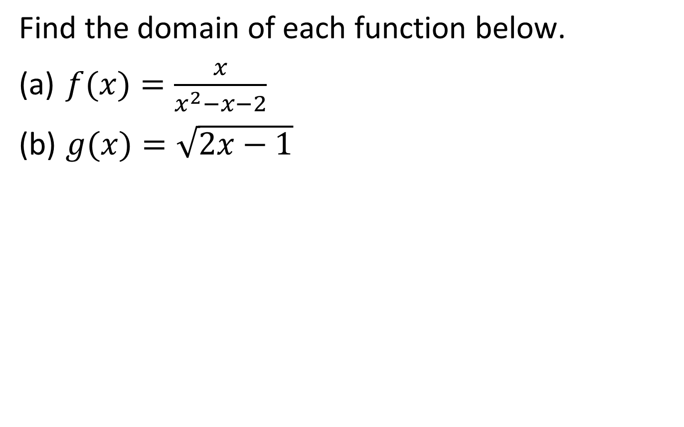
Example 3
Slide <number> (of 41)
Notes:
(x – 2)(x + 1) = 0, hence domain: x 𝜖 R, x ≠ 2 or x ≠ -1 or (-∞, -1), (-1, 2), (2, +∞).
2x – 1 ≥ 0, x ≥ ½, domain: x 𝜖 R, x ≥ ½ or [½, +∞).

Slide 11
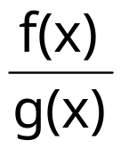
Main Teaching Points
Operations on Functions
  Sum of functions
  (f +g)(x) = f(x) + g(x)
  Difference of functions
  (f – g)(x) = f(x) – g(x)
  Product of functions
  (fg)(x) = f(x) . g(x)
  Quotient of functions
  (f/g)(x) =
Slide <number> (of 41)

Slide 12
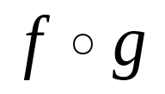
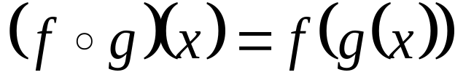
Combinations of Functions
Composite Function
Given 2 functions f and g, the composite function (also called the composition of f & g) is defined by
The domain of is the set of all x in the domain of g such that g(x) is in the domain of f .
Slide <number> (of 41)

Slide 13
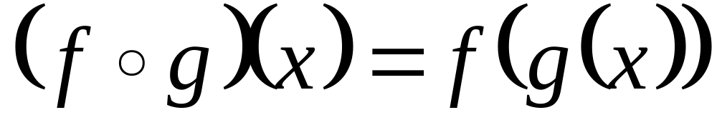
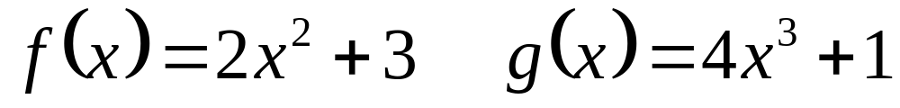
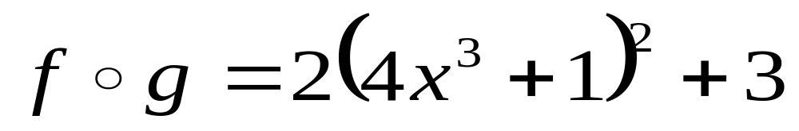
Compositions Functions
f composition g - copy the f function down but where ever you see an x, substitute in the g function.
Slide <number> (of 41)

Slide 14
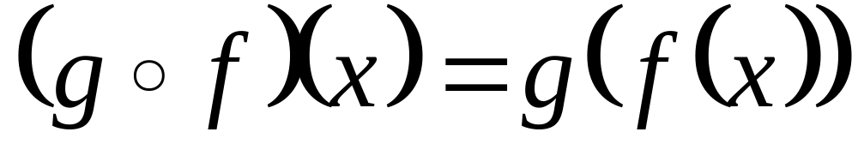
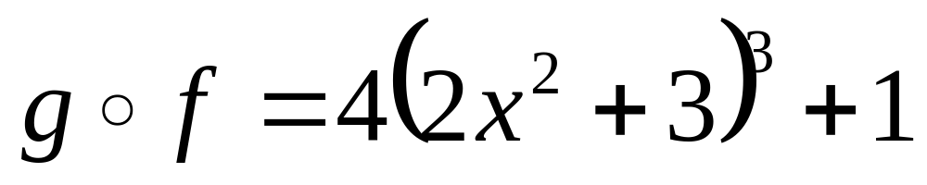
Compositions Functions
g composition f - copy the g function down but where ever you see an x, substitute in the f function.
Slide <number> (of 41)

Slide 15
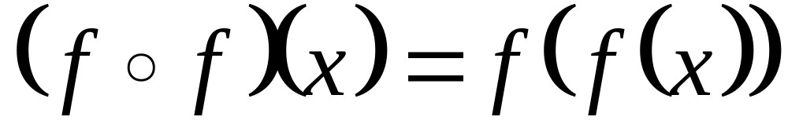
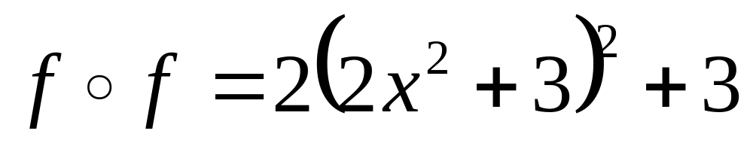
Compositions Functions
f composition f - copy the f function down but where ever you see an x, substitute in the f function (so substitute the function into itself).
Slide <number> (of 41)

Slide 16
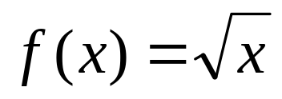
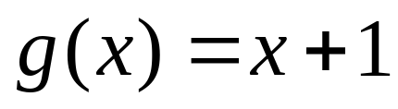
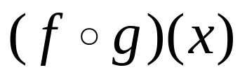
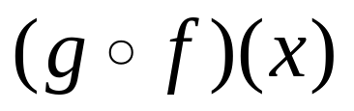
Example 8
(Composition Functions)
Let and . Find the following and its domain if it does exists.
(a)
(b)
Slide <number> (of 41)

Slide 17
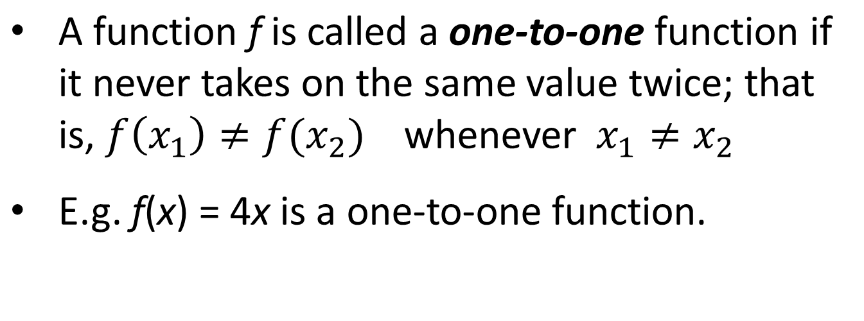
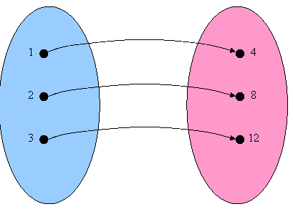
Inverse Functions
Slide <number> (of 41)
Notes:
e.g. (2𝑥^4−𝑥^2+1)/(𝑥^2−4)

Slide 18
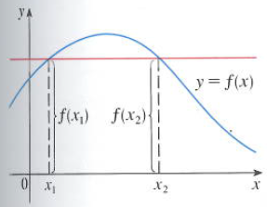
Inverse Functions
Horizontal Line Test
A function is one-to-one if and only if no horizontal line intersects its graph more than once.
Slide <number> (of 41)
Notes:
e.g. (2𝑥^4−𝑥^2+1)/(𝑥^2−4)

Slide 19
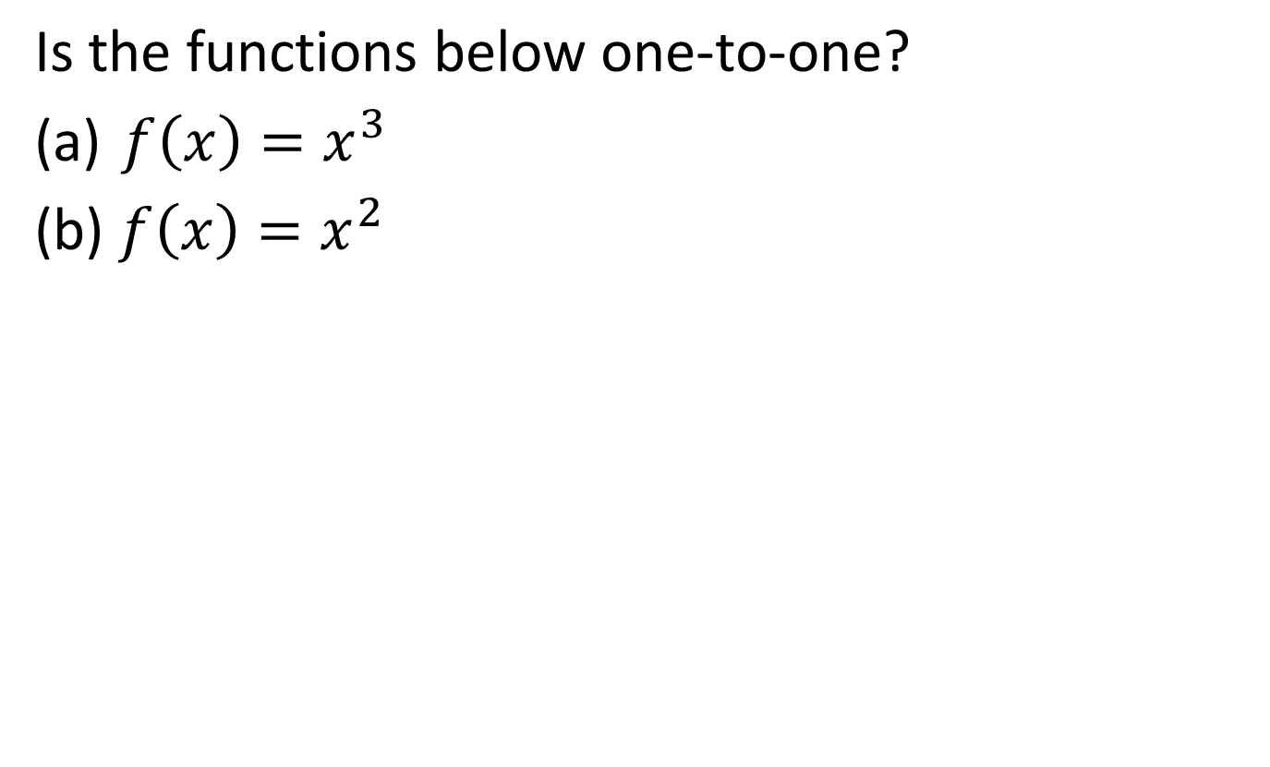
Example 9
(One-to-one Functions)
Slide <number> (of 41)

Slide 20
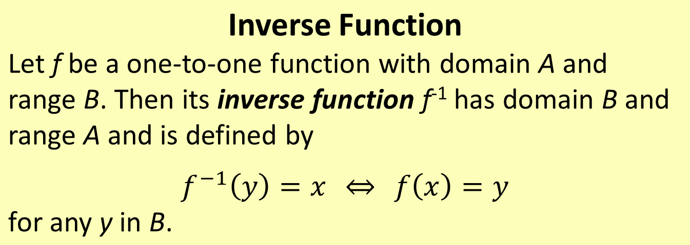
Inverse Functions
This definition says that if f maps x into y, then f⁻¹ maps y back into x.
Domain of f⁻¹ = Range of f
Range of f⁻¹ = Domain of f
Slide <number> (of 41)
Notes:
e.g. (2𝑥^4−𝑥^2+1)/(𝑥^2−4)

Slide 21
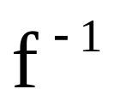
Main Teaching Points
  Invertible Functions
  Any function has an inverse relation . The inverse relation does not need to be a function. If the inverse relation of a function is a function, we say that the function is invertible.
Slide <number> (of 41)

Slide 22
Taking a set X and mapping into a Set Y
1
2
2
4
3
6
4
8
5
10
Set X
Set Y
An inverse function would reverse that process and map from SetY back into Set X
Slide <number> (of 41)

Slide 23
If we map what we get out of the function back, we won’t always have a function going back.
1
2
2
4
3
6
4
8
5
Since going back, 6 goes back to both 3 and 5, the mapping going back is NOT a function
These functions are called
many-to-one functions
Only functions that pair the y value (value in the range) with only one x will be functions going back the other way. These functions are called one-to-one functions.
Slide <number> (of 41)

Slide 24
This would not be a one-to-one function because to be one-to-one, each y would only be used once with an x.
1
1
2
2
2
2
4
3
4
3
6
4
6
4
8
8
5
10
5
10
This is a function IS one-to-one. Each x is paired with only one y and each y is paired with only one x
Only one-to-one functions will have inverse functions, meaning the mapping back to the original values is also a function.
Slide <number> (of 41)

Slide 25
Question and Answer Session
?
Slide <number> (of 41)

Slide 26
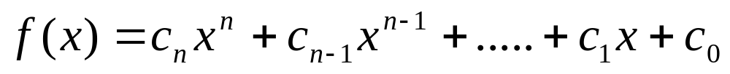
Different Types of Functions
Constant function – e.g. h(x) = c, where c is a constant and the domain of h are all real numbers. All function values are c.
A polynomial function is a function of the form
where n is the degree of the polynomial and c is the leading coefficient.
Slide <number> (of 41)

Slide 27
Different Types of Functions
Examples of polynomial
linear has degree 1
quadratic has degree 2
cubic has degree 3
quartic has degree 4
Slide <number> (of 41)

Slide 28
Exponential Function
  y = b^{x}
  has a variable exponent, x. This value is called the logarithm of y to the base b.
  we write
  log_{b} y = x
Slide <number> (of 41)

Slide 29
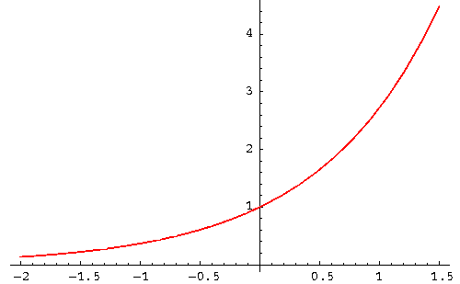
Graph of Exponential Function, e^{x}
Slide <number> (of 41)

Slide 30
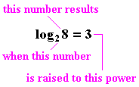
Logarithm
Slide <number> (of 41)

Slide 31
  Common logarithm
    base is always 10
    if no base is explicitly indicated, base 10 is implied
  Natural logarithm
    base is always 2.718281828
    base is usually indicated as e
    usually indicated as ln
Slide <number> (of 41)

Slide 32
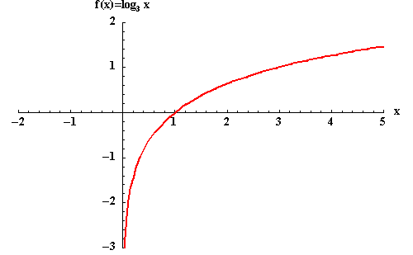
Graphs of logarithm
Slide <number> (of 41)

Slide 33
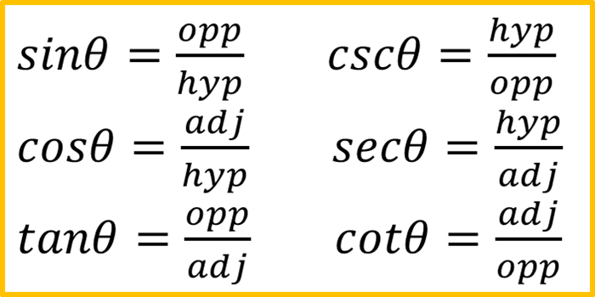
Trigonometric Functions
The six trigonometric functions are sine (sin), cosine (cos), tangent (tan), cotangent (cot), secant (sec) and cosecant (csc).
hypotenuse
opposite
θ
adjacent
Slide <number> (of 41)

Slide 34
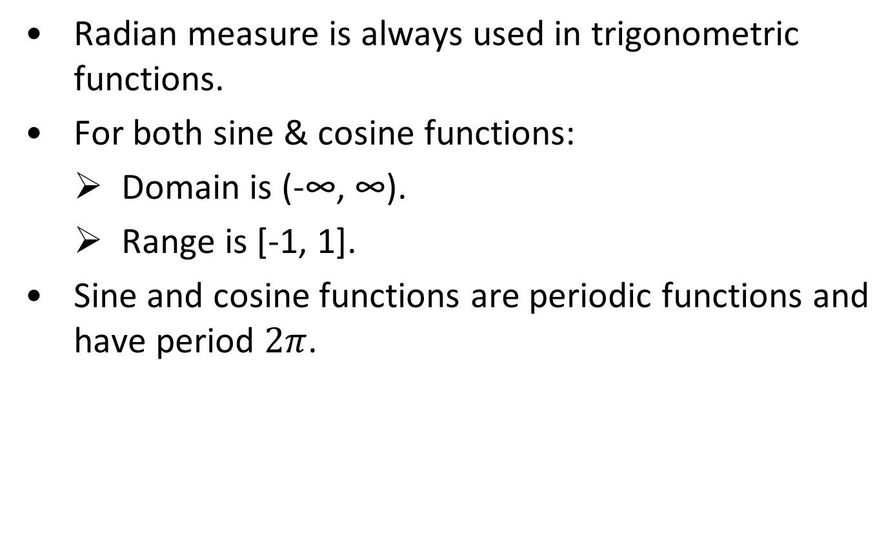
Trigonometric Functions
Slide <number> (of 41)

Slide 35




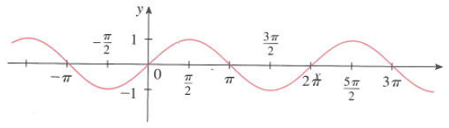
Trigonometric Functions
(Sine Function)
x
0
sin x
0
1
0
-1
0
y = sin x
Slide <number> (of 41)

Slide 36




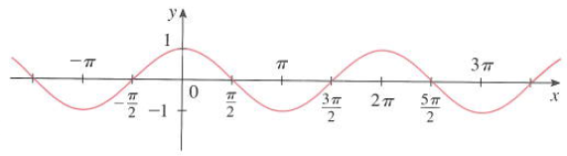
Trigonometric Functions
(Cosine Function)
x
0
cos x
1
0
-1
0
1
y = cos x
Slide <number> (of 41)

Slide 37
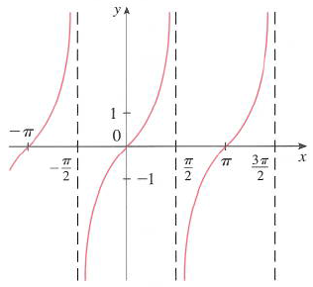
Trigonometric Functions
(Others)
y = tan x
Slide <number> (of 41)

Slide 38
Quick Review Question
?
Slide <number> (of 41)

Slide 39
Summary of Main Teaching Points
Concept of function
Operations of functions
Inverse function
Polynomials function
Logarithmic function
Exponent function
Trigonometric function
Slide <number> (of 41)

Slide 40
Question and Answer Session
Q & A
Slide <number> (of 41)

Slide 41
Next Session
Solving Equations
Slide <number> (of 41)

