Slide 1
Solving Equations
Numerical Methods

Slide 2
Topic & Structure of the lesson
Topic Outline
  Determining the equation of a straight line
  Solving linear equation
  Solving simultaneous equations
  Determining the quadratic equation
  Solving quadratic equations
  Solving exponential equations
  Solving logarithm equations
  Solving trigonometric equations
Slide <number> of 33

Slide 3
Learning Outcomes
  On completion of this topic, you should be able to:
  Solve simple linear and simultaneous equations.
  Find solutions of quadratic equations
  Solve exponential equations
  Solve logarithm equations
  Solve trigonometric equations
Slide <number> of 33

Slide 4
Key Terms you must be able to use
If you have mastered this topic, you should be able to use the following terms correctly in your assignments and exams:
Slide <number> of 33

Slide 5
Linear Functions
Determining the equation of a straight line
  gradient
  y-intercept
  x-intercept
  Given the linear function, defined by the equation y = mx + c, where m is the slope or gradient and c is the y-intercept.
Slide <number> of 33

Slide 6
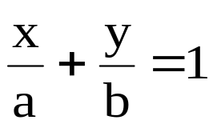
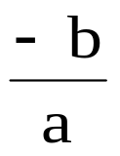
A linear function can also be expressed as
where, a is the x – intercept
b is the y – intercept
and the slope / gradient =
Slide <number> of 33

Slide 7
  Two lines when graphed on the same coordinate system, they are either parallel or intersect at one point. We use the slope/gradient of the two lines to determine whether they intersect or are parallel
    Given two lines with slopes m₁ and m₂:
      the two lines intersects if m₁ ≠m₂
      the 2 lines are parallel if m₁ = m₂
      the 2 lines are perpendicular to each other if m₁ x m₂ = -1.
      (Note that this property does not apply to horizontal and vertical lines since the slope of a horizontal line is zero while the slope of a vertical line is undefined)
Slide <number> of 33

Slide 8
  The equation of a line can be determined if given the following information
    slope/gradient and intercept
    slope/gradient and a point
    two points on the straight line
Slide <number> of 33

Slide 9
Solving linear equation
  Analytic (algebraic) techniques
    it involves manipulating the given equation algebraically
  Graphical techniques
    it involves drawing the appropriate graph and find where the line intersects the x – axis.
Slide <number> of 33

Slide 10
Solving simultaneous equations
  2 x 2
  3 x 3
    using
      elimination
      substitution
Slide <number> of 33

Slide 11
Quadratic Functions
Determining the quadratic equation
  A quadratic equation can always be put into a general form, ax² + bx + c = 0 where a, b, and c can take any numeric values.
Slide <number> of 33

Slide 12
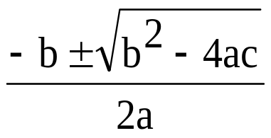
Solving quadratic equations
  algebraically
    by formula
    x =
    by factorising
    by completing the square
  graphical approach
    the graphical method is to plot the function and identify the x values where the curve meets the x-axis.
Slide <number> of 33

Slide 13
  Generally a quadratic equation will yield two solutions, but students should be aware that in fact quadratic equation can have either two, one or no solutions.
    if b² = 4ac there is one solution
    if b² < 4ac there are no solutions
    if b² > 4ac there are two distinct solutions
Slide <number> of 33

Slide 14
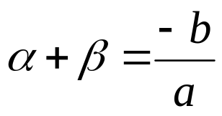
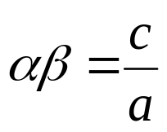
  If the equation ax² + bx + c = 0 has roots α and β then
  and
Slide <number> of 33

Slide 15

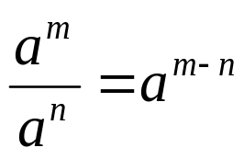
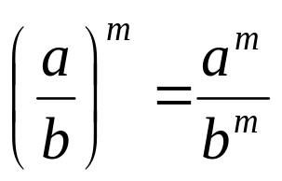



Law of Exponents
  How to multiply or divide two powers
    and
  How to calculate a power of a product or quotient
    and
  How to calculate a power of a power
  Note
Slide <number> of 33

Slide 16
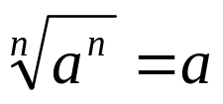
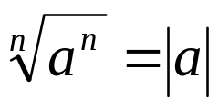
Properties of Radicals
  First property of radicals
  (n odd)
  (n even)
Slide <number> of 33

Slide 17


  Second Property of Radicals
    A root of a product is the product of the roots, if n is odd, or if n is even, provided all factors are nonnegative.
    If a < 0, b < 0, then
Slide <number> of 33

Slide 18
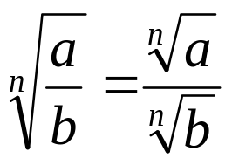
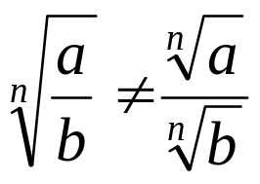
  Third Property of Radicals
    If a < 0, b < 0, then
Slide <number> of 33

Slide 19
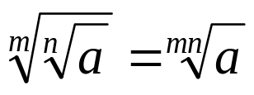
  Fourth Property of Radicals
    A root of a root is ….another root.
Slide <number> of 33

Slide 20
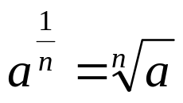
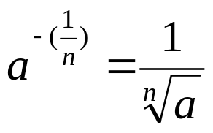
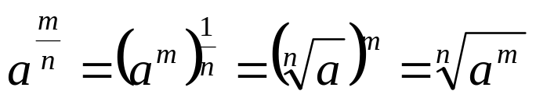
Fractional Exponents
  Let a be a number
    For n a natural number,
    and
    If m and n are integers,
Slide <number> of 33

Slide 21
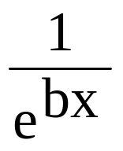
Properties of exponential function
  e^{z+c} = e^{z} x e^{c}
  e^{bx} =(e^{b})^{x} =(e^{x})^{b}
  e⁰ = 1
  e^{-bx} =
Slide <number> of 33

Slide 22
  Logarithm
  How to express the exponential function in logarithm form
  How to express the logarithm form in the exponential function
  How to determine the unknown
    log₁₀0.01 = x
    log_{b} (1/4) = -(1/2)
Slide <number> of 33

Slide 23

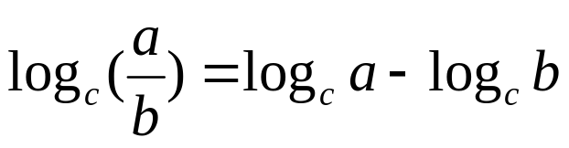



Laws of logarithms
Note That
Slide <number> of 33

Slide 24
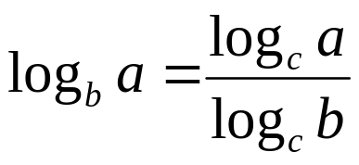
Changing the base of a logarithm
  The logarithm of a number to any base can always be calculated using natural or common logarithms
  Let a, b, and c be positive real numbers such that a ≠1 and b ≠1
  Then log_{b}a can be converted to the base c by
Slide <number> of 33

Slide 25
Antilogarithm
  is the inverse logarithm of a number
  is the number obtained when ten is raised to a power
  in base b of z =b^{z}
  it is not possible to find the logarithm of a negative number but possible to obtain the antilogarithm of a negative power.
Slide <number> of 33

Slide 26



Trigonometric Identities
Slide <number> of 33

Slide 27
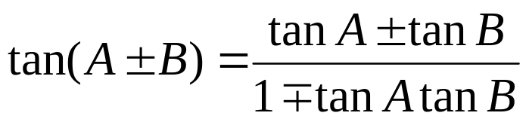
Compound Angle Identities
Slide <number> of 33

Slide 28




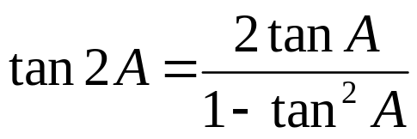
Double Angle Identities
Slide <number> of 33

Slide 29
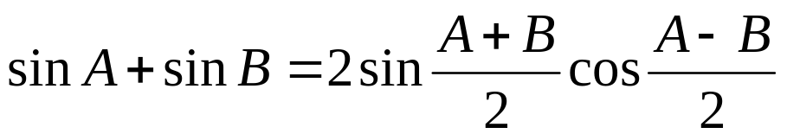
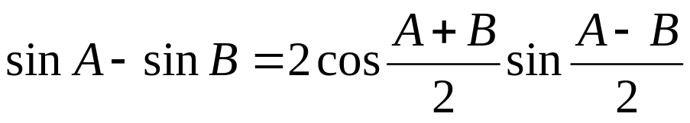
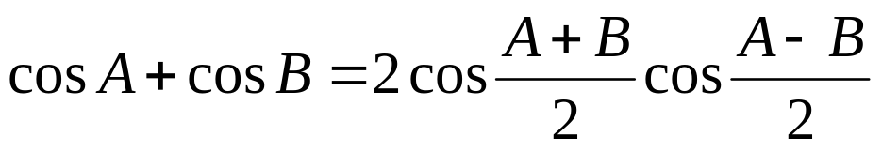
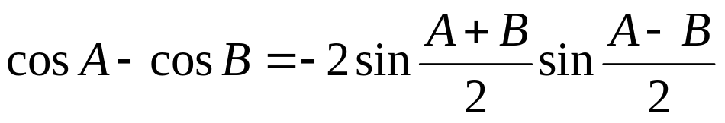
The Factor Formulae
Slide <number> of 33

Slide 30
Quick Review Question
?
Slide <number> of 33

Slide 31
Summary of Main Teaching Points
  Determining the equation of a straight line
  Solving linear equation
  Solving simultaneous equations
  Determining the quadratic equation
  Solving quadratic equations
  Solving exponential equations
  Solving logarithm equations
  Solving trigonometric equations
Slide <number> of 33

Slide 32
Question and Answer Session
Q & A
Slide <number> of 33

Slide 33
Next Session
Graph of Linear & Quadratic Functions
Slide <number> of 33

