Slide 1
Graph of Linear & Quadratic Functions
Numerical Methods

Slide 2
Topic & structure of the lesson
Graphs of linear functions
Graphs of quadratic functions
Slide <number> of 12

Slide 3
Learning Outcomes
At the end of this topic, YOU should be able to:
  Graphs both linear and quadratic functions.
Slide <number> of 12

Slide 4
Key Terms you must be able to use
If you have mastered this topic, you should be able to use the following terms correctly in your assignments and exams:
Slide <number> of 12

Slide 5


Draw linear graphs
  The straight line equation ax + by = c can be drawn by
    the line cuts the x-axis at x =
    the line cuts the y-axis at y =
Slide <number> of 12

Slide 6
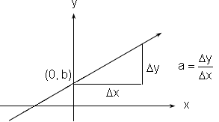
Graph of Linear Functions
f(x) = ax + b where a ≠ 0
A straight line
Slide <number> of 12

Slide 7
Draw quadratic graphs
  A quadratic equation when plotted on a graph is called a parabola.
  Plotting a parabola consists of
    choosing at least four of five relevant x-values
    substituting those values into the given quadratic equation to find the corresponding y-values
    plotting these points on a graph
    joining the points with a smooth curve.
Slide <number> of 12

Slide 8
Maximum or minimum value
  Use graphical approach to find the maximum or minimum value of y for quadratic functions
Slide <number> of 12

Slide 9
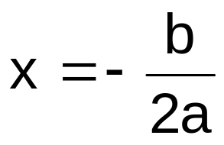
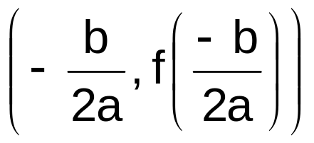
Graph of Quadratic Functions
f(x) = ax² + bx + c where a ≠ 0
  A parabola
  If a < 0, shape ∩ and maxima
  If a > 0, shape ∪ and minima
  Symmetrical about the axis of symmetry
  The turning point:
Slide <number> of 12

Slide 10
Summary of Main Teaching Points
Graphs of linear functions
Graphs of quadratic functions
Slide <number> of 12

Slide 11
Question and Answer Session
Q & A
Slide <number> of 12

Slide 12
Next Session
Differentiation
Slide <number> of 12

