Slide 1
Differentiation
Numerical Methods

Slide 2
Topic & Structure of the lesson
Topic Outline
  Basic differentiation rules
  Derivatives of polynomial functions
  Derivatives of trigonometric functions
  Derivatives of exponential functions
  Derivatives of logarithmic functions
Slide <number> of 24

Slide 3
Learning Outcomes
  On completion of this topic, you should be able to:
  differentiate polynomial, trigonometric exponential and logarithmic functions.
Slide <number> of 24

Slide 4
Main Teaching Points
Introduction
  Differentiation can be used to find maxima or minima of business functions.
  It can also be used to measure the rate of change in one variable resulting from a change in another variable at a particular point.
  The syllabus that this topic covers deal with calculus only at an elementary level and require:
    familiarity with a few simple rules
    an understanding of some relevant applications
Slide <number> of 24

Slide 5
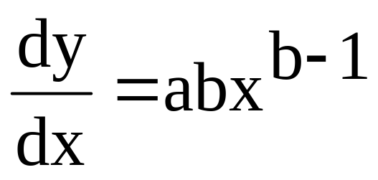
Differentiation
  Differentiation can be thought of as a process which transforms one function into a different one. The new function is known as the derivative of the original one.
  The derivative of the simple function,
  y = ax^{b} is given by
Slide <number> of 24

Slide 6
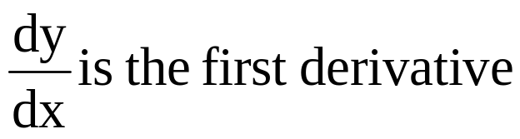
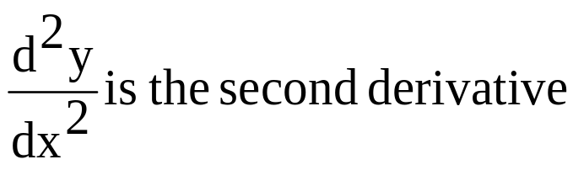
  The derivative of the sum of two or more simple functions is the sum of the separate derivatives of the functions.
  Differentiation can be repeated as many times as necessary on any given function.
  If y is any function of x:
Slide <number> of 24

Slide 7
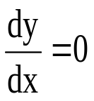
  Solving the equation,
  will identify the turning points of a function.
  The second derivative can then be used to indicate whether the turning point is a maximum or minimum.
    when the second derivative is positive, it signifies a minima.
    when the second derivative is negative, it signifies a maxima.
Slide <number> of 24

Slide 8
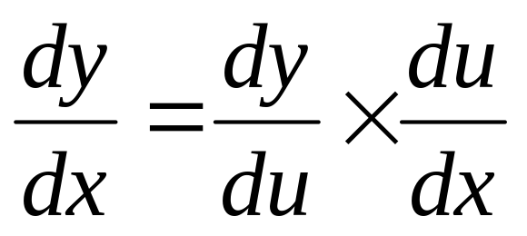
Chain Rule
If y = u and u = f(x) then
Slide <number> of 24

Slide 9
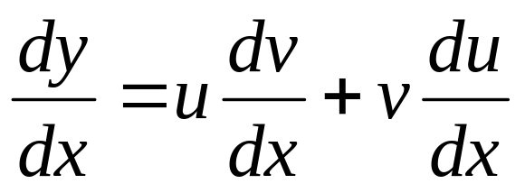
Product Rule
If y = uv and u = f₁(x), v = f₂(x) then
Slide <number> of 24

Slide 10

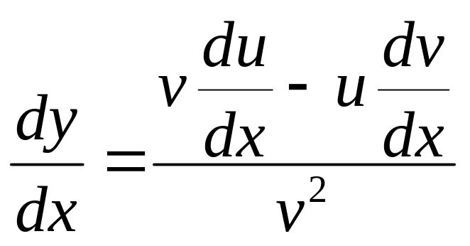
Quotient Rule
If y = and u = f₁(x), v = f₂(x) then
Slide <number> of 24

Slide 11
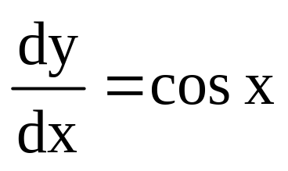
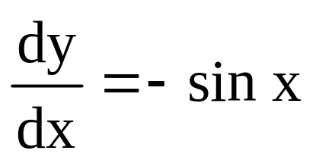
Derivatives of trigonometric functions
  y = sin x
  y = cos x
Slide <number> of 24

Slide 12
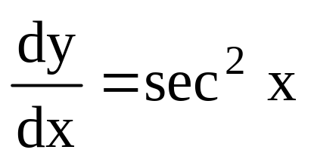
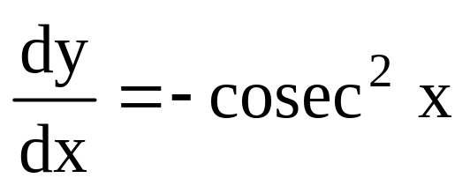
  y = tan x
  y = cot x
Slide <number> of 24

Slide 13
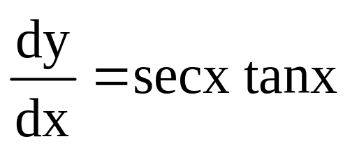
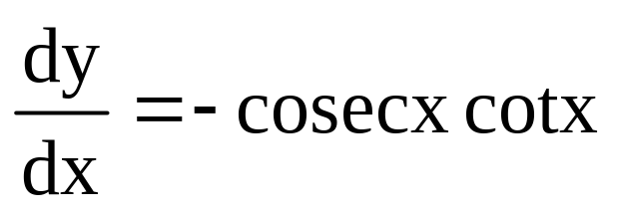
  y = sec x
  y = cosec x
Slide <number> of 24

Slide 14
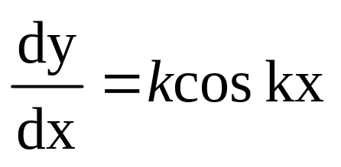
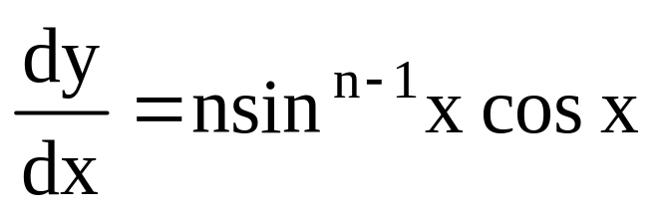
Using chain rule on trigonometric functions
  y = sin kx
  y = sin^{n} x
Slide <number> of 24

Slide 15
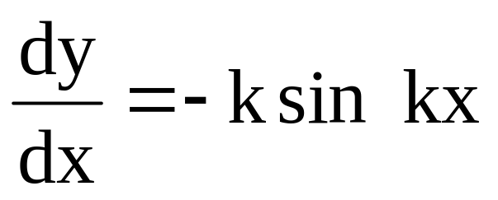
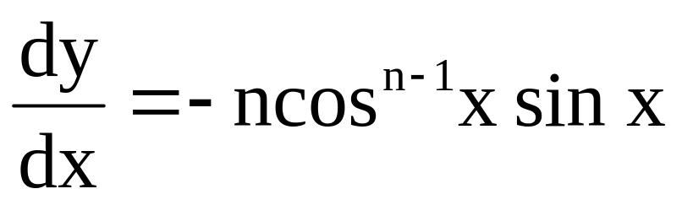
  y = cos kx
  y =cos^{n} x
Slide <number> of 24

Slide 16
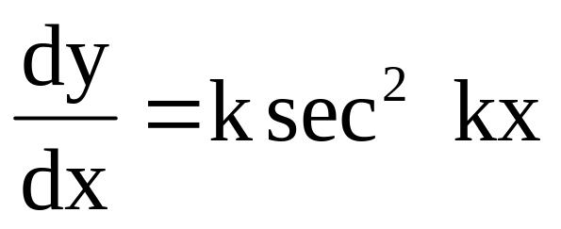
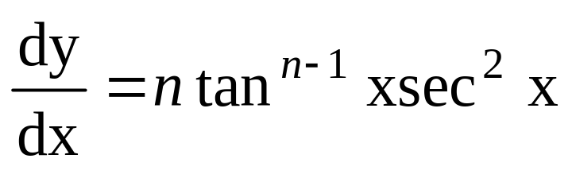
  y =tan kx
  y = tan^{n} x
Slide <number> of 24

Slide 17
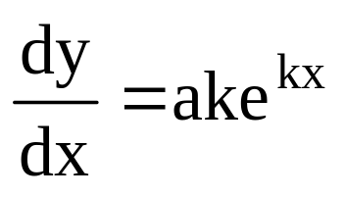
Derivatives of a exponential & logarithmic functions
  Exponential function
    y = ae^{kx}
    Notice that the power of e does not change after differentiation. You simply multiply by the number in front of the x.
Slide <number> of 24

Slide 18
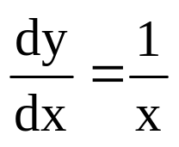
  logarithmic functions
    y = ln x
    In fact, whatever k, if y = ln kx
    then,
    This is because ln 2x = ln 2 + lnx and since ln 2 is just a number, it disappears upon differentiation.
Slide <number> of 24

Slide 19
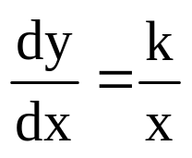
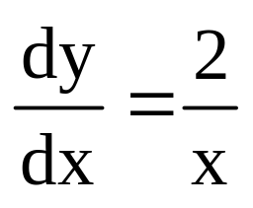
  y = ln x^{k}
    This is because ln x^{k} ≡k lnx
  Example:
  y = ln x²
Slide <number> of 24

Slide 20
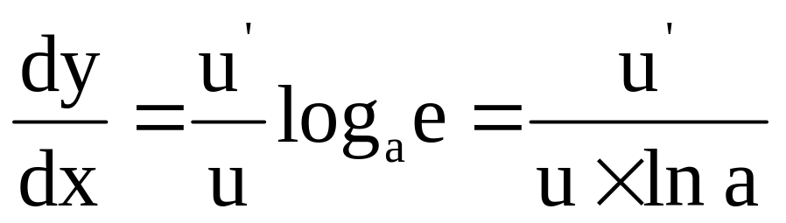
  y = log_{a} u
Slide <number> of 24

Slide 21
Quick Review Question
?
Slide <number> of 24

Slide 22
Summary of Main Teaching Points
  Basic differentiation rules
  Derivatives of polynomial functions
  Derivatives of trigonometric functions
  Derivatives of exponential functions
  Derivatives of logarithmic functions
Slide <number> of 24

Slide 23
Question and Answer Session
Q & A
Slide <number> of 24

Slide 24
Next Session
Integration
Slide <number> of 24

