Slide 1
Integration
Numerical Methods

Slide 2
Topic & Structure of the lesson
Topic Outline
Sum and sigma notation
The area problem and definite integral
Properties of the definite integral
The fundamental theorem of calculus
Indefinite integrals and the Total Change Theorem
The Substitution Rule
The Logarithm Defined as an integral
Slide <number> of 61

Slide 3
Learning Outcomes
  On completion of this topic, you should be able to:
to formulate problems involving integration.
use the formulas and properties of integration and indefinite integrals.
solve applications using integration and indefinite integrals.
Evaluate definite integrals and areas under the curve
Slide <number> of 61

Slide 4
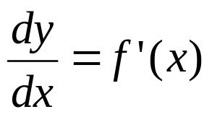
Integration
  Can be regarded as the reverse of differentiation (anti-derivative)
  Given that y = f(x), if we differentiate both sides with respect to x
Slide <number> of 61

Slide 5
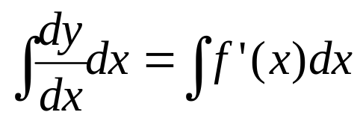
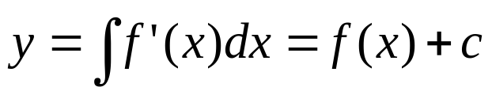
Integration
When we integrate both sides with respect to x,
, where c is a constant
This is known as indefinite integral. The process of finding anti-derivative is called anti-differentiation or integration. A function F is called an anti-derivative of a function f if the derivative of F is f.
Slide <number> of 61

Slide 6
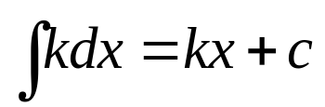
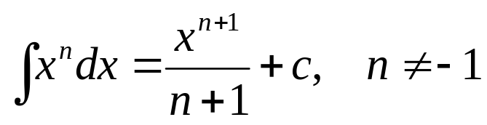
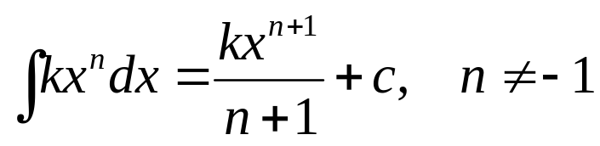
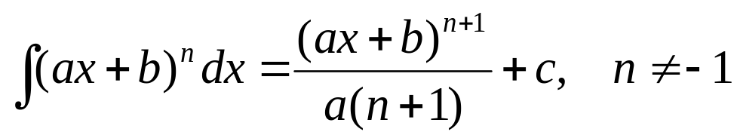
Basic Rules of Integration
, where k and c are costants.
In general
Slide <number> of 61

Slide 7
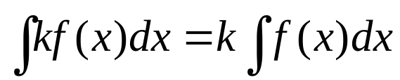
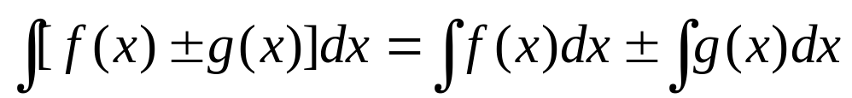
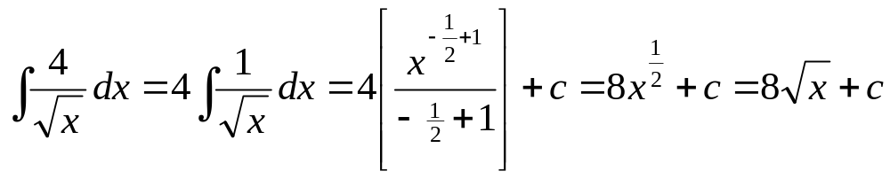
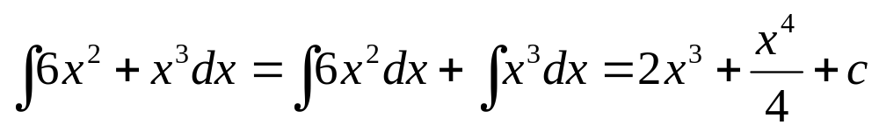
Basic Rules of Integration
,
Example:
Slide <number> of 61

Slide 8
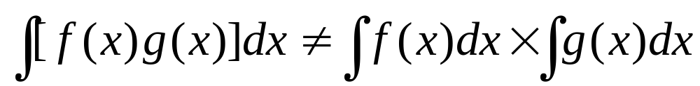
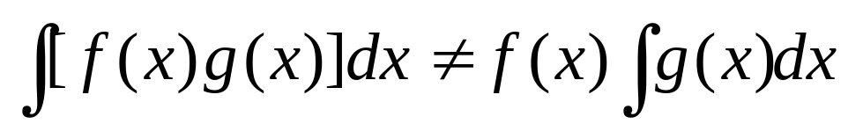
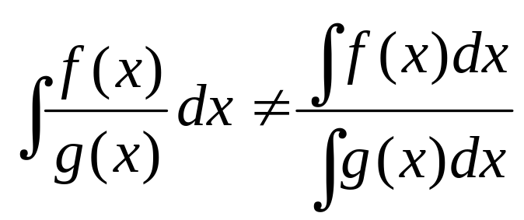
Caution
Slide <number> of 61

Slide 9
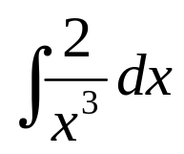
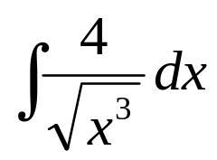
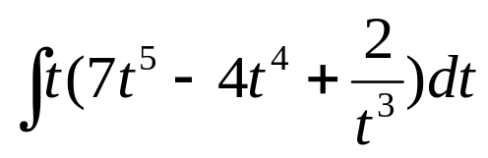
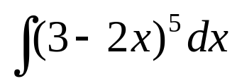
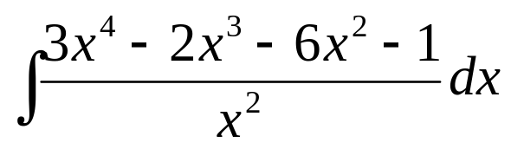
Quick Review Question
Evaluate the following integrals:
Slide <number> of 61

Slide 10

Quick Review Question
Find the anti-derivative F(x) of f(x) = that satisfies
F(1) = 2.
Slide <number> of 61

Slide 11
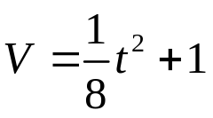
Definite Integral
When we find the area under a curve by adding rectangles, the answer is called a Rieman sum.
The width of a rectangle is called a subinterval.
subinterval
The entire interval is called the partition.
partition
Subintervals do not all have to be the same size.
Slide <number> of 61

Slide 12
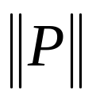
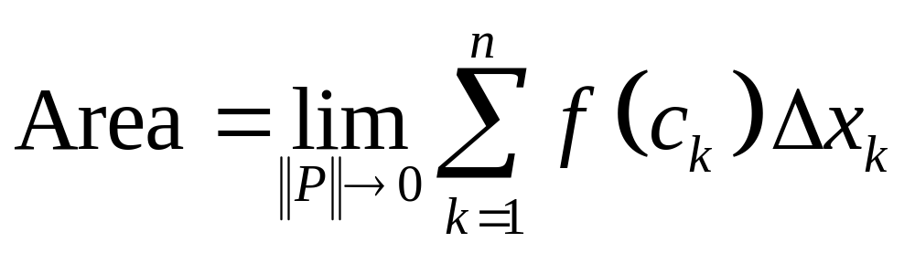
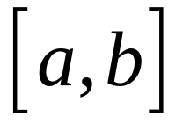
If the partition is denoted by P, then the length of the longest subinterval is called the norm of P and is denoted by .
subinterval
As gets smaller, the approximation for the area gets better.
partition
if P is a partition
of the interval
Slide <number> of 61

Slide 13
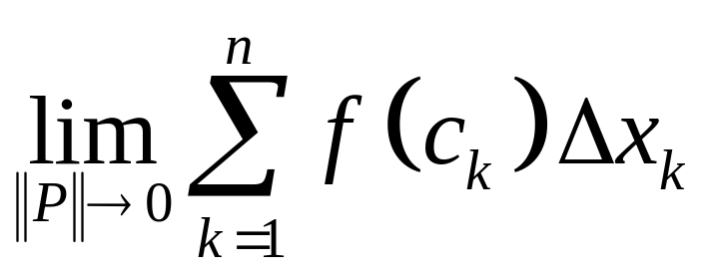
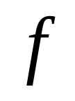
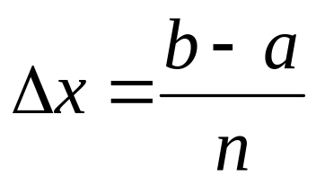
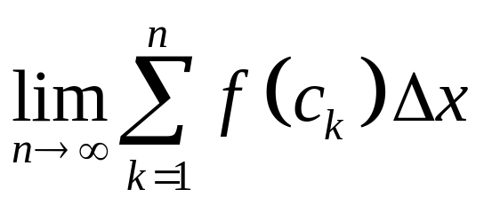
is called the definite integral of
over .
If we use subintervals of equal length, then the length of a subinterval is:
The definite integral is then given by:
Slide <number> of 61

Slide 14
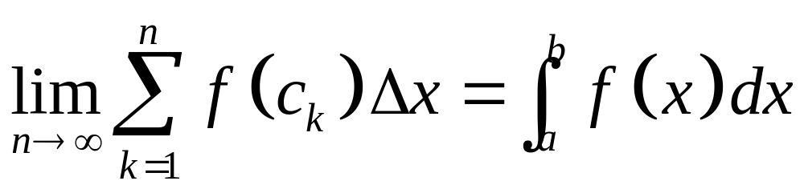
Leibnitz introduced a simpler notation for the definite integral:
Note that the very small change in x becomes dx.
Slide <number> of 61

Slide 15
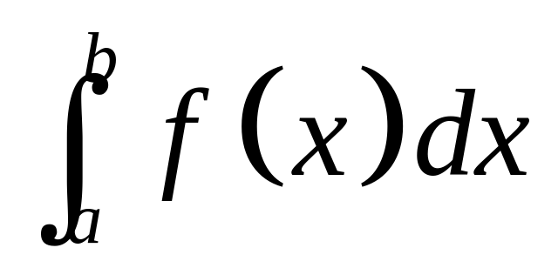
upper limit of integration
Integration
Symbol
integrand
variable of integration
(dummy variable)
lower limit of integration
It is called a dummy variable because the answer does not depend on the variable chosen.
Slide <number> of 61

Slide 16
Definite Integral
Method of evaluating the definite integral ,
Find the indefinite integral but omit c.
Draw square brackets and hang the limit on the end.
Replace with the top limit and the bottom limit
Subtract the top limit value with the bottom limit value.
:
Slide <number> of 61

Slide 17
Method of evaluating the definite integral
Find the indefinite integral but omit C
Draw square brackets and hang the limits on the end
Replace x with
the top limit
the bottom limit
Subtract and evaluate
Slide <number> of 61

Slide 18
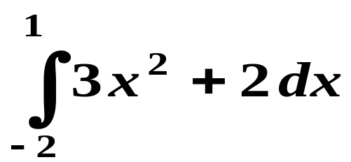
Example
is a definite integral
The numbers on the integral sign are called the limits of integration
Slide <number> of 61

Slide 19
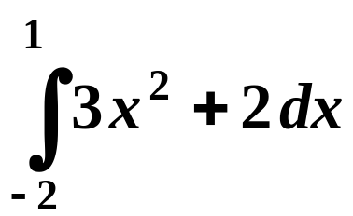
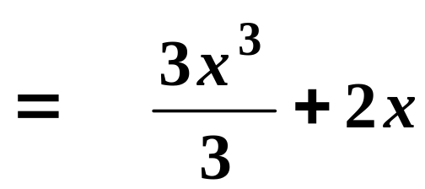
Evaluating the Definite Integral
The definite integration results in a value.
e.g.1
Find the indefinite integral but omit c
Slide <number> of 61

Slide 20
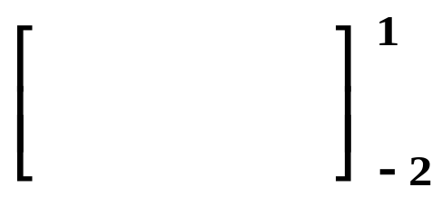
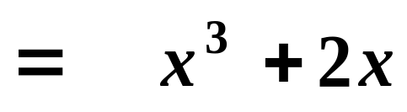
Draw square brackets and hang the limits on the end
Slide <number> of 61

Slide 21
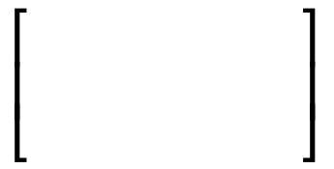


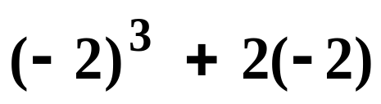


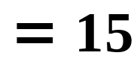
Replace x with
the top limit
the bottom limit
Subtract and evaluate
Slide <number> of 61

Slide 22
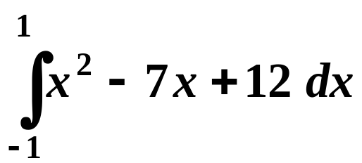
Quick Review Question
Find
Slide <number> of 61

Slide 23
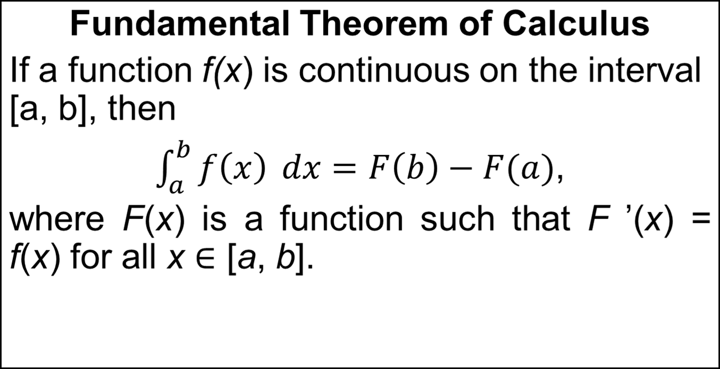
Definite Integral
Slide <number> of 61

Slide 24
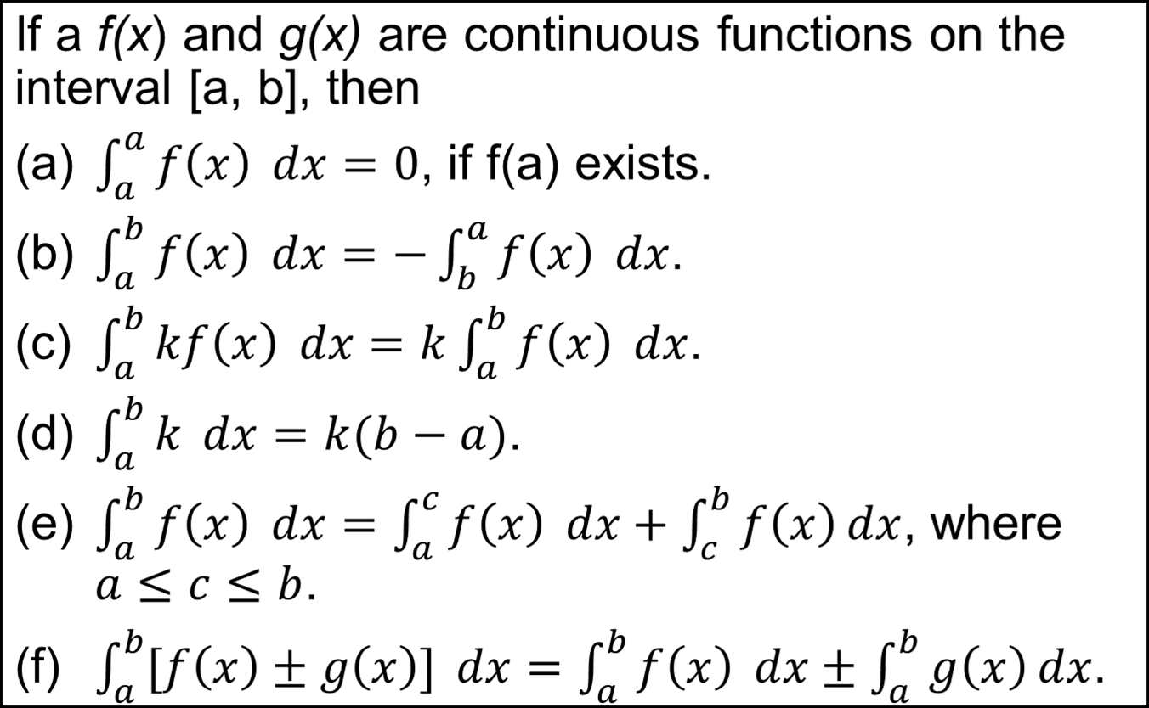
Basic Properties of Definite Integral
Slide <number> of 61

Slide 25
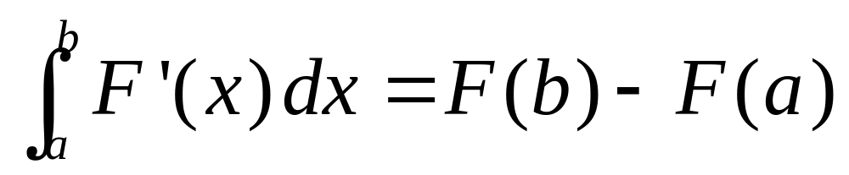
Net Change Theorem
The integral of a rate of change is the net change:
Slide <number> of 61

Slide 26
APPLICATIONS
We know F ’(x) represents the rate of change of y = F(x) with respect to x and F(b) – F(a) is the change in y when x changes from a to b.
  Note that y could, for instance, increase,
  then decrease, then increase again.
  Although y might change in both directions,
  F(b) – F(a) represents the net change in y.
Slide <number> of 61

Slide 27
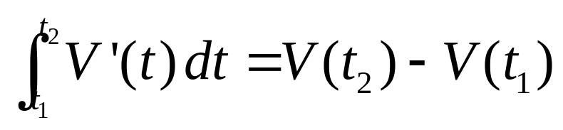
Example
If V(t) is the volume of water in a reservoir at time t, its derivative V’(t) is the rate at which water flows into the reservoir at time t.
  So,
  is the change in the amount of water in the reservoir between time t₁ and time t₂.
Slide <number> of 61

Slide 28
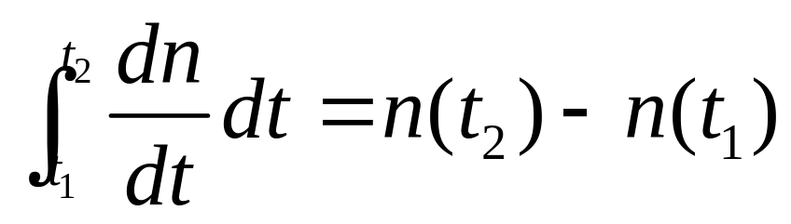
If the rate of growth of a population is dn/dt, then
is the net change in population during the time period from t₁ to t₂.
  The population increases when births happen
  and decreases when deaths occur.
  The net change takes into account both births
  and deaths.
Slide <number> of 61

Slide 29
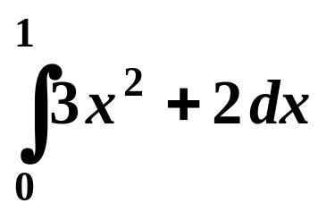
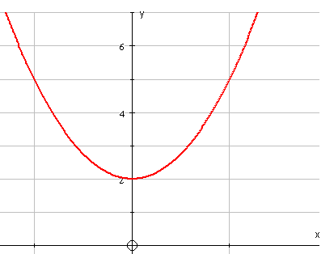

Definite Integration and areas
Definite integration can be used to find an area bounded, in part, by a curve
e.g.
gives the area shaded on the graph
The limits of integration . . .
0
1
Slide <number> of 61

Slide 30
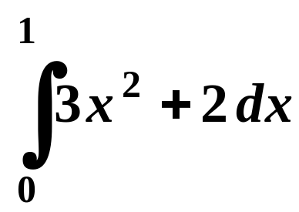
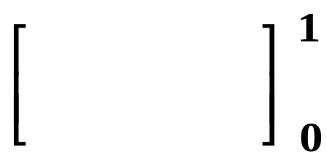
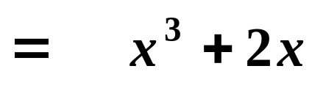

Since
y
=
3
x
2
+
2
the shaded area equals 3
0
1
The units are usually unknown in this type of question
Slide <number> of 61

Slide 31
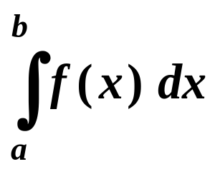
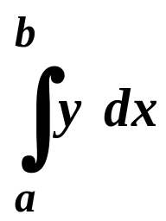

The definite integral or gives the area between
the curve
the x-axis and
the lines x = a and x = b
PROVIDED that
the curve lies on, or above, the x-axis between the values x = a and x = b
Slide <number> of 61

Slide 32





Example
A
B
For parts of the curve below the x-axis, the definite integral is negative, so
Slide <number> of 61

Slide 33







A
Area A
Slide <number> of 61

Slide 34





B
Area B
Slide <number> of 61

Slide 35
Take note
An area is always positive.
The definite integral is positive for areas above the x-axis but negative for areas below the axis.
To find an area, we need to know whether the curve crosses the x-axis between the boundaries.
For areas above the axis, the definite integral gives the area.
For areas below the axis, we need to change the sign of the definite integral to find the area.
Slide <number> of 61

Slide 36


Quick Review Question
Find the area between the curve
the x-axis and the lines x = 1 and x = 3.
2. Find the area between the curve
, the x-axis and the x = 2
and x = 3.
Slide <number> of 61

Slide 37



The Integration of 1/x
Example :
Slide <number> of 61

Slide 38



The Integration of 1/(ax + b)
Example :
Slide <number> of 61

Slide 39



Quick Review Question
Find,
Slide <number> of 61

Slide 40


Integral of Exponential Functions
Example :
Slide <number> of 61

Slide 41




Integral of Exponential Functions
Example :
Slide <number> of 61

Slide 42



Integral of Exponential Functions
Example :
Slide <number> of 61

Slide 43




Quick Review Question
Find the integral of the exponential functions below,
Slide <number> of 61

Slide 44





Take Note
Integral of Exponential Functions are,
Slide <number> of 61

Slide 45


Integration(Substitution Techniques)
Step 1 : Substitute u = g(x) ⇒ du = g’(x) dx
to obtain the integral
Step 2 : Integrate f(u) with respect to u
Step 3 : Replace u by g(x) in the result
Slide <number> of 61

Slide 46




Example 1
Find the integration of
Solution
As we can see that it is similar to
Except that it is replaced by a liner function (3x + 2)
Let , u = (3x + 2)
We get ,
Slide <number> of 61

Slide 47




Therefore,
Thus,
Slide <number> of 61

Slide 48

Example 2
Find,
Slide <number> of 61

Slide 49

Example 3
Find,
Slide <number> of 61

Slide 50

Example 4
Find,
Slide <number> of 61

Slide 51



As we can see from example 3 and 4 , we find that
thus , we can write
Slide <number> of 61

Slide 52




Quick Review Question
Exercise 1
Determine the integrals below
a)
b)
c)
d)
Slide <number> of 61

Slide 53

Integration ( By parts Techniques)
We need to make a judicious choice of u and dv to
make the right-hand side of the integration by parts
rule becomes the one you know how to integrate.
Slide <number> of 61

Slide 54







Example 5
Evaluate
Solution
There are two choices we can make for u and
First we let
and
Then
and
and integration by parts yields
We note that the problem is getting more complicated. Therefore, this choice of u and dv
is not suitable.
Slide <number> of 61

Slide 55






A second choice is
u = x and
and
Substitution in formula yields
Slide <number> of 61

Slide 56



Quick Review Question
Example 6
(a)
(b)
(c)
Slide <number> of 61

Slide 57






Quick Review Question
Find the integrals below
a)
A
N
S
W
E
R
S
b)
c)
Slide <number> of 61

Slide 58
Quick Review Question
?
Slide <number> of 61

Slide 59
Summary of Main Teaching Points
Sum and sigma notation
The area problem and definite integral
Properties of the definite integral
The fundamental theorem of calculus
Indefinite integrals and the Total Change Theorem
The Substitution Rule
The Logarithm Defined as an integral
Slide <number> of 61

Slide 60
Question and Answer Session
Q & A
Slide <number> of 61

Slide 61
Next Session
Real and Complex Numbers
Slide <number> of 61

