Slide 1
Real and Complex Numbers
Numerical Methods

Slide 2
Topic & Structure of the lesson
  Introduction
  Manipulation of complex numbers
  Illustration of complex numbers
    Cartesian form: notation & Argand diagram,
    Polar Form
Slide <number> of 30

Slide 3
Learning Outcomes
On completion of this module, you should be able to:
Perform simple arithmetic on Complex Numbers and illustrate the results geometrically
Slide <number> of 30

Slide 4
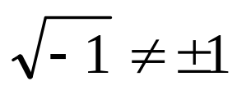
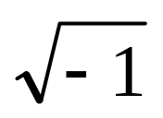
The Square Root of Minus One!
  If we want to calculate the square root of a negative number, it rapidly becomes clear that neither a positive or a negative number can do it.
  E.g., since 1² = (-1)² = +1
  To find we introduce a new quantity i,defined to be such that i² = -1
Slide <number> of 30

Slide 5
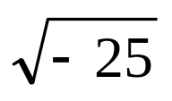
  Example 1
= 5i
Since (5i)² = 5^{2 x} i²
= 25 × ( - 1)
= - 25 .
Slide <number> of 30

Slide 6

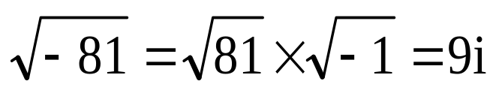
Real, Imaginary and Complex Numbers
  Real numbers are the usual positive and negative numbers.If we multiply a real number by i, we call the result an imaginary number.
  Example:
  i = (i² = -1)
  This is an imaginary number, it does not exist.
  Example:
Slide <number> of 30

Slide 7
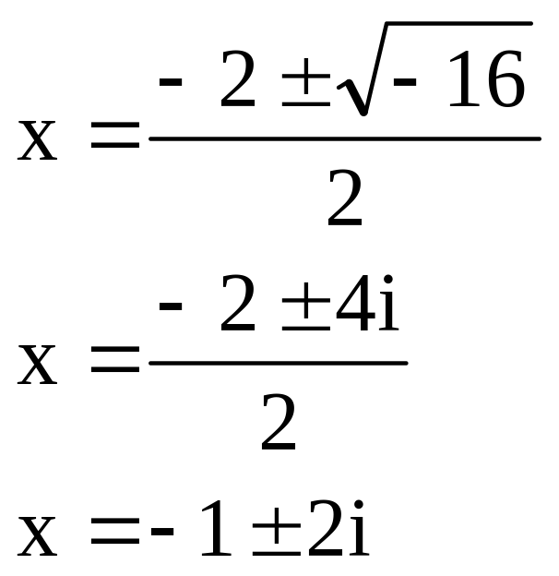
  Example:
  Solve x² + 2x + 5 = 0
Slide <number> of 30

Slide 8
  Numbers of the form a + bi (as above) where a∈ℜ and b ∈ℜ, are complex numbers. a is the real part while b is the imaginary part.
  Re (a + bi) = a
  Im (a + bi) = b
  If b = 0, the number is real, Therefore ℜ is a subset of complex numbers
Slide <number> of 30

Slide 9
Adding and Subtracting Complex Numbers
  If we want to add or subtract two complex numbers,
  z₁ = a + ib and z₂ = c +id, the rule is to add the real and imaginary parts separately:
  z₁ + z₂ = a + ib + c + id = a + c + i(b + d)
  z₁ - z₂ = a + ib - c - id = a - c + i(b - d)
  Example 2
    (1 + i) + (3 + i) = 1 + 3 + i(1 + 1) = 4 + 2i
    (b) (2 + 5i) - (1 - 4i) = 2 + 5i - 1 + 4i = 1 + 9i
Slide <number> of 30

Slide 10
Multiplying Complex Numbers
  We multiply two complex numbers just as we would multiply expressions of the form (x + y) together (see the package on Brackets)
  (a + ib)(c + id) = ac + a(id) + (ib)c + (ib)(id)
  = ac + iad + ibc - bd
= ac - bd + i(ad + bc)
Example 3
  (2 + 3i)(3 + 2i) = 2 × 3 + 2 × 2i + 3i × 3 + 3i × 2i
= 6 + 4i + 9i - 6
= 13i
Slide <number> of 30

Slide 11
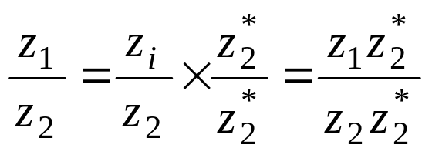
Dividing Complex Numbers
  The trick for dividing two complex numbers is to multiply top and bottom by the complex conjugate of the denominator:
  The denominator, z₂Z₂*, is now a real number
Slide <number> of 30

Slide 12
  Conjugate Number
    The conjugate (or complex conjugate) of the complex number a + bi is a - bi.
    Conjugates are important because of the fact that a complex number times its conjugate is real; i.e., its imaginary part is zero.
  (a + bi)(a - bi) = (a² + b²) + 0i = a² + b².
Slide <number> of 30

Slide 13
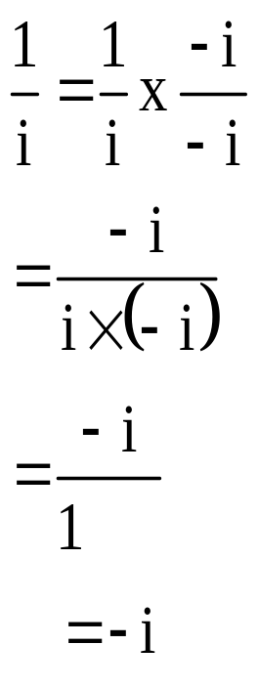
  Example:
Slide <number> of 30

Slide 14
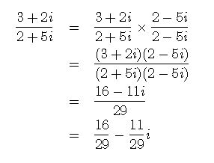
  Example
Slide <number> of 30

Slide 15
Illustration of complex numbers
  Cartesian form
    Notation
    Argand diagram
  polar form
  exponential form
Slide <number> of 30

Slide 16
Cartesian form
  The format of expressing complex numbers is called “Rectangular form” or “Cartesian Form”
  Notation
    For differing or unknown values of the complex number, for instance the "H" that was used to represent the hypotenuse, a standard set of characters are used as illustrated in the diagram below;
Slide <number> of 30

Slide 17
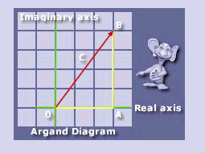
Slide <number> of 30

Slide 18
  As you can readily see, this means that "c = a +jb" there are other notations used, for instance in electrical engineering, values of impedance et cetera are depicted as z for the hypotenuse.
Slide <number> of 30

Slide 19
Graphing Complex Numbers
  You graph real numbers on a number line, but you graph complex numbers the same way you would graph an ordered pair, such as (x, y), but the x-axis is replaced by the real axis, and the y-axis is replaced by the imaginary axis.
  Example: Graph:
    A: 3 + 2i
    B: -4 + 5i
    C: -5 - 4i
    D: i
Slide <number> of 30

Slide 20
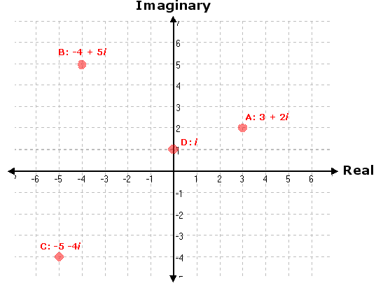
Slide <number> of 30

Slide 21
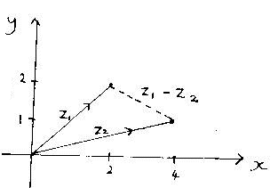
Argand Diagram
  Similarly, they may be vectors: (which allows geometry to be used to add and subtract)
  z₁ = 2 + 2i
  z₂ = 4 + i
Slide <number> of 30

Slide 22
Polar form
  Simply another way of expressing a complex number
  Complex number not only be expressed by giving real and imaginary values but by giving the magnitude (length) of the hypotenuse, called the modulus, with respect to the angle between it and the real axis. The angle is referred to as the argument between the modulus and the real axis. The diagram below illustrates the modulus and the argument.
Slide <number> of 30

Slide 23
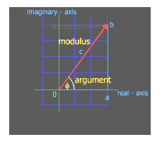
Slide <number> of 30

Slide 24
  The Polar form of a complex number is written in the following way C∠φ
  The C denotes the Modulus and the Greek symbol Phi represents the Argument.
Slide <number> of 30

Slide 25
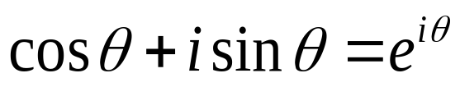
Exponential form
  A complex number also can be expressed in an exponential form.
Slide <number> of 30

Slide 26
  De Moivre’s Theorem
Slide <number> of 30

Slide 27
Quick Review Question
?
Slide <number> of 30

Slide 28
Summary of Main Teaching Points
Real & Imaginary Numbers
i
Complex Numbers
Conjugate
Argand Diagram
Polar Form
Slide <number> of 30

Slide 29
Question and Answer Session
Q & A
Slide <number> of 30

Slide 30
Next Session
The End
Slide <number> of 30

