Slide 1
Intelligent Student Performance Analytics and Learning Strategy Optimization
A DATA MINING APPROACH USING THE OPEN UNIVERSITY LEARNING ANALYTICS DATASET
S.D. Prematunga
268382R

Slide 2
PROBLEM & OBJECTIVES
The Challenge
Objectives
Student dropout and failure remain persistent issues in higher education.
Traditional identification of at-risk students is reactive and often too late.
Need: Proactive, data-driven early-warning systems.
Identify key factors influencing student outcomes.
Build predictive models to flag at-risk students early.
Discover natural student segments through clustering.
Generate actionable recommendations for educators

Slide 3
DATASET & PREPARATION
Open University Learning Analytics Dataset (OULAD):
32,593 students across multiple course presentations
7 interrelated data files merged into a unified dataset
Data Integration Pipeline:
Student Assessments: total_weighted_score, avg_score, assessments_submitted
VLE Interactions: total_clicks, active_days, unique_activities
Registration Records: earliest_registration, has_unregistered
Student Demographics: gender, age_band, education, region, disability
Missing values are filled with 0
Engineered features (5):
clicks_per_day, assessment_completion_rate, score_per_assessment, early_registration, is_at_risk

Slide 4
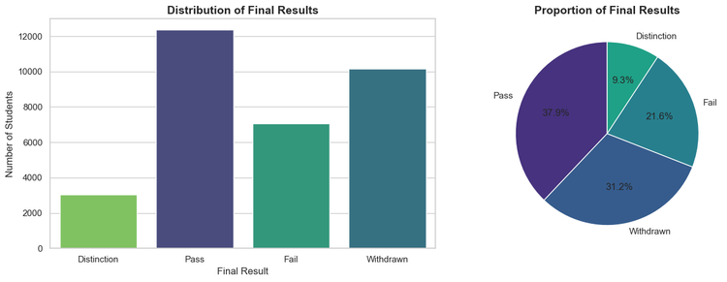
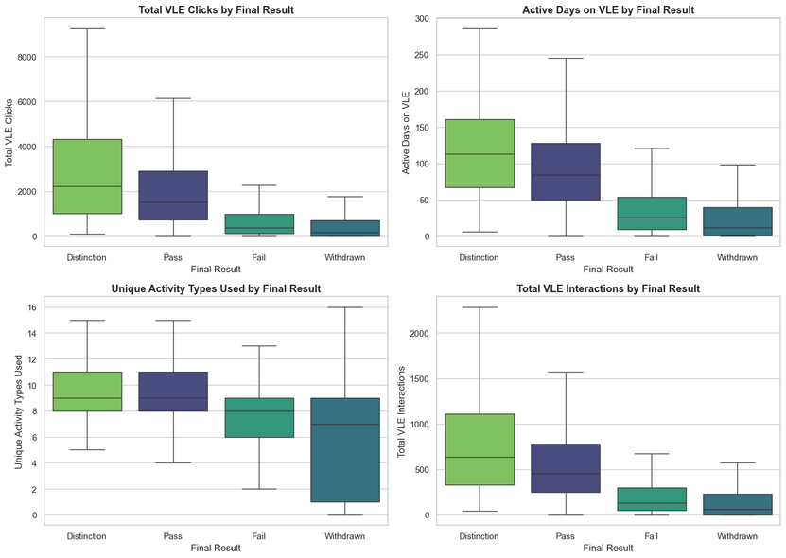
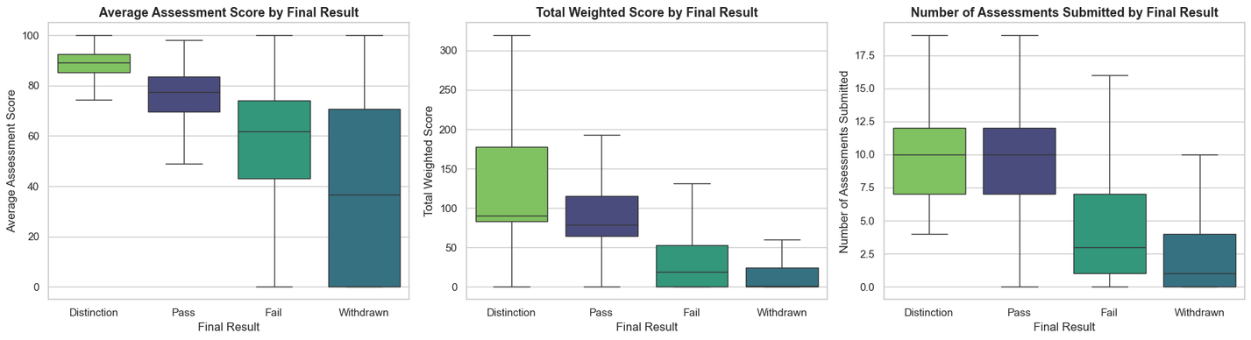
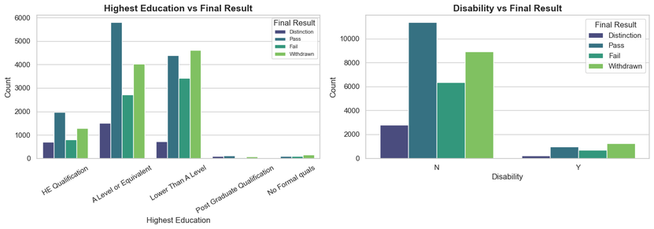
EXPLORATORY DATA ANALYSIS — KEY FINDINGS
Target Distribution:
52.8% At-Risk (Fail + Withdrawn) vs. 47.2% Successful
Key Patterns Discovered:
Engagement : Successful students exhibit substantially higher total clicks,
active days, unique activities, and total VLE interactions.
Assessment performance: Successful students exhibit Higher average score,
higher total weighted score and higher number of assessment submissions.
Educational analysis: Student has more prior qualifications
exhibits a higher pass rate.
Disability: Students who are disabled have a higher withdrawal rate.

Slide 5
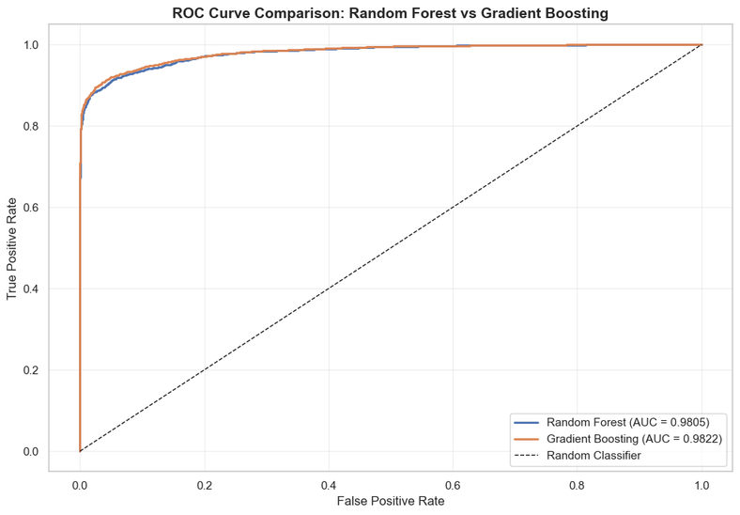
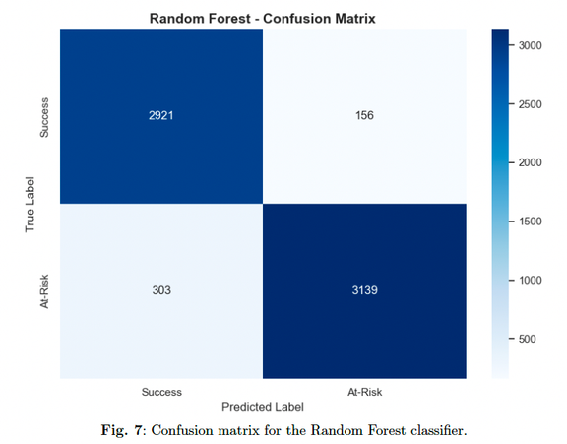
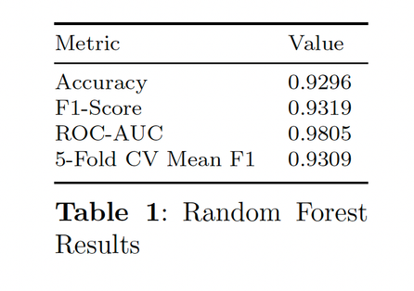
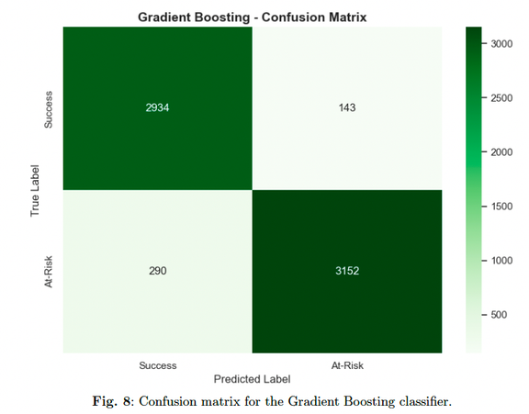
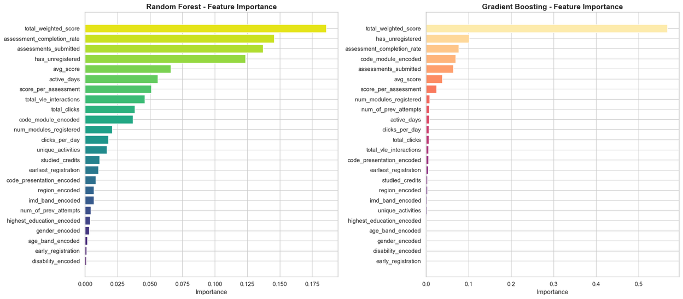
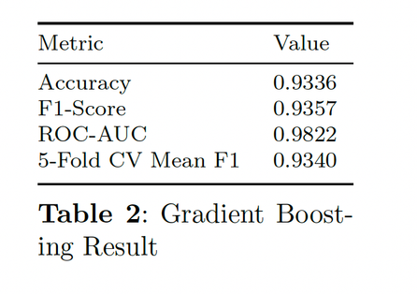
PREDICTIVE MODELING RESULTS
Random Forest and Gradient Boosting Models with 80/20 data split. Assessment engagement dominates prediction. Students who submit and score well are far less likely to fail.

Slide 6
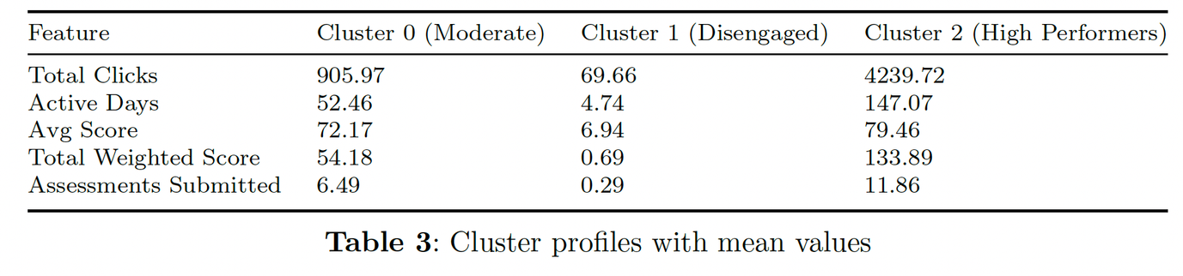
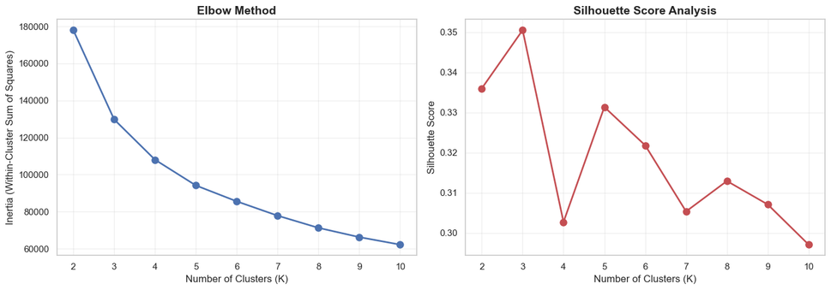
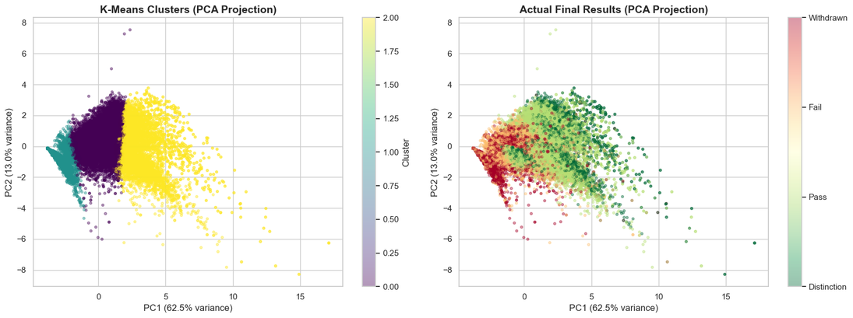
UNSUPERVISED LEARNING — STUDENT SEGMENTS
K-Means Clustering (K=3, Silhouette Score = 0.351):
Association Rule Mining:
Apriori Algorithm: Min support 0.05, Confidence 0.5
7,320 Rules Discovered
Key rule:
Low score + Inactive VLE + Few assessments → Withdrawn (lift ~5.5)

Slide 7
RECOMMENDATIONS & CONCLUSION
Data-Driven Recommendations:
Deploy early-warning system: Use a model to flag at-risk students in the early stage
Prioritize Cluster 0 (Moderate) students: Engaged but at risk; highest intervention ROI
Monitor module unregistration: Early red flag for advisor outreach
Assessment completion support: Completion rate is a top predictor of success
Investigate Cluster 1 barriers: Understand why disengaged students never participate
Ethical Considerations:
Audit models for demographic bias
Use predictions to support, not penalize students
Ensure privacy compliance and student consent

Slide 8
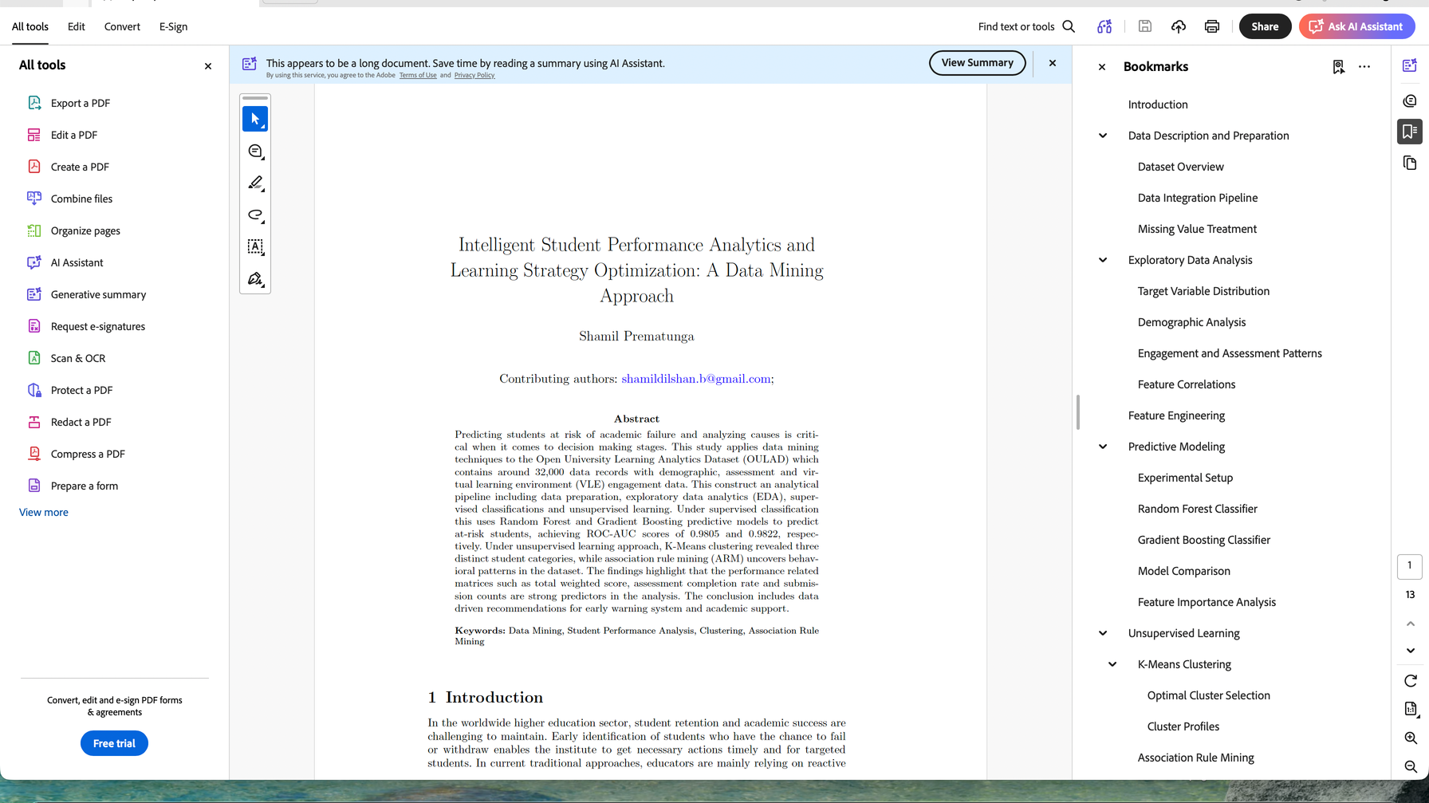
Thank you!
S.D. Prematunga
268382R

