Slide 1
Statistical Analysis of Volatility and Distribution Patterns of Global Top 10 Stocks
Statistics for IT
Group: C
Institution: Kyoto College of Graduate Studies for Informatics
Date: January 14th, 2026

Slide 2
Presentation Overview
Background and motivation
Objectives and statistical questions
Dataset and methodology
Key analysis results
Conclusions and insights

Slide 3
Introduction
Financial markets generate massive time series data
Technology stocks are high growth but highly volatile
Statistical analysis is essential for IT-based financial systems
Focus on understanding return behavior beyond averages

Slide 4
Objective & Research Questions
Main Objectives:
  Analyze volatility and return distributions
  Test normality assumptions in stock returns
  Examine volume-volatility relationships
Key Questions:
  Are returns normally distributed?
  How risky are these assets statistically?
  Does volume predict volatility?

Slide 5
Dataset Overview
10 global companies:
  NVDA, GOOGL, AAPL, MSFT, AMZN
  TSM, AVGO, META, TSLA, Saudi Aramco (2222.SR)
5 years of daily historical data
Data source: Yahoo Finance (via yfinance API)
Variables: Date, Close Price, Trading Volume

Slide 6
Tools and Environment
Python-based analysis
Libraries used:
  yfinance – data acquisition
  Pandas & NumPy – data processing
  Matplotlib & Seaborn – visualization
  SciPy – statistical testing
Reproducible workflow using Google Colab

Slide 7
Data Preprocessing
Raw prices converted to returns for comparison
Daily Return:
  Rt = (Pt − Pt−1) / Pt−1
Absolute Return used as volatility measure
Missing values removed after return calculation

Slide 8
Statistical Techniques Used
Descriptive statistics:
  Mean, Standard Deviation
  Skewness, Kurtosis
Normality testing:
  Shapiro-Wilk test (α = 0.05)
Correlation analysis:
  Pearson correlation (Volume vs Volatility

Slide 9
Descriptive Statistics (Key Findings)
TSLA shows highest volatility (Std Dev = 0.0381)
Saudi Aramco is most stable (Std Dev = 0.0097)
META shows extreme kurtosis (21.04)
Evidence of fat-tailed return distributions

Slide 10
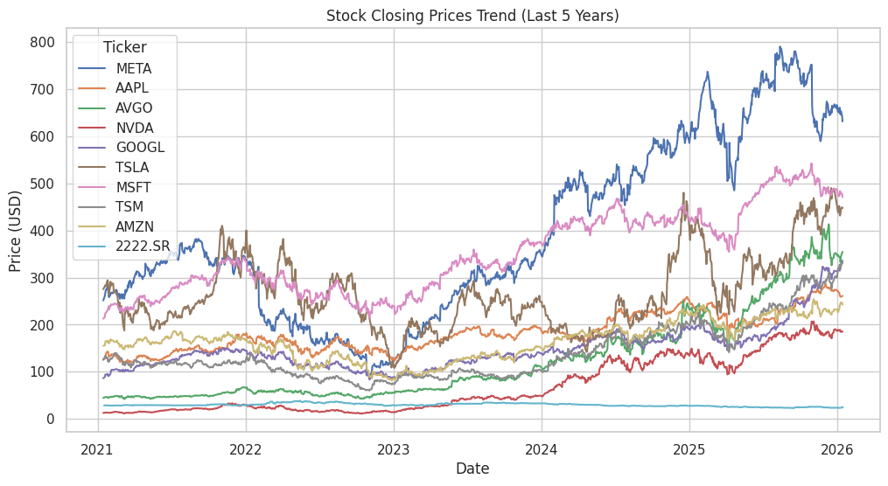
Price Trend Visualization
Line chart of closing prices (5 years)
Clear growth patterns in US tech stocks
Higher fluctuation intensity in NVDA, TSLA, META
Industrial stock shows smoother trend

Slide 11
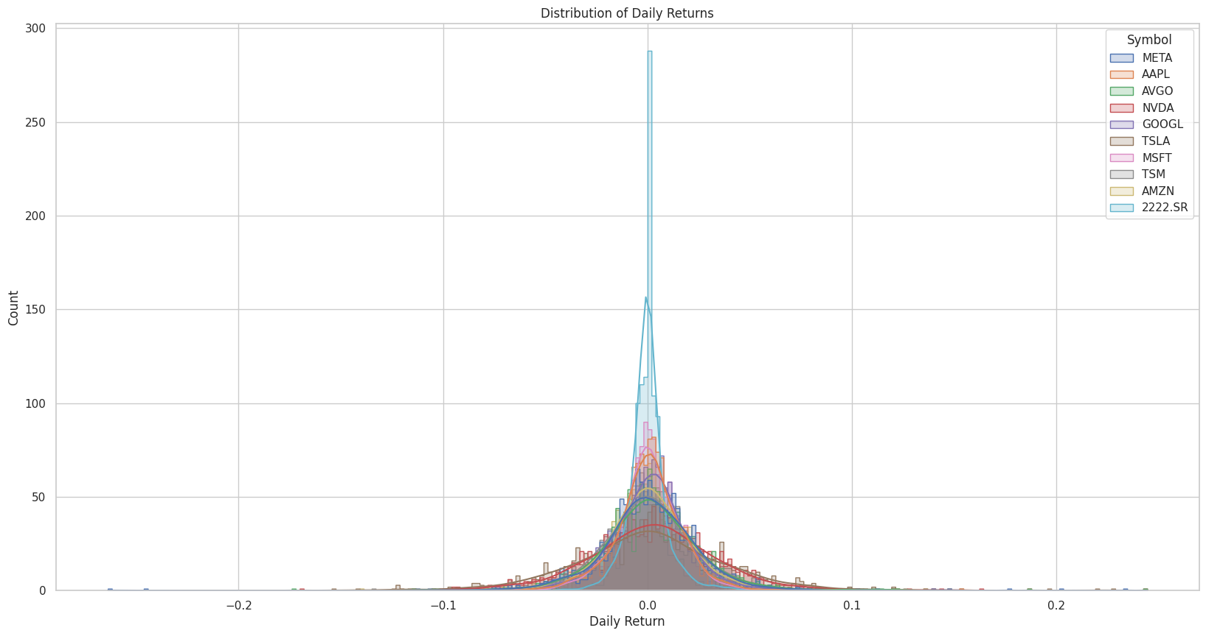
Distribution Analysis
Histograms with KDE vs normal curve
Returns show asymmetry and heavy tails
Normal distribution assumption visually violated
Extreme events occur more frequently than expected

Slide 12
Normality Test Results
Shapiro-Wilk test applied to all stocks
P-values ≈ 0 for all assets
Null hypothesis rejected in every case
Conclusion: No stock follows a normal distribution

Slide 13
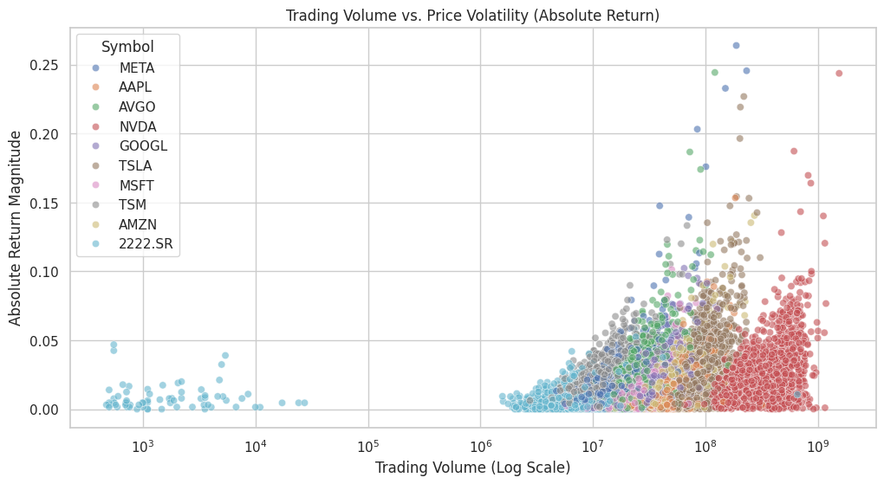
Volume vs Volatility Correlation
Strong correlation in US tech stocks
  META: r ≈ 0.66 (highest)
Weak correlation in Saudi Aramco (r ≈ 0.13)
All correlations statistically significant (p < 0.05)

Slide 14
Key Insights
Standard deviation alone is not enough
Fat tails imply frequent extreme price shocks
Normality based financial models are unreliable
Volume is a strong volatility signal in tech stocks

Slide 15
Conclusion & Takeaways
Financial IT systems must use advanced models
Asset specific risk modeling is essential
Volume based signals improve volatility prediction
Findings support robust, non Gaussian approaches
Thank You

