Slide 1
SDS-Mini-Project
Sem-3
S. No. | Name | SRN | Section
1. | K Manish Gowd | PES1UG19CS200 | C
2. | Justin James | PES1UG19CS198 | C
3. | Harshit Khashoo | PES1UG19CS183 | C
4. | Dhanush Patel YP | PES1UG19CS141 | C

Slide 2
1. Abstract:
This dataset consists of the weather records for a month taken with the observations being taken down and noted per hour. It consists of various aspects of weather like precipitation, humidity, wind speed, wind bearing, visibility, loud cover, pressure, temperature, apparent temperature against a particular instant of time. The summary and the daily summary are noted down appropriately as per the parameters collected. With the help of the appropriate operations on the given statistics, we were able to infer a great deal of information for the population. So, coming to the data, we first displayed various forms of data in various forms of visual representation such as graphs, scatterplot, charts, etc after performing the necessary operations such as dropping the redundant and repeated observations, outliers, typos and inconsistent capitalization. We then standardized the data for bringing it down to a common scale and then displayed it. The normality of the data had also been tested simultaneously using the histogram. For the hypothesis testing we performed the above operations in addition to ensuring proper precautions in ensuring the normality of the data and then came up with the appropriate conclusion based upon the appropriate z-score and the P-value obtained with the help of z-score.

Slide 3
2. Introduction:
Source: https://www.kaggle.com/muthuj7/weather-dataset
This dataset consists of the weather records for a month taken with the observations being taken down and noted per hour. It consists of various aspects of weather like precipitation, humidity, wind speed, wind bearing, visibility, loud cover, pressure, temperature, apparent temperature against a particular instant of time. The summary and the daily summary are noted down appropriately as per the parameters collected.
Most of the parameters are numerical with the remaining few being categorical. The objective of this project is to make optimum use of the dataset to extract maximum and most relevant information out of the dataset for various purposes. The first section of the project would consist of descriptive statistics while the second half would contain inferential statistics. With the help of the relationships generated between various variables, we can appropriately put this to a great use by inferring various parameters from it. While this is just a sample of 720 records, we can easily put this to a great use to infer about various weather parameters on the other given days with optimal accuracy and precision along with minimal margin of error.

Slide 4
3. Dataset:
Source: https://www.kaggle.com/muthuj7/weather-dataset
This dataset consists of the weather records for a month taken with the observations being taken down and noted per hour. It consists of various aspects of weather like precipitation, humidity, wind speed, wind bearing, visibility, loud cover, pressure, temperature, apparent temperature against a particular instant of time. The summary and the daily summary are noted down appropriately as per the parameters collected.
Most of the parameters are numerical with the remaining few being categorical. The objective of this project is to make optimum use of the dataset to extract maximum and most relevant information out of the dataset for various purposes. The first section of the project would consist of descriptive statistics while the second half would contain inferential statistics. With the help of the relationships generated between various variables, we can appropriately put this to a great use by inferring various parameters from it. While this is just a sample of 720 records, we can easily put this to a great use to infer about various weather parameters on the other given days with optimal accuracy and precision along with minimal margin of error.

Slide 5
4. Preprocessing or Data Cleaning:
Techniques used:
Correction of inconsistent capitalization and typos.
Dropping of excessively repetitive and redundant parameters and observations.
Replacement of NaN with 0.
Replacing NaN by techniques such as imputing by interpolation, etc.
Removal of outliers before testing for normality of the distribution
Reasons for cleaning:
For easier data processing and visualization
For better and more accurate results
For easier and better inferences

Slide 6
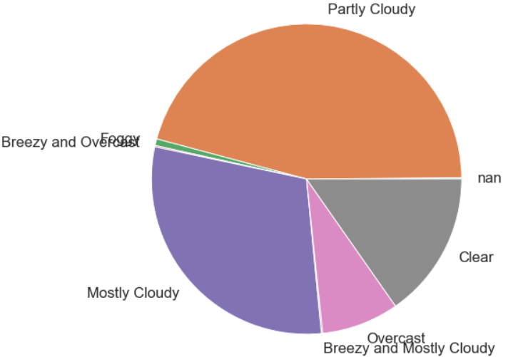
5. Exploratory Data Analysis:
Insights obtained from EDA:
Most of the days are cloudy

Slide 7
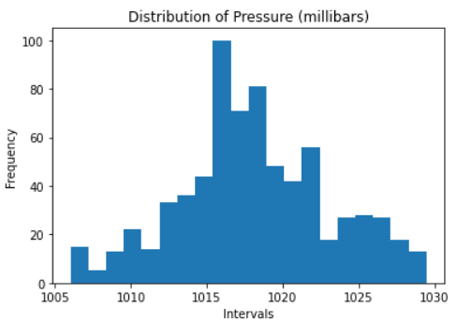
Most of the numerical parameters in the dataset are normally distributed. e.g.: Pressure.

Slide 8
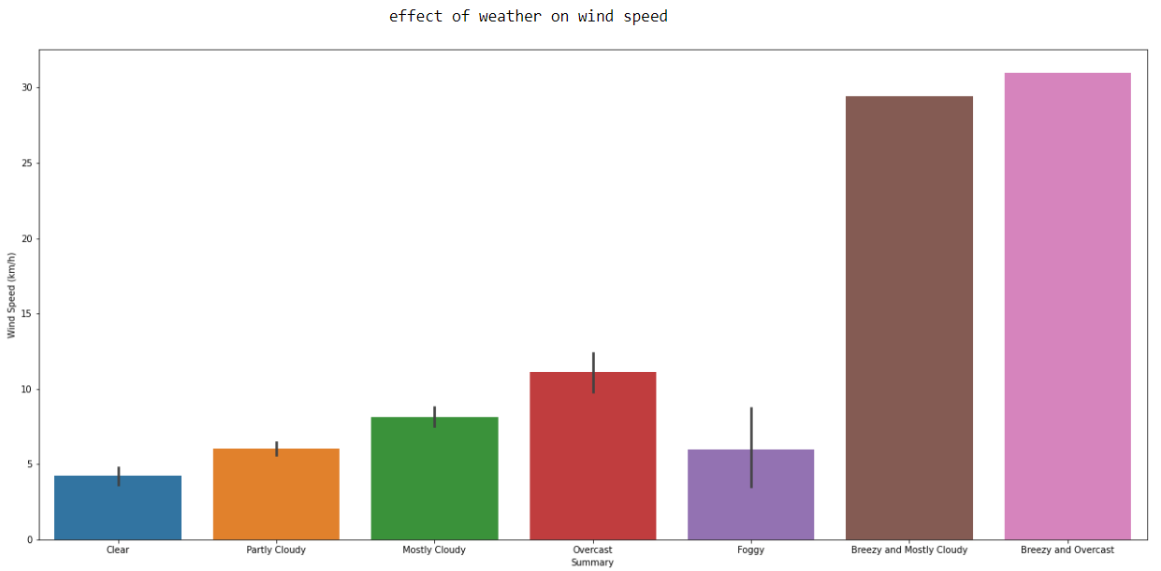
Breezy and overcast weather resulted in having the highest wind speed.

Slide 9
The sample is representative of the population.
The sample had been taken during the rainy season during the month of September.
Since, the sample had been taken during a particular month, it wouldn’t be right to treat is as the population and then collect a smaller sample from it to check whether a random sample would be representative of the population.
So, a better approach for hypothesis testing would be the to take a known statistic for the entire population (applicable in this case) and then compare the statistics of the dataset to the one of population.

Slide 10
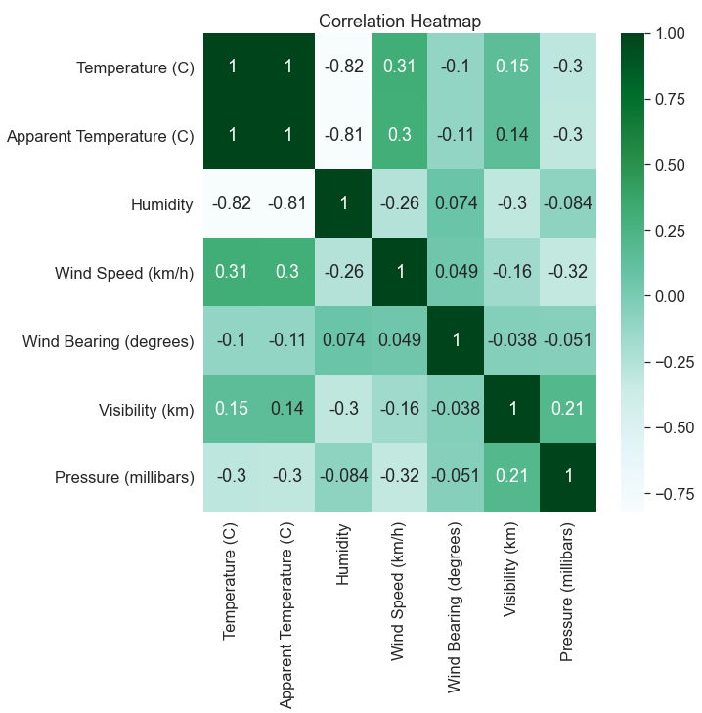
All the numerical variables have some kind of correlation with each other since this is a weather-based dataset, so all the numerical variables would somehow influence each other.

Slide 11
6. Hypothesis Testing:
5% statistical significance:
Since P-Value is less than 0.05, (taking at 5% statistical significance), we reject H0, the original hypothesis, and accept our claim that there is no specific relationship between temperature and pressure to be plausible
But we know that pressure is directly proportional to temperature only at constant volume. We also know that the volume doesn't always remain constant. The change in volume to most extent would be practically significant. But the changes at times are definitely statistically significant. That's the main reason why we the null hypothesis was rejected by taking 5% statistical significance.
Therefore, a better solution is to increase the level of accuracy and bring the level of statistical significance down to 1%, which obviously seems to be a better choice in this scenario.
1% statistical significance:
So, since P-value is greater than 0.01, (taking at 1% statistical significance), we do not reject H0, the original hypothesis, and continue with the accepted fact i.e. the null hypothesis
Therefore, we can confidently conclude that the null hypothesis is supported.

Slide 12
Results and Discussion of your problem statement
With the assistance of data and results proved above, we obtain various inferences on the nature of the dataset as mentioned below:
Most of the days were rainy and cloudy in nature since the observations in the dataset have been from the month of September. We can also easily infer and predict the weather in the forthcoming couple of months, using the given statistics to find the parameters. We can also predict the weather in the similar months in the upcoming few years, but at the same time, we would also need to take into account the rising rate of various environmental effects like greenhouse effect leading to global warming thereby leading to ecological imbalance. The average temperature of the earth is also rising slowly but steadily. So, it wouldn't be wrong to say that the inferences and predictions made in the future i.e. after 5 years and more... wouldn't be plausible as they are for the near future. But we can predict the weather to some extent in general even in the upcoming years, just that the degree of uncertainty would be witnessing an exponential rise, which isn't of any help to the statisticians even by the slightest of means.
So, take care of the environment as well :)

