Slide 1

NYC Housing Conditions
Andrew Moore
STAT 493

Slide 2

Overview
Why are Housing Conditions Important?
Analysis of Data
Quality Index
Goals

Slide 3

Why are Housing Conditions Important?
“The Congress hereby declares that the general welfare and security of the Nation and the health and living standards of its people require ... the realization as soon as feasible of the goal of a decent home and a suitable living environment for every American family ....”
- Section 2 Housing Act of 1949

Slide 4
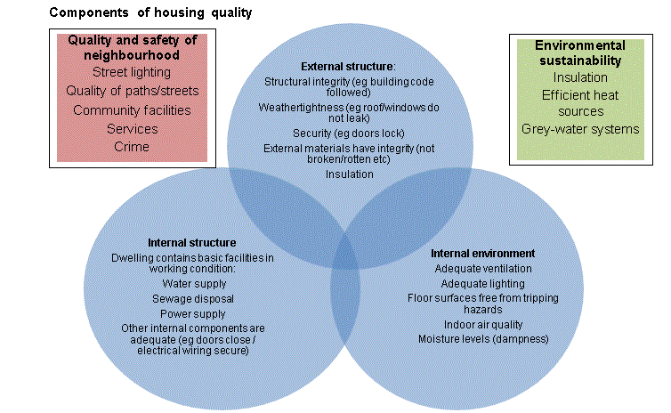
Why are Housing Conditions Important?

Slide 5
Housing Condition Variables
Conditions of exterior, windows, stairways, floors
Overall condition of building
Number of housing units, stories, rooms, bedrooms
Condition of interior walls
Complete plumbing facilities, toilet breakdowns
Kitchen facilities and whether they are functioning
Type of heating
Additional Sources of heat
Water leakage
Heating equipment breakdown
Functioning air conditioning
Presence of mice/rats
Number of cockroaches

Slide 6
External Structure
Conditions of exterior, windows, stairways*, floors
Overall condition of building*
Number of housing units, stories, rooms, bedrooms
Condition of interior walls
Complete plumbing facilities, toilet breakdowns
Kitchen facilities and whether they are functioning
Type of heating
Additional Sources of heat
Water leakage
Heating equipment breakdown
Functioning air conditioning
Presence of mice/rats
Number of cockroaches

Slide 7
Internal Structure
Conditions of exterior, windows, stairways*, floors
Overall condition of building*
Number of housing units, stories, rooms, bedrooms
Condition of interior walls
Complete plumbing facilities, toilet breakdowns
Kitchen facilities and whether they are functioning
Type of heating
Additional Sources of heat
Water leakage*
Heating equipment breakdown
Functioning air conditioning
Presence of mice/rats
Number of cockroaches

Slide 8
Internal Environment
Conditions of exterior, windows, stairways, floors
Overall condition of building*
Number of housing units, stories, rooms, bedrooms
Condition of interior walls
Complete plumbing facilities, toilet breakdowns
Kitchen facilities and whether they are functioning
Type of heating
Additional Sources of heat
Water leakage*
Heating equipment breakdown
Functioning air conditioning
Presence of mice/rats
Number of cockroaches

Slide 9
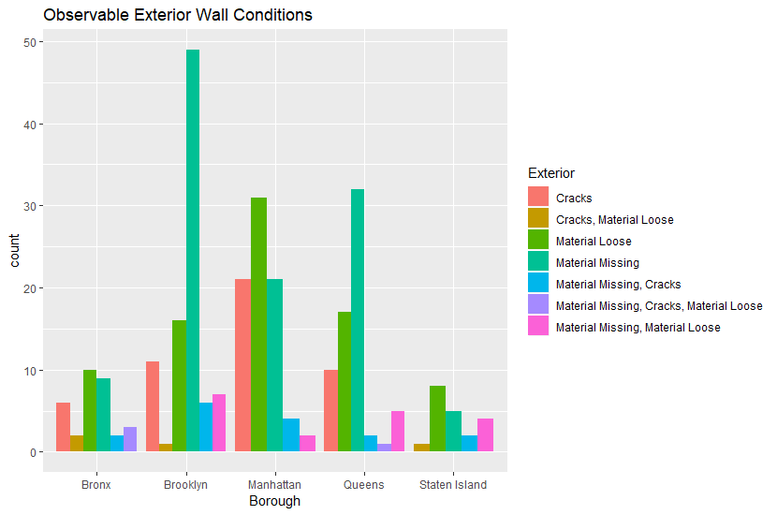
External Structure

Slide 10
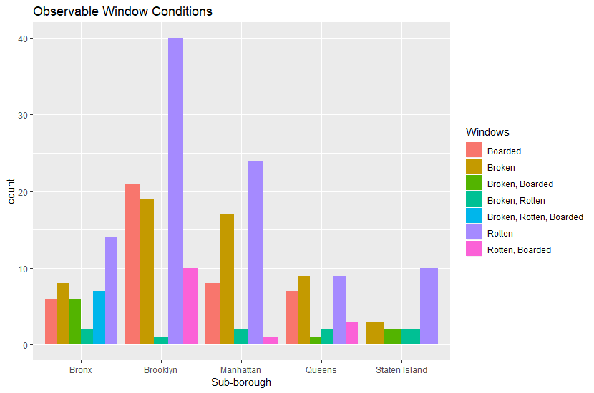
External Structure

Slide 11
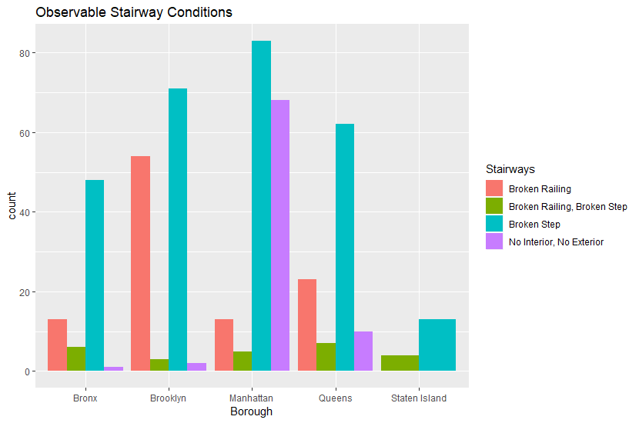
External & Internal Structure

Slide 12
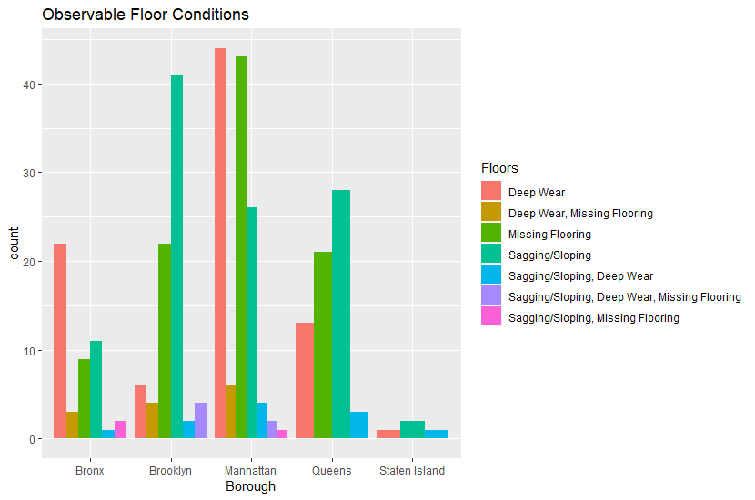
Internal Structure

Slide 13
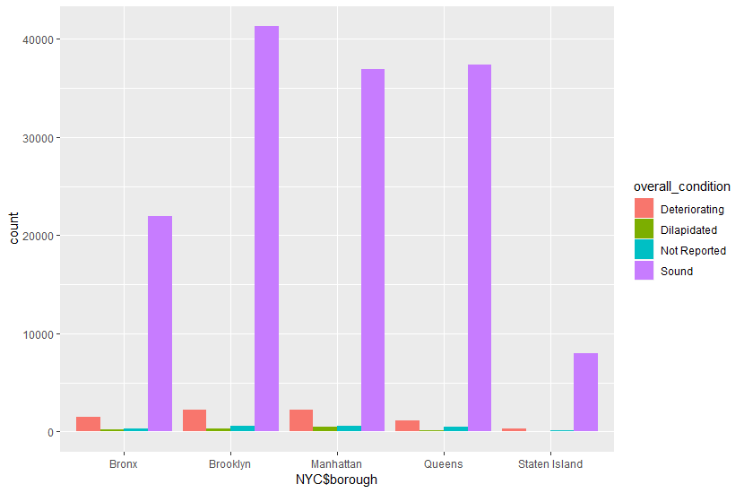
Overall Structure

Slide 14
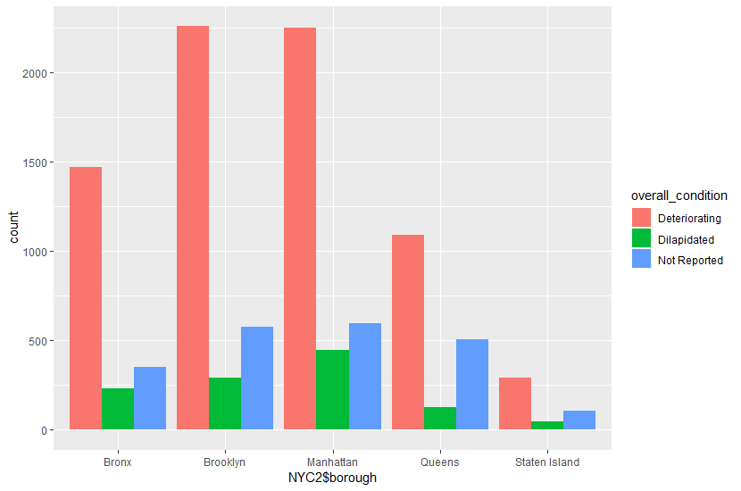
Overall Structure

Slide 15
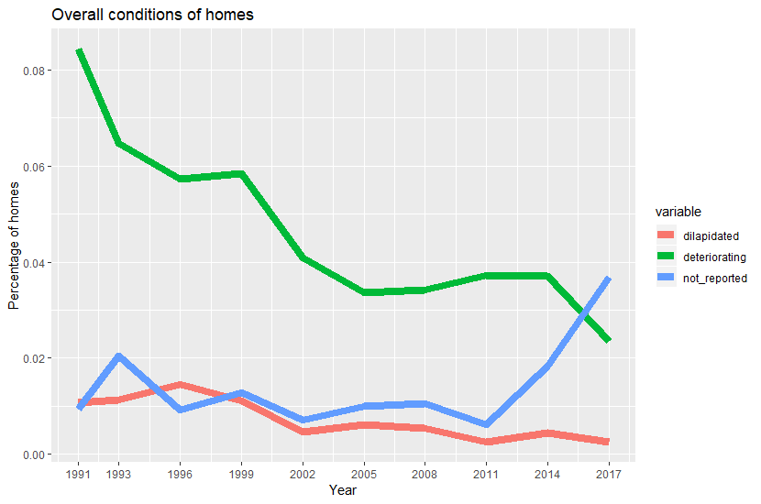
Overall Structure

Slide 16
Quality Index
How to place a quantitative value on “a decent home and a suitable living environment”?
“Creating a housing quality index is easy. There are an infinite number of ways of combining any selected set of components into a summary measure. However, creating a housing quality index that is meaningful for use in framing and carrying out housing policy is more difficult.”
-John L. Goodman

Slide 17
Goodman’s Experiment
Examined the effects of demand-based variables on the quality of a random sample (n = 1256) of low-income rental households in Pennsylvania
Indicators: Rent burden, crowding, unit and neighborhood quality (based on rent & utilities minus adjustment for furnishings)
Causes: Annual household income, family size, education, race
Goodman, John L. "Causes and indicators of housing quality." Social Indicators Research 5.1-4 (1978): 195-210.

Slide 18
Goodman’s Conclusions
His proposed indicators could not be predicted by his proposed causes
“The analysis leads to the conclusion that there is no single variable called 'housing quality’”
Goodman, John L. "Causes and indicators of housing quality." Social Indicators Research 5.1-4 (1978): 195-210.

Slide 19
Goals
Examine structural and environmental effects on rent and value of housing
Examine internal environment’s effects on health of respondents
Attempt to build pricing and health indices, weighted based on these effects

