Slide 1
SP
ARCHITECTURE REVIEW / SOFTWARE DESIGN
01 Browser SPA
StarPlus Energy
Asset Management System
React 19 • Router 7 • State engine
02 Express API
SPE-AMS v1.2.2 — integrated view of the client, API, persistence, data exchange and asset state lifecycle.
Node.js 22+ • Express 5 • /api/*
CLIENT–SERVER
CENTRAL SQLITE
VALIDATED STATES
03 Shared persistence
SQLite • WAL mode • inventory.db
One intranet host. Multiple workstations. One shared operational record.
Repository: github.com/SDSAJames/Inventory-Management-Software
Design basis: Software Design Document v1.2.2 • October 2026

Slide 2
01 / OVERVIEW
The architecture in one minute
SPE-AMS is an intranet-hosted custody portal: the browser provides workflow and file handling; the server mediates API access and shared persistence.
RUNTIME
DOMAIN
EXCHANGE
Shared operational record
Rule-enforced custody
Spreadsheet interoperability
Asset masters, loan activity and ownership history are coordinated through a central Express service and SQLite database.
Six exclusive asset states plus holder invariants and passive reconciliation keep asset status aligned with active loans.
The browser parses Excel-derived tab-delimited TXT and generates reference-format XLSX files with pre-import restore capability.
SYSTEM BOUNDARIES
Browser / presentation
API / domain services
Persistent data
React routes, page components, form workflows, client-side import/export.
Express routes, validation, transaction handling and asset/loan reconciliation.
Embedded node:sqlite in WAL mode at server/data/inventory.db.
Operational deployment: Node.js 22+ • Express 5 • port 5000 • no cloud/CDN/telemetry dependencies.
Sources: repository README; Technical Specification §1; Software Design Document §§1 and 3.

Slide 3
02 / ARCHITECTURE
Integrated production architecture
Main runtime path follows the repository README and Technical Specification: browser → Express API → embedded SQLite.
CORPORATE LAN
BROWSER SPA
INTRANET SERVER
React 19 • React Router 7
Node.js 22+ • Express 5
Operator A
Eight routes and reusable UI components
HTTP
request / response
0.0.0.0:5000
Browser
UI
SQL
read / write
useDb / API adapter and state integrity engine
REST API: assets, loans, exchange, directory, stats, auth
CENTRAL SQLITE
Operator B
LocalStorage cache / backup resilience
Serves built dist/ with SPA fallback
node:sqlite • WAL mode
Browser
TXT parser + client-side OpenXML XLSX generator
Validates writes and reconciles asset / loan state
server/data/
inventory.db
Many clients
shared URL
VITE 6 = BUILD TOOL
BOUNDARY RULE • Browsers never open SQLite directly. Production reads and writes pass through the Express API; the browser cache is not the shared database.
Sources: README; Technical Specification §1 and §2; SDD §3. Documentation difference on local storage is called out on slide 13.

Slide 4
03 / CLIENT
Browser-side component architecture
Client-side modules organize the operator workflows, validate asset-state rules, and handle spreadsheet files without external services.
PRESENTATION
SHARED APP SERVICES
CLIENT-SIDE FILE TOOLING
Dashboard
/
AppShell / route composition
txtImport.js
Asset Register
/assets
Shared navigation, page shell, modals and feedback.
Reads tab-delimited TXT exported from Excel; strips BOM, detects file signatures, handles multiline quoted fields and normalizes dates.
Loans & Custody
/loans
In & Out Calendar
/calendar
useDb / API adapter
Central hook for data access and mutations; talks to /api endpoints.
xlsx.js / OpenXML
Business Travelers
/business-travelers
Directory
/directory
assetIntegrity.js
Builds reference-format .xlsx client-side; 19-column parity for equipment and loan workbooks.
Data Exchange
/exchange
State enums, invariant validation, passive sync and ownership history.
Patch History
/patch-history
lib/db.js cache layer
No remote fonts, CDN scripts or telemetry dependencies.
Browser-local snapshots / offline cache.
Source: Technical Specification §2 and §6; SDD §§3 and 6. Vite 6 bundles the SPA at build time; it is not in the production request path.

Slide 5
04 / SERVER
API surface, persistence and core records
The backend is intentionally compact: one Node/Express process serves the SPA and owns the embedded database.
EXPRESS 5 / Node.js 22+
WRITE / RECONCILIATION PATH
PERSISTENCE
PORT 5000
1
Receive API mutation
SQLite / node:sqlite
/api/assets
Inventory CRUD, filtering and bulk operations
WAL mode • server/data/inventory.db
2
Validate request / domain rules
/api/loans
Scheduled, active, overdue and returned custody
/api/exchange
Import commit, revert and export data access
3
Apply transactional database write
Asset master
Code, status, owner, location, updated, ownershipHistory
/api/directory
People, departments and facility references
4
Reconcile assets against active loans
Loan record
Assignee, assetCode, pickup/return dates, status, accessories
/api/stats
Dashboard counters / health statistics
5
Return updated result to browser
/api/auth
Cookie-based authentication surface
Also serves dist/ with an Express SPA fallback; /api/health reports system health and database stats.
Core invariant: every asset has a stable master identity; custody events update status/holder and append history rather than replacing lineage.
Source: README; Technical Specification §§1, 3 and 4. Production persistence path follows the centralized SQLite deployment description.

Slide 6
05 / APPLICATION MAP
Eight application views, one custody workflow
The UI is organized around the asset lifecycle—not around separate copies of spreadsheet data.
01
Operations Dashboard
/
02
Asset Register
/assets
Fleet KPIs, issue signals and quick filtered lists
Master inventory, filters, batch updates and ownership transfer
03
Loans & Custody
/loans
04
In & Out Calendar
/calendar
Pickup, accessory checklist, overdue tracking and return
Shared checkout / return schedule with requester filters
05
Business Travelers
/business-travelers
06
Directory
/directory
Mobile workforce roster, locations and trip custody
Personnel, Knox IDs, departments and facility references
07
Data Exchange
/exchange
08
Patch History
/patch-history
TXT import, pre-flight preview, XLSX export and rollback
Versioned release notes, keyword filtering and changelog
Cross-cutting behavior
Asset state validation • passive reconciliation • ownership history • release governance
Sources: SDD §7; repository README; Technical Specification §2.

Slide 7
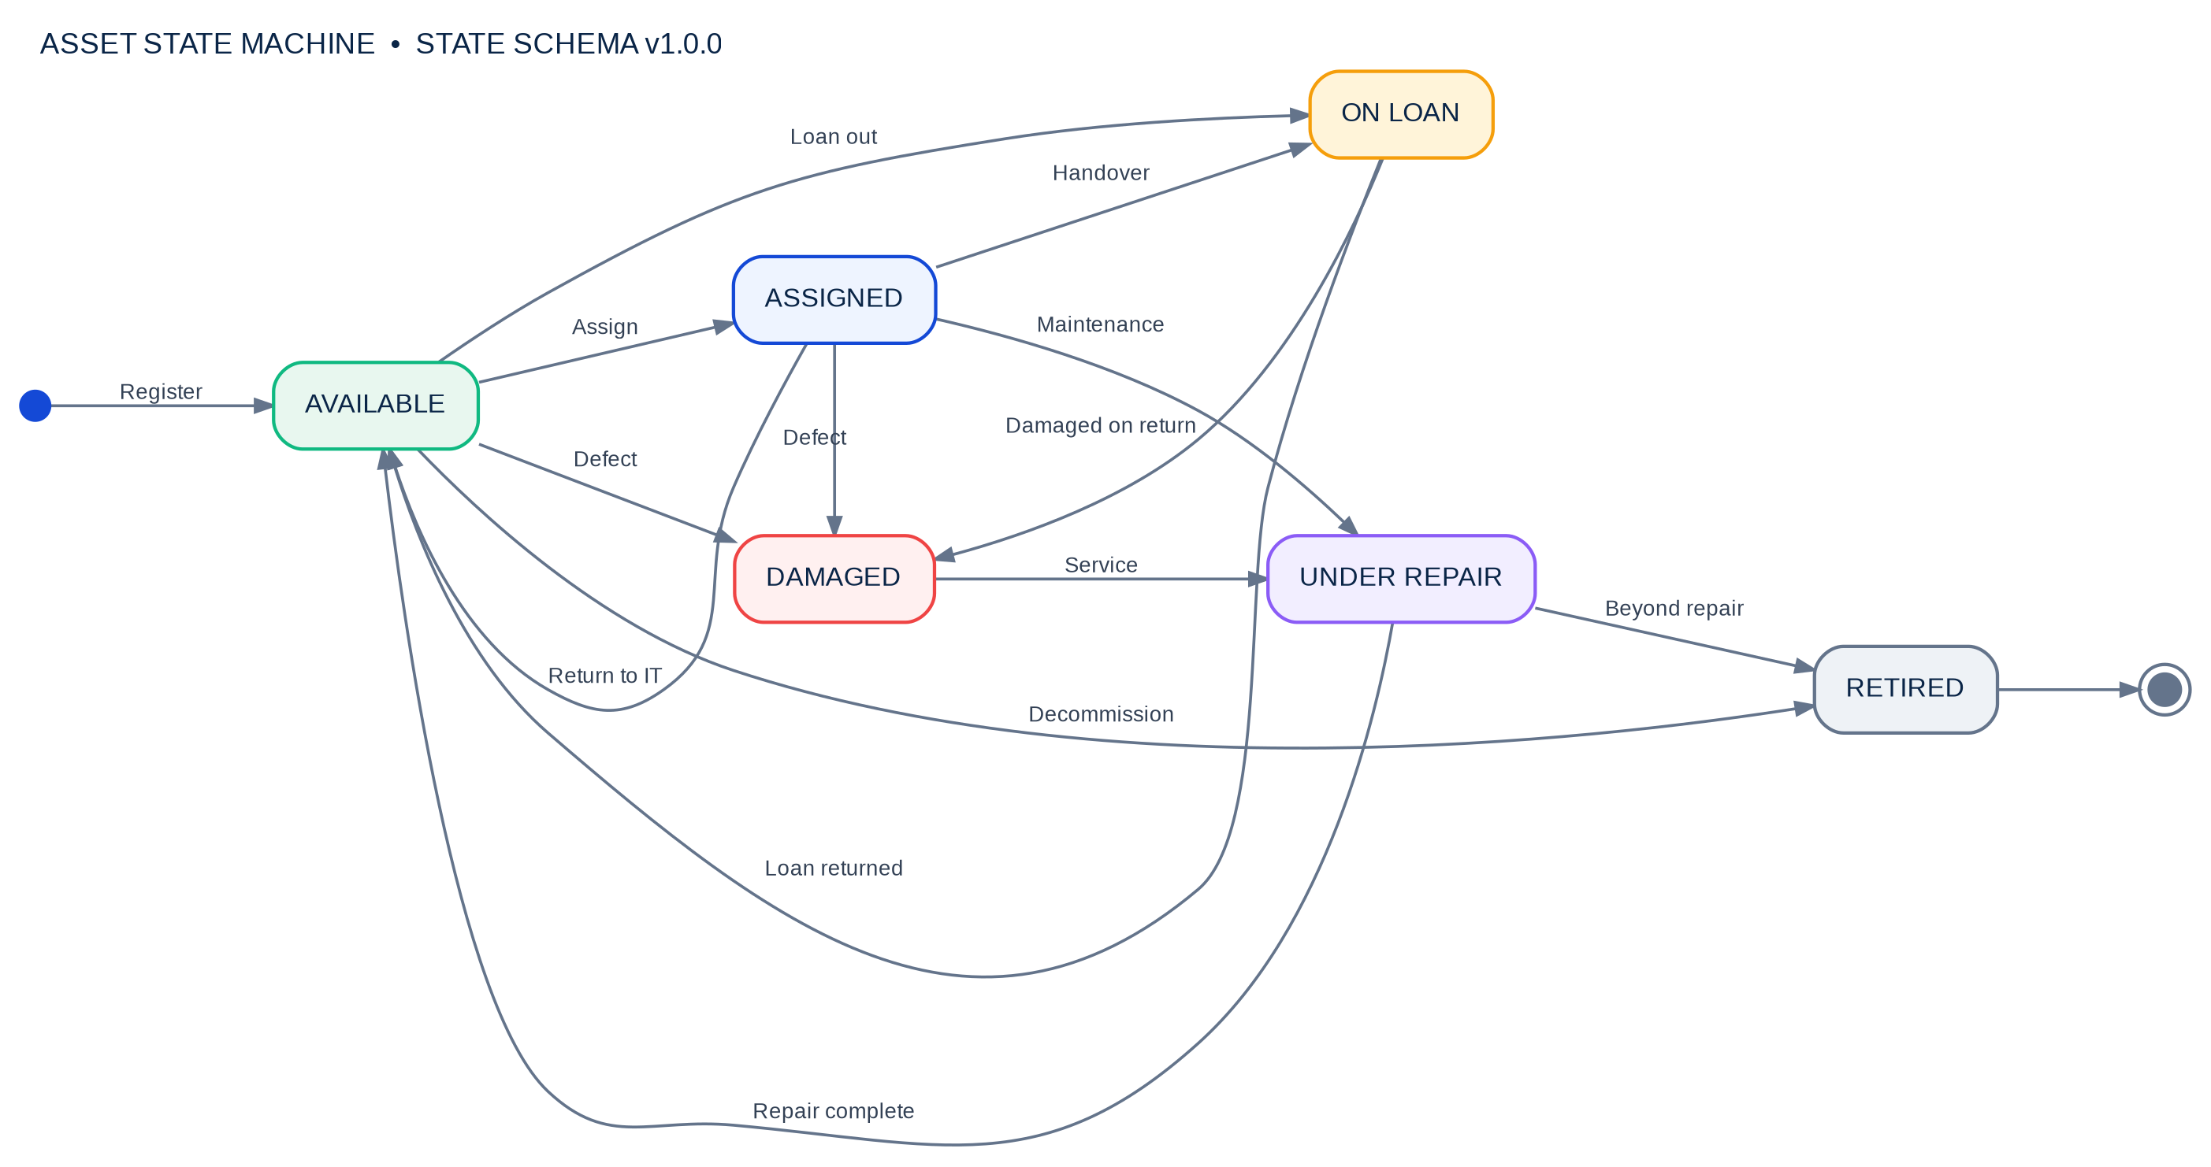
06 / LIFECYCLE
State Transition Diagram
The six states and event labels follow State Schema v1.0.0 in the Software Design Document; a complete transition register follows.
Final state: Retired is terminal. Damaged assets route to service; loan returns route to IT unless damage is recorded.
Source: Software Design Document §4.2; Technical Specification §4.1. Arrow labels are shortened here for readability; exact event wording appears on slide 8.

Slide 8
07 / LIFECYCLE RULES
Transition register: every permitted edge
Use this ledger with the state diagram. The document defines these transitions; it does not imply every pair of states can transition directly.
FROM
EVENT
TO
FROM
EVENT
TO
Available
Assign to employee / department
Assigned
On loan
Loan returned (holder → IT)
Available
Available
Check out on loan (pickup)
On loan
On loan
Defect on return
Damaged
Available
Defect reported
Damaged
Damaged
Sent for servicing
Under repair
Available
Decommissioned
Retired
Under repair
Repair completed (holder → IT)
Available
Assigned
Return to IT department
Available
Under repair
Beyond economic repair
Retired
Assigned
Handover to loan
On loan
Assigned
Defect reported
Damaged
CROSS-CUTTING GUARDS
Assigned
Maintenance
Under repair
Named non-IT holder → Assigned (or On loan if actively checked out).
Available → holder is IT department or blank.
Return to IT appends history; a damaged return stays Damaged.
Start → Available
Asset registered
Retired → End
Terminal / no outgoing state transition
State changes must also satisfy the holder invariant and the active-loan reconciliation rules.
Source: Software Design Document §4.2. The state diagram is defined as a finite set of permitted transitions, not arbitrary status editing.

Slide 9
08 / CONSISTENCY
Invariant checks and passive reconciliation
The integrity service resolves conflicting asset and loan records without requiring an operator to start a manual sync.
STATE / HOLDER INVARIANTS
RECONCILE ALL ASSETS
Available
Holder must be IT department or blank.
Trigger
Database initialization or state mutation
Assigned
Must have a named employee or department holder.
Active picked-up loan?
Yes → enforce On loan + loan holder + loan location
On loan
Holder and location must match the active loan assignee / loan record.
No active loan
If prior On loan: restore Assigned for employee holder; otherwise Available / IT
Damaged
Held by IT or reporting employee while awaiting evaluation.
Under repair
Holder is IT department or vendor.
Normalize records
Normalize legacy “pool” values; repair status / holder mismatches
Retired
Decommissioned asset remains in the archive for audit history.
Commit reconciled state
Continue with consistent asset and loan records
Exception: a returned asset flagged as Damaged does not automatically become Available.
Sources: SDD §4.3; Technical Specification §4.2. Storage wording differs across documents; see slide 13.

Slide 10
09 / CUSTODY LINEAGE
Returns and transfers preserve the audit trail
Asset identity is durable: the holder can change, but the master record and chronological ownership history remain.
Available
Assigned
On loan
Return to IT
1
2
3
4
IT department
Named holder
Active loan assignee
Holder becomes IT
Asset registered
or returned to fleet
Employee / department
receives asset
Pickup, due date and
accessory checklist
Close loan; status Available
unless damaged
OWNERSHIP HISTORY ENTRY
RETURN-TO-IT GUARANTEE
previousOwner
newOwner
date
• Set holder = IT department
• Clear assigned department
• Set Available unless Damaged
• Append a dated history entry
Prior custodian
Incoming holder / IT department
Timestamp
reason
notes
Transfer / return reason
Optional context
Sources: SDD §§1, 4.3 and 5; Technical Specification §§3–5. Transfers keep previousOwner/newOwner/reason and event date.

Slide 11
10 / DATA EXCHANGE
Import, reconcile, export—and recover
The browser owns parsing and workbook generation; the import commit uses the API, creates a restore point, writes transactionally and reconciles state.
IMPORT / COMMIT
1
Excel workbook
2
Browser parser
3
Pre-flight preview
4
Import API
5
Transactional write
Operator saves source workbook as tab-delimited TXT
Detect format; strip BOM; normalize multiline headers / dates
Review records, validation and Merge vs Replace mode
POST /api/exchange/import; create restore snapshot first
Write changes and run asset / loan reconciliation
Rollback path: Revert last import → POST /api/exchange/revert → restore the pre-import snapshot.
EXPORT
Server data
Browser generator
XLSX download
GET /api/exchange/export
Pure JavaScript OpenXML writer
Reference-format workbook
Compatibility target: 19-column parity with corporate equipment and IT-loan workbooks.
Sources: README; Technical Specification §§6.1–6.2; SDD §6; ExchangePage / server exchange routes described in the source deck.

Slide 12
11 / OPERATIONS
Deployment model and architectural trade-offs
A single production command path keeps the install and runtime footprint small; it also centralizes availability and persistence on one host.
PRODUCTION STARTUP
1
npm install
2
npm run build
3
npm start
ACCESS / HEALTH
Install dependencies
Emit optimized dist/ SPA bundle
Serve UI + API on port 5000
http://<server-ip>:5000 • /api/health
DEVELOPMENT
TRADE-OFFS
npm run dev:all
Embedded SQLite
Client-side XLSX
API :5000 + Vite HMR :5173
No separate DB service; host-level backup / recovery is important.
Offline and dependency-light; large files consume workstation resources.
LocalStorage cache
No external assets
Fast startup / resilience; must be clearly separated from authoritative server state.
Works without internet; typographic customization is constrained to system fonts.
Runtime prerequisite: Node.js 22+ for native node:sqlite. Vite is build-time tooling, not a production service.
Sources: README; Technical Specification §1.

Slide 13
12 / REVIEW NOTES
Documentation alignment and design questions
The merged view combines the production deployment description with the SDD’s client modules, rules and workflows. One persistence detail needs a single source of truth.
DEPLOYMENT VIEW
CLIENT-CACHE VIEW
README + Technical Specification §1
SDD §3 + Technical Specification §2
Describe multiple workstations calling the Express API on :5000, which owns the central node:sqlite database in WAL mode at server/data/inventory.db.
Also describe lib/db.js and browser LocalStorage / IndexedDB, including local snapshots and cache-based resilience. That language can be read as local-first persistence.
Interpretation used in this presentation
Central SQLite is the shared runtime source of truth; LocalStorage is shown as a browser cache / backup layer. Confirm snapshot location and reconciliation persistence against current code before changing implementation or operational runbooks.
SOURCE DOCUMENTS
Repository README
Software Design Document
Technical Specification
Patch Notes
Architecture takeaway: browser workflows + strict state rules + one intranet API boundary + durable asset and custody history.
Prepared by integrating both supplied PPTX decks and cross-checking the repository documentation available on 22 Oct 2026.

