Slide 1
Portability, Accessibility, and Localization
Ross Hoyer, Erik Hattervig, and Joshua Schultz
In response to: CS 492 Mobile Computing Student Presentations
Taught by Professor Butterfield assisted by Dr. Logar

Slide 2

Intro
Accessibility - Ross
Making Applications Accessible
Developer Accessibility Checklist
Building Accessibility Services
Portability - Josh
Screen Sizes
Screen Density
Orientation
Density Independent Pixel
Localization - Erik
Translations
Layout Fitting

Slide 3
What could we go through?
Accessibility
Making Applications Accessible
Labeling User Interface Elements
Enabling Focus Navigation
Enabling view focus
Controlling focus order
Building Accessible Custom Views
Handling directional controller clicks
Implementing accessibility API methods
Sending accessibility events
Populating accessibility events
Providing a customized accessibility context
Handling custom touch events
Accessibility Developer Checklist
Accessibility Requirements
Accessibility Recommendations
Special Cases and Considerations
Building Accessibility Services
Manifest Declarations and Permissions
Accessibility service declaration
Accessibility service configuration
Registering for Accessibility Events
AccessibilityService Methods
Getting Event Details
Taking Action for Users
Listening for gestures
Using accessibility actions
Using focus types

Slide 4
Making Applications Accessible
All apps utilize Androids built in accessibility options by default
However developers should take steps to optimize the accessibility
Accessibility options are usually set inside UI creation
Using the android:contentDescription tag you can define the content of the view. Helps provide textual representation.
Make sure all UI elements can be reached with a directional controller, D-pad or navigation gestures
Make sure all audio prompts have a visual representation
Test using all accessibility options

Slide 5
Labeling User Interface Elements
Used for the user with poor eyesight will read the contentDescription when focus is on the object
Note: Hint will be read unless content description is set
<ImageButton android:id=”@+id/add_note_button” android:src=”@drawable/add_note” android:contentDescription=”@string/add_note”/>

Slide 6
Enabling Focus Navigation
Step through a UI using directional controllers
All interactive UI elements need to be focusable and interactive through non touch screen methods
Enabling
Order
android:nextFocusLeft="@id/editText1"
android:nextFocusRight="@id/textViewFeelsLikeTemp"
android:nextFocusUp="@id/labelAsOfTime"
android:nextFocusDown="@id/textViewTemp"
android:nextFocusForward="@id/labelTemp"
android:hint="Hello Poppit"
android:contentDescription="Enter the name of your Poppit"

Slide 7
Building Accessible Custom Views
Handling directional controller clicks
Implementing accessibility API methods
Sending accessibility events
Populating accessibility events
Providing a customized accessibility context
Handling custom touch events
@Override public boolean onKeyUp (int keyCode, KeyEvent event) { if (keyCode == KeyEvent.KEYCODE_DPAD_LEFT) { mCurrentValue--; sendAccessibilityEvent(AccessibilityEvent.TYPE_VIEW_TEXT_CHANGED); return true; } ... }

Slide 8
Building Accessibility Services
<application>
<service android:name=".MyAccessibilityService" android:label="@string/accessibility_service_label">
<intent-filter>
<action android:name="android.accessibilityservice.AccessibilityService" />
</intent-filter> </service>
<uses-permission android:name="android.permission.BIND_ACCESSIBILITY_SERVICE" />
</application>
Manifest Declarations and Permissions
Accessibility service declaration
Accessibility service configuration
Registering for Accessibility Events
Package Names
Event Types
AccessibilityService Methods
Getting Event Details
Taking Action for Users
Listening for gestures
Using accessibility actions
Using focus types

Slide 9
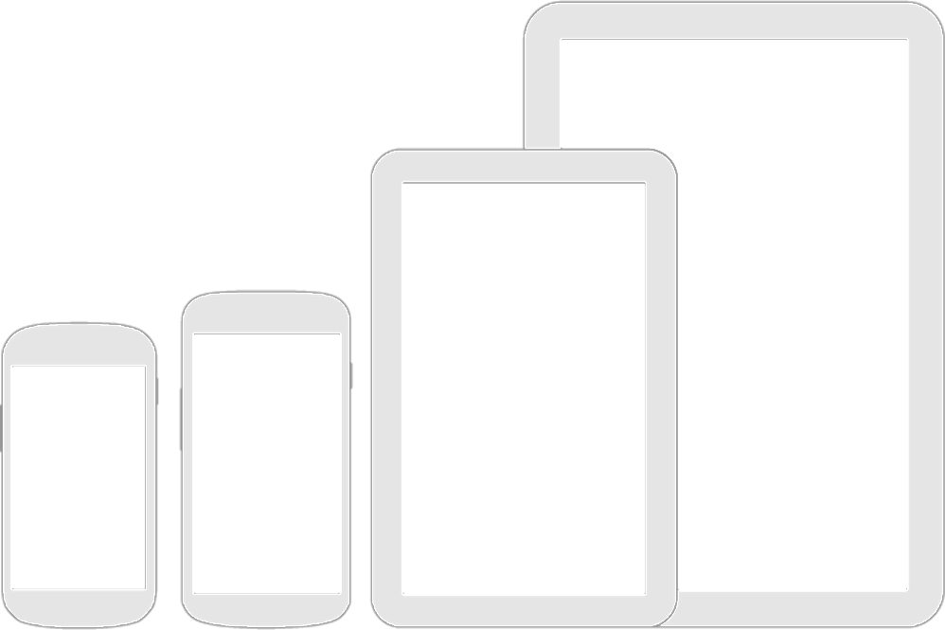
Portability
Screen Size
Screen Density
Orientation
Density-Independent pixel

Slide 10
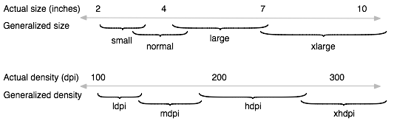
Screen Size
Physical size of device
Small
Normal
Large
Extra Large

Slide 11
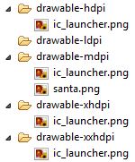
Screen Density
Number of pixels per area
Dots per inch DPI
Low – ldpi (~120 dpi)
Normal – mdpi (~160 dpi)
High – hdpi (~240 dpi)
Extra high – xhdpi (~300 dpi)
Extra extra high – xxhdpi (~480 dpi)

Slide 12
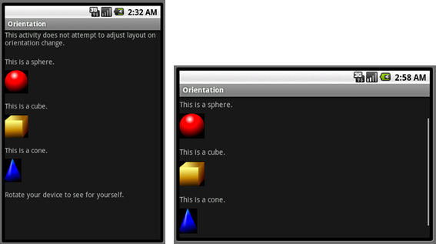
Orientation
Portrait
Landscape

Slide 13
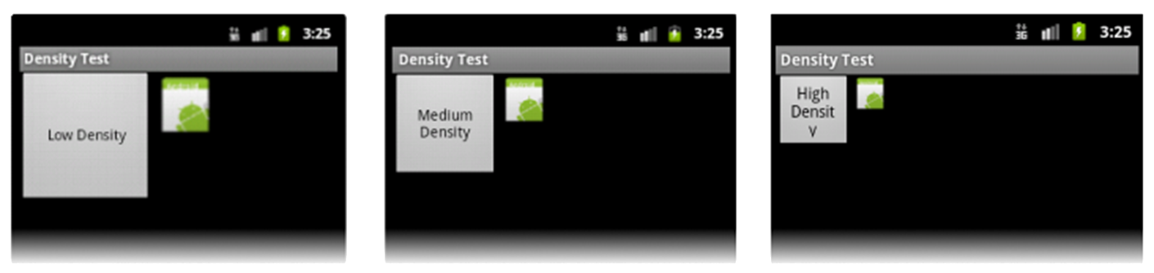
Density-Independent Pixel
dp
1 dp = 1 pixel in 160 dpi (mdpi)
1 dp = 1.5 pixel in 240 dpi (hdpi)
Easier for developer
3:4:6:8:12 rule

Slide 14
Android 3.2 (API 13 – Honeycomb) and Above
Smallest width sw<N>dp
Width w<N>dp
Height h<N>dp
320dp: a typical phone screen
480dp: a phablet
600dp: a 7” tablet
720dp: a 10” tablet
res/layout/main_activity.xml res/layout-sw600dp/main_activity.xml
res/layout-sw600dp-land/main_activity.xml res/layout-land/main_activity.xml

Slide 15
Specify Supported Screen Sizes
<manifest ... > <compatible-screens> <!-- all small size screens --> <screen android:screenSize="small" android:screenDensity="ldpi" /> <screen android:screenSize="small" android:screenDensity="mdpi" /> <screen android:screenSize="small" android:screenDensity="hdpi" /> <screen android:screenSize="small" android:screenDensity="xhdpi" /> <!-- all normal size screens --> <screen android:screenSize="normal" android:screenDensity="ldpi" /> <screen android:screenSize="normal" android:screenDensity="mdpi" /> <screen android:screenSize="normal" android:screenDensity="hdpi" /> <screen android:screenSize="normal" android:screenDensity="xhdpi" /> </compatible-screens> ... <application ... > ... <application> </manifest>

Slide 16
Specify Supported Screen Sizes
<manifest ... > <supports-screens android:smallScreens="false" android:normalScreens="false" android:largeScreens="true" android:xlargeScreens="true" android:requiresSmallestWidthDp="600" /> ... <application ... > ... </application> </manifest>

Slide 17

Localization
Developing apps for use with other languages
Translations
Layout Fitting

Slide 18
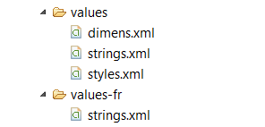
Localization
res/values
Default location
Language folders
ISO 639-1 language code
res/values-fr
Drawable

Slide 19
Resources
http://developer.android.com/guide/practices/screens_support.html
http://developer.android.com/guide/topics/ui/accessibility/index.html
http://developer.android.com/guide/topics/resources/localization.html

