Slide 1


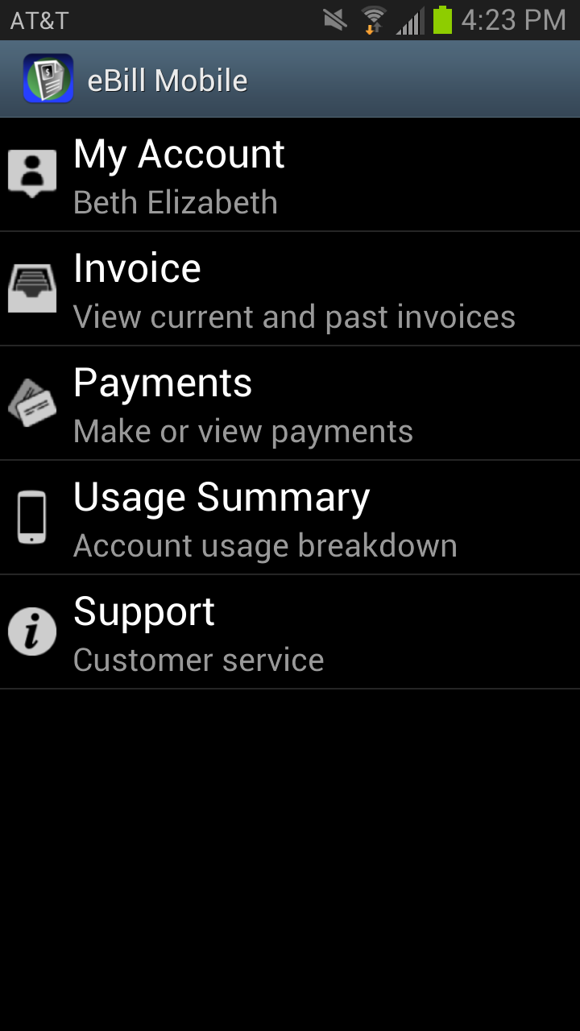
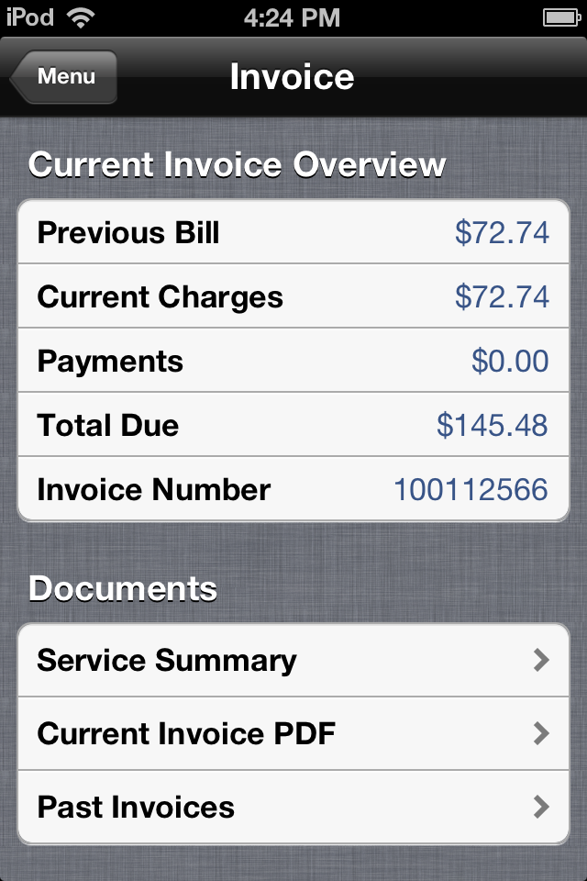


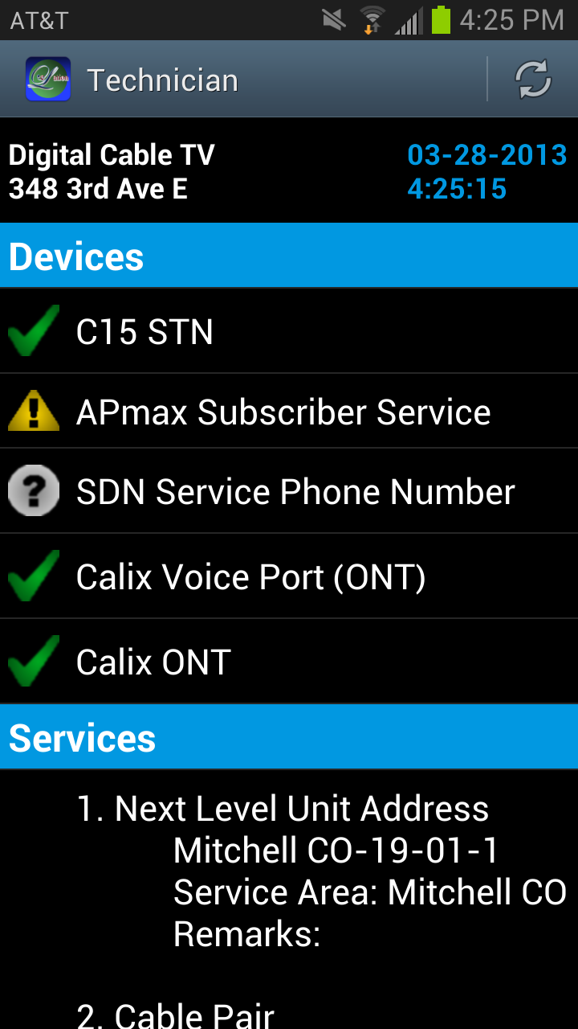
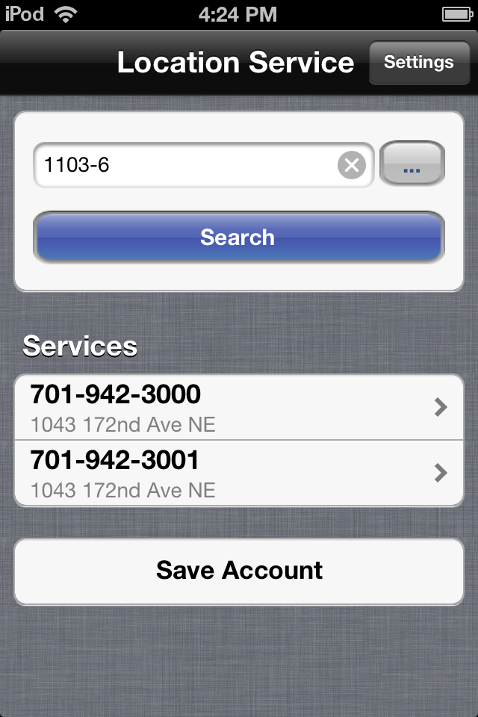
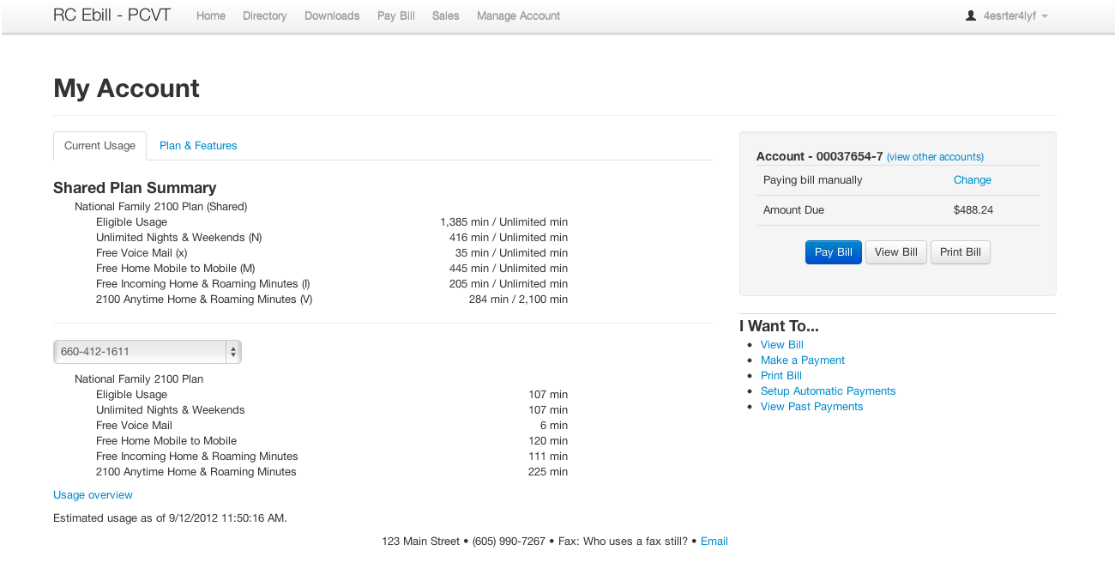
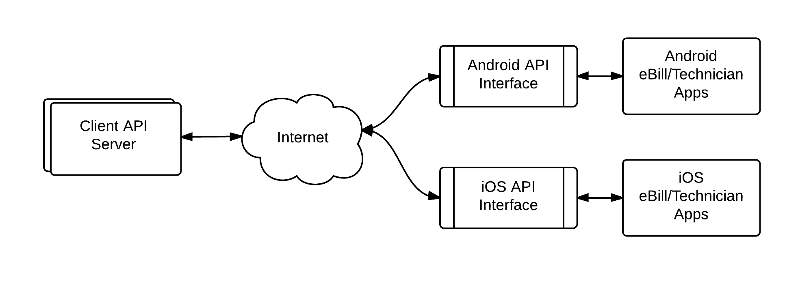
eBill Mobile
Mobile Apps
Special Thanks To: Brain Butterfield Chris Ortman
David Springhetti Wyatt Zochert
Michael Malkowski
Rachel Pekarek
Jeremy Warner
Technician
Mission
Provide a mobile solution for the existing eLation eBill web application on both iOS and Android platforms
Develop a mobile application to assist Innovative Systems technicians in the filed on both iOS and Android platforms
Features
Access Account Information
Access Invoice Information
View and Make Payments
View Current Usage
Access Support Information
Existing eLation
eBill Web Application
Application Programming Interface (API)
Features
Search Accounts
Display Hardware Diagnostic Information
Display Service Diagnostic Information
Web API was developed with Mitchell to provide existing functionality to mobile applications

