Slide 1
eLation Nation
eLation Cross Platform Mobile Apps for Innovative Systems, LLC

Slide 2
Introduction
Innovative Systems
eBill Mobile Application
Technician Mobile Application
Cross Platform: iOS and Android
Notes:
Jeremy

Slide 3
Project History
Sprint 1 & 2
Set up IDEs and SVN Code Repository
Built test JSON communication to Android devices
Created basic UI layouts
Installed eBill service on local server
Got provided API calls working and implemented
Sprint 3
Built Technician App
Wrote Technician API
Implemented API calls in eBill App

Slide 4
Project History Continued…
Sprint 4
Finished Technician App (Mostly)
Continued work on eLation eBill App
Finalized API Implementation
Sprint 5
Implemented eLation eBill UI backend
Updated UI features
Miscellaneous API fixes and Unit Testing

Slide 5
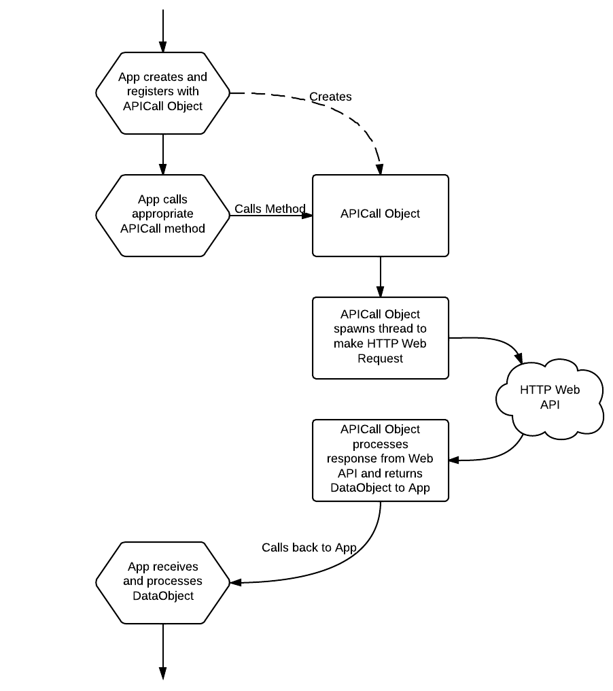
API Usage Diagram

Slide 6
Planned Deliverables
Tested and Documented Technician App
Username and Password Authentication
View Device Diagnostics
Save Location Accounts for Easy Access
Tested and Documented eBill App
Username and Password Authentication
View/Modify Account Information
View Payment History and Make New Payments
View Invoice Overviews or Full .PDF files
View Current Usage
Display Support Information and Allow Trouble Ticket Submission

Slide 7
What’s Left
Technician App
Testing and Documentation
eBill App
Testing and Documentation
Display Support Information and Allow Trouble Ticket Submission
Minor Account Information Modifications
API
Testing and Documentation

Slide 8
Testing
Apple Testing
SenTestingKit
Unit Tests
Frank
Automated UI Testing
Android Testing
Robotium Test Automation Framework
Unit Tests
Automated UI Testing
API Testing
JUnit Test Framework
Unit Tests
System Tests

Slide 9
eBill App Demo
Apple
Notes:
Rachel

Slide 10
Technician App Demo
Android
Notes:
Mike

Slide 11
Questions?
Notes:
Jeremy

