Slide 1



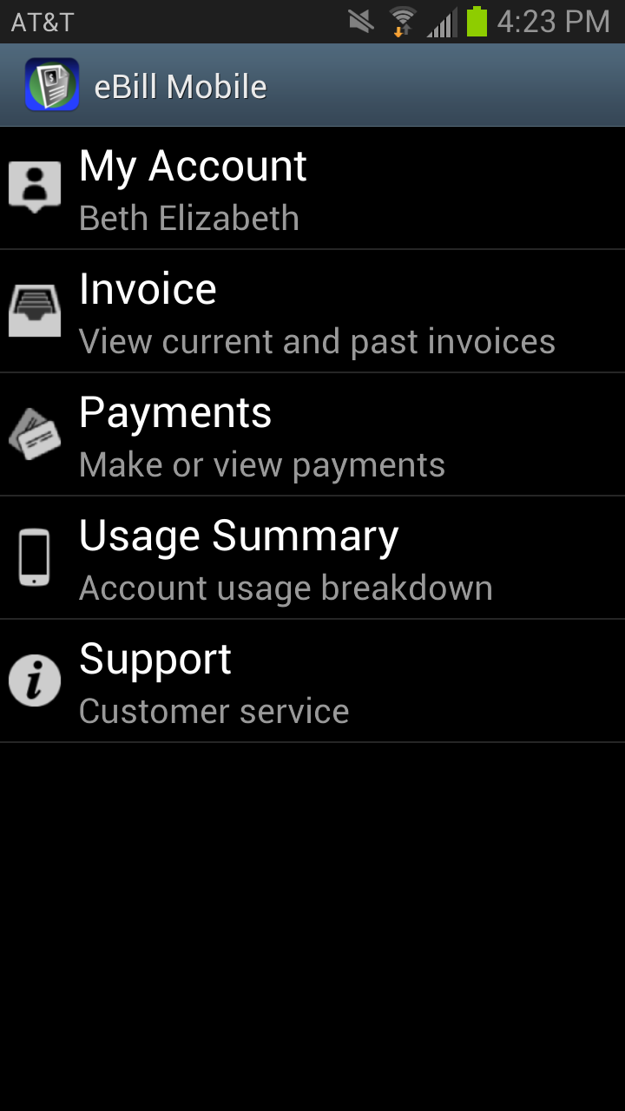
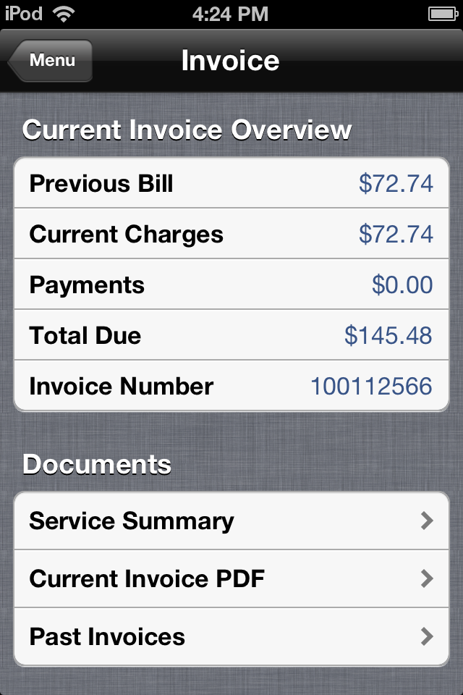

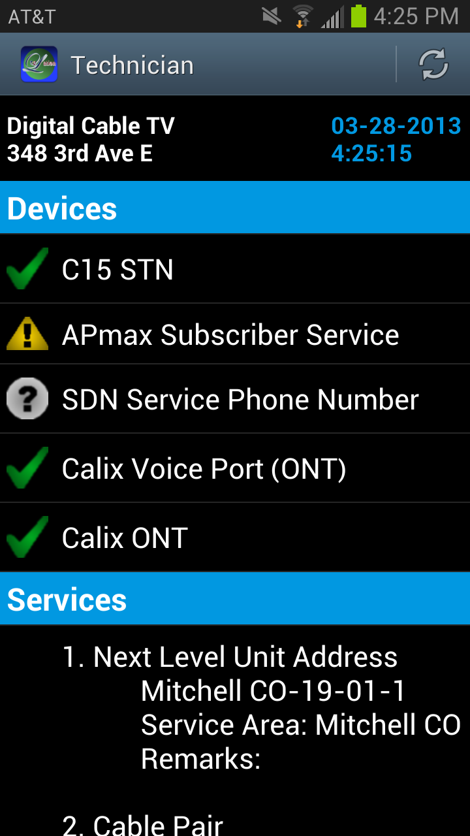
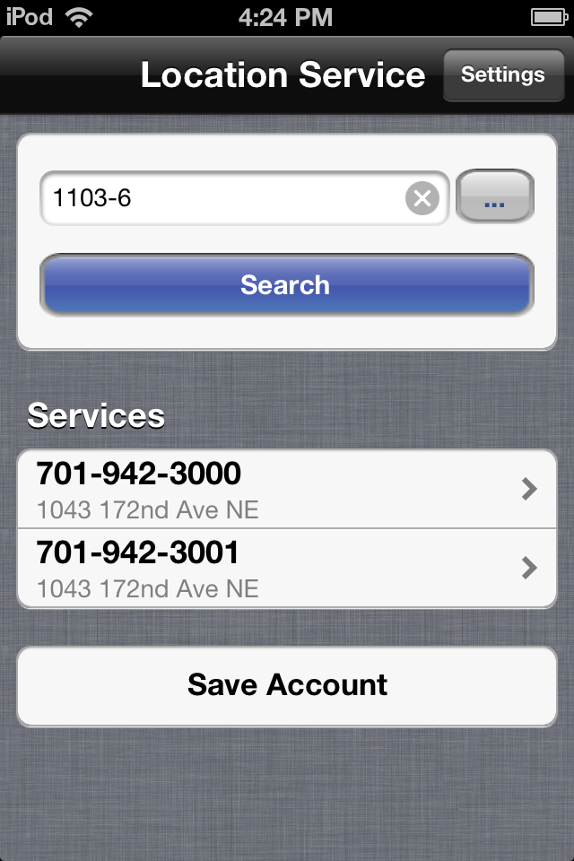
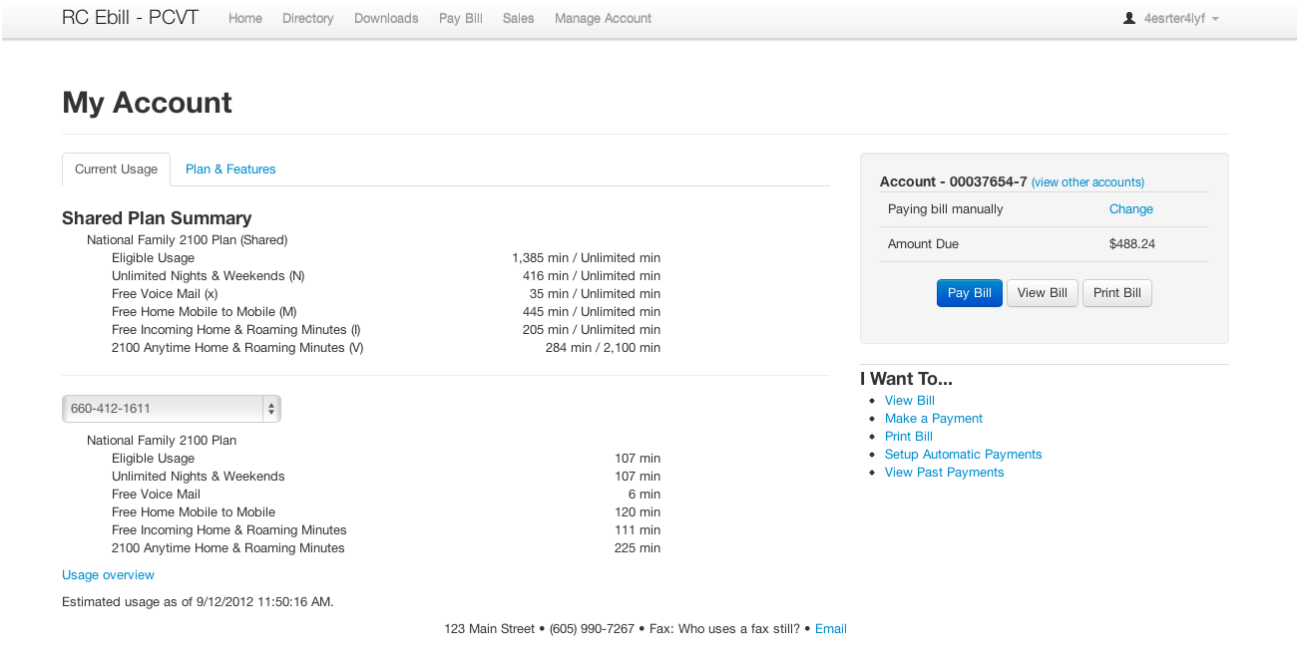
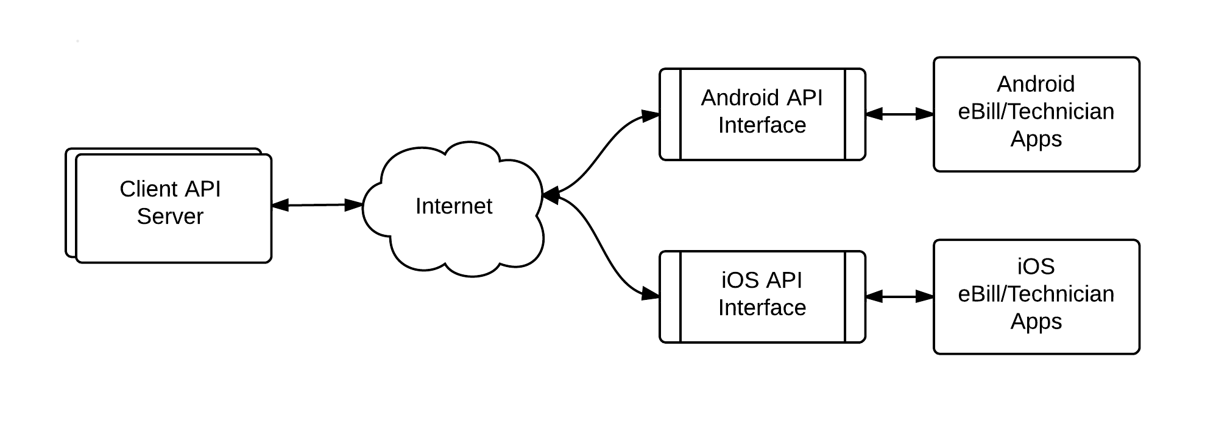
eBill Mobile
Mobile Apps
Michael Malkowski
Rachel Pekarek
Jeremy Warner
Special Thanks To… Brian Butterfield Chris Ortman
David Springhetti Wyatt Zochert
Technician
Mission
Provide a mobile solution for the existing eLation eBill web application on both iOS and Android platforms.
Develop a mobile application to assist service provider technicians in the field on both iOS and Android platforms.
Features
Access Account Information
Access Invoice Information
View and Make Payments
View Current Usage
Access Support Information
Existing eLation eBill Web Application:
Features
Application Programming Interface (API)
Search Accounts and Services
Display Hardware Diagnostic Information
Display Service Diagnostic Information
Communication layer between server and mobile apps
Developed with Mitchell to provide existing functionality to mobile apps

