Slide 1
eLation Nation
eLation Cross Platform Mobile Apps for Innovative Systems, LLC

Slide 2
Overview
Product Description: The cross platform mobile apps allow customers to utilize the eLation eBill application on their Android and iOS mobile devices.
Features:
Secure method of logging into the device
Changeable account settings
Access to previous billing invoices/service summaries
Payment processing
Usage statistics
Support information
Key Business Goals:
Add appeal to the already existing Elation product
Make app intuitive/easy to use
Maintain same look and feel between platforms
Notes:
Jeremy

Slide 3
User Stories
User Stories
As a customer with a telecom that uses Innovative Systems products, I want to change information on my account <change email, change password> from my <iOS device, Android device>.
As a customer with a telecom that uses Innovative Systems products, I want to see my <latest, past> invoice for my account from my <iOS device, Android device>.
As a customer with a telecom that uses Innovative Systems products, I want to see a summary of my service for my account from my <iOS device, Android device>.
As a customer with a telecom that uses Innovative Systems products, I want to see the current balance for my account from my <iOS device, Android device>.
As a customer with a telecom that uses Innovative Systems products, I want to make a payment on my balance for my account from my <iOS device, Android device>.
As a customer with a telecom that uses Innovative Systems products, I want to set up recurring payments for my account from my <iOS device, Android device>.
Business User Stories
As a customer with a telecom that uses Innovative Systems products, I want to get contact information for the support for my company from my <iOS device, Android device>.
As a customer with a telecom that uses Innovative Systems products, I have multiple accounts for both my business and my home with the same telecom. I want to be able to easily access the mobile application for both accounts from my <iOS device, Android device>.
As a telecom that uses Innovative Systems products, I want my customers to see a banner that displays my telecom’s name on the mobile apps that my customers use to check their account information.
Notes:
Mike

Slide 4
Backlog Categories
API Work
Device UI Work
Device UI Back End
Database
Sign In
Logging
PDF Implementation
Notes:
Mike

Slide 5
Challenges
Multi-platform Applications
Similar Interface
Different Languages
Different Devices
Interfacing with existing services
PDF display and usage
Multiple Account handling
Tablet and Mobile Device Compatibility
Notes:
Jeremy

Slide 6
Risks
API Not Complete
Risk Mitigation
Weekly communication with API Team
Notes:
Jeremy

Slide 7
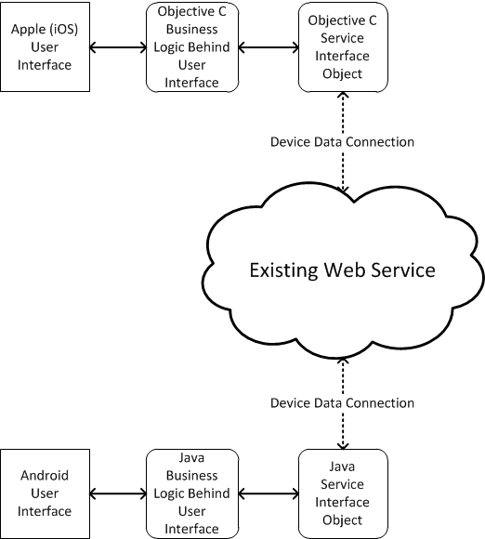
Architecture
APIs
Libraries exist within Android
Some external libraries will be needed for JSON on iOS
OAuth, open authorization protocol
Asynchronous Calls
Notes:
Jeremy

Slide 8
Tools
Using two Mac’s and two PCs for development
Android
Eclipse, Android SDK
Samsung Galaxy SIII, Nexus 7, Droid Pro II
iOS
Xcode, StoryBoard
iPod, iPad
Web Service
API via JSON
Repositories
Versions SVN: Code Repository
GitHub: Documentation
Notes:
Rachel

Slide 9
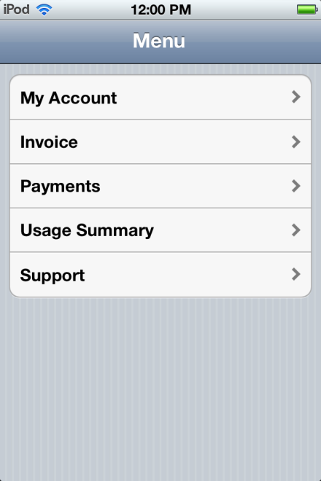
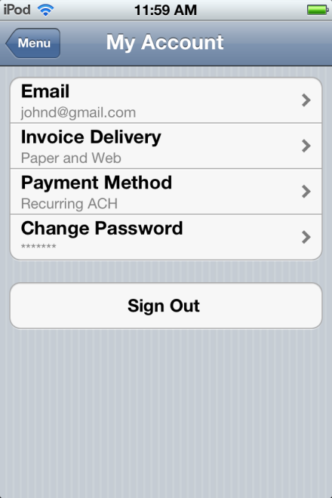
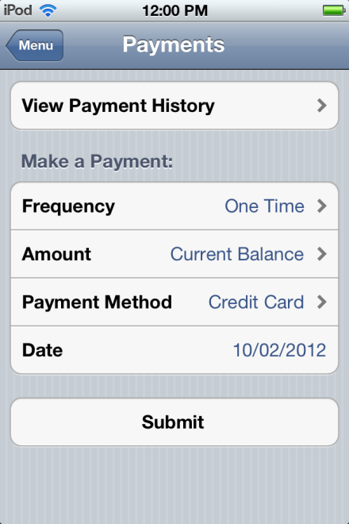
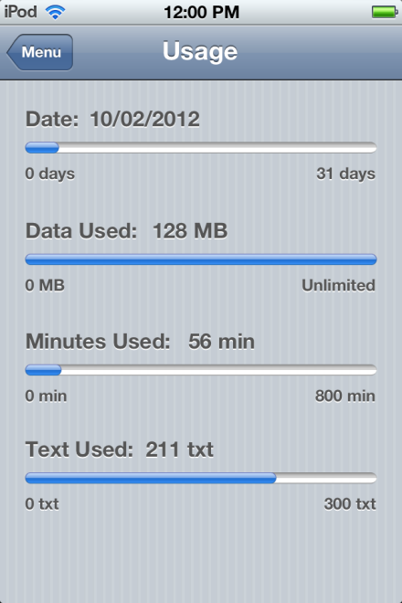
iOS App Design
High Level Layout
Notes:
Rachel

Slide 10
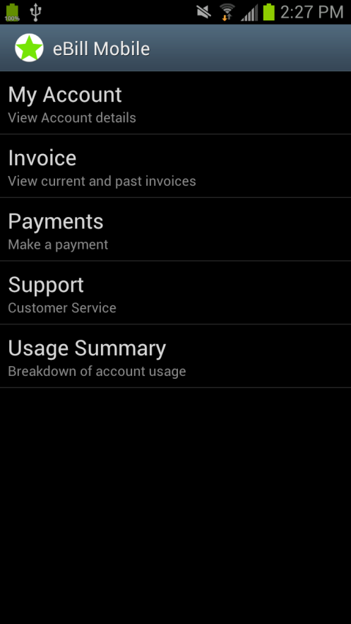
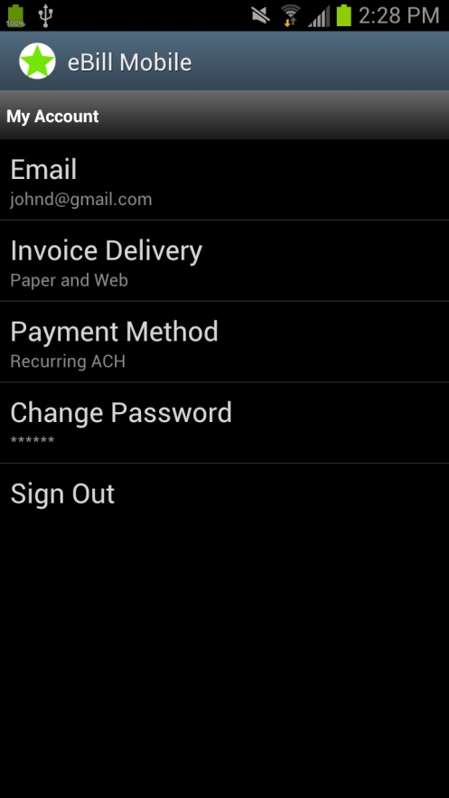
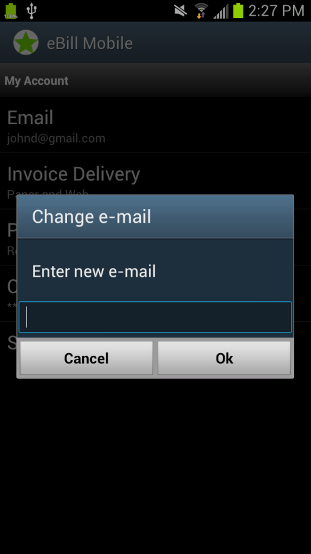
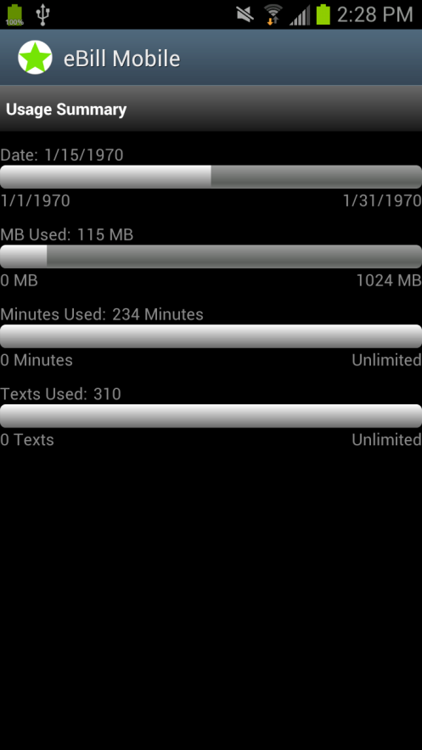
Android App Design
High Level Layout
Notes:
Mike

Slide 11
Testing
Unit Testing
JUnit and Sen Testing Kit
System Testing
Testing on devices
Network Issues
Notes:
Mike

Slide 12
Sprint 1
September 19, 2012 – October 3, 2012
Environment Setup
Set up IDEs on Mac, Windows
Set up code repository
Development
Build test JSON communication to Android and iOS devices
Build Android and iOS layout
Documents
Team Name
Design Document
Software Contract
Mission Statement
CONOPS
User Stories
Notes:
Mike

Slide 13
Sprint 2
October 10, 2012 – October 31, 2012
Environment
Get eBill service installed on local server for testing
Development
Finish Android and iOS UI
Investigate PDF on Android and iOS
Implement API calls
Android UI back end
Documents
Master UI Document
Notes:
Rachel

Slide 14
Budget
Hours Worked
Sunk Costs
Mobile Devices
Development Machines
Development Server
API Development
Notes:
Rachel

Slide 15
Questions?

