Slide 1
eLation Nation
eLation Cross Platform Mobile Apps for Innovative Systems, LLC

Slide 2
Introduction
Innovative Systems
eBill Mobile Application
Technician Mobile Application
Cross Platform: iOS and Android
Notes:
Jeremy

Slide 3
Previous Sprints
Sprint 1
  Set up IDEs and SVN Code Repository
  Built test JSON communication to Android devices
  Created basic UI layouts
Sprint 2
  Installed eBill service on local server
  Got provided API calls working and implemented
  Continued developing UI
Notes:
Jeremy

Slide 4
Sprint 3 Goals
eBill Application
  Implement all API call functionality available (at beginning of Sprint 3) in UI pages
  Implement PDF Viewer
  Set up Database/Build internal data storage structure
Technician Application
  Build application
Expand API error checking
Documentation
Notes:
Rachel

Slide 5
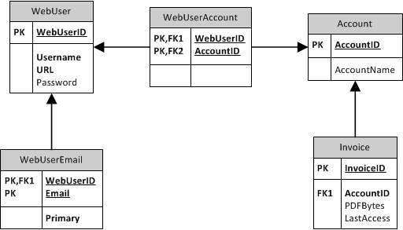
Database Design
Notes:
Rachel
Set up database for multiple users
Implemented class structure internally

Slide 6
eBill App Prototype
Apple
Notes:
Rachel

Slide 7

Notes:
Rachel

Slide 8
Technician App Prototype
Android
Notes:
Mike

Slide 9

Notes:
Mike

Slide 10
Successes
eBill App API Implementation
  Invoice Overview
  Invoice List
  View Invoice as PDF
  Service Summary
  Payment History
Technician App API Implementation
  Built Application
  Services Query
  Diagnostics Query
Notes:
Mike

Slide 11
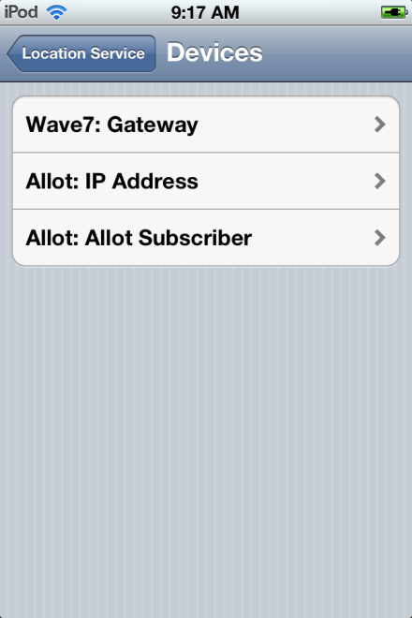
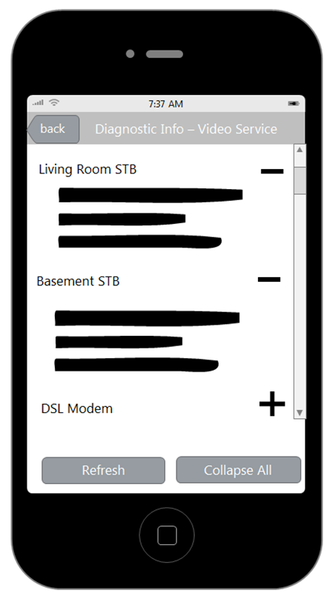
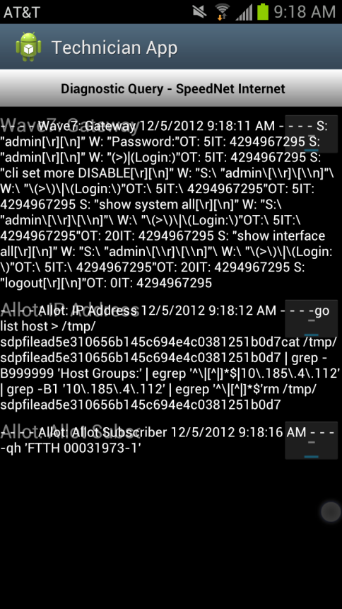
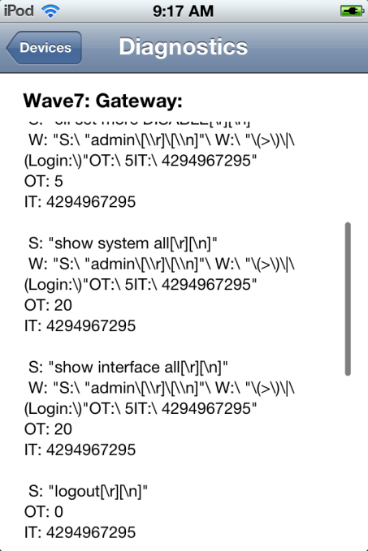
Issues
The expandable list:
Notes:
Mike

Slide 12
Still in progress…
Documentation
Expand Error checking
Current Usage API
Payments API
Implement Past Invoices – Android
Implement database storage
Notes:
Jeremy

Slide 13
Remaining Backlog
Documentation
OAuth Login
API Functionality
  Manage Account
  Current Usage
  Additional Payment Options
Make iPad Compatible Apps
Trouble Tickets
Unit Tests
Handling Data throughout App Lifecycle
Accommodating Multiple Web Users
Notes:
Jeremy

Slide 14
Questions?
Notes:
Jeremy

