Slide 1
Set Top Box Multiplayer Framework
Team: Plugged-In
Marshall Gaucher, David Jarman, Kevin Worner
Sponsored by: Innovative Systems, L.L.C
Notes:
Introduction

Slide 2
Client
Innovative Systems
Provides integrated solutions for the independent telecommunications industry.
APMax
Application Server providing services such as:
IPTV Video Solutions
Unified Messaging
Single Number Service
STB
Set-top-box providing television and integrated telephony applications
Notes:
David

Slide 3
Project
Create a server to host STB multiplayer game plugins
Design a template game UI for STBs in an APMax environment
Build a virtual APMax to simulate future communication protocols
Convert games to proof-of-concept multiplayer games.
Notes:
David

Slide 4
Sprint Review
Sprint #1
Initial design of STBMF system
Researched current Innovative System network communications
Sprint #2
Designed prototypes of STBMF System (vSTB, vAPMAX, Game Server)
Designed communication definitions for STBMF
Sprint #3
Implemented prototypes to test designed communication definitions
Created sand box environment for development
Notes:
Kevin

Slide 5
System Design
3 Major Components:
vSTB
vAPMAX
Game Server
Communication:
UDP and TCP
CommandLink protocol
Notes:
Kevin

Slide 6
Prototypes
vSTB
Scalable module to handle game environment request/response from user
vAPMAX
Message handler between vSTB and Game Server
Game Server
Process requests from/responses to users on vSTB
Notes:
Kevin

Slide 7
vSTB
New request response definitions
Scalable
Modular (vSTB Tester, vSTB Multiplayer)
Platform independent
Increased availability to Users
Notes:
Marshall

Slide 8
User Story
vSTB must work on actual STB
Amino Live Connectivity: Dual gigabit Ethernet via RJ-45 shielded connector, 802.11n wireless, Bluetooth, sim or smart card Outputs: HDMI 1.4 with HDCP. USB 2.0 8 3.0 Memory: 2 GB DDR 3 RAM HDD: 250GB standard. Other sizes on request. Codecs: MPEG-2 MP@HL, MPEG-4 pt10 AVC/H.264 HP@L4 Multi-plane dual HD (1080p) decode and display of video (MPEG 2, VCI and H264) and other low bit rate codec support CPU: Intel® Dual Core Atom™ based with hyper threading Graphics: Advanced graphics core with OpenGL2.0 and 3D shader support | Amino A140 Connectivity: Ethernet 10/100 BaseT via RJ-45 shielded connector Outputs: HDMI 1.3a. (excl. Deep colour and DTS audio) with HDCP.S/PDIF (optical). USB2.0. 10-way Mini-DIN for Composite video, Component (YPrPb),RGB, S-Video and analogue audio. RF Mod and loop through. Codecs: MPEG-2 MP@HL. MPEG-4 pt10 AVC/H.264 HP@L4 GRAPHICS RESOLUTIONS HD graphics up to 1280x720 Memory: 128MB Flash, 256MB RAM CPU: 800 Mhz Processor

Slide 9
User Story
vSTB must be fully Unit Tested
Unit Testing: QtTestLib
Lightweight library, around 6000 lines of code and 60 exported symbols.
Data-driven unit testing and GUI testing.
IDE Integration for Visual Studio and KDevelop.
Thread-safe error reporting.
Self-contained, requires only Qt Core for non-gui testing.
Rapid testing, no special runners required.
Rapid test creation, no special utilities or testcase-registration required.
Easily extendable test logging, outputs plain text or xml.
QElapsedTimer
milliseconds, nanoseconds(best estimated by system)

Slide 10
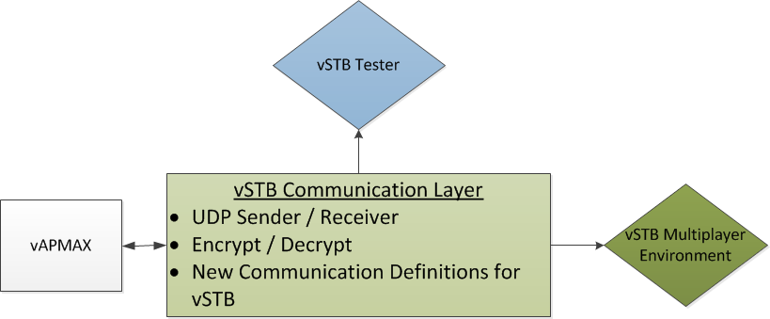
vSTB Design
vSTB Tester
Provides vAPMAX intuitive interface to test environment
Provides Game Server a flexible tool to view deployed objects
vSTB Multiplayer Environment
Reduces current load on STB
Framework provides foundation to add future features to meet demand of end user and technology
Notes:
Marshall

Slide 11
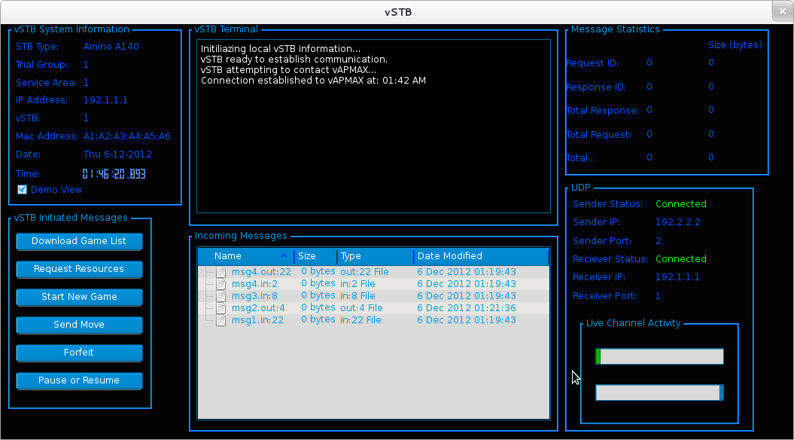
vSTB Tester

Slide 12
Current STB Game Architecture
Single Player Environment
vSTB removes current load to be stored on Game Server

Slide 13
vSTB Direction
Stabilize communication layer
Redesign single player game architecture to exist with new live multiplayer environment

Slide 14
vAPMax
Pass through messaging system
STB
Game Server
Performs quick formatting
Allows quicker development
Can test new communication protocols
Notes:
David

Slide 15
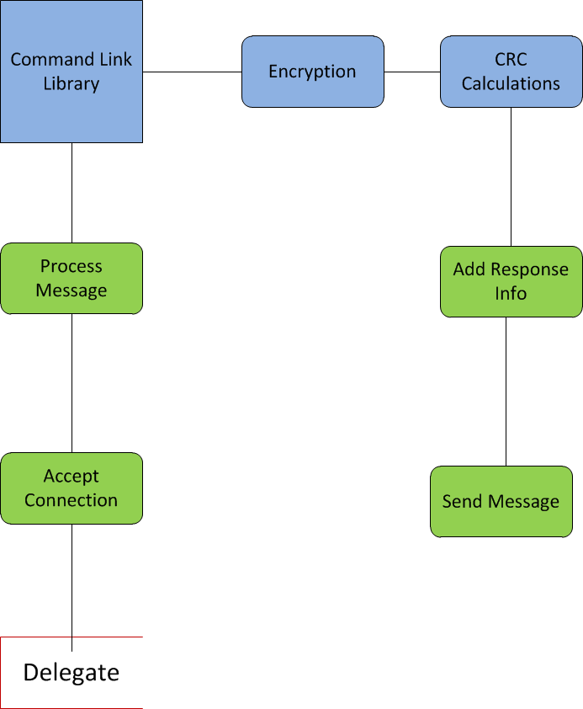
vAPMax Dataflow
Notes:
David

Slide 16
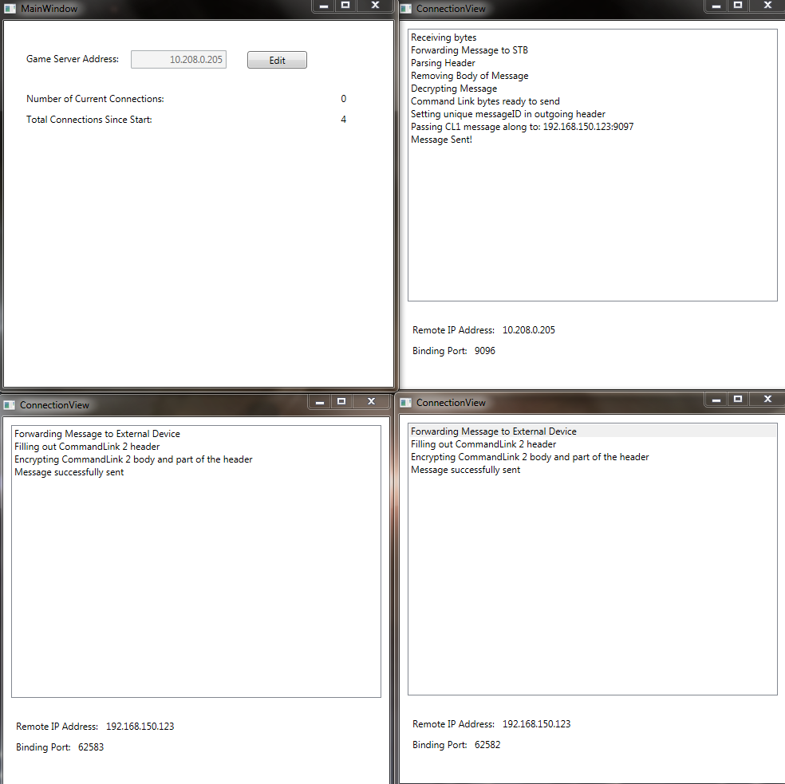
vAPMax Prototype

Slide 17
Game Server
Will manage game resources/instances/stats
Right now: Manages communication
Communication Handler
Receive message
Send response
Data Handler
Process message
Decrypt
Read
Prepare response
Encrypt
TCP In
TCP Out
UI Buttons
Send custom, hardcoded messages
Gamer Server
Notes:
Kevin

Slide 18
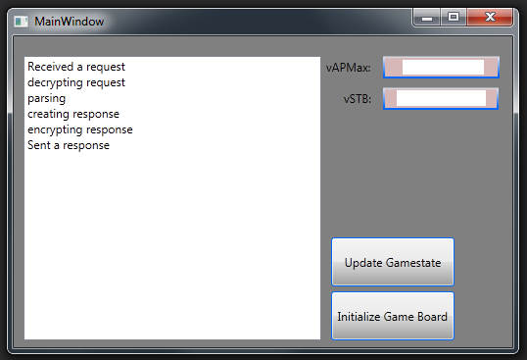
Game Server Prototype

Slide 19
Product Backlog
vSTB
Research Qt Unit Testing
Create Checkers game as a proof of concept
Prove out and implement QUiLoader
Research Dynamic UI
Refactor existing STB game view/model architecture to meet STBMF requirements
Create Memory game as a proof of concept
vAPMAX
Integrate Logger into project and provide basic command line usage to view.
Unit Testing
Update Reactive Extension package to latest
Game Server
Server: Plugin Interface
Server: Database
Server: UI - Stats, Import
Server: Future - server components, database
Server: Design: game interface - loading game, playing game
Server: Unit Test
Server: Build template GUI
Server: Research Server operating systems
Server: Research Security
Server: Convert to a service
Server: Research attaching a GUI to a service using C#
Notes:
Kevin

Slide 20
Questions

