Slide 1
Set Top Box Multiplayer Framework
Team: Plugged-In
Marshall Gaucher, David Jarman, Kevin Worner
Sponsored by: Innovative Systems, L.L.C

Slide 2
Client
Innovative Systems
Provides integrated solutions for the independent telecommunications industry.
APMAX
Application Server providing services such as:
IPTV Video Solutions
Unified Messaging
Single Number Service
STB
Set-top-box providing television and integrated telephony applications
Notes:
(1 minute)

Slide 3
Project Overview
Modify the existing STB architecture to allow multiplayer games to be played
Create a server to host game plugins and communication between clients
Write a set of protocols that allow a generalized subset of games to be played
i.e. board games, card games, etc…
Notes:
(1 minute)

Slide 4
Project Overview (cont..)
Implement a temporary pass-through messaging middle layer to simulate and extend the current in place system.
Choose a board game and using our own framework, create a fully functional multiplayer version as a proof of concept

Slide 5
Last Semester
Collected user stories
Designed protocols
Researched tools
Implemented virtual APMAX
Notes:
(2 minutes)
Last semester
Collected user stories
Clarified our own vision
Switched to sand box environment
Designed protocols
Extended Innovative’s proprietary CommandLink protocols to include client side message initiation
Revised several times to meet changing requirements
Still being revised
Researched tools
Ran code experiments to determine what tools to use
Reactive Extensions
LINQ to Entities
Protocol Buffers
Moq
QUiLoader
QTestLib vs QTest
Researched and modified pre existing internal tools
BinSerializerLib
CommandLinkLib

Slide 6
This Semester
Sprint 4
Designed server architecture
Designed vSTB layout
Created demo to show client
Sprint 5
Implemented server and began unit testing
Created checkers logic and AI
Refactored vSTB
Notes:
(2 minutes)
Sprint 4
Designed server architecture
Created the bare bones structure and begin filling in the pieces
Designed vSTB layout
Stubbed out communication methods
Focused on UI layout
Create demo to show client
Sent a message from the server to the client and displayed the contents
Sprint 5
Implemented server and began unit testing
Refactoring was necessary to make code more unit testable
Created checkers logic and AI
Wrote checkers logic using the framework we had setup for creating games
Wrote checkers AI using the same framework
100% unit testable code coverage
Refactored vSTB
Needed some organization reworking
Made code more modular and unit testable

Slide 7
Remaining Work
Server
Finish unit testing
Create load testing environment
Documentation
Current system
Unimplemented features
vSTB
Finish remote control functionality
Begin unit testing
Documentation
Checkers
Optimize AI
Documentation

Slide 8
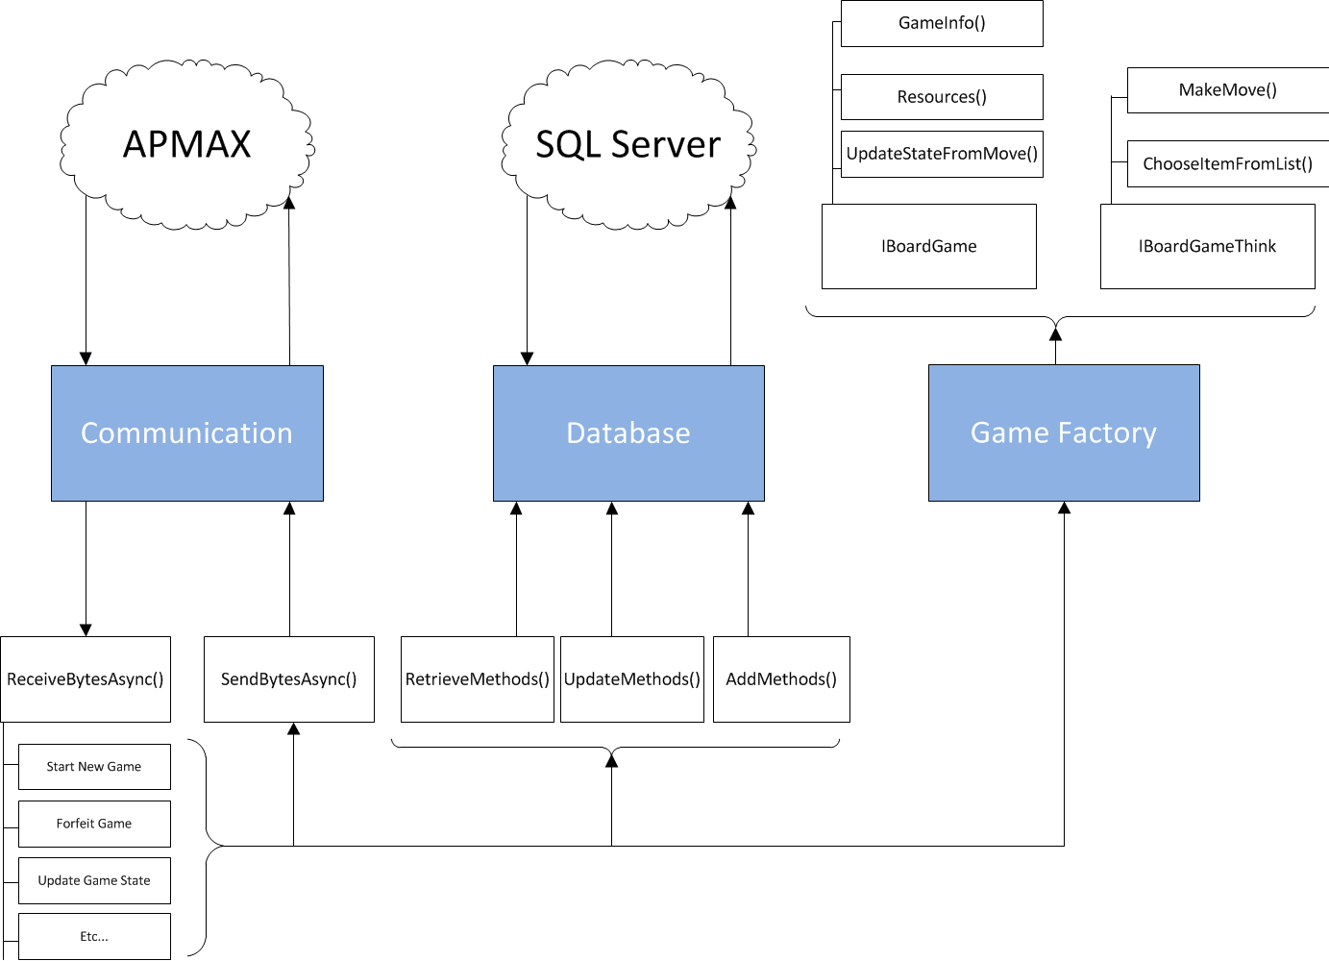
Server Architecture
Notes:
(1-2 minute)
Server Architecture

Slide 9
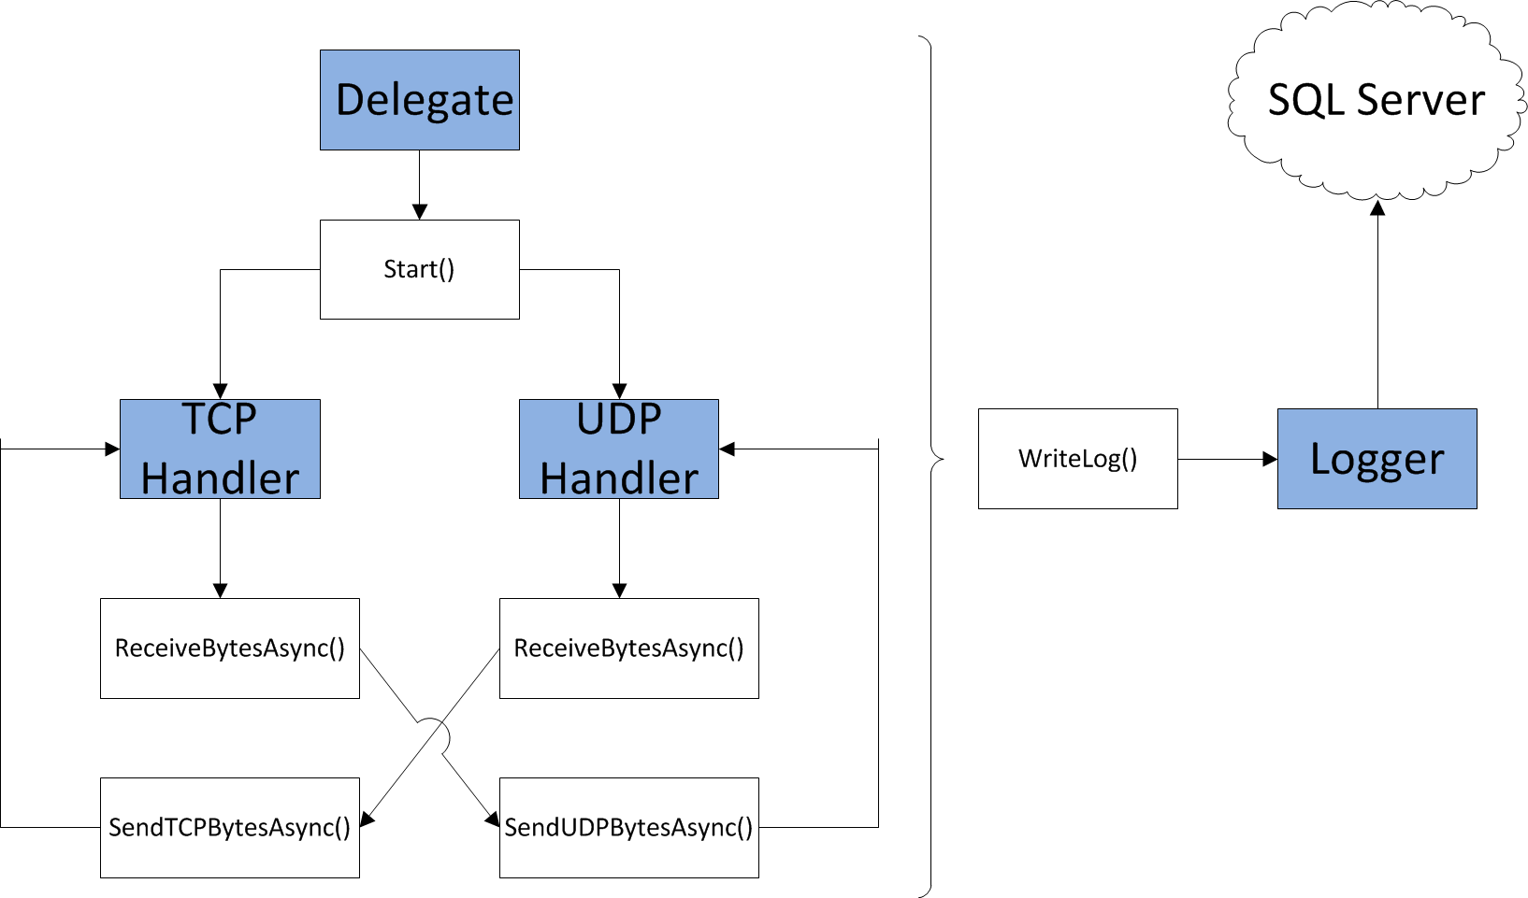
vAPMAX Architecture
Notes:
(30 seconds)
vAPMAX Architecture

Slide 10
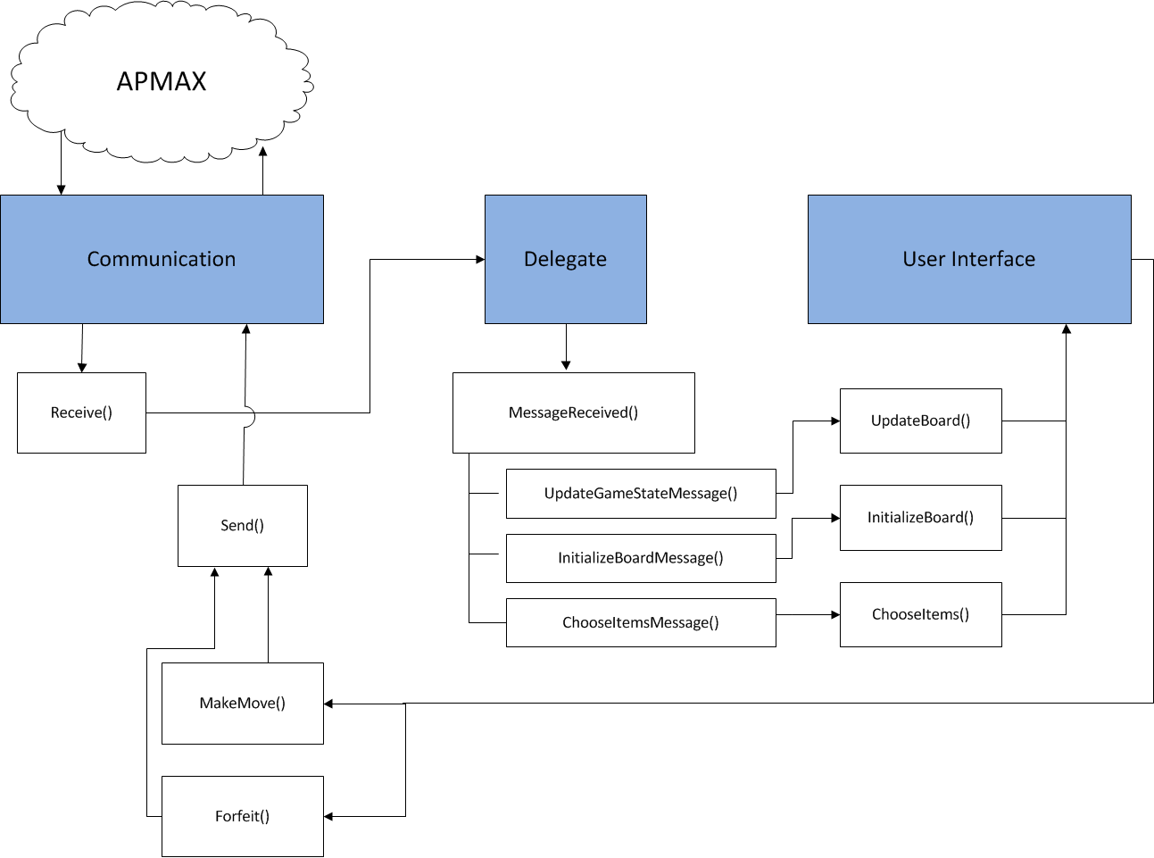
vSTB Architecture

Slide 11
Checkers
Human vs. Human
Validate move
Return updated game
Human vs. AI
Using MiniMax
4 move look-ahead (2 ply)
Improvements to AI
Alpha-Beta Pruning
Allow larger look-ahead
AI specific move validation
Existing validation proving too bulky
Notes:
(1-4 minutes)

Slide 12
Testing Plan
Server
Unit Testing
Moq library
Dependency injection
Load Testing
Response time
Reduce bottlenecks
vSTB
QTest vs QTestLib
vAPMAX
Checkers

Slide 13
Demo

Slide 14
Questions?

