Slide 1

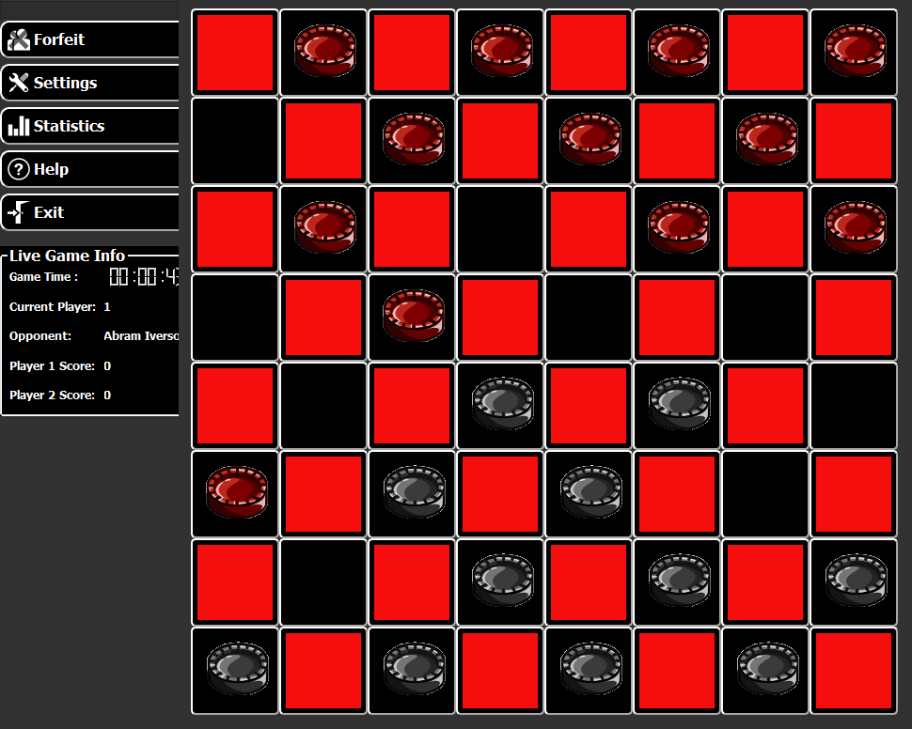



Multiplayer Game Framework
David Jarman | Marshall Gaucher | Kevin Worner
Project Goals
Team Sponsor
Software Requirements
The goal of this project is to create a framework that can be used to develop and deploy multiplayer games to Set Top Boxes without the need to edit existing STB firmware for new game releases and updates
Modify the existing STB architecture to allow multiplayer games to be played
Create a server to host game plugins and communication between clients
Server should be able to host up to 10,000 simultaneous games
Implement a temporary pass-through messaging middle layer to simulate and extend the current in place system
Choose a board game and create a fully functional multiplayer version using the framework
Host game play
Manage game opponents
Load game plugins
Tools
C# and .NET 4.5
Reactive Extensions
Linq to Entities
Extend APMAX message passing
Minimal message processing
Tools
C# and .NET 4.5
Reactive Extensions
CommandLink lib
Generic game UI
Agnostic to game logic
Tools
C++
Qt Creator
Game Server
vAPMAX
Client

