Slide 1

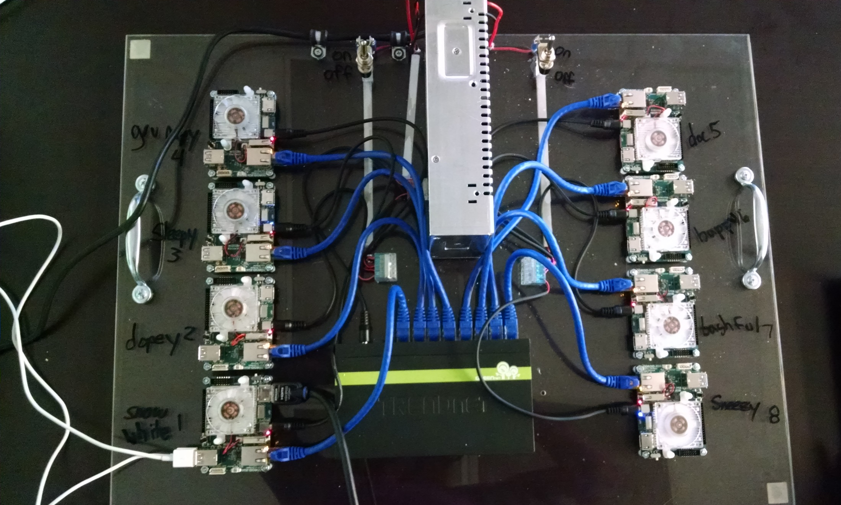
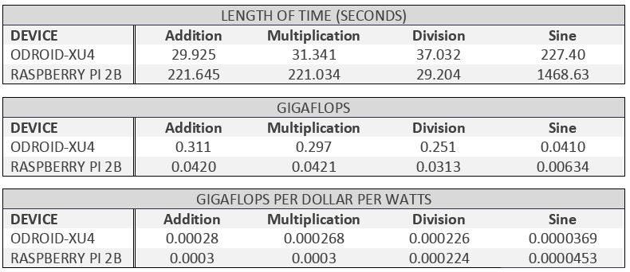
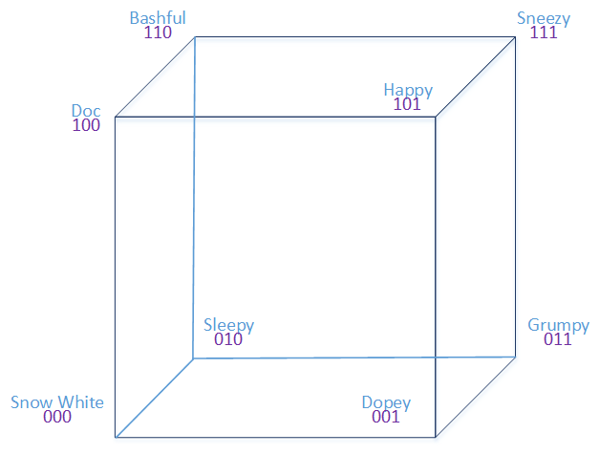
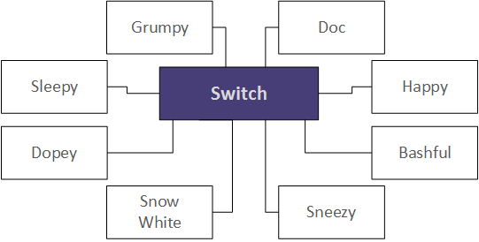
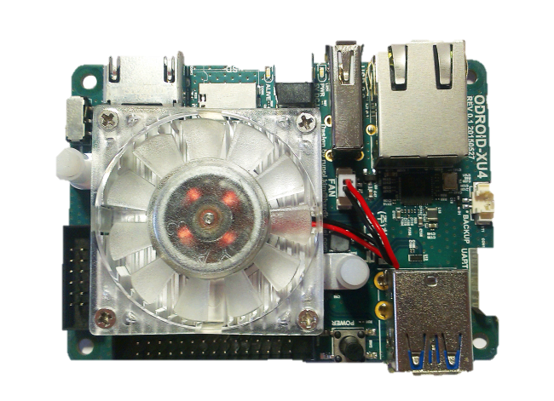
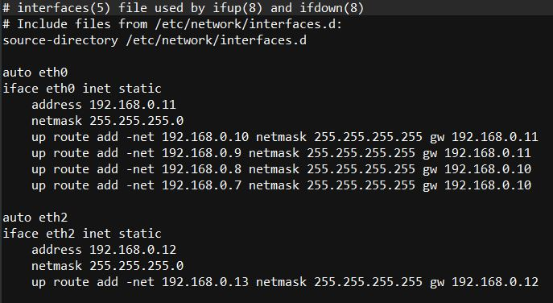
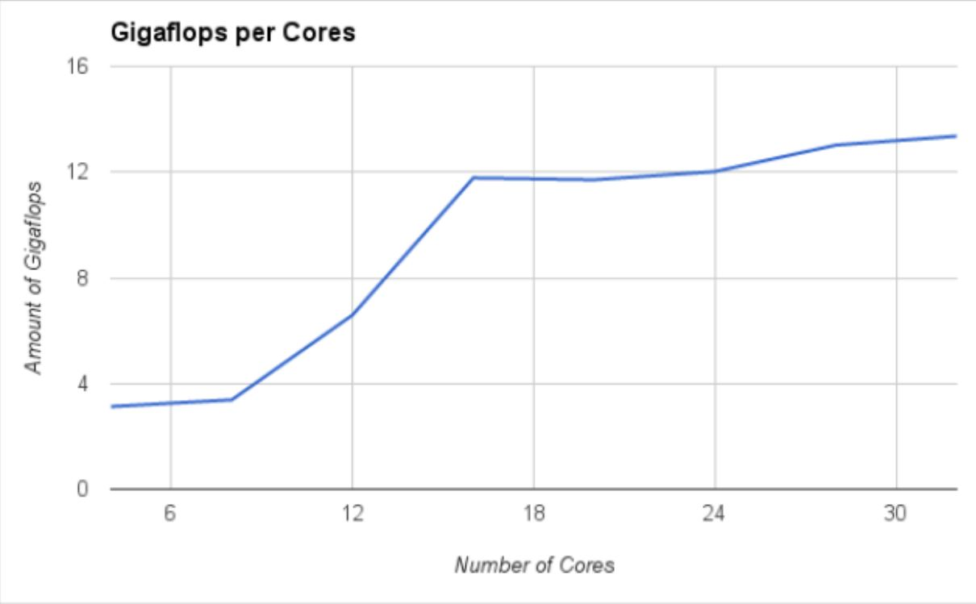
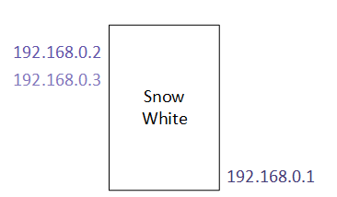
ARM Cluster: A Research Tool
Project by: Andrew K. Hoover and Christine N. Sorensen
Sponsored by: Dr. Christer Karlsson
South Dakota School of Mines and Technology, Department of Mathematics and Computer Science
Acknowledgments
Dr. Jeff McGough
Dr. Mengyu Qiao
Steph Athow
Dan Nix
ODROID vs Raspberry Pi
Mission
To build the fastest, most efficient cluster of single-board computers.
Topology
The ODROID XU4 and the Raspberry Pi 2B were benchmarked by running math equations and were compared on speed and power.
The 8 ODROIDS were connected into a Star Topology; each connected to a switch via Ethernet. Ring and Hypercube were connected using an Ethernet-to-USB cord.
Hypercube and Ring Topology
Cluster in Star Topology
Results
ODROID XU4
Communication
Using four a7 cores per node, all eight nodes, produced 13.36 Gigaflops. Using two a15 cores per node on all eight nodes produced 26.23 Gigaflops. An i7 device using four cores gave 61.3
2 x USB 3.0 Host
1 X USB 2.0 Host
Gigabit Ethernet Port
2 GB RAM
Added 16 GB Storage
7.4 x faster than Pi 2B
8 cores: 4 x a15, 4 x a7
USB and GPIO connections were tested. Currently, there’s no way to connect through USB, and GPIO was slower than Ethernet.
Three IP Addresses were assigned to each ODROID: one for Ethernet and one for each USB 3.0 port. Routing tables were created for each ODROID
HPLinpack Benchmark
Routing Table
LINPACK measures the computing power by solving linear in parallel on the system. It was used to benchmark the cluster in the star topology.
IP Addresses
LINPACK results for star topology on a7’s
Tools LINPACK | C/C++ | WiringPi | GPIO | USB | Ethernet | USB to Ethernet | Python | OpenMPI | MPICH | Ubuntu Linux | Bash

