Slide 1

ARM Cluster: A Research Tool
Project by: Andrew K. Hoover and Christine N. Sorensen
Sponsored by: Dr. Christer Karlsson
South Dakota School of Mines and Technology, Department of Mathematics and Computer Science
Notes:
cs

Slide 2
Introduction
South Dakota School of Mines and Technology
Senior Design project
Dr. Christer Karlsson
Supercomputers
Notes:
cs

Slide 3
Mission
To build the fastest, most efficient cluster of single board computers
Notes:
Cs Definitions of: Cluster Uses Single-board ARM Benchmark

Slide 4
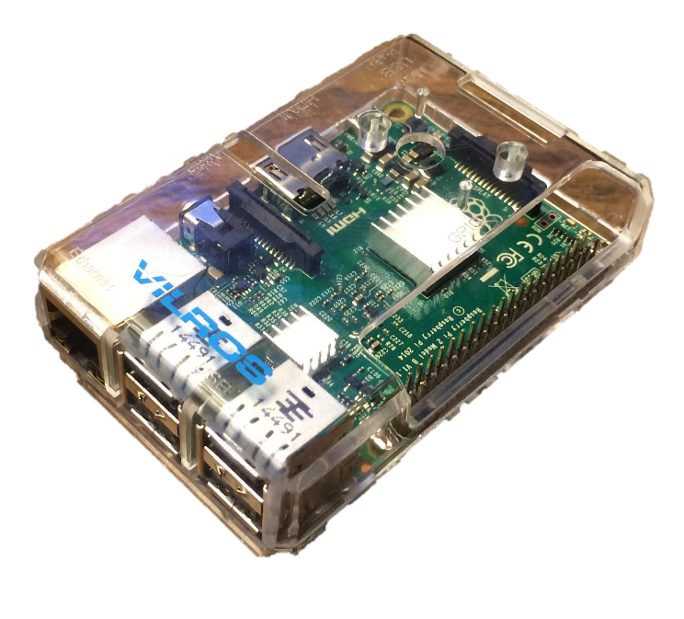
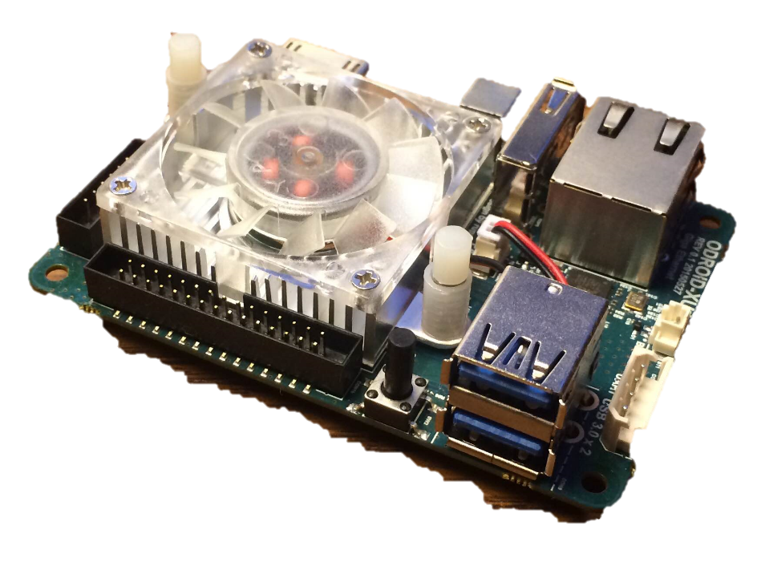
Single-Board Computer
PcDuino not available
Raspberry Pi 2B:
$35
4 A7 cores
4 USB 2.0 ports
1 GB memory
1 Gigabit Ethernet
ODROID XU4:
$75
4 A7 cores, 4 A15 cores
2 USB 3.0 ports, 1 USB 2.0 port
2 GB memory
1 Gigabit Ethernet
Notes:
ah

Slide 5
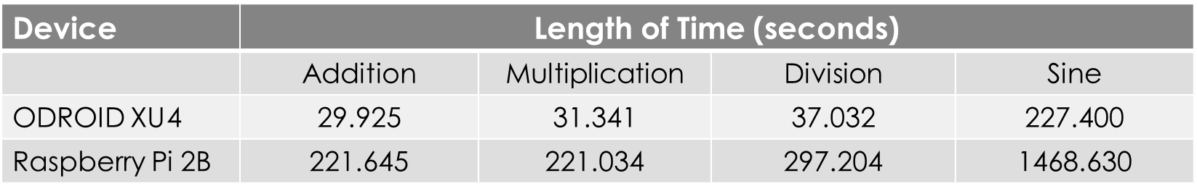
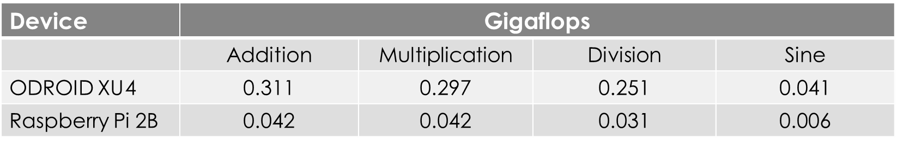
Benchmark
Compared computation speed using large matrices of random floating point values
Notes:
ah

Slide 6
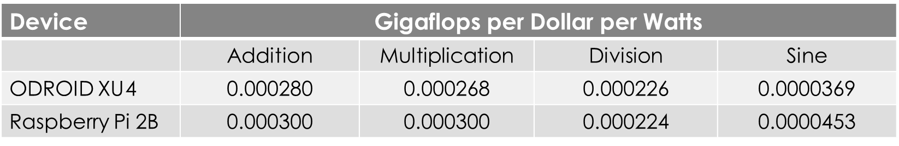
Deciding ODROID
Compared gigaflops per dollar per watts.
Raspberry Pi 2B:
$35
4 watts
ODROID XU4:
$75
15 watts
Used communication options to decide on ODROID XU4.
Notes:
ah

Slide 7
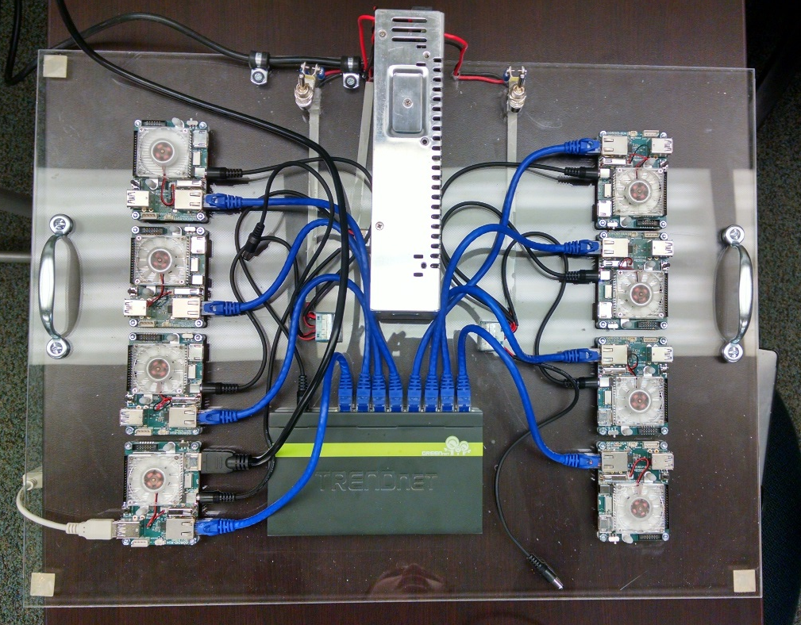
Initial Setup
8 ODROID XU4s
Power Supply
8 Port Gigabit Switch
Cat 5e Ethernet Cables
Two on/off switches
Notes:
Ah

Slide 8
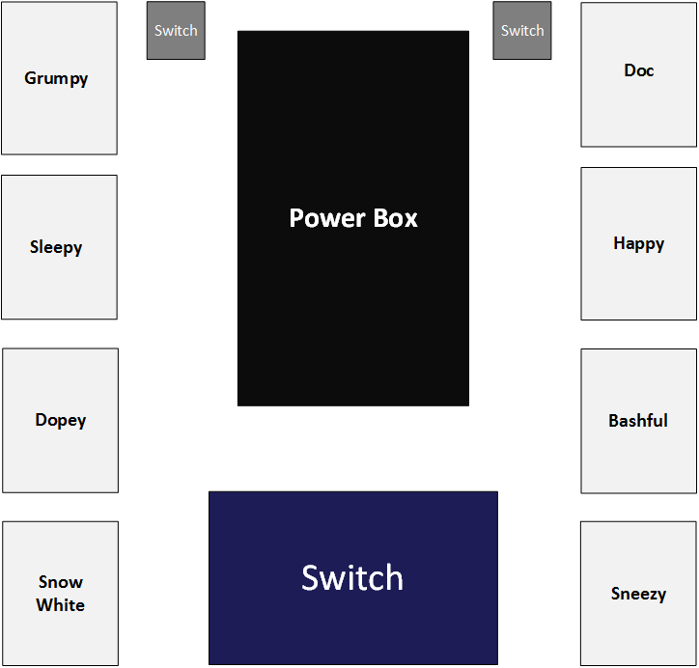
Introducing the Cluster
Notes:
Cs create diagram

Slide 9
LINPACK
Test the speed of the cluster.
Install OpenMPI, download the source and ATLAS source.
Build the code and configure the options file.
Used in top500 to test supercomputers.
Notes:
cs

Slide 10
LINPACK for ARM
There was no LINPACK for ARM
Created Makefile for ARM
Built Debian package
Notes:
ah

Slide 11
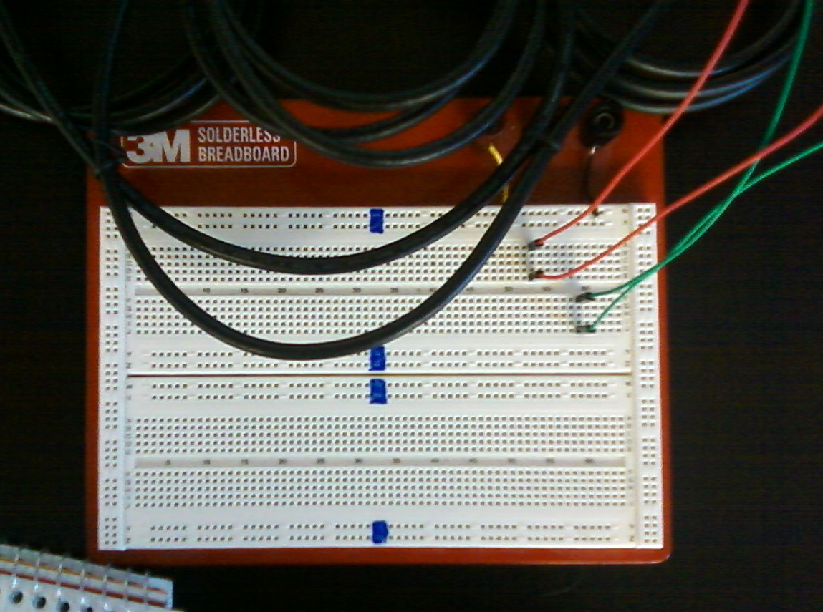
USB and GPIO
USB communication with PyUSB.
Not possible to communicate host to host with current OS.
GPIO communication with WiringPi and sysfs.
Both found to be slow, 0.5 Mbps. Ethernet was 750 Mbps.
Notes:
Ah
Switch WILL be the bottle neck - transition

Slide 12
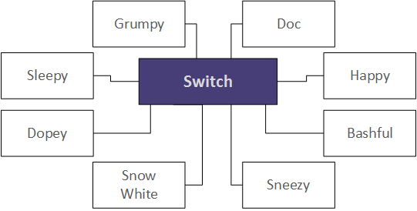
Other Topologies
Notes:
Cs
We did get the ring/hypercube to work, but not with linpack

Slide 13
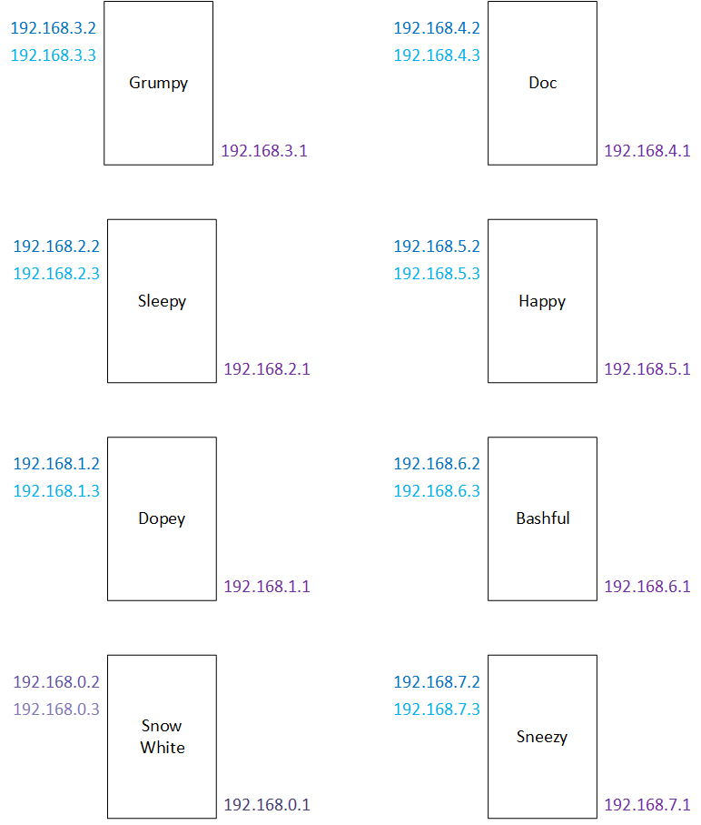
Other Topologies
Notes:
Cs
We did get the ring/hypercube to work, but not with linpack

Slide 14
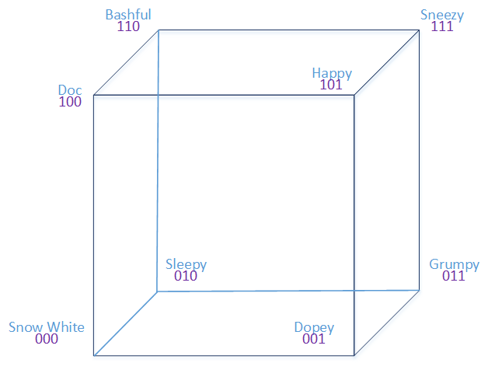
Other Topologies
Notes:
Cs
We did get the ring/hypercube to work, but not with linpack

Slide 15
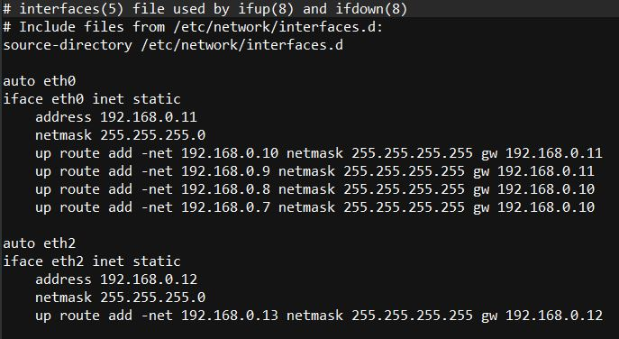
Networking
IP Addresses
Routing tables
Notes:
Cs ah

Slide 16
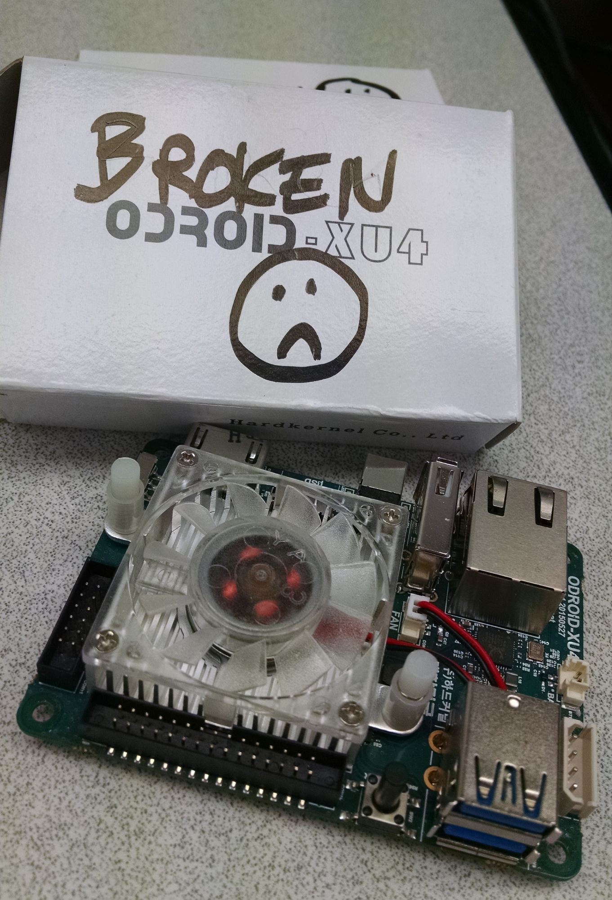
Problems
PcDuino
Broken ODROIDS
WiringPi requiring to update the kernel
USB to USB connection is impossible
GPIO complexity and lack of speed
LINPACK and multiple interfaces
Notes:
cs

Slide 17
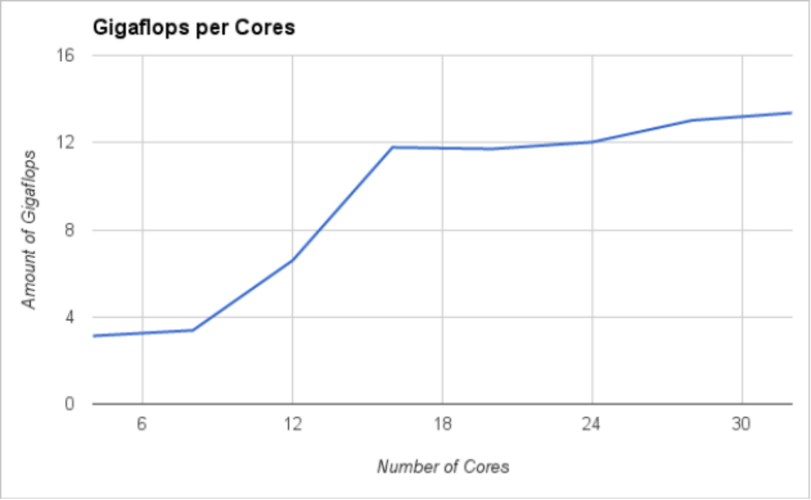
Results
Using 4 A7 core per node
With 1 A15 core per node:
17.05 gigaflops
With 2 A15 cores per node:
26.23 gigaflops
Notes:
ah

Slide 18
Future Projects
Using for research for other research
Other connections
Perform problems
Notes:
cs

Slide 19
Conclusion
Created cluster of single board computers
Tested several communication protocols and topologies
Benchmarked the cluster
Hand off for further study
Notes:
cs

