Slide 1

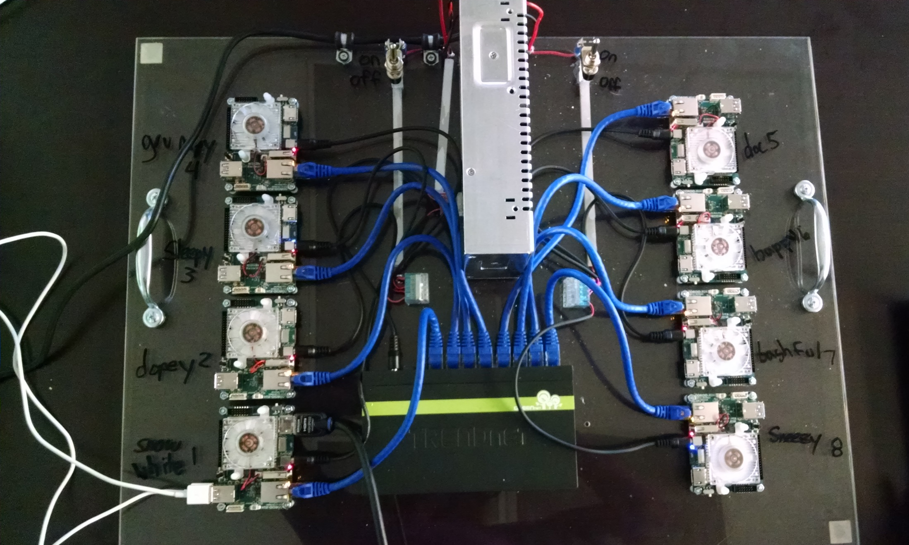
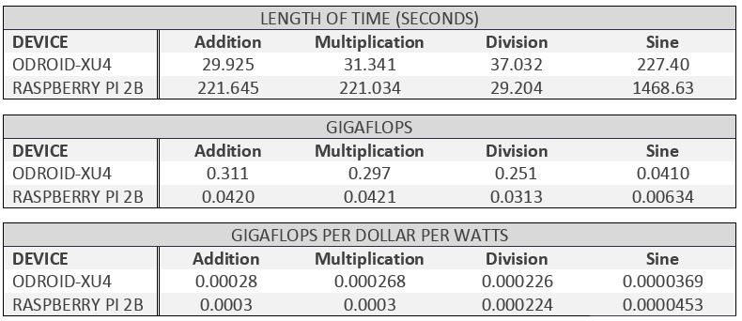
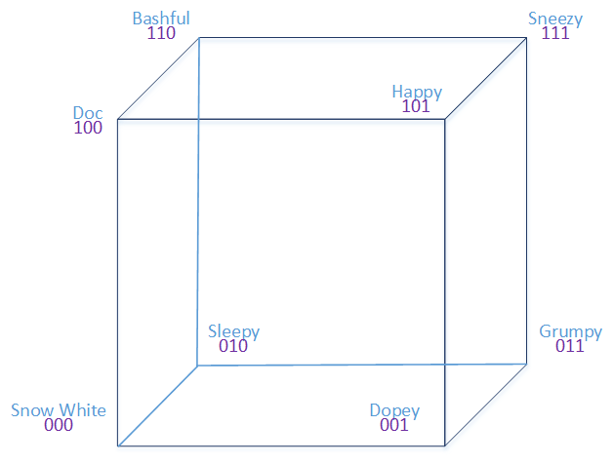
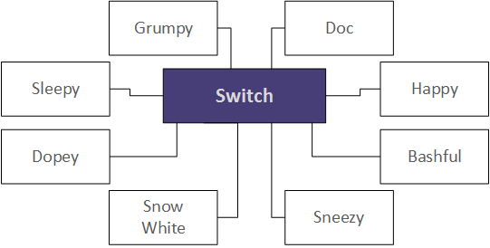
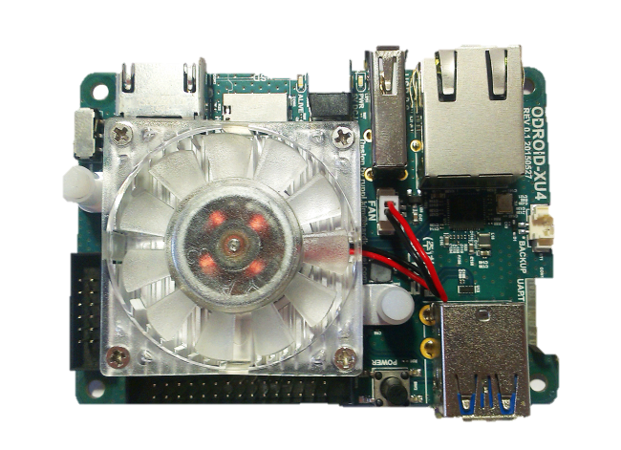
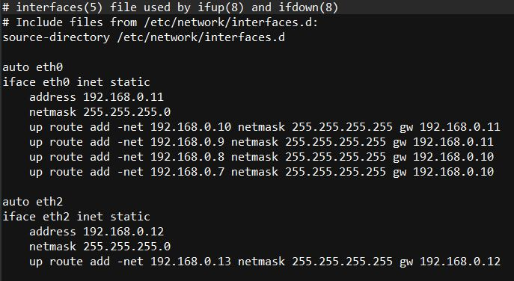
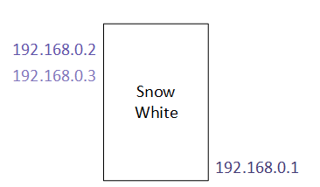
ARM Cluster: A Research Tool
Project by: Andrew K. Hoover and Christine N. Sorensen
Sponsored by: Dr. Christer Karlsson
South Dakota School of Mines and Technology, Department of Mathematics and Computer Science
ODROID vs Raspberry Pi
Mission
To build the fastest, most efficient cluster of single-board computers.
Topology
The ODROID XU4 and the Raspberry Pi 2B were benchmarked by running math equations and were compared on speed and power.
The 8 ODROIDS were connected into a Star Topology; each connected to a switch via Ethernet.
Ring and Hypercube
ODROID XU4
2 x USB 3.0 Host
1 X USB 2.0 Host
Gigabit Ethernet Port
2 GB RAM
Added 16 GB Storage
7.4 x faster than Pi 2B
8 cores: 4 x a15, 4 x a7
Results
Communication
Three IP Addresses were assigned to each ODROID: one for Ethernet and one for each USB 3.0 port. Routing tables were created for each ODROID
HPLinpack Benchmark
LINPACK measures the computing power by solving linear in parallel on the system. It was used to benchmark the cluster in the star topology.
Tools LINPACK | C/C++ | WiringPi | GPIO | USB | Ethernet | USB to Ethernet | Python | OpenMPI | MPICH | Ubuntu Linux | Bash

