Slide 1
ARM CLUSTER
By Andrew Hoover, Samantha Kranstz, and Christine Sorensen

Slide 2
Our client
Dr. Christer Karlsson
Our client’s needs
A cluster of 6-12 single-board computers
Benchmarked
Fastest and most efficient
Notes:
Sam

Slide 3
Our Project
Research
Establish proof of Concept
Notes:
Sam

Slide 4
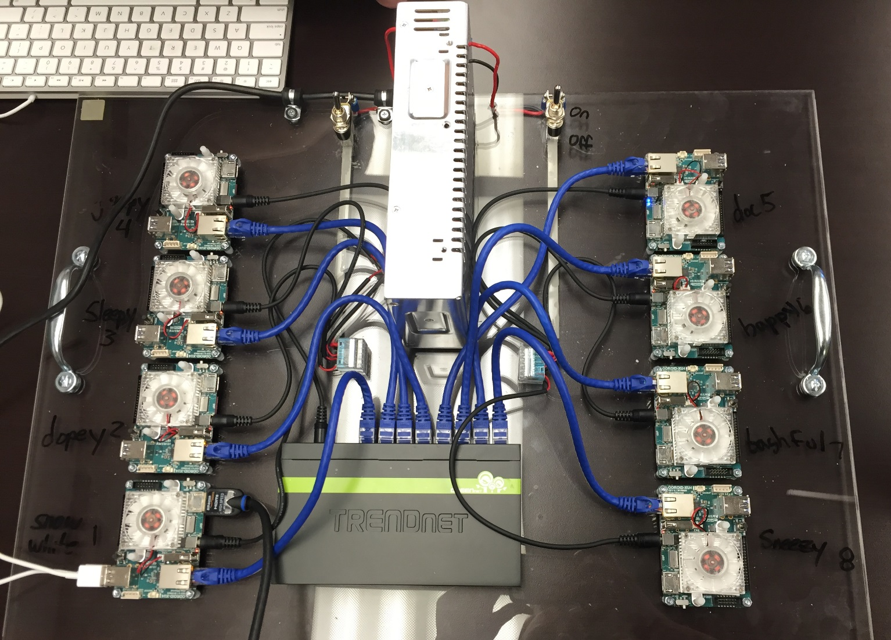
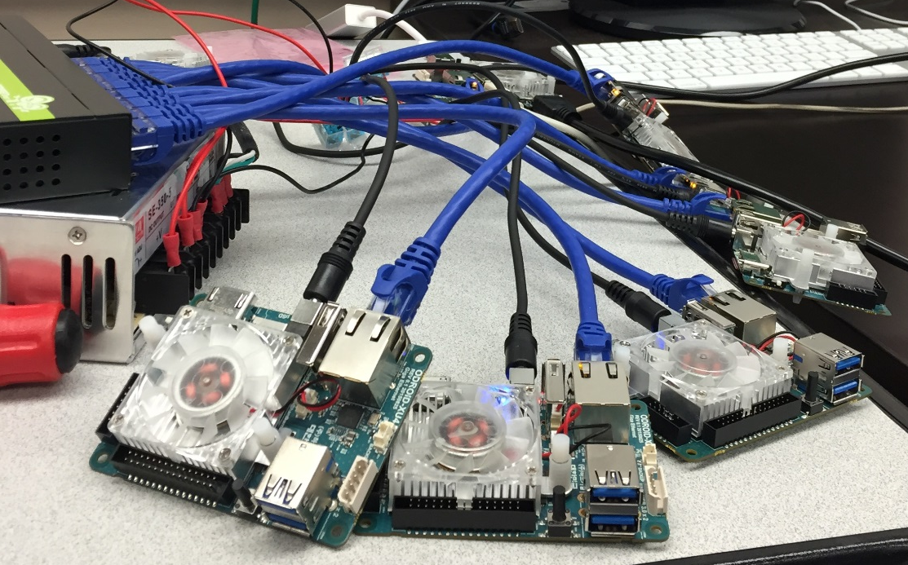
The Cluster
Snow White and the seven dwarfs
ODROID XU4
Grumpy
Doc
Sleepy
Happy
Dopey
Bashful
Sneezy
Snow White
Notes:
Sam //include star model

Slide 5
The process
Configure network
NFS share
Configure sudo
Host name
ssh configure
Notes:
Christine

Slide 6
Tools
Trello
Github
LINPACK
MPI
Python
C++
Bash
Linux
Screwdriver
Notes:
Christine

Slide 7
Testing
tests
Purpose of test
Ping Pong
Hello
Switch test
LINPACK
Pinging tests if the devices can communicate with each other
Tests all the ODRIODs’ communication
Tests the network
Benchmarks the cluster, testing by solving a system of linear equations
Notes:
Christine

Slide 8
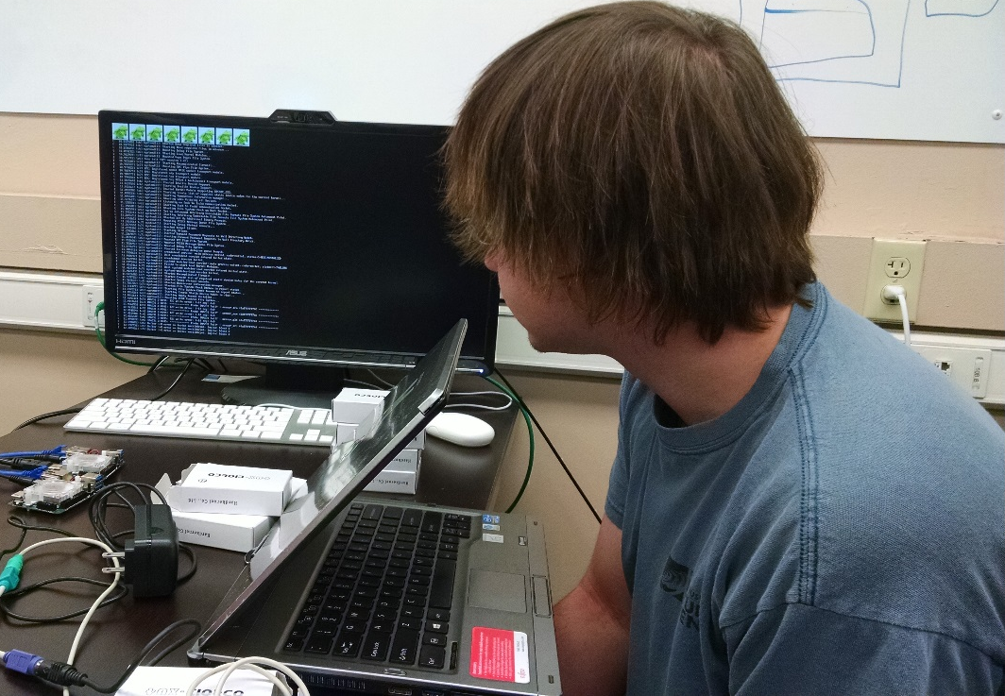
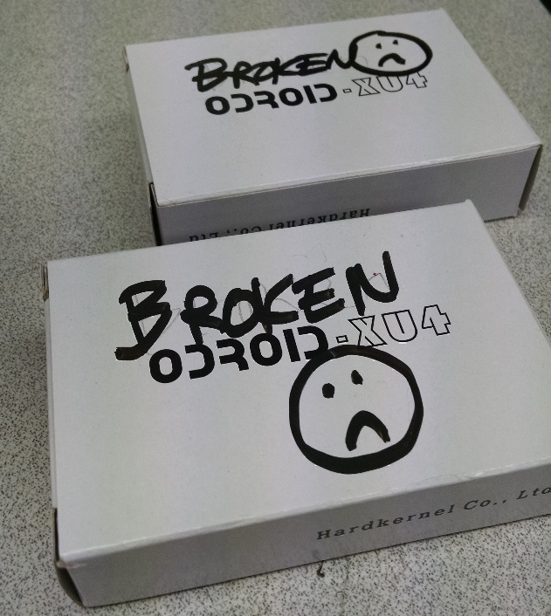
Our issues and problems
Fstab
LINPACK
Building
Figuring it out
Static Frying
Two broken
Backorder
Other message passing protocols
Notes:
Andrew //Christine other protocols

Slide 9
Prototype
Notes:
Andrew

Slide 10
Our Results
Cluster built and running
Running LINPACK using 8 cores on all 8 devices
10.48 GigaFlops
Running LINPACK using 8 cores on Snow White
3.17 GigaFlops
Notes:
Andrew

Slide 11
Budget and costs
Switch
(1) $39.99
Ethernet cables
(8) 1’ $2.99 each
Power Unit
(1) $49.99
Memory
(8) 16 GB $38.00 each
ODROID Ux4
(8) $76.00 each
Replacement ODROID Ux4
(2) $76.00 each
Acrylic board
(1) $25.00
Miscellaneous
$25.00
Notes:
Sam
4.99 3’

Slide 12
Remaining Backlog
Explore other communication methods
Develop and benchmark a new communication
Research Symposium
Design Fair
Notes:
Christine

Slide 13
Schedule And deliverables
Sprint 4: 1/18/15-2/5/15
Research
Prototype
Sprint 5: 2/15/16-3/4/16
Benchmark
Abstract
Sprint 6: 3/21/16-4/15/16
Product
Research Symposium: 4/7/2016
Design Fair: 4/19/16
Notes:
Christine // need to figure this out precisly

Slide 14
Questions?

