Slide 1
ARM Cluster: A Research Tool
Daenerys Targaryen
and Andrew the Hoover

Slide 2
Intro
Supercomputers
Notes:
CS

Slide 3
Problem/Mission
Notes:
CS

Slide 4
Definitions
Cluster
Uses
Single-board
ARM
Benchmark
Notes:
With mission

Slide 5
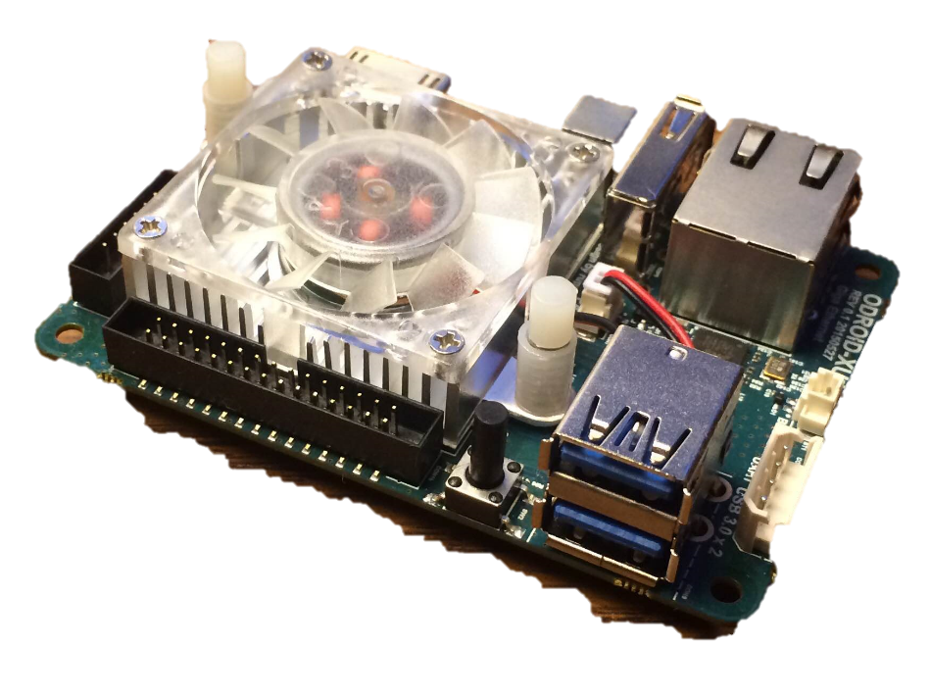
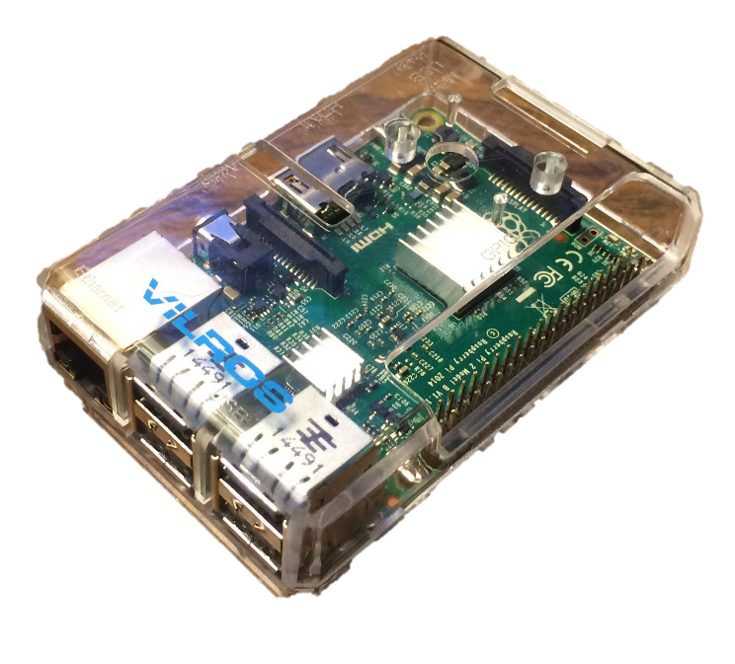
Pi vs ODROID vs PcDuino
PcDruino not available
Raspberry Pi 2B:
$35
4 a7 cores
4 USB 2.0 ports
1 GM memory
1 Gigabit Ethernet
ODROID xu4:
$75
4 a7 cores, 4 a15 cores
2 USB 3.0 ports, 1 USB 2.0 port
2 GM memory
1 Gigabit Ethernet
Notes:
ah

Slide 6
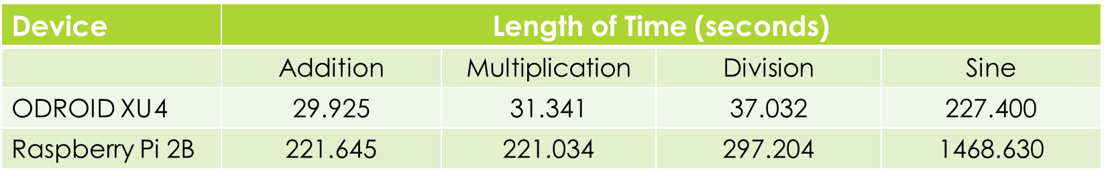
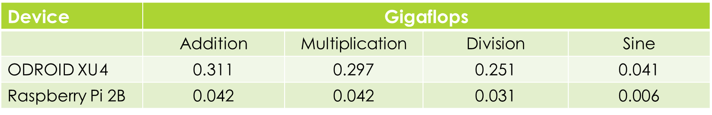
Benchmark
Compared computation speed using large matrices of random floating point values.
Notes:
ah

Slide 7
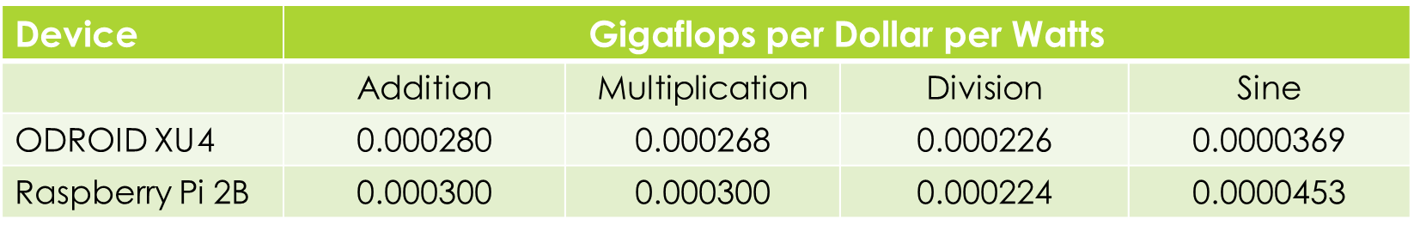
ODROID > Pi
Compared gigaflops per dollar per watts.
Raspberry Pi 2B:
$35
4 watts
Used communication options to decide on ODROID XU4.
ODROID XU 4:
$75
15 watts
Notes:
Ah

Slide 8
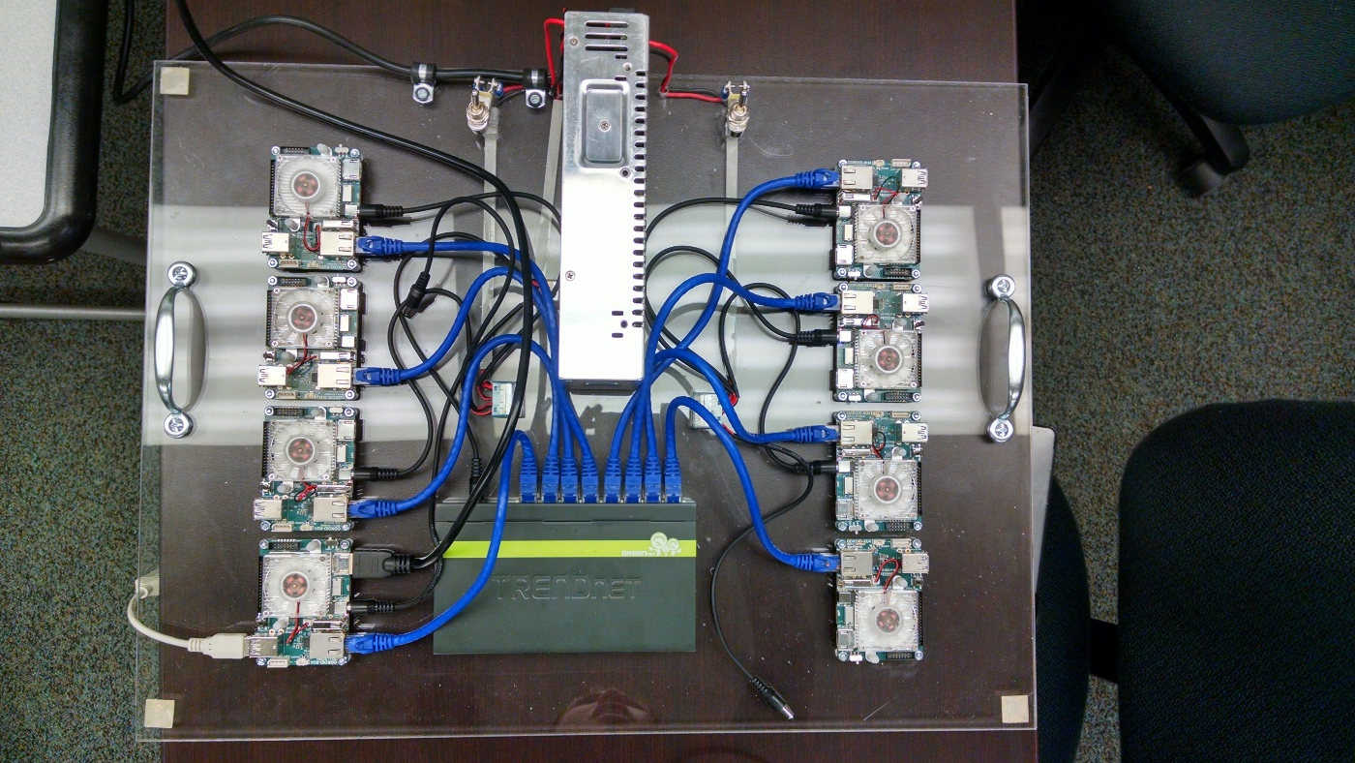
Initial Setup
8 ODROID XU4s
Power Supply
8 Port Gigabit Switch
Cat 5e Ethernet Cables
Two on/off switches
Notes:
ah

Slide 9
Introduce the cluster
How to start it up
Star topology
Snow White and Seven Dwarfs
Notes:
cs

Slide 10
LINPACK
Test the speed of the cluster.
Install OpenMPI, download the source and ATLAS source.
Build the code and configure the options file.
Used in top500 to test supercomputers.
Notes:
ah

Slide 11
LINPACK for ARM
Created Makefile for ARM
Built Debian package
Notes:
ah

Slide 12
USB and GPIO
USB communication with PyUSB.
Not possible to communicate host to host with current OS.
GPIO communication with WiringPi and sysfs.
Both found to be slow, roughly 0.5 Mbps. Ethernet was 750 Mbps.
Notes:
ah

Slide 13
Hypercube and ring
Notes:
cs

Slide 14
Problems
Notes:
cs

Slide 15
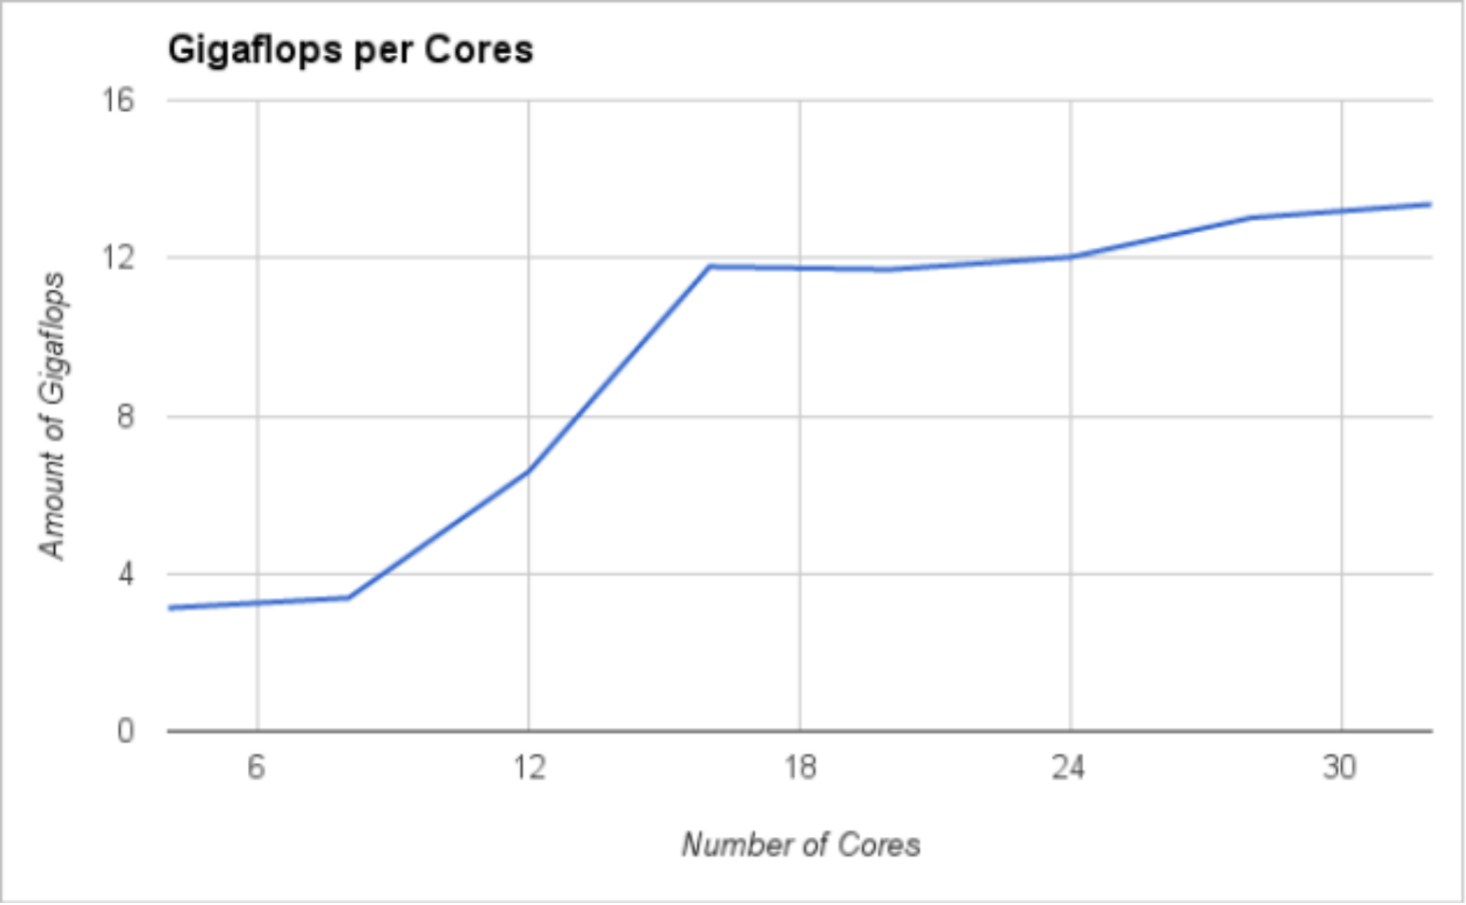
Results
Using 4 a7 core per node With 1 a15 core per node:
17.05 gigaflops.
With 2 a15 cores per node:
26.23 gigaflops.
Notes:
Ah

Slide 16
Future Projects
Notes:
cs

Slide 17
Conclusion
Notes:
cs

