Slide 1

Arm Cluster
Researched by:
Samantha Kranstz, Andrew Hoover, Christine Sorensen

Slide 2
Our Client
Dr. Christer Karlsson is our sponsor and client
Assistant Professor
Former Captain in the Swedish Army
Research focuses

Slide 3
The Client’s Needs
A cluster of 6-12 single-board computers
Fastest and most efficient
Stay within the budget and get all the needed materials
Design and build communication mode
Develop and benchmark the new connection

Slide 4
Our Project (under construction)
Our project is one of research
Establish proof of concept

Slide 5
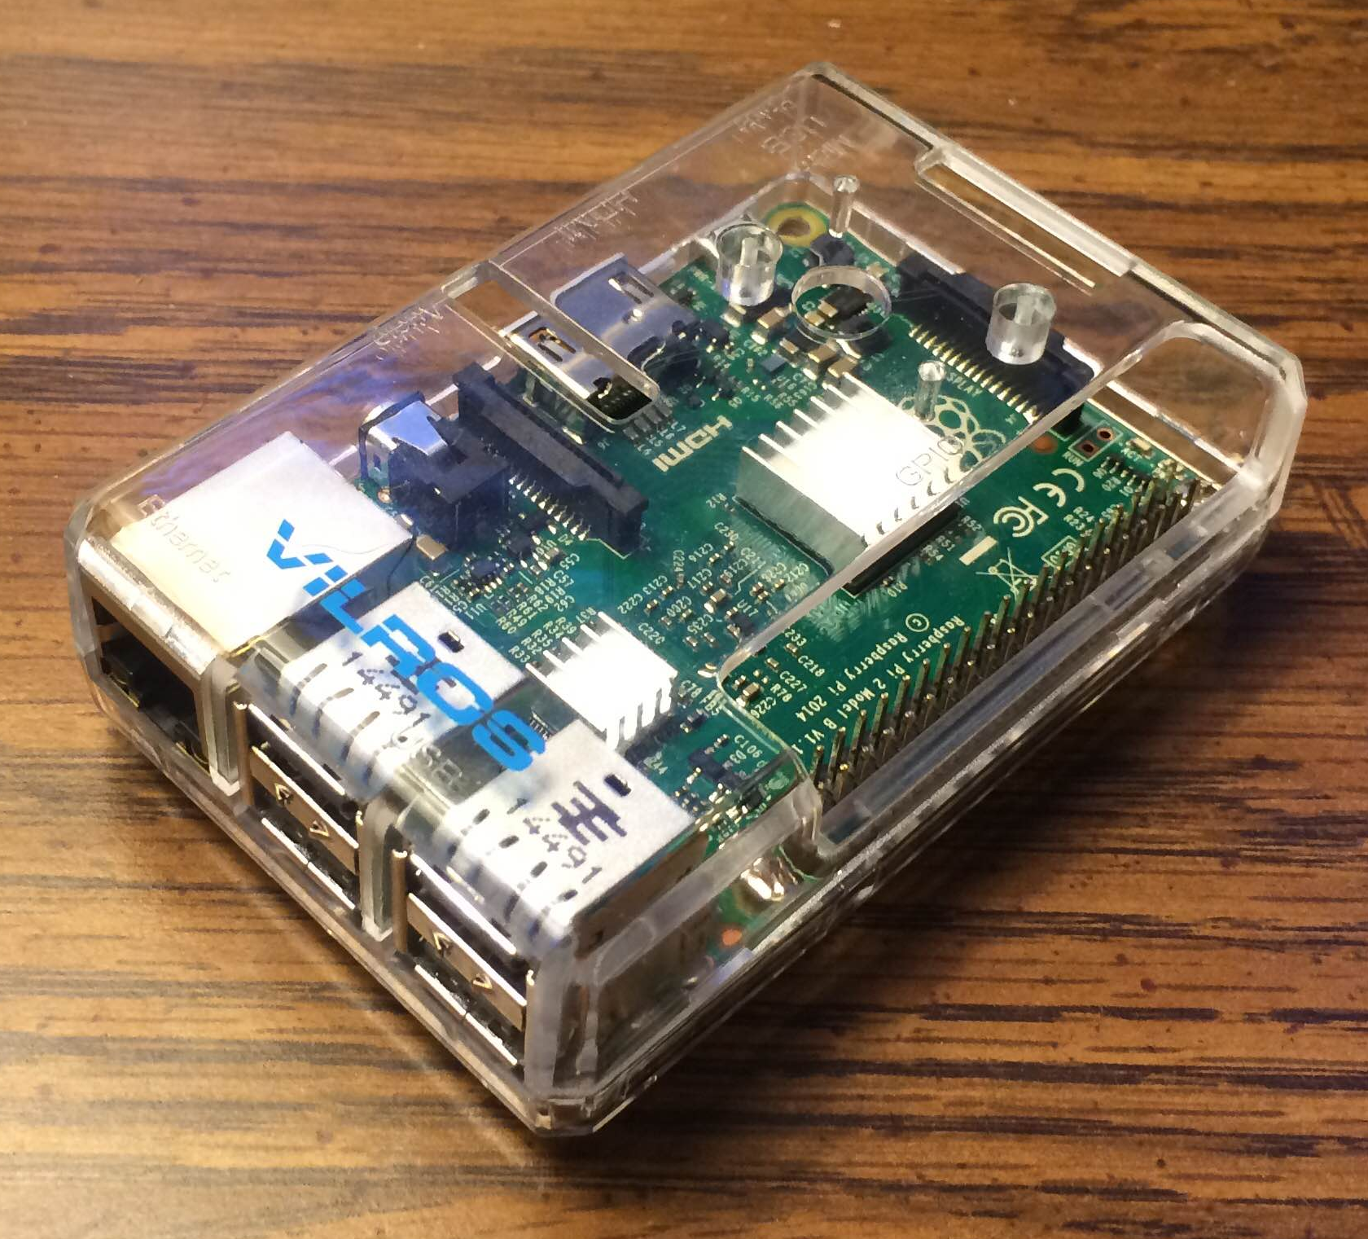
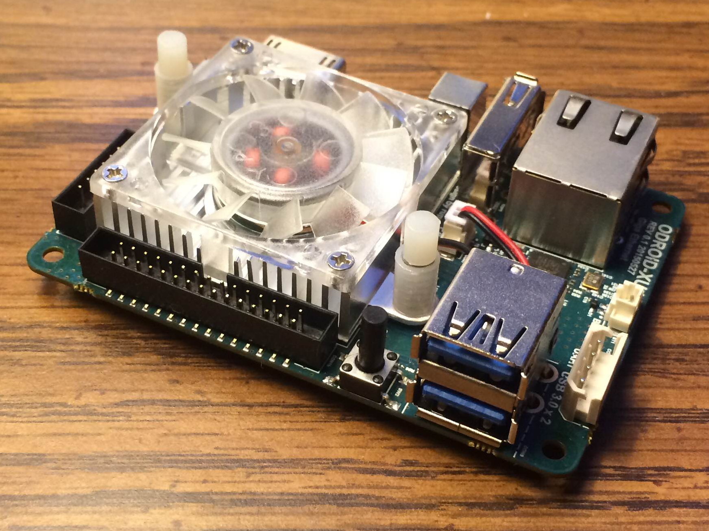
The Candidates
The Raspberry PI 2B
4 cores
4 USB ports
Approximately $40
Odroid 4xU
8 cores
2 USB ports
Approximately $80

Slide 6
The Benchmarking
Benchmarking in computing is the act of running a program on a machine to determine the machine’s performance.
Our benchmark included the operations:
Addition
Multiplication
Division
A function of sine.
The same 100,000 random numbers were generated to be run on both machines

Slide 7
Our Results
Device | Length of Time (seconds)
 | Addition | Multiplication | Division | Sine
Odroid 4xU | 29.925 | 31.341 | 37.032 | 227.400
Raspberry Pi 2B | 221.645 | 221.034 | 297.204 | 1468.630
Device | GIgaflops
 | Addition | Multiplication | Division | Sine
Odroid 4xU | 0.311 | 0.297 | 0.251 | 0.041
Raspberry Pi 2B | 0.042 | 0.042 | 0.031 | 0.006
Device | Gigaflops per Dollar per Watts
 | Addition | Multiplication | Division | Sine
Odroid 4xU | 0.000280 | 0.000268 | 0.000226 | 0.0000369
Raspberry Pi 2B | 0.000300 | 0.000300 | 0.000224 | 0.0000453

Slide 8
Our Decision
ODroid 4xU
Pros
Double the cores so faster process
2 USB ports on 3.0 bus
Cons
Double the price
More watt usage
Raspberry Pi 2B
Pros
Cheaper face value
Less watt usage
Cons
4 USB ports but only 1 2.0 bus
Slower
The ODroid 4xU is the device that will be used in our cluster

Slide 9
Our Budget
The budget is $1,200 and must be used on the following materials
6-12 single-board devices
A switch
Power Strips
USB cords
Memory
Cables

Slide 10
Our Next Steps
Use a few more benchmarks to support our decision
Order our materials
Connect all of the devices
Find a different communication mode

Slide 11
Schedule and Deliverables
10/12/15 – 10/30/15: Sprint 2 - Ordering materials
11/9/15 – 11/27/15: Sprint 3 – Assembling the cluster and more benchmarking
1/4/15 – 2/5/15: Sprint 4 – Create a new communication

