Slide 1
ARM CLUSTER
By Andrew Hoover, Samantha Kranstz, and Christine Sorensen

Slide 2
Our client
Dr. Christer Karlsson
Our client’s needs
A cluster of 6-12 single-board computers
Benchmarked
Fastest and most efficient
Notes:
Sam

Slide 3
Our Project
Research
Establish proof of Concept
Notes:
Sam

Slide 4
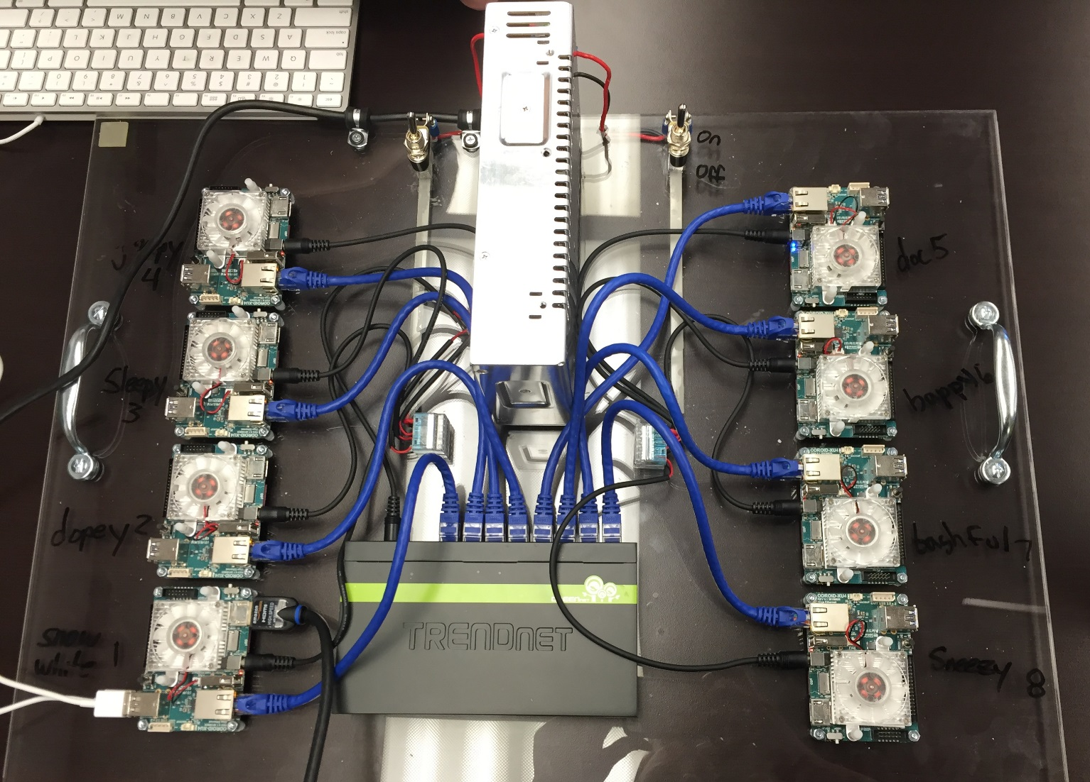
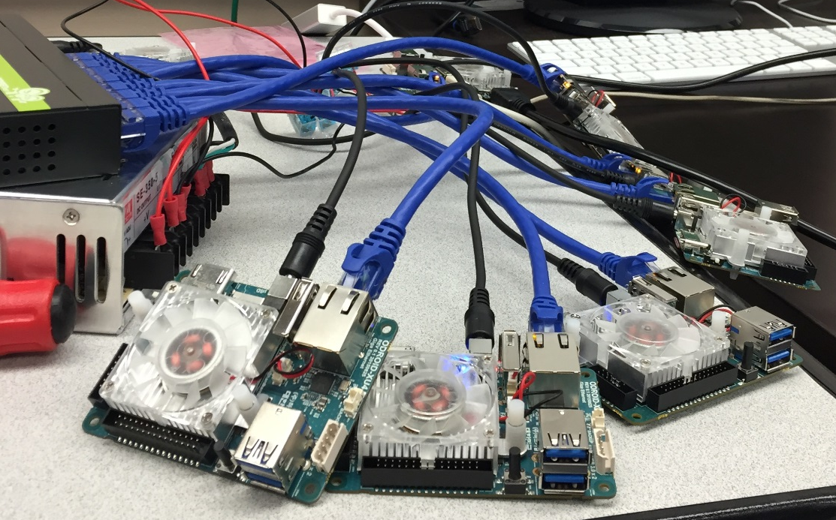
The Cluster
Snow White and the seven dwarfs
ODROID Ux4
Grumpy
Doc
Sleepy
Happy
Dopey
Bashful
Sneezy
Snow White
Notes:
Sam

Slide 5
The process
Configure network
NFS share
Configure sudo
Host name
ssh configure
Notes:
Christine

Slide 6
Tools
Trello
Github
LINPACK
Screwdriver
MPI
Python
C++
Bash
Linux
Notes:
Christine

Slide 7
Testing
tests
Purpose of test
Ping Pong
LINPACK
Hello
Switch test
Pinging tests if the devices can communicate with each other
Benchmarks the cluster, testing by solving a system of linear equations
Tests all the ODRIODs’ communication
Tests the network
Notes:
Christine

Slide 8
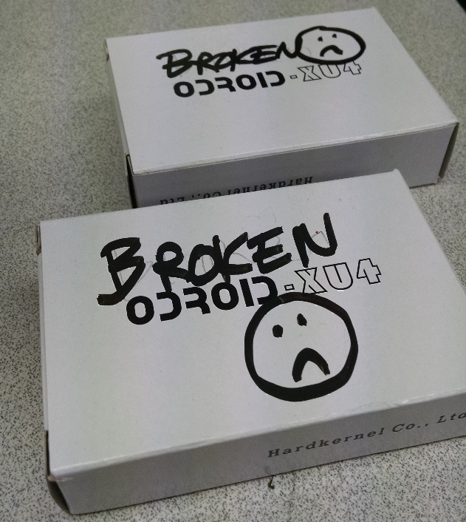
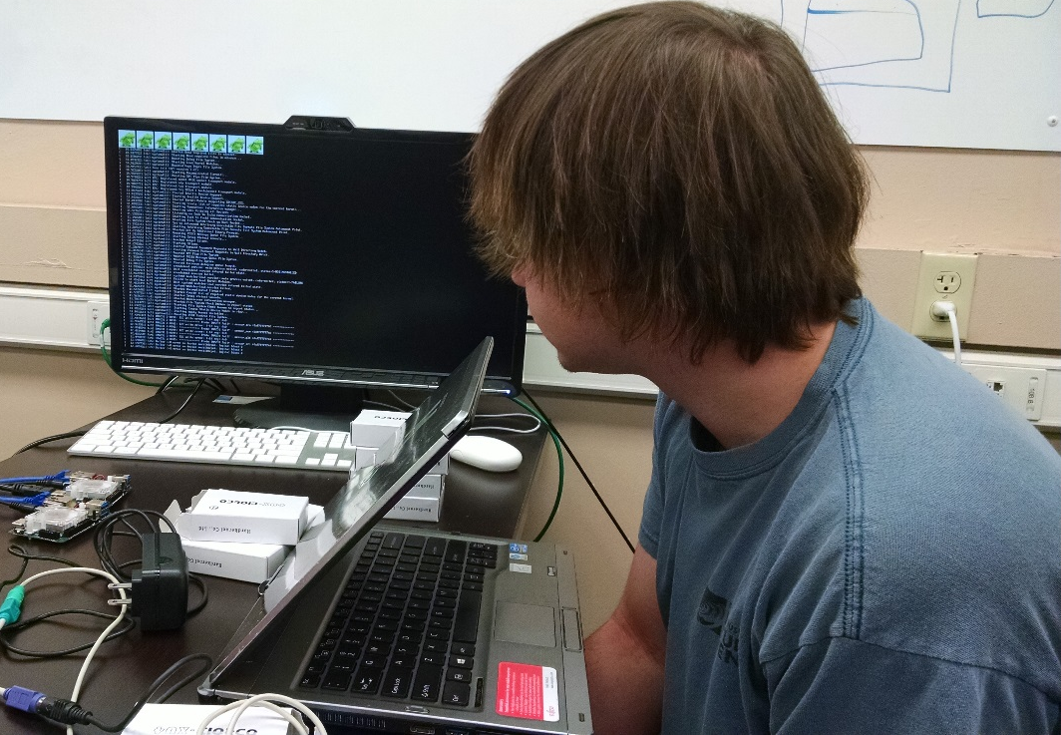
Our issues and problems
Fstab
LINPACK
Building
Figuring it out
Static Frying
Two broken
Backorder
Notes:
Andrew

Slide 9
Demonstration
Notes:
Andrew

Slide 10
Our Results
Cluster built and running
Running LINPACK using 8 cores on all 8 devices
8.5 GigaFlops
Running LINPACK using 8 cores on Snow White
6.3 GigaFlops
Notes:
Andrew

Slide 11
Budget and costs
Switch
(1) $
Ethernet cables
(8) 1’ $2.99 each
Power Unit
(1) $
Memory
(8) 16 GB $38.00 each
ODROID Ux4
(8) $76.00 each
Notes:
Sam
4.99 3’

Slide 12
Remaining Backlog
Explore other communication methods
Develop and benchmark a new communication
Research Symposium
Design Fair
Notes:
Christine

Slide 13
Schedule And deliverables
Sprint 4: 1/18/15-2/5/15
Research
Prototype
Sprint 5: 2/15/16-3/4/16
Benchmark
Abstract
Sprint 6: 3/21/16-4/15/16
Product
Research Symposium: 4/7/2016
Design Fair: 4/19/16
Notes:
Christine // need to figure this out precisly

