Slide 1

Disney World: The ARM Cluster
Andrew Hoover Christine Sorensen
March 24, 2016
Notes:
Christine

Slide 2
Client
Dr. Christer Karlsson
Client Needs
Cluster of 6 – 12 single-board ARM computers
Benchmarked
Fastest and most efficient design
Notes:
Christine

Slide 3
Project Overview
Project
Establish proof of concept
Gather more LINPACK data
Test new communication
GPIO
USB
Test different topologies
Ring
Hypercube
Notes:
Christine

Slide 4
Tools
Linux
Bash
GitHub
WiringPi
C
LINPACK
OpenMPI, MPICH
Python
Pyplot
Routing Tables
USB to Ethernet
Notes:
Andrew

Slide 5
Deliverables
Benchmark LINPACK on multiple number of devices
Compared cluster to i7
LINPACK Debian package
USB and GPIO
Research on USB
Tests with GPIO
Topology Design
Ring and hypercube
Routing tables
MICS Conference
Paper and abstract
SDSMT Research Symposium
Abstract
Notes:
Andrew

Slide 6
ARM LINPACK
Created Debian package of HPL
Tuned to work on ARM
Successfully installs on dwarfs with dpkg install command
Notes:
Andrew

Slide 7
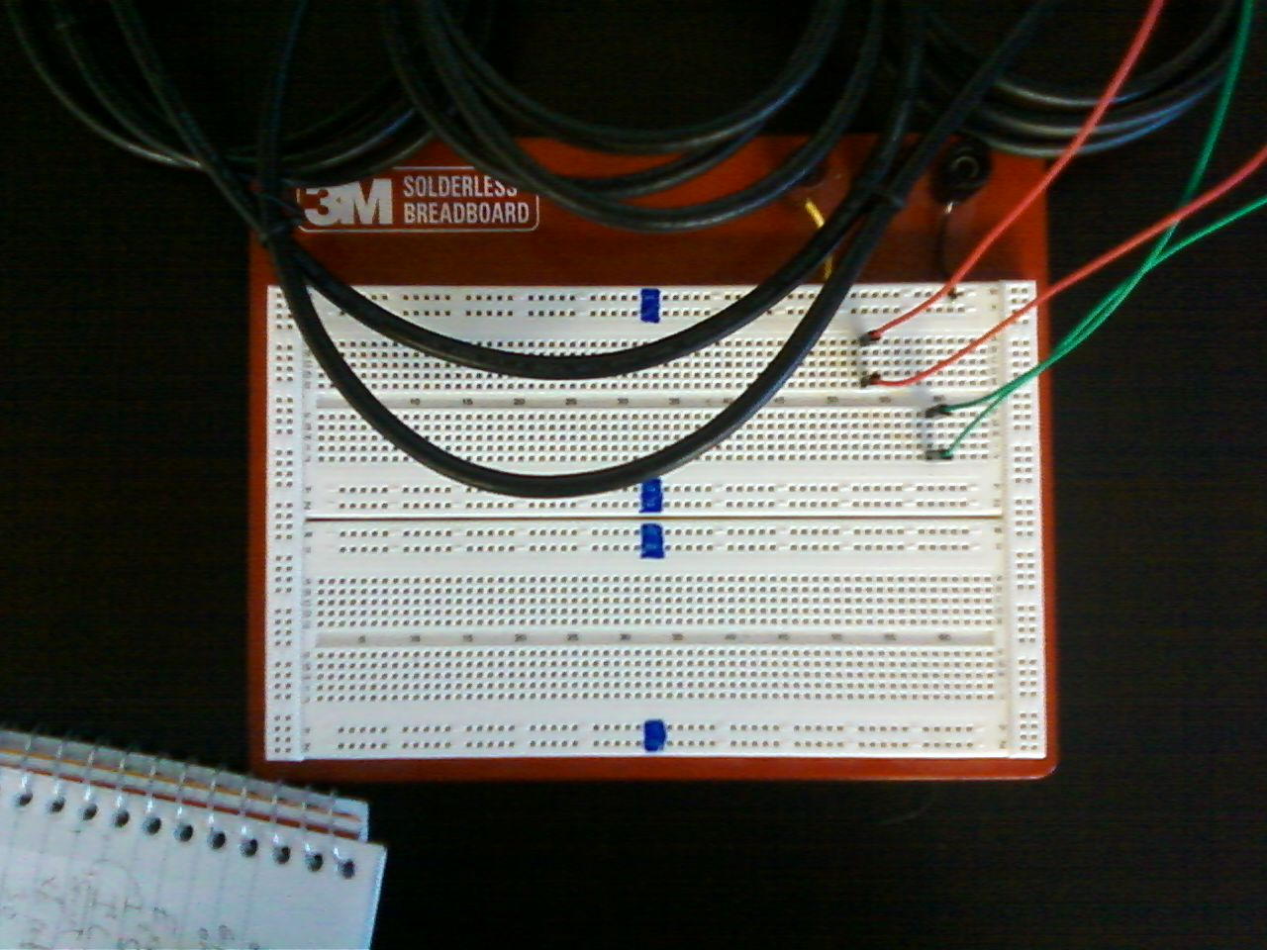
GPIO
WiringPi
Pins connected
Results
Notes:
Andrew and Christine

Slide 8
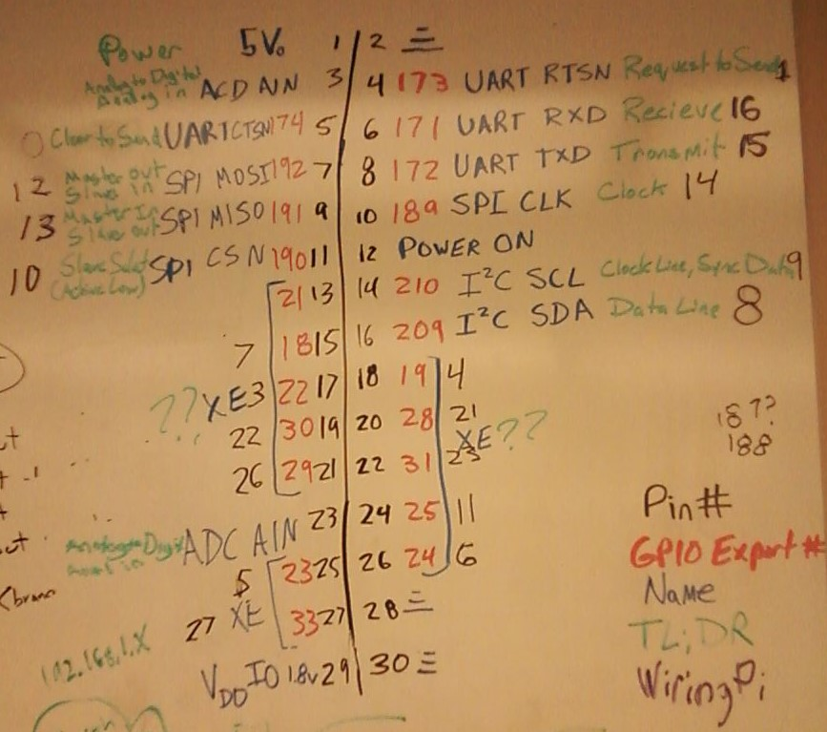
Notes:
Andrew and Christine

Slide 9
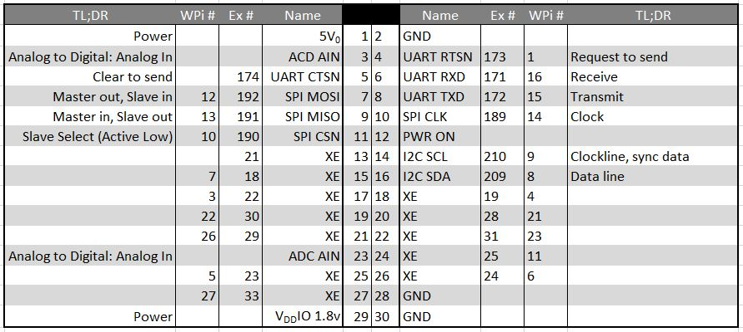
Notes:
Andrew and Christine

Slide 10
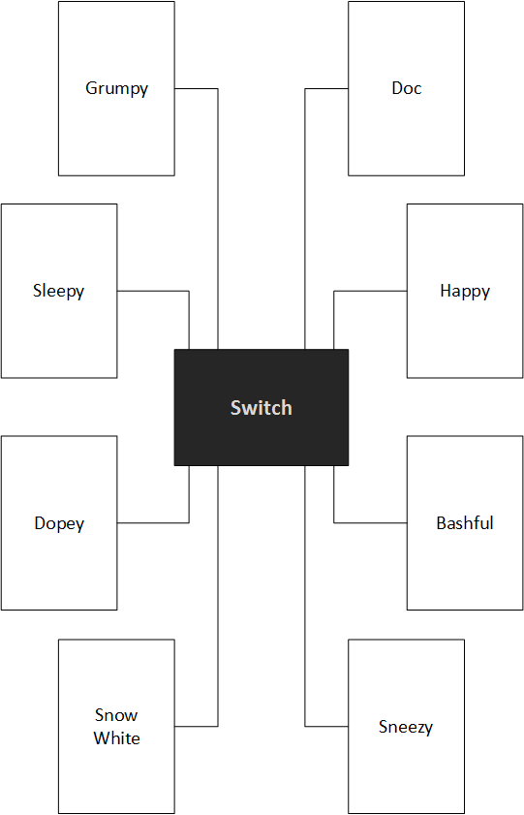
Star Topology
Initial setup
Each dwarf connected to an unmanaged switch
Notes:
Andrew

Slide 11
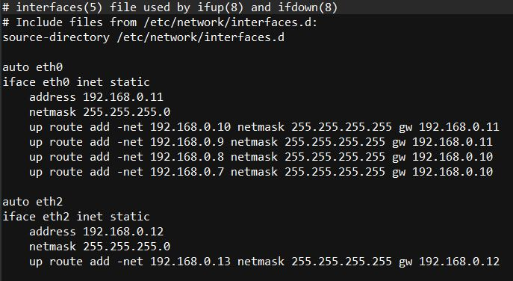
Routing Table
Notes:
Andrew

Slide 12
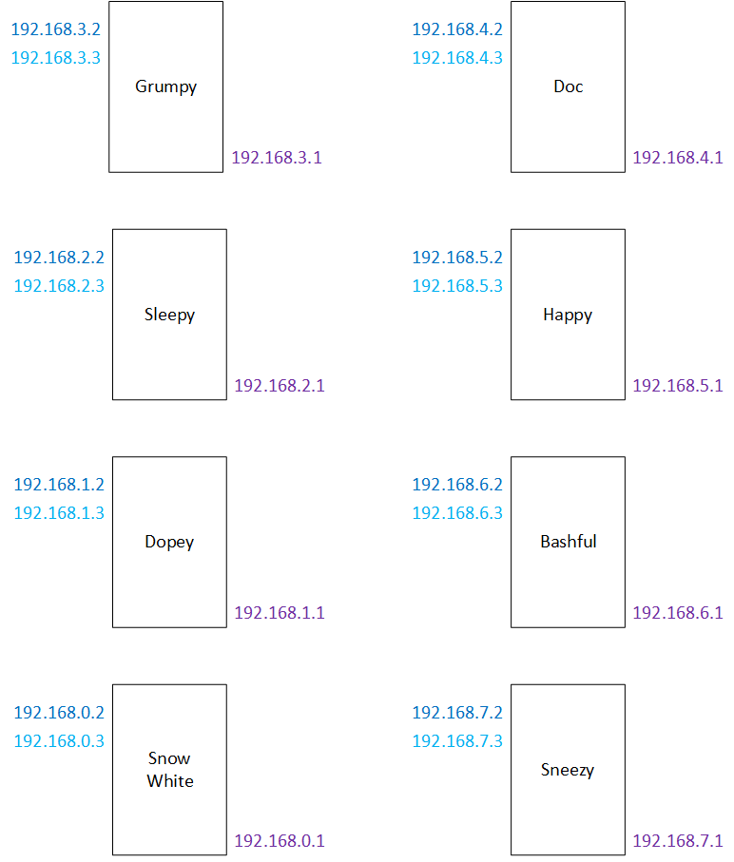
IP Addresses
Notes:
Andrew

Slide 13
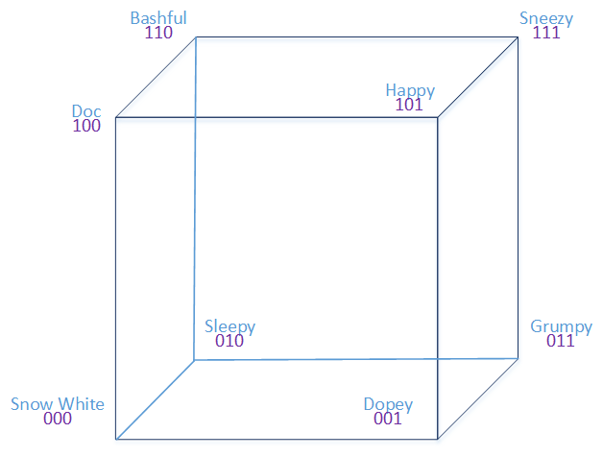
Hypercube
Notes:
Christine

Slide 14
Results
Gigaflops per number of devices
USB not practical
GPIO with WiringPi slow
Routing tables, ring topology functional
Notes:
Andrew

Slide 15
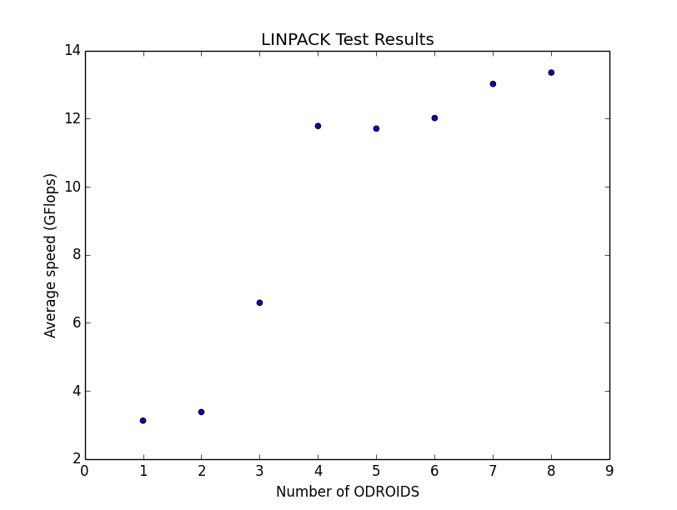
Speedup
1 → 2 devices = 1 speedup
2 → 3 = 4
3 → 4 = 5
Max speedup
4 → 5 = 1
5 → 6 = -1
6 → 7 = 2
7 → 8 = 1
Notes:
Christine

Slide 16


Amdahl’s Law
$speedup ≤ \frac{1}{S+ \frac{(1 −S)}{N}}$
S = portion serial
N = number of cores
Unsure of portion sizes
If all parallel
$speedup ≤N$
All serial
$speedup ≤1$
Increasing the number of cores
$\lim_{N→∞}{=\frac{1}{S}}$
Speedup will not achieve more than $\frac{1}{S}$
Notes:
Christine

Slide 17
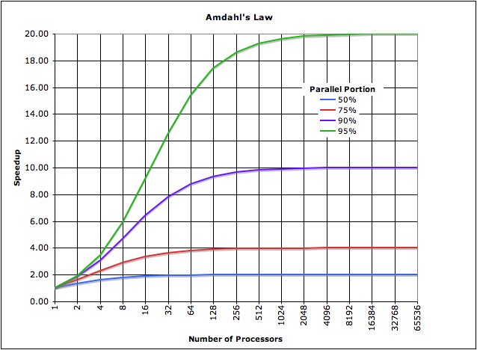
Notes:
Christine

Slide 18
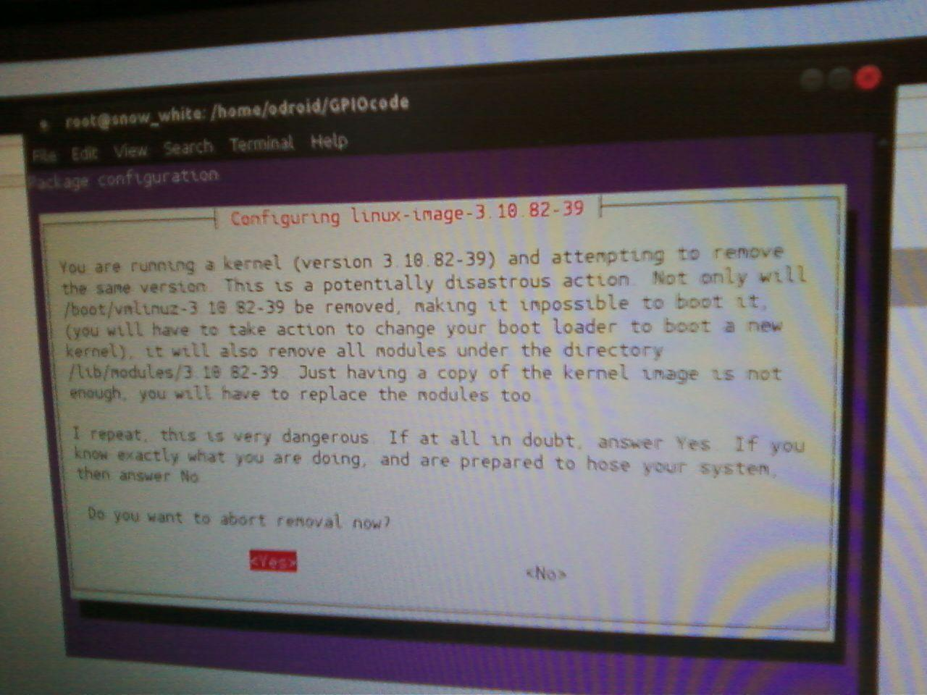
Issues
WiringPi
Updating the kernel
GPIO pin numbers to physical numbers
Topologies
Create appropriate network
Access devices through others
LINPACK
Testing on ring topology
Notes:
Andrew

Slide 19
Budget
MICS Registration
$35.00
Miscellaneous
$25.00
Acrylic board
$25.00
Replacemnet ORDOID-XU4
2 at $76.00 each
ODROID-XU$
8 at $76.00 each
Memory
8 at $38.00 each
Power Unit
$49.99
Ethernet cables
8 at $2.99 each
Switch
$39.99
Notes:
Christine

Slide 20
Remaining Backlog
LINPACK over ring and hypercube
SDSMT Symposium
MICS Symposium
Design Fair
Design Documentation
Notes:
Christine

Slide 21
Revised Goals
Debug LINPACK
SDSMT Symposium
Notes:
Andrew

Slide 22
Schedule
Sprint 6: 3/21/16
Documentation
Presentation preparations
SDSMT Research Symposium: 4/7/16
Design Fair: 4/19/16
MICS: 4/23/16
Notes:
Christine

Slide 23
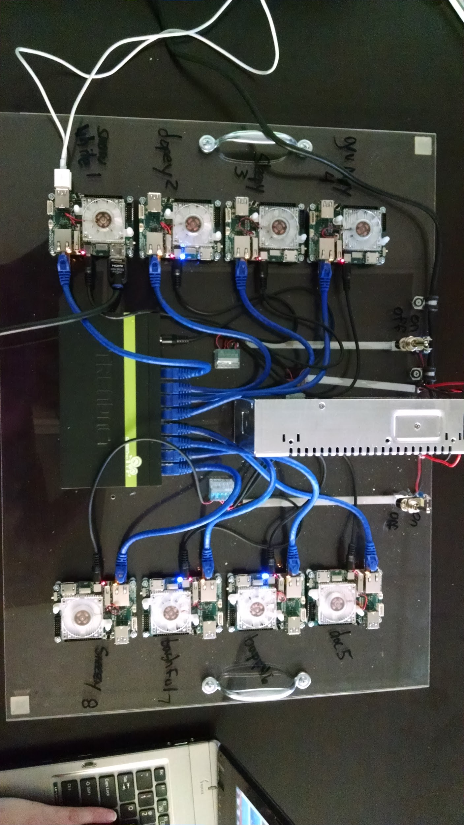
Prototype

Slide 26
Questions?

Slide 27
Education Tool
lsdkfjsldakjf

