Slide 1

AIML INTERNSHIP
HENOTIC TECHNOLOGY PRIVATE LIMITED
7th July 2022 to 06th September 2022
Presented by:
SISTU DATT SAI ADITYA
20B91A05S8
DEPARTMENT OF COMPUTER SCIENCE AND ENGINEERING,SRKREC

Slide 2
CONTENTS
INTRODUCTION ABOUT DATASET
OBJECTIVE
DATA SCIENCE PROJECT LIFE CYCLE
RESULTS
RECOMMENDATIONS AND CONCLUSIONS
REFERENCES

Slide 3
Bank Customer Churn Prediction
DATASET:

Slide 4
INTRODUCTION ABOUT DATASET
Bank Customer Churn prediction means knowing which customers are likely to leave or unsubscribe from your Bank.
Customer churn has become a major problem in banking industry and banks have always tried to track customer interaction with the company to detect early warning signs in customer’s behavior.
This example uses customer data from a bank to build a predictive model for the likely churn clients. As we know, it is much more expensive to sign in a new client than to keep an existing one.
It is advantageous for banks to know what leads clients to leave the Bank. The data set is about the customers of the bank having factors like geography, cutomerid,surname,gender,
balance,Gender,age.

Slide 5
OBJECTIVE
The main Objective of this project is:
Identify and visualize which factors contribute to customer churn.
We first have to do some Exploratory Data Analysis in the Dataset, then fit the dataset into Machine Learning Classification Algorithm and choose the best Algorithm for the Bank Customer Churn Dataset.
choose a model that will attach a probability to the churn to make it easier for customer service to target low hanging fruits in their efforts to prevent churn

Slide 6
Data Science Project Life Cycle
Data Pre-processing
The variable to be predicted is binary (churn or loyal). Therefore this is a classification project.
The goal here is to model churn probability, conditioned on the customer features.
Check the Duplicate and low variation data
Identify and address the missing variables
Handling of Outliers
Categorical data and Encoding Techniques
Feature Scaling
Selection of Dependent and Independent variable
In this dataset, the target variable is Exited
Training Models

Slide 7
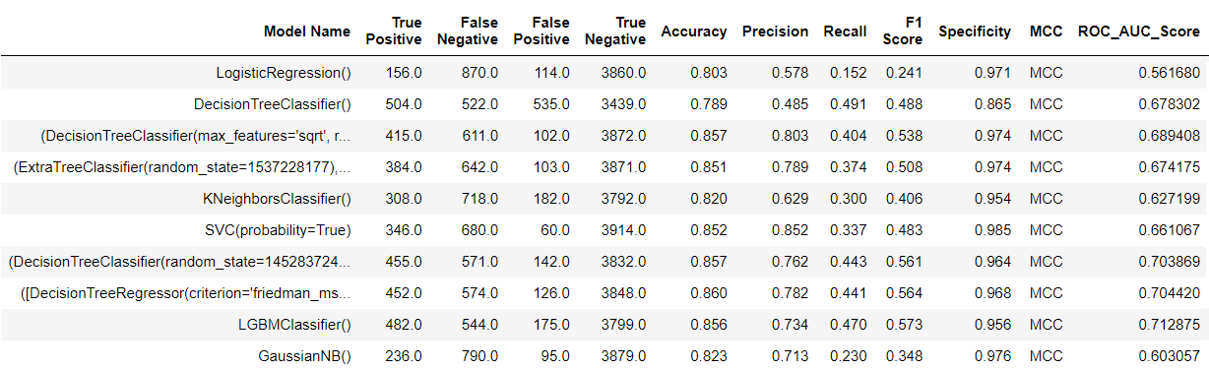
Results
Based on the analysis , these are the results generated from different models

Slide 8
Results
The model results in the following order by considering the model accuracy, F1 score and RoC AUC score.
1) Decision Tree Classifier
2) XGB Classifier
3) LGBM Classifier

Slide 9
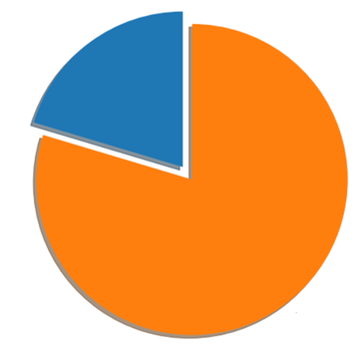
RECOMMENDATIONS AND CONCLUSIONS
Exited (20.4%)
Retained (79.6%)
Proportion of customer churned and retained

Slide 10
REFERENCES
https://www.kaggle.com/code/kmalit/bank-customer-churn-prediction

Slide 11
THANK YOU

