Slide 1
Find words game and Store Game Record in SQL Database
Sicheng Yu

Slide 2
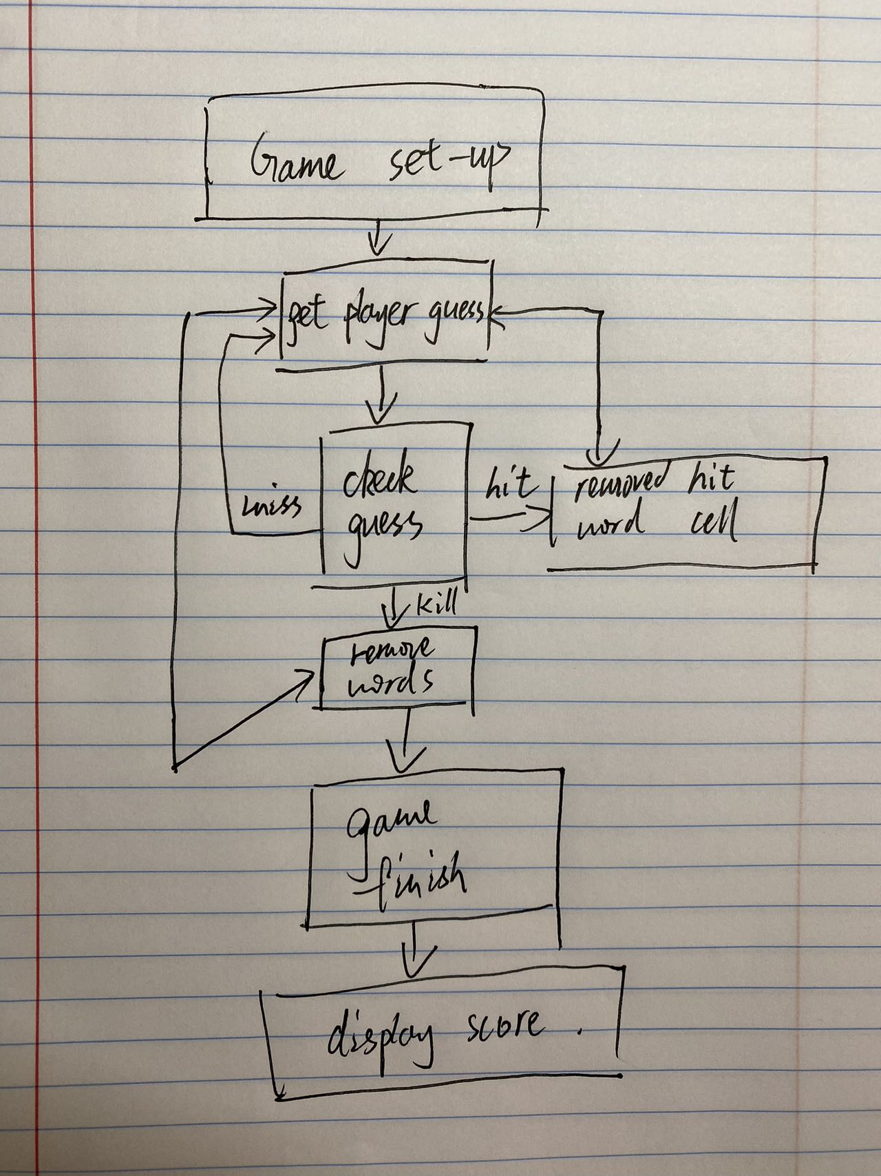
Find words game
Design:
12/20/22
PRESENTATION TITLE

Slide 3
Game structure
4 classes, 3 handle output, game frame, logic .
1 main class. Clear code.
Take user input in lowercase.
12/20/22
PRESENTATION TITLE

Slide 4
How to play
 | 0 | 1 | 2 | 3 | 4 | 5 | 6
A
B
C
D
E
F
G
Enter A0 – G6 to guess where the words are located. Find one get a hit. Find all three get a kill. Game finish.
computer
Banana
Apple
12/20/22
PRESENTATION TITLE

Slide 5
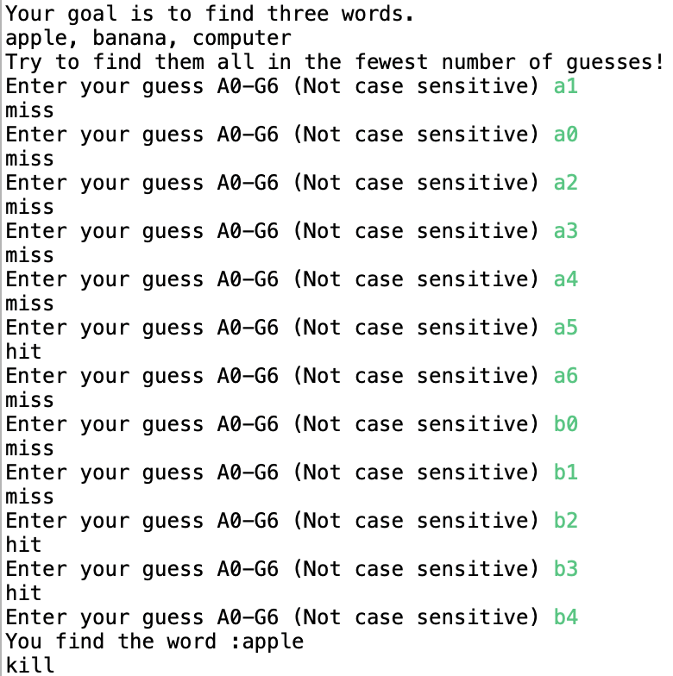
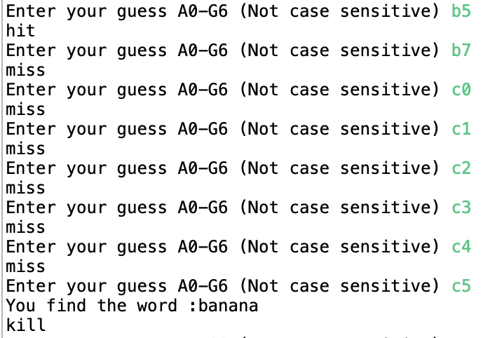
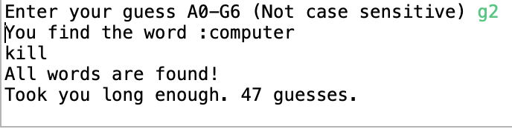
Out put of the game

Slide 6
Purpose of the game
Practice logic.
Get first hit then get precise guess
Try get higher score.

Slide 7
SQL database or relational database is a collection of highly structured tables, wherein each row reflects a data entity, and every column defines a specific information field. Relational databases are built using the structured query language (SQL) to create, store, update, and retrieve data.
“
What is SQL Database
”
My approach: Using Java to make connection and access SQL DataBase
12/20/22
PRESENTATION TITLE

Slide 8
Why use SQL DataBase
Higher Flexibility
Better Data consistency
Minimum Redundancy
Easy to Maintain
12/20/22
PRESENTATION TITLE

Slide 9
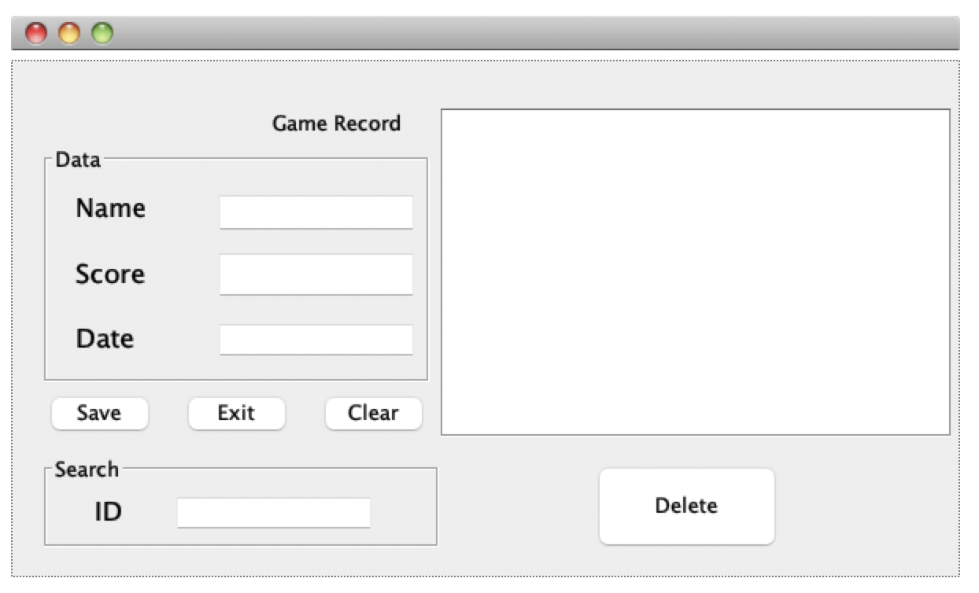
Java User Interface interact with SQL DataBase (Example)
12/20/22
PRESENTATION TITLE

Slide 10
How to connect to Database
1
2
3
4
Register the Driver class
Create connection
Create Statement
Execute queries
12/19/2022

Slide 11
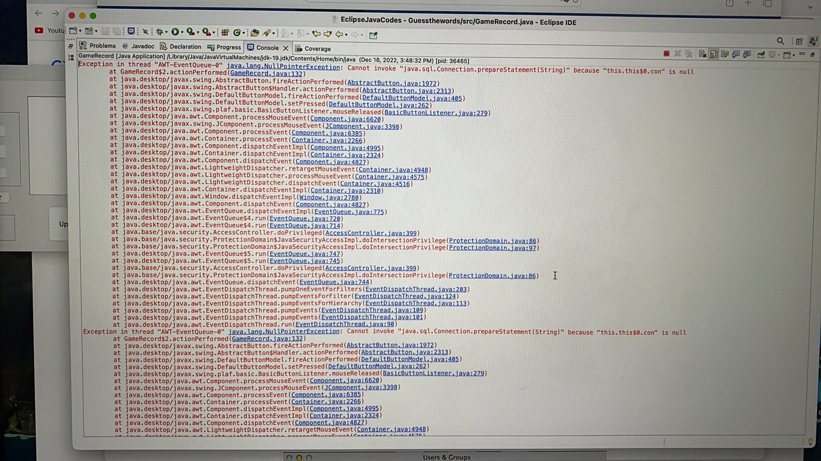

Slide 12
Wrap up
Design a small game and store the scores into Database.
To show you the simple version how to use get connection, design and use SQL DataBase.
12/20/22
PRESENTATION TITLE

Slide 13
Thank you
ysc1998@bu.edu

