Slide 1
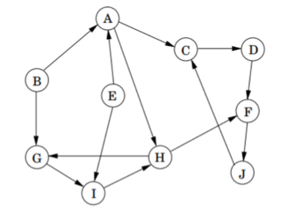
Algo Lab 2 Checkpoint 1: BFS 1 Start from A
A (S)
C ∞
D ∞
Order of Visitation | Queue contents after processing node
 | [S]
B ∞
E ∞
F ∞
G ∞
H ∞
snap
J ∞
I ∞

Slide 2
Algo Lab 2 Checkpoint 1: BFS 1 Start from A
A (S)
C 1
D ∞
Order of Visitation | Queue contents after processing node
 | [S]
S | [B E H C]
B 1
E 1
F ∞
G ∞
H 1
snap
J ∞
I ∞

Slide 3
Algo Lab 2 Checkpoint 1: BFS 1 Start from A
A (S)
C 1
D ∞
Order of Visitation | Queue contents after processing node
 | [S]
S | [B E H C]
B | [E H C G]
B 1
E 1
F ∞
G 2
H 1
snap
J ∞
I ∞

Slide 4
Algo Lab 2 Checkpoint 1: BFS 1 Start from A
A (S)
C 1
D ∞
Order of Visitation | Queue contents after processing node
 | [S]
S | [B E H C]
B | [E H C G]
E | [H C G I]
B 1
E 1
F ∞
G 2
H 1
snap
J ∞
I 2

Slide 5
Algo Lab 2 Checkpoint 1: BFS 1 Start from A
A (S)
C 1
D ∞
Order of Visitation | Queue contents after processing node
 | [S]
S | [B E H C]
B | [E H C G]
E | [H C G I]
H | [C G I F]
B 1
E 1
F 2
G 2
H 1
snap
J ∞
I 2

Slide 6
Algo Lab 2 Checkpoint 1: BFS 1 Start from A
A (S)
C 1
D 2
Order of Visitation | Queue contents after processing node
 | [S]
S | [B E H C]
B | [E H C G]
E | [H C G I]
H | [C G I F]
C | [G I F D J]
B 1
E 1
F 2
G 2
H 1
snap
J 2
I 2

Slide 7
Algo Lab 2 Checkpoint 1: BFS 1 Start from A
A (S)
C 1
D 2
Order of Visitation | Queue contents after processing node
 | [S]
S | [B E H C]
B | [E H C G]
E | [H C G I]
H | [C G I F]
C | [G I F D J]
G | [I F D J]
B 1
E 1
F 2
G 2
H 1
snap
J 2
I 2

Slide 8
Algo Lab 2 Checkpoint 1: BFS 1 Start from A
A (S)
C 1
D 2
Order of Visitation | Queue contents after processing node
 | [S]
S | [B E H C]
B | [E H C G]
E | [H C G I]
H | [C G I F]
C | [G I F D J]
G | [I F D J]
I | [F D J]
B 1
E 1
F 2
G 2
H 1
snap
J 2
I 2

Slide 9
Algo Lab 2 Checkpoint 1: BFS 1 Start from A
A (S)
C 1
D 2
Order of Visitation | Queue contents after processing node
 | [S]
S | [B E H C]
B | [E H C G]
E | [H C G I]
H | [C G I F]
C | [G I F D J]
G | [I F D J]
I | [F D J]
F | [D J]
B 1
E 1
F 2
G 2
H 1
snap
J 2
I 2

Slide 10
Algo Lab 2 Checkpoint 1: BFS 1 Start from A
A (S)
C 1
D 2
Order of Visitation | Queue contents after processing node
 | [S]
S | [B E H C]
B | [E H C G]
E | [H C G I]
H | [C G I F]
C | [G I F D J]
G | [I F D J]
I | [F D J]
F | [D J]
D | [J]
B 1
E 1
F 2
G 2
H 1
snap
J 2
I 2

Slide 11
Algo Lab 2 Checkpoint 1: BFS 1 Start from A
A (S)
C 1
D 2
Order of Visitation | Queue contents after processing node
 | [S]
S | [B E H C]
B | [E H C G]
E | [H C G I]
H | [C G I F]
C | [G I F D J]
G | [I F D J]
I | [F D J]
F | [D J]
D | [J]
J | []
B 1
E 1
F 2
G 2
H 1
snap
J 2
I 2

Slide 12
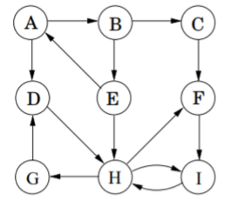
Algo Lab 2 Checkpoint 1: BFS 2 Start from A
1 2
Order of Visitation | Queue contents after processing node
 | [S]
S | [D B E]
D | [B E G H]
B | [E G H C]
E | [G H C]
G | [H C]
H | [C F I]
C | [F I]
F | [I]
I | []
S
1
2
1
3
3
2

Slide 13
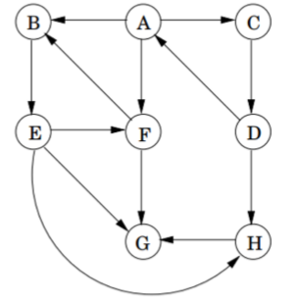
Algo Lab 2 Checkpoint 1: BFS 3 Start from A
1
S
1
Order of Visitation | Queue contents after processing node
 | [S]
S | [B F D C]
B | [F D C E]
F | [D C E G]
D | [C E G H]
C | [E G H]
E | [G H]
G | [H]
H | []
2
1
1
2
2

Slide 14
Algo Lab 2 Checkpoint 1: BFS 1 Start from G
2
3
3
Order of Visitation | Queue contents after processing node
 | [S]
S | [I B H]
I | [B H E]
B | [H E A]
H | [E A F]
E | [A F]
A | [F C]
F | [C D J]
C | [D J]
D | [J]
J | []
1
2
2
S
1
3
1

Slide 15
Algo Lab 2 Checkpoint 1: BFS 2 Start from G
3 3
Order of Visitation | Queue contents after processing node
 | [S]
S | [D H]
D | [H A]
H | [A E F I]
A | [E F I B]
E | [F I B]
F | [I B C]
I | [B C]
B | [C]
C | []
2
1
S
2
2
2
1

Slide 16
Algo Lab 2 Checkpoint 1: BFS 3 Start from G
2
2
3
Order of Visitation | Queue contents after processing node
 | [S]
S | [H F E]
H | [F E D]
F | [E D A B]
E | [D A B]
D | [A B C]
A | [B C]
B | [C]
C | []
1
1
2
1
S

Slide 17
Algo Lab 2 Checkpoint 2 Part 1
3.8 a
3.8 b
10 Pint | 7 Pint | 4 Pint
0 | 7 | 4
10 | 1 | 0
6 | 1 | 4
6 | 5 | 0
2 | 5 | 4
Step 1: Ensure 10pint =0, 7pint=7, 4pint=4
Step 2: Empty 4pint then 7pint into 10pint
Step 3: Fill the 4 pint container from the 10 pint container
Step 4: Empty the 4 pint container into the 7 pint container
Step 5: Repeat 3 and 4 once.
Complete 10Pint=2, 7pint=5, 4pint=4

