Slide 1
Analysis of Usability Dataset
2025-08-02
Samuel Theising

Slide 2
First Look
Observations
Restrictions
First Look
Brainstorming
Synthesis
Recommendation
Data is well organized
Columns designed for human readability, not analysis.
Only one building worth of data.
No physical layout.
Unknown if individual workstations are assigned.
Unknown restrictions on usage of conference rooms

Slide 3
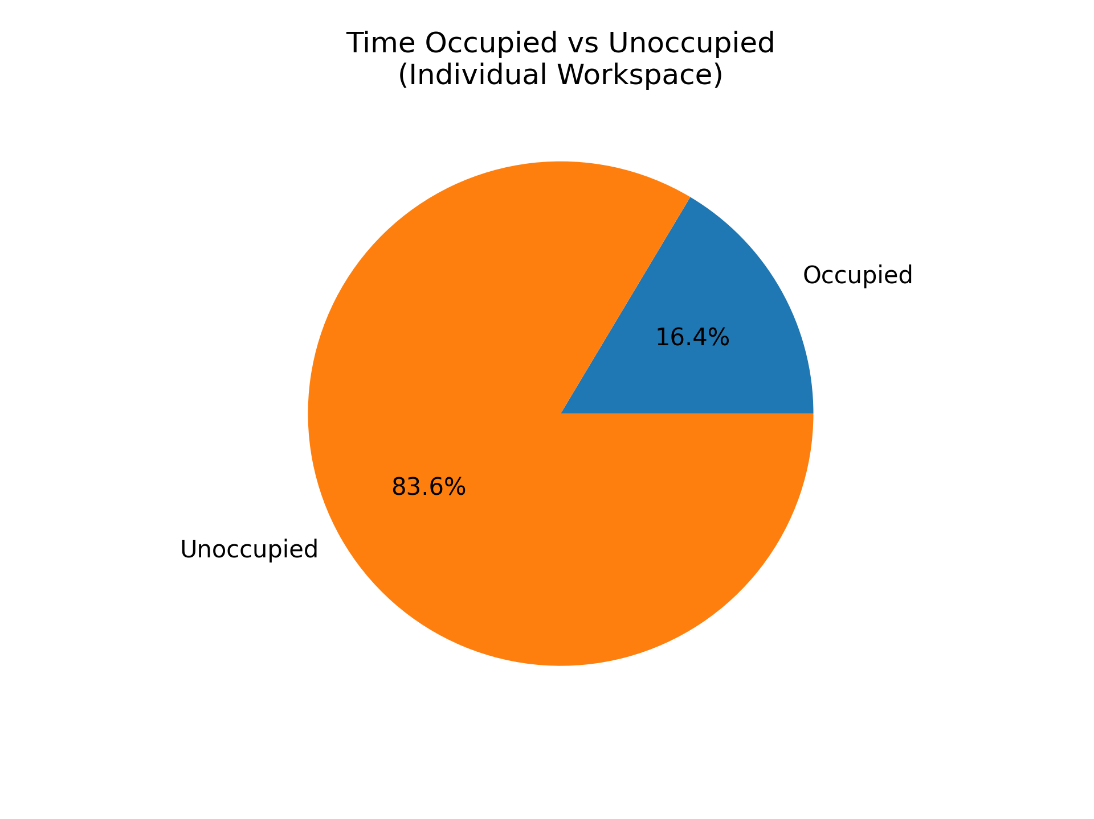
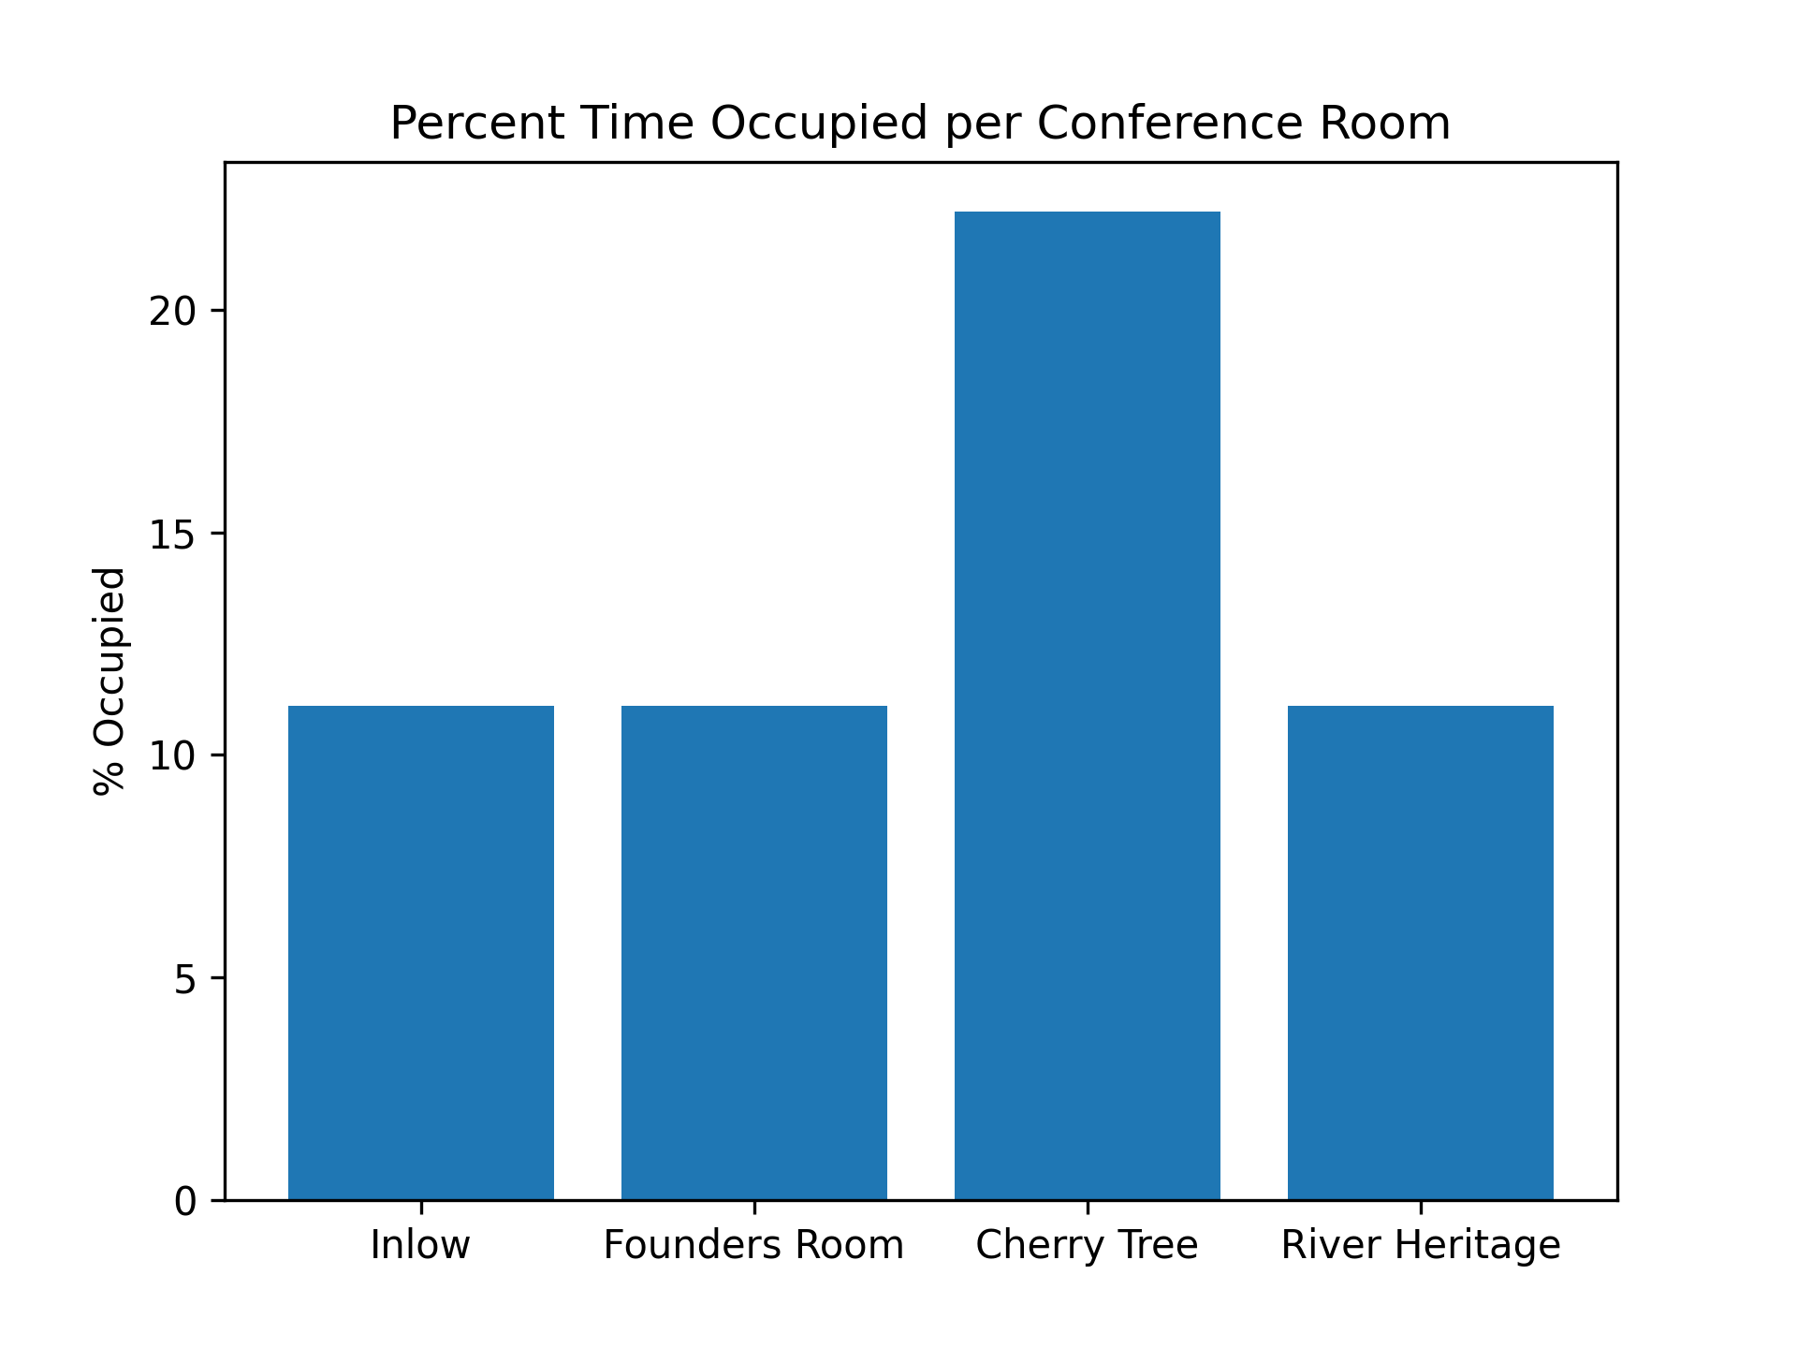
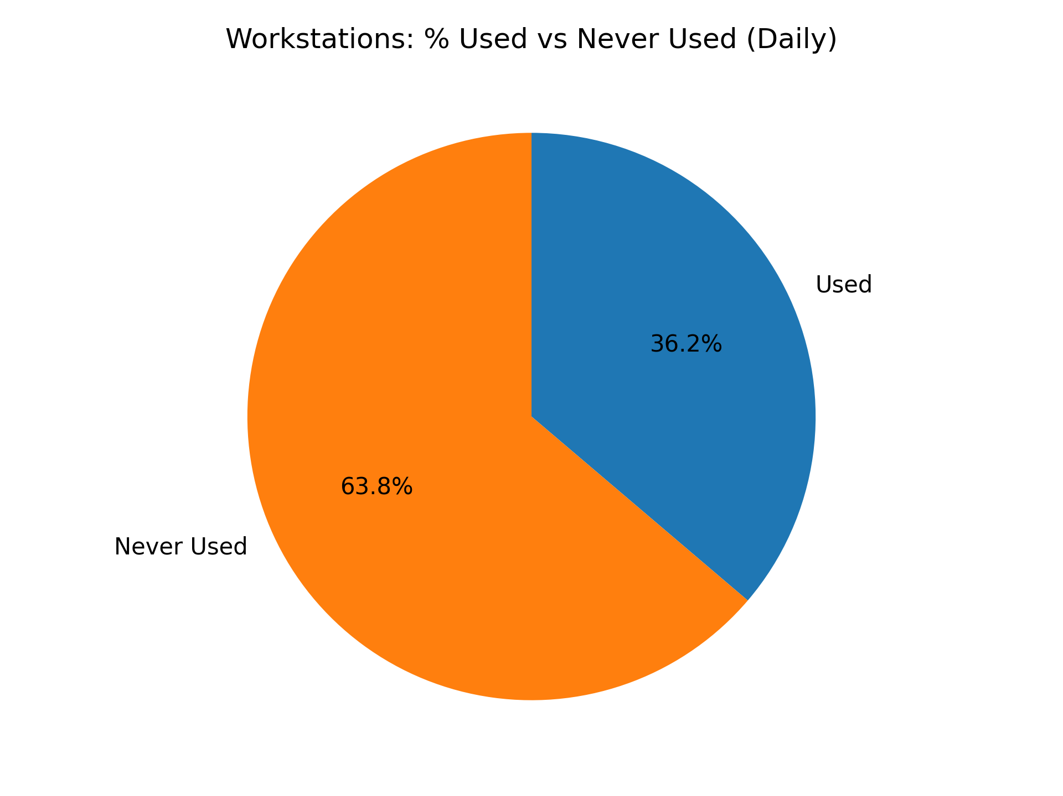
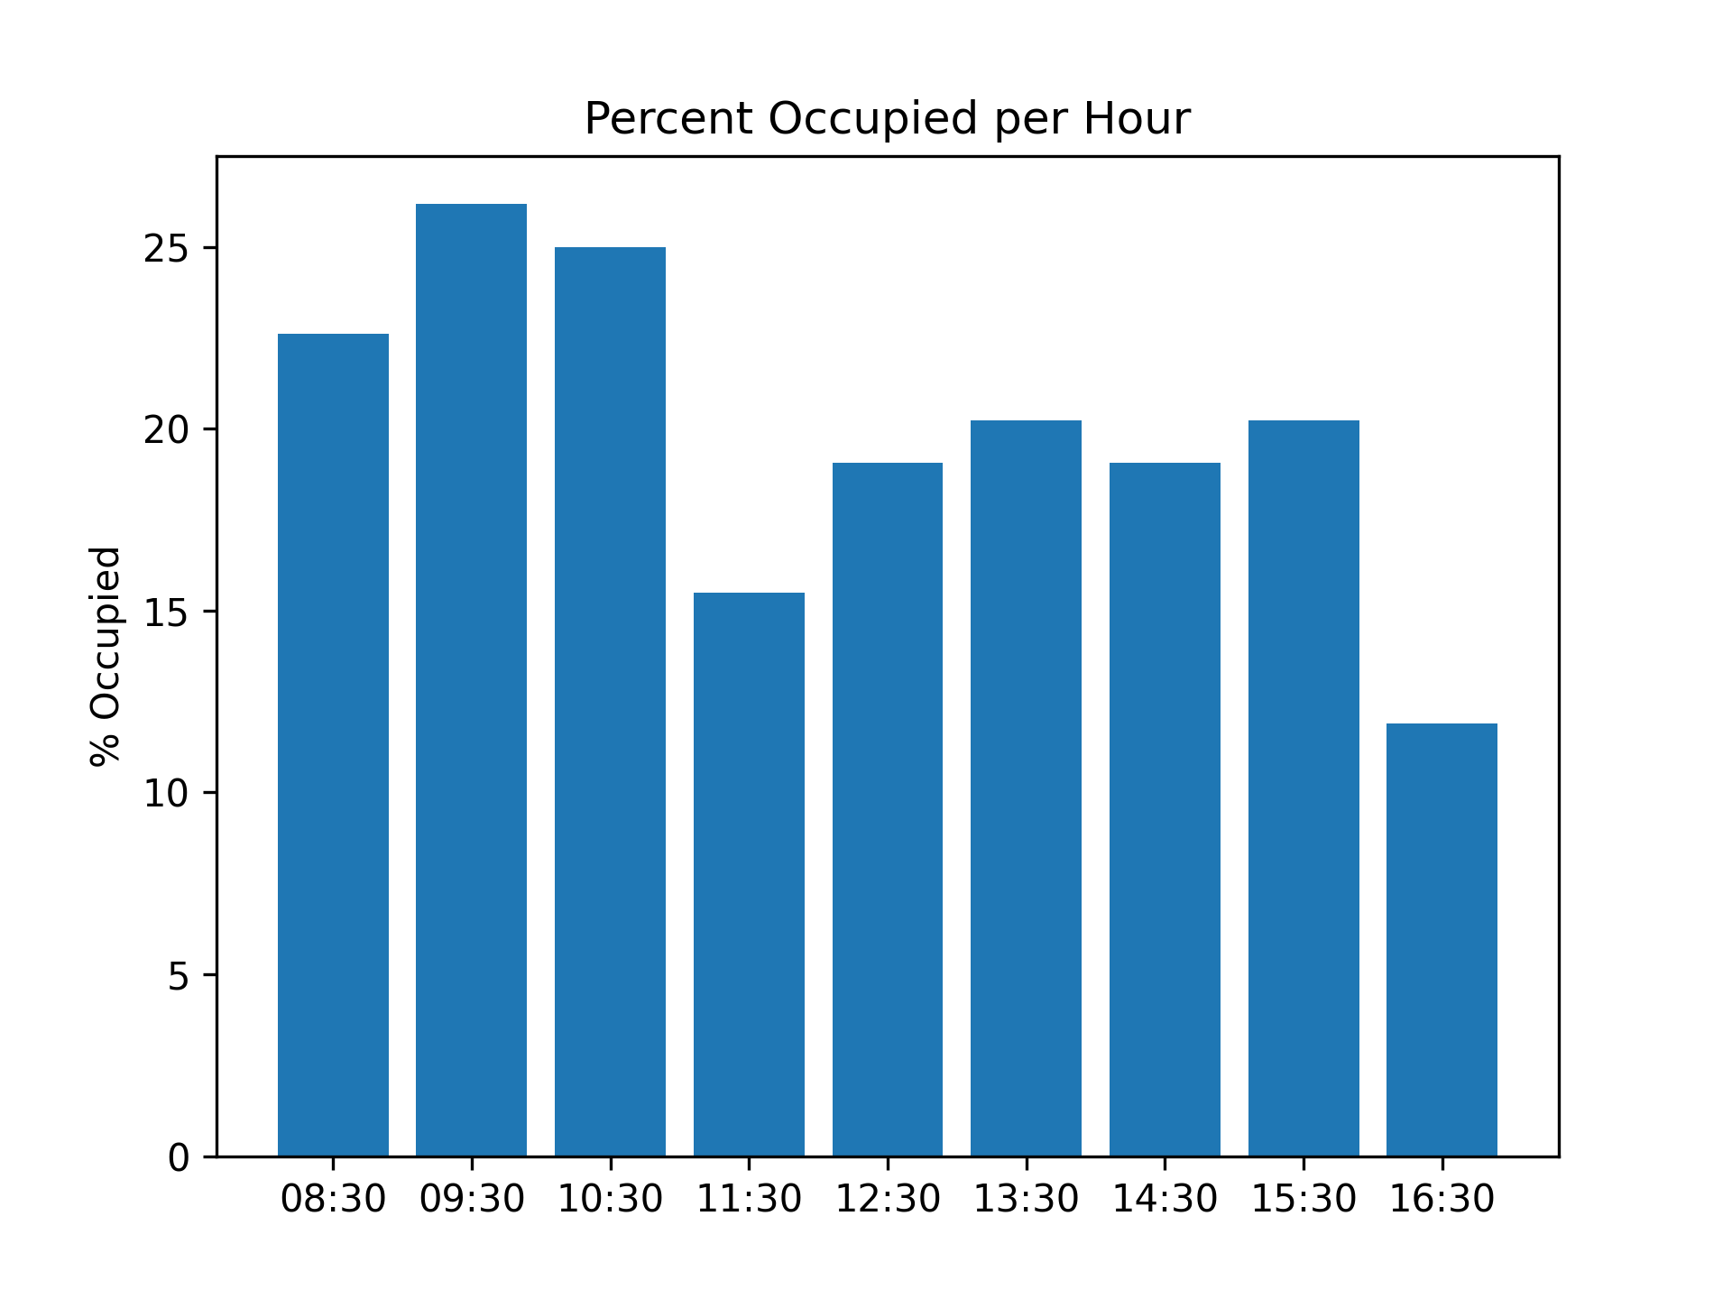
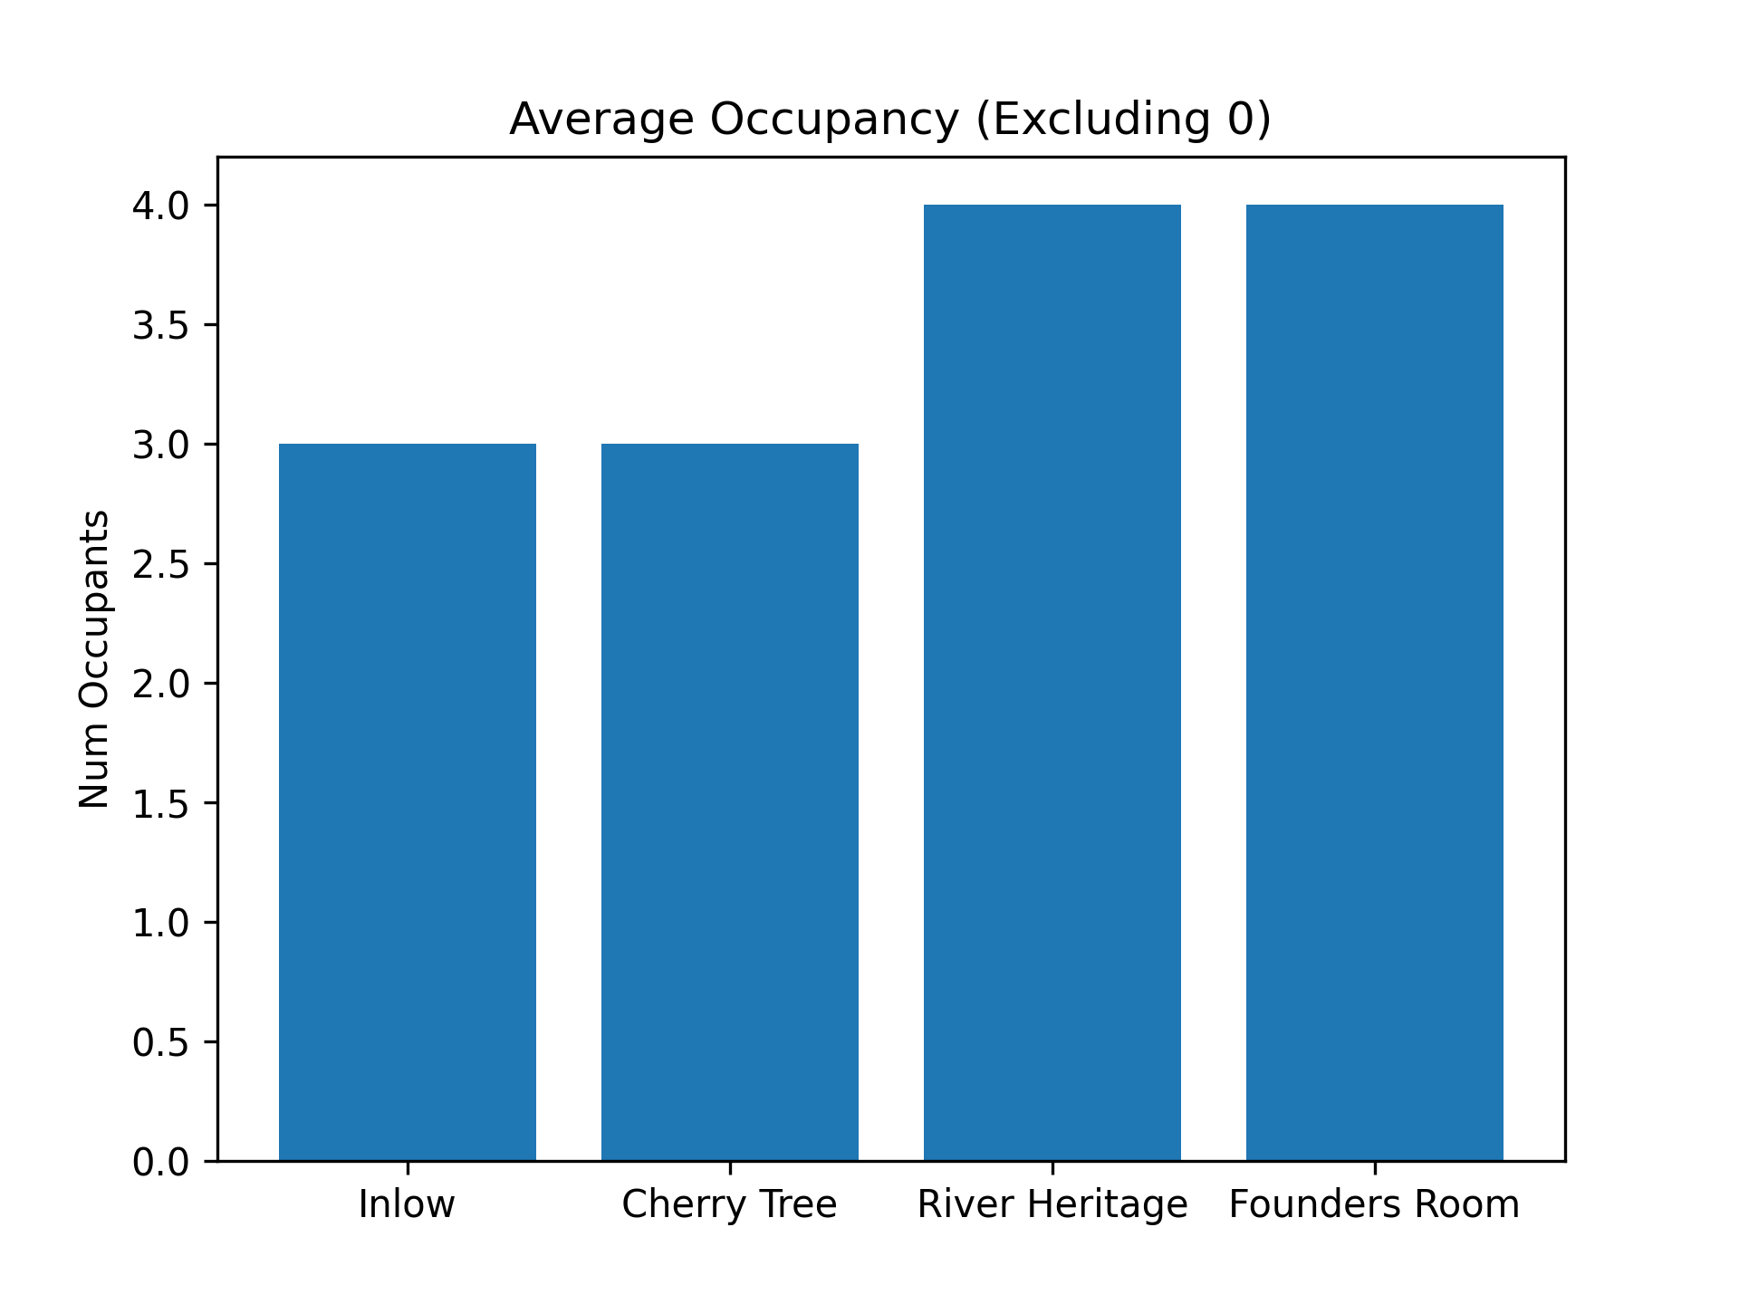
First Look
Brainstorming
Synthesis
Recommendation
Initial Ideas
Idea: How used are the conference rooms, by time and capacity?
Additional analyses identified after the initial pass, during the days when I wasn’t able to actively work on the project.
Cherry Tree is an anomaly due to being the only room with 2 visits.
Idea: What percentage of the rooms are occupied per hour?
This anomaly was further shown here, as one of the two visits were a single worker taking the room.
Worth noting: Founders room saw roughly equal occupancy despite higher capacity.
(21 vs 6-8)
Idea: Are the individual workstations underutilized? How many are actually used?

Slide 4
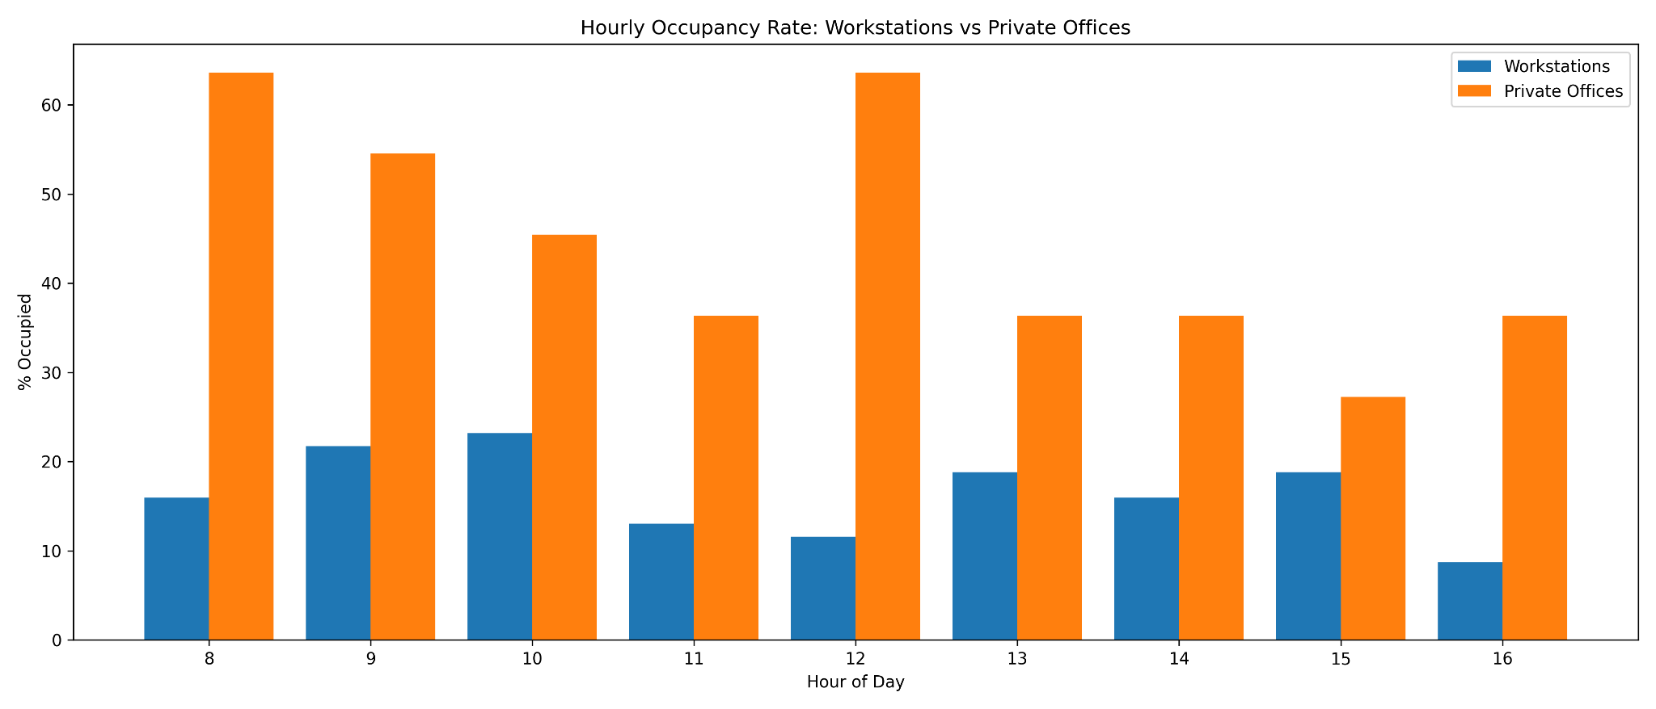
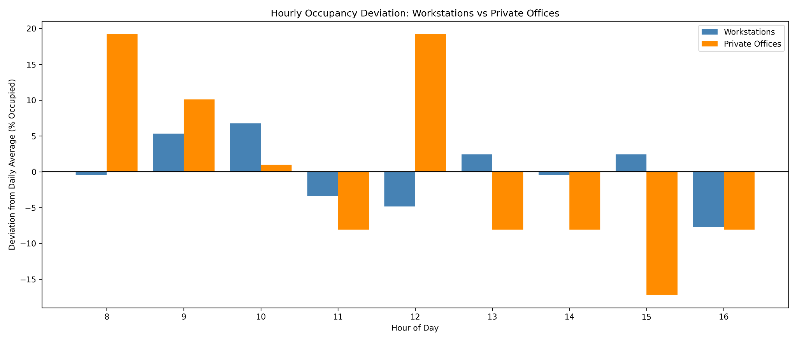
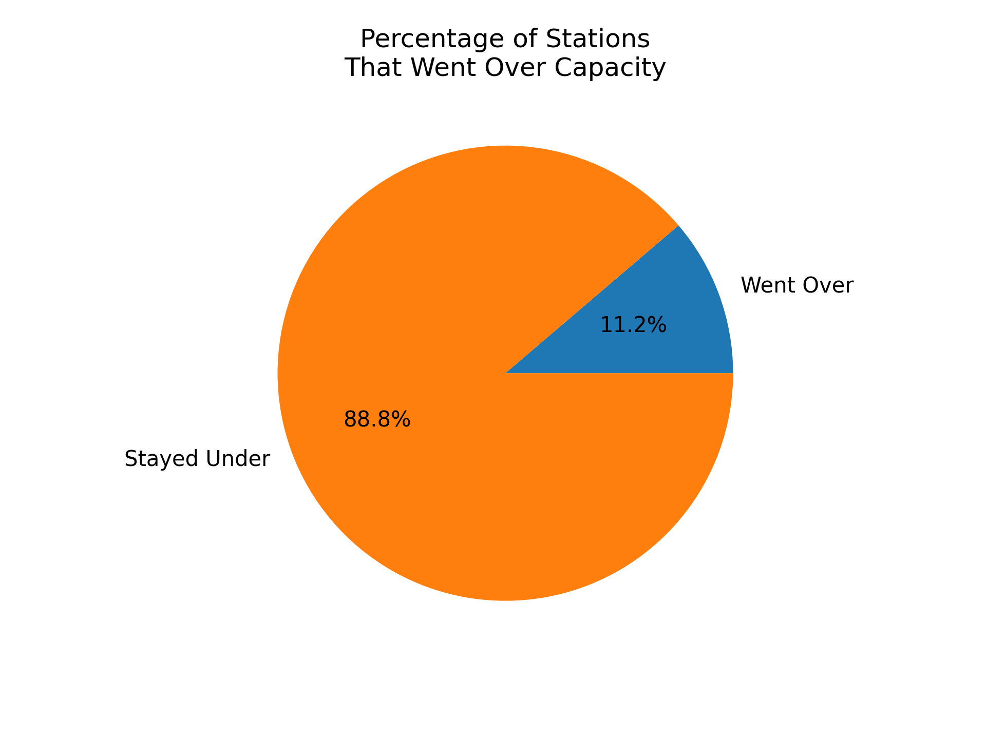
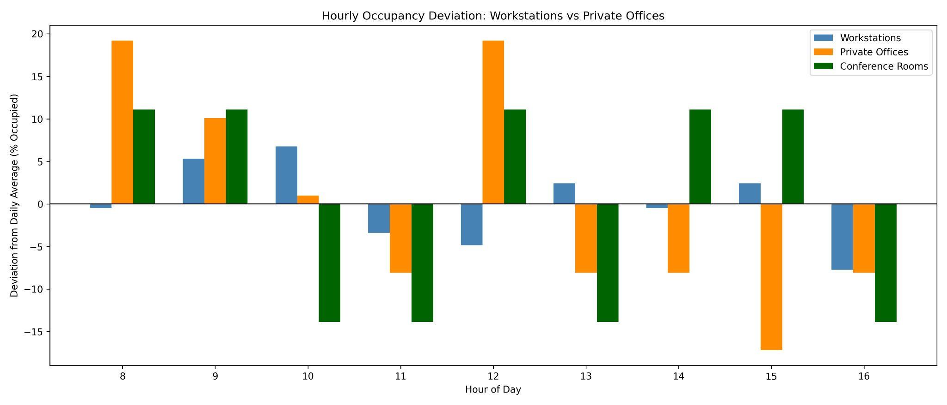
Brainstorming
Bringing It Together
First Look
Synthesis
Recommendation
All stations saw major drops during lunch, but offices recovered faster.
Key Metrics:
Private offices were consistently at higher occupancy. Not unexpected considering their smaller volume.
Workstations never used: 63.8%
Avg conf-room visits: 1.25/day
11.2% single person areas over capacity
Private offices held higher peaks during mornings and lunch, but individual stations remained consistent all day.
11.2% of single-person areas exceeded capacity at least once. That accounts for 26% of the total occupied single-person areas.
When accounting for deviations from the mean across all work areas, there wasn’t an obvious pattern.
The morning meetings coincided with spikes of private office occupancy, implying they were not the ones booking. The afternoon saw opposite spikes.

Slide 5
Recommendation
Actionable Insights
First Look
Brainstorming
Synthesis
Conference rooms were underutilized, with only 1-2 uses per day per room, and never above 70% capacity.
There was consistent collaboration outside of areas with capacity for 2+ individuals
A significant number (64%) of individual workstations went unused across the day
Pilot turning 10-15% of lowest-use workstations into free-form collab areas. Keep or increase if usage and collaboration rise without harming work quality.
This will better fit with the current employee workflow, and encourage further collaboration.

Slide 6
Resources Used
Language: Python
Libraries
Tools
Resources
Polars
https://pola.rs/
Matplotlib
https://matplotlib.org/
Editor
VS Code
Runtime
Python 3.13.5
Version Control
GitHub
GitHub: https://github.com/SDTheising/DORIS_Interview
Contact theisingsamuel@gmail.com
(812)582-9228

