Slide 1
JIRA-SDU BUG TRACKING SYSTEM AIOT TEAM
Talgat Naurzaliyev
Adil Yergaliyev
Islam Madeniyat
Olzhas Zholamanuly

Slide 2
ABSTRACT
For many years Bug Tracking mechanism is employed only in some of the large software development houses. Most of the others never bothered with bug tracking at all and instead simply relied on shared lists and email to monitor the status of defects
Bug Tracking System is a desktop-based application that is designed to help quality assurance and programmers keep track of reported software bugs in their work. Bugs will be assigned to a person with a bug id, flag, description, project name.
Nowadays, when project are so extensive defects or bugs have been existed as a problem in the system and they are normally inevitable in software development. A bug could be in either a program’s source code or its design.

Slide 3
INTRODUCTION
Bug Tracking System is a desktop-based application that is designed to help quality assurance and programmers keep track of reported software bugs in their work..
Bugs will be assigned to a person with a bug id, flag, description, project name.
Bug can be submitted to the tester with an attachment for the bug detailed report.
Admin can maintain users, projects, organizations, bug categories, bug priorities, status of bug etc.

Slide 4
PURPOSE OF THE PROJECT
Bug Tracking System is to test the application for the bugs and report it to the project manager and developer.
The main intention behind the Bug Tracking System is that to track bugs and report them.
Store the bug information with a unique id in the database.

Slide 5
FUNCTIONAL REQUIREMENTS
Admin: This module has the entire access to all other modules, admin creates the project and assigning the projects to the created manager, adding members to the managers, assigning bugs based on the priority.
Manager: Manager has the full access to the particular project assigned by the admin and controls the team member’s access to the bugs assigned.
Developer: Can access the task or bug assigned by the manager, view assigned projects and resolving the assigned bug. Developer can view the bugs list assigned by the manager.
Tester: Tester can access to the projects or bugs assigned by the manager, can view the assigned projects and can add a new bug to the list and send the bug back to the manager. Tester can login to the system and access the assigned projects list.
Reports: Both Admin and Manager can access this module and generate the reports based on the requirements.

Slide 6
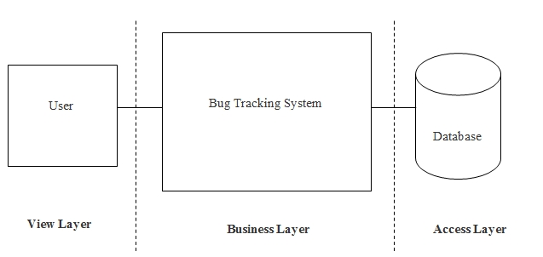
SYSTEM DESIGN DOCUMENT
ARCHITECTURAL DESIGN
Architectural Design is a process of decomposing a large complex system into small subsystems. These subsystems are meant for providing some related services.

Slide 7
DATA FLOW DIAGRAMS
Level-0:

Slide 8
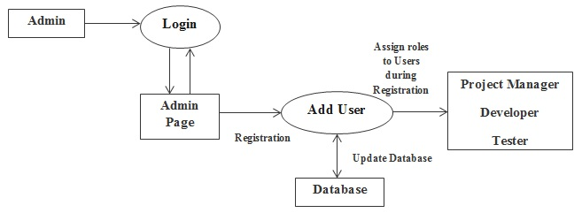
DATA FLOW DIAGRAMS
Level-1:

Slide 9
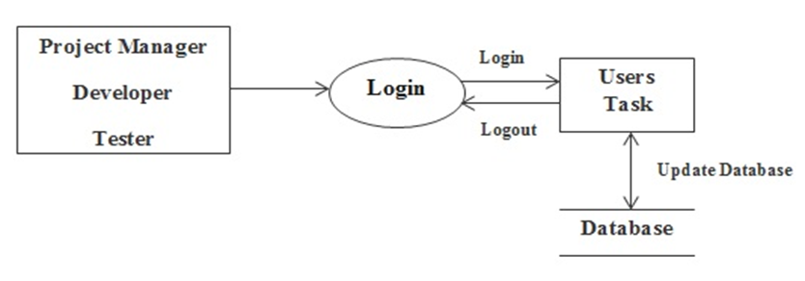
DATA FLOW DIAGRAMS
Level-1.1:

Slide 10
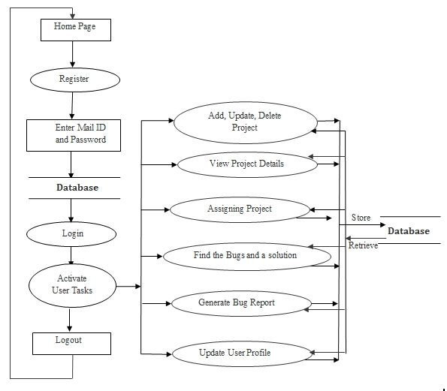
DATA FLOW DIAGRAMS
Level-2:

Slide 11
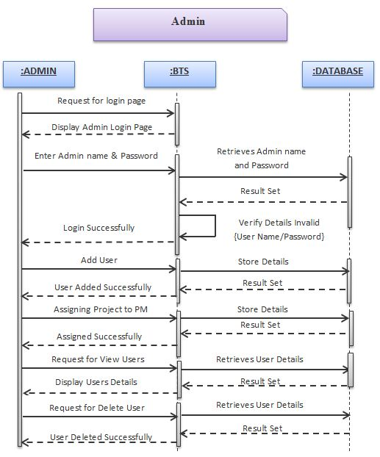
SEQUENCE DIAGRAM

Slide 12
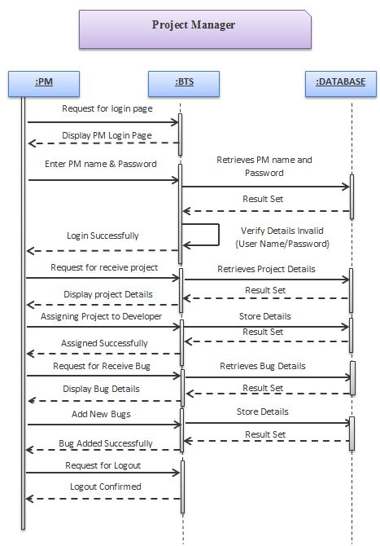
SEQUENCE DIAGRAM

Slide 13
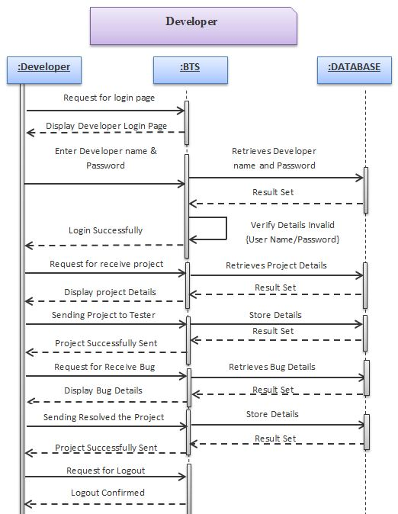
SEQUENCE DIAGRAM

Slide 14
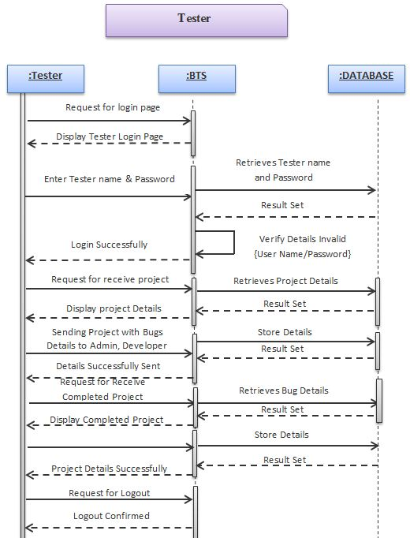
SEQUENCE DIAGRAM

Slide 15
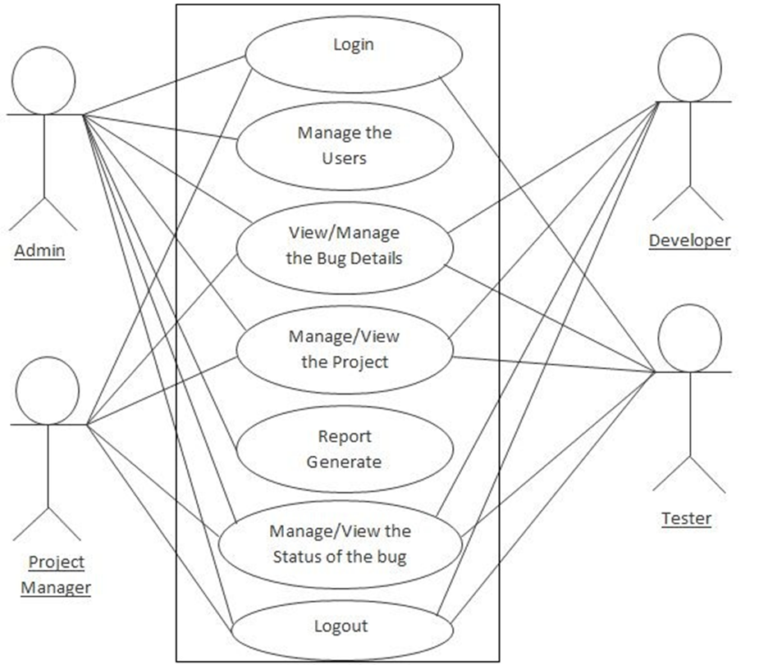
USE CASE DIAGRAM

Slide 16
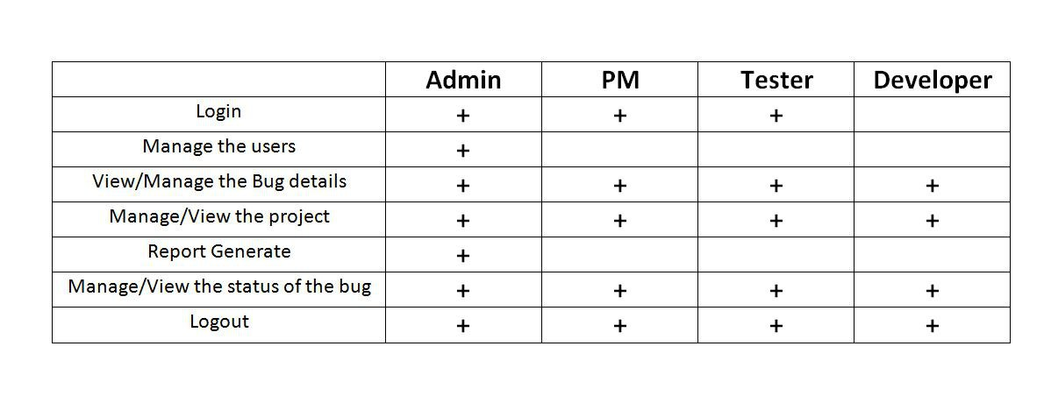
USE CASE

Slide 17
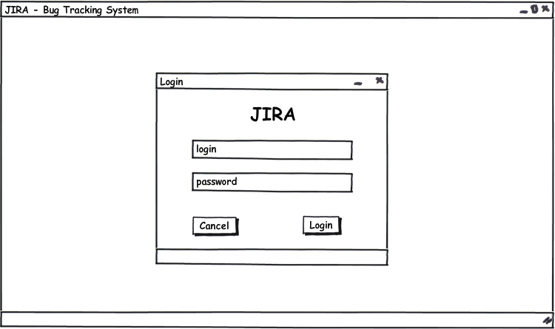
PRE-DESIGN SCREENSHOTS
Login:

Slide 18
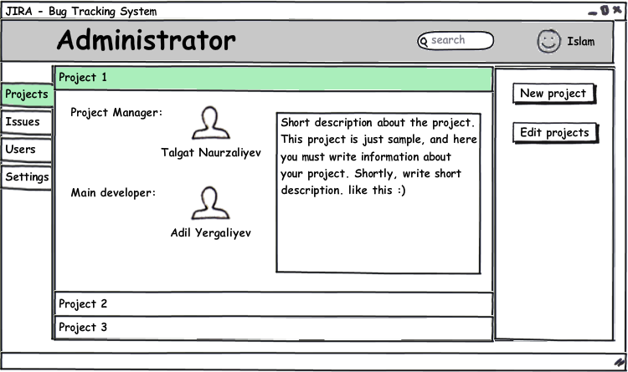
PRE-DESIGN SCREENSHOTS

Slide 19
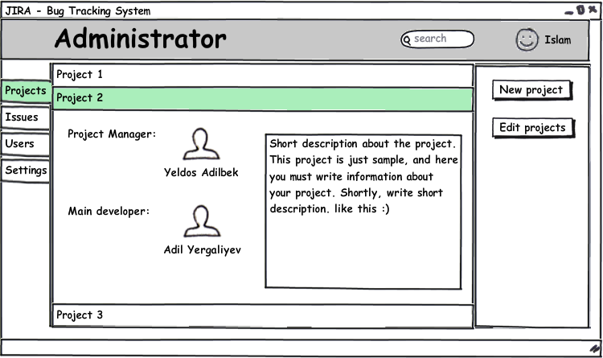
PRE-DESIGN SCREENSHOTS

Slide 20
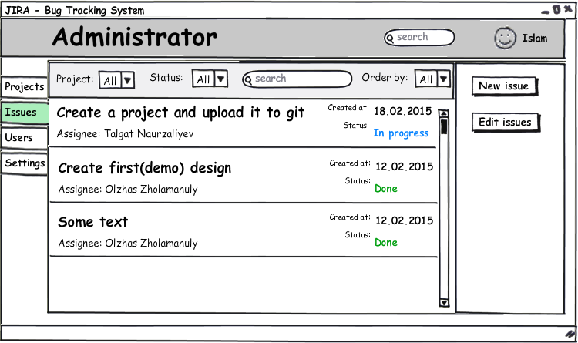
PRE-DESIGN SCREENSHOTS
Issues:

Slide 21
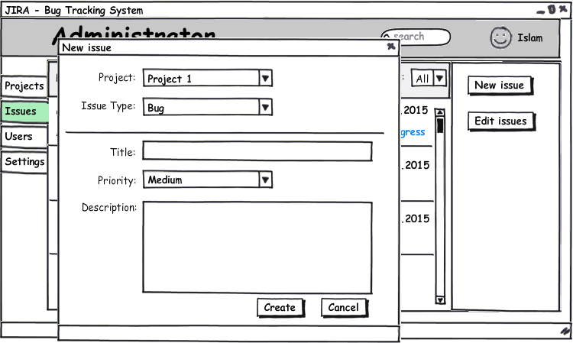
PRE-DESIGN SCREENSHOTS
New issue:

Slide 22
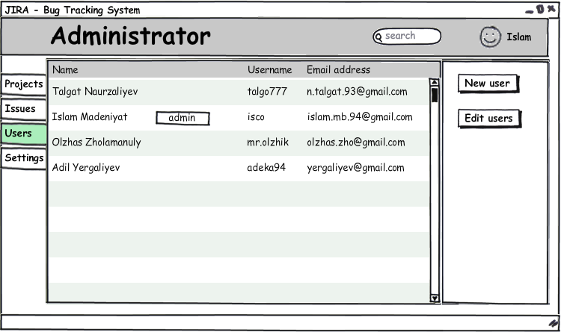
PRE-DESIGN SCREENSHOTS
Users:

Slide 23
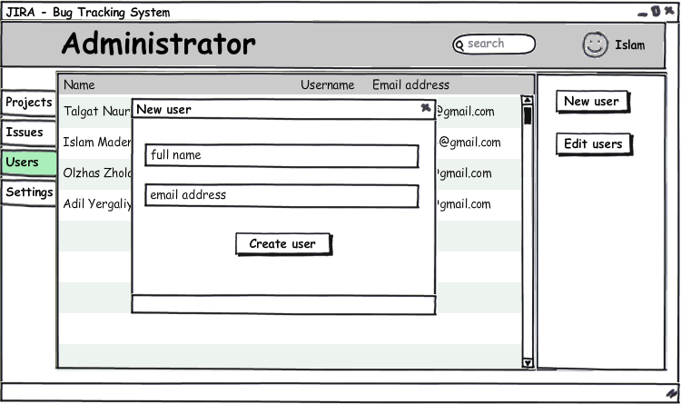
PRE-DESIGN SCREENSHOTS
New user:

Slide 24
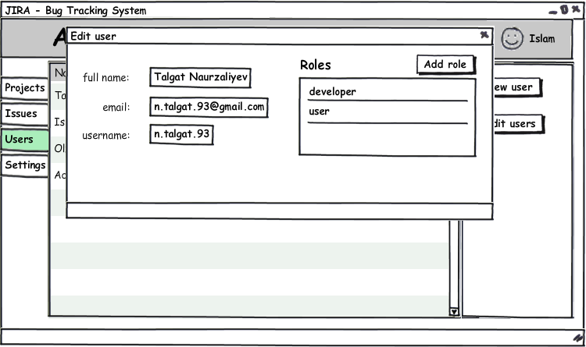
PRE-DESIGN SCREENSHOTS
Edit user:

