Slide 1


Slide 2
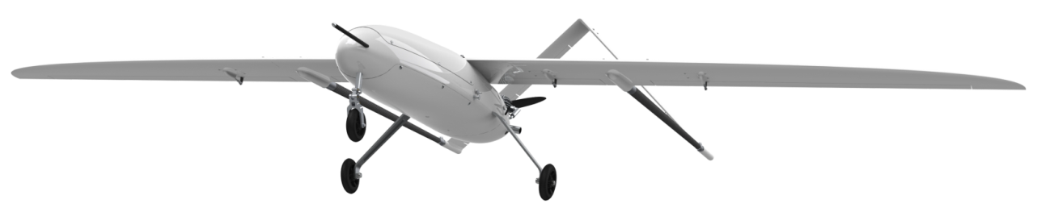
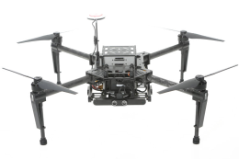
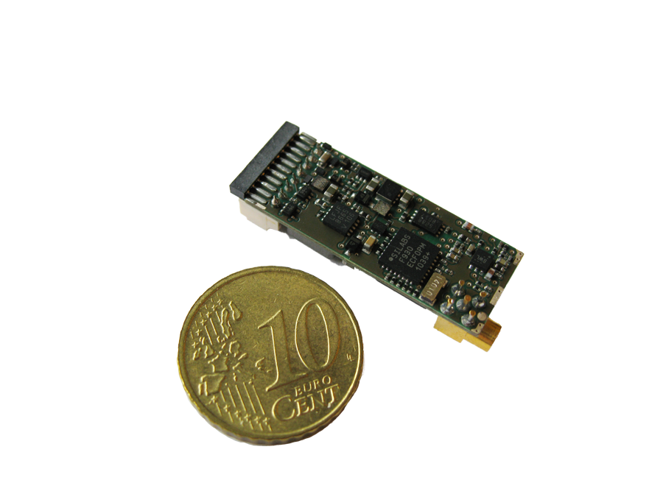
UAV ID System
The system consists of transponders which are able to broadcast
their identification and position.
Applications:
Identification
Tracking
Situational awareness
C2, (Command & Control)

Slide 3
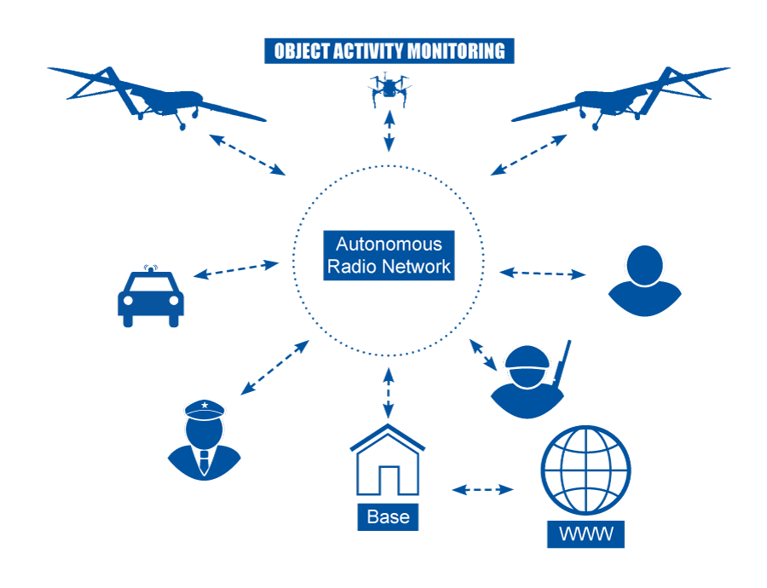
Situational Awareness
A moving communication bubbel is surrounding each ID System.
Afixed communication bubble is created arround a ground station.
When bubbles are overlapping two-way communication is possible.
Air-to-ait communication is independant of groundstations.

Slide 4
UAV ID System
The transponders are made in two versions:
High power version = Size, Weight and Power consumption is of no concern
The low power version = Size, Weight and Power consumption is highly important
Transponder features 1/2:
Narrowband (12,5- or 25kHz channel) can operate in Aviation, Land mobile,
and cellular frequecy bands
All transponders can operate on one single predefined frequency
No need for Base- or ground station
Air to Air, Air to Ground and Ground to Air communication
Well proven VDL Mode 4 Aviation technology
Handling 4500 Transponders within Line Of Sight @ 1 min. update rate
Handling 75 Transponders within Line Of Sight @ 1 sec. update rate
AES128 Encryption
Built in GPS

Slide 5
UAV ID System
The transponders are able to exchange information at a high rate between two units if necessary; alternatively it can broadcast to all units.
Discrete I/O and Analog inputs provide the possibility of communicate the environmental condition of each transponder.
All communication is encrypted, and performed on a single narrowband frequency.
Transponder features 2/2:
Built in SD Card, for Activity Logging
Built in Accelerometer and Barometric sensor
Two Discrete I/O
Two A/D inputs
Optional bidirectional Serial data port for interfacing to other systems
Maintenance data port
Weight < 50g (low power version)
Size < 5 cm3 (low power version)
External power input 5-12 VDC

Slide 6
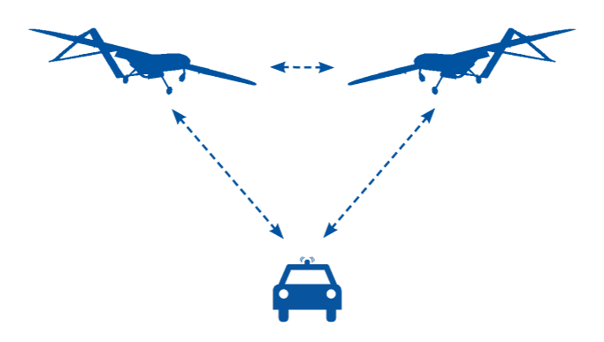
Drone ID and Intercom

Slide 7
UAV ID System
Two bidirectional serial data ports:
One for maintenance
One for interfacing to other systems like a tablet or smartphone showing a map with your own position, as well as all other transponders within range.
A list of nearby transponders will show, with information about unique identification, position, direction, elevation, velocity, and optional data based on installed sensors.
The high power transponder version also provides Bluetooth interface which make it very easy to connect to a tablet or smartphone.

Slide 8
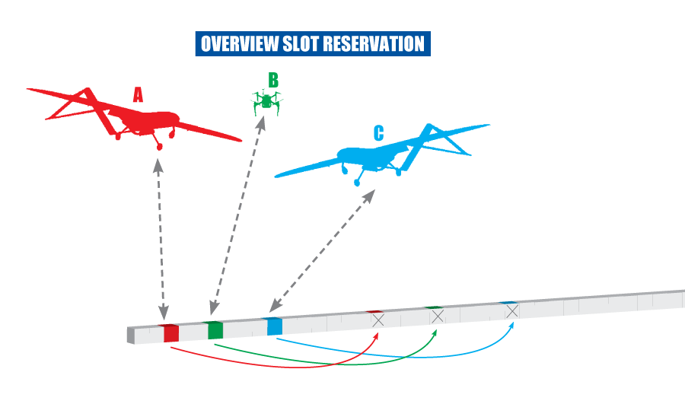
UAV ID System
The ID System of drone A
sends the position message in one time slot. At the same time it reserves another time slot for the next position message.
The same procedure is repeated by all other ID System equipped drones.
Each time slot
represents
13,3 milliseconds

Slide 9
UAV ID System
The SA Group provides UAV services as assembly, MRO, upgrades etc.
SA is part of UAV Test Center Denmark, and coorporate with other companies in regards to total UAV solutions.
SA applies to UAV standards and regulations, all based on our expertise and knowledge from more than 37 years within avionics in the aviation industry.
The SA Group holds the following approvals:
EASA/FAA Part-145 Maintenance Organization Approval
Part-21J Design Organization Approval
Part-21G Production Organization Approval
Part-147 Training Organization Approval
A number of local Maintenance Organization Approvals

Slide 10
The SA Group
For further information please contact:
Per K. Nielsen
Phone: +45 2047 2298
Email: pkn@scanav.com
Or visit
www.scanav.com
THANK YOU

