Slide 1
Sentiment Analysis
Group Member：Xiaohui Zhao, Baodi Shan
zxh991103[at]gmail[dot]com lwshanbd[at]gmail[dot]com

Slide 2
Contents
1. Abstract
2. Key-Words
3. Introduction to Data
4. Introduction to Gloves
5. Introduction to Models
6. Evaluation
7. Test
8. Future Work

Slide 3
Part 1 Abstract
Sentiment analysis is a hot research topic in the field of natural language processing. The main idea is to obtain the emotional possibility of the sentence and segment the deep information by segmenting the natural sentence.
In our pre-research, we used Logistic Regression , SVM, KNN and Naive Bayes, classic Machine Learning models, to achieve the preliminary goal of Sentiment Analysis.

Slide 4
Part 2 Key Words
Scikit-learn
SVM
Logistic Regression
Naive Bayes
NLP

Slide 5
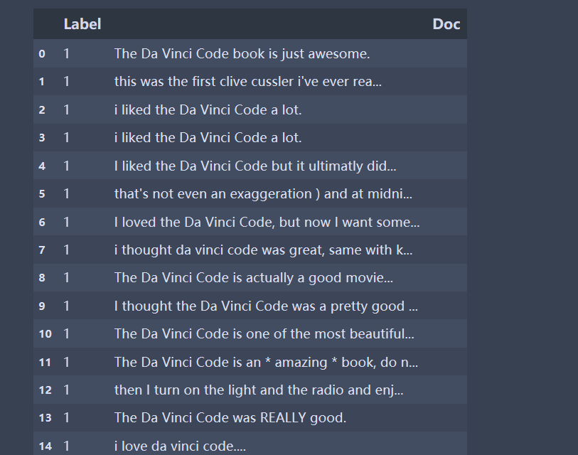
Part 3 Introduction to Data Set
opinions.tsv

Slide 6
Part 4 Introduction to GloVe
GloVe, Global Vectors for Word Representation. It is a word2vec based on global analysis, which is presented by Jeffrey Pennington.
Training is performed on aggregated global word-word co-occurrence statistics(基于全局词频统计)from a corpus, and the resulting representations showcase interesting linear substructures of the word vector space.
Stanford University,2014

Slide 7
Part 5 Introduction to Models
Naive Bayes
Logistic Regression
Linear-SVM
KNN
127.0.0.1:8888/notebooks/Desktop/BasedOnGloves.ipynb

Slide 8
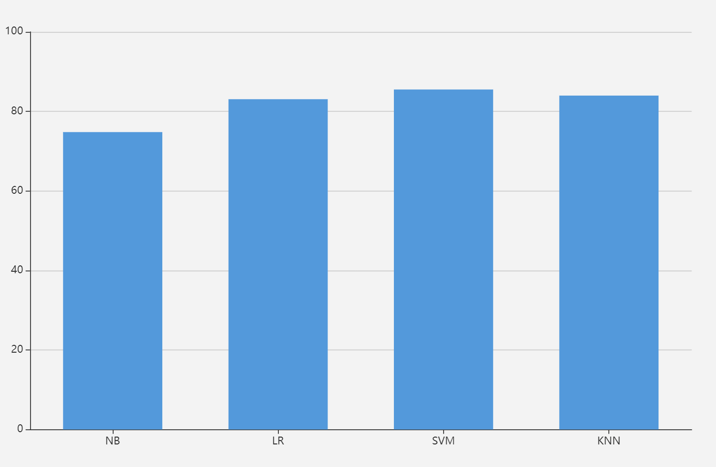
Part 6 Evaluation

Slide 9
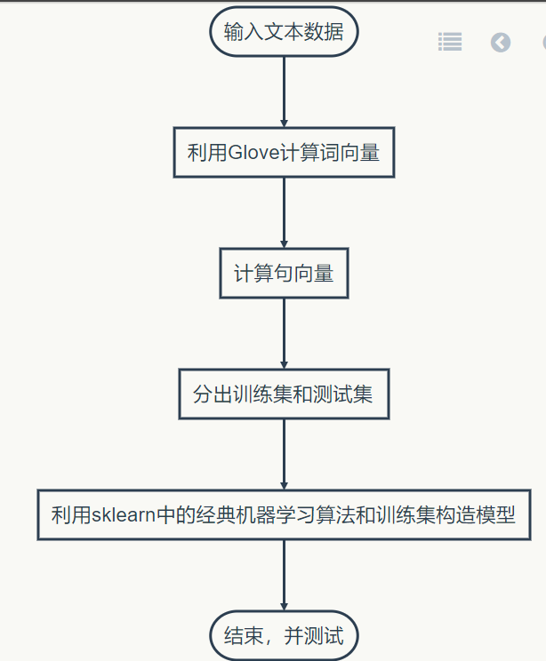
Part 7 Test
Test Sentences in English:
127.0.0.1:8888/notebooks/Desktop/BasedOnGloves.ipynb

Slide 10
Part 8 Future Work
Problems
Hard to get labels of data
Scores of Users’ Comments are not so accurate
Semi-Supervised Learning（SSL）
Active learning

Slide 11
Part 8 Future Work
生成式方法
高斯混合模型
EM算法
半监督SVM(S3VM)
TSVM
图半监督学习
标记传播方法
基于分歧的方法
协同训练
Deep learning (pytorch)

Slide 12
Q&A

