Slide 1
Online job scheduling in Distributed Machine Learning Clusters
段新朋

Slide 2
Problem
Parameter Server机器学习训练模型下的工作调度问题
分为worker和server，前者用于计算梯度，后者用于保存以及更新参数
新来一个job的时候，需要为这个job分配若干worker和server以满足训练需求，同时满足资源总量的限制
输入数据分成若干chunk，每个chunk由一个worker负责训练，一个chunk又分为多个mini-batch，每次训练一个mini-batch
参数根据server的数量均分为若干份，每个server保存参数的一部分。

Slide 3
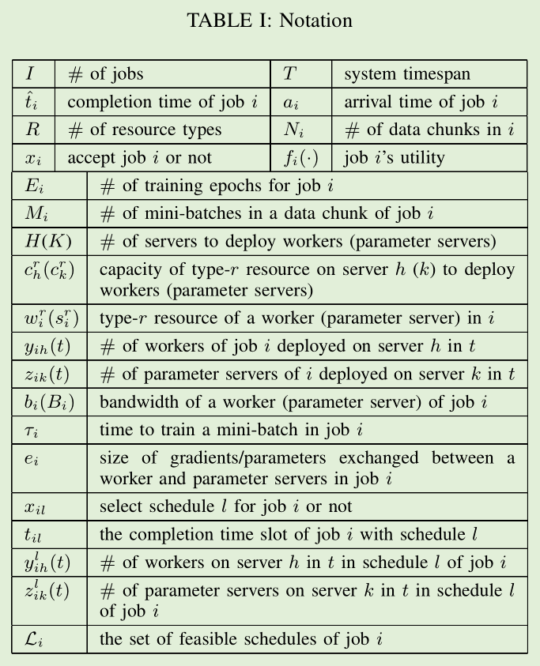
Modeling

Slide 4
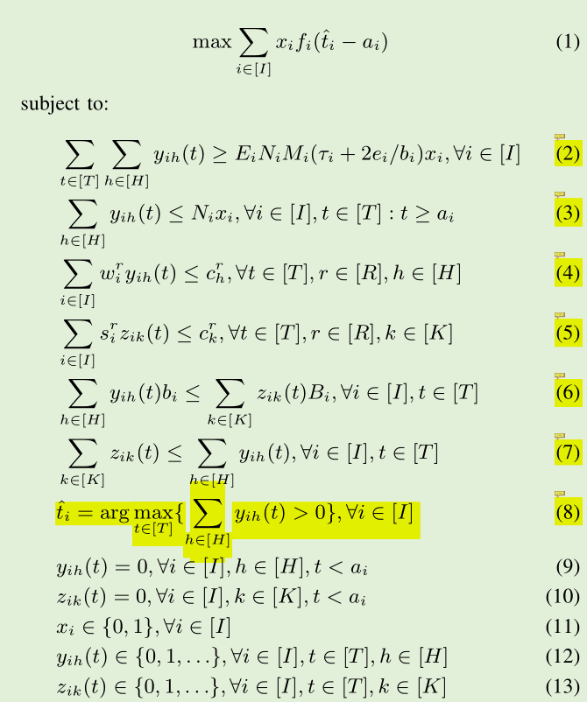
Offline Algorithm
确定接受哪些job，不接受哪些job，并为每一个job分配worker和server，最终实现所有job的效用函数最大化的同时满足各种限制。

Slide 5
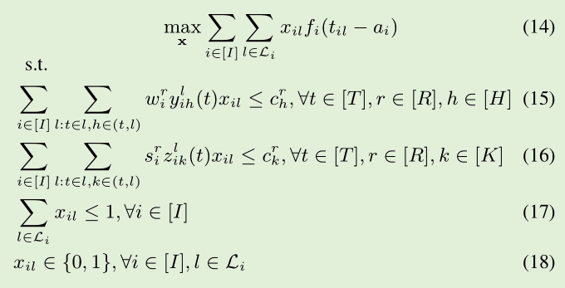
Online Algorithm
We formulate the dual of (14) by relaxing integrality constraints (18) and associating dual variables p r h (t), q R k (t) and µ i with (15), (16) and (17), respectively.

Slide 6
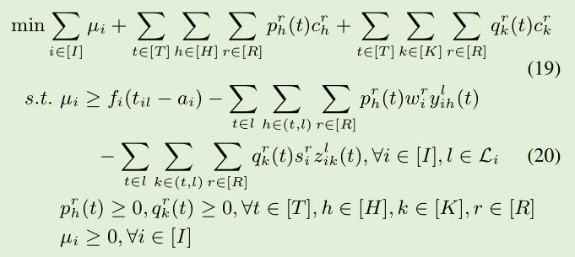
Primal-dual
μ：payoff
P:unit-cost for type-r resource
Q:
f: utility function

Slide 7
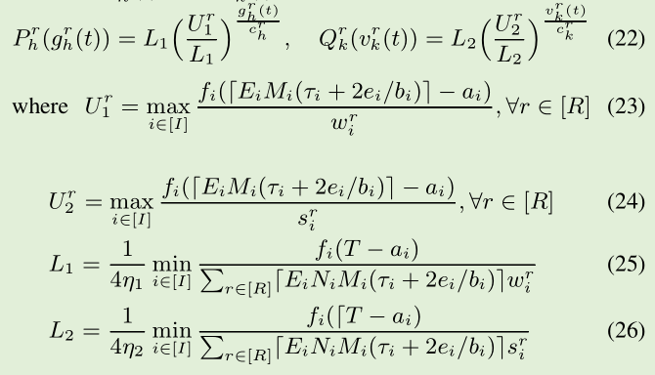
P,Q
P: unit cost for type-r resource on
the worker in t.
Q:unit cost for type-r resource on
the server in t.
U:maximum per-unit-resource job utility for type-
r resource on physical servers to deploy workers
L: L 1 (L 2 ) represents the minimum unit-time-unit-resource job utility on physical servers to deploy workers (parameter servers), among
all jobs

Slide 8
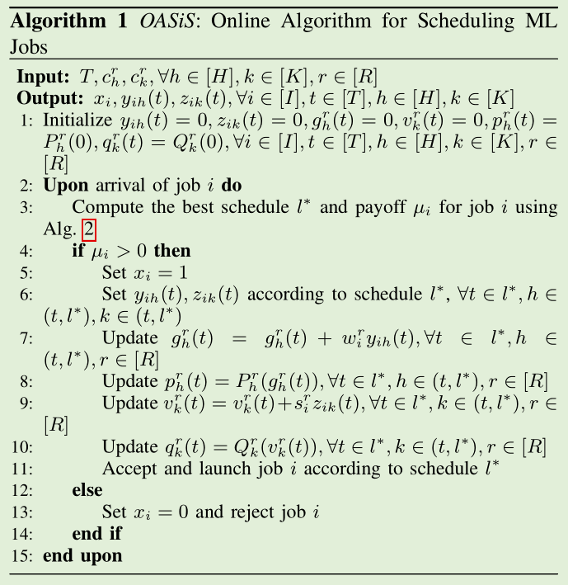
Online Algorithm

Slide 9
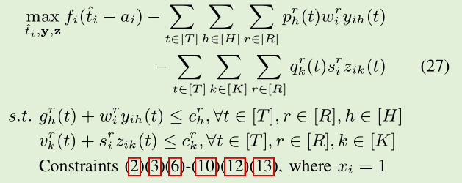
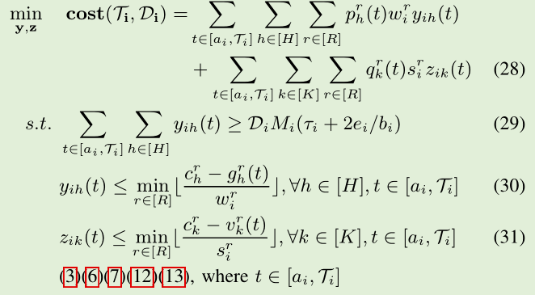
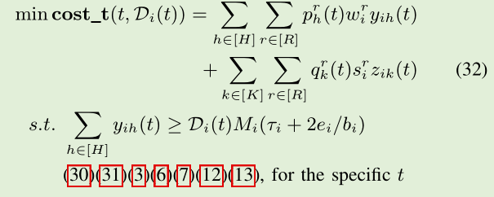
Finding best job schedule

Slide 10
