Slide 1




Performance evaluation of multi-label classification over pre trained
models for anuran calls classification

Slide 2
Problem-Statement
Problem definition
Objectives
How can be evaluated the efficiency and accuracy of supervised machine learning pre trained models in anuran acoustic monitoring using multi-label data sets?
To evaluate the performance of CNN pre trained models in the detection and classification of calls from the anurans Boana albopunctata, Physalaemus cuvieri and Boana lundii

Slide 3
Clarification
Dropout can help prevent over-reliance on specific features by randomly dropping out some nodes during training. This can help the model learn more robust and generalizable representations, which can lead to better performance on unseen data.
L2 regularization can prevent overfitting by adding a penalty term to the loss function, which encourages the model to use smaller weights. This can help prevent the model from overfitting to the training data and improve its generalization ability.
Adam optimizer + binary cross-entropy + F1 score with average none: Implementing all three techniques together, may result in a more robust and accurate pre-trained model for multi-label classification on spectrograms. The Adam optimizer will help converge faster, the binary cross-entropy will handle the classification task better, and the F1 score with average none will ensure equal importance is given to each label's precision and recall.

Slide 4
Hypothesis
The addition of n fully connected layers to a pre-trained model can improve the model's ability to learn complex non-linear relationships in the data, resulting in improved performance for the task.
The addition of n fully connected layers may result in overfitting the model to the training data, leading to poor generalization performance on unseen data.

Slide 5
Hypothesis
Models with lower number of parameters can perform better for this problem.
The combination of Adam optimizer, binary cross-entropy, and F1 score with average none as the preferred metric can lead to an efficient training process.

Slide 6
WORKFLOW
Pre-Processing
Datasets creation
Training
Testing
Models selection

Slide 7
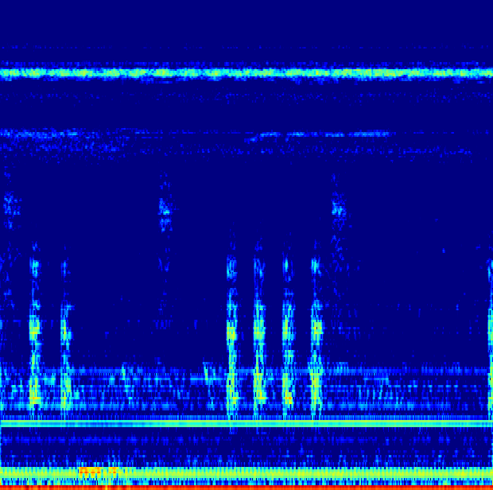
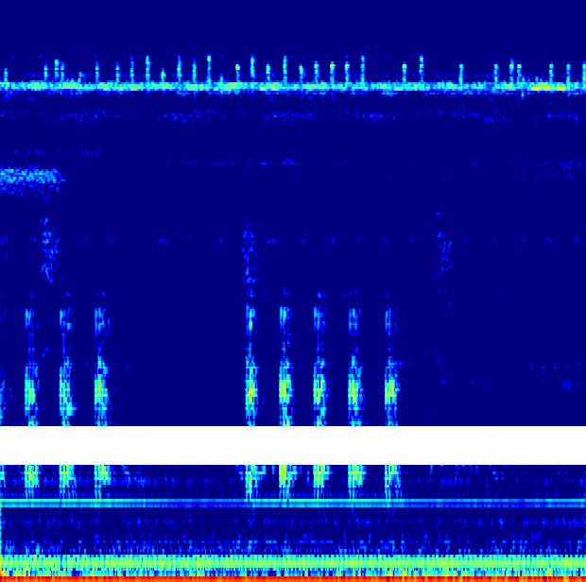
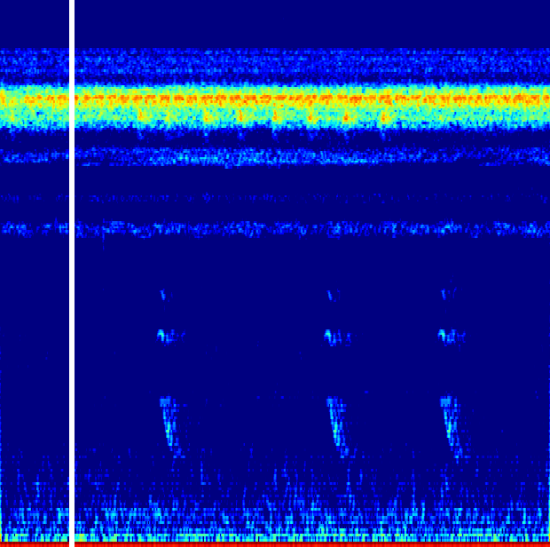
Pre-Processing INCT41
Trimming audios 5sec length windows
Extracting species presence from audios and annotations PHYCUV: 91 | BOAALB: 554 | BOALUM:417
Generating images from audios Size 224x224 N_FFT = 1024 / Hop_Lenght = 64 /N_Mels = 256
Mel spectrograms Time Masking Frecuency Masking

Slide 8
Dataset Creation
Intended to be the input for our model, it shows the path where each spectrograms are located and the presence or absence of the species in that spectrogram
Structure:
Name | Path | PHYCUV | BOAALB | BOALUM
Model name | path/model/imag | 1 | 0 | 1

Slide 9
Training Testing Validation
DATASETS DIVISION
Not augmented Augmented: Frecuency mask - Time mask
70% training 30% testing 70% training 30% testing - validation(Real data)
70%
30%
Complete dataset
Complete dataset

Slide 10
#Samples per model training - testing - validation
Datasets division - Not augmented
Train
PHYCUV:64 | BOAALB: 388 | BOALUM: 292
Test
PHYCUV:27 | BOAALB: 166 | BOALUM: 125
Datasets division - Time masking
Train
PHYCUV:256 | BOAALB: 253 | BOALUM: 190
Test
PHYCUV:111 | BOAALB: 88 | BOALUM: 82
Validation
PHYCUV: 31 | BOAALB: 193 | BOALUM: 145
Datasets division - Frequency masking
Train
PHYCUV:426 | BOAALB: 421 | BOALUM: 422
Test
PHYCUV:183 | BOAALB: 180 | BOALUM: 180
Validation
PHYCUV: 31 | BOAALB: 193 | BOALUM: 145

Slide 11
Architecture definition
Selected models: Resnet50 | MobileNet | InceptionV3 | Densenet121
All models will have the following fixed parameters for training:
Adam optimizer with learning rate 0.00001
Drop out (0.5)
L2 Regularization
Top epochs 1000
Early stopping patience = 5
Loss: Binary Crossentropy
Top layer input shape (224,224,3)
Weights: Imagenet
Output layer Activation : sigmoid
We will vary the following parameters per model
Dataset: Augmented (Time masking, Frequency masking), Not augmented
Number of extra fully-connected layers (1 or 2)
Cross-validation 5 folds
Total of trained models 48, but we extracted each fold as a model, then we have 144 trained models

Slide 12
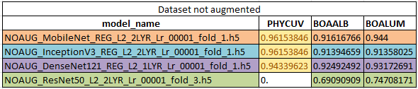
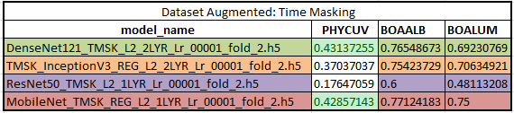
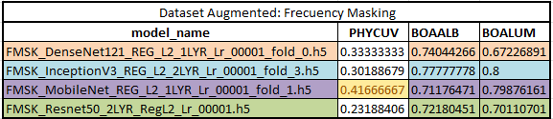
Validation best results F1 Score

Slide 13
MobileNet trained models have the best performance over all trained ones.
In not-augmented dataset and time mask-augmented dataset, adding 2 fully connected layers achieves a better performance in the models over other architectures.
Data leaking occurs on no augmented trained model because of no validation dataset usage to determine real performance scores.
Time masking data augmentation method is preferred for our problem.
The combination of Adam optimizer, binary cross-entropy, and F1 score has demonstrated to be a useful combination to evaluate and improve the real performance or our models.
Conclusions

Slide 14
UPDATE

Slide 15
Time stretching
What was done?
Modification of raw audios
Stretch from 60s to 110s
Windows of 4s and 5s
Modification of ETL for audio segmentation and Spectrograms extraction
Function modification for better extraction process
What have we found?
The raw dataset can have annotations as long as the audio, this
interfered with the audio segmentation methodology we were following. Several labels were not taken account for the training process in the past because of this returning a smaller Dataset

Slide 16
Datasets creation
The new datasets created were built with the following data:
Time stretching data for training process
New dataset with no augmentation, obtained with the new methodology.
Time Mask – Frecuency Mask- Time-Stretching and New-no-augmented data
PHYCUV: 1290
BOAALB: 1871
BOALUN: 950
PHYCUV: 575
BOAALB: 1198
BOALUN: 646
PHYCUV: 2073
BOAALB: 2239
BOALUN:1372

Slide 17
OLD-METRICS VS NEW-Metrics

Slide 18
Hypothesis
Thanks to the new dataset generated, by performing these tests with the previously trained models, we could appreciate a difference in terms of which model gave a more accurate result identifying the species.
Hypothesis: The dataset on which the models were being tested may not contain enough data to identify which models perform better.

Slide 19
TIME MASK BEST MODELS

Slide 20
FRECUENCY MASK BEST MODELS

Slide 21
NO AUGMENTATION BEST MODELS

Slide 22
NEW model Metrics

Slide 23
Hypothesis
Due to the above results, the following was proposed:
Train a new set of models using a dataset composed of all previously implemented augmentation techniques
Hypothesis: This new data set will deliver more robust models which would be reflected in an improvement in performance metrics.

Slide 24
MODELS PERFORMANCE

Slide 25
MODELS PERFORMANCE

Slide 26
MODELS PERFORMANCE

Slide 27
BEST MODELS PERFORMANCE

Slide 28
Conclusion
The dataset isolated from the training data on which the models were being tested did not have enough data to provide a dissenting result as to the overall behavior of the trained models.
Combining the augmentation methods in a dataset makes the trained models more robust and improves their performance significantly.
Extracting more data from the raw data was an achievement derived from the need to improve the information extraction process and make it more adequate for the problem.
Resnet50 is the worst-performing model in all tests.
MobileNet was from the beginning the best model in terms of performance.

Slide 29
F1 – Score metrics

Slide 30
F1 – Score metrics

Slide 31
F1 – Score metrics

