Slide 1
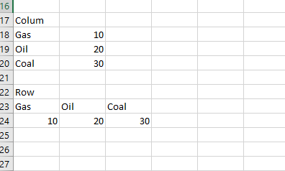
source dimension along rows with step 1
source dimension along cols with step 1

Slide 2
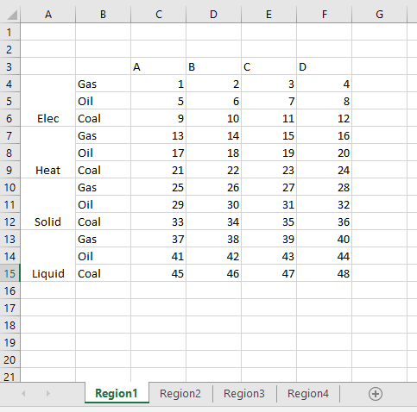
sector dimension along cols with step 1
source dimension along rows with step 1
out dimension along rows with step 3
region dimension along sheets
Region1, Region2, Region3, Region4

